Slide 1


Integrating ChatGPT into Your
Economics and History Classroom
What’s In Your Toolkit?

Slide 2

Doug Young Presenter
Head Coach of The Wiser Choice.
An award-winning N.Y. State classroom teacher, coach, and educational consultant with more than 30 years of experience.
For ten years he worked as a facilitator and trainer on school reform with the Coalition of Essential Schools at Brown University’s School of Education.
He also contributed to McDougal Littel’s Economic textbook, “Concepts and Choices”.
He was Senior Director of Education at CEE for several years.
He has trained over 3,000 educators in personal finance, economics, and integrating economics into U.S. History and Global Studies classes.

Slide 3
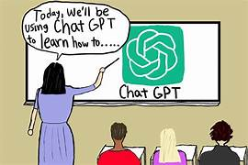
Who’s Using ChatGPT in their Classroom now?
Briefly share how you're using it.
Please send in your response using the chat box below.

Slide 4
TABLE OF CONTENTS
OBJECTIVES OF THE WEBINAR.
WHAT IS ChatGPT?
WHY USE ChatGTP?
WHAT IS A CHATBOT?
WHAT IS A PROMPT?
4. TYPES OF PROMPTS.
5. ANATOMY OF A GREAT PROMPT.
6. CHALLENGES OF USING AI.
7. CREATING AN AI PROMPT FOR CLASSROOM USE.
8. AI CREATED SLIDES, GRAPHS, AND CHARTS I CREATED

Slide 5
OBJECTIVES
Demonstrate how teachers can integrate Chat GPT into their classroom.
Show the process of using a chatbot, how it works, and a step-by step example of using a chatbot to lesson workload.
Explain how a well-defined prompt is the key to get the in-depth and precise outcome from a question to a final response that a teacher wants.
Using screen shots, show examples of how you can create a prompt and how the information is sent to you to improve classroom teaching.
Examples of charts, graphs and content slides which can be integrated into a lesson, a slide as a bell ringer or conclusion for an upcoming assessment.

Slide 6
Economic Concepts
Scarcity
Choices
Trade-offs
Decision-Making
Opportunity Costs
Goods and Services
Capital Resources
Risk-Return
Incentives
Intended Consequences
Unintended Consequemces
Human Capital
Supply
Demand
Productivity
Efficiency

Slide 7
National Standards
STANDARD 1: SCARCITY
STANDARD 2: DECISION MAKING
New York State Standards
E1 INDIVIDUAL RESPONSIBILITY AND THE ECONOMY
E2 INDIVIDUALS AND BUSINESSES IN THE PRODUCT AND FACTOR MARKET

Slide 8
Why Teachers Should Learn to Use ChatGPT
⏳ Charts Time → Drafts lesson plans, rubrics, quizzes, and parent letters quickly.
📚 Differentiation Needs → Adjusts reading levels, simplifies texts, and creates enrichment tasks.
💡 Need for Fresh Ideas → Generates engaging activities, projects, and discussion prompts.C
📝 Feedback Takes Time → Models clear, constructive feedback for writing and presentations.
🌐 Resource Overload → Summarizes articles, curates text sets, and finds multimedia resources.
🎯 Building Student Skills → Supports questioning, research, and critical thinking practice.

Slide 9
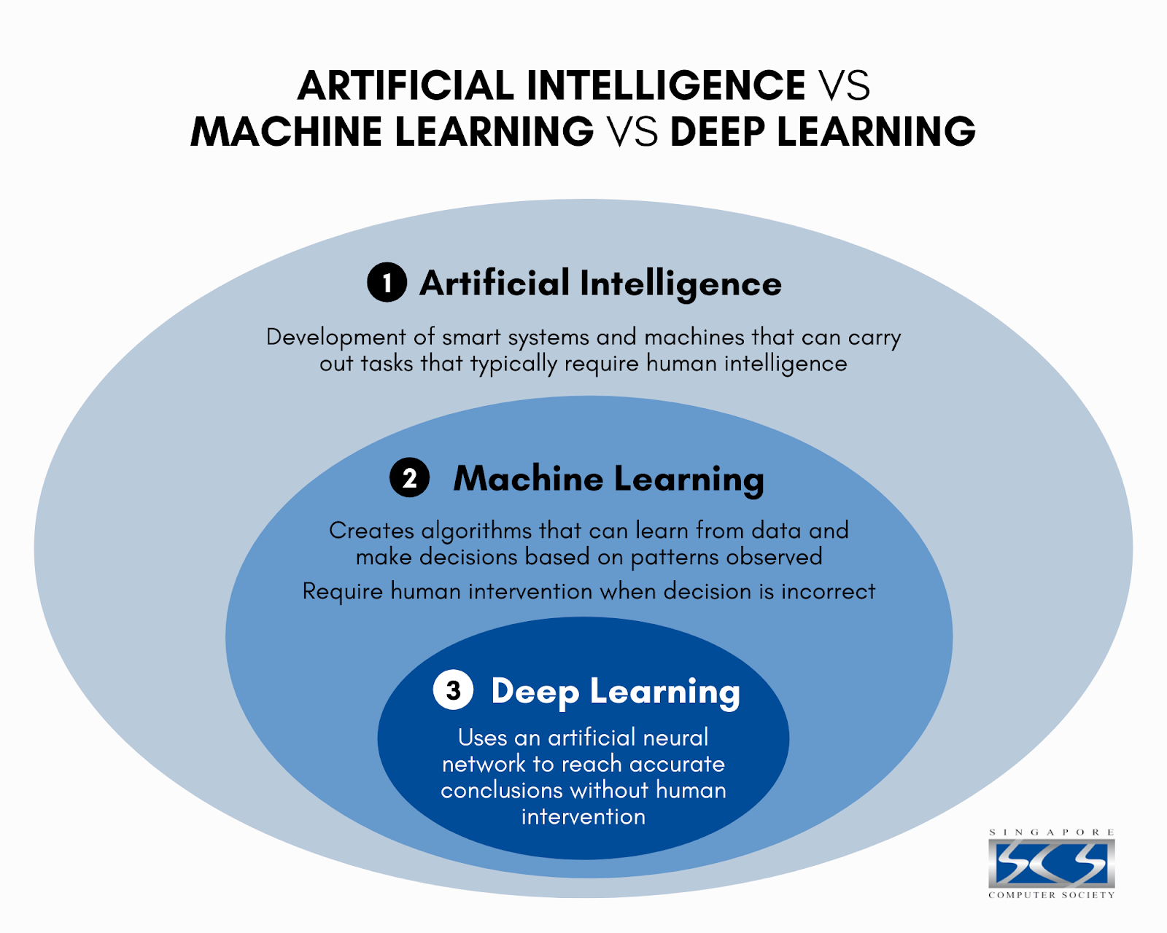
WHAT IS ChatGPT (AI)?
ChatGPT is a tool that uses:
  7.5+ million books.
  81 million research articles.
  15 million “YouTube” videos.
  Writing from tens of thousands of movies and Tv programs.
AI takes the information from these sources, scans, analyzes, and then responds to your question.

Slide 10



WHAT IS A CHATBOT?
IT READS YOUR PROMPT (a need)
  You type in a question or request, and the chatbot breaks it down to figure out what you're asking
IT PREDICTS THE BEST RESPONSE (a want)
  The chatbot uses what it has learned from tons of text (like books and websites) to predict the best next words — like a really smart version of autocomplete.
IT RESPONDS LIKE A HUMAN WOULD (productive and efficient)
  It puts together a full sentence or paragraph that sounds natural — even though it doesn’t actually understand like a person.

Slide 11
STEP-BY-STEP EXAMPLE:
YOU ASK A QUESTION: | You type: “What are the major causes of inflation.”
CHATBOT ANALYZES YOUR PROMPT | It breaks down your sentences into parts- it knows you want a definition, and it knows you want several causes.
IT SEARCHES ITS TRAINING DATA (KIND OF) | The chatbot has read billions of words from books, websites, conversations, and more. It doesn’t search the internet, but it uses what it already learned to guess what a good response would be.
IT PREDICTS THE BEST RESPONSE | It doesn’t think like a person — it just predicts the most likely next words based on your question. You have the final word.
IT WRITES THE ANSWER ONE WORD AT A TIME | You’ll notice it types out the response gradually. It’s literally predicting and writing one word at a time, really fast.

Slide 12



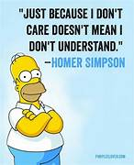
What it doesn’t do!
DOES NOT UNDERSTAND
A Chatbot does not understand your question the way a human does.
DOES NOT REMEMBER:
A Chatbot does not remember past chats unless you’re in the same session or using custom instructions.
DOES NOT KNOW THE CURRENT NEWS
Unless you’re using a version with web access.
DOES NOT HAVE FEELINGS,
OPINIONS OR BELIEFS.
It doesn’t have a brain or a heart – but it can fake having one pretty well.

Slide 13

What is a Prompt?
Practice of crafting clear, structured, and intentional input (called a prompt) to guide a language model toward producing a relevant, accurate, or creative output.
Prompts can be questions, instructions, or contextual statements, and their effectiveness depends on clarity, specificity, structure, and context.

Slide 14
ANATOMY OF A GOOD PROMPT
ACTION: What do you want the AI to do?
SUBJECT: What is it about?
DETAILS: Who’s it for? How long? What format? Any limits?

Slide 15



EXAMPLES:
BASIC: “Tell me about inflation.” (It’ll give you an answer, but it might be too broad).
BETTER:
“Describe inflation fluctuations using easy-to-understand language.” (This version is clearer and more accessible for beginners).
BEST:
“Explain the major concepts of inflation in 5 bullet points using simple language, as if you’re talking to a 10-year-old.” (Super clear, structured and directed at a specific audience)

Slide 16
WHY PROMPTING MATTERS:
Prompting is more than just “asking a question.” It’s the key to:
Getting accurate, useful answers
Tailoring responses to your audience
Controlling tone, style, and length
Getting creative or professional content
Avoiding confusion or errors in the answer
Prompting is how you talk to an AI to get useful answers.

Slide 17
Challenges Related to ChatGTP
“Cavet Emptor”
It may generate inaccurate or outdated information if not carefully checked.
Responses can be overly generic or lack deeper context.
Difficulty handling highly specialized, authoritative or technical tasks without sufficient prompting which might have a negative effect on your task.
Cannot access real-time data or external databases unless explicitly provided.
May misinterpret vague or ambiguous queries without clear instruction.
Be careful about using it for human decisions like health, politics, or finance.

Slide 18
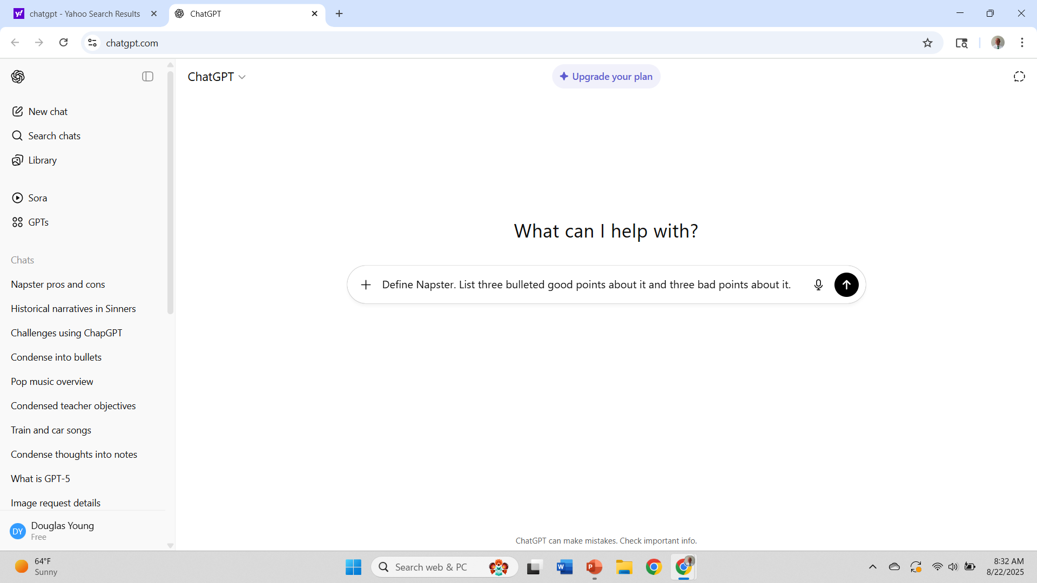
Creating a Specific Prompt

Slide 19
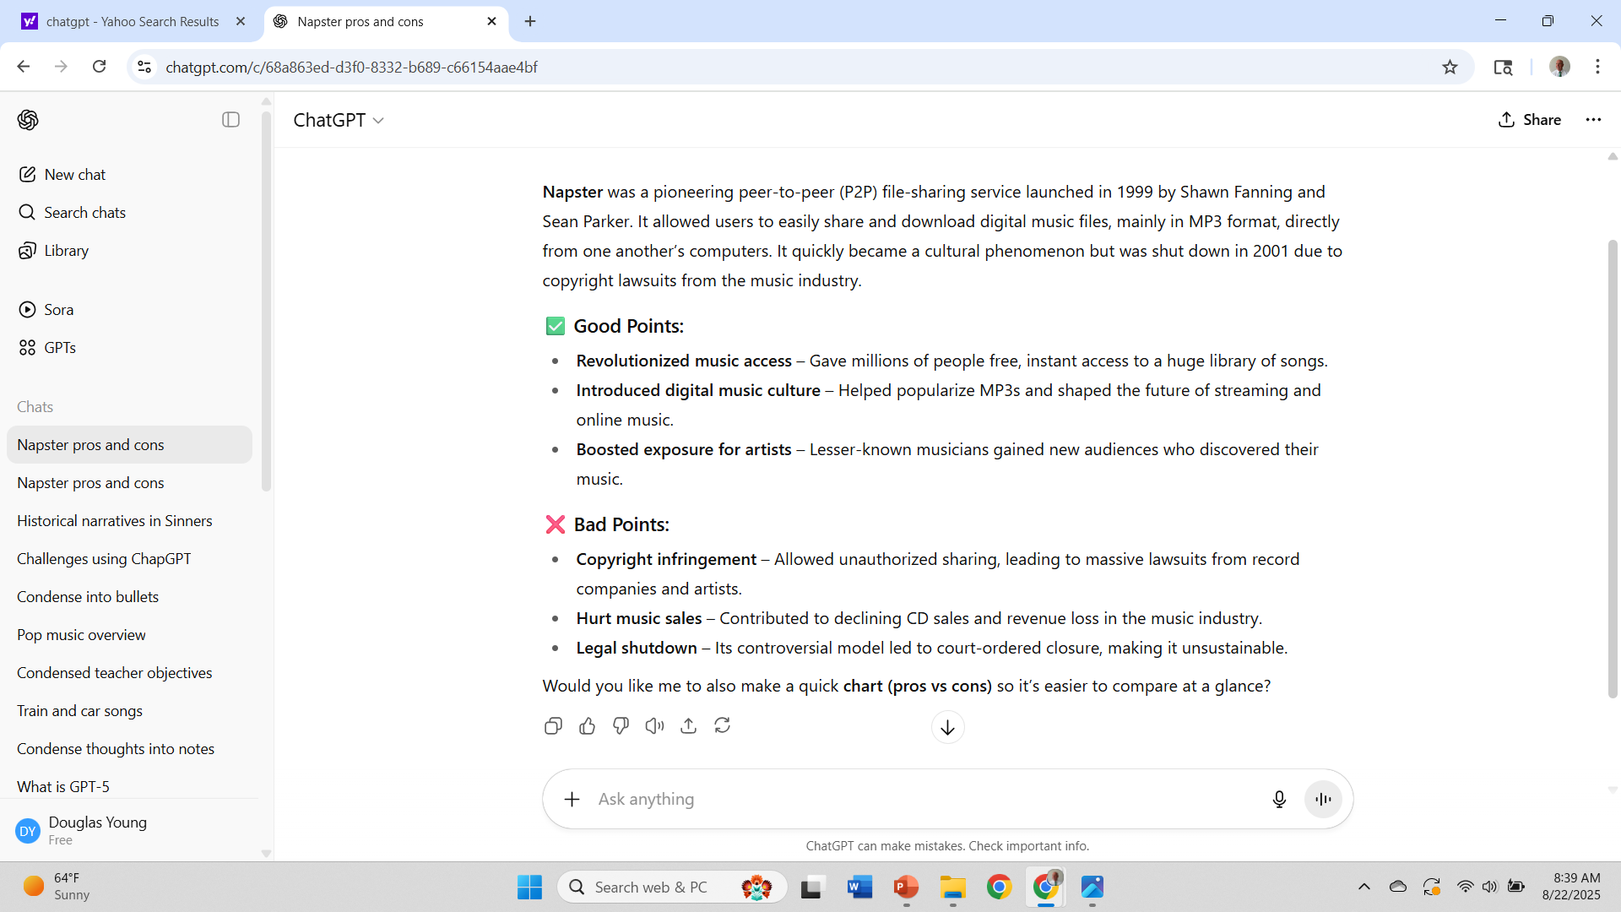
Results of My Prompt

Slide 20
What was “Napster”?
It was shut down in 2001 due to copyright lawsuits from the music industry.
Napster was a pioneering peer-to-peer (P2P) file-sharing service
Launched in 1999 by Shawn Fanning and Sean Parker.
It allowed users to easily share and download digital music files.
Mainly in MP3 format, directly from one another’s computers.
It quickly became a cultural phenomenon.

Slide 21
Napster: Pros and Cons
Good Points About Napster
  Revolutionized music access – made millions of songs instantly available worldwide, changing how people discovered and consumed music.
  Introduced digital music sharing – helped popularize MP3s and the idea of online music communities.
  Influenced future streaming services – its model inspired platforms like iTunes, Spotify, and Apple Music.
Bad Points
  Copyright infringement – most music was shared without permission, leading to lawsuits from artists and record companies.
  Hurt music industry revenue – record labels claimed massive financial losses due to free downloads replacing paid sales.
  Short-lived service – legal pressure forced Napster to shut down in 2001, frustrating users and leaving a fragmented file-sharing landscape.

Slide 22
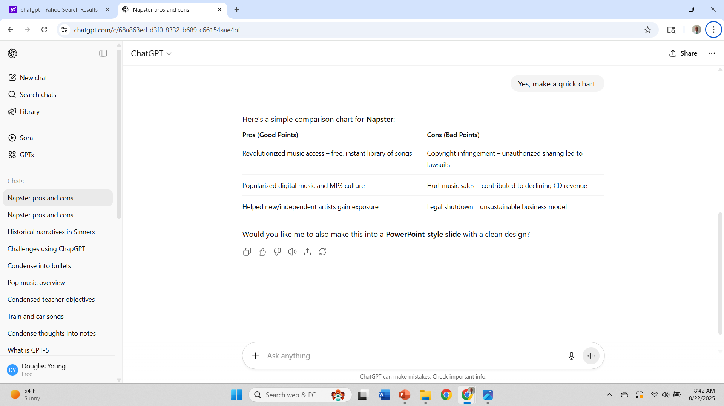
What was Napster?
Napster was a peer-to-peer (P2P) file-sharing service
  Launched in 1999.
  It allowed users to share and download MP3 music files for free.
  It revolutionized how people accessed music.
  It also caused major legal battles with the recording industry.

Slide 23
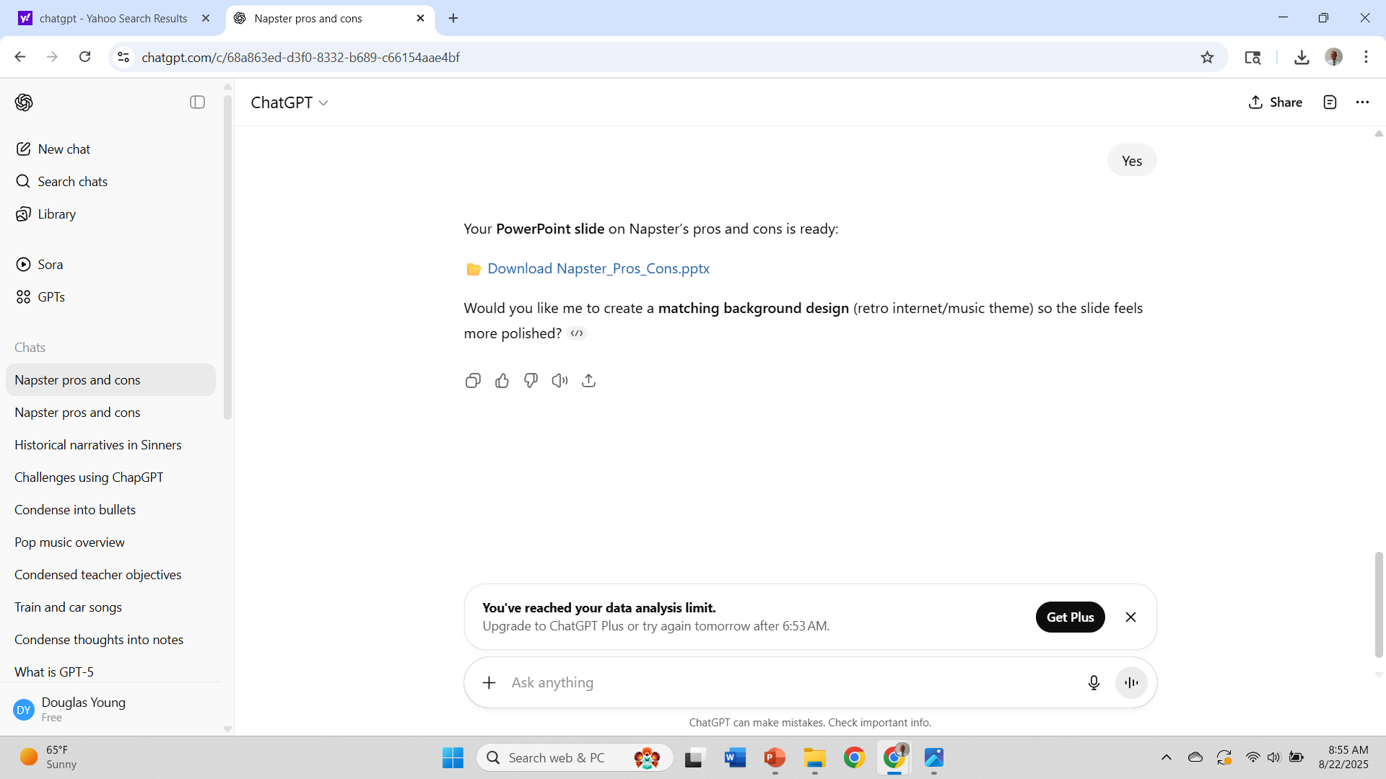

Slide 24
Napster: Pros and Cons
Good Points (Pros) | Bad Points (Cons)
Revolutionized music access – instant availability of millions of songs | Copyright infringement led to lawsuits from artists and record companies
Introduced digital music sharing and online music communities | Hurt music industry revenue due to free downloads replacing sales
Influenced future streaming services like iTunes and Spotify | Shut down in 2001 under legal pressure, leaving fragmented file-sharing

Slide 25
Napster: Pros and Cons 🎵💻
✅ Pros:
🎶 Revolutionized music access: free, instant library of songs.
💿 Popularized digital music and MP3 culture.
🌟 Helped new/independent artists gain exposure.
❌ Cons:
⚖️ Copyright infringement: unauthorized sharing led to lawsuits.
📉 Hurt music sales: contributed to declining CD revenue.
⛔ Legal shutdown: unsustainable business model.

Slide 26
Limits of Using the Free ChatGPT!

Slide 27

Let’s create a few prompts on subjects and utilize the chat box below for your responses.

Slide 28
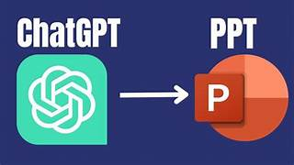
ChatGPT Slides Created for a Future Webinar

Slide 29
Major Artists and Publishing Companies - 1950s
The Secret, Dirty Dealings of the Music Industry
Artist | Key Songs / Hits | Music Publisher | Notes
Elvis Presley | Heartbreak Hotel, Hound Dog | Hill and Range / Gladys Music | Shared publishing via Gladys Music, but controlled by Hill and Range
Chuck Berry | Johnny B. Goode, Maybellene | Arc Music (Chess) | Signed away rights early on; legal disputes later
Fats Domino | Ain’t That a Shame | Jewel / Champion / Imperial-affiliated | Imperial Records-linked publishers held control
Little Richard | Tutti Frutti | Specialty Music / Venice Music | Rights controlled by Art Rupe’s Specialty Records
Buddy Holly | That’ll Be the Day | NorVaJak / Peer Int’l | Rare case where artist co-owned publishing
Everly Brothers | Bye Bye Love | Acuff-Rose Music | Signed early with respected country publisher
Bo Diddley | Bo Diddley | Arc Music | Published under Chess’s arm, often unfair deals
Ray Charles | I Got a Woman | Progressive / Tangerine (later) | Initially no rights, later formed his own company
Muddy Waters | Hoochie Coochie Man | Arc Music | Rights owned by Chess's publishing company
B.B. King | Three O’Clock Blues | Modern Music (Bihari Bros.) | Rights claimed through co-writing scams
Big Mama Thornton | Hound Dog | Travis Music / Leiber-Stoller | Recorded original; didn’t own publishing
Carl Perkins | Blue Suede Shoes | Hi-Lo / Knox Music | Published by Sun Records' affiliate
Jerry Lee Lewis | Great Balls of Fire | Hill and Range / Knox Music | Publishing tied to label contracts
Hank Williams | Hey Good Lookin’ | Acuff-Rose Music | Had trusted publisher relationship

Slide 30
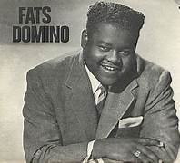
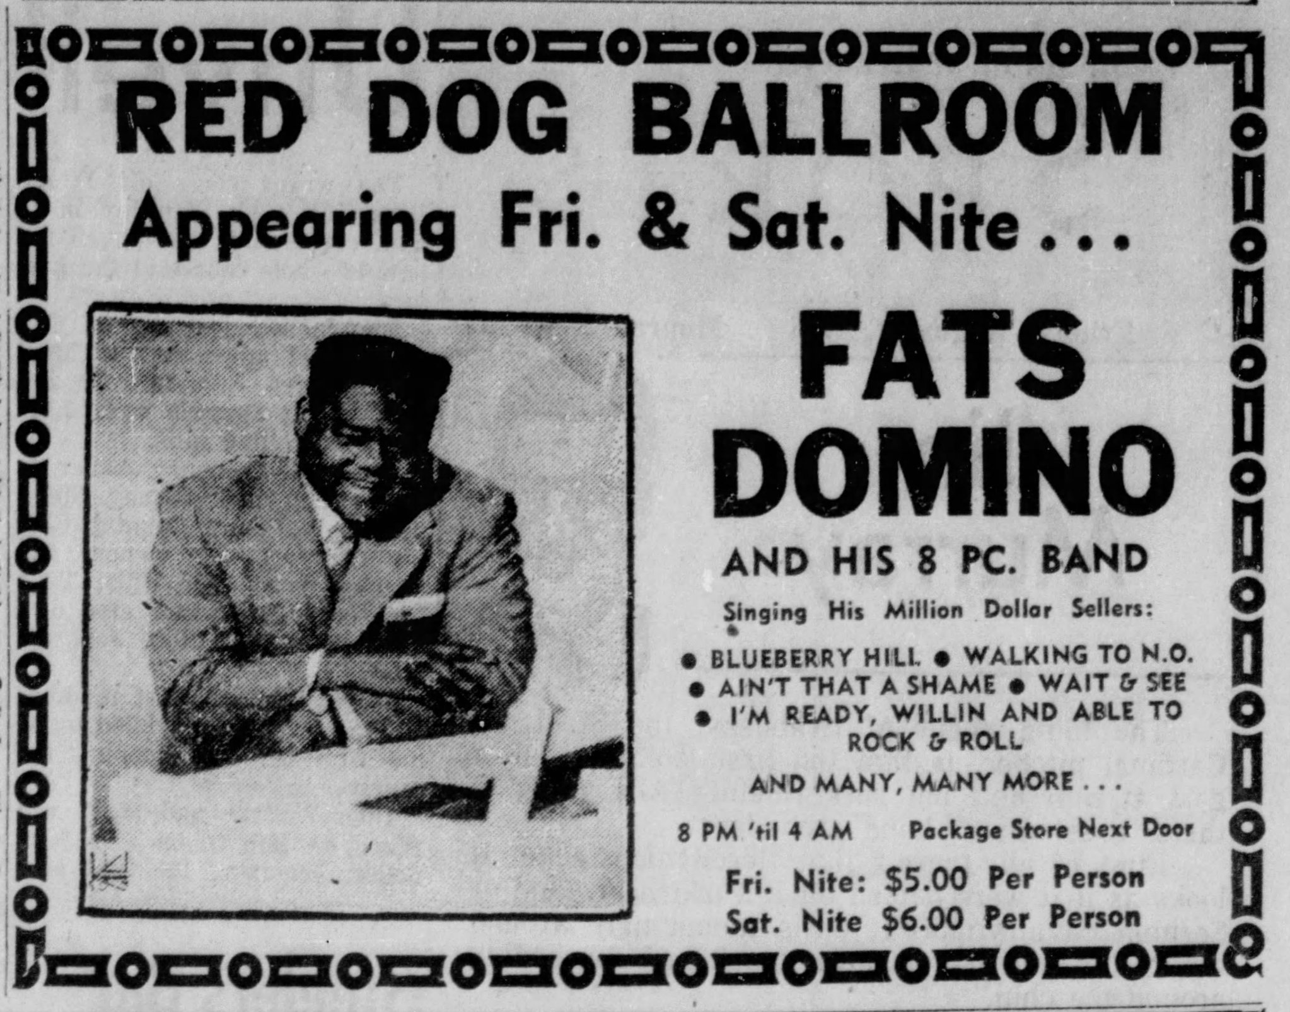
The Great “Fats Domino"
“From Blueberry Hill to Ain’t That a Shame”
Fats was the only major pre-rock R&B star to thrive and grow even bigger during the “Rock’nRoll” boom.
He transitioned from R&B hits to mainstream rock, becoming the second-best-selling artist of 1956—only behind Elvis. (Ironically, Doris Day outsold both with Que Sera Sera.)
To survive financially, Fats toured on the “Chitlin’ Circuit”, logging over 13,000 miles, 355 shows, and releasing 60 records.
His concerts were sometimes marred by riots in Roanoke, San Jose, Newport, and Houston—fueled by racial tensions, alcohol, segregation, and fears over his music crossing racial lines.
His songs were often recorded by white artists like Pat Boone, Rocky Nelson and The Beatles outselling Fats original
His career spanned from the late 1940s to 1995. A humble and introverted man, Fats remained devoted to New Orleans, was married for 61 years, and received two National Medals of Arts.

Slide 31
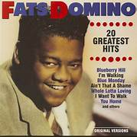
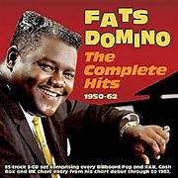
Fats Domino:
R&B Pioneer Turned Rock Star
Only major pre-rock R&B star to thrive during the Rock ’n’ Roll boom.
2nd-best-selling artist of 1956 (behind Elvis; Doris Day outsold both).
Toured the Chitlin’ Circuit: 13,000+ miles, 355 shows, 60 records.
Concerts sometimes led to riots due to racial tensions, alcohol and integration fears.
Many hits were covered—and outsold—by white artists (e.g., Pat Boone, Beatles).
Career spanned 1940s to 1995; known for humility and loyalty to New Orleans.
Married 61 years; received 2 National Medals of Arts.

Slide 32
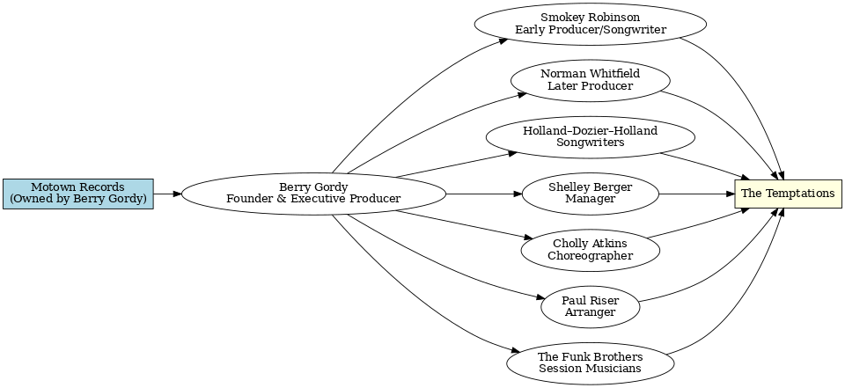
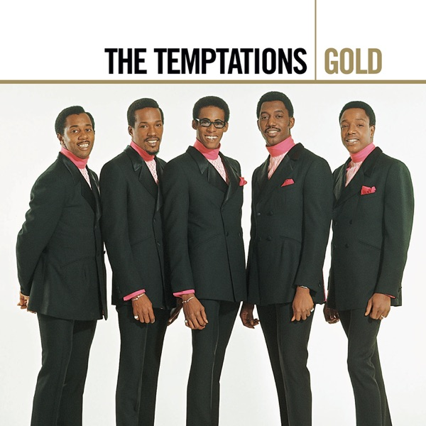
Team Needed for Producing a Gold Record
“My Girl” - 1964
Written by Smokey Robinson
*Most solo singers/groups either had an agent or dealt with them individually.

Slide 33
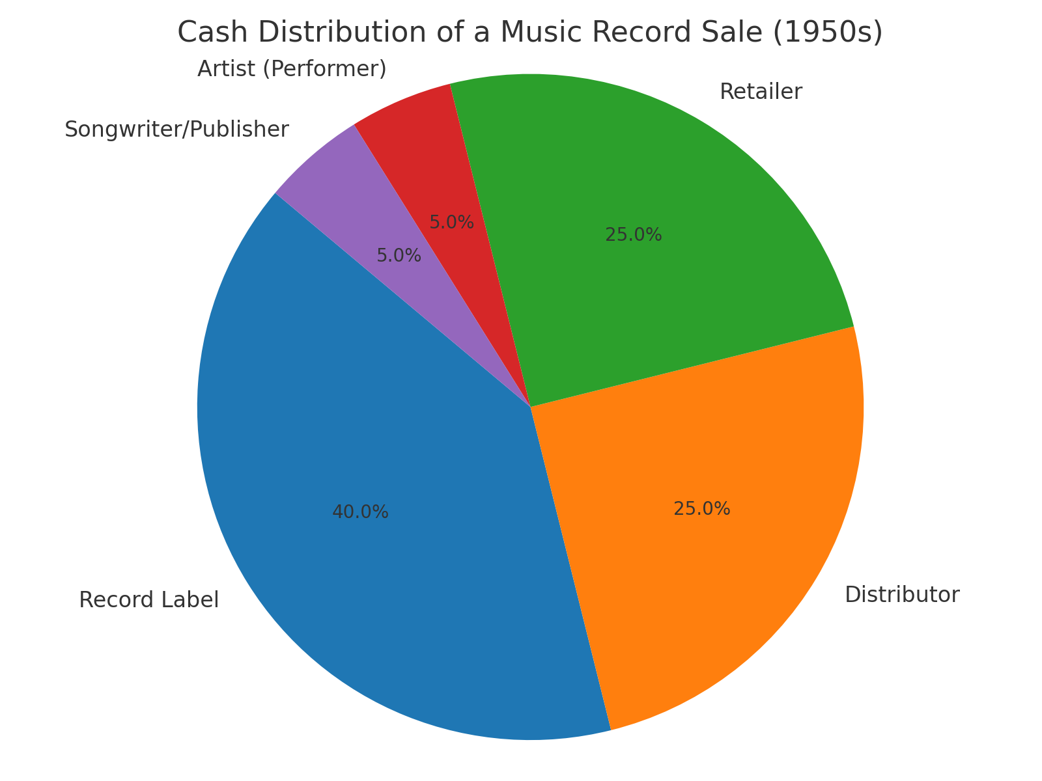
Cash Distribution of a Music Record Sale (1950's)

Slide 34
Blues vs Rhythm & Blues (1880’s – 1970’s)
Feature | Blues | Rhythm & Blues (R&B)
Origins | Late 1800s–early 1900s, Deep South (African American work songs, field hollers, spirituals) | Late 1940s, evolved from blues, gospel, and jazz with stronger backbeat
Primary Style | Slow to mid-tempo, emotional storytelling; often 12-bar structure | Upbeat, danceable, more emphasis on rhythm and horn sections
Themes | Heartache, struggle, love, daily life | Love, relationships, nightlife, dance
Instrumentation | Guitar (acoustic or electric), harmonica, piano, bass, drums | Electric guitar, bass, drums, piano, brass/woodwind sections, saxophone
Rhythm | Shuffle rhythm or slow swing feel | Strong, steady 4/4 beat; more syncopated and driving
Audience in Early Days | Southern rural African American communities. “Juke Joints” informal establishments featuring music, dancing, gambling, and drinking. | Broader urban African American audience, later crossover to white teens
Famous Artists | Robert Johnson, B.B. King, Muddy Waters, Howlin’ Wolf, John Lee Hooker | Ray Charles, "Queen” Ruth Brown, Fats Domino, Little Richard, Clyde McPhatter, Big Joe Turner
Legacy | Direct influence on rock, soul, and modern blues | Precursor to soul, rock ’n’ roll, funk, and modern R&B

Slide 35
Simplified Flow: Fed Rate Cut → Consumer Impact
Federal Reserve
cuts Fed Funds Rate
Banks lower borrowing
& lending costs
Cheaper loans for
businesses & consumers
More investment
& consumer spending
Economic growth
(+ jobs, possible inflation)
Increases liquidity in the financial system, promoting investment.
Can lead to a weaker dollar, boosting exports by making them cheaper abroad.
May stimulate stock market growth as investors seek higher returns.
Risks potential inflation if rates remain low for too long.

Slide 36
The Travels of a T-shirt in a Global Economy by Pietra Rivoli.
Part I: King Cotton –
  The journey begins with the raw material: cotton..
  The book details how cotton is grown in the United States, often with the help of government subsidies
    and advanced agricultural technology. The cotton is harvested, bailed, and sold on the global market.
Part II: Made in China –
  The cotton is then shipped to China, where it is spun into yarn, knitted into cloth, and then cut and sewn
    into a T-shirt in a factory.
  This stage highlights the "race to the bottom," where companies seek out the lowest-cost labor
    to produce goods.
Part III: Trouble at the Border –
  The finished T-shirt is shipped back to the United States.
  This part of the book explores the complex political landscape of global trade, including tariffs, quotas, and
    lobbying efforts by domestic industries to protect themselves from foreign competition.
Part IV: My T-shirt Finally Encounters a Free Market –
  After being sold in a U.S. store, the T-shirt eventually
    ends up in the used clothing market. It is often donated and then shipped to Africa, where it is sold in
    open-air markets.
  This final stage reveals a surprisingly vibrant and competitive free market for used goods.
c

Slide 37
Prompts for Analyzing Economic Policies with ChatGPT
Consider using these prompts for insightful discussions:
  “Evaluate the effectiveness of fiscal policy in managing economic downturns.”
  “Discuss how monetary policy can impact inflation rates.”
  “What role does government intervention play in stabilizing an economy?”
  “Analyze the implications of a recent tax policy change.”
  “How do external factors influence domestic economic policies?”

Slide 38
Council for Economic Education Lessons
Level Up Economics: Engaging Students with EdTech & AI
https://econedlink.org/webinar/level-up-economics-engaging-students-with-edtech-ai/
Your 24/7 AI Econ Sidekick
https://econedlink.org/webinar/your-24-7-ai-econ-sidekick/
AI Series: Helping Students Use AI Thoughtfully
https://econedlink.org/webinar/ai-series-helping-students-use-ai-thoughtfully/
AI Series: Rethinking Assessment in the Age of AI
https://econedlink.org/webinar/ai-series-rethinking-assessment-in-the-age-of-ai/
Can’t Stop the Music! Adding Music and AI into Your Classroom
https://econedlink.org/webinar/ai-series-cant-stop-the-music-and-ai/
AI Series: AI in Personal Finance
https://econedlink.org/webinar/ai-series-ai-in-personal-finance/
AI Series: Customize Activities and Lesson Plans
https://econedlink.org/webinar/ai-series-amplifying-student-learning-through-ai-powered-instruction-in-differentiated-classroom/
AI-Enhanced Assessment Design: Crafting Authentic Evaluations and Effective Rubrics
https://econedlink.org/webinar/ai-series-crafting-authentic-evaluations-and-effective-rubrics/

Slide 39
“We must choose wisely. We must design intentionally. And we must keep humans at the center of this revolution. Because the real breakthrough isn’t building machines that think like us. It’s building a future that brings out the best in us.”
Marc Benioff, CEO of Salesforce and co-chair of TIME

Slide 40
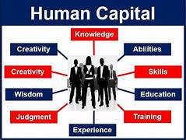
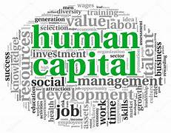
Doug Young
THE WISER CHOICE
Head Coach
Social Studies Educator
doug.n.young@gmail.com
“Doug’s my name, developing
‘Human Capital’ is my game.”
Special thanks to Brianna Tabil - Public Technology Trainer
Boynton Beach City Library, Florida, FL.

