Slide 1

Monkey
Business
Teaching Economics with Curious George
SC Council on Economic Education Sarah Ostergaard: sarah.ostergaard@moore.sc.edu

Slide 2
What is SC Economics?
Workshops & Webinars
Financial Literacy Master Teacher Program
Student Contests
Teacher Support
SC Economics is a non-profit organization dedicated to providing SC K-12 teachers with continuing education in economics and personal finance.
We offer myriad no cost workshops, webinars, and other resources to help teachers understand & teach the fundamentals of economics and personal finance.

Slide 3
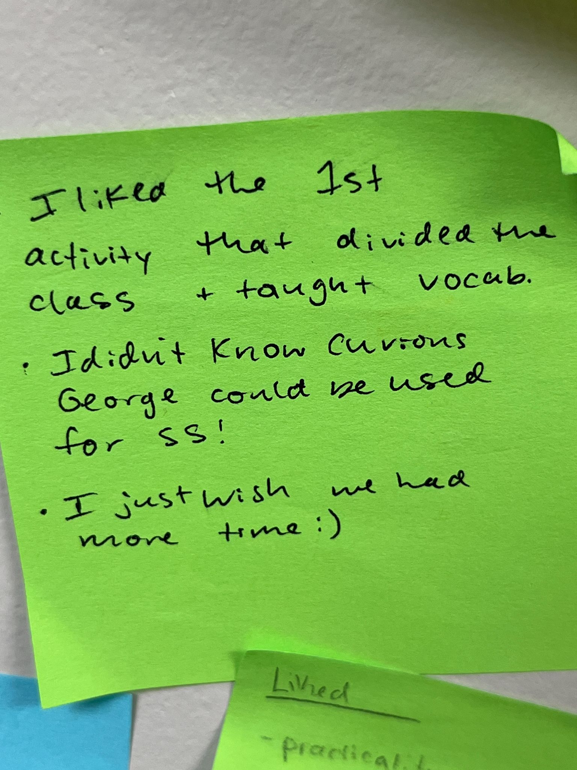
Agenda:
What’s in the picture? (vocab)
Curious George Economics (application)

Slide 4

What’s In The Picture?
In the next few slides, consider which economics-related vocabulary word best describes the picture.
Type it in the chat.
Be prepared to explain your answer!

Slide 5

Good or Service?

Slide 6

Income
or
Work?

Slide 7
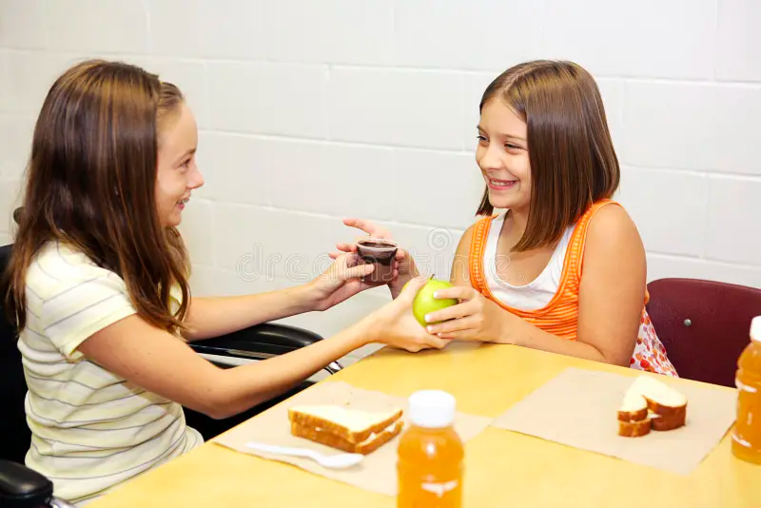
Barter or Goods?

Slide 8
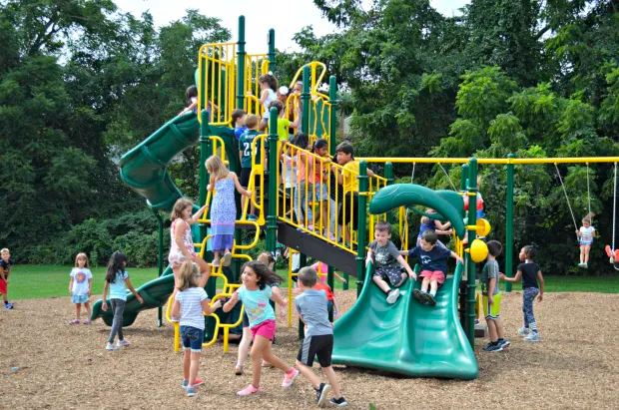
Scarcity or Choice?

Slide 9
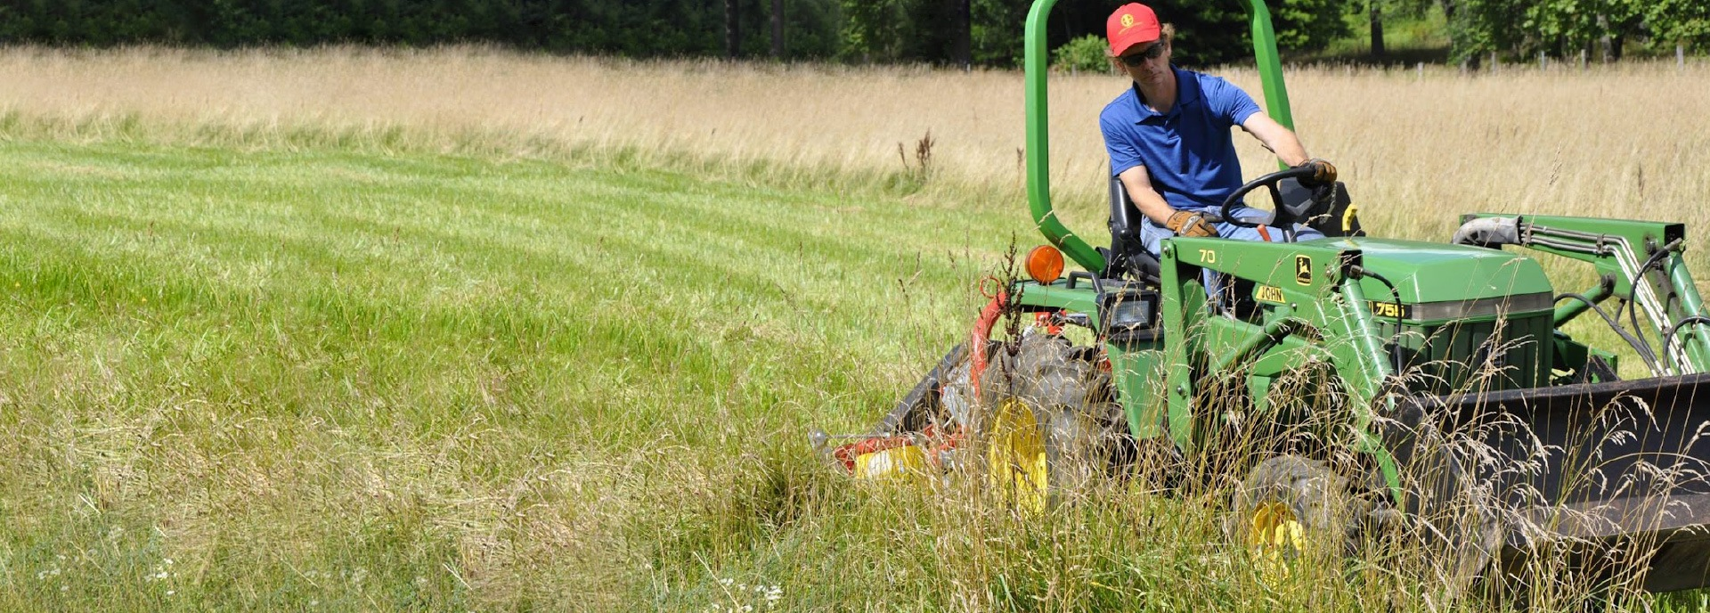
Capital Resources or Entrepreneurship?

Slide 10
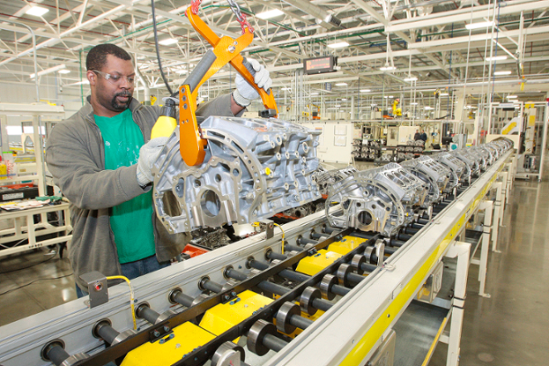
Specialization or Productivity?

Slide 11
What’s In The Picture?
How would you use this type of a lesson in your classroom?
Would you use it as an Intro activity, or at the end to summarize?

Slide 12

Curious George Econ.
Use the lovable character Curious George to capture your students’ attention while teaching about business. Each lesson features a specific Curious George children’s book and includes fun activities to help your students learn. Concepts concepts will include goods and services, natural, capital, and human resources, production, specialization, interdependence, and saving.

Slide 13
Topics: Goods & Services
Resources
Specialization
Savings

Slide 14
Goods & Services
Resources
Savings
Specialization

Slide 15

Goods and Services
What is a Good?
What is a Service?
Goods are tangible things such as food, clothes, and cars.
Services are physically intangible things such as medical care, haircuts, and education.

Slide 16

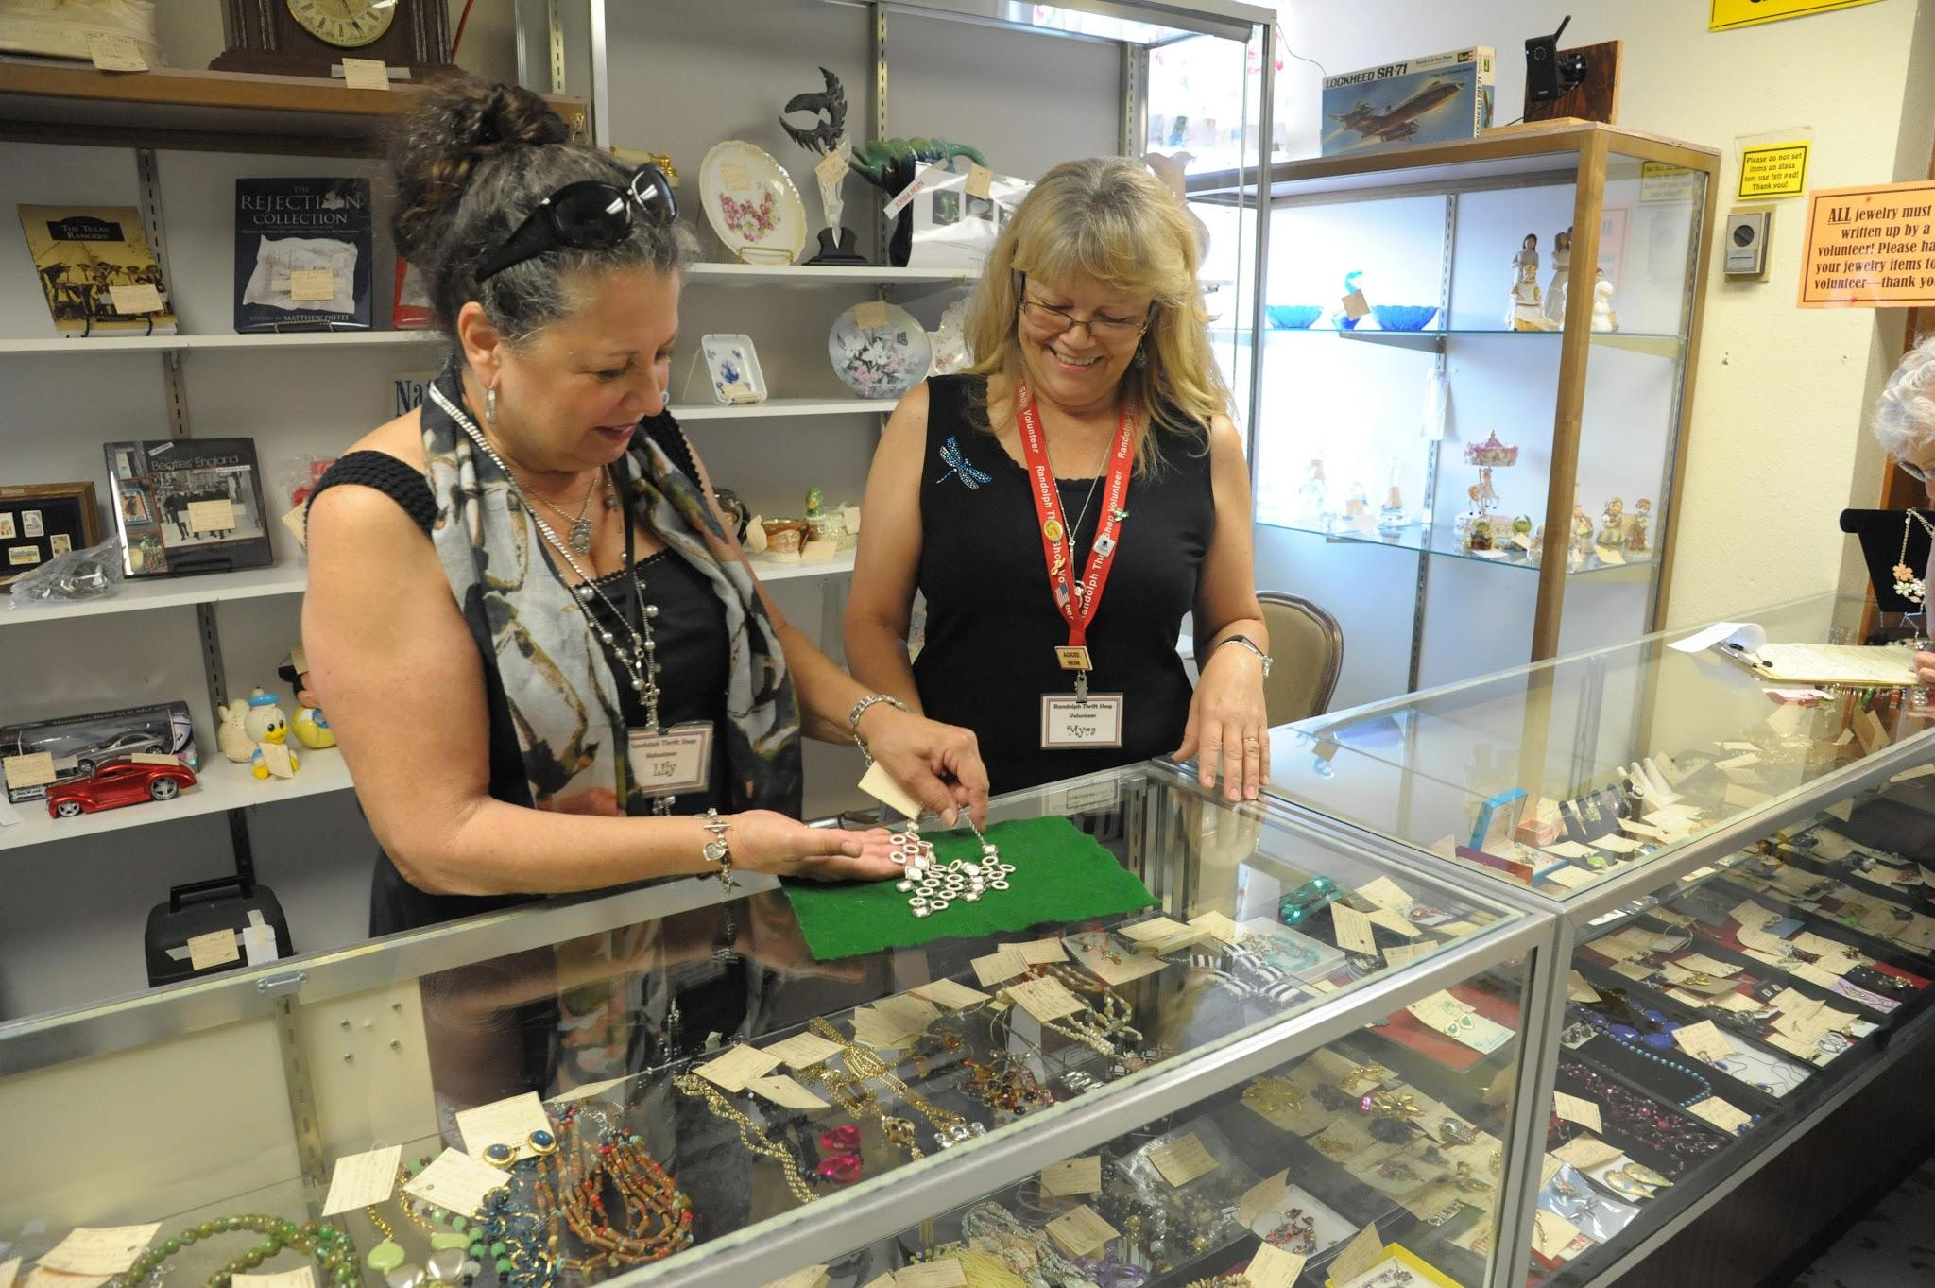
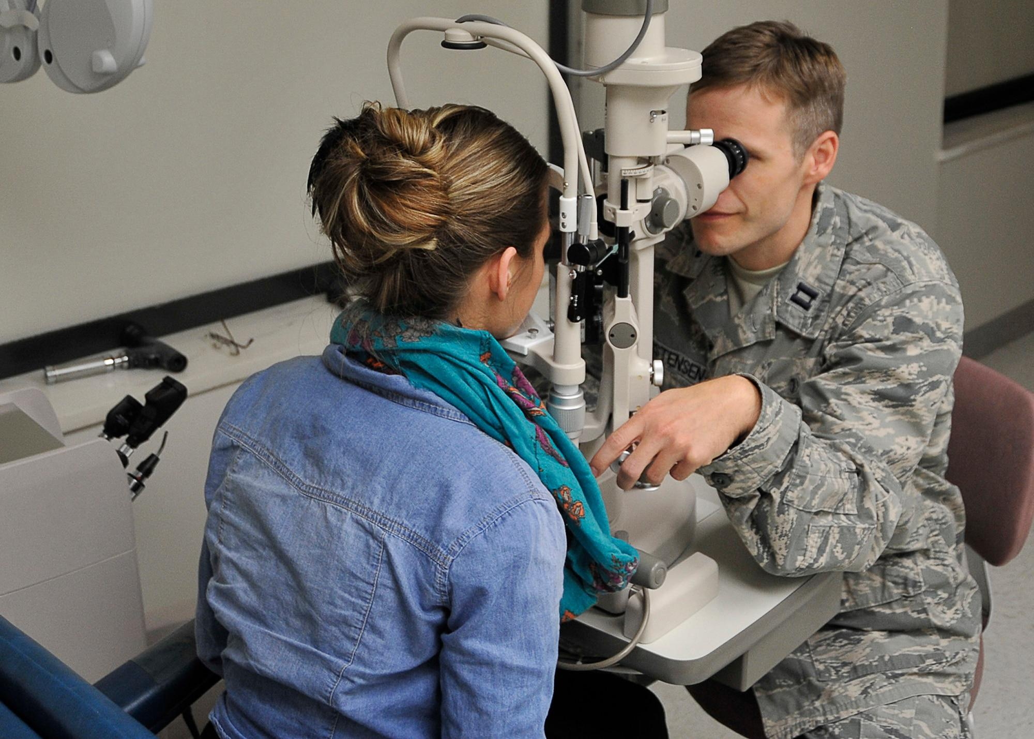
Goods & Services
A bookstore provides…
A jewelry store provides…
A optometrist office provides…
Is a copy of Cloudy with a Chance of Meatballs a good or service?
Is a pair of earrings a good or service?
Is an eye exam a good or service?
Is broken or damaged ring repair a good or service?
Are prescription eyeglasses a good or service?
Is children’s story time every Wednesday a good or service?

Slide 17
Are you Team
Read Aloud or
Play a YouTube video?

Slide 18
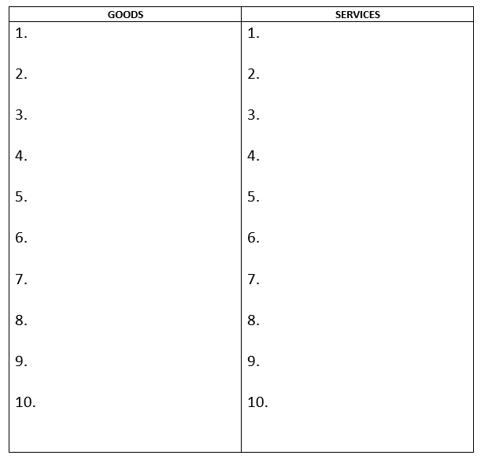


Goods and Services
On a piece of paper, draw two columns. Label one column goods and one column services.
Put your pencil down when you are ready to move on.

Slide 19

Type in the Chat!
Other options include: Padlet, shared google doc, word bubble…
Goods
Look at the picture.
In 1 minute, type all the GOODS you see into the chat. Type as many as you can!

Slide 20
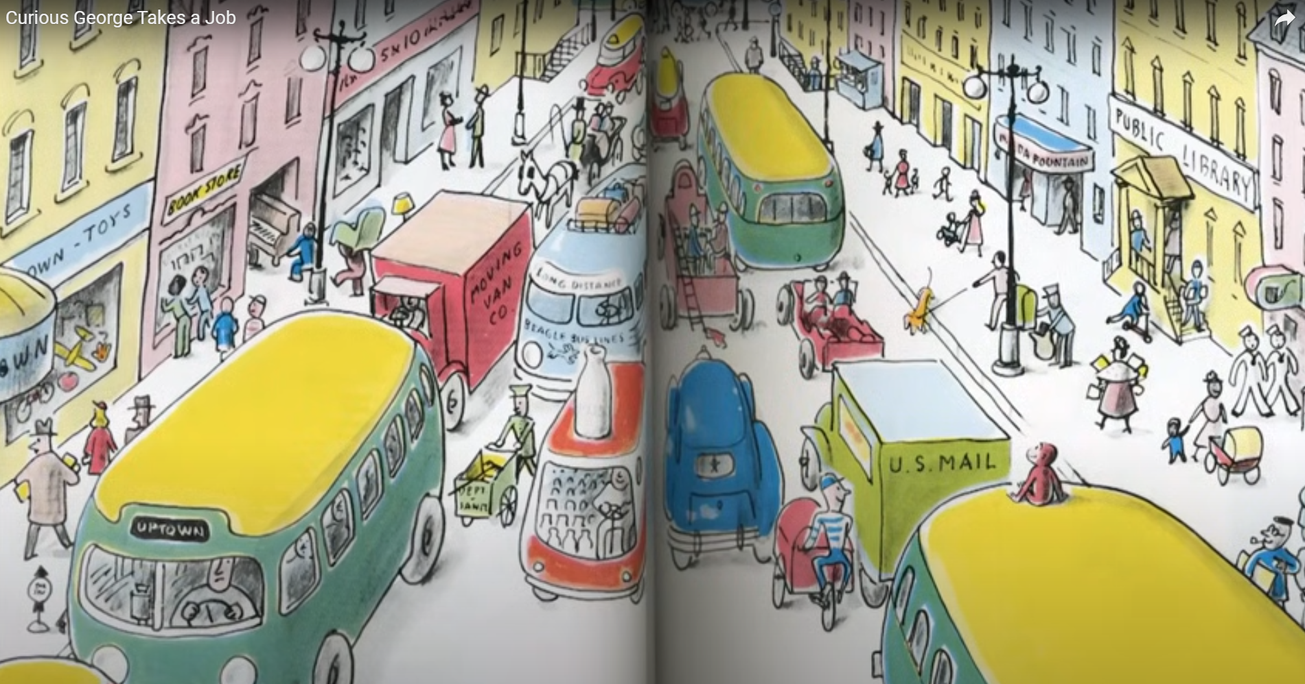
Using the illustration of a busy city street, list as many examples of GOODS as you can in the allocated time.
Be prepared to share your findings with the class.

Slide 21
Type in the Chat!
Other options include: Padlet, shared google doc, word bubble…
Services
Look at the picture.
In 1 minute, type all the SERVICES you see into the chat. Type as many as you can!

Slide 22
Using the illustration of a busy city street, list as many examples of GOODS and SERVICES as you can in the allocated time.
Be prepared to share your findings with the class.

Slide 23
Goods & Services
Resources
Savings
Specialization

Slide 24

Productive Resources
Capital Resources are man made resources such tools, buildings, and vehicles used in production.
Natural Resources are gifts of nature.
Human Resources are people who work.

Slide 25
Productive Resources Around the Room
Natural Resources
Capital Resources
Human Resources
Look around you. What productive resources do you see? Let us know!
Annotate directly on this slide,
Unmute and shout them out, or
Type them in the chat.

Slide 26
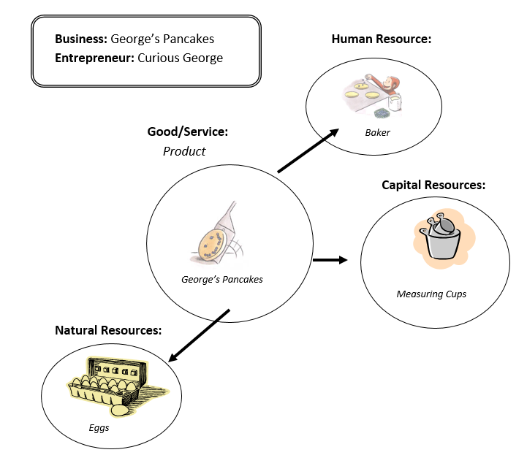
Productive Resource Web

Slide 27
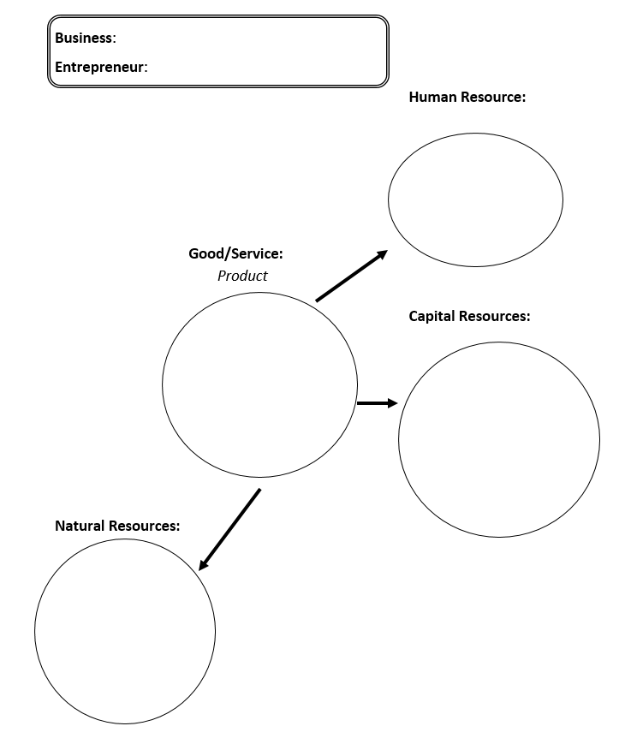
Productive Resource Web

Slide 28

Productive Resources x2
Capital Resources are man made resources such tools, buildings, and vehicles used in production.
Natural Resources are gifts of nature.
Human Resources are people who work.

Slide 29
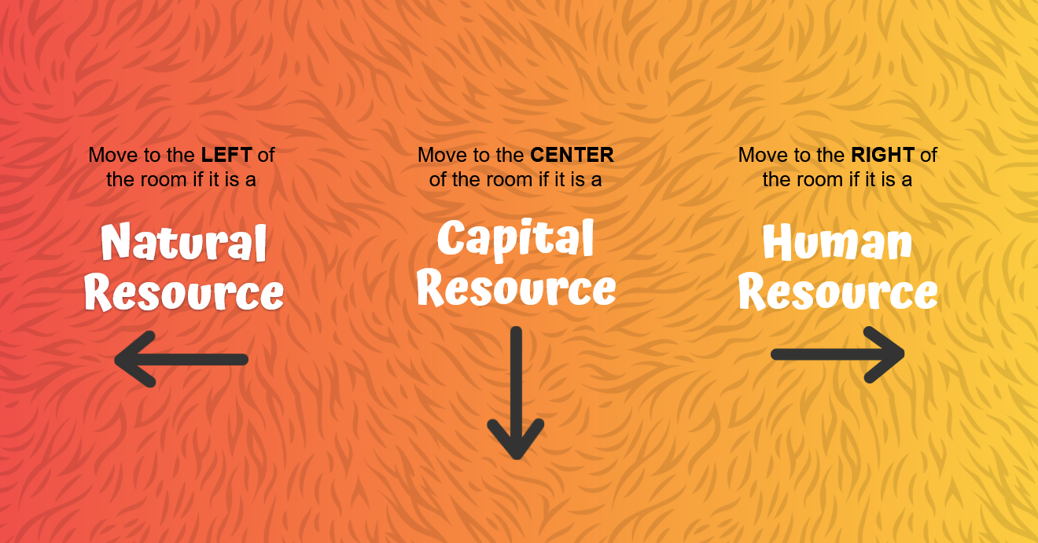

Slide 30
Productive Resource Web

Slide 31
Goods & Services
Resources
Savings
Specialization

Slide 32

Saving and
Savings Goal
Saving means keeping some of your income to buy things in the future.
Savings goal is a good or service that you want to buy in the future.

Slide 33
Income and Gift Money
Income is payment for work you do.
Gift money is freely given and not earned.

Slide 34


What is George Saving for in the story?
How did George earn the money?

Slide 35
Income and Gift Money
Income is payment people earn for the work that they do.
What if someone gives me money?
Gift money is freely given and not earned. (But it can be saved or spent!)

Slide 36




Let’s set a savings goal!
Select a savings goal from the list below and write it the top of your paper / online document.
Soccer Ball
$16
Puzzle
$22
Lunch
$12
New Book
$18

Slide 37
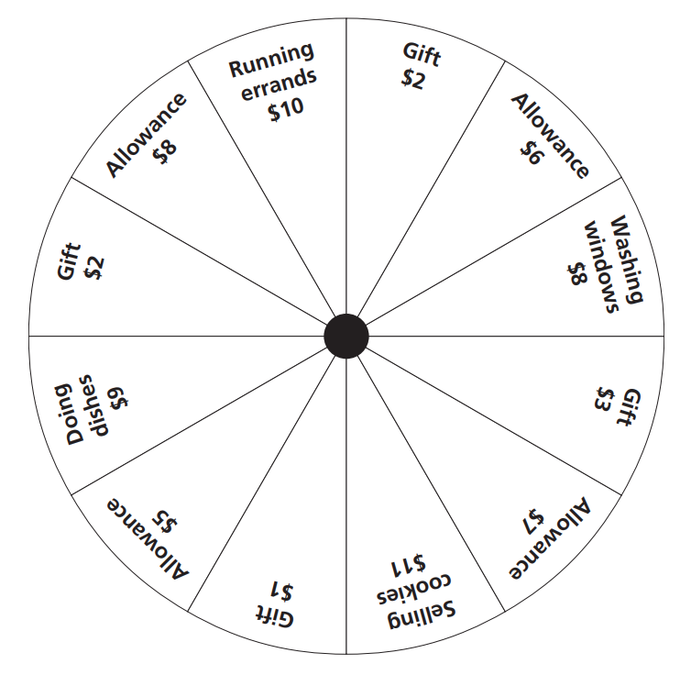
Money Wheel
Take turns spinning the money wheel!
Place the end of the paper clip over the large black dot in the center, then place the pencil inside the paperclip on the dot.
Spin the paper clip.
Where it lands will determine what your have earned or been gifted.
Cheer when you’ve reached your savings goal!

Slide 38
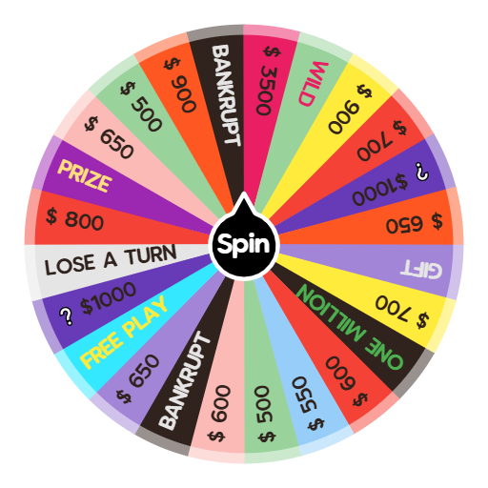
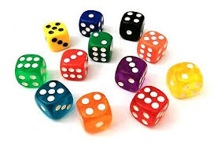
Online Options
Online Dice
Wheel of Fortune (link)
Breakout Rooms

Slide 39
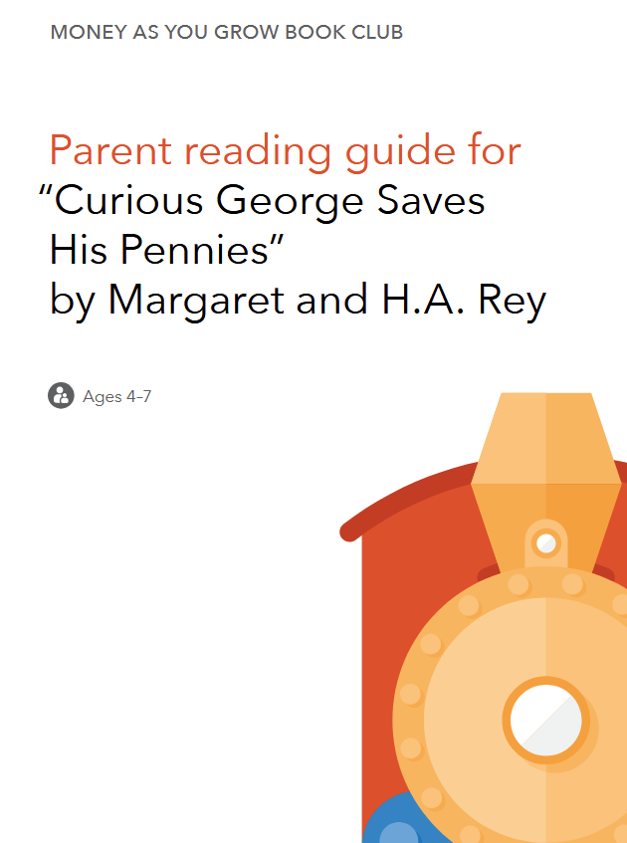
There is a no-cost Parent Guide! (link)
by the Consumer Financial Protection Bureau
Access all the CFPB “Money as you Grow” resources here.

Slide 40
Goods & Services
Resources
Savings
Specialization

Slide 41

Specialization is when producers make only one type of good or only provide one type of service.
Interdependence is when producers rely on other producers to help create goods and services.

Slide 42
Let’s create!

Slide 43
What would help?
A directions sheet.
An example.
A demonstration.

Slide 44
Now, let’s create!
Make your own product.
Specialization

Slide 45
Create Together!
Work in your group to create one product together.
Each team member must do at least one step of the process.
Specialization AND Interdependence

Slide 46
Where did all this monkey business come from?!
Curious George Economics
Use the lovable character Curious George to capture your students’ attention while teaching about business. Each lesson features a specific Curious George children’s book and includes fun activities to help your students learn. Concepts concepts will include goods and services, natural, capital, and human resources, production, specialization, interdependence, and saving.

Slide 47
How could you increase the rigor of these lessons to make it more challenging for advanced students?
Which of these lessons apply most to your classroom?
What other books or stories does this inspire you to possible use in your classroom?
Apply our learning!
How might you assess students’ understanding through a similar approach?
What is the most valuable takeaway from today’s session?
Have you ever seen children’s literature or stories used in a classroom in Social Studies? If so, what were the results?
What other “out of the box” strategies do you use to keep students engaged in your classroom?
What suggestions do you have for modifying this idea for your classroom?

Slide 48

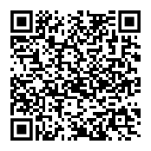
Thank You!
Sarah.Ostergaard@moore.sc.edu
Notes:
https://docs.google.com/forms/d/e/1FAIpQLSfgyraQR9SQ831rkbK5pZCHswVAaa5HqzS7Uo-tf7gFcU9_pw/viewform?usp=dialog

