Slide 1

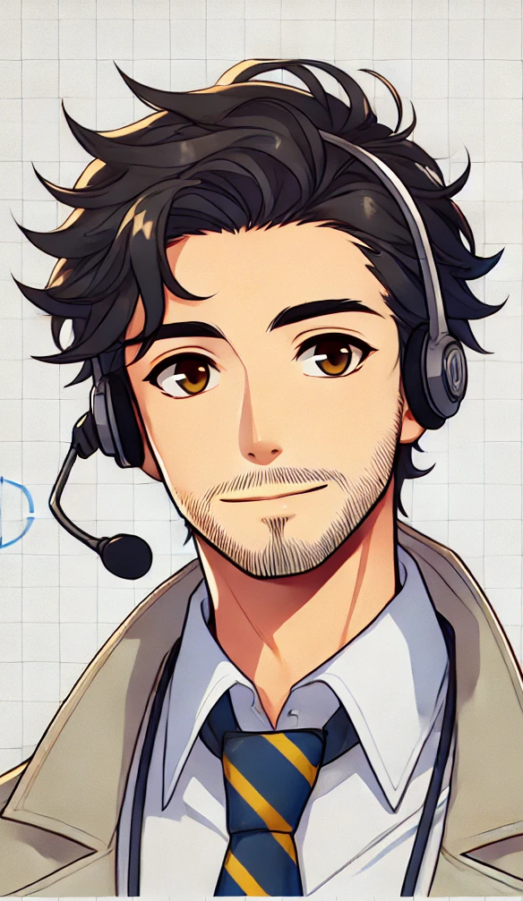
No Cash? No Checks? No Clue?
Gen Alpha has entered the chat!
Alex Lamon ✌🏼 Lead Business Teacher | NJ CEE Executive Director | Lazy Millennial
Notes:
Gen Alpha is here—cash is rare, Venmo rules, and their first "money" experiences involve V-Bucks. Does personal finance need an overhaul? We’ll challenge generational myths, explore key financial shifts, and share ready-to-use lessons to keep financial literacy relevant—without reinventing the wheel
The problems and pitfalls of generational generalizations
How is this gen actually different?
Activities that are tied to the previously identified differences -- they can also be generally relatable -- could also do PF myths to stop pedaling to this gen because of their different experiences (stop ordering sbux - Ramsey) - also can be something about economic realities, like home ownership…even if those stats are for this generation, harder for trends to turn around
--
Getting a job harder now
Do a Generation poll - who is represented? What negative stereotypes have you heard about your generation???

Slide 2

Have at it! What’s wrong with Gen Alpha?
Don’t worry, they’re not here, they can’t hurt you.
Notes:
If you don’t have firsthand experience, what have you heard?

Slide 3
Very lazy!
Who said this quote?
It’s a KNOWN FACT that millennials perfected laziness!
They ask for “work life balance”
They refuse to pull themselves up by their bootstraps!
They’d not be in so much debt if it wasn’t for all that avocado toast!
“They should move out of their parent’s basement and buy a starter house with a single family income, like I did!”
Notes:
Popular financial advice giver, older generation, sometimes controversial
Dave ramsey joke, point is we need to be mindful to not become out of touch with the economic realities and how things really are different
Leave time to guess the quotee

Slide 4

DAVE RAMSEY!
Just kidding, I made it up.
But it’s not so far from the truth!
“[Millennials & Gen Z] say: ‘You can’t do it, the system has to change’ and they’re a victim and they’re entitled...there’s a segment of them that just sucks. They’re just awful. I mean, their participation trophy, they live in their mother’s basement and they can’t figure out why they can’t buy a house — because they don’t work.”
Notes:
I actually found the real quote after, lol, I think his was worse than mine
Source

Slide 5

Generational Generalizations
Built Different?
Personal Finance Implications
Activities!
Exploring the harms and pitfalls
What are the actual differences?
01
02
What conclusions can we make about Gen Alpha’s realities?
Because you can’t spell SCHOOL without FUN!
03
04
Notes:
When we get to the activities - toolbox session - take what you like, modify, leave the rest
Little opinionated! I’m just one guy though. Don’t be shy to share your experiences. Especially if they’re classroom based - we learn from each other

Slide 6
Generational Generalizations
01
Exploring the harms and pitfalls

Slide 7
Talkin' 'bout YOUR generation
What generations are
represented in the room?
Notes:
Hand raises / poll
What negative stereotypes have you heard aimed at your gen?

Slide 8
“They have trouble making decisions. They would rather hike in the Himalayas than climb a corporate ladder. They prize flexibility and leisure over work.”
Source: Time Magazine, 1990 describing Generation X
Notes:
Guess the generation that’s being discussed

Slide 9
“They want the job on their own terms. They expect to be promoted after a few months, and they question authority constantly.”
Source: WSJ, 2002 describing Millennials
Notes:
Guess the generation that’s being discussed

Slide 10
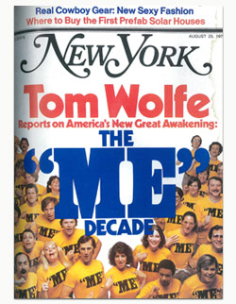
“Young people today are too focused on themselves. They care more about their own happiness than about duty or responsibility.”
Source: The ‘Me’ Decade, 1976, describing Boomers
Notes:
Guess the generation that’s being discussed

Slide 11
“They have been coddled and protected, and now they’re shocked when the real world doesn’t hand them everything they want.”
Source: The Atlantic, 2012 describing Millennials
Notes:
Guess the generation that’s being discussed
This quote is from 13 years ago, but it could be a subject of a LinkedIn rant on Gen Z in the workforce TODAY. So, what do we do to stop the generational generalizations - all the fighting?

Slide 12
Generations:
Science or Marketing?
The name Generation Alpha originated from a 2008 survey conducted by the Australian consulting agency McCrindle Research,founder Mark McCrindle is generally credited with the term.
Notes:
First, let’s remember generations aren’t too serious. They aren’t scientific. They’re marketing.
There is technically no consensus if Gen Alpha started with this freshmen class (birth year 2010) - some go as late as 2013.
My students were OFFENDED to be called Gen Alpha - what does that tell you?
“When I was researching my book The ABC of XYZ: Understanding the Global Generations (published in 2009) it became apparent that a new generation was about to commence and there was no name for them. So I conducted a survey (we're researchers after all) to find out what people think the generation after Z should be called and while many names emerged, and Generation A was the most mentioned, Generation Alpha got some mentions too and so I settled on that for the title of the chapter Beyond Z: Meet Generation Alpha. It just made sense as it is in keeping with scientific nomenclature of using the Greek alphabet in lieu of the Latin and it didn't make sense to go back to A, after all they are the first generation wholly born in the 21st Century and so they are the start of something new not a return to the old.” McCrindle

Slide 13
Built Different?
02
What are the actual differences?

Slide 14



Dave vs. Alex
Dave
Alex
Born: 1960
33 in 1993
Median home price: $129,000
Median household income: $30,960
Born: 1992
33 in 2025
Median home price: $410,800¹
Median household income: $45,140²
Notes:
If home prices increased at the same rate as inflation since 1963, the median price of a typical house in the U.S. would be $177,511, according to a new research report by Clever, a real estate data company.
In reality, the cost of a typical house in the U.S. is nearly half a million dollars
What else makes it harder TODAY to own a home, besides the fact that home prices have outpaced income?
Property tax skyrocketing, lack of availability, lack of good paying jobs, greater levels of student loan debt
How will things be even harder (or are harder) for Gen Z?

Slide 15
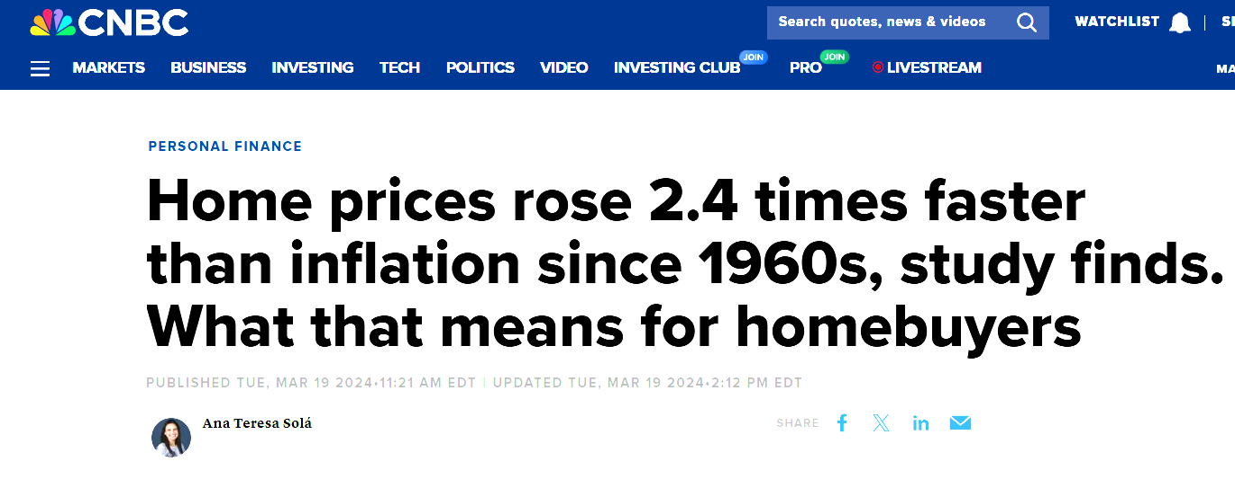
Dave vs. Alex
Dave
Alex
Born: 1960
33 in 1993
Median home price: $129,000
Median household income: $30,960
Born: 1992
33 in 2025
Median home price: $410,800¹
Median household income: $45,140²
Notes:
If home prices increased at the same rate as inflation since 1963, the median price of a typical house in the U.S. would be $177,511, according to a new research report by Clever, a real estate data company.
In reality, the cost of a typical house in the U.S. is nearly half a million dollars
What else makes it harder TODAY to own a home, besides the fact that home prices have outpaced income?
Property tax skyrocketing, lack of availability, lack of good paying jobs, greater levels of student loan debt
How will things be even harder (or are harder) for Gen Z?

Slide 16
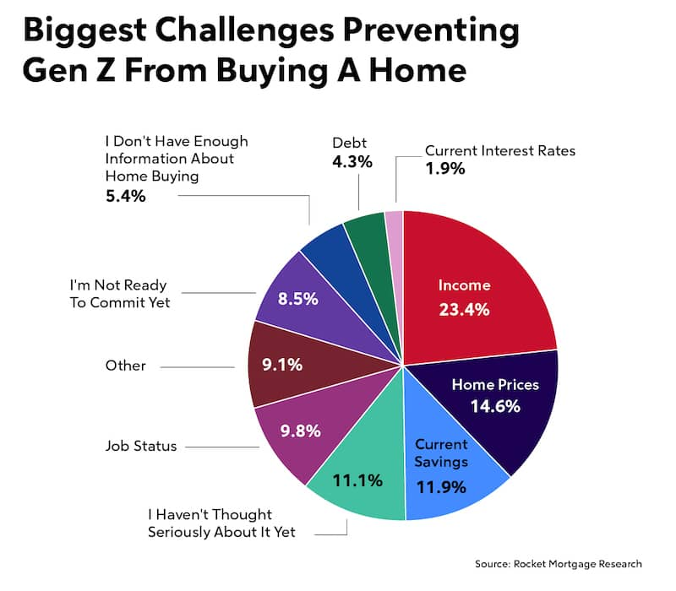
Notes:
Is it laziness? Or external factors?
Source

Slide 17
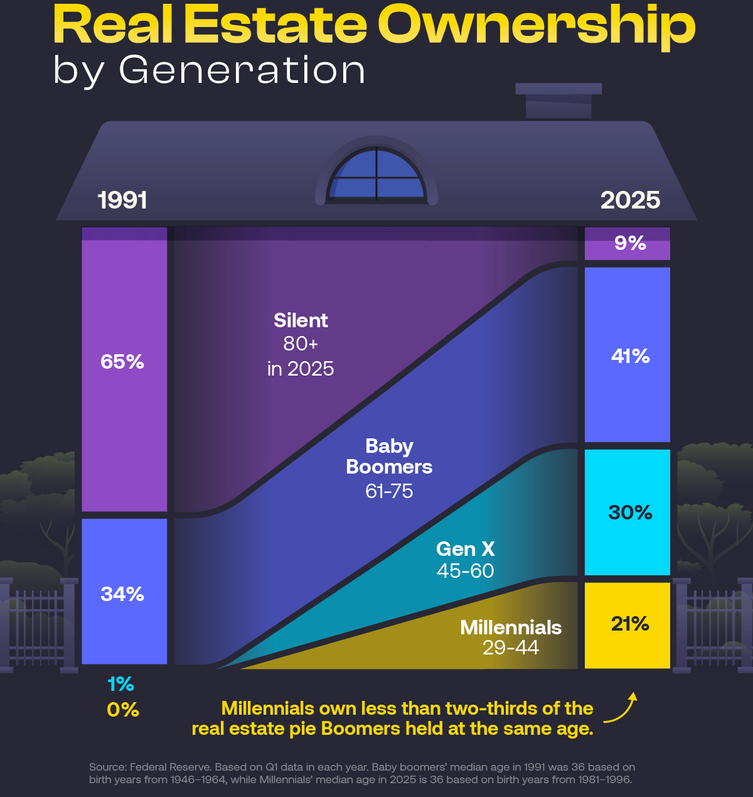
Notes:
Source

Slide 18

Financial realities come way before home ownership.
What’s one of your earliest money memories?
Money memories of Gen Alpha:
Classic: toothfairy, doing chores, bday cash
Modern: v-bucks, and robux!
money is far less tangible so spending it is not only easy, it doesn’t feel real
$50 on 6 DoorDash insomnia cookies
How much USD is 1,000 v-bucks?
Notes:
TPS: what’s one of your earliest money memories?
Explore the v-bucks shop

Slide 19
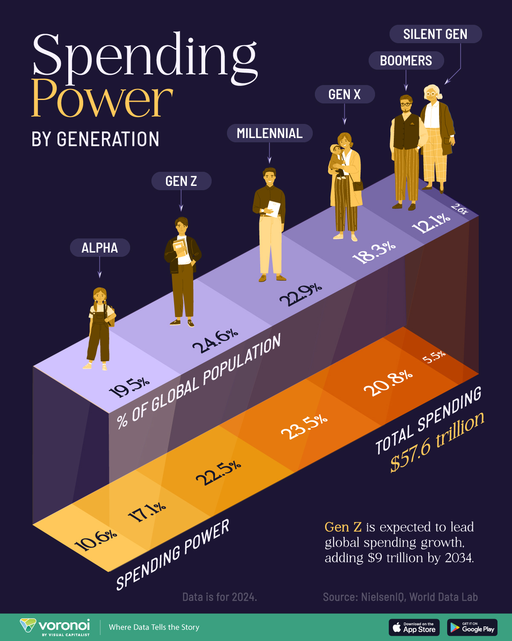
Notes:
Let’s look at overall spending trends by generation
Source

Slide 20
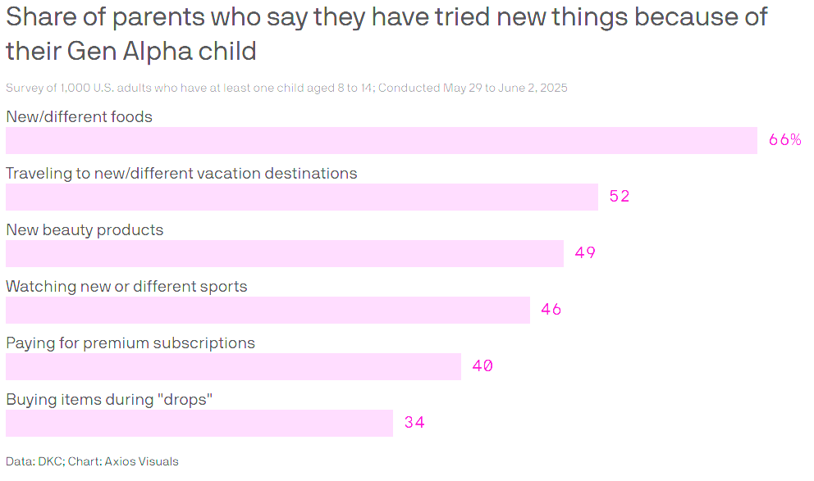
Notes:
Generation Alpha influences just under half of their households' spending according to a report shared exclusively with Axios from public relations firm DKC.
The young cohort's $101 billion in direct spending power gives restaurants and retailers a glimmer of hope at a time when the kids' parents are fretting about the state of the economy.
"They have more spending money directly than you might think they would have, and their economic influence is enormous," DKC President Matthew Traub told Axios.
"That's why we call it the gateway generation, because they're this gateway into household spending decisions and what brands are patronized in a way that I think earlier generations haven't ever wielded,"
By the numbers: 42% of all household spending is influenced by 8- to 14-year-olds, American parents said in the survey.
The age group is directly spending $101 billion per year, in addition to the influence they have over their parents' wallets.
The average Gen Alpha child has $67 of their own money to spend in a typical week, amounting to $3,484 per year. This is an almost 50% increase in direct spending over 2024.
The intrigue: "It's not just thinking about what an 8- to 14-year-old is going to purchase or ask their parents to purchase for them, but also how they're influencing the entire household's spending," Traub said.
52% of parents said they traveled to new or different vacation destinations after being prompted by their children. 61% said they're making more online purchases.
More than half of parents surveyed also said their Gen Alpha kids are pushing them to give charitable donations.
91% of Gen Alpha children are earning their own money either through payment for chores, good grades and behavior, doing odd jobs outside of the house, or online selling and reselling.
"They're already positioning themselves to earn more money and be savvier about how they spend it than any generation before that," Traub said.
Source

Slide 21

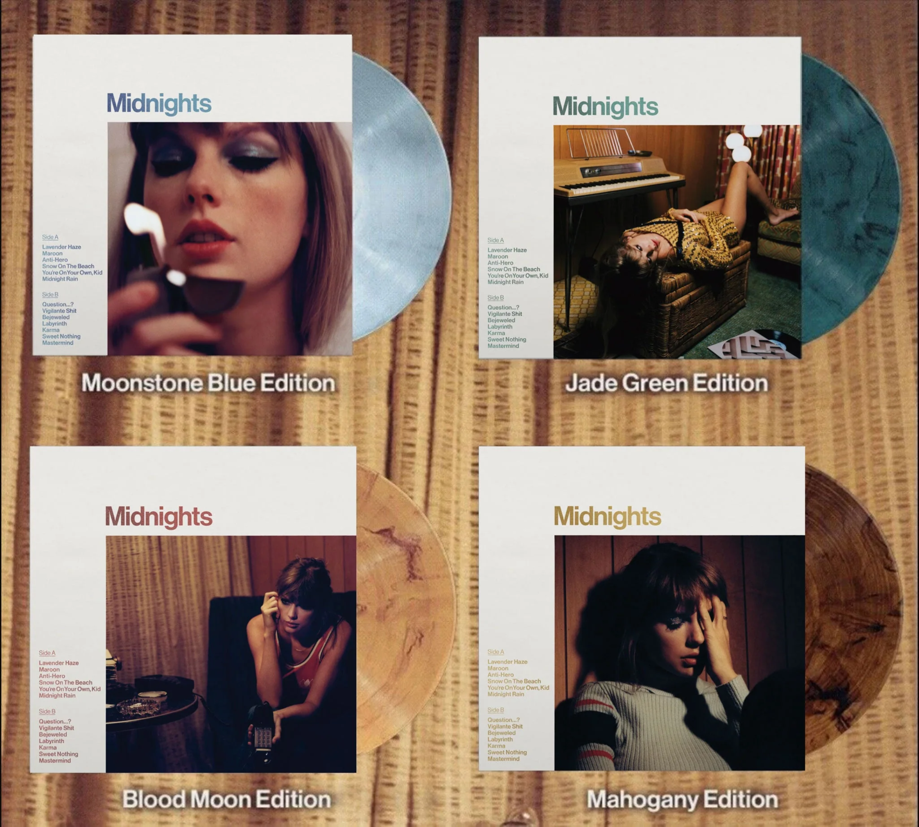



The Gen Alpha & Gen Z Paradox

Slide 22

Paradoxes
Behavior: PwC's five-year view of Gen Z indicates that more than 79% wait for products to go on sale, and only 21% regularly pay full price.
Paradox: Buy-now-pay-later (BNPL) accounts for 1.5% to 2.5% of all transactions.
According to LendingTree, 64% have tried it at least once, and BNPL loans surpassed credit card use during peak holiday periods.
More than 40% have made a late payment, up seven points from a year earlier.
11% say it’s one of their top three preferred payment methods this holiday season.
Notes:
Source

Slide 23
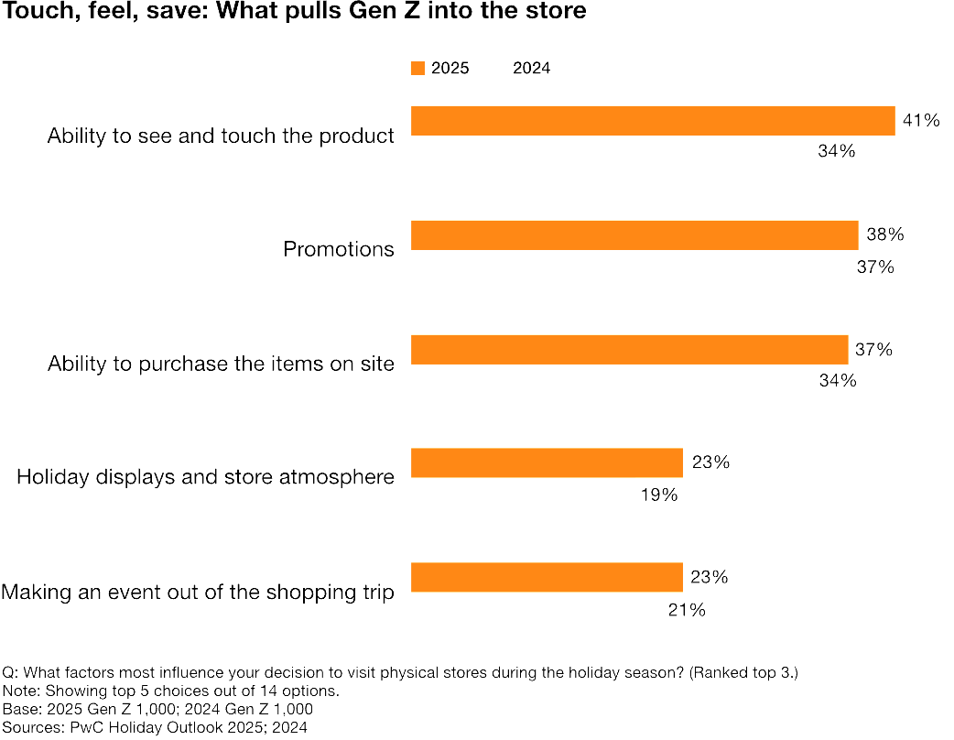
Paradoxes
Behavior: Gen Z and Gen Alpha are the most online generation ever.
Paradox: PwC’s analysis shows that 61% of Gen Z prefers to discover new products in-store.

Slide 24
Paradoxes
Behavior: Fewer 25-year olds own a home today than any point in history. Personal savings has been depressed. Median real cash balances and income growth are still low compared to pre-pandemic levels.
Paradox: "Fewer 25-year-olds own a home, but more 25-year-olds are investing in the stock market" (Eckerd, JPMorgan Chase Institute).
People with below-median incomes were five times more likely to be adding money to financial investments than they were a decade ago.
33% of 25-year-olds have investment accounts today. That's a sixfold increase relative to 2015.
Notes:
What are some reasons for this uptick?
Source

Slide 25
Personal Finance Implications
03
What conclusions can we make about Gen Alpha’s realities?
Notes:
I’ve made 3 conclusions here, and have created small activities to help address all of them - important needs to Gen Alpha and Z

Slide 26
1: Affordable Affluence
‘The smart splurge’
Reality: Stagnant wages, high costs of living, and social media-fueled consumption have pushed Gen Alpha to seek “micro luxuries” - small, premium-feeling items that convey status and self-expression without financial overreach.
Notes:
Behavior/attitude:
Gen Z equates value with savviness, not excess. They see “affordable” as smart — whether that’s a dupe, private label, or limited drop that feels curated. They crave intentional value and transparent pricing over pure brand prestige.
WHERE/HOW do you see this with your students? I.e. what micro luxuries? What are they buying that fuels self-expression?
Personal finance implication:
Gen Alpha and Z spending shows the tension between aspiration and affordability. They’re learning to balance emotional satisfaction (luxury, relevance, self-branding) with financial discipline. For personal finance, this means focusing on discerning spending habits, evaluating wants vs. smart buys, and understanding the psychology of money and marketing.

Slide 27
2: The Experience Generation
Reality: Gen Alpha is growing up in a digital-first, post-pandemic world where experiences drive connection and memory-making.
Notes:
Behavior/attitude:
They prefer immersive, shareable, or interactive experiences over material goods. This generation’s consumption will be less about ownership and more about participation and storytelling.
WHERE/HOW do you see this with your students? I.e. leaving school to buy concert tickets
Personal finance implication:
Gen Alpha will need to understand experiential spending — learning how to budget for travel, entertainment, and digital participation without sacrificing savings or future goals. Teaching them early about trade-offs, delayed gratification, and emotional value will be essential as they become the “subscription and access” generation.

Slide 28

3: Investing as Expression
Reality: The pandemic, easy-access apps, and viral financial content have drawn younger investors into markets earlier than ever - often through gamified, price-driven decisions.
Notes:
Behavior/attitude:
Gen Z (and eventually Gen Alpha) is highly responsive to price movements, hype, and peer influence. Many treat investing like trend participation rather than long-term strategy — they chase highs or dips instead of practicing steady investing.
WHERE/HOW do you see this with your students? I.e. are your students investing? Is it good, or does it make you worry?
Personal finance implication:
This reflects a need for financial literacy around emotional investing and long-term thinking. Educators can help students differentiate between speculation and strategy, understand risk tolerance, and practice habits like dollar-cost averaging and diversified investing

Slide 29
Activities!
04
Because you can’t spell SCHOOL without FUN!
Notes:
Gen Alpha is new, so is activity development!

Slide 30

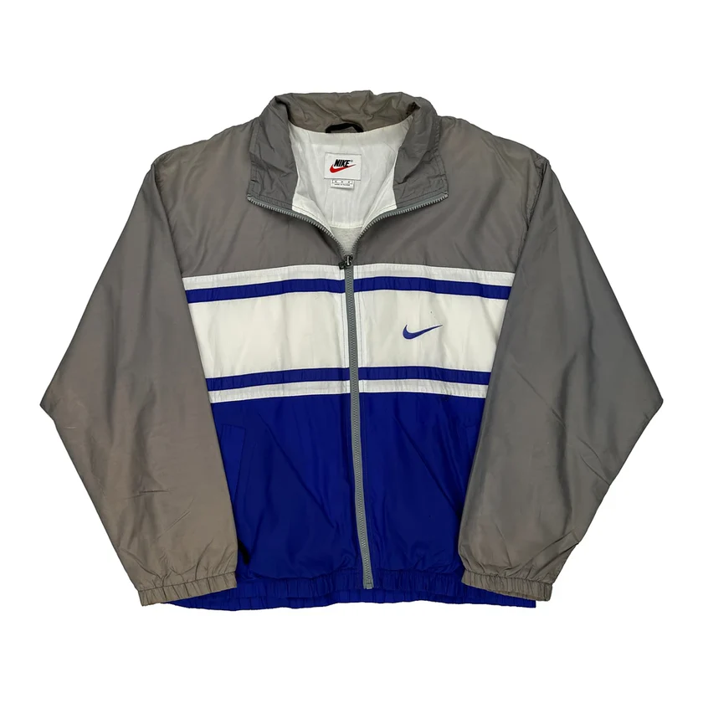

Nike
$78.00 -- Thrift -- LINK
Uniqlo
$39.90 -- Fast Fashion -- LINK
LOUIS VUITTON
$3,579.523 -- Luxury-- LINK
Activity 1: Thrift or Treat!
Is Thrifting Always a Smart Buy?
Notes:
"Which would you buy and why?"
"What makes something feel like a good deal?"
Btw: you can use BNPL for all of these

Slide 31
Item | Affordability (1-5) | Durability / Quality (1-5) | Brand/ Status Appeal (1-5) | Sustainability (1-5) | Resale Value (1-5)
Thrifted
Fast Fashion
Luxury
Activity 1: Thrift or Treat!
Is Thrifting Always a Smart Buy?
Notes:
In small groups, students make a Value Scorecard (cost, durability, brand status, sustainability, resale potential).
Rate each item 1–5 per category.
Discuss:
Which item gives the most value per dollar? (total score / price)
How much do non-financial factors (style, brand) matter to you?
Would your answer change if you just got a bonus at your job?
Share choices and reasoning.
WRAP UP: Is thrifting a smart buy here, or not?

Slide 32
Let’s explore!
Affordable Affluence | The Experience Generation | Investing as Expression
Thrift or Treat! Is Thrifting Always a Smart Buy? | Planning the Perfect Experience | Trend or Strategy? Simulated Stock Decisions
The $100 Closet Challenge | Buy Now, Pay Later: The Hidden Cost of Convenience | Dollar Dilemma: Understanding Long-Term Investing
Dupes, Drops & Discounts – The Psychology of Smart Spending |  | Gambling or Investing? – Market Hype & Perception
Notes:
What activity did you explore?
What made you pick this activity and can you imagine using it in your classroom? (how? Modifications? extensions?)

Slide 33

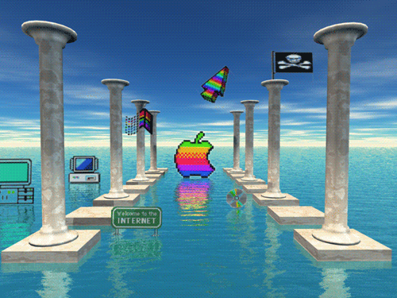
Thanks!
Stay in touch!
linkedin.com/in/alexlamon
lamonteach@gmail.com

Slide 34


Slide 35


Slide 36


Slide 37


