Slide 1


[INSERT FEATURED IMAGE OF WEBINAR SESSION]
Economics in the Everyday: Pop Culture as a Learning Tool

Slide 2
Certificate Requirements
To earn professional development hours for webinars, you must:
Watch a minimum of 45 minutes of this 60 minute session
You will automatically receive a professional development certificate via e-mail within 24 to 48 hours.

Slide 3
Objectives
You will be able to:
Create assessment questions
Implement interactive activities in the classroom
Connect Lessons to Pop culture

Slide 4

Presenter(s)
Brian Lynch
fezcgdad@gmail.com

Slide 5

Session Agenda
Background
Why pop culture
Creating videos
Assessment tools
Audience Interaction

Slide 6

National Standards
Decision Making
Scarcity
Allocation
https://www.councilforeconed.org/policy-advocacy/k-12-standards/

Slide 7
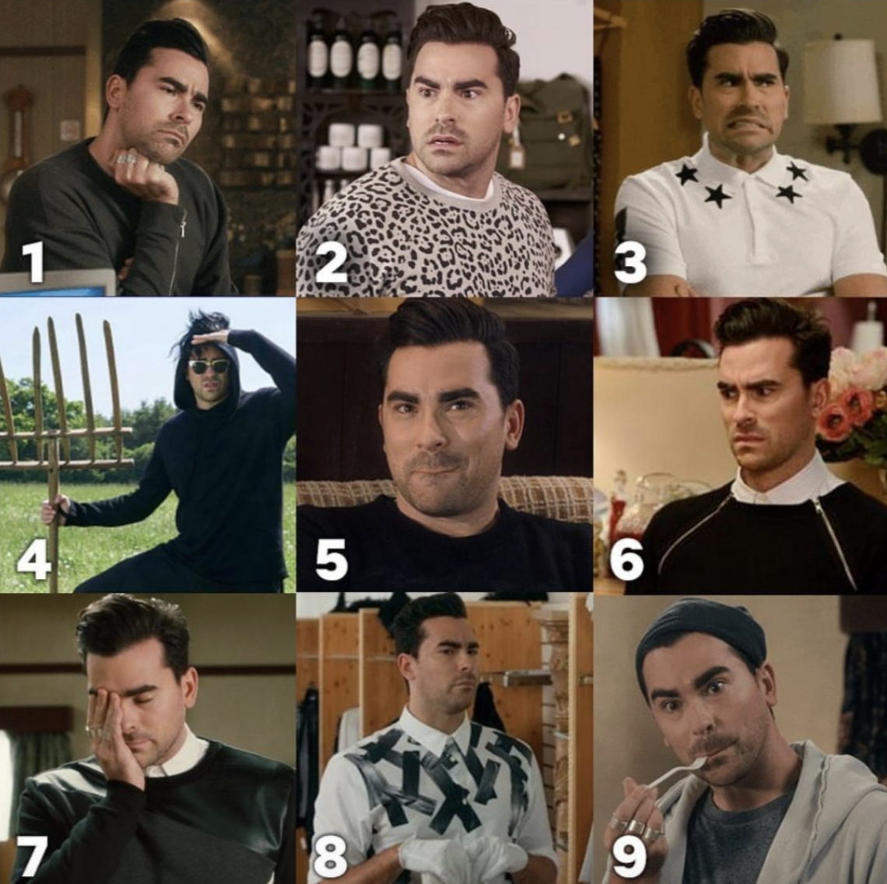
Quick Question
In the chat, please put the number that best describes your knowledge of resources for economics media clips
7
8
9

Slide 8
Quick Question
In the chat, please put the number that best describes your comfort level as a teacher with using media clips as assessment tools
7
8
9

Slide 9
Quick Question
In the chat, please put the number that describes your comfort level with using an LMS
7
8
9

Slide 10

Background
ThePhoto by PhotoAuthor is licensed under CCYYSA.

Slide 11

You are with them for the year
ThePhoto by PhotoAuthor is licensed under CCYYSA.

Slide 12
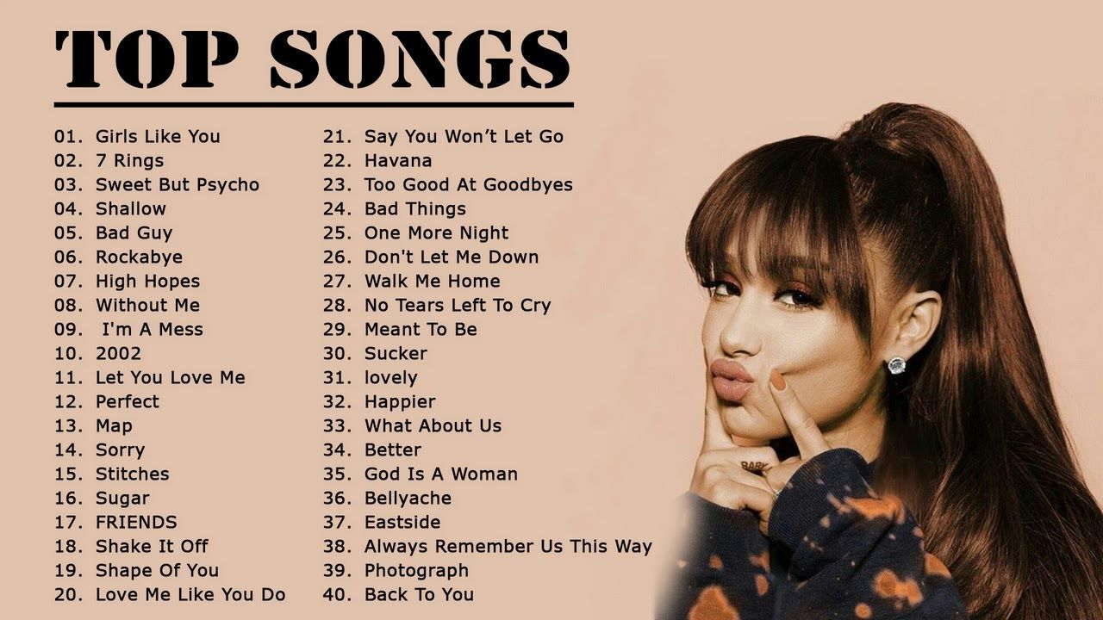
Background
What songs do they want to walk into class with?
What songs do they want to leave class with?
ThePhoto by PhotoAuthor is licensed under CCYYSA.

Slide 13

Background
We lecture more than most
Why do we do this?
ThePhoto by PhotoAuthor is licensed under CCYYSA.

Slide 14

Background
Untapped reserves
516 original, scripted television programs aired in the US

Slide 15

2.Why pop culture
ThePhoto by PhotoAuthor is licensed under CCYYSA.

Slide 16
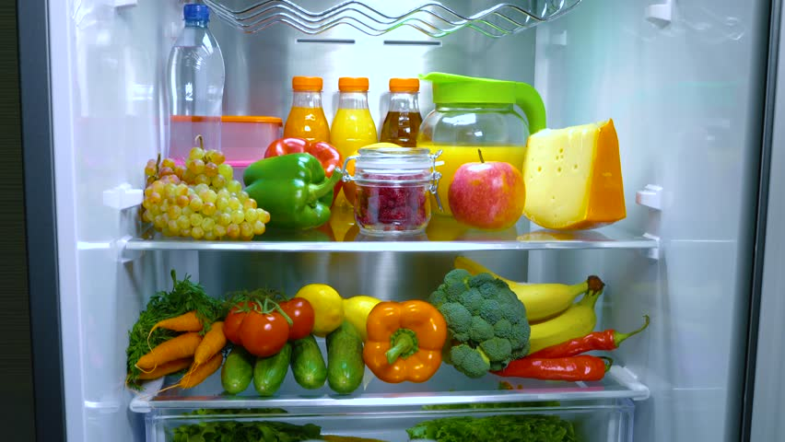
Why pop culture
We need to keep things fresh
ThePhoto by PhotoAthor is licensed under CCYYSA.

Slide 17


Why pop culture
Storytelling - literacy targeted approach
When did we stop involving students?
ThePhoto by PhotoAuthor is licensed under CCYYSA.
ThePhoto by PhotoAuthor is licensed under CCYYSA.

Slide 18

3.Creating videos
ThePhoto by PhotoAuthor is licensed under CCYYSA.
ThePhoto by PhotoAuthor is licensed under CCYYSA.

Slide 19
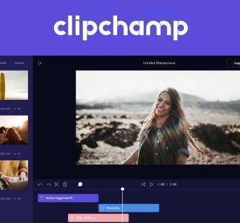
Creating videos
Can edit it and make clips seamless
Use existing clips

Slide 20
Creating videos
User-friendly
Creates mp4 files

Slide 21

Creating videos
Creates mp4 files
In house
ThePhoto by PhotoAuthor is licensed under CCYYSA.

Slide 22

Creating videos
Creates mp4 files
Clunky?
ThePhoto by PhotoAuthor is licensed under CCYYSA.
ThePhoto by PhotoAuthor is licensed under CCYYSA.

Slide 23
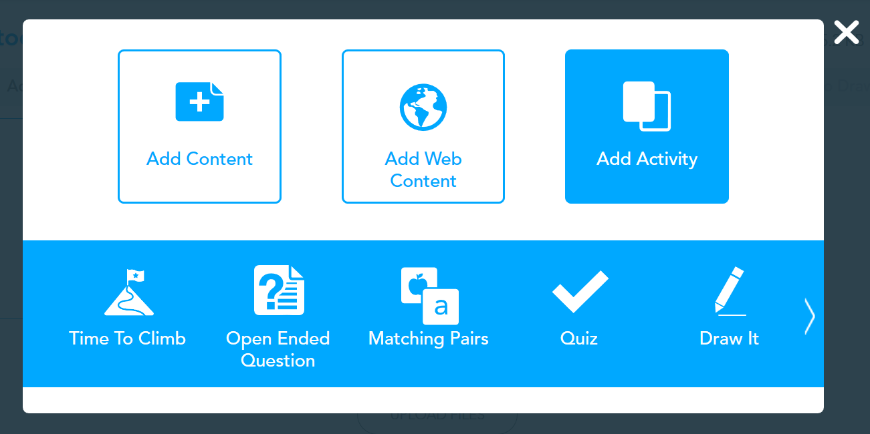
Creating videos
Can edit it and make clips seamless
Use existing clips
ThePhoto by PhotoAuthor is licensed under CCYYSA.
ThePhoto by PhotoAuthor is licensed under CCYYSA.

Slide 24

4. Assessment tools

Slide 25

Assessment tools
Pause clips
Create questions
ThePhoto by PhotoAuthor is licensed under CCYYSA.
ThePhoto by PhotoAuthor is licensed under CCYYSA.
ThePhoto by PhotoAuthor is licensed under CCYYSA.
ThePhoto by PhotoAuthor is licensed under CCYYSA.

Slide 26

Assessment tools
Pause clips
Create questions
ThePhoto by PhotoAuthor is licensed under CCYYSA.

Slide 27

Assessment tools
Pause clips
Create questions
ThePhoto by PhotoAuthor is licensed under CCYYSA.
ThePhoto by PhotoAuthor is licensed under CCYYSA.
ThePhoto by PhotoAuthor is licensed under CCYYSA.
ThePhoto by PhotoAuthor is licensed under CCYYSA.

Slide 28


Assessment tools
Tech issues
School approved clips?
If in doubt, don't!
ThePhoto by PhotoAuthor is licensed under CCYYSA.

Slide 29

Assessment
ThePhoto by PhotoAuthor is licensed under CCYYSA.

Slide 30

Assessment
Effective Assessments
Test questions
ThePhoto by PhotoAuthor is licensed under CCYYSA.
ThePhoto by PhotoAuthor is licensed under CCYYSA.

Slide 31

Assessment
Effective Assessments
Substance matters
ThePhoto by PhotoAuthor is licensed under CCYYSA.
ThePhoto by PhotoAuthor is licensed under CCYYSA.

Slide 32
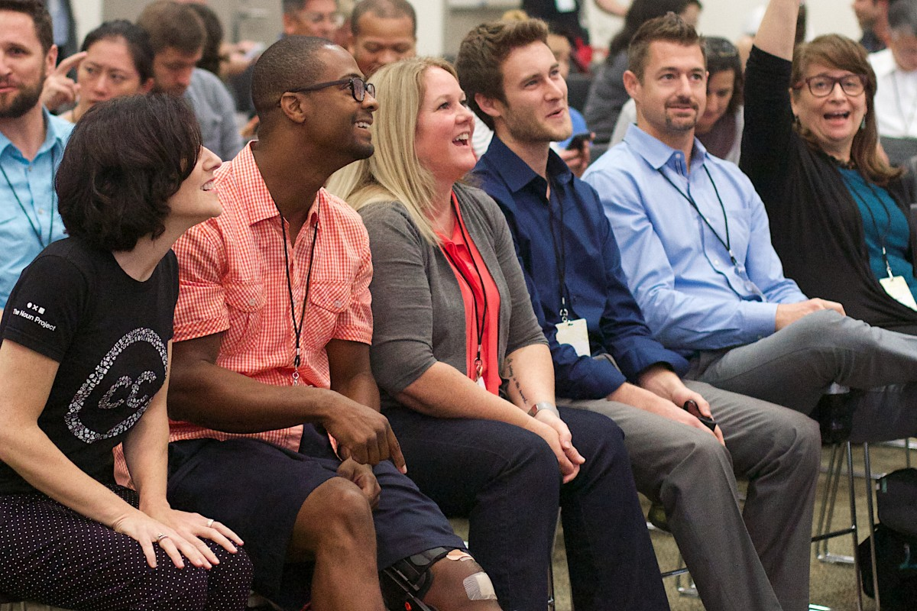
5.Audience interaction- your turn
ThePhoto by PhotoAuthor is licensed under CCYYSA.
ThePhoto by PhotoAuthor is licensed under CCYYSA.

Slide 33
Resources
Critical commons clips (download mp4 files)
Jadrian Wooten's econ clips
Teaching with superstore
Bob's burgers paper

Slide 34
Presenter(s)
Brian Lynch
fezcgdad@gmail.com

Slide 35


Slide 36
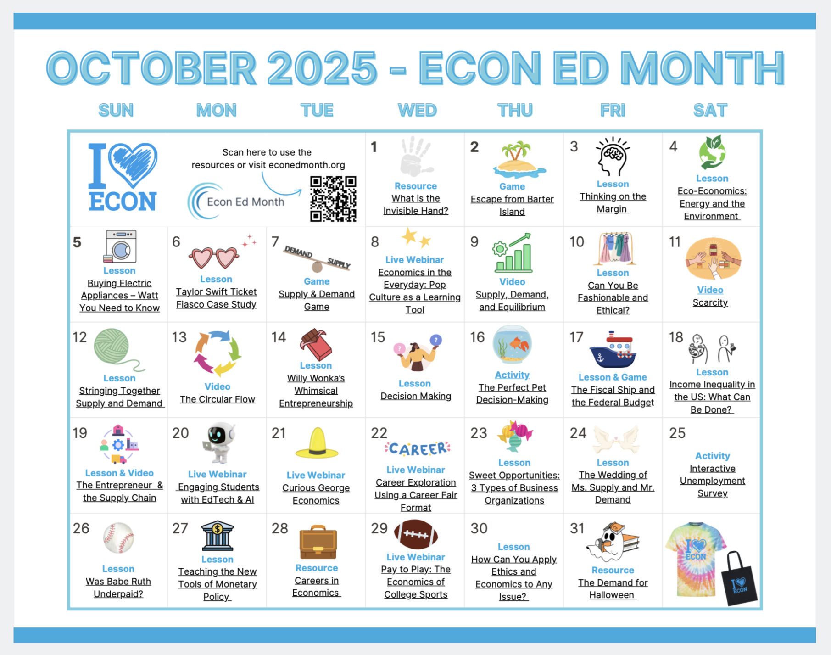
Happy Econ Ed Month!

Slide 37


Slide 38


Slide 39

[INSERT FEATURED IMAGE OF WEBINAR SESSION]
Thank you

