Slide 1

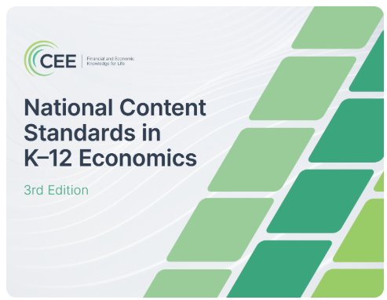
New Standards, New Strategies: Teaching Economics for Today’s Classroom

Slide 2

Presenter
Dr. Chris Cannon
Associate Director – Georgia Council on Economic Education
ccannon11@gsu.edu
Facebook.com/georgiaecon1

Slide 3
Certificate Requirements
To earn professional development hours for webinars, you must:
Watch a minimum of 75% for all sessions
You will automatically receive a professional development certificate via e-mail within 24 to 48 hours.

Slide 4
Objectives
You will be able to:
Understand key shifts in new economics standards.
Explore adaptable strategies and resources that align with new requirements.
Learn how to integrate real-world examples that keep lessons relevant and engaging.

Slide 5

Session Agenda
Overview of new standards
Highlights of key changes
Resources to teach selected standards
Evaluation/exploration of these resources

Slide 6
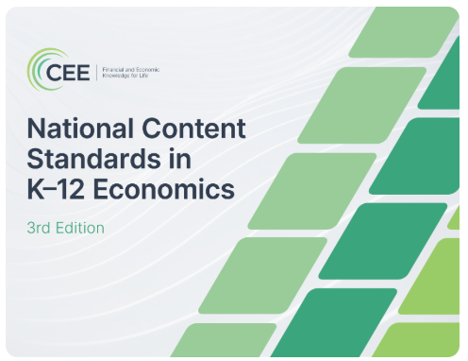
National Standards
Lots!
https://www.councilforeconed.org/wp-content/uploads/National-Content-Standards-in-K%E2%80%9312-Economics-3rd-Edition.pdf

Slide 7
National Standards
Discussion question:
Why is it important to have National Standards?

Slide 8
National Standards
Provide a shared foundation
Inform state and local standards
Promote coherence and progression
Support curriculum, assessments, and resources
Elevate the discipline
Create a common language

Slide 9

Standards build and spiral
Standards build over grade levels
DOES NOT imply that grade level is “best”

Slide 10
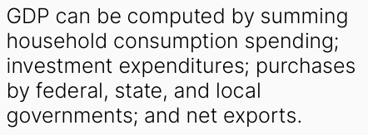
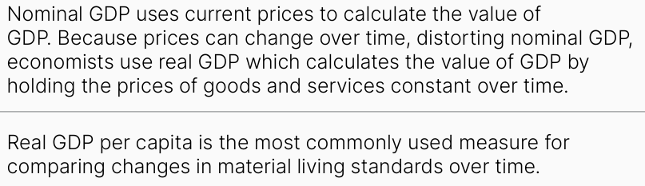
Building example
What grade level does this standard belong to?
Corresponding High School standard
(11.H.1&2)
MIDDLE SCHOOL (11.M.2)

Slide 11
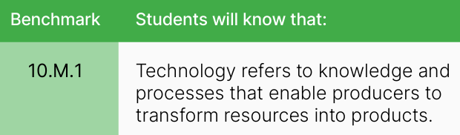
Don’t over complicate
Some benchmarks convey simple content
Not everything needs a full-blown “lesson plan” to teach

Slide 12

Overall purpose
Use standards to inform local/state decisions
“Picking and choosing” is allowed

Slide 13
Revising the
National Content Standards in K-12 Economics thank you to William Bosshardt

Slide 14
Thank you to:
Writing Committee
  William Bosshardt, Florida Atlantic University, Committee Chair
  Sam Allgood, University of Nebraska-Lincoln
  Marwa Hassan, The College Board
  Bonnie Meszaros, University of Delaware
  Akila Weerapana, Wellesley College
  Scott Wolla, Federal Reserve Bank of St. Louis

Slide 15
Goals of the revision
Initial thoughts:
Streamline the standards, if possible (teachers want fewer standards)
Add economic content that has become more relevant in the last 15 years
Give the standards a modern look (no references to yellow pages)

Slide 16
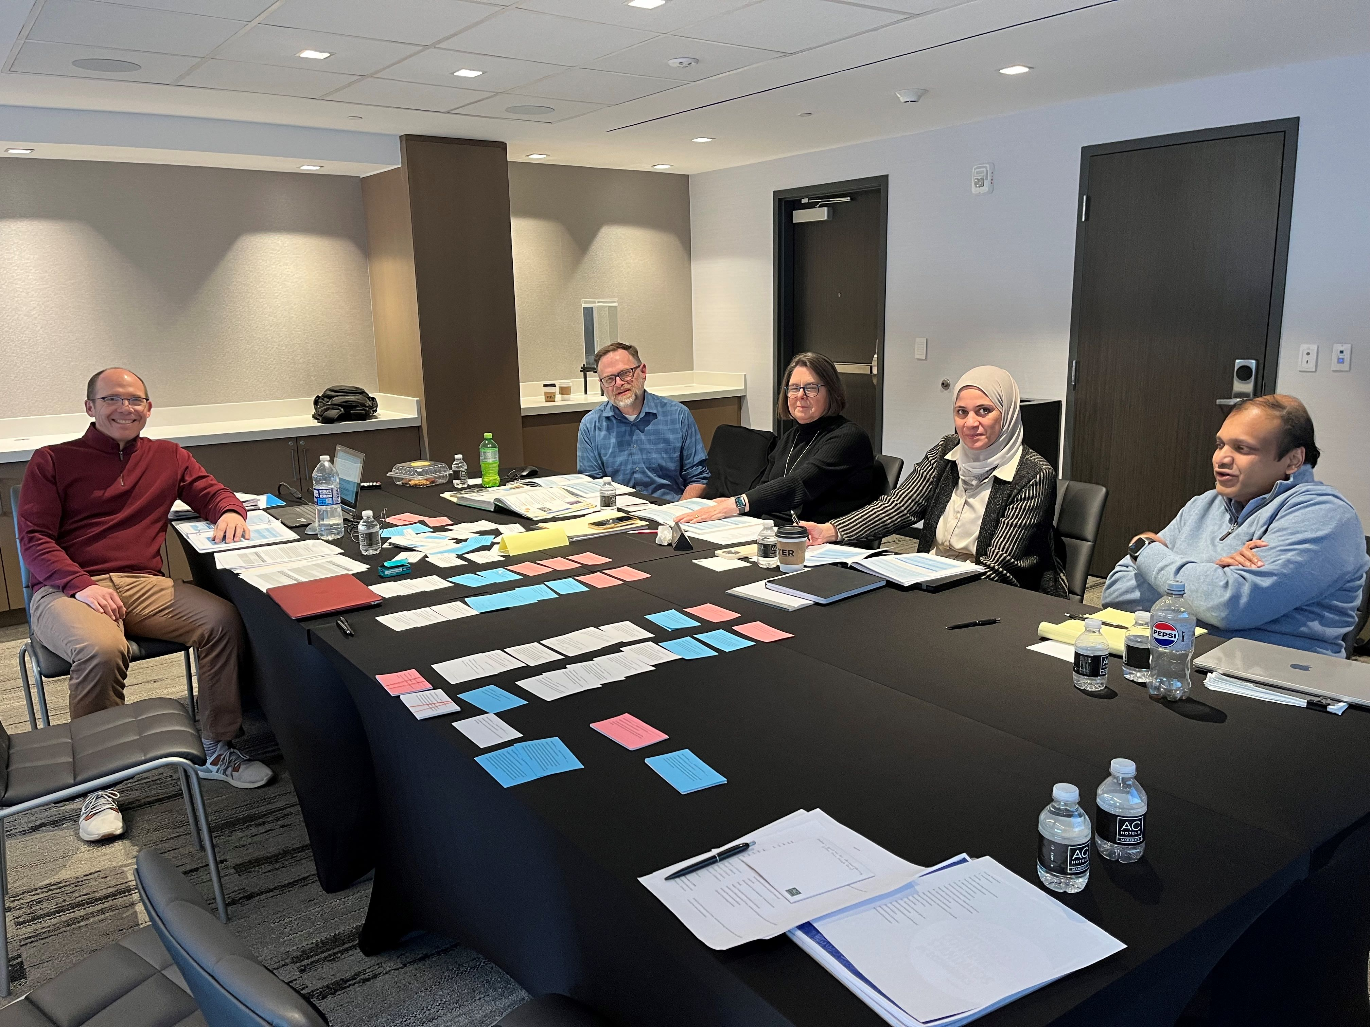
Streamlining the standards…
Old Standard | Old Name | New Standard | New Name | Notes:
1 | Scarcity | 1 | Scarcity and Allocation
 |  | 2 | Decision Making
2 | Decision Making | 2 | Decision Making
3 | Allocation | 1 | Scarcity and Allocation
4 | Incentives | 2 | Decision Making
5 | Trade | 3 | Specialization and Exchange | Trade between people
 |  | 9 | International Trade | International trade
6 | Specialization | 3 | Specialization and Exchange | Specialization between people
 |  | 9 | International Trade | Specialization between countries
7 | Market and Prices | 4 | Markets
8 | Role of Prices | 4 | Markets
9 | Competition and Market Structure | 5 | Business Decisions and Market Structure
10 | Institutions | X | No easy crosswalk. | Could be 3, 5, 7, 8, 14 - depends on institution.
11 | Money and Inflation | 13 | Money | Money oriented topics.
 |  | 15 | Inflation | Inflation oriented topics.
12 | Interest Rates | 14 | Banks, Interest Rates, and Financial Markets
13 | Income | 8 | Labor and Income
14 | Entrepreneurship | 5 | Business Decisions and Market Structure
15 | Economic Growth | 16 | Growth and Fluctuations
16 | Role of Gov't & Market Failure | 6 | Market Failure | Describes market failure
 |  | 7 | Role of Government | Describes solutions to market failure
 |  | 18 | Fiscal Policy and Taxation | Discusses taxes and fiscal solutions
17 | Government Failure | 7 | Role of Government
18 | Economic Fluctuations | 11 | GDP | GDP and descriptions thereof
 |  | 16 | Growth and Fluctuations | Business cycles and growth
19 | Unemployment and Inflation | 12 | Unemployment | Unemployment topics
 |  | 15 | Inflation | Inflation Topics
20 | Fiscal & Monetary Policy | 17 | Monetary Policy | Monetary policy topics
 |  | 18 | Fiscal Policy and Taxation | Fiscal policy topics
New |  | 10 | Technology

Slide 17
The Result - https://www.councilforeconed.org/policy-advocacy/k-12-standards/
Standard | Name |  | Standard | Name
1 | Scarcity and Allocation |  | 10 | Technology
2 | Decision-Making |  | 11 | Gross National Product
3 | Specialization and Exchange |  | 12 | Unemployment
4 | Markets |  | 13 | Money
5 | Business Decisions and Market Structure |  | 14 | Banks, Interest Rates, and Financial Markets
6 | Market Failure |  | 15 | Inflation
7 | Role of Government |  | 16 | Growth and Fluctuations
8 | Labor and Income |  | 17 | Monetary Policy
9 | International Trade |  | 18 | Fiscal Policy and Taxation

Slide 18
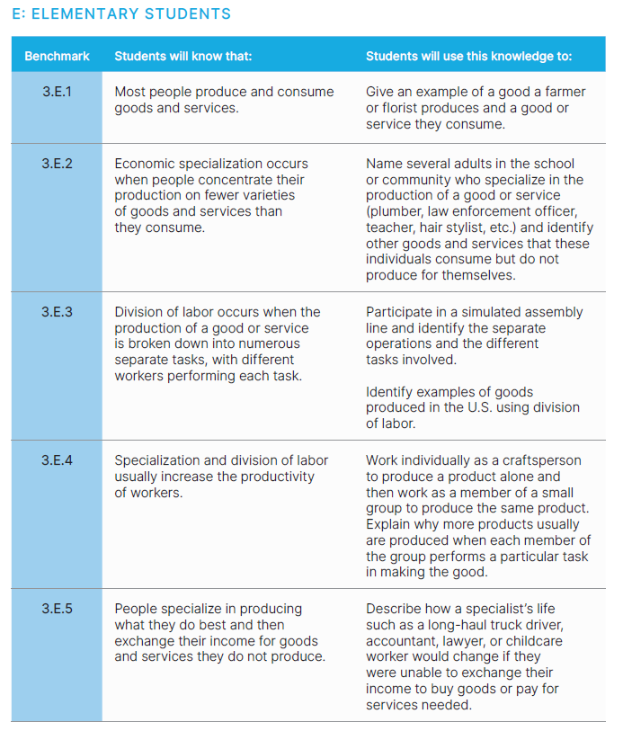
Enhanced right-hand side
“Students will use this knowledge to…”
Meant as examples, not requirements

Slide 19
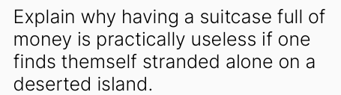
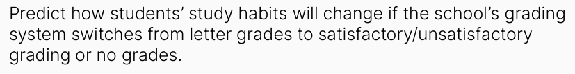


Slide 20

Today’s Highlighted Topics
International Trade
Technology
Monetary Policy
Entrepreneurship
Review content and look at related resources

Slide 21
International
Extracted from old Specialization and Trade standards.
Two prong focus…PEOPLE TRADE and COUNTRIES TRADE
Elementary School:
  Exports and imports, interdependence, trade makes people better off
  Middle School:
  Specialization, division of labor, gains from trade unequal, reasons to restrict trade
  High School:
  Comparative advantage, globalization, exchange rates

Slide 22
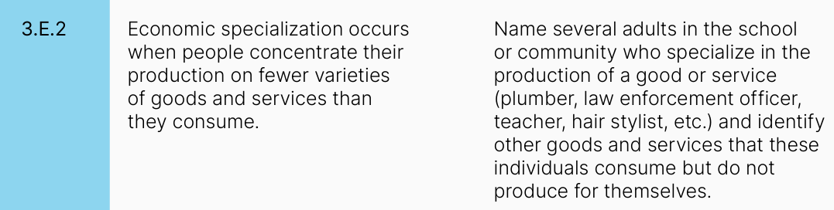
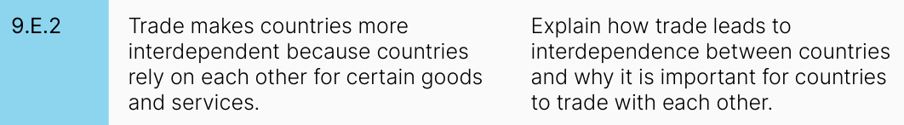

Slide 23


Slide 24
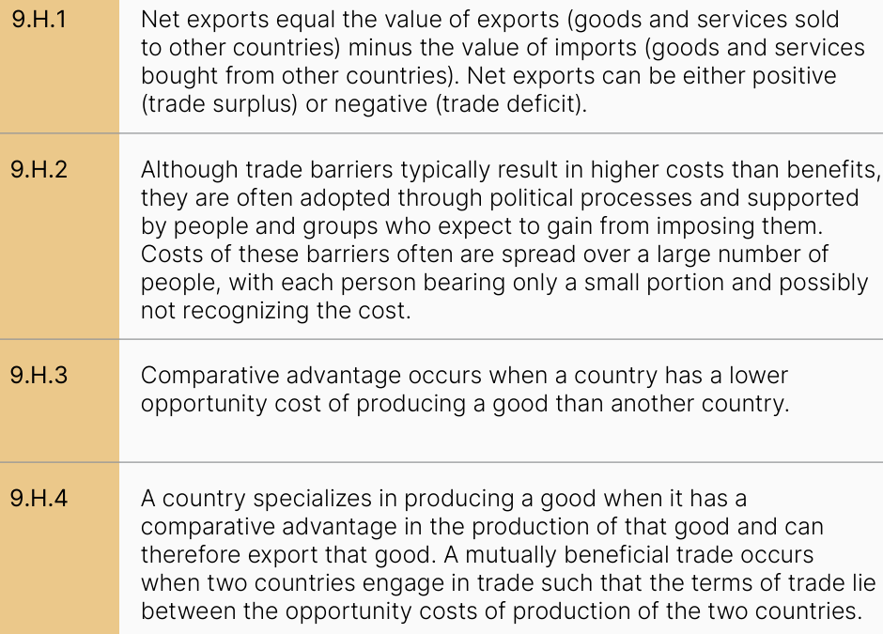
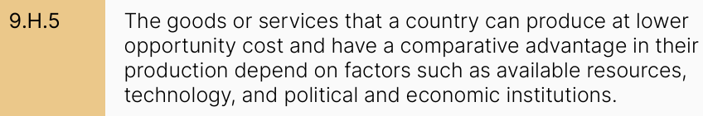

Slide 25
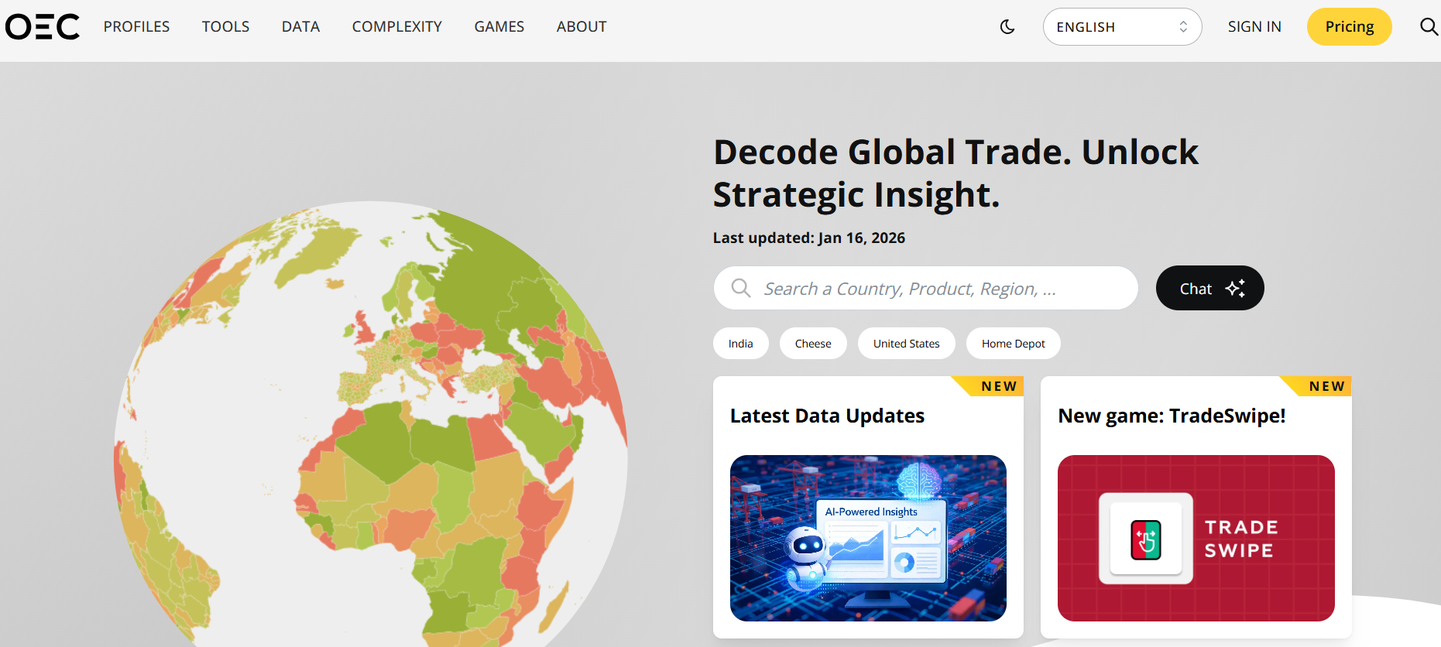
Resource Deep Dive
https://oec.world/en

Slide 26

National Standards
Discussion question:
What should students understand about the relationship of “Technology” and “Economics?”

Slide 27
Technology
      Technology in old standards: Shifts supply, determines trade, drives growth.
      New standards call it out as an independent topic in Middle and High School
      Broader view of technology presented

Slide 28
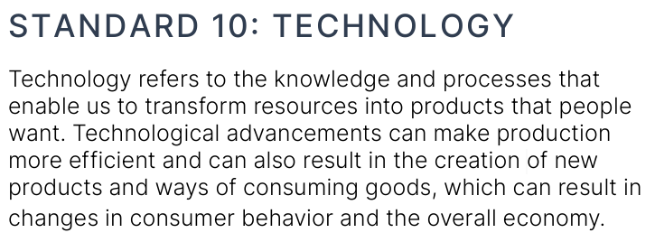

Slide 29
technology
10.M.3: Technological advancements can expand employment opportunities through job creation in innovative and emerging industries. However, technology also carries the risk of job displacement for specific tasks that become automated or obsolete.
10.H.1: The profit motive drives businesses to innovate and seek new technologies that improve efficiency and reduce costs. Governments can support businesses’ initiatives to develop new technologies by funding research and development, providing tax incentives and subsidies, creating favorable environments, and investing in human capital.

Slide 30

Technology
10.H.6: Technology can narrow gaps in education and improve economic well-being and social equity by promoting access to information and markets. However, disparities in access and utilization of technology, online privacy and security risks, and job displacement can worsen economic and social inequities.
10.H.3: Artificial intelligence is an example of a technology that can transform the workforce, affecting the way people approach various tasks and processes. It can enhance human capabilities and support certain tasks, boosting productivity, or it can serve as a replacement for specific tasks. AI can also create new job opportunities and lead to skill transformation.

Slide 31

Resource Deep Dive
The Jobs AI Can Do (And Those It Shouldn’t)
https://docs.google.com/presentation/d/1VkTHUi8gahQqCCm50O6UH5TW7dlL3gk7FFA4UUwFPSE/edit?usp=sharing

Slide 32

National Standards
Discussion question:
What are two benefits/positives of being an entrepreneur?

Slide 33
National Standards
Discussion question:
What are two drawbacks/negatives of being an entrepreneur?

Slide 34
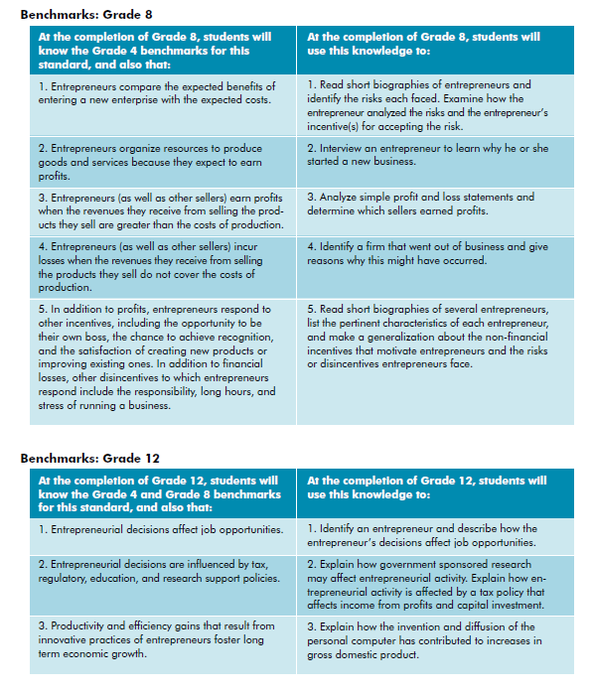
entrepreneurship
Distinguishing between entrepreneurship and what all firms do!

Slide 35
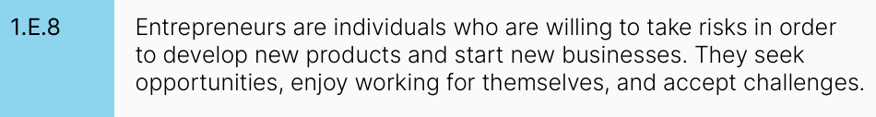
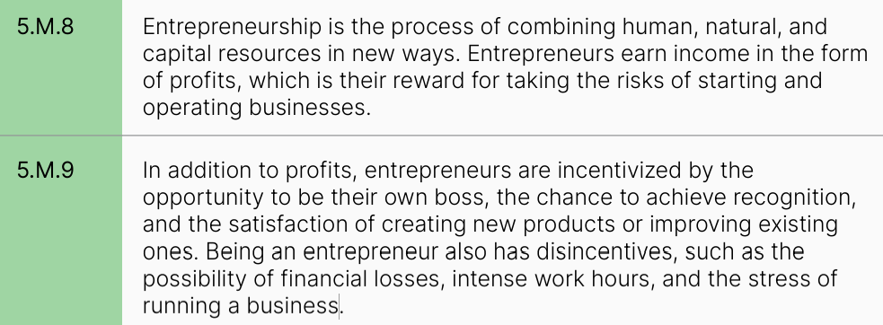
Entrepreneurship in new standards

Slide 36
Entrepreneurship in new standards

Slide 37

Resource Deep Dive
Start it UP
Student Playthrough Document: https://docs.google.com/document/d/1reTXQ7e1EAM-SIkDwJecSaSbT99X4kPtQI11LRU7ZZU/edit?usp=drive_link
Gpb.org/start-it-up

Slide 38
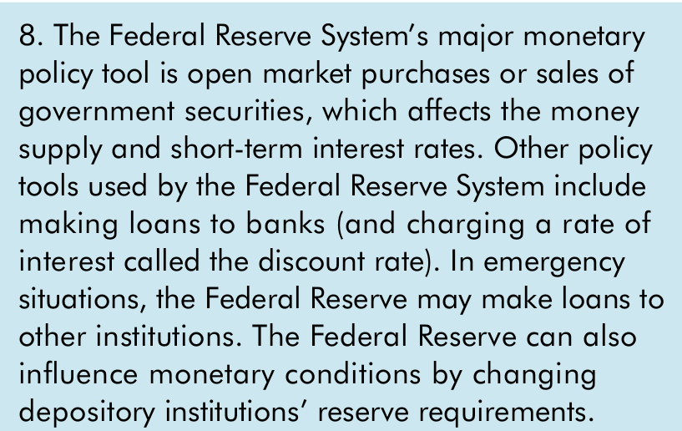

National Standards
Discussion question:
“What’s wrong with this picture?”

Slide 39

Monetary Policy
17.H.1: The Federal Reserve System is composed of three entities: the Federal Reserve Board of Governors, which oversees all aspects of the Federal Reserve; the 12 Federal Reserve Banks, which examine and supervise financial institutions, act as lenders of last resort, and provide U.S. payments system services; and the Federal Open Market Committee (FOMC), which is responsible for determining U.S. monetary policy.
17.H.5: The Federal Reserve’s primary monetary policy tool is the interest it pays banks to keep reserves at the Federal Reserve, called the interest on reserve balances (IORB). The Federal Reserve implements policy by using the IORB interest rate to steer the federal funds rate to the FOMC’s target range.

Slide 40
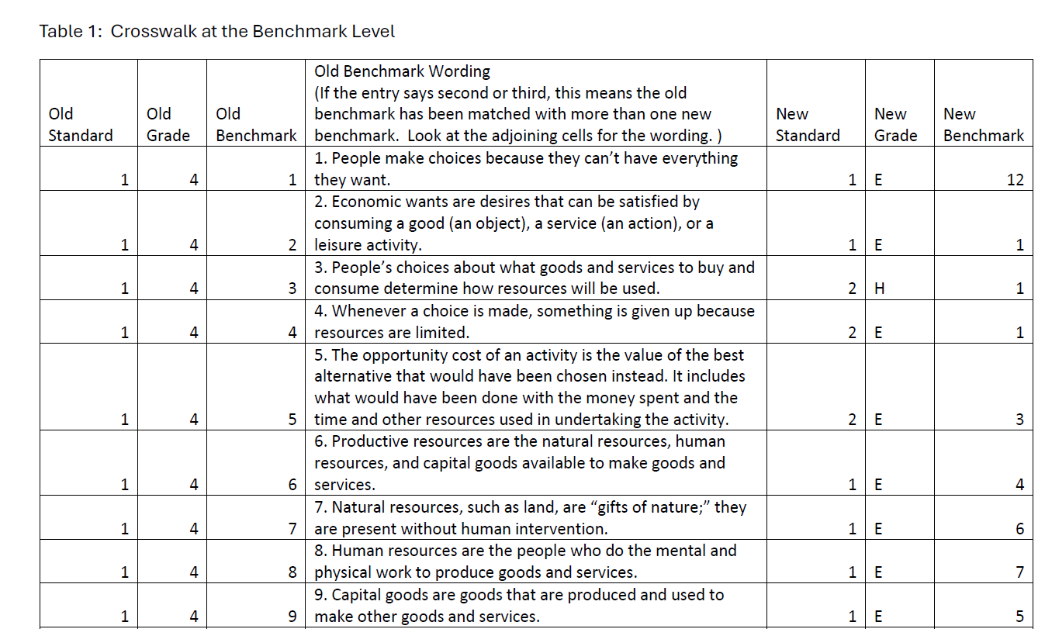
Crosswalks!
Old to new…
If they’d be helpful for you, contact me and I can send them to you

Slide 41


Sample Lessons:
https://docs.google.com/presentation/d/1ANvRAayM_ruRaIWDmR-GjZa7bm5lWPU8zuL62JCe_as/edit?usp=sharing

Slide 42

Thank you
ccannon11@gsu.edu

