Slide 1



Exploring Monetary Policy with Wayground
Presented by:
Karen Yancy: yancyk@joshuaisd.org
Katie Beth Miller: millerk@joshuaisd.org
Date: December 8, 2025
Notes:
Open these:
Presentation Outline
https://wayground.com/admin/quiz/68ebe30f5fcf8eb9dab0dd20
https://docs.google.com/presentation/d/1bnxWUpoxs3-hUjfoF1v9yT0ZmZsW8ffEkXdfKgO11D0/edit?usp=sharing

Slide 2
About Us
Karen Yancy
Economics, Macroeconomics, & US Government Teacher
30+ years teaching experience at high school and college level
Several lessons published by EconEd
I strive to make lessons engaging and meaningful for all students.
Katie Beth Miller
Instructional Technologist
15 years in education as a librarian, English teacher, and instructional technologist at the secondary level
Presented at local, regional, and state conferences
I advocate for using technology to expand understanding and save time.

Slide 3

Expectations
Please keep on your video so we can familiarize names and faces.
2. Add any questions in the chat during the session.
3. Engage in the presentation during the Q/A and group discussion.

Slide 4
Overview
Formative assessments
Question variety
Accommodations
Data
AI

Slide 5
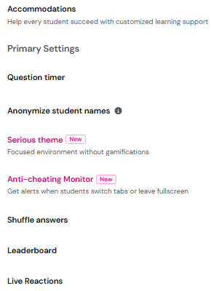
Host
Select from Student paced or Teacher led. Switch modes when you want.
Assign to class or have students join with a link or code.
Adjust settings﻿
Embedded features
Notes:
https://wayground.com/admin/quiz/68ebe30f5fcf8eb9dab0dd20

Slide 6
Results
Sessions
Status
Participants
Questions
Accommodations
Overview
Standards
Classes
View
LMS integration
Filter by grade
Add co-teacher

Slide 7
Create
What?
Assessments
Presentations
Videos
Passages
Flashcards
How?
Import worksheets/questions
Generate with AI
Create from scratch

Slide 8
Quiz
What?
Use to introduce
Use to review
Use to assess
Change question types
How?
Import worksheet/questions
Generate with AI
Create from scratch

Slide 9
Presentation
What?
Use to introduce
Use to review
Use to assess
Work as class
Work independently
Embed videos and passages
How?
Import worksheet/questions
Generate with AI
Create from scratch

Slide 10
Examples
Lessons
PPC, AD/AS, Reserves & Money Market Graphs
Assessments
Fiscal, Limited Monetary & Ample Monetary Policies
Monetary Policy: Limited vs Ample

Slide 11
Questions?
Wayground Help

Slide 12
Thank you!
Karen Yancy: yancyk@joshuaisd.org
Katie Beth Miller: millerk@joshuaisd.org
Date: December, 2025

