Slide 1



Two Worlds, One Classroom: A Holistic Approach to Financial Education
[INSERT FEATURED IMAGE OF WEBINAR SESSION]

Slide 2
Certificate Requirements
To earn professional development hours for webinars, you must:
Watch a minimum of 75% for all sessions
You will automatically receive a professional development certificate via e-mail within 24 to 48 hours.
Make sure to always check your spam/junk folder, if its not there, go on your EEL dashboard and try resending. Yes! You can resend yourself your certificates as an EEL member.

Slide 3
Today's Objectives
Teachers will be able to:
Integrate economic reasoning with personal finance instruction.
Build coherent lessons that connect financial choices to economic principles.
Provide students with a deeper, more holistic understanding of financial wellbeing.

Slide 4

Presenter: Cynthia Fitzthum
Dr. Cynthia Fitzthum
Cjfitzthum@stcloudstate.edu
Session Description: Financial education thrives when economic reasoning meets personal finance skills. This session shows how to bridge the two “worlds,” helping students understand not just how to manage money but why financial decisions matter within a broader economic context.

Slide 5
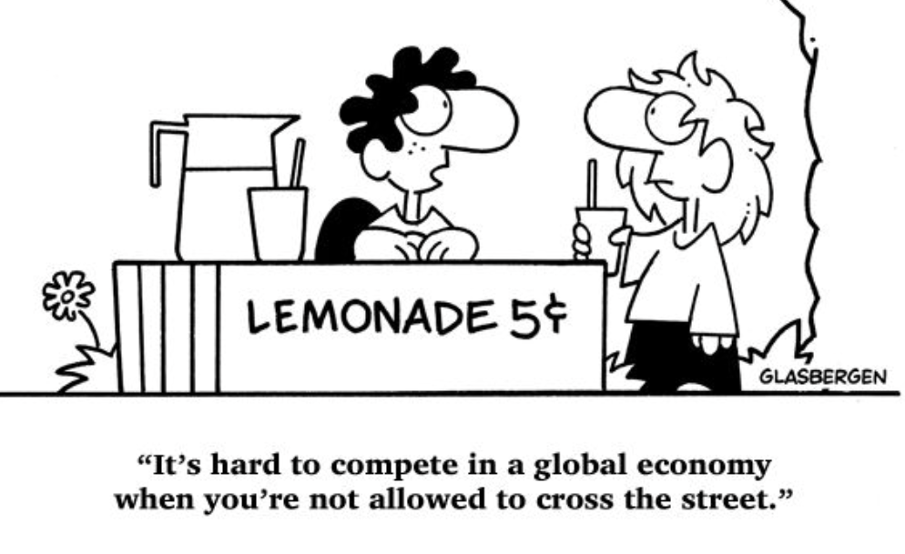

Slide 6
The Big Picture
Personal finance is full of economic principles, such as; scarcity, tradeoffs and opportunity costs.
Think complements, NOT substitutes
Economics can help students understand the global economy
Both apply decision making skills and understanding
Goal: The HOW and the WHY

Slide 7
Session Agenda
Welcome and Big Picture
How can we integrate economic reasoning with personal finance?
Define clearly.
What lessons can I use that connect financial choices to economic principles?
Examples.
Assessment Ideas
How can students understand financial wellbeing better?
Best practices.
Breakout Rooms- Interactive Time
Wrap-up and Questions

Slide 8
Session Agenda: Reflections
Reflection time is noted in RED.
Please take time to journal or utilize an online document to gather these reflections.
The goal is to make meaningful connections to your current or future classroom(s) to immediately use this content to enhance your teaching. (This will also be helpful in the breakout rooms after the presentation.)
Goal: How can you bring this content back and make it relevant for your students?

Slide 9
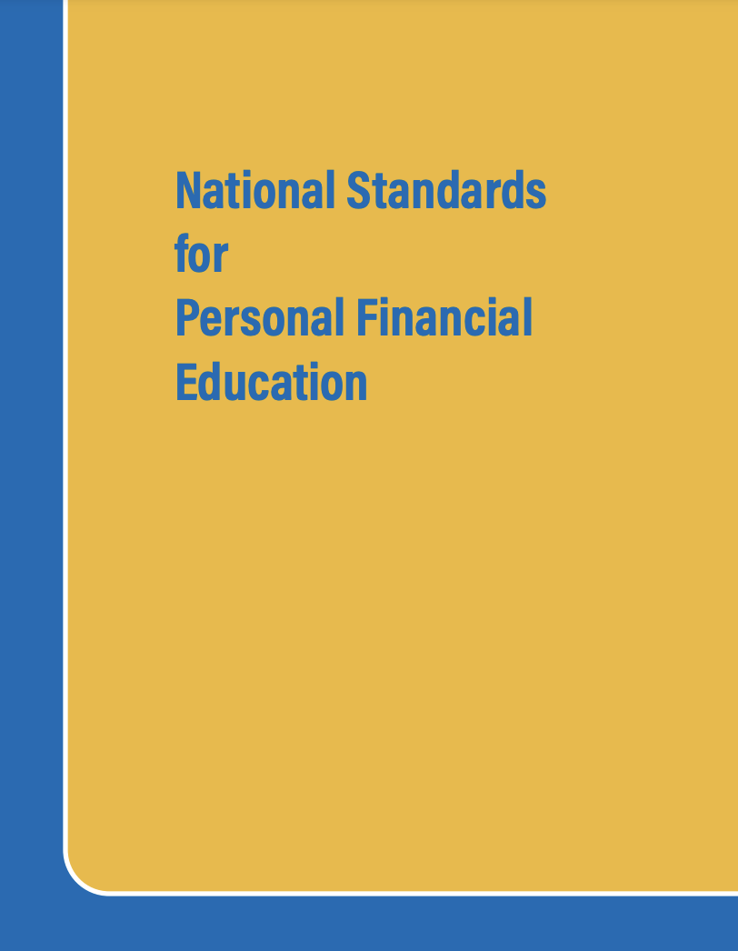
National Standards
12.1 A budget helps people achieve their financial goals by allocating income to necessary and desired spending, saving, and philanthropy.
12.2 Consumer decisions are influenced by the price of products or services, the price of alternatives, the consumer’s budget and preferences, and potential impact on the environment, society, and economy.
https://www.councilforeconed.org/policy-advocacy/k-12-standards/

Slide 10

National Standards
2.H.2 Choices made by individuals, firms, or government officials are constrained by the resources they can use.
2.H.4 Choices made by individuals, firms, or government officials often have long-term unintended consequences that can partially or entirely offset or supplement the intended effects of the decision.
https://www.councilforeconed.org/policy-advocacy/k-12-standards/

Slide 11

How can we integrate economic reasoning with personal finance?

Slide 12
Activity Time!
ECONOMICS
+
PERSONAL FINANCE
=

Slide 13
Define Clearly.
Reflect: How are they alike? How are they different?
Economics: The everyday business of life. A social science that studies the decisions people make when faced with scarce resources. In particular, economics is about decisions related to the production, distribution, and consumption of goods and services. (Federal Reserve, 2025)
Personal Finance: Personal finance is the practice of managing your money as well as saving and investing. (Investopedia, 2025)

Slide 14
Ways to Integrate: Topics
BUDGETS
SCARCITY
OPPORTUNITY COST
Other?

Slide 15
Ways to Integrate: Quick Ideas
CLASSROOM ECONOMY: Earn by completing tasks, good behavior or other work, "save" or "spend" the classroom ECONObucks
SIMULATIONS & PROJECTS: Stock market game, iCivics, business plans
INTERDISCIPLINARY APPROACH: "Great Depression Example"
Reflect: How can I assess these and check for understanding?

Slide 16

What lessons can I use that connect financial choices to economic principles?

Slide 17
EconEdLink Reflection
What is your favorite economic/personal finance lesson to teach?
How does it cross into both "worlds"?

Slide 18
Lesson Idea #1
Risky Spending and Teen Gambling
Key Concepts: costs and benefits, budgeting, money management, risk
Have you played an online game with pay-to-play activities where you pay for extra coins, gems, power-ups, loot boxes, and skins? Have you ever spent more money than you intended?
In this personal finance lesson, students review statistics about underage gambling, listen to a section of a podcast on how teens get hooked on sports betting, give thumbs up or thumbs down to statements that they believe are gambling, and create a public service poster to alert their peers to the dangers of teenage gambling.
https://econedlink.org/resources/risky-spending-and-teen-gambling/

Slide 19

Lesson Idea #1
Risky Spending and Teen Gambling: OVERVIEW
First, review statistics of teen gambling with your students. (included in lesson)
Listen to a Podcast about teen gambling.
Thumbs up or thumbs down question activity.
Public service poster activity.
Wrap up and extensions.
https://econedlink.org/resources/risky-spending-and-teen-gambling/

Slide 20
Lesson Idea #1
Risky Spending and Teen Gambling
THE HOW: How does this lesson reflect on budgeting and how to manage money?
THE WHY: Why is this lesson important to understand decision making better?
https://econedlink.org/resources/risky-spending-and-teen-gambling/

Slide 21
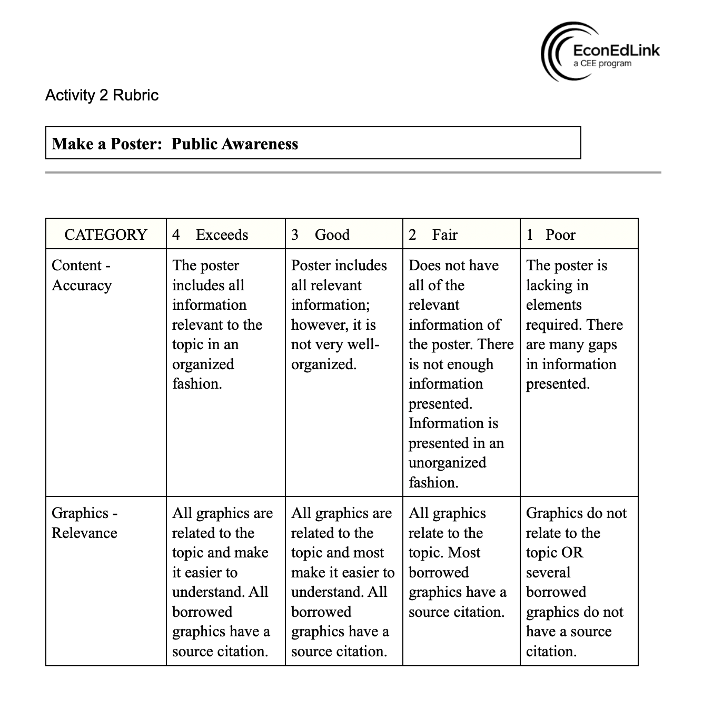
Assessments: Recap

Slide 22
Lesson Idea #2
Mario’s Choice – Decision Making and Opportunity Cost
Key Concepts: decision making, choices, scarcity
In this updated lesson from the CEE curriculum “Choices and Changes: In Life, School, and Work for Grades 7-8”, Mario has money in his pocket and can’t decide how to spend it. Students read about Mario’s three choices – a Nintendo Switch 2, a new Lego Set, and tickets to a basketball game – and decide what his choice and opportunity cost will be.
They then write their own “Scarcity Story” – a story similar to Mario’s story which shows a situation of scarcity in their lives or in the life of someone they know.
https://econedlink.org/resources/marios-choice-decision-making-and-opportunity-cost/

Slide 23

Lesson Idea #2
Mario’s Choice – Decision Making and Opportunity Cost: OVERVIEW
First, ask students about economic wants.
Define scarcity.
Read "Marios Lucky Day".
Student Journal Activity.
Review Mario's alternatives and discuss.
Define opportunity cost.
Evaluation.
https://econedlink.org/resources/marios-choice-decision-making-and-opportunity-cost/

Slide 24
Lesson Idea #2
Mario’s Choice – Decision Making and Opportunity Cost
THE HOW: How can you evaluate the alternatives when making a choice?
THE WHY: Why is it important to consider the opportunity cost of each decision?
https://econedlink.org/resources/marios-choice-decision-making-and-opportunity-cost/

Slide 25
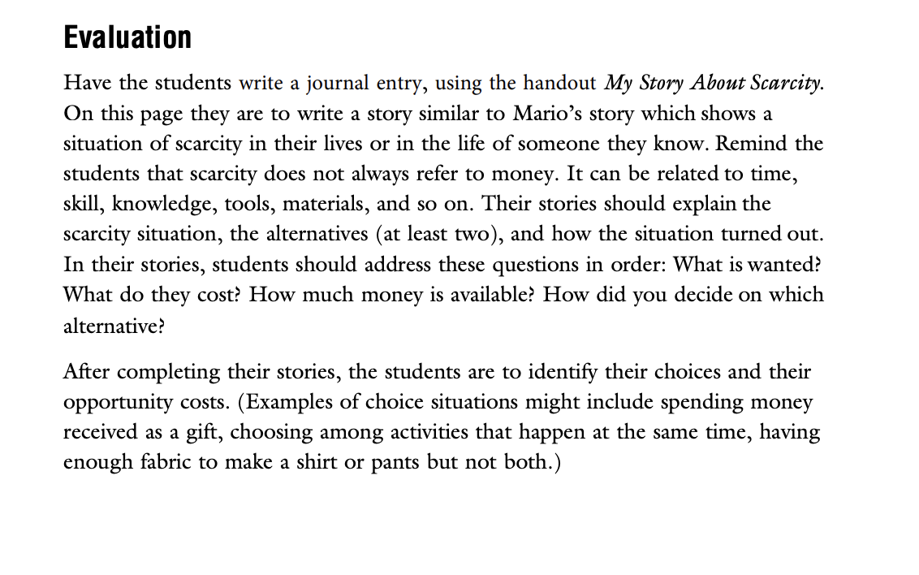
Assessments: Recap

Slide 26

How can students understand financial wellbeing better?

Slide 27
Financial wellbeing is learning how to manage your money and resources responsibly with an eye toward long-term financial security.
Boston University

Slide 28
Reflect: YOUR financial wellbeing
Do you feel in control of your finances?
Can you pay all your bills and other obligations when due?
How do you handle unexpected costs?
Do you feel secure about your financial future?
Can you make decisions that enhance your life and goals?
Do you feel a sense of security about your finances overall?
Key Concept Considerations: Consistent budgeting, emergency savings/goals, debt management, making informed decisions through financial and economic literacy education (how can we teach this to MS and HS students?)

Slide 29
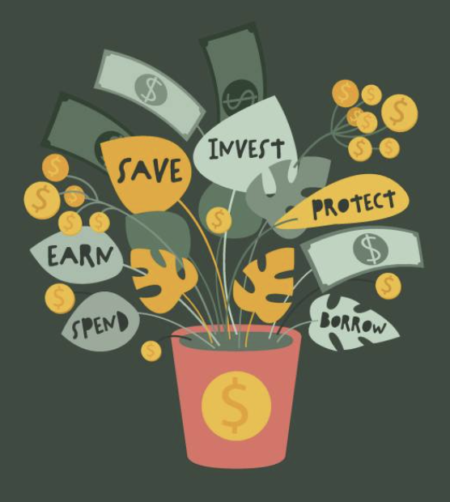
Middle School & High School
Financial Independence
Real-World Applications
Critical Thinking Skills
Responsibility
Promoting Equity
Continuous Reflection and Learning

Slide 30
Financial wellbeing is learning the HOW (personal finance principles) and the WHY (economic fundamentals).

Slide 31

Now, let's start putting this all together.

Slide 32
Recap
Main Objectives:
Teachers will be able to:
Integrate economic reasoning with personal finance instruction.
Build coherent lessons that connect financial choices to economic principles.
Provide students with a deeper, more holistic understanding of financial wellbeing.

Slide 33
Breakout Rooms- Interactive Time
Directions for Breakout Rooms:
Questions for each group
How can we integrate economic reasoning with personal finance? (10 minutes)
What lessons can I use that connect financial choices to economic principles? Share an example from EconEdLink if able. (20 minutes)
How can my students understand financial wellbeing better? Describe ideas or examples. (15 minutes)
Large Group: Wrap-up (15 minutes)

Slide 34

Thank you!
Cjfitzthum@stcloudstate.edu

