Slide 1


2026 Winter Institute:
Trending Topics, Timeless Lessons: Social Media, News, and Modern Money Lessons

Slide 2
Certificate Requirements
To earn professional development hours for webinars, you must:
Watch a minimum of 75% for all sessions
You will automatically receive a professional development certificate via e-mail within 24 to 48 hours.

Slide 3
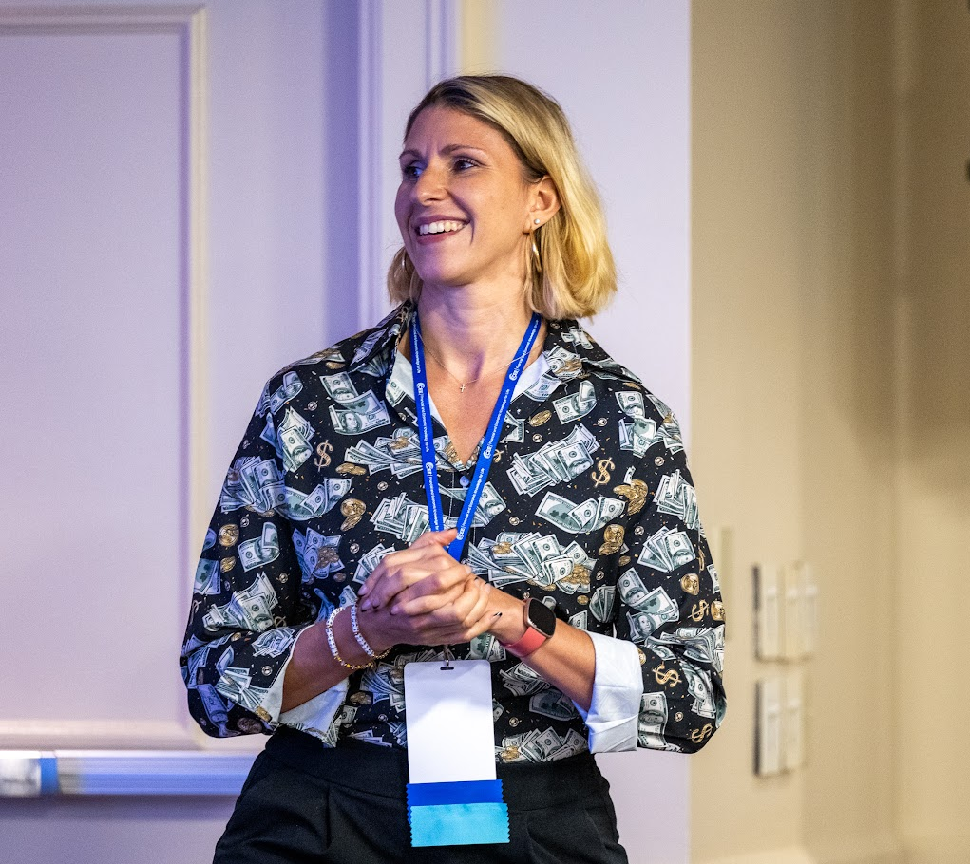
Presenter
¡Hola! I'm Diana Isern:
Assistant Principal – 20 years in NYC Public Schools
Financial Educator & Advocate
Advisor, Invest in Girls (A Program of CEE)
Curriculum Designer
AFC® Accredited Financial Counselor
Soon-to-be author August '26!
Money Talks: An Educator's Guide to Financial Empowerment
LinkedIn: linkedin.com/in/dianaisern ​ Email: Disern@schools.nyc.gov​
Website: dianafinancialeducation.com

Slide 4
Objectives
You will be able to:
Bring financial media into class with newsletters, podcasts, and trusted social content.
Teach students to spot quality info and train their feeds for smarter algorithms.
Grab ready-to-use resources—a toolkit of websites, podcasts, and activities by topic.

Slide 5

Session Agenda
Introduction: Yay, you're here!
Opening: Community Connection
Part 1: Daily Dose - Newsletters & News
Part 2: Leveling Up Our Algorithm$ - Social Media
Part 3: Unit-Specific Modern Money Tools

Slide 6
Opening Connection
What’s one money message you’ve heard recently—online, from family, or in the news?

Slide 7

Part 1: Our Daily Dose of
Newsletters& News

Slide 8
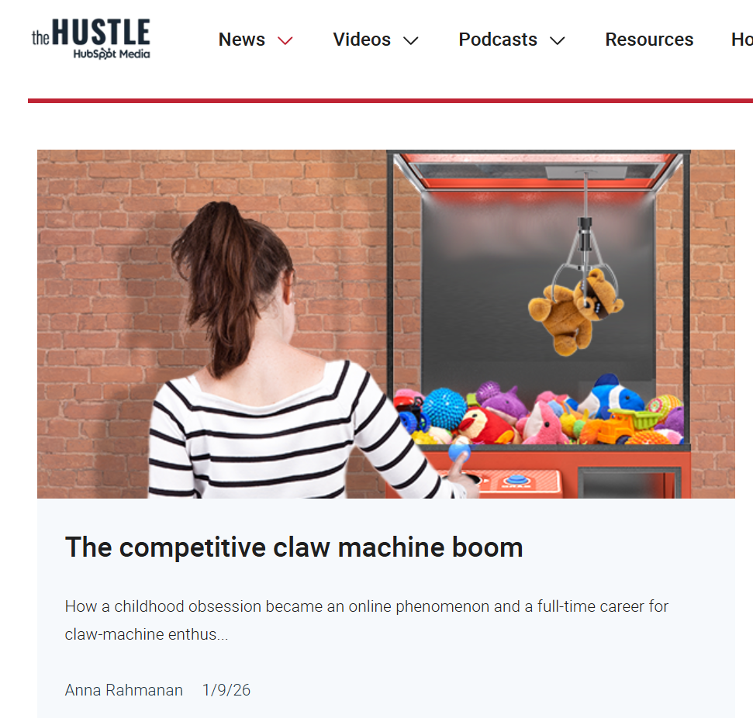
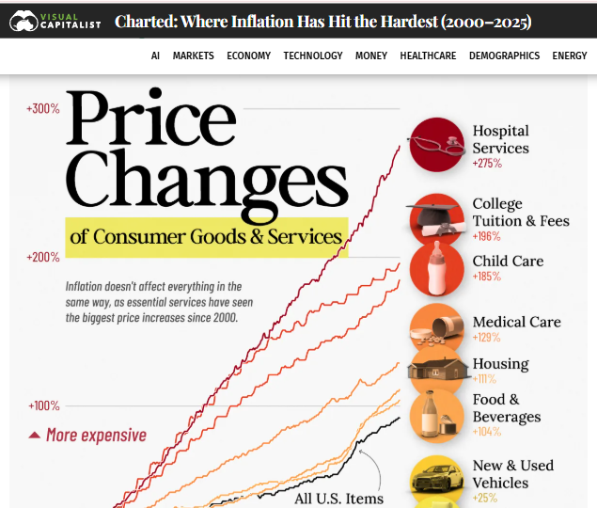
Daily Financial Newsletters
Most of these have news on their website and also a free daily newsletter. These are ones that work well in the classroom:
Sherwood Snacks - daily market news, accessible
Visual Capitalist - interesting infographics on money topics
Morning Brew - business news for younger audiences
Market Briefs - wide range of market information in chunks
The Hustle - unconventional tech and business trends
Finimize - 3-minute financial news

Slide 9
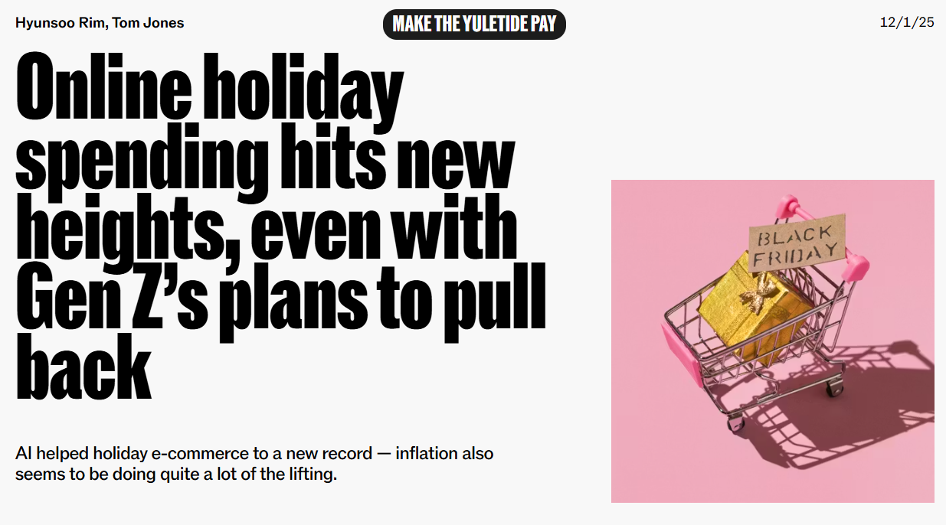
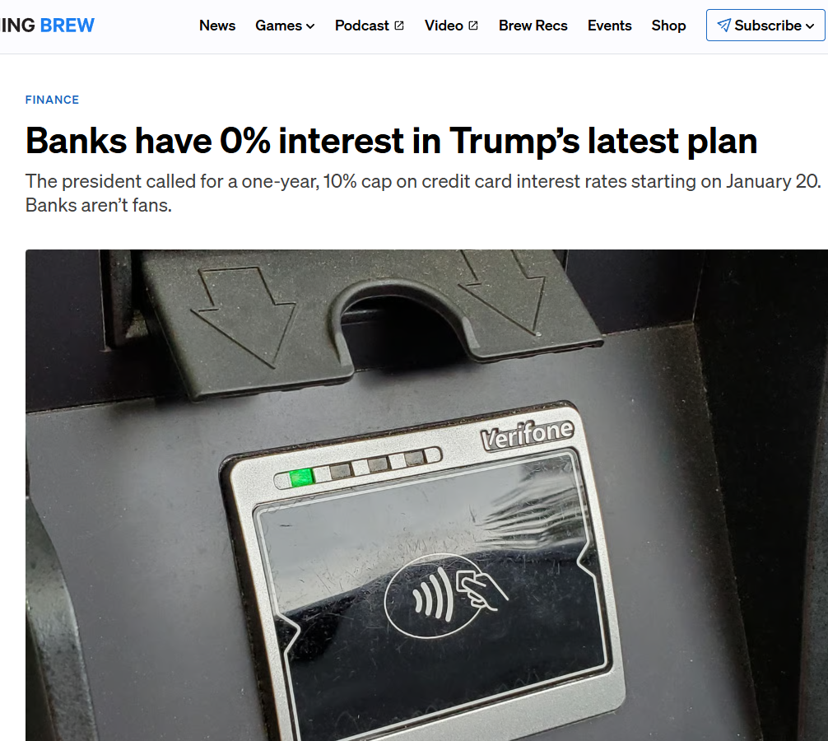
Daily Financial Newsletters
Start class with a 5-minute "financial breakfast." Students read
and/or discuss one newsletter or current event 2-3 times per week.
Why It Works:
Builds routine and financial vocabulary
Shows that money is current and always evolving
Builds student confidence in real‑world topics
Sample Structure:
Monday: "Market Weekend Recap" - what happened Fri-Sun
Wednesday: Newsletter day - project one on screen, discuss as class
Friday: Student choice - they bring a financial headline

Slide 10
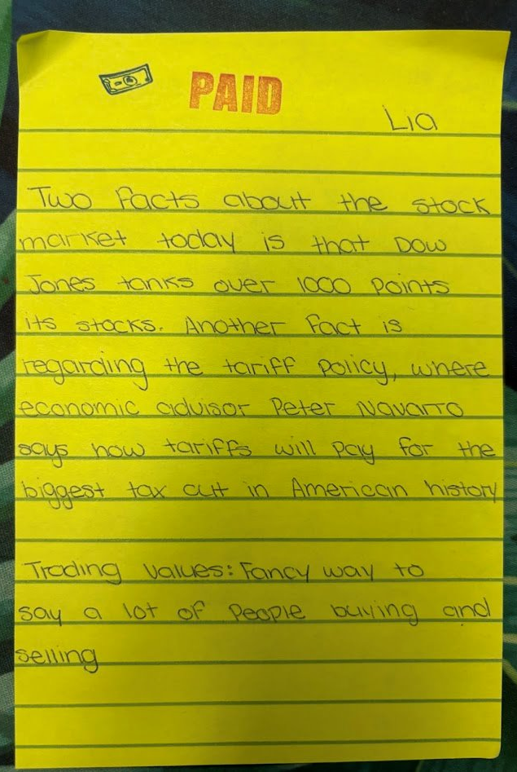
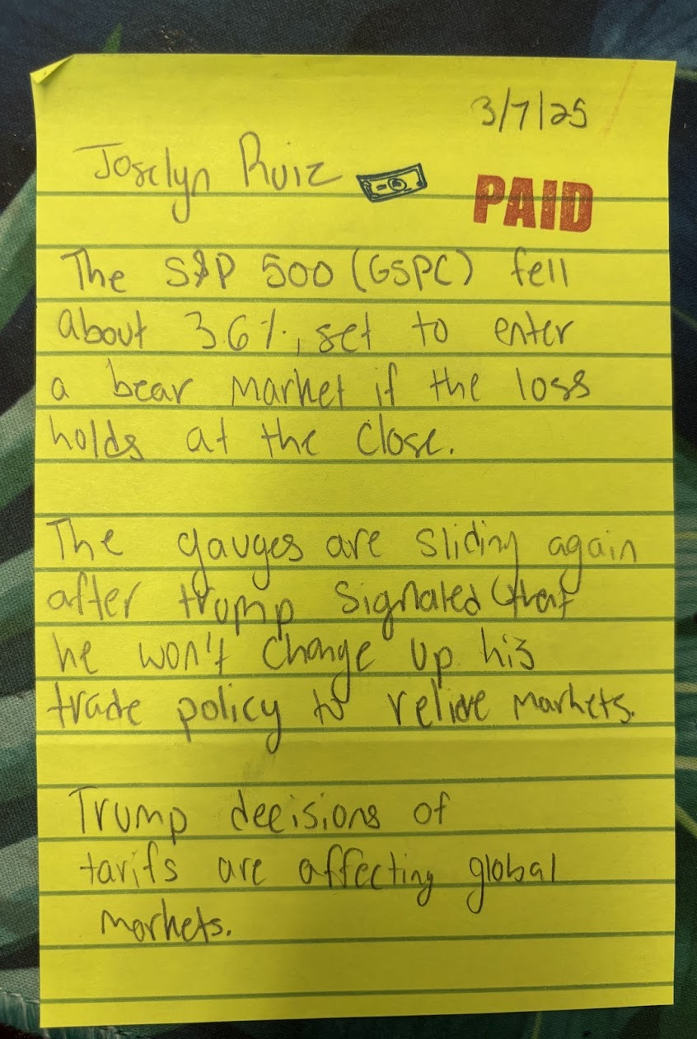
Questions you could use:
"What is happening?" "What's the main financial concept at play here?"
"Who benefits from this? Who might be harmed?"
"How does this connect to our unit on ______?"
"How does this impact us and our community?"

Slide 11
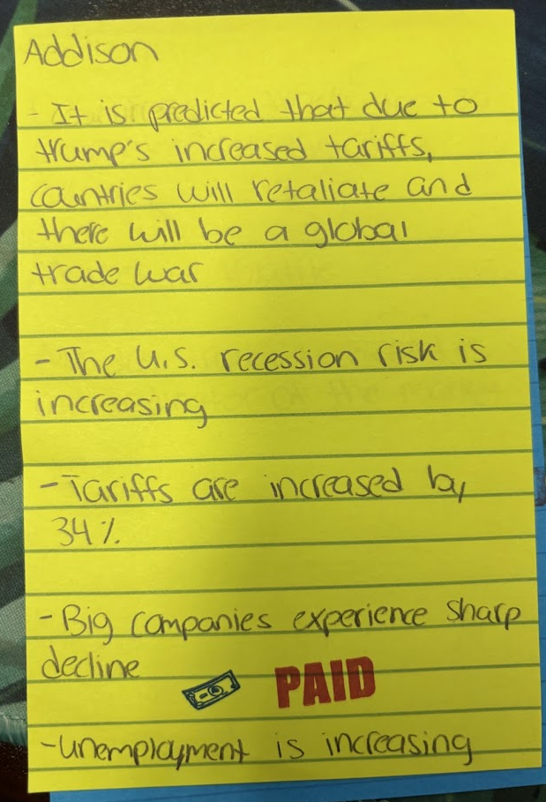
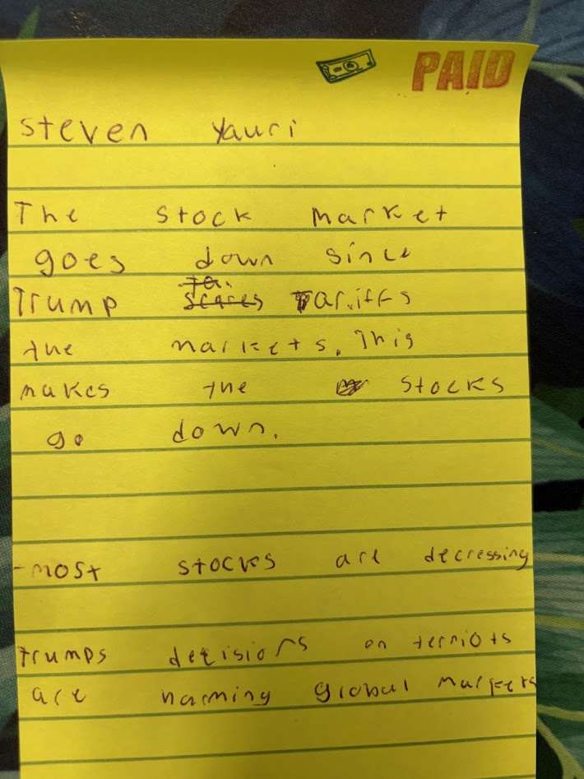
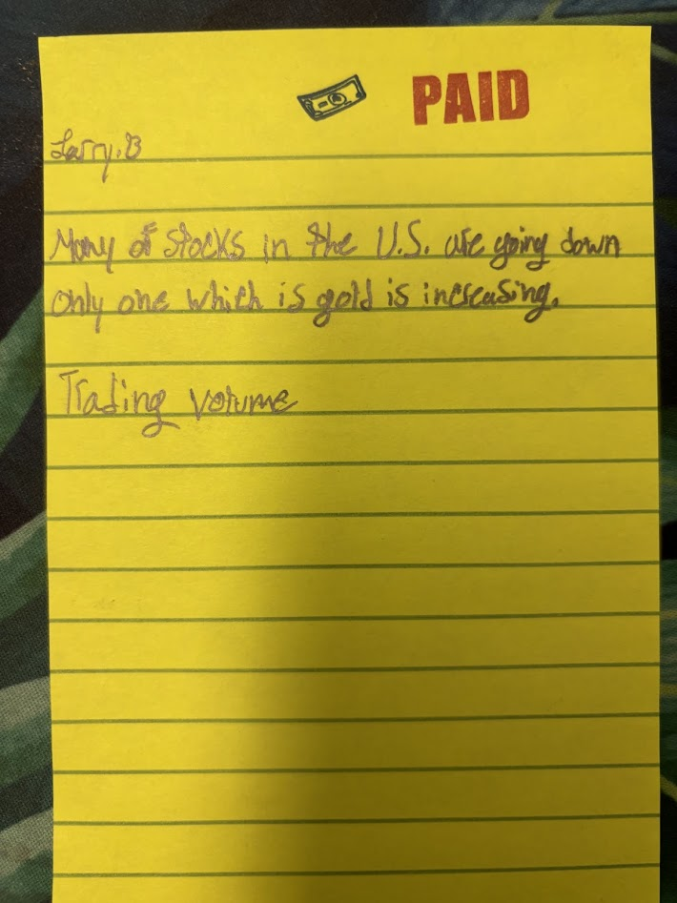
Student examples

Slide 12
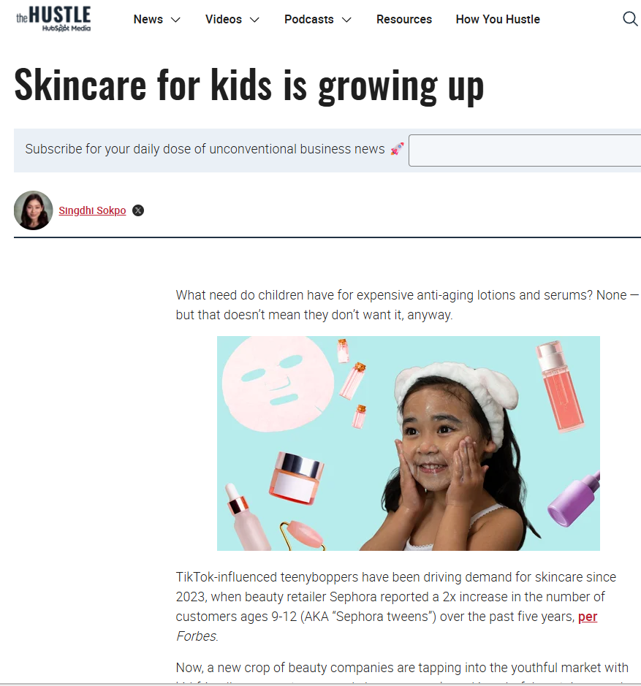
Breakout #1 (10 min)
1. Open a newsletter and choose 1 article (2 mins):
Sherwood: sherwood.news
Visual Capitalist: visualcapitalist.com
Morning Brew: morningbrew.com
The Hustle: thehustle.co
Finimize: finimize.com
2. Everyone do a rapid share of their topic (30 sec each)
3. As a group, create (5 mins):
Two discussion questions you'd ask students
One connection to a financial literacy topic (budgeting, investing, credit, etc.)
One potential barrier for your specific students (reading level, vocab, interest) and how you'd address it

Slide 13
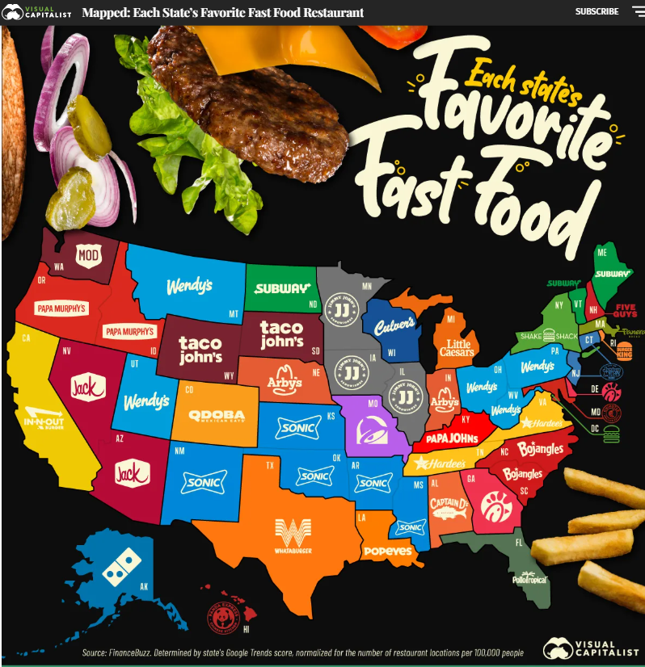
Share Out
What newsletter and article did you choose? What's one question you created?
Is this a practice you can use in your context?
<--(Also...is this true for you?) 🍔🍟

Slide 14
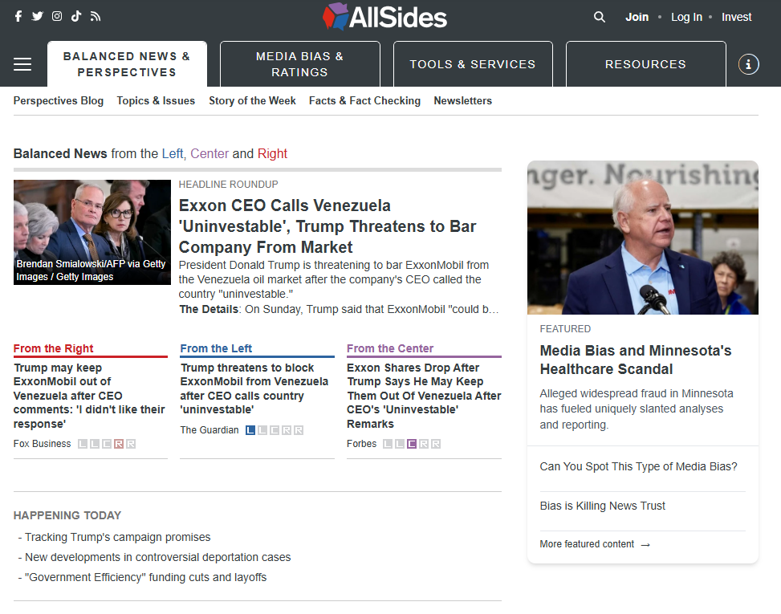
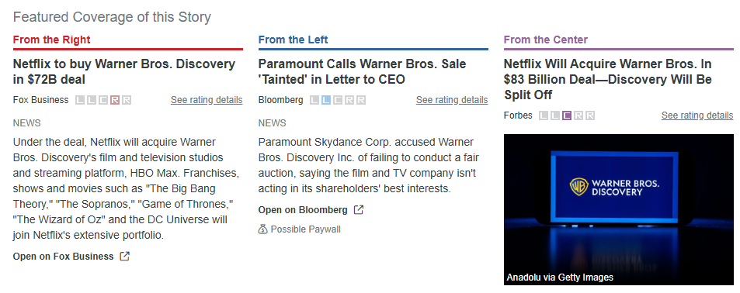
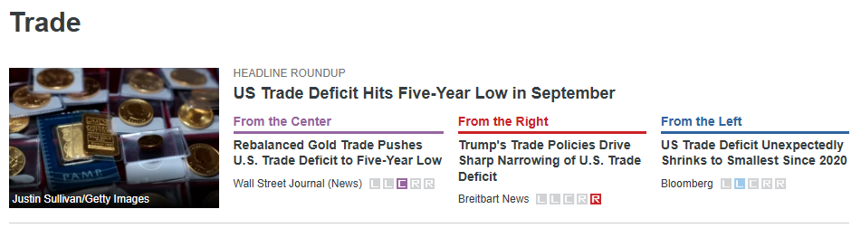
Civics + $ Project: AllSides.com

Slide 15
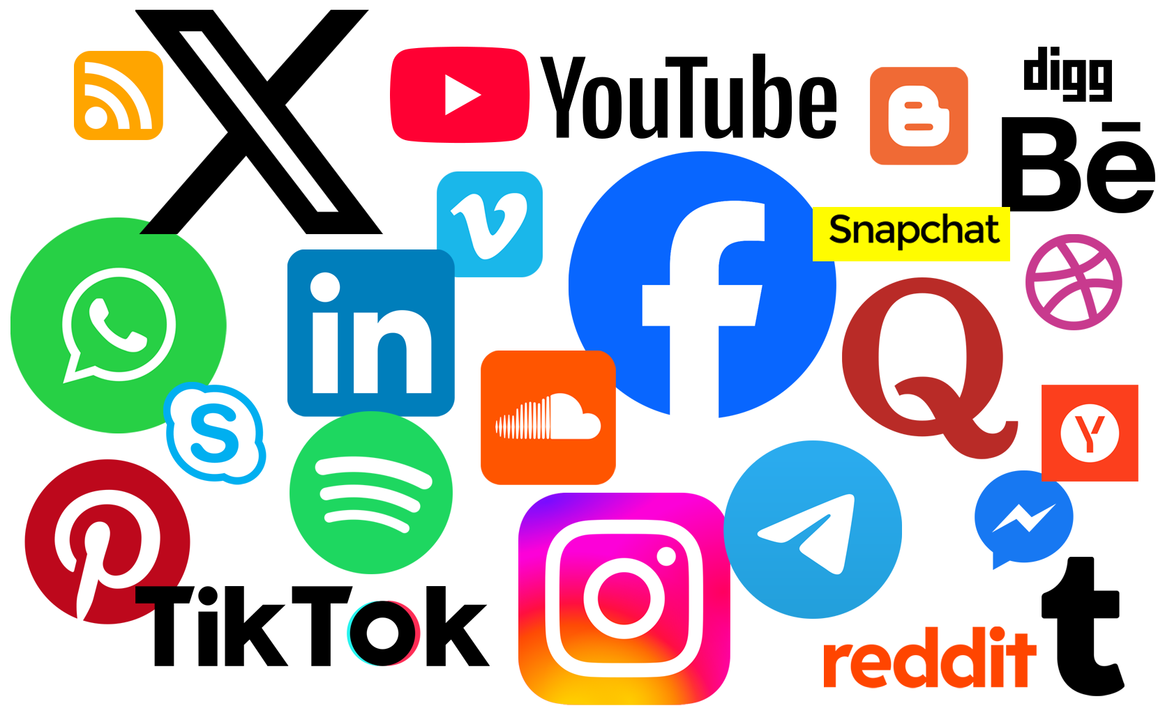
Part 2:
Leveling Up Our
Algorithm$

Slide 16
Drop it in the chat!
What kind of financial content shows up in your feed?
Budget hacks
Crypto drama
Real estate tips
Side hustle ideas
Nothing yet (I mostly see...)

Slide 17

Finfluencer Project
Students' For You Pages are full of financial advice - some credible, some dangerous. There’s plenty of good information out there,
and we need help them learn to tell what’s legit and what’s not.
Why Social Media:
It’s accessible and engaging: Students already spend time on social media, so financial content feels easy to reach.
It feels real and relatable: Influencers share everyday money decisions in ways that mirror students’ own lives.
It supports peer learning: Students see, share, and discuss financial wins and mistakes.
Options to structure:
You can do this as a 1-day activity, or you can extend into a project.
You can focus on financial content and only provide trusted sources.
You can have students find their own and evaluate for credibility.

Slide 18
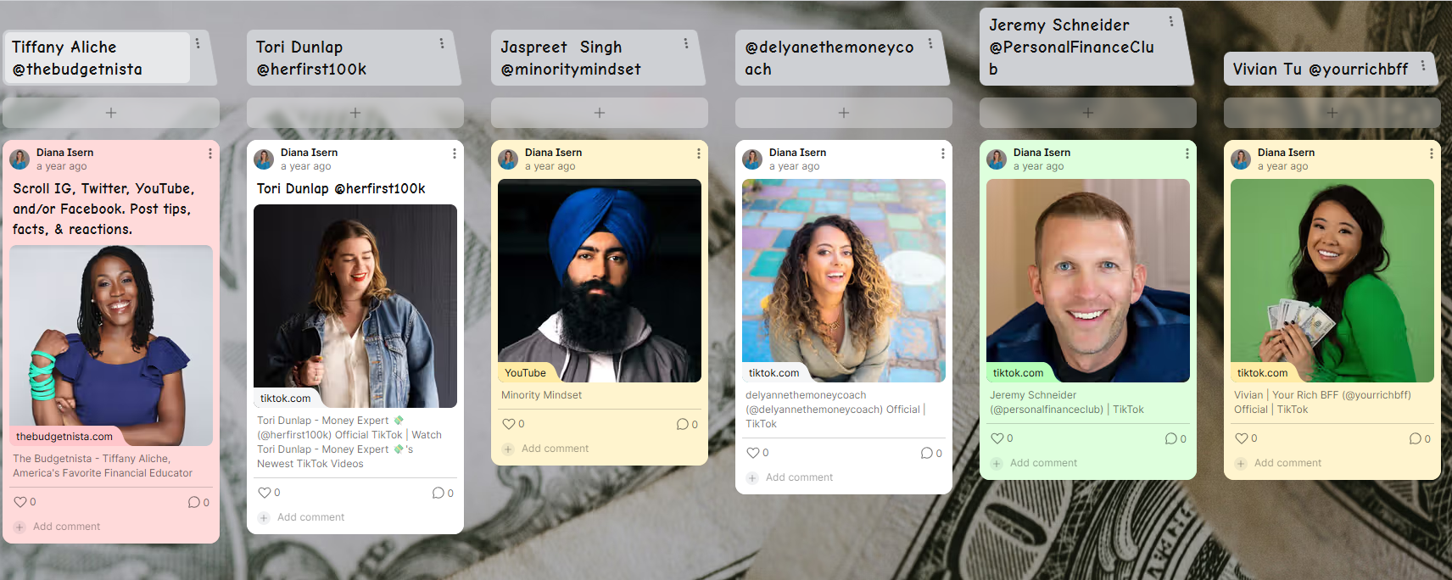
Finfluencer Project

Slide 19

Finfluencer Project
The Credibility Framework I Teach (adjust as you see fit!):
✅ Cites sources
✅ Discloses sponsorships
✅ Acknowledges complexity ("it depends on your situation")
✅ Has credentials or lived experience they're transparent about
❌ Promises "get rich quick"
❌ Sells courses as main income source
❌ Uses fear tactics
Good read before project:
dfpi.ca.gov/news/insights/social-media-finfluencers-who-should-you-trust/

Slide 20
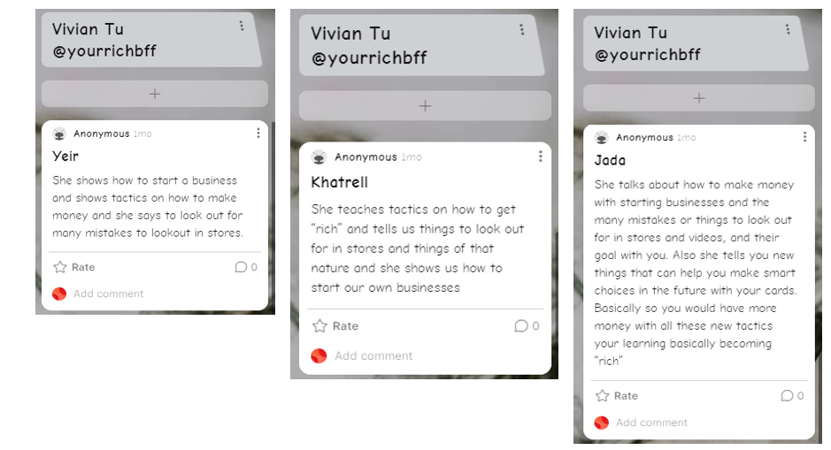
Student examples

Slide 21
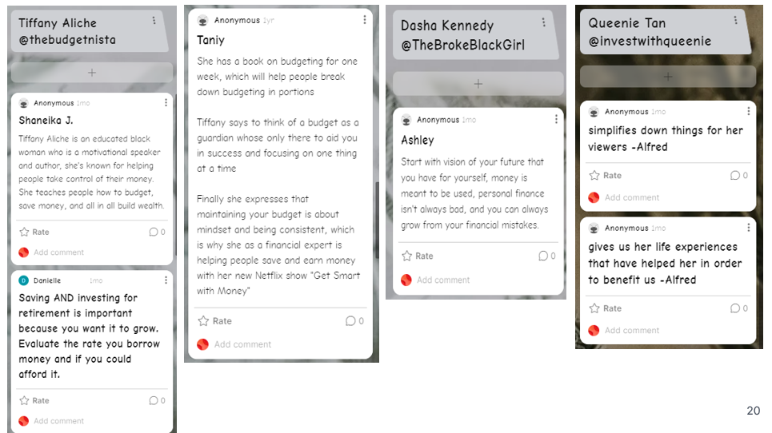
Student examples

Slide 22

Breakout #2
1. Vote on one finfluencer to investigate (as a group)​
2. Look at their last 5 posts: ​
What topics do they cover?
Do they cite sources?
What's their tone/approach?
Any red flags?​
3. Decide as a group: ​
Would you approve them for students? Why/why not?​
What age group is this appropriate for?​
What conversation would you have with students BEFORE sending them to this creator?

Slide 23
Share Out
Which creator did you investigate?
Approved or not approved - and why?
What ideas do you use to get students to analyze?

Slide 24
Closing
Connection
What’s one thing you’ll try with students this week?

Slide 25
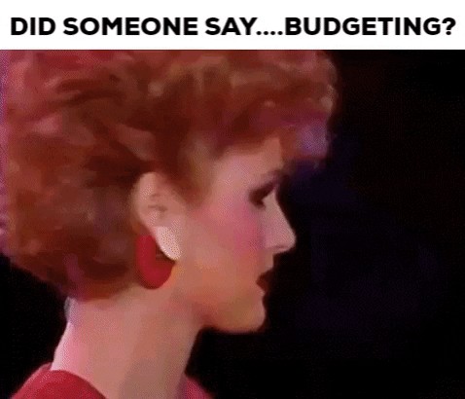

Part 3:
Unit-Specific Modern Money Tool$
Budget, Credit and Investing Resources & Crowdsource!

Slide 26
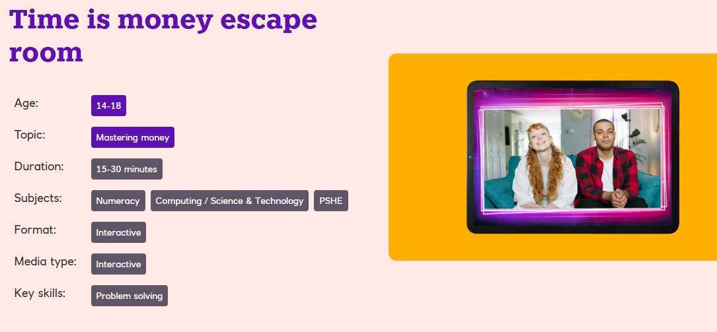
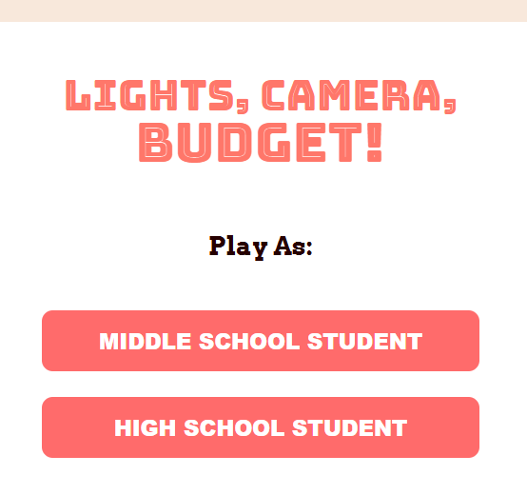
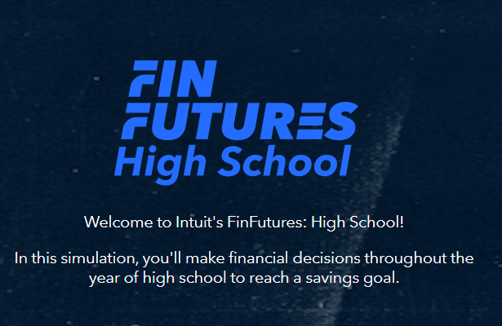
Budget Unit (Standard I & II)
Games
NatWest: Time is Money Escape Room
https://natwestthrive.com/resource-hub/time-is-money-escape-room
Fintutures
finfutures.intuit.com/student
Georgia Public Broadcast:
gpb.org/lights-camera-budget-game/

Slide 27
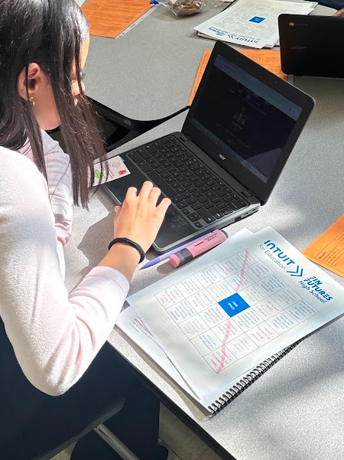
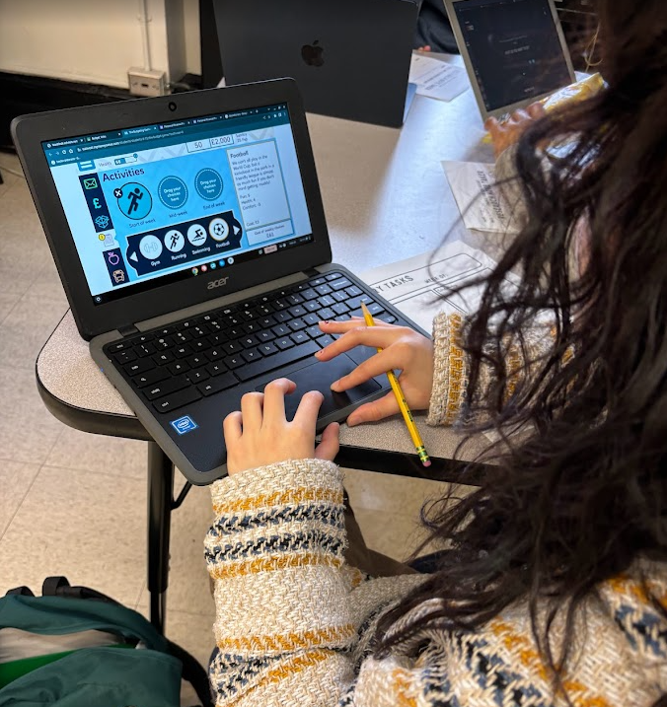
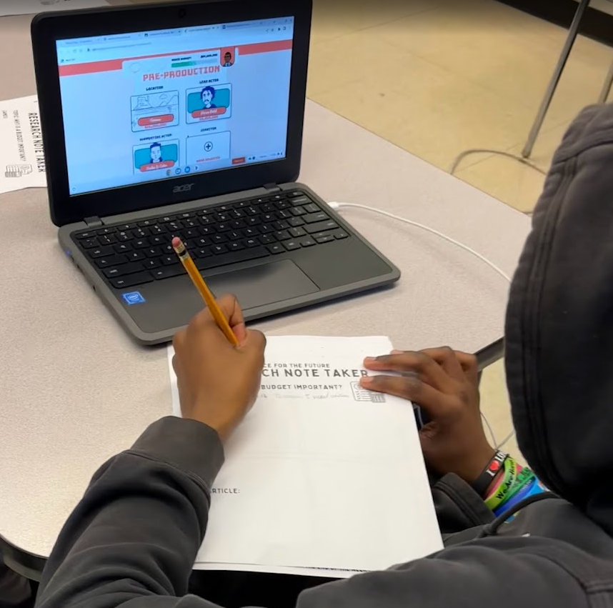
Student examples

Slide 28
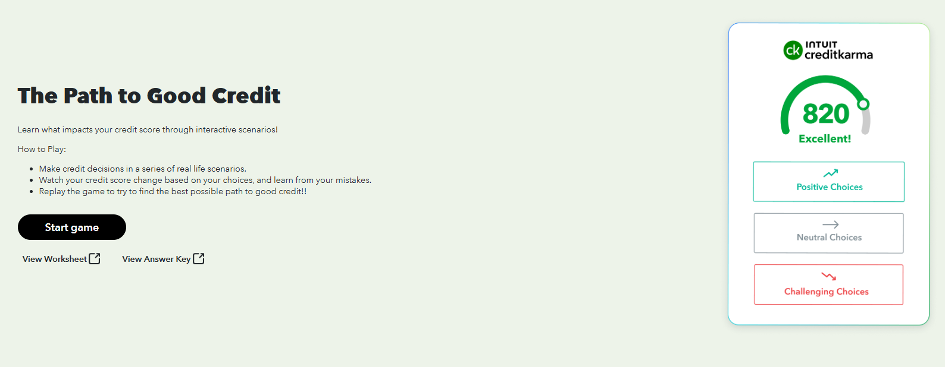
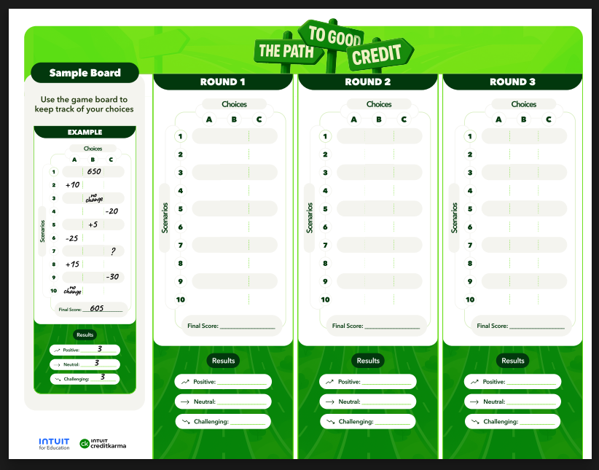
Credit Unit (Standard IV)
Game:
The Path to Good Credit: education.intuit.com/home/game/the_path_to_good_credit

Slide 29
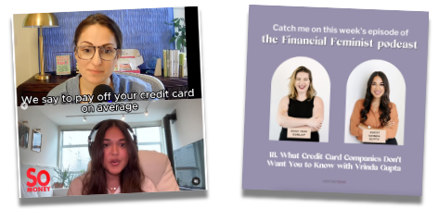
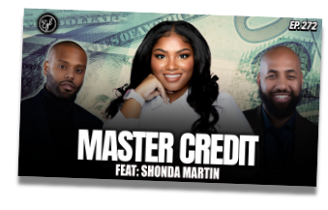
Credit Unit (Standard IV)
Podcasts & Episodes:
Earn Your Leisure
Establishing Credit at a Young Age (Total time 10:07)
How to Master Your Credit (Total time 8:47)
So Money with Farnoosh
Smart Credit and Banking Moves for Women w/Vrinda Gupta (5:00-15:00)
Financial Feminist
Credit Card Company Secrets w/Vrinda Gupta (2:55-6:00)

Slide 30
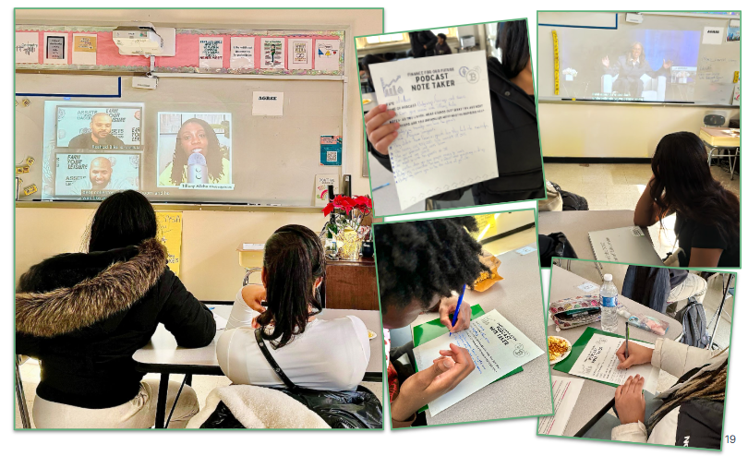
Student examples

Slide 31
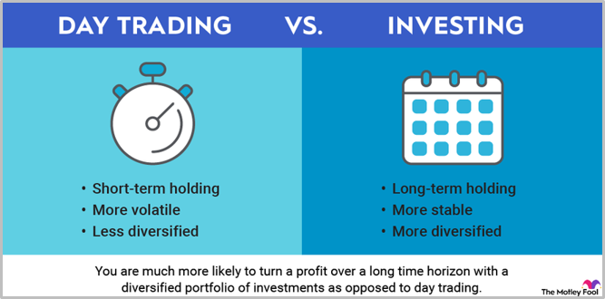
Investing Unit (Standard V)
Discussion: Day Trading
Many of my students are interested in day trading. This interest can create an engaging moment to have a discussion around the risks and rewards.
Resources
CNBC Article: Attention Robinhood power users: Most day traders lose money
Charles Schwab Article: Investing vs. Trading: What's the Difference?
Popcorn Finance Podcast: Trading vs. Investing
CNBC Video: Investing 101: Lessons from Self-Made Millionaire Tiffany James

Slide 32
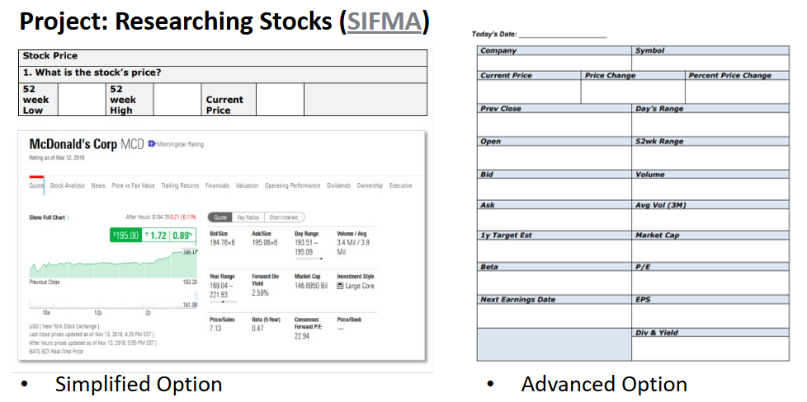
Investing Unit (Standard V)
RESOURCES
Yahoo Finance
finance.yahoo.com
MooMoo
Library
CEE: What is a Stock?
econedlink.org/resources/what-is-a-stock/

Slide 33
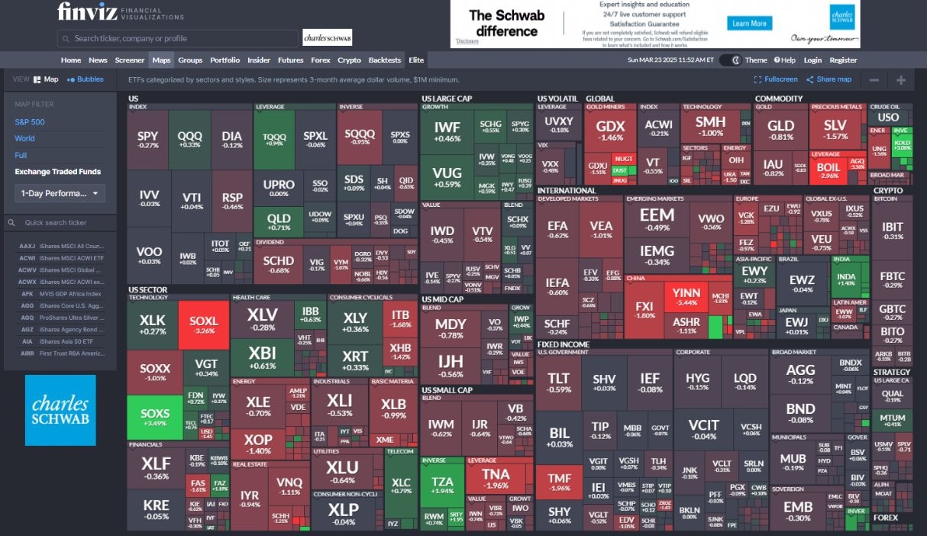
Investing Unit (Standard V)
Project: Researching Funds
Choose 3 ETFs to analyze on Yahoo Finance or Finviz.com:
What are the fund's top 10 holdings?
Describe the fund. What companies and industries is it invested?
What is its performance for 1 year, 3 years, 5 years, All time?
Is this fund a good investment? Explain.

Slide 34
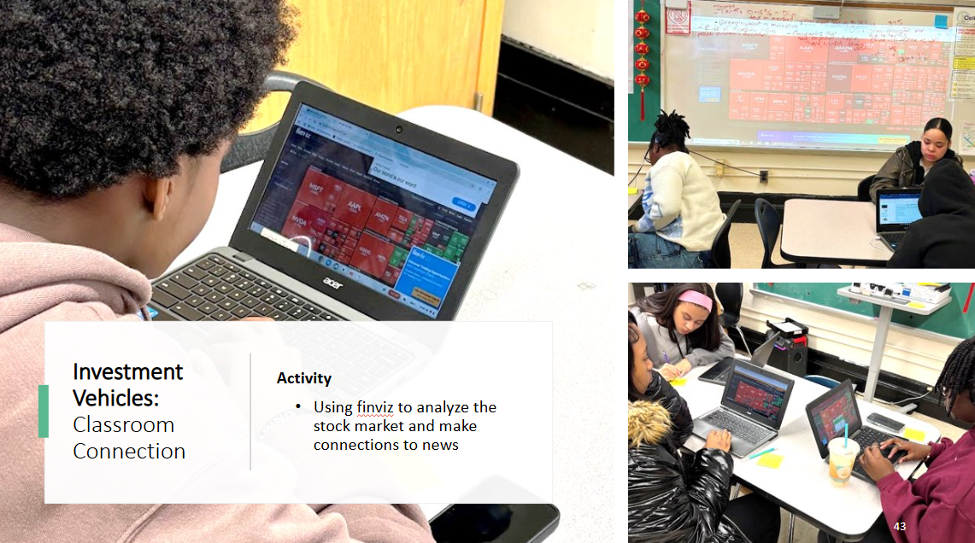
Student examples

Slide 35
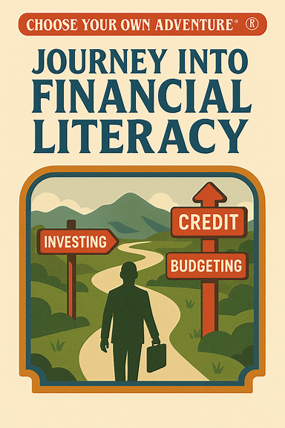
Breakout #3
Instructions: Choose the unit that interests you​
Breakouts by Unit:​ Budget, Credit & Investing
Explore 2-3 resources from that unit
Open the websites/podcasts, click around, test student view​
Design a 15-minute activity or lesson:
Where will the resource fit in your teaching?
What will students learn?​
How will you know they got it?​
What's one modification for SPED, ELL or accelerated learners?

Slide 36
Share Out
What unit did you work on?
Share your 15-minute activity in 30 seconds
Drop additional resources in the chat so we all have it!

Slide 37
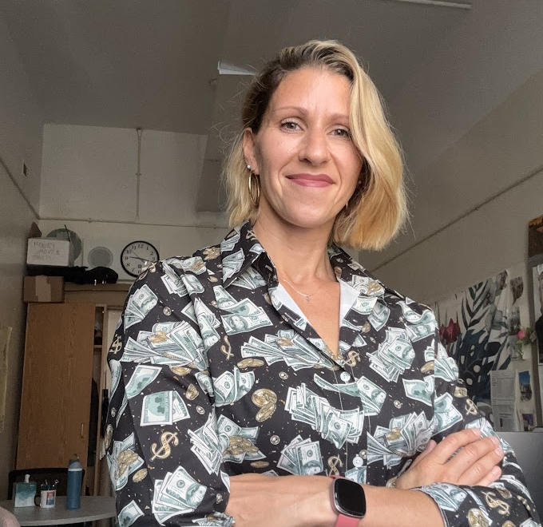
Thank you!
LinkedIn me! linkedin.com/in/dianaisern
Email me! Disern@schools.nyc.gov
Instagram me! @Dianadinero_edu
Web: dianafinancialeducation.com
Let's connect!

