Slide 1

CEE Winter Institute:
Unified Strategies for Personal Finance & Economics
Alex Lamon
☃️☃️
1/23/26
Notes:
I love participation, we will learn a lot and share and participate.

Slide 2
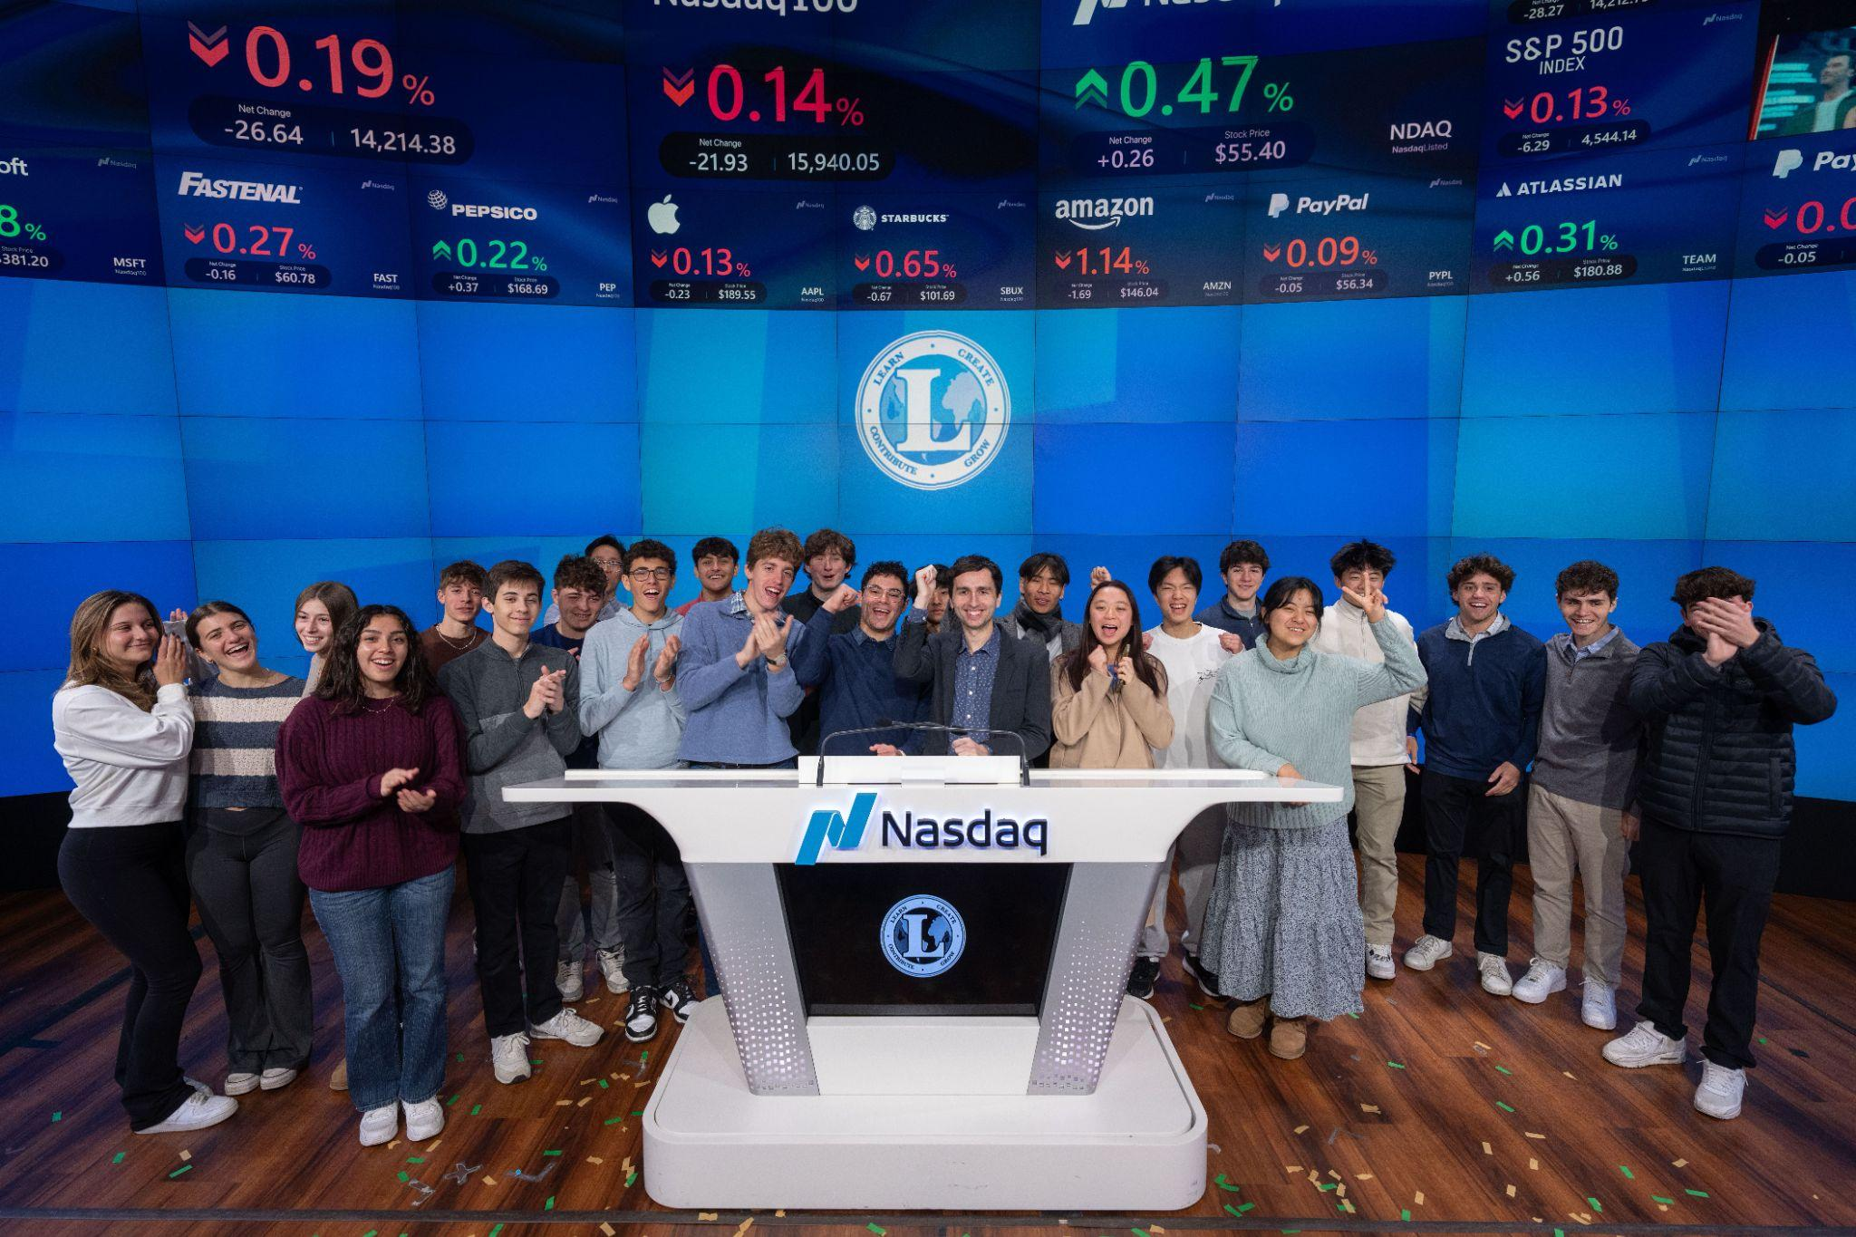

We teach & help students experience the real world!
Notes:
Just like I do in class. Describe my teaching context.

Slide 3
Lead Teacher of Business Education
NJ CEE Executive Director
Curriculum consultant, teacher trainer, grad professor
Hello!
njeconomics.com
linkedin.com/in/alexlamon
lamonteach@gmail.com
Notes:
Introduction and tell me who you teach - are you ECON, PF or both?

Slide 4
Today’s Topics (High Level)
01
02
03
With a focus on…
01
02
03
Course Structure
Economic Indicators
Shared Skills Across Econ & PF
Teaching strategies
Personal finance as applied Economics
Activities & student engagement
Notes:
Focus on strategies and topics for the first 3 units of AP Macro. Will work to make whole morning a mix of interactive and demonstrations.

Slide 5
Maximizing Your Utility
Toolbox Session
Longer Session
Take what you like, what will work best in your context for your students, and leave the rest
Participate as much as you can, however you need

Slide 6
Typical Class Setup (Econ)
1st
3rd
Students watch video content on the module before class
AP level tests, including exam corrections
2nd
4th
Some lecture, most class time in spent on simulations & practice
Reassessments, to focus on student mastery

Slide 7
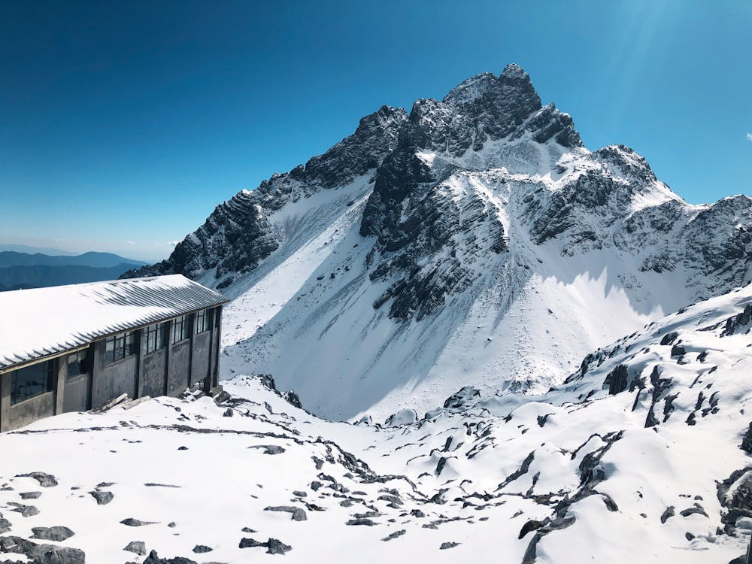
Typical Class Pacing (PF Semester)
Careers
Paying for College
Taxes & Income
Checking
Savings
Credit
Investing
Insurance
Budgeting

Slide 8


Economic Indicators
How does the topic relate to Econ? PF?
ECON: Causes of inflation, monetary policy, GDP, productivity, unemployment
PF: Interest rates, high prices for everything, career availability, income growth
Notes:
Answer 1 question in the chat

Slide 9
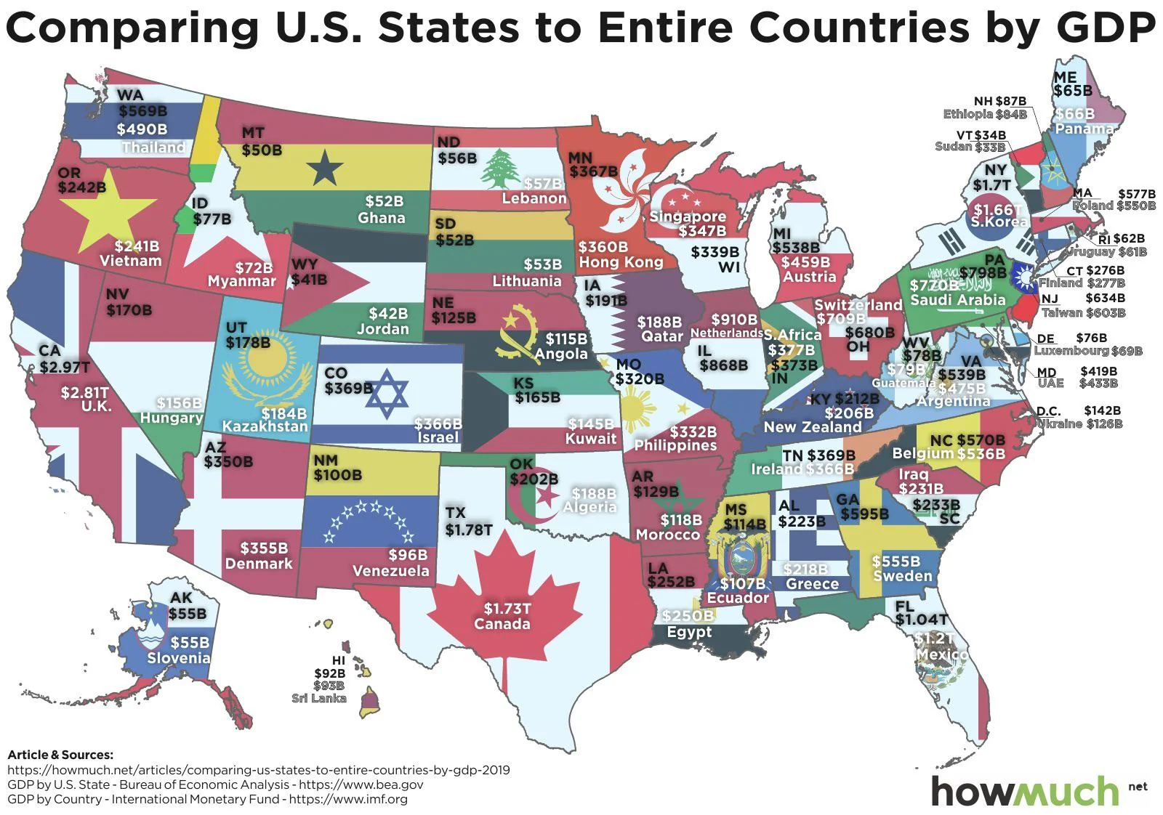

Slide 10
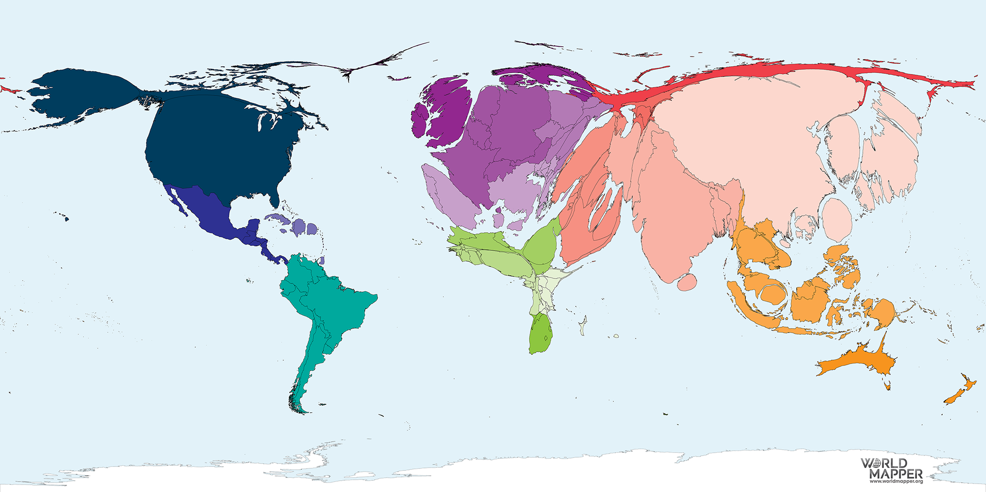
Notes:
2018 GDP data

Slide 11
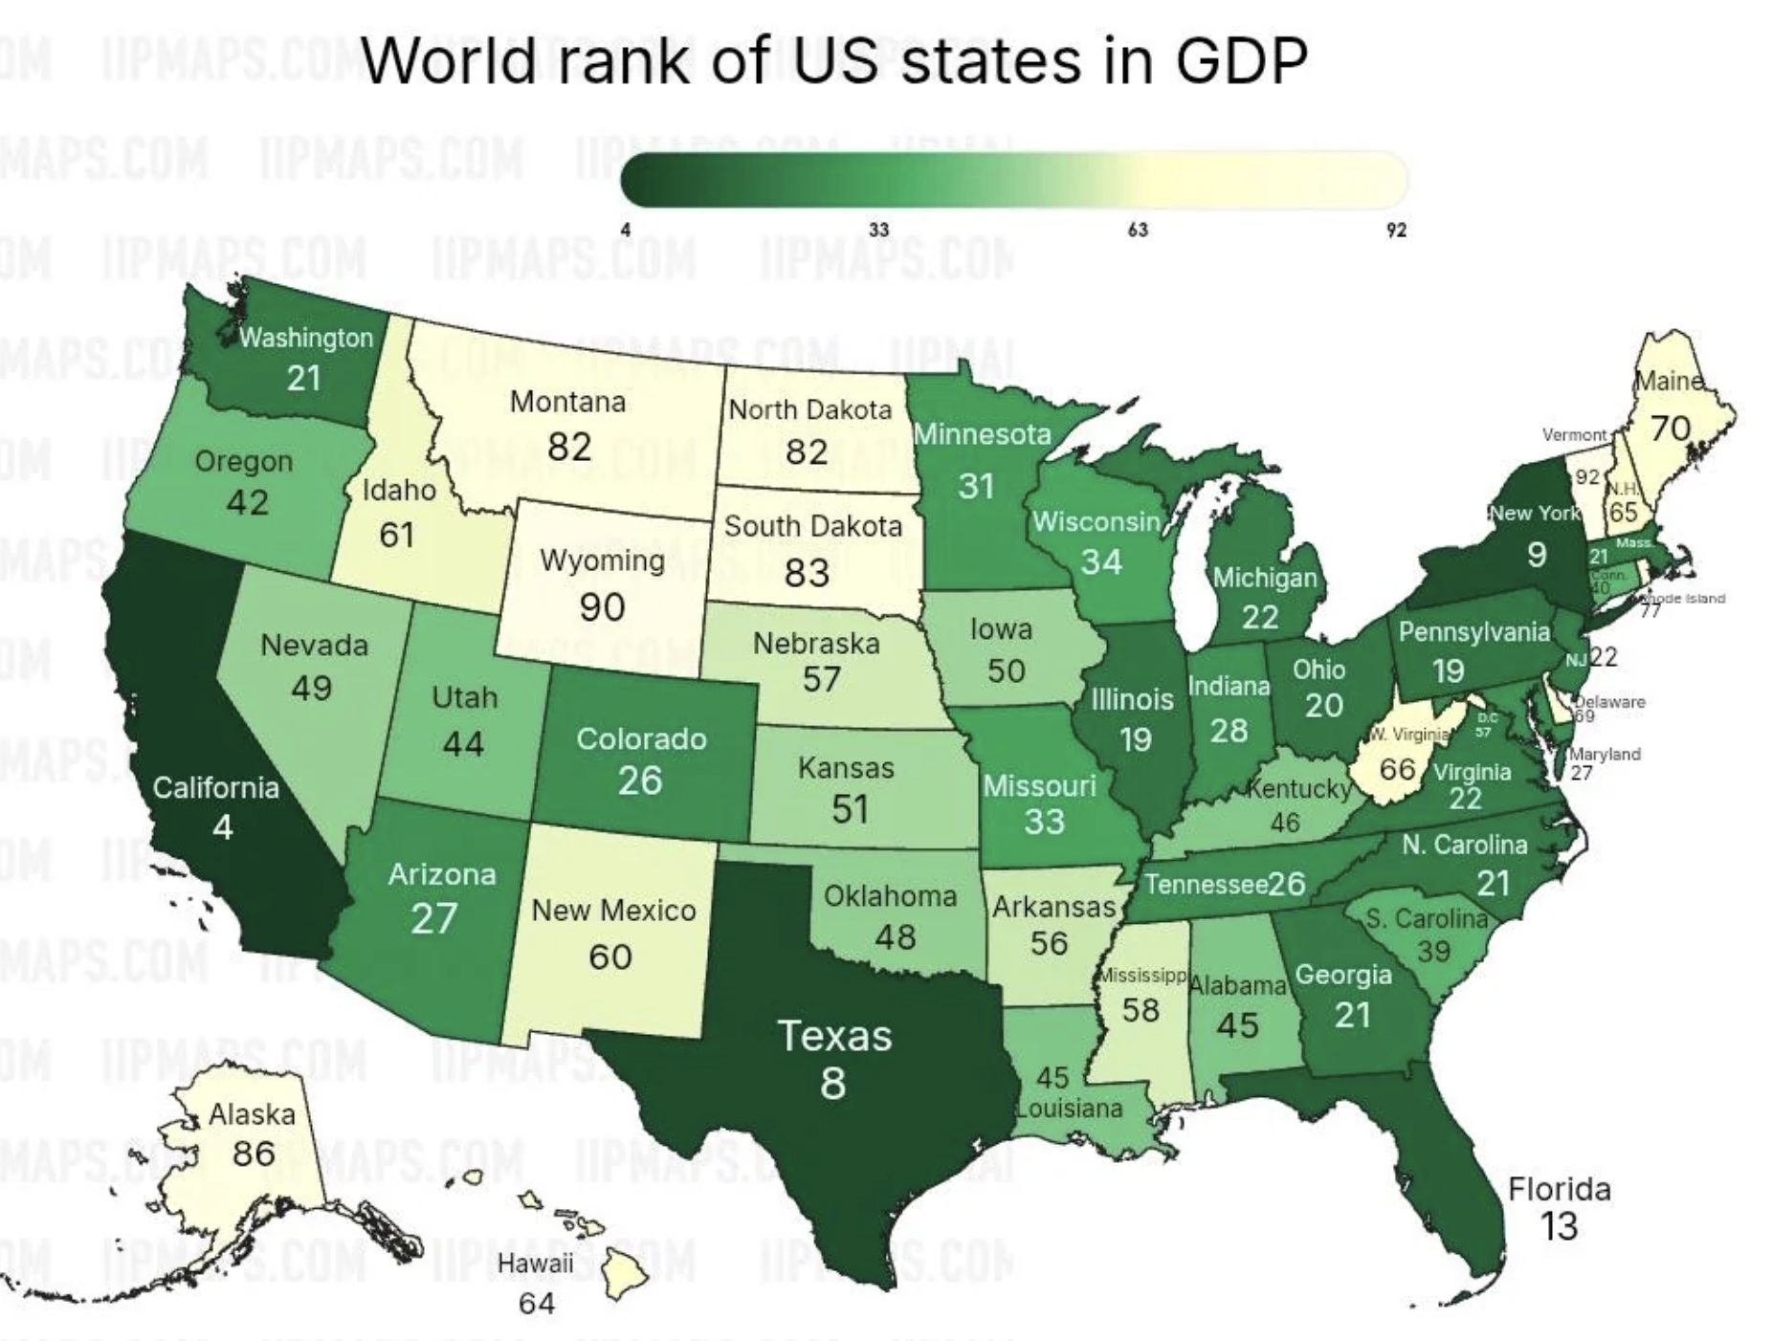
Notes:
2018 GDP data

Slide 12
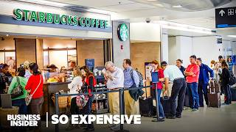
Economic Indicators
Inflation, GDP & Unemployment
The Econ Lens
Activity: Take a Seat at the Table
Inflation Race
Zimbabwe’s Inflation
Inflation: Winners & Losers
Monetary Policies: Cause & Effect
Federal Reserve’s Dual Mandate
Activity: Labor Market Detective
Activity: GDP at the Movies
What’s included in GDP?
Classroom unemployment
Guess the trend
The PF Lens
Which is cheaper?
Inflation on your birthday
So Expensive Series [Airport food] [Concert tickets]
Fighting Against Inflation
Labor Market Simulation
Have Real Wages Changed Over Time?

Slide 13
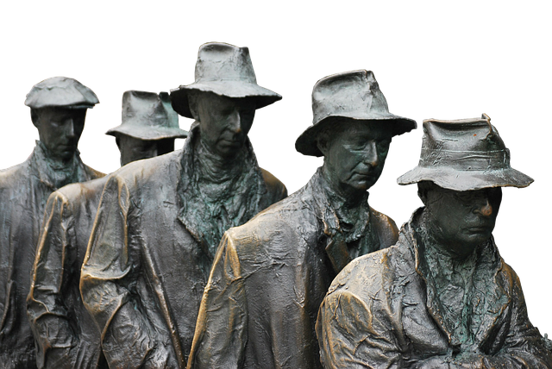
Labor Market Detective
Objective: Students analyze real-world unemployment data to identify patterns and causes of changes in unemployment rates.
  Provide students with recent Bureau of Labor Statistics (BLS) data on unemployment
  Assign students roles as labor market detectives investigating a specific group's unemployment trends or a key question from the data. Examples:
    How do unemployment rates differ by educational attainment?
    Are there disparities in unemployment rates based on race and ethnicity?
    What are the differences in unemployment trends between men and women?
    How does the unemployment rate differ across age groups?
    How do unemployment rates for veterans compare to non-veterans?
    What is driving unemployment? How do discouraged workers fit in?
  Groups present their key question, conclusions they made, & what data lead them to those conclusions.

Slide 14
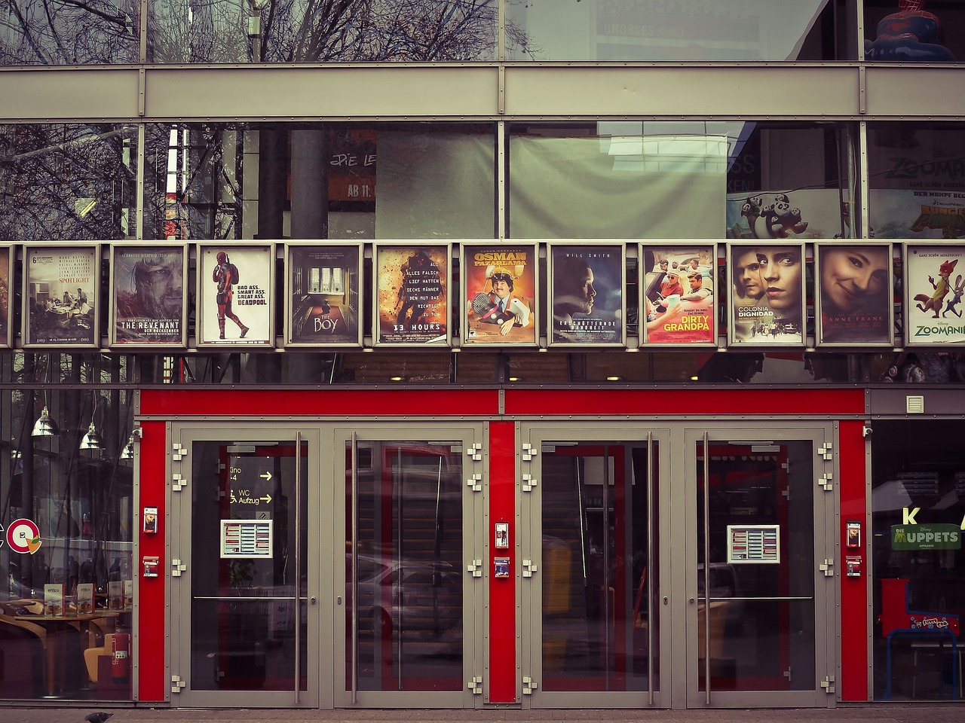
GDP at The Movies
What’s the most popular movie (worldwide ticket sales) of all time?

Slide 15
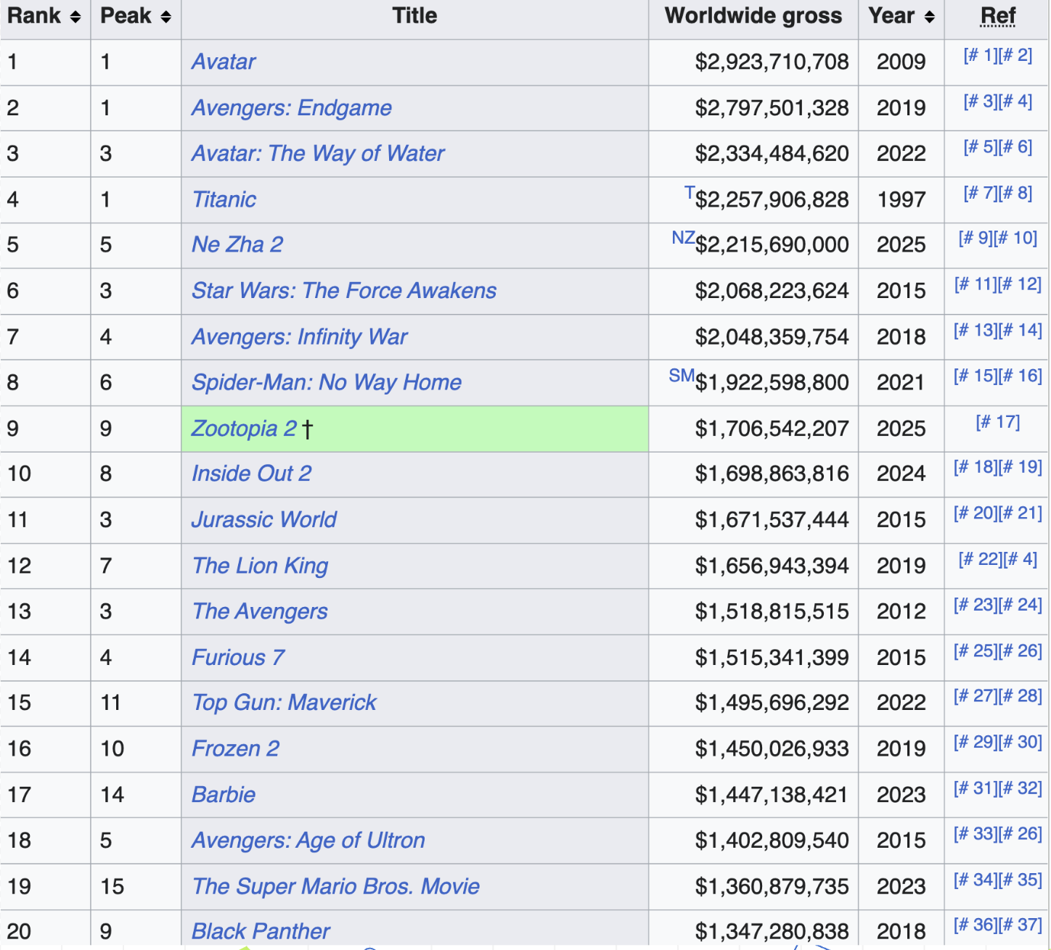

What is the problem with this method?

Slide 16
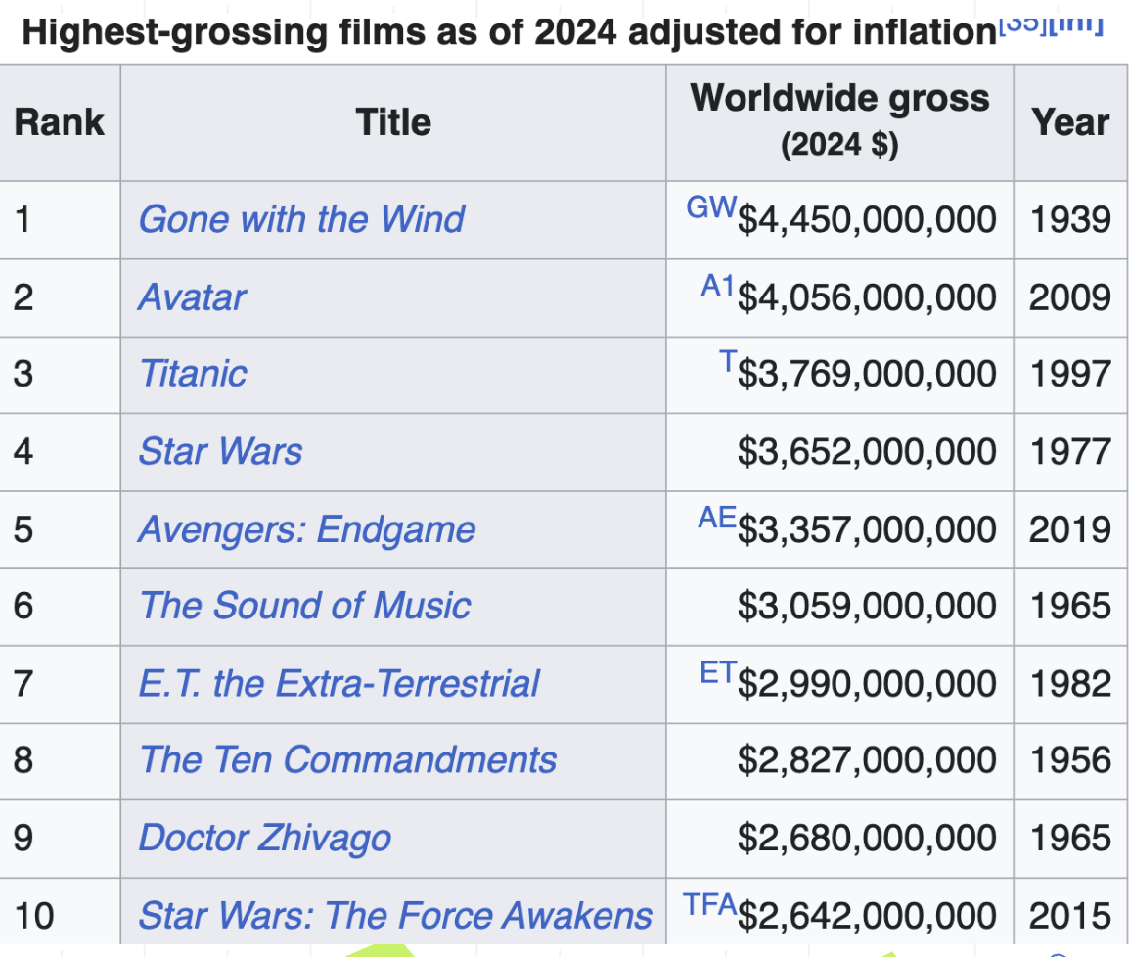
How can you figure out which is the most popular movie of all time?
REAL Box Office Receipts
(adjusted for inflation)
Notes:
https://en.wikipedia.org/wiki/List_of_highest-grossing_films

Slide 17
GDP at The Movies
Objective: Students learn real versus nominal GDP by considering what movies top the box office.
Ask students: What movie do you think made the most money ever?
Show them the nominal box office receipts (highest grossing films) and ask what the problem is with this method for popularity?
After some response, show the box office receipts adjusted for inflation as a launching off point for real vs. nominal GDP
Debrief:
Average movie ticket prices by state in 2025
In contrast, in 1939, when Gone with the Wind was released, the average movie ticket price was about 23 cents. Adjusting for inflation, this would be approximately $4.52 in today's dollars, indicating that movie ticket prices have increased beyond the rate of inflation over the past several decades.

Slide 18
Take a Seat at the Table: Day 1
Objective: Students participate in a simulated FOMC meeting and use economic evidence to make a decision about interest rates
Overview the structure of the Federal Reserve and the FOMC meeting in prep for simulation
Tell students that they are going to act as the president of a Federal Reserve Bank and bring the information from their Bank’s Beige Book to discussion in our FOMC meeting
Divide class into 12 groups. Assign each group a Federal Reserve District.
Distribute copies of Handout 1 (5 pages) and the chapter of the Beige Book corresponding to the group’s assigned Federal Reserve District.
Each group should fill out page 1 of Handout 1 using information on upside and downside risks found in the Beige Book. Students wait to make a policy recommendation.

Slide 19
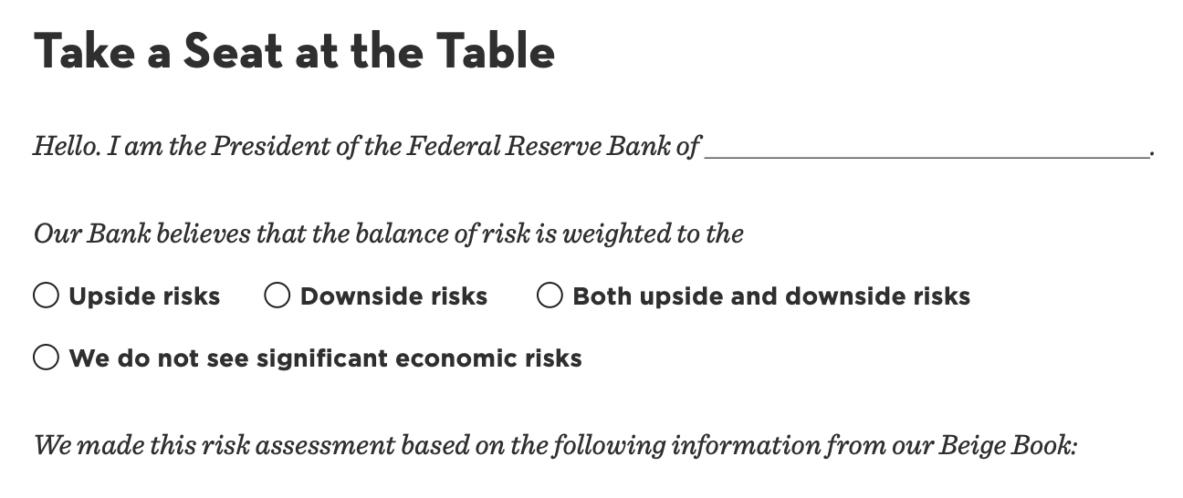
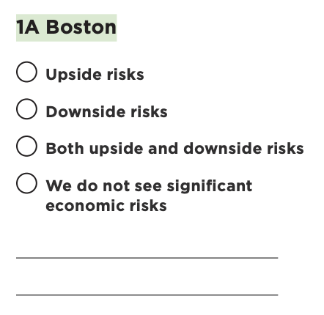
Take a Seat at the Table: Day 2
Create a boardroom atmosphere in your classroom or reserve a space in your school, if possible. Students sit around table with their partner.
Each bank president introduces themselves, explains their upside or downside risks
Other bankers record notes during each regional presentation
Students discuss (with their regional bank president only) what they should do to interest rates based on the data from their bank and all other regional presidents
Present that information to the FOMC

Slide 20
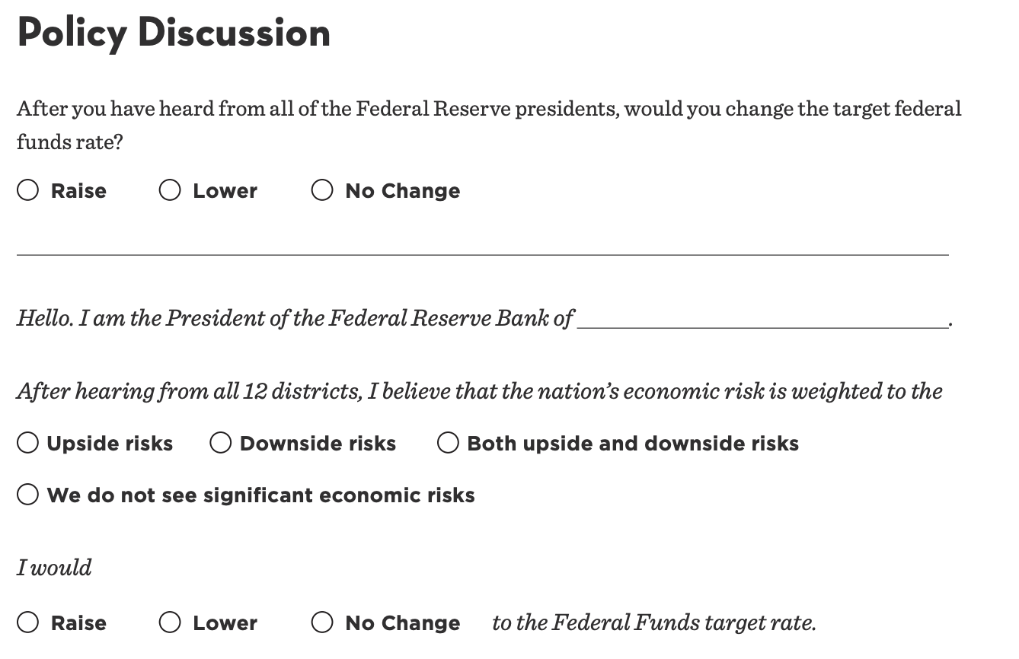
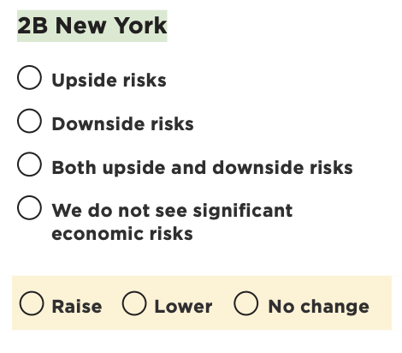
Take a Seat at the Table: Day 2 cont.
Students discuss (with their regional bank president only) what they should do to interest rates based on the data from their bank and all other regional presidents
Present that information to the FOMC and take notes on the decisions of other regional presidents
Tally the results, and complete a press release presenting the policy action, economic conditions, and balance of risk (Handout 2)

Slide 21
Shared Skills
Personal Finance is Applied Economics!
5 Key Shared Skills
Analytical Skills
Cost benefit analysis, trade offs: Shopportunity Cost
Quantitative Skills
Interpreting graphs, tables, and calculators: Auto-loan Calculator
Decision Making Skills
Budgeting, comparing alternatives, justifications: Household vs. Country Budgeting & Prosperity Quest
Civic & Real World Reasoning
Connecting personal decisions to economic realities, recognizing winners and losers: Dollar Street
Critical Thinking
Understanding bias, economic reasoning: Sunk Cost Scenarios, MRU

Slide 22
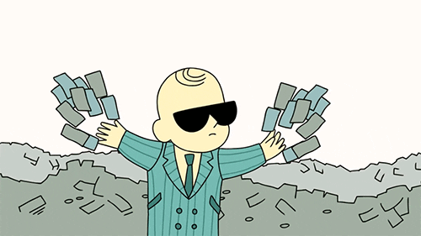
Thank you!
Let’s stay connected!
njeconomics.com
linkedin.com/in/alexlamon
lamonteach@gmail.com

