Slide 1
Lessons/Resources to help correlated with updated standards

Slide 2
General Resources

Slide 3
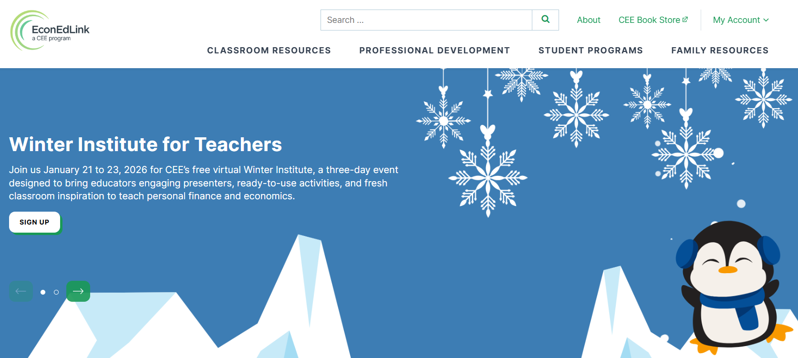
https://econedlink.org/

Slide 4

https://www.federalreserveeducation.org/

Slide 5
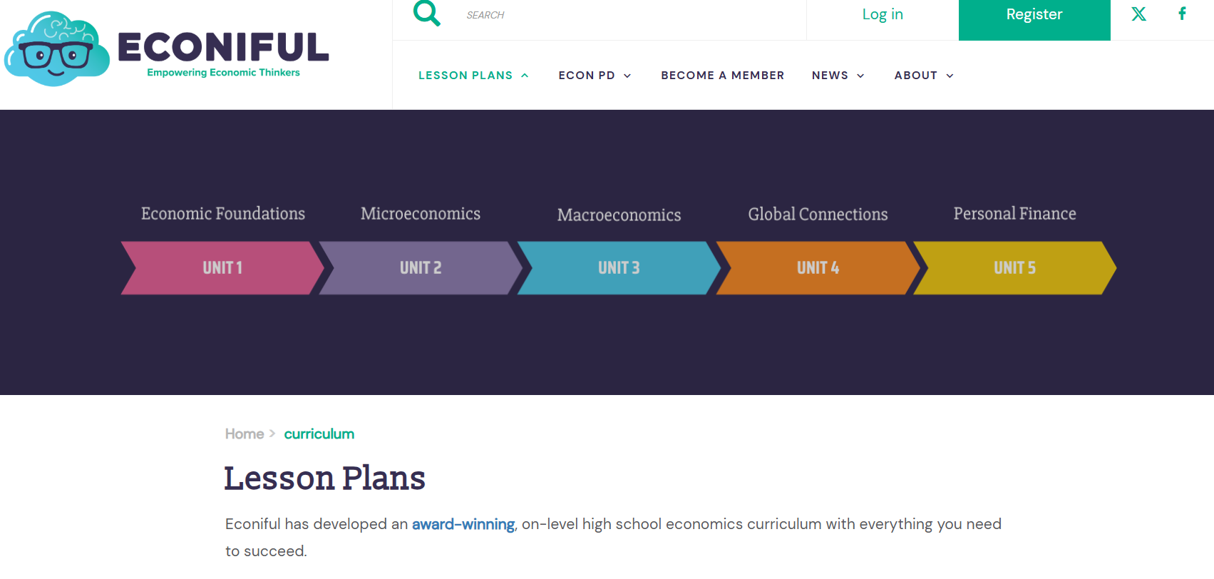
https://econiful.org/

Slide 6

https://www.gpb.org/education/econ-express

Slide 7

https://www.gpb.org/education/smartpath

Slide 8

https://teachrock.org/

Slide 9
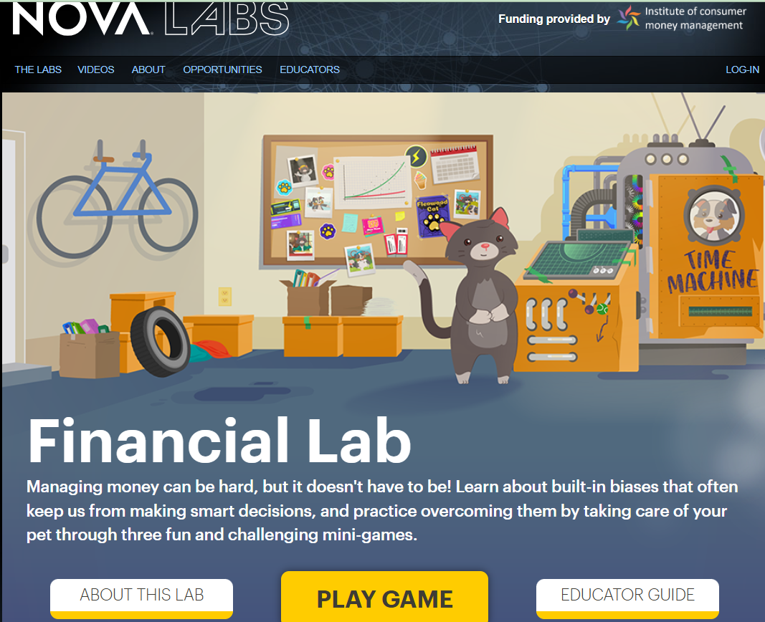
https://www.pbs.org/wgbh/nova/labs/lab/financial/research/home/games

Slide 10
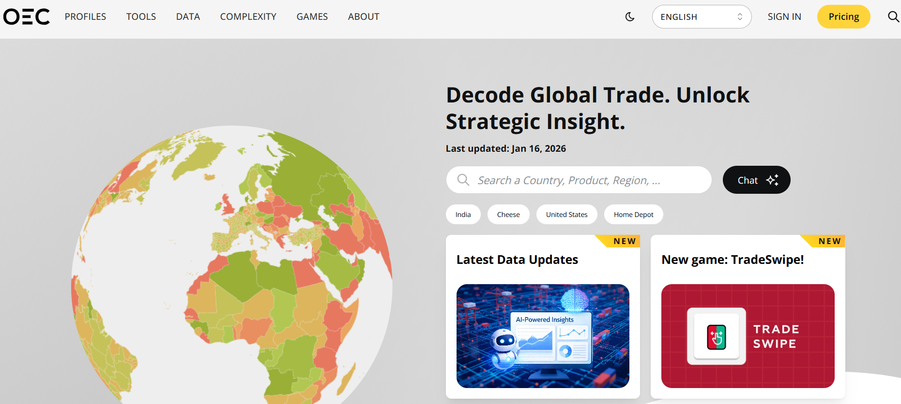
https://oec.world/en

Slide 11
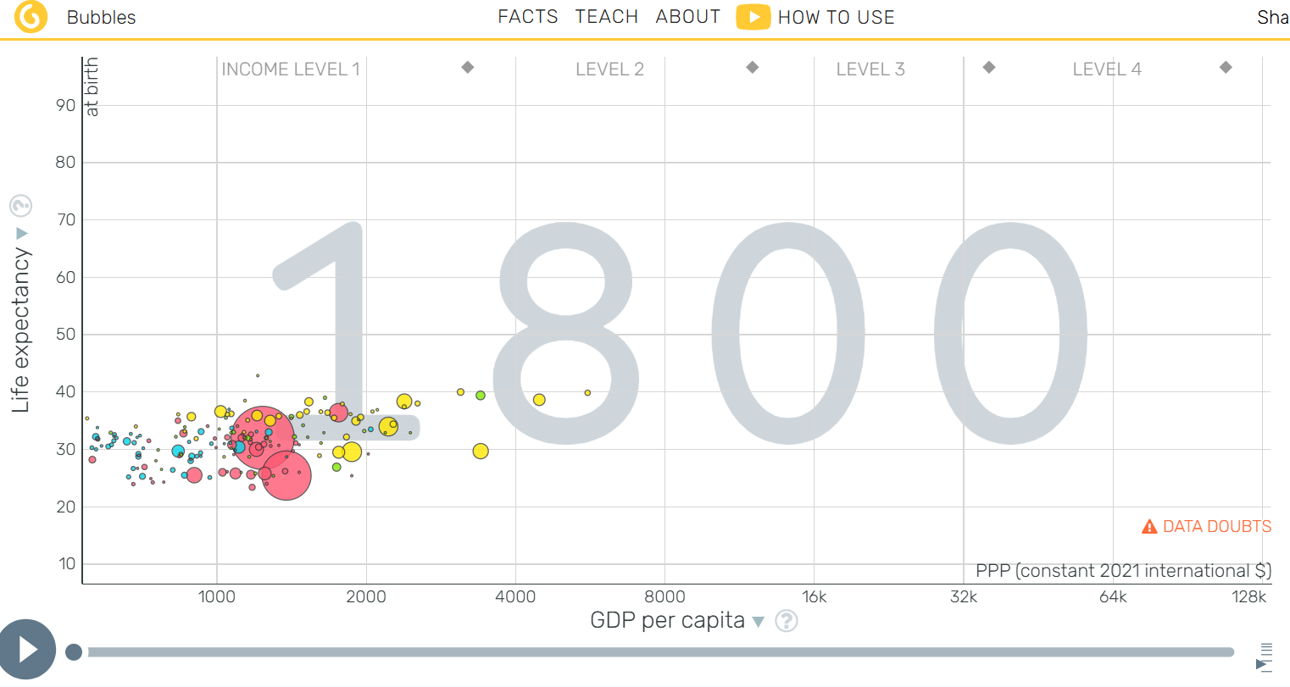
https://www.gapminder.org/tools/#$model$markers$bubble$encoding$frame$value=1800&speed:1015;;;;;&chart-type=bubbles&url=v2

Slide 12

https://www.gpb.org/education/start-it-up
Student Playthrough Document: https://docs.google.com/document/d/1reTXQ7e1EAM-SIkDwJecSaSbT99X4kPtQI11LRU7ZZU/edit?usp=drive_link

Slide 13
Elementary Grades

Slide 14
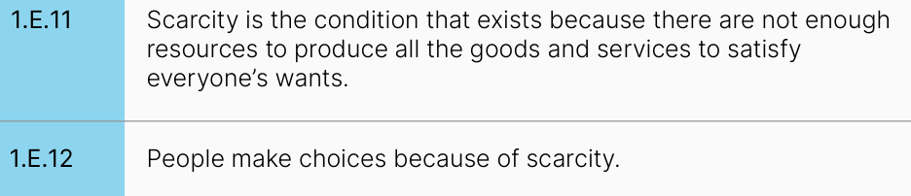
Suggested Resource/Lesson:
From Powerplant to Playstation
Source: EconEdLink Lesson
https://econedlink.org/resources/from-power-plant-to-playstation-electricitys-journey-from-producer-to-consumer/

Slide 15
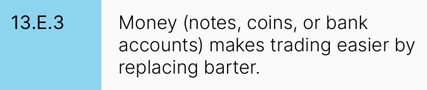
Suggested Resource/Lesson:
Earl and Starla Go To A Federal Reserve Bank
Source: GCEE Resource
https://docs.google.com/document/d/1djWJvN0pX6JXJyTRGbNVfCI2qBxjD7PL6QC1e504d7k/edit?usp=sharing

Slide 16
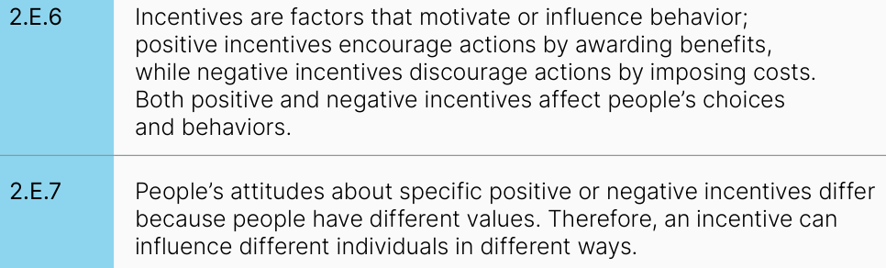
Suggested Resource/Lesson:
Incentivizing Conservation at School
Source: FRE.org Lesson
https://econedlink.org/resources/incentivizing-energy-conservation-at-our-school/

Slide 17
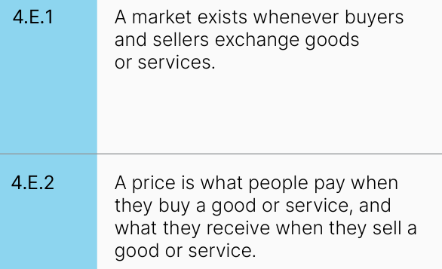
Suggested Resource/Lesson:
Little Red Hen Makes a Pizza
Source: FRE.org Lesson
https://www.federalreserveeducation.org/teaching-resources/economics/markets/the-little-red-hen-makes-a-pizza?f=Resource-Type:Lesson-Activity|Grade-Level:K-5&s=relevance

Slide 18
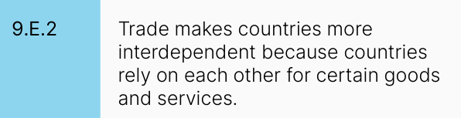
Suggested Resource/Lesson:
Specialization and the Cookie Trade
Source: GCEE Lesson
https://drive.google.com/drive/folders/1aAmeHH15fKaJhL3QRq2LTlauZqosBq6R?usp=drive_link

Slide 19

Suggested Resource/Lesson:
Elementary CPI Lesson
Source: FRE.org Lesson
https://www.federalreserveeducation.org/teaching-resources/economics/inflation/the-cpi-market-basket?f=Resource-Type:Lesson-Activity|Grade-Level:K-5&s=relevance

Slide 20
Middle Grades

Slide 21
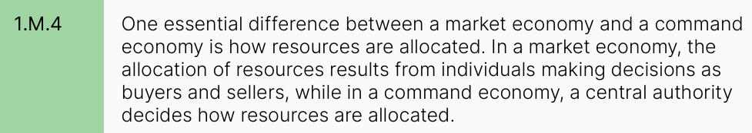
Suggested Resource/Lesson:
Economic Systems Handout
Source: GCEE Handout
https://docs.google.com/document/d/1iUgKw-UHw5SPsi3s03NQ1QvFg3UZNfjSQo2TqtpMT94/edit?usp=drive_link
Teacher guide
https://docs.google.com/document/d/1oUSAa_foM_YBw5i7ZSJE5HzoUv6G65KG-OrCDO71wDQ/edit?usp=sharing

Slide 22
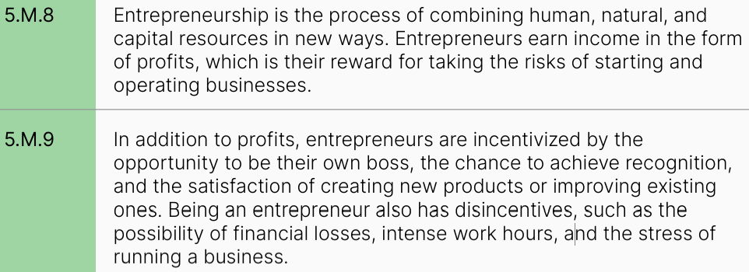
Suggested Resource/Lesson:
Various Entrepreneurship Materials (folder)
Source: Various
https://drive.google.com/drive/folders/105VdcPM43xjwvGNTUurkQdUJlnX-A4et?usp=drive_link

Slide 23
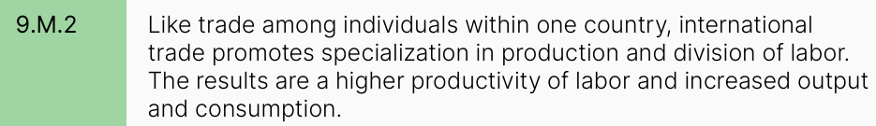
Suggested Resource/Lesson:
Specialization and the Cookie Trade
Source: GCEE Lesson
https://drive.google.com/drive/folders/1aAmeHH15fKaJhL3QRq2LTlauZqosBq6R?usp=drive_link

Slide 24
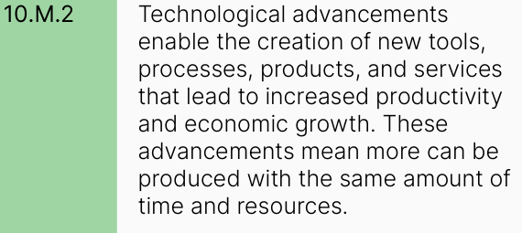
Suggested Resource/Lesson:
T-Shirt Production Country Variations
Source: GCEE Lesson
https://docs.google.com/document/d/1N071IbVwAC4Bk508ZlShRz4Vgtio0knk/edit?usp=sharing&ouid=101548772430474325355&rtpof=true&sd=true

Slide 25
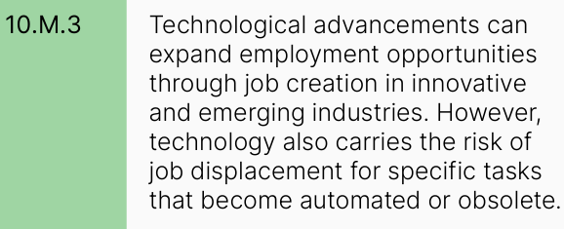
Suggested Resource/Lesson:
Teaching Innovation Slides
Source: GCEE Slideshow
https://docs.google.com/presentation/d/13EOMbeu-tJAuHoqIn0N8rmvrPfa0kze0z8Xi8nGINpA/edit?usp=sharing

Slide 26
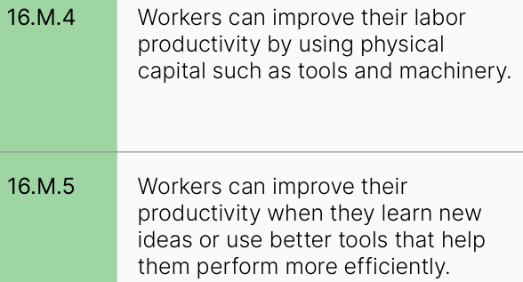
Suggested Resource/Lesson:
Technological Innovation and Economic Growth
Source: Econiful
https://docs.google.com/document/d/1L-g1PoIPlrE7IjDUOmR02i6HYT3p17h2fGMTGU3Ky3E/edit?usp=sharing

Slide 27
High School

Slide 28
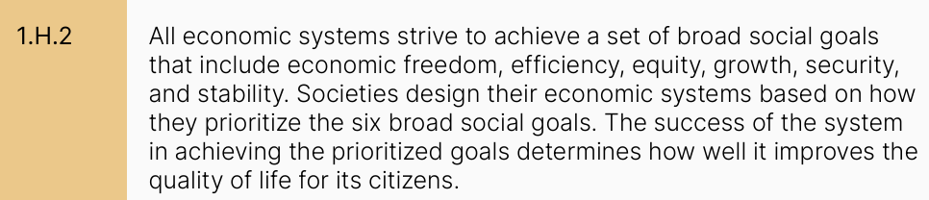
Suggested Resource/Lesson:
Economic Goals Handout
Source: GCEE Lesson
https://docs.google.com/document/d/1guoJA8YOHAODbfc8WFqVnxuUhkVtx2KphezJb65nQ84/edit?usp=drive_link
Teacher guide: https://docs.google.com/document/d/14MPuZ8Cpi3_1vm5HGeGr6bCvp0syCdiIml7_QsrJOeY/edit?usp=drive_link

Slide 29
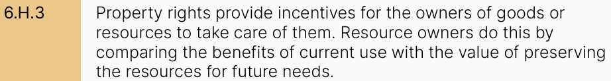
Suggested Resource/Lesson:
You Gotta Fight (For Your Copyright)
Source: TeachRock
https://teachrock.org/lesson/you-gotta-fight-for-your-copyright-understanding-copyright-and-fair-use/

Slide 30
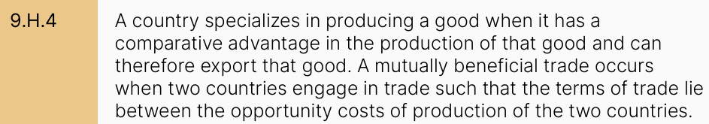
Suggested Resource/Lesson:
Specialization and the Cookie Trade
Source: GCEE Lesson
https://drive.google.com/drive/folders/1aAmeHH15fKaJhL3QRq2LTlauZqosBq6R?usp=drive_link
More “advanced” version: https://docs.google.com/document/d/1YmfVilSky9p8QDZPae2hEKhEOTNv_j_c/edit?usp=sharing&ouid=101548772430474325355&rtpof=true&sd=true

Slide 31
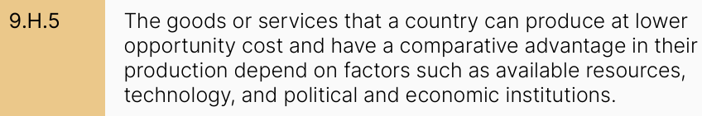
Suggested Resource/Lesson:
T-Shirt Production Country Variations
Source: GCEE Lesson
https://docs.google.com/document/d/1N071IbVwAC4Bk508ZlShRz4Vgtio0knk/edit?usp=sharing&ouid=101548772430474325355&rtpof=true&sd=true

Slide 32
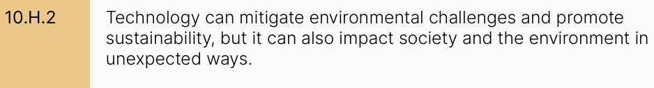
Suggested Resource/Lesson:
Teaching Innovation Slides
Source: GCEE Slideshow
https://docs.google.com/presentation/d/13EOMbeu-tJAuHoqIn0N8rmvrPfa0kze0z8Xi8nGINpA/edit?usp=sharing

Slide 33
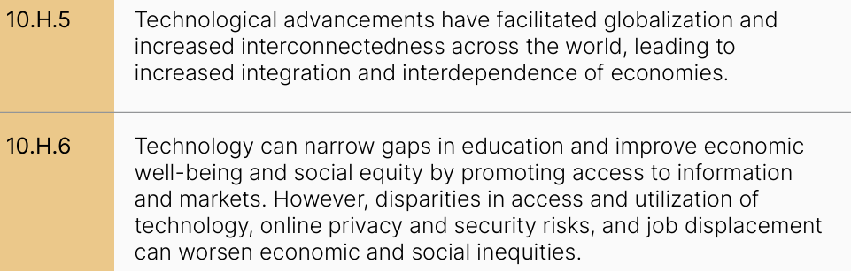
Suggested Resource/Lesson:
Global Inequality: Causes and Consequences
Source: EconEdLink Lesson
https://econedlink.org/resources/global-income-inequality-what-are-the-causes-and-consequences/

Slide 34
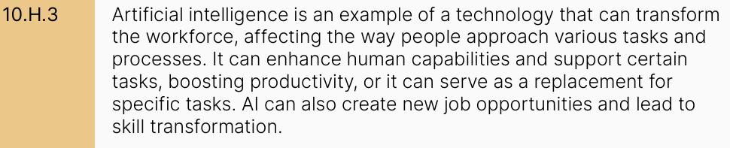
Suggested Resource/Lesson:
The Jobs AI Can Do (And Those It Shouldn’t)
Source: FEE Lesson
https://docs.google.com/presentation/d/1VkTHUi8gahQqCCm50O6UH5TW7dlL3gk7FFA4UUwFPSE/edit?usp=sharing

Slide 35
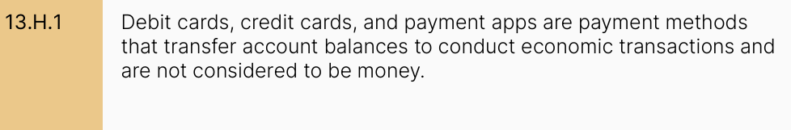
Suggested Resource/Lesson:
Ways to pay
Source: Fed/GCEE Lesson
https://docs.google.com/document/d/1946zzf4oKPAqeaAL-XEq1yqM--LCkYsZ/edit?usp=drive_link&ouid=115808800905162364447&rtpof=true&sd=true

Slide 36
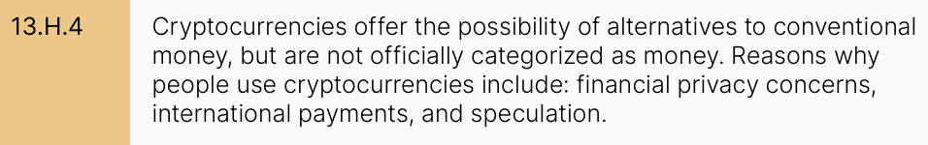
Suggested Resource/Lesson:
Something From Nothing: How Cryptocurrency Works
Source: GCEE Lesson
https://docs.google.com/document/d/1gAdxIUfdCRrcEHgN0EjbV-gwKDYZ0Iqf/edit?usp=sharing&ouid=101548772430474325355&rtpof=true&sd=true

Slide 37
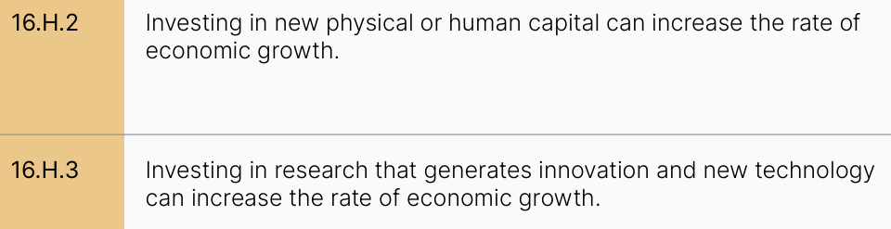
Suggested Resource/Lesson:
Technological Innovation and Economic Growth
Source: Econiful
https://docs.google.com/document/d/1L-g1PoIPlrE7IjDUOmR02i6HYT3p17h2fGMTGU3Ky3E/edit?usp=sharing

Slide 38
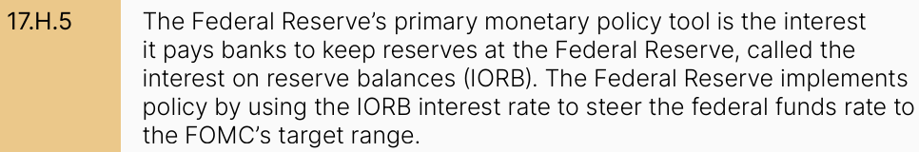
Suggested Resource/Lesson:
Teaching the New Tools of Monetary Policy
Source: FRE.org Lesson
https://www.federalreserveeducation.org/teaching-resources/economics/curriculum/new-monetary-policy-tools-landing-page

