Slide 1

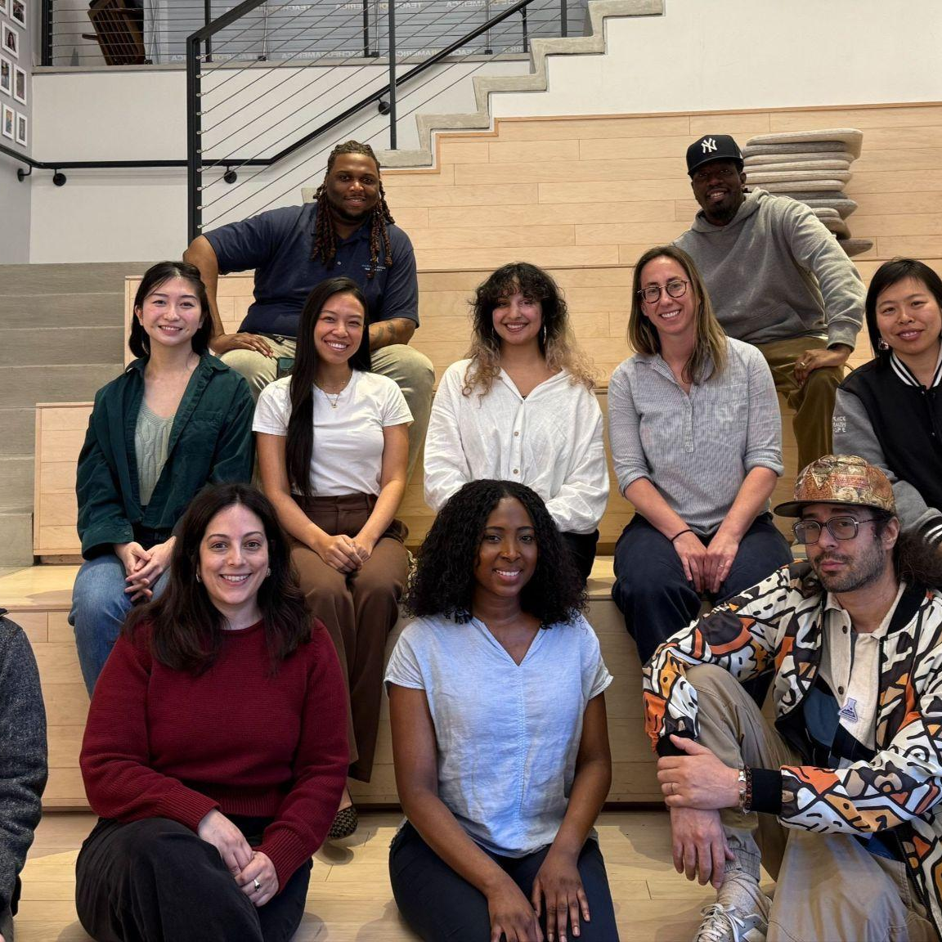
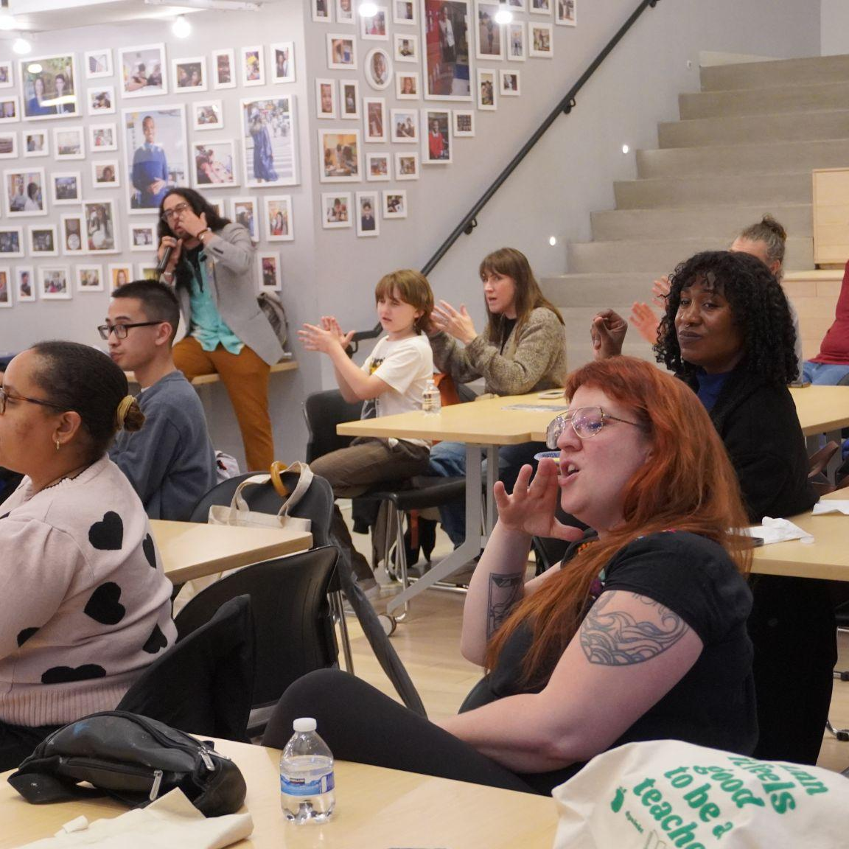
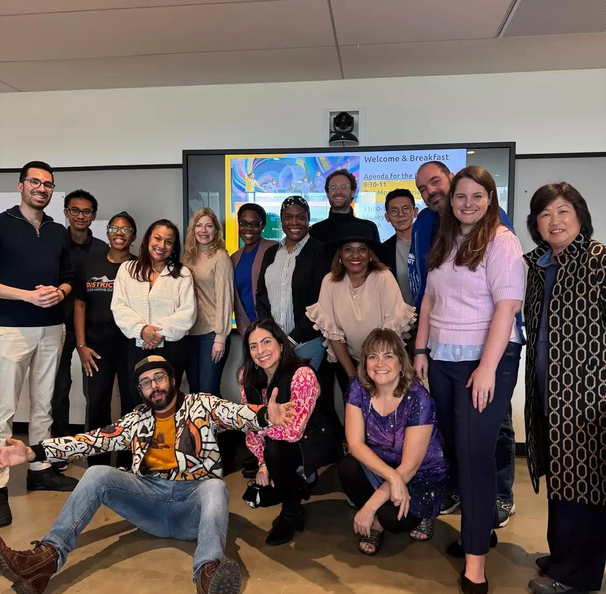
Notes:
What you’ll walk away with:
Strategies for navigating financial choices with confidence and compassion
Tools for restorative and relational conversations about money
Approaches to support holistic mental well-being
Community connections with other educators
Curriculum resources for both financial education and educator wellness

Slide 2
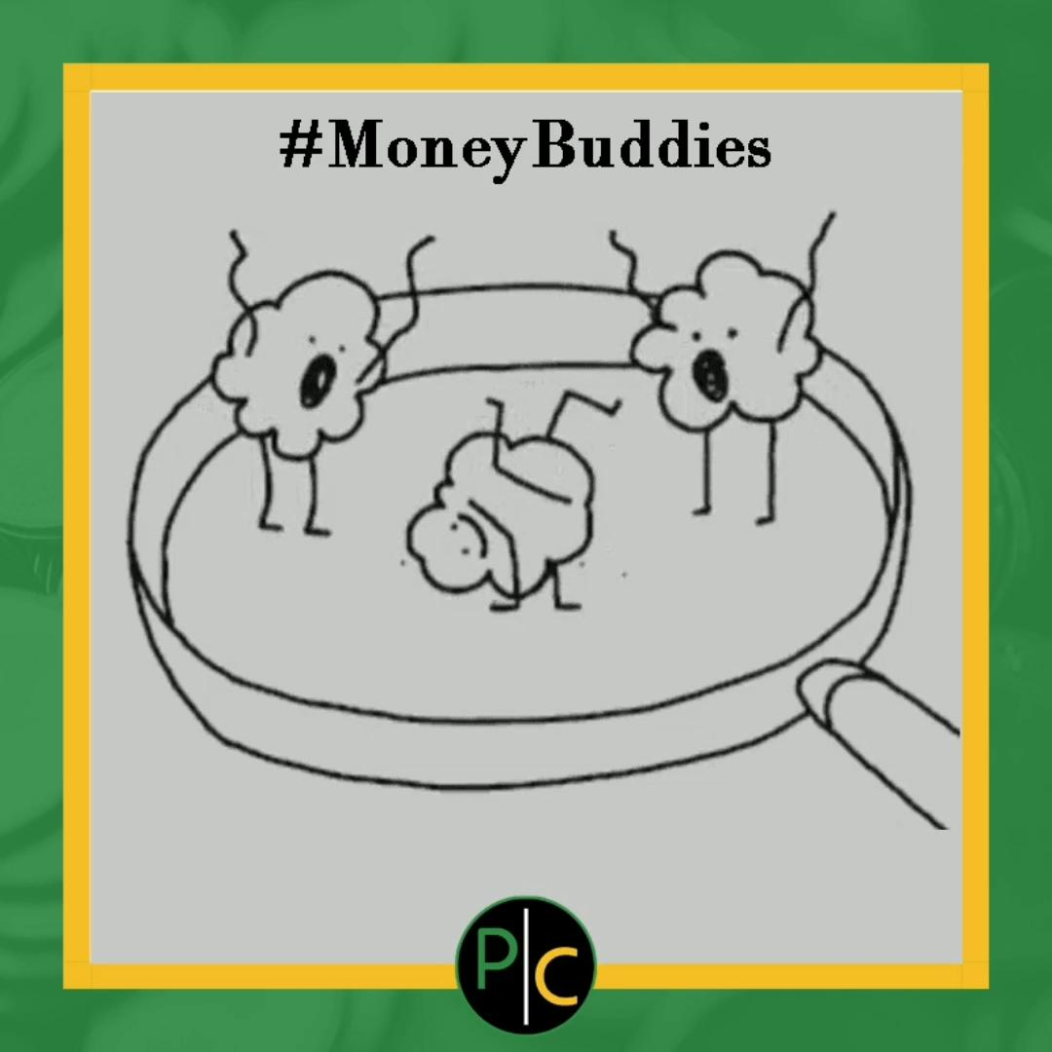
Who’s in the room
Name
Grade levels you teach
What you’re most interested in learning?
What you’re most excited to share?

Slide 3
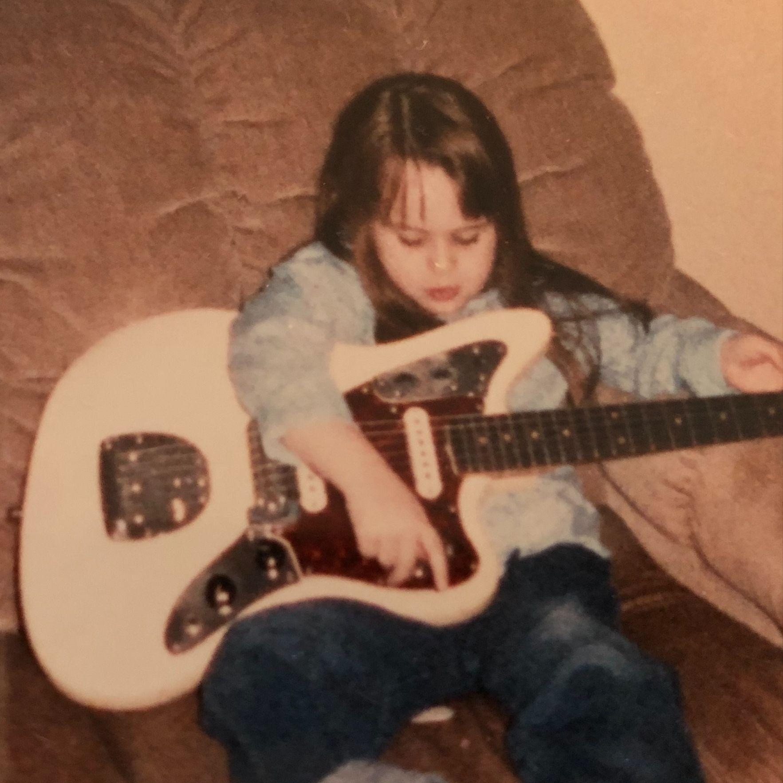
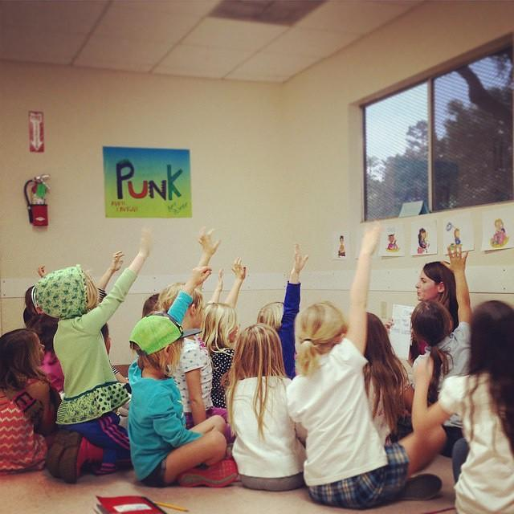
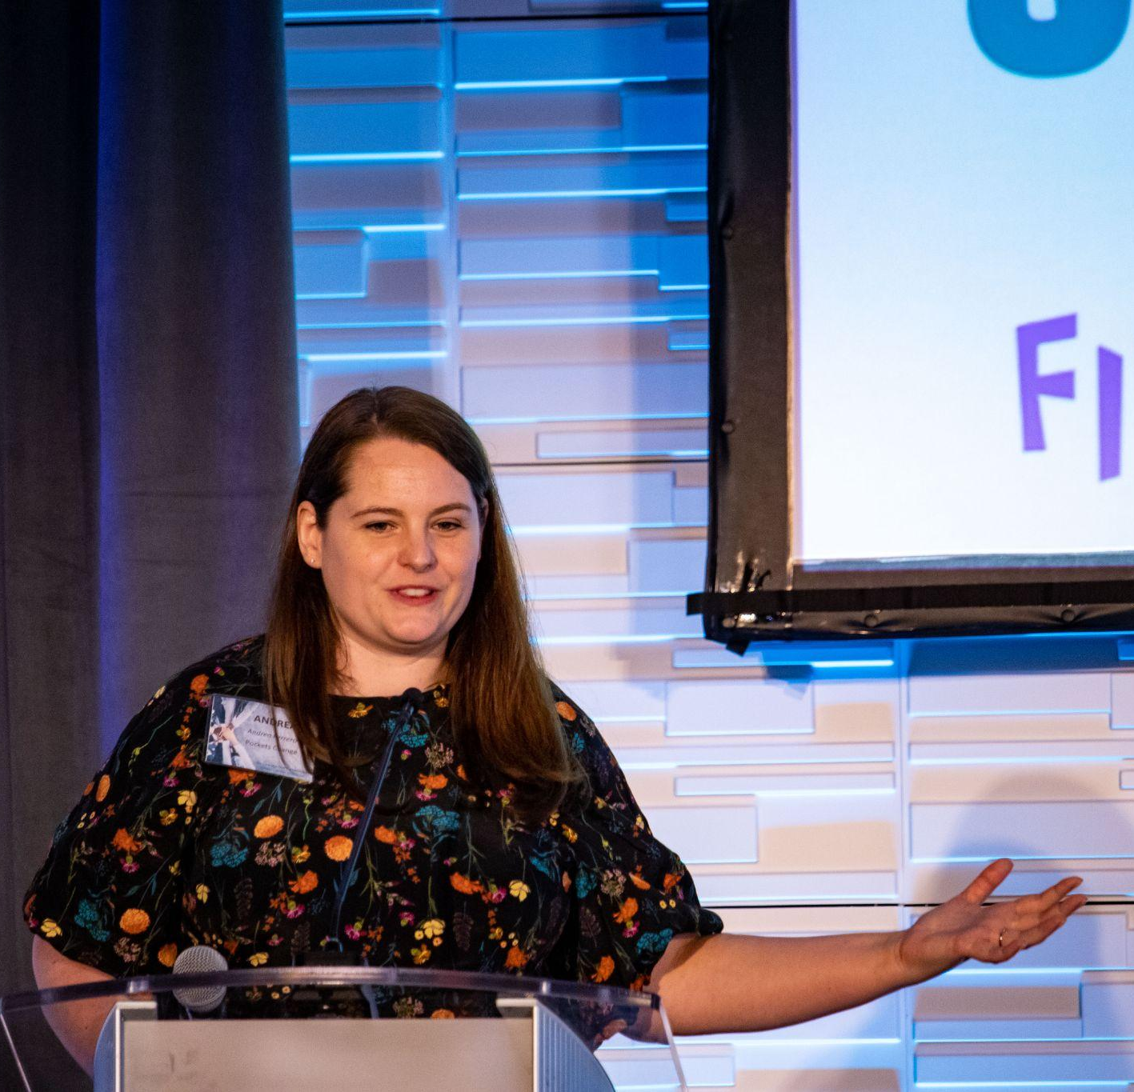
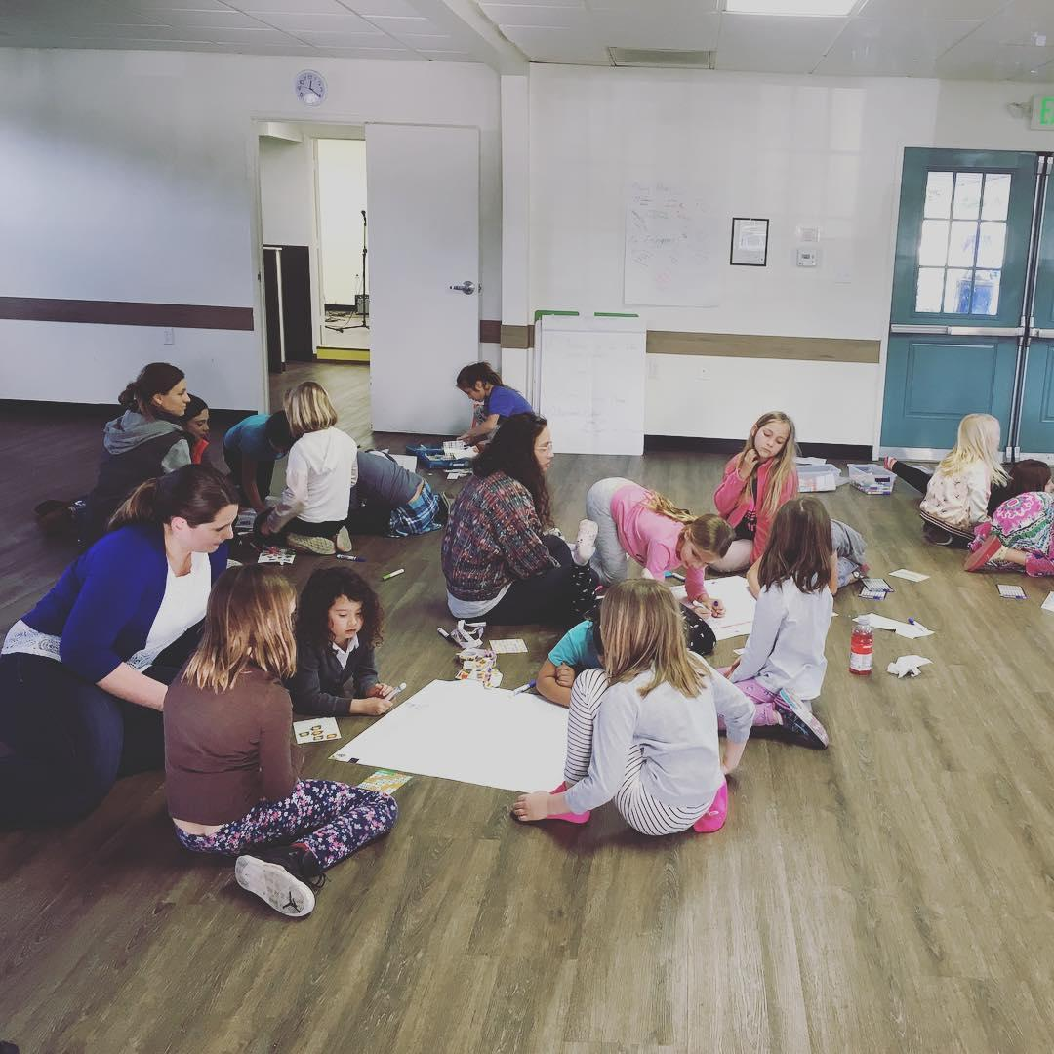

Andrea Ferrero-Haggerty, Executive Director

Slide 4
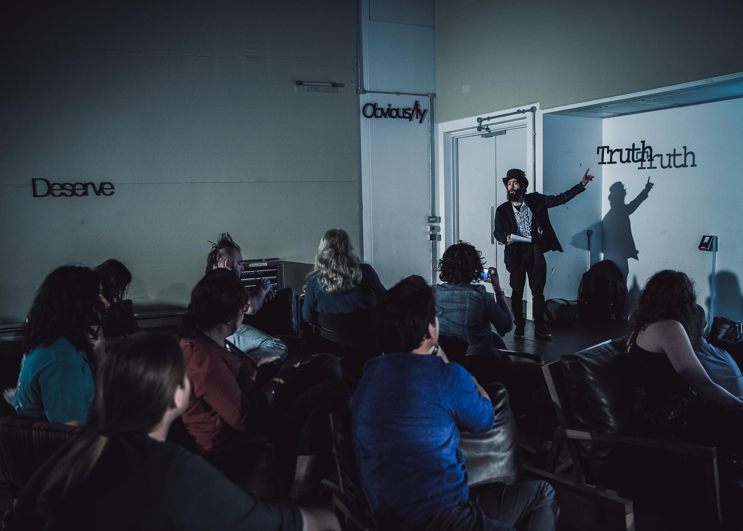
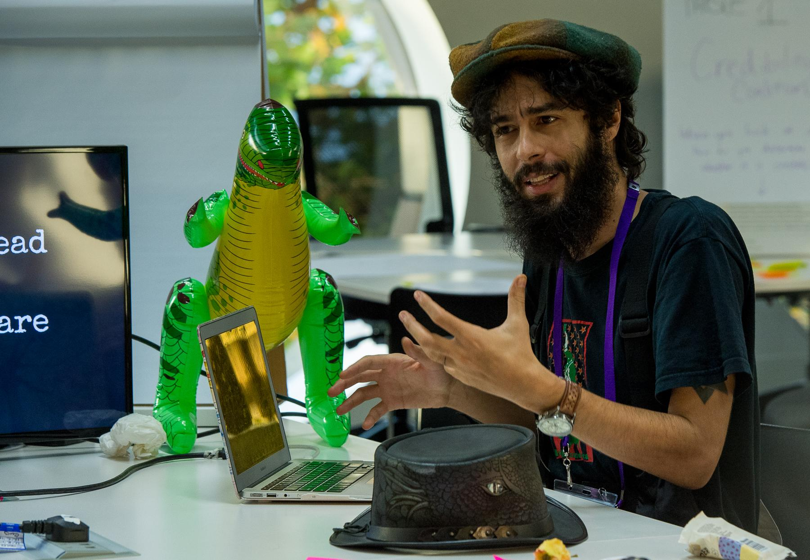
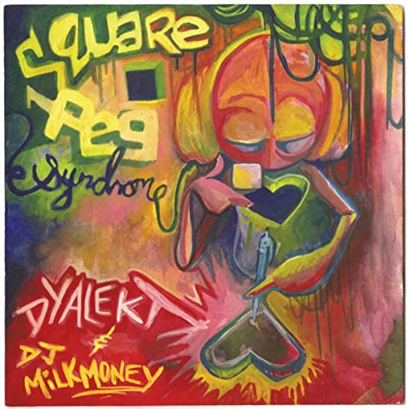

HISTORY OF ME
Dyalekt, Director of Pedagogy

Slide 5
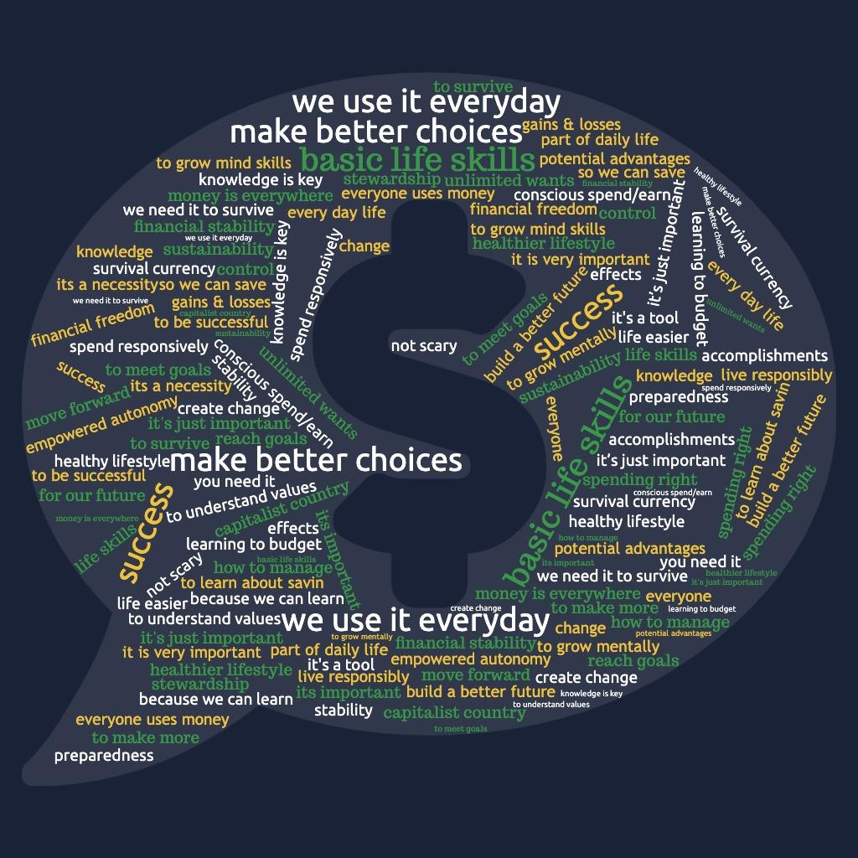
Share in chat or unmute
Why do we need to talk about money?
Get the Slides: https://bit.ly/FinEdArts

Slide 6
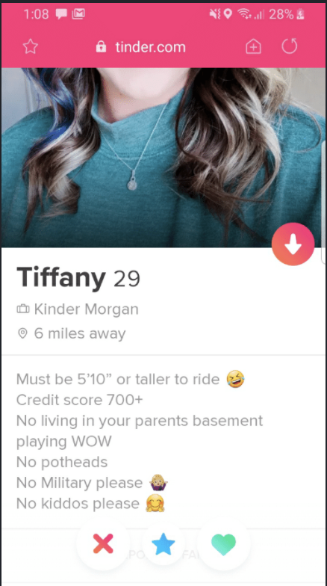

Slide 7
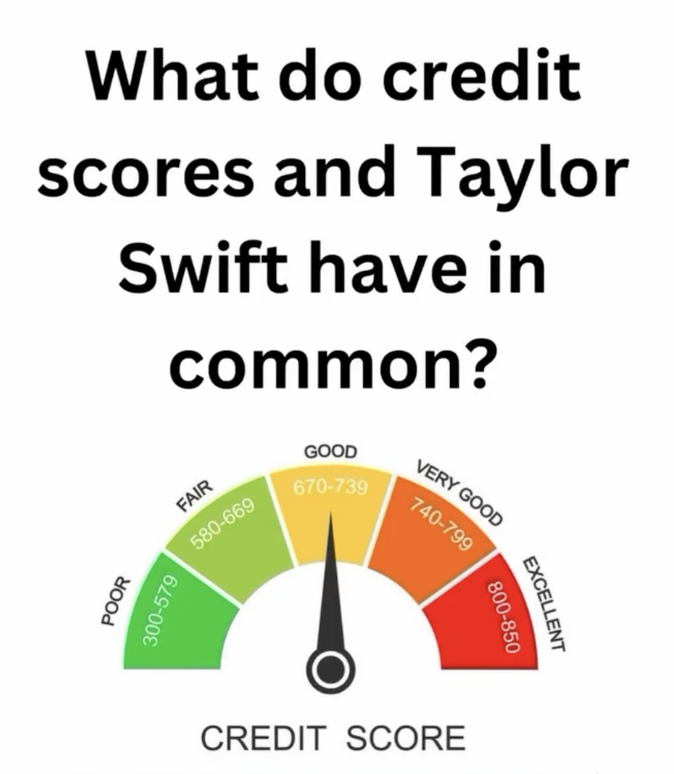

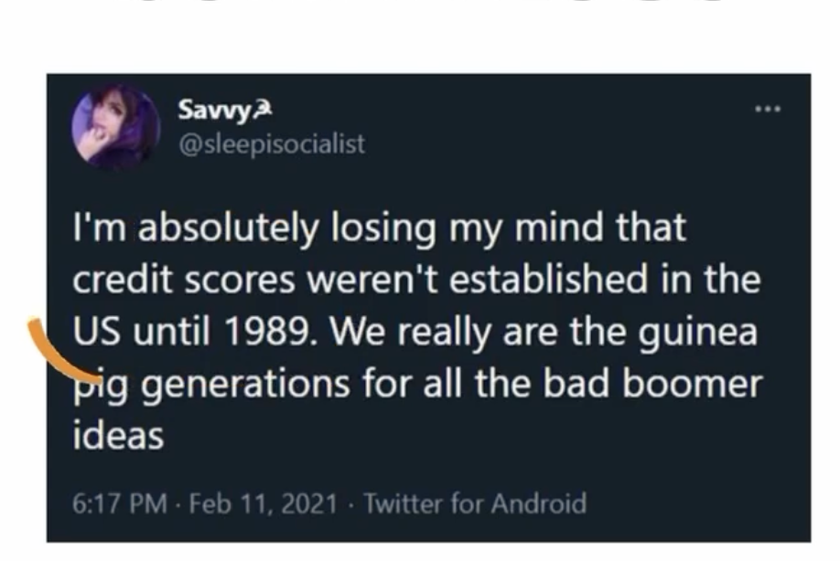

Slide 8
You’re part of a system that’s designed to take you out:
Bad credit score? Your landlord, employer, utility company, cell phone company, insurance company can penalize you
Didn’t file taxes every year? Can’t buy a house, get a business loan, might owe back taxes
No estate plan? All the work it took to accumulate wealth goes to lawyers and court fees

Slide 9
You’re not wrong,
you’re not a fool,
you’re not alone

Slide 10
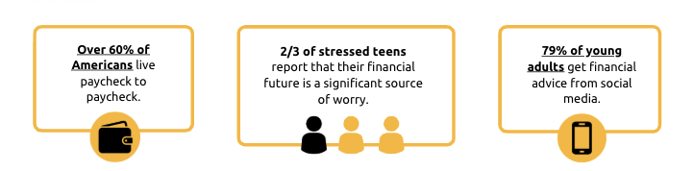
Why We Need to Talk About Money
Financial Education is an Urgent Need
Pockets Change Approach
🎤 Learner-Centered
📓 Standards Aligned
💡 Transformative Financial Education Learning
Experiences & Creative Career Development
Get the Slides: https://bit.ly/328ART
Notes:
Learner Centered-We take a standards based backwards design approach to curriculum design. We believe that a holistic curriculum should attend to content focus, skills and the dispositional development of the learner. Our curricula provides opportunities for learners to construct their own learning through a series of focused learning experiences and culturally relevant social interactions.
Standards Aligned- We believe that a holistic curriculum should attend to content focus, skills and the dispositional development of the learner. The modules for this program will align to the National Standards for Personal Finance Education, NYS Next Generation Learning Standards and the CFPB building blocks. We’ll also incorporate the Universal Design for Learning principles in each module.
Transformative Personal Finance Learning Experiences- Above all, we believe that learning should be FUN! Multiple studies and surveys have shown that learners are more likely to apply their learning beyond the classroom when programs are engaging and culturally responsive. The modules for this program will incorporate culturally relevant learning experiences that incorporate games, the arts and opportunities to grow financial behaviors, knowledge and habits.

Slide 11

“Money Speaks” Breadwinna CJ
Art Creates Change
https://bit.ly/MoneySpeaksVideo

Slide 12
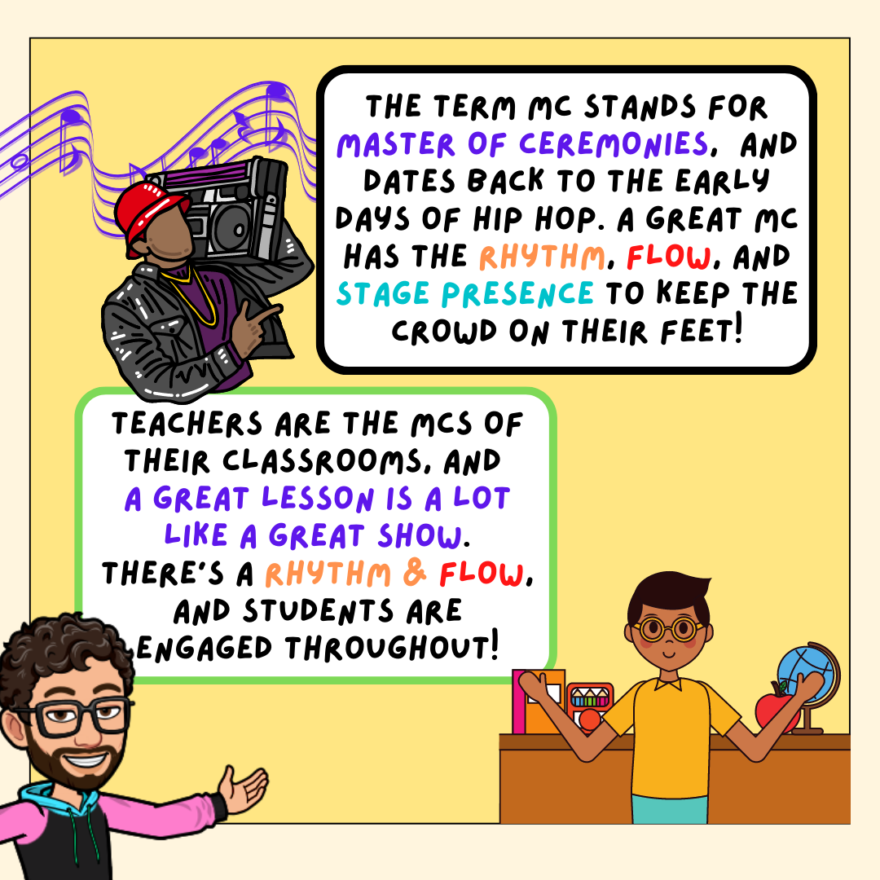
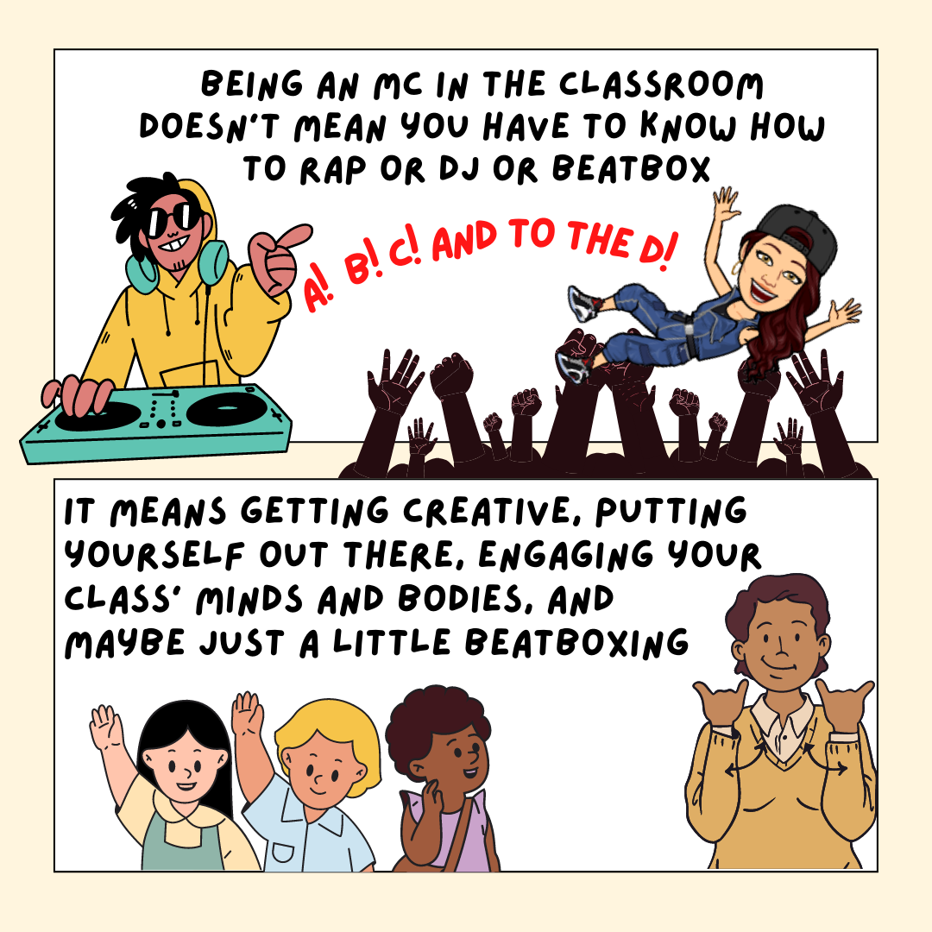
Art to Express and Decompress
Get the Slides: https://bit.ly/FinEdArts
Notes:
Innovation out of necessity
Community upholds collective care
Shared Rhythm Inspires Us to Keep Showing Up in the Ways that matter to us
Teaching is an Art, Hip Hop Pedagogy has made me a stronger practitioner

Slide 13
💕 HUGE acknowledgement to our interpersonal neurobiology teachers, who have asked to remain anonymous, for this transformative information. Anything in italics is a direct quote from them
Neuroception
The automatic process involving brain areas that process cues of safety, danger, or life threat
You’re consciously reading the cues but you’re unconsciously feeling the vibes

Slide 14
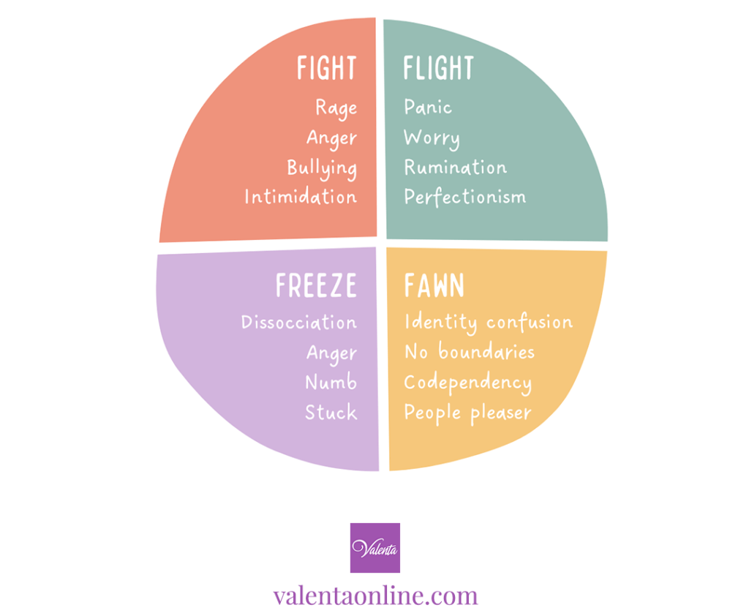
When your body senses danger, it goes into one of the 4 trauma responses:

Slide 15
Neuroception
It is very difficult to envision the future if your nervous system doesn’t feel safe in the present

Slide 16
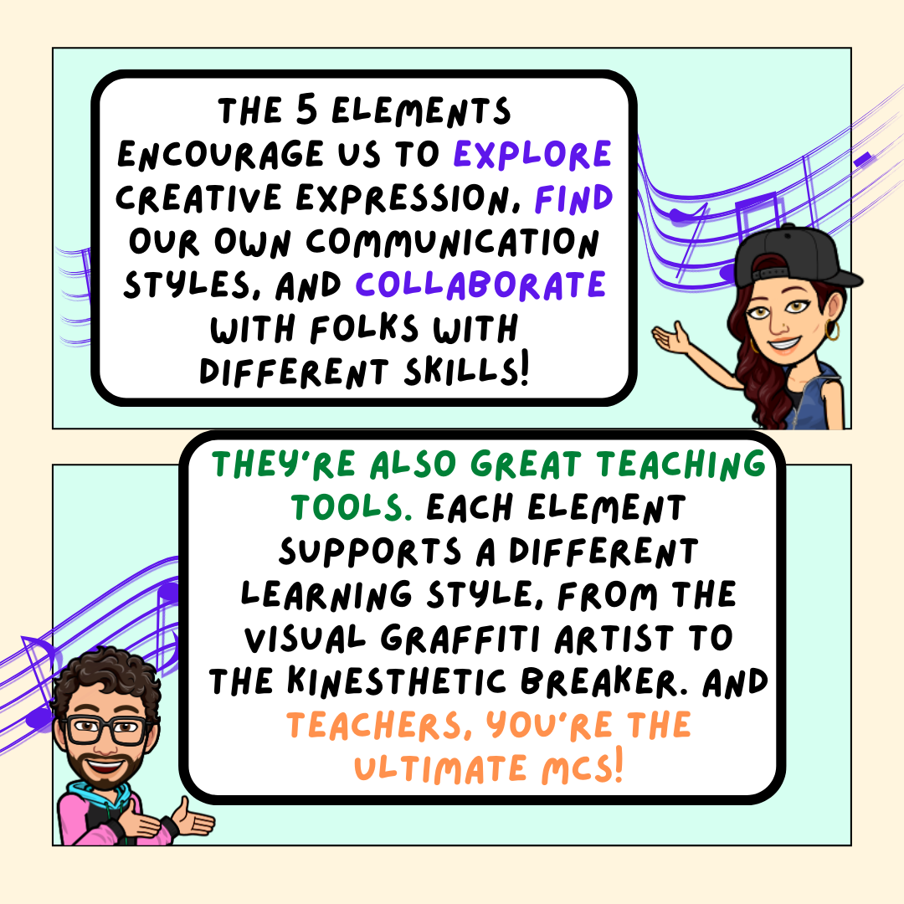
Get the Slides: https://bit.ly/328ART

Slide 17
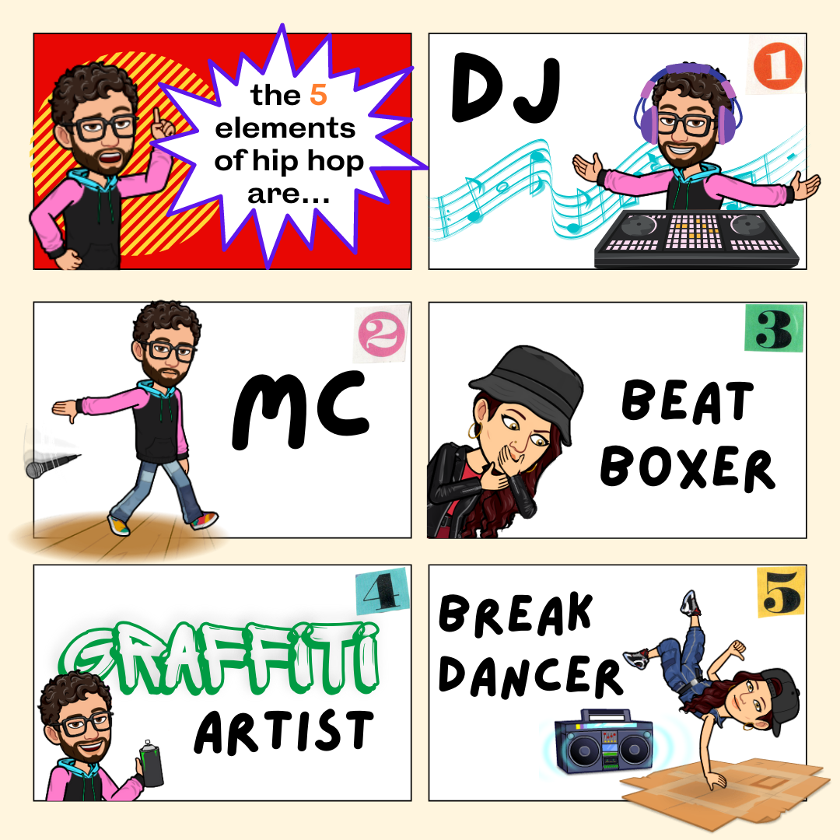

Slide 18
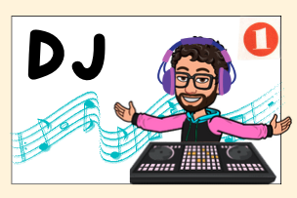
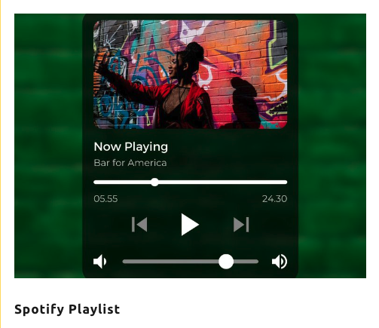
Art to Express and Decompress
Art to Express and Decompress
Create a playlist of 3-5 songs that feel like you
Get together with a group and create a money personality playlist
Tools to Use:
Canva for playlist handout
Spotify

Slide 19
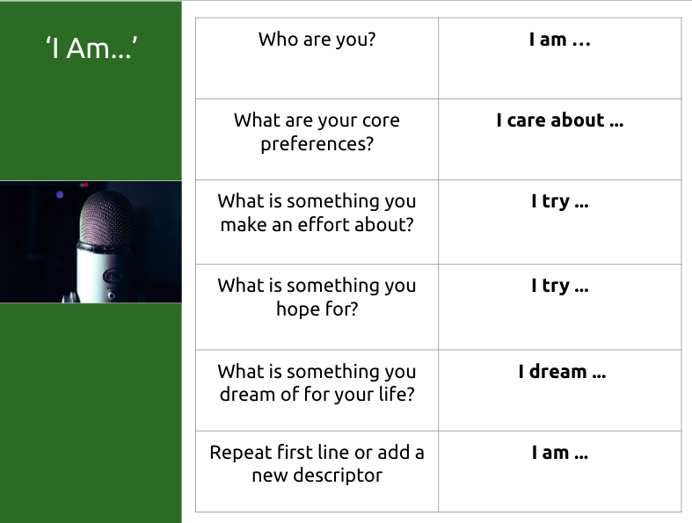
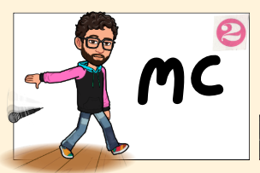
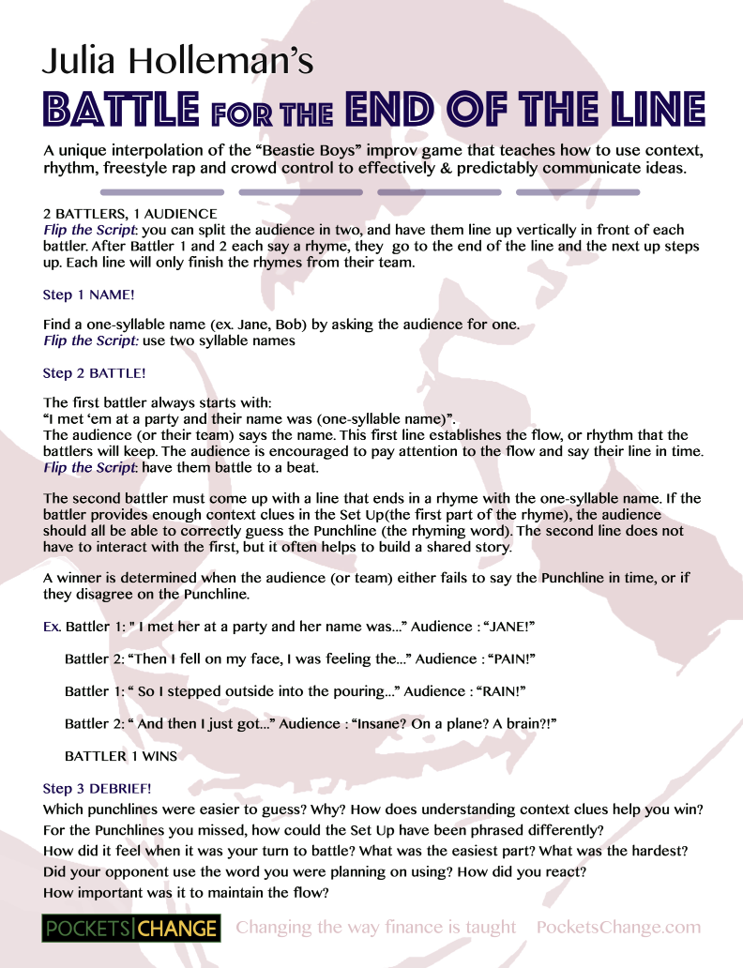
Art to Express and Decompress
Art to Express and Decompress
With a group, play Battle for the End of the Line and discuss context & improvisation
Write an I Am Poem and share with a money buddy

Slide 20
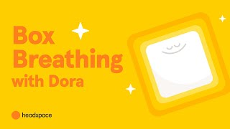
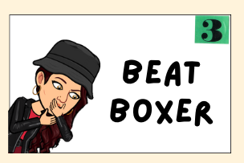
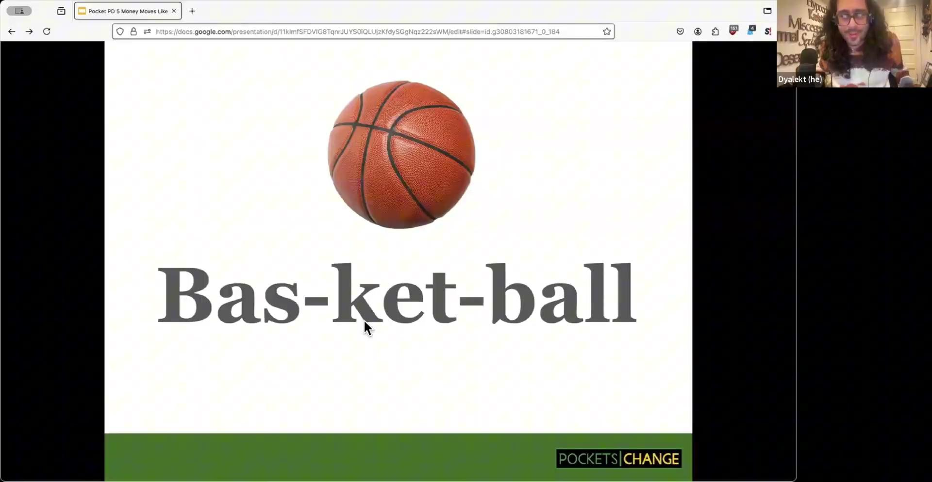
Art to Express and Decompress
Art to Express and Decompress
Try out Box Breathing for Grounding
Try out Beatbox Breath with a group
For more professional beatboxers:
https://youtube.com/@americanbeatbox?si=y5MvlcP7pUR9hM_H

Slide 21
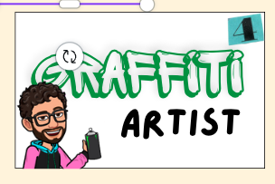
Art to Express and Decompress
Art to Express and Decompress
Create a mood board with artists/works of art that can answer the following prompts:
What does money mean to you?
What do you want to preserve?
What do you want to change?
Tools to use: Canva, physically cut from magazines, or drawn on poster board or notebooks.

Slide 22

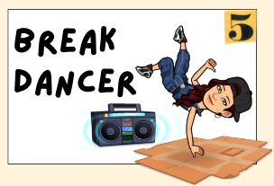
Art to Express and Decompress
Art to Express and Decompress
Create a 2-minute movement about the feelings of spending
Try out Learning Studio
Hip Hop Public Health
Take a Hype Break with A collection of fifty 2-minute fun hip-hop dance physical activity break instructional videos designed to energize, invigorate, and motivate!
Hip Hop Public Health

Slide 23
Window of Tolerance
Notes:
choose one category to focus on reducing your spending in

Slide 24
Window of Tolerance
OR Why we spend more money when we’re tired, pissed off, afraid, anxious, overwhelmed, or depressed

Slide 25
Window of Tolerance
💕 HUGE acknowledgement to our interpersonal neurobiology teachers, who have asked to remain anonymous, for this transformative information
Anything in italics is a direct quote from them

Slide 26
Window of Tolerance
The fancy definition:
The emotional zone where our nervous system is most regulated and we’re able to function and thrive in daily life, access our executive functioning, and communicate effectively

Slide 27
Window of Tolerance
In other words, when you’re living in your window of tolerance, you feel like you can handle anything life throws your way
You’re IN THE ZONE

Slide 28
(hyperarousal - FIGHT or FLIGHT)
Anxiety, irritability, overwhelm, HYPERVIGILANCE
Energy, activity, excitement
🪟
Window of Tolerance
Optimal emotional zone
Relaxation, deep rest
Fatigue, depression, shut down, SHAME
(hypoarousal - FREEZE)

Slide 29
Window of Tolerance
There are neurophysiological responses that we cannot control when something exceeds our window of tolerance
Can fluctuate in size depending on what’s going on in our lives - tired, hungry, no sleep, stressors

Slide 30
SMALL Window of Tolerance
Too much responsibility and not enough support = much smaller window of tolerance
Every time you have to code switch, deal with a microaggression, put on a fake smile, suppress a reaction to an injustice, or hide who you really are, your window of tolerance gets smaller

Slide 31
SMALL Window of Tolerance
A small window of tolerance is the emotional equivalent of living paycheck to paycheck
This is why people might spend more money when they are in financial crisis - their window of tolerance is small, they’re in f* it mode

Slide 32
BIGGER Window of Tolerance
More space and more support = bigger window of tolerance
Feels supported as the raw emotion comes up, not about toning down feelings but having someone hold them
A supportive relationship is more emotionally regulating than food, sleep, water, etc.

Slide 33
JOINED Window of Tolerance
Joined window of tolerance - another person joining your window of tolerance allows you to expand your own window of tolerance
Relief of someone naming what’s happening and articulate what you’ve been going through

Slide 34
JOINED Window of Tolerance
“Being felt, seen, and heard does not stop oppression from happening, but allows us to keep going and get our humanity back”
Interpersonal neurobiology teachers

Slide 35
What’s your art?
Get the Slides: https://bit.ly/328ART
Notes:
Money Buddies or share-out depending on group

Slide 36
Find Your Rhythm with Finance
Project Ideas/Templates
What kind of projects can students create & share?
📓Poems
👾 Games
🎤 Songs
📱 Videos
🎨 Visual Art
💡Creative Projects that Share Financial Knowledge (posters, podcasts, pitches,presentations, paintings, photos and more)

Slide 37
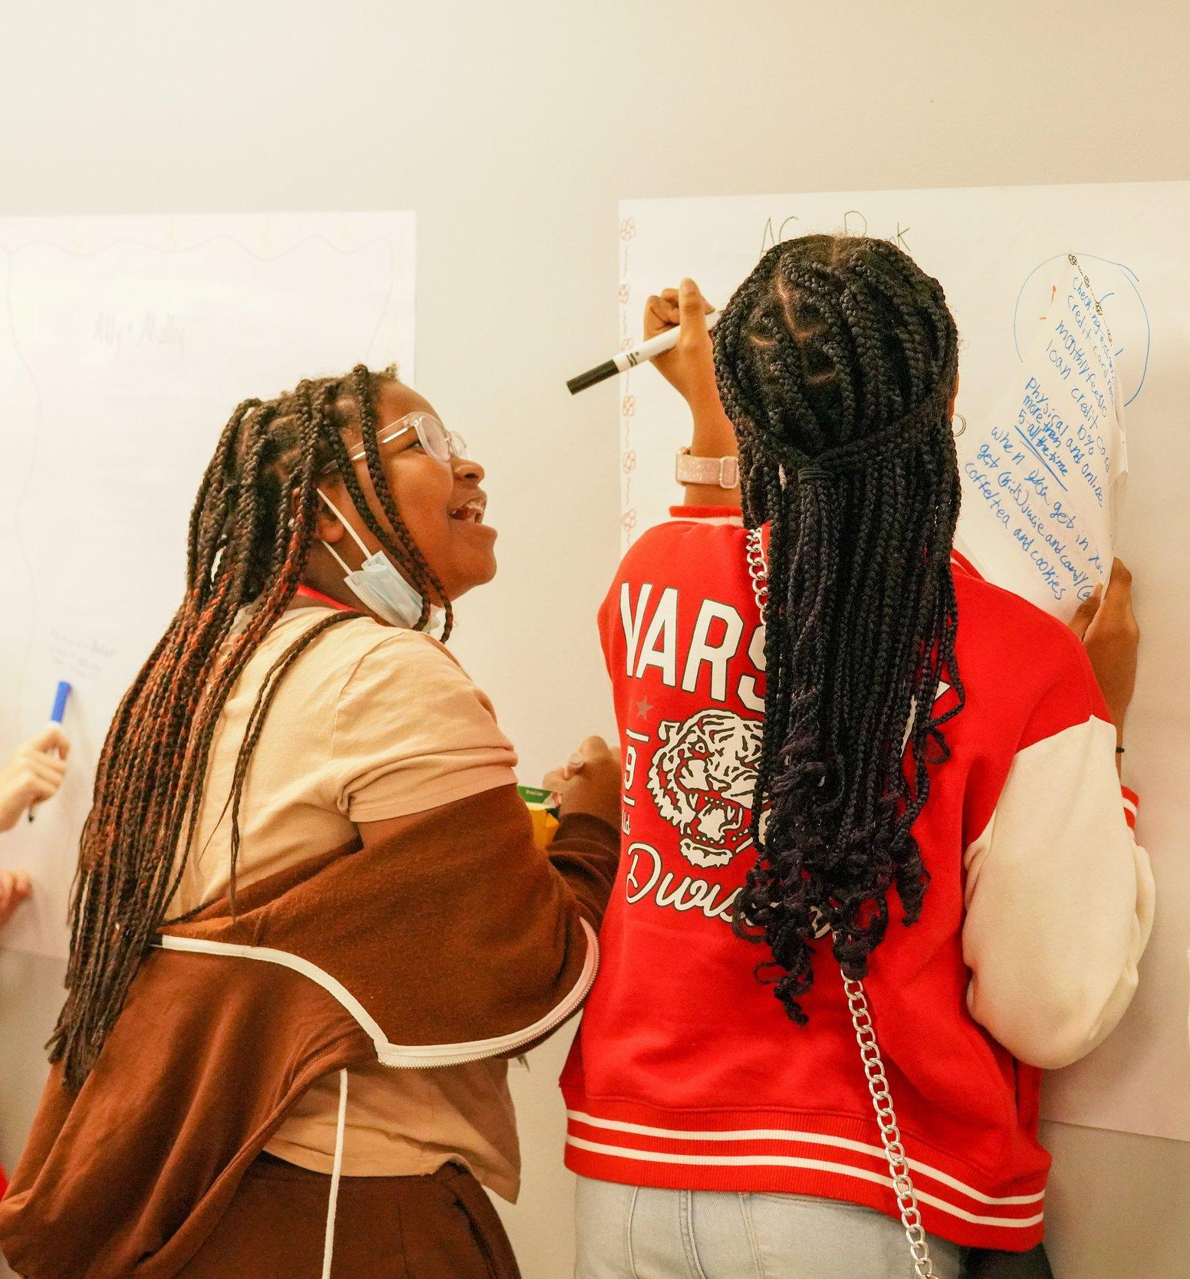
Creative Projects for K-12
Celebrate Ideas & Money Talks
What makes an awesome project?
Communicates a clear idea
Demonstrates financial understanding
Shares a personal point of view
Engages peers with information
Promotes conversation and curiosity

Slide 38
Financial Education
Guiding Questions
What kinds of questions can prompt project design?
How do you make lasting change for your community by getting control of your finances?
If you could start a scholarship for anything, what would it be? Who would it serve?
What would you change about the way money works? How it’s distributed? How important it is to the world?
What’s one thing people need to know about money that would change their life for the better?
Write about something worth saving money for (car, school, trip around the world) and how creative you can be about saving.
Make and break down a budget for something complicated and ambitious, like an indie film, medical school, or opening a restaurant. Bonus points for real numbers and percentages.

Slide 39
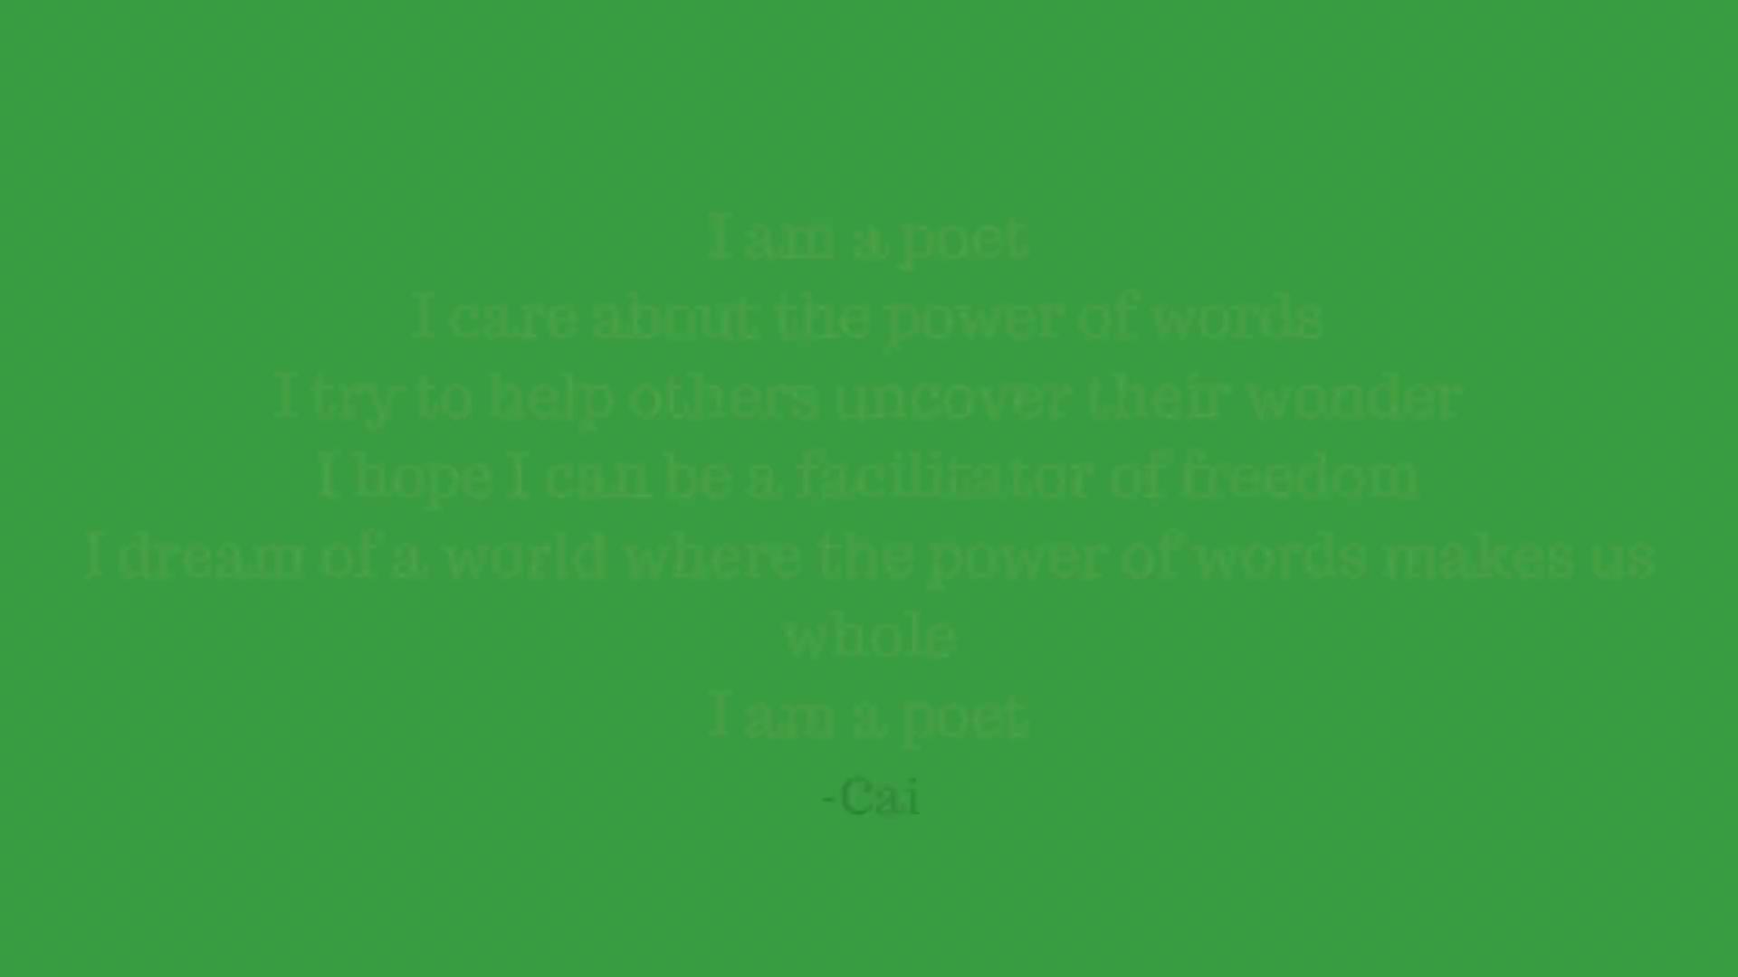
Write a Poem
I Am Poem Template
I Am Poem Example

Slide 40
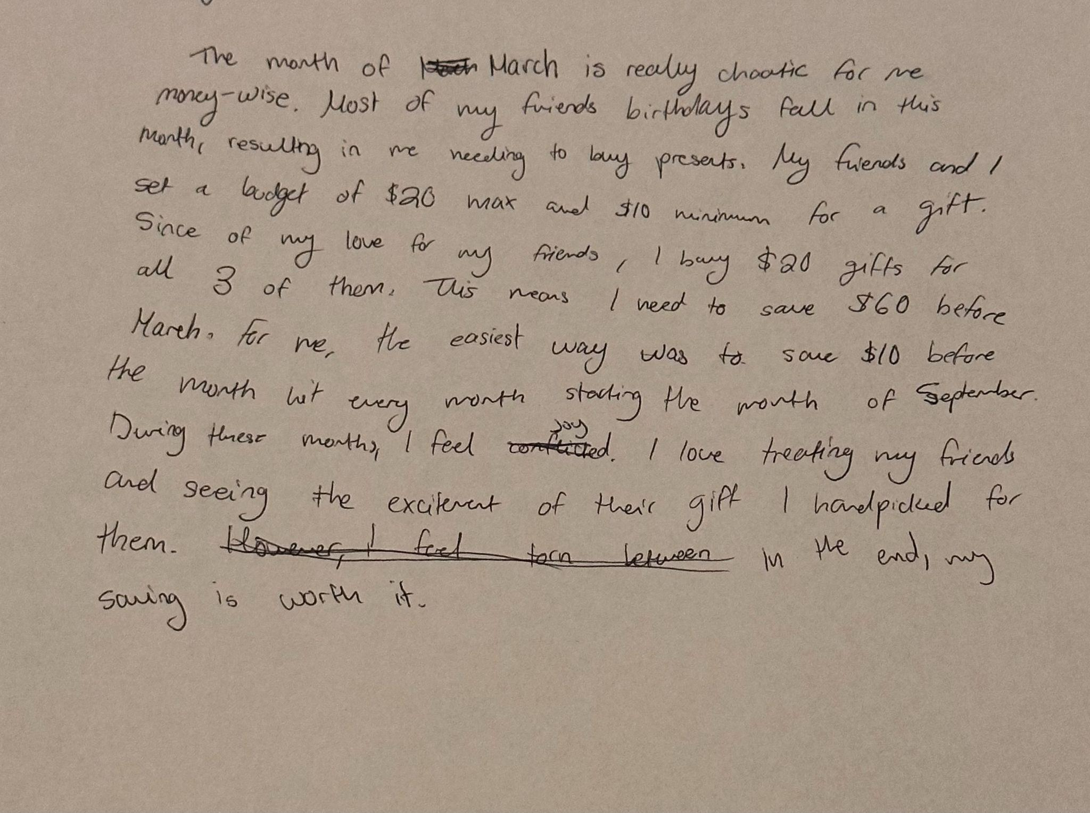
Share a Story
Spending Values & Savings Strategies
For Reflection and Instructional Anecdotes

Slide 41
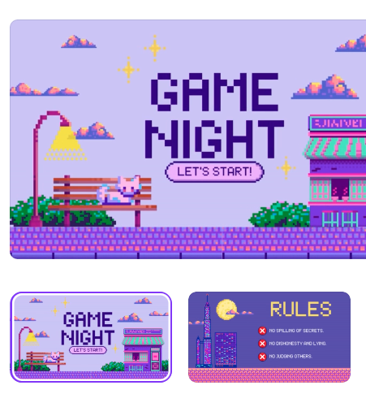

Design a Game
Game Templates
https://www.canva.com/templates/s/game/

Slide 42
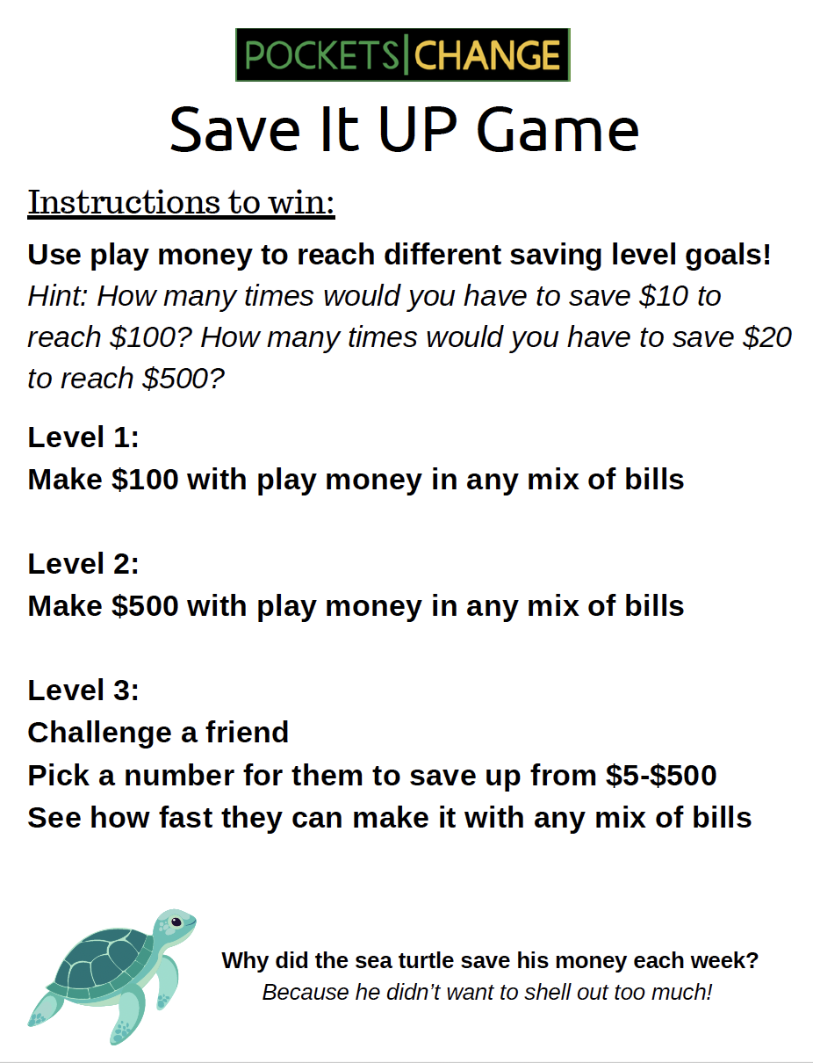
Design a Game: Save It Up
https://bit.ly/saveitupgame
Teen Train-the-Trainer Summer Program
Notes:
Individual and Teams Game
Math and Savings Conversations
Story Problems in Action

Slide 43


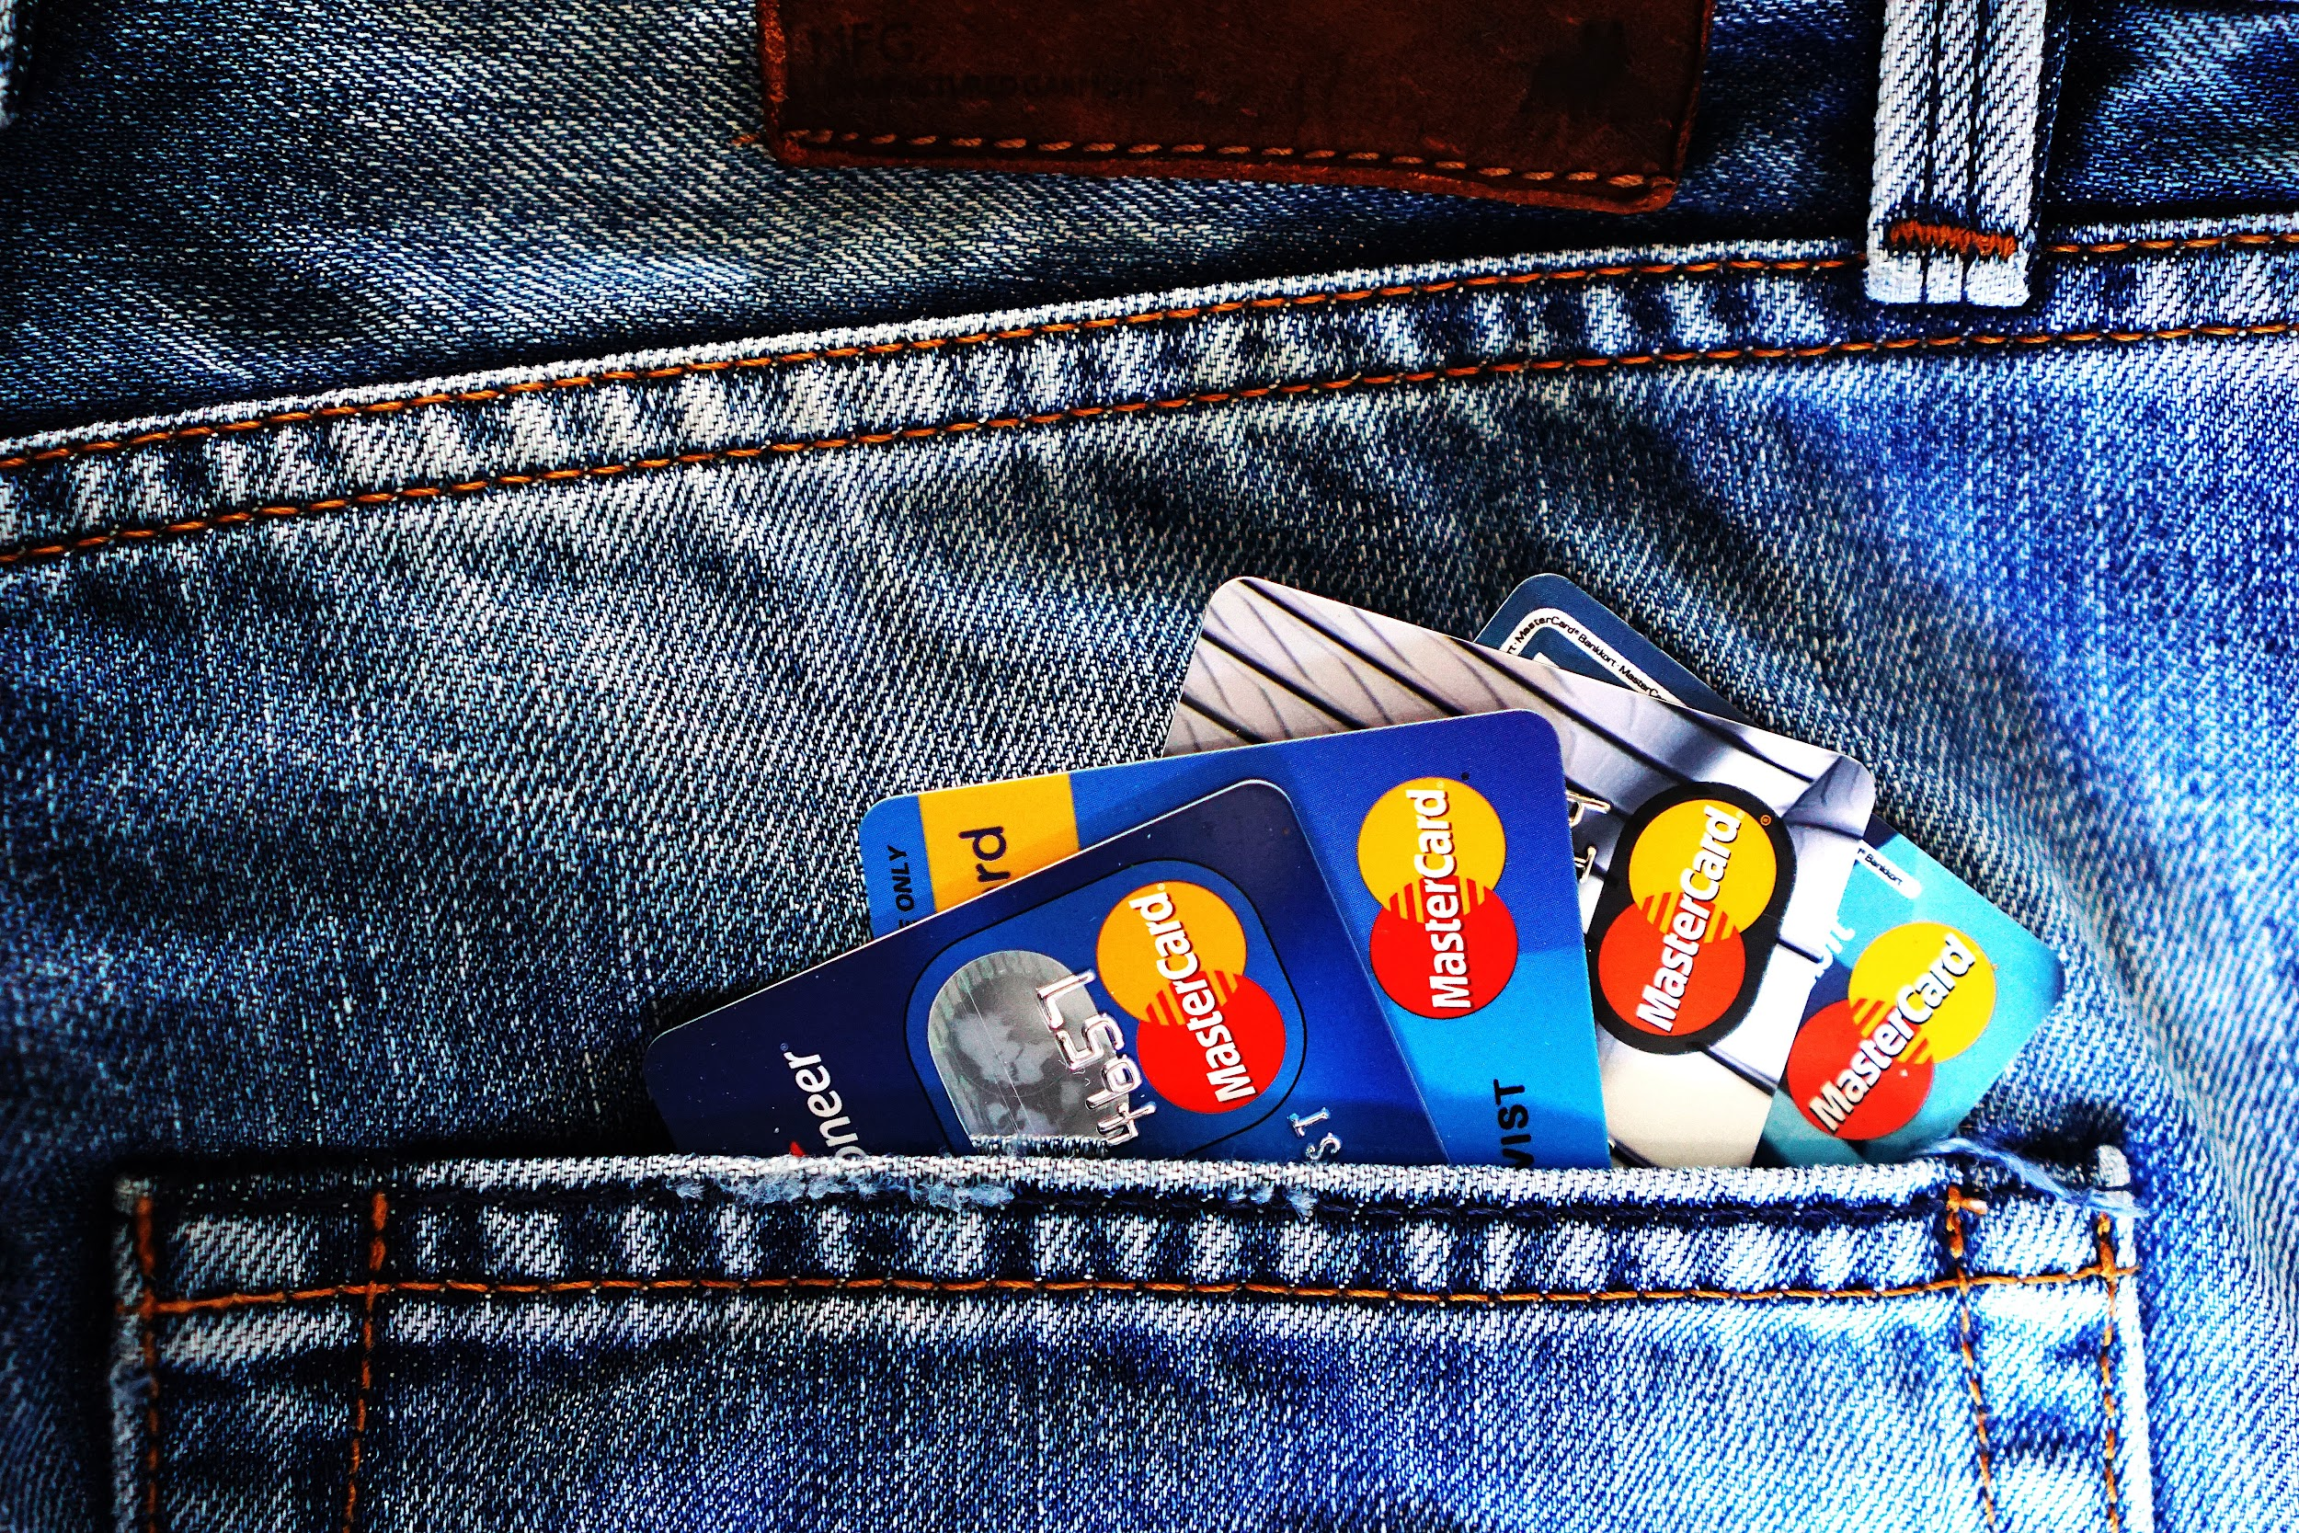



35% payment history
late payments negatively affect your credit score for 7 years
PRO TIP: set your minimum payments to autopay
30% amounts owed
keep your credit card balances 30% below the limit
PRO TIP: call to increase the limits on your cards periodically
Credit Score Rules
10% new credit
opening (or trying to open) new lines of credit
negatively affect your score, opening new credit also affects average length of credit history
PRO TIP: don’t open more than one line of credit every 12 months.
15% credit history
your credit score increases the longer you’ve had credit and based on the average age of your credit lines
PRO TIP: never close your oldest card
SUPER PRO TIP: make sure the first card you open doesn’t have an annual fee
10% credit mix in use
having different types of credit open increases your score (credit cards, store cards, student loans, auto, personal, mortgages, etc)
PRO TIP: if you’re new to credit, consider getting a store credit card at a place you shop often
Topics like this can inspire student game design.
Notes:
The rules of credit are contradictory and the system is not built to help us get ahead.
There are groups actively working to make the credit system more equitable.
Until that day, we need to understand the game so we can get where we want to go.
Topics like this can inspire student game design.

Slide 44


Create a Song
Song Writing Tips & Tools
For a detailed breakdown on songwriting check out this article by Soundtrap
Visit www.pocketschange.com/finfest for lessons

Slide 45
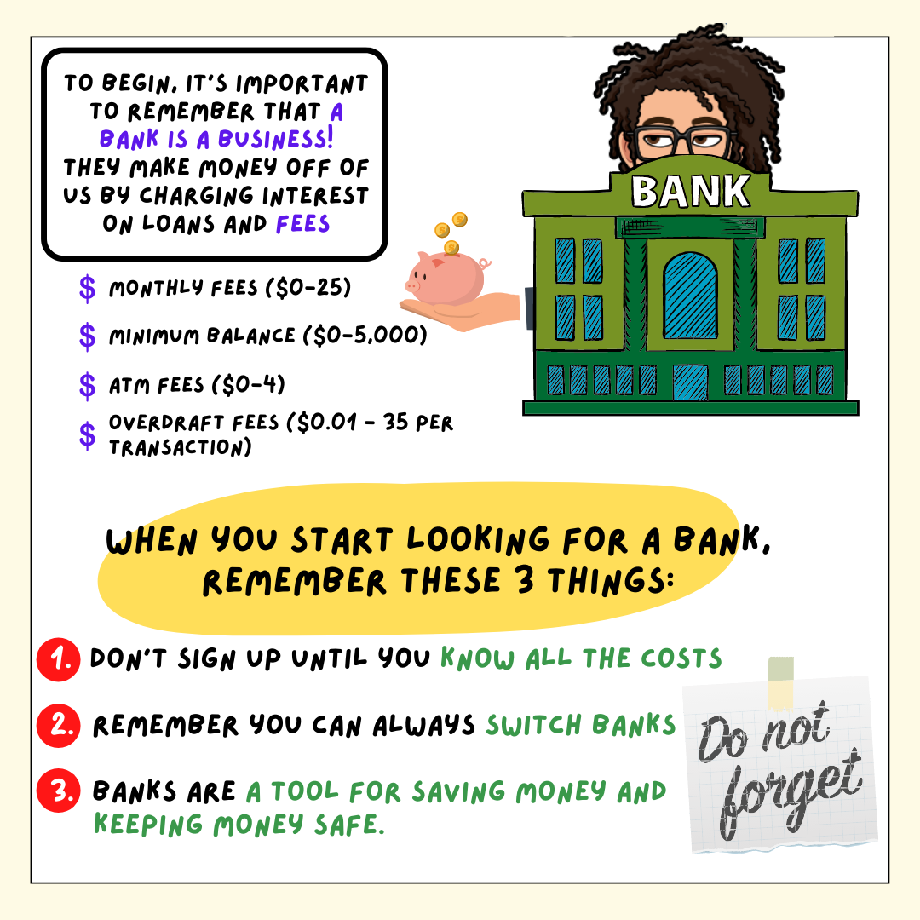
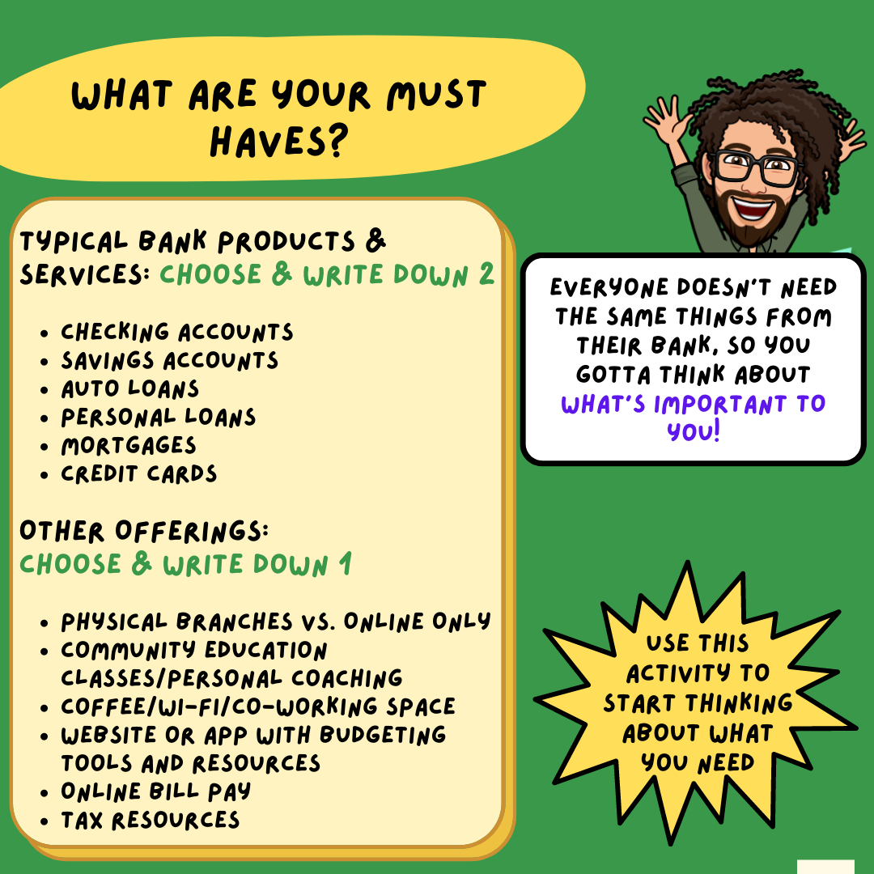
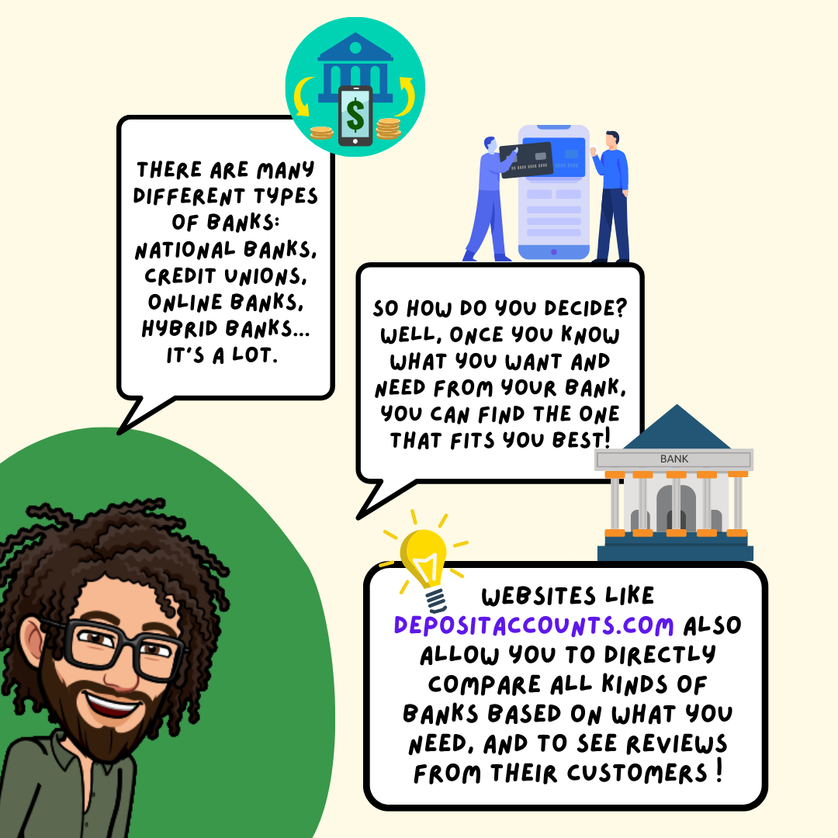
Draw a Webcomic
For comic templates & guides visit:
https://www.canva.com/create/comic-strips/
For More Asking for a Friend webcomics visit:
https://www.pocketschange.com/money-buddies-lesson

Slide 46
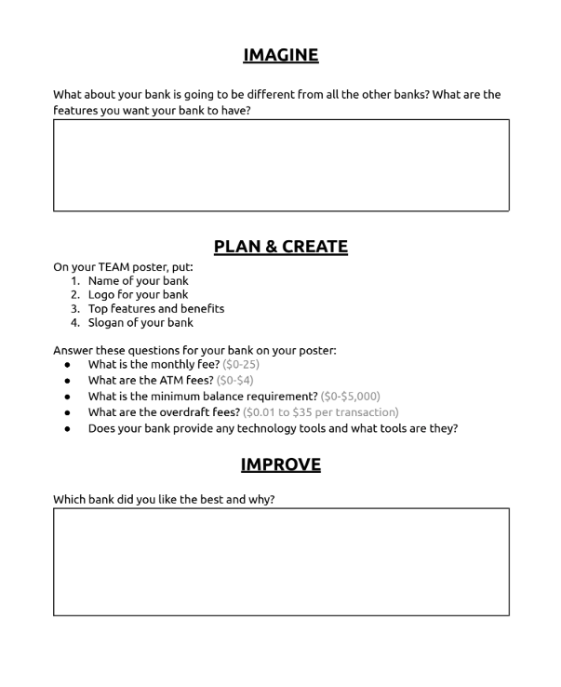
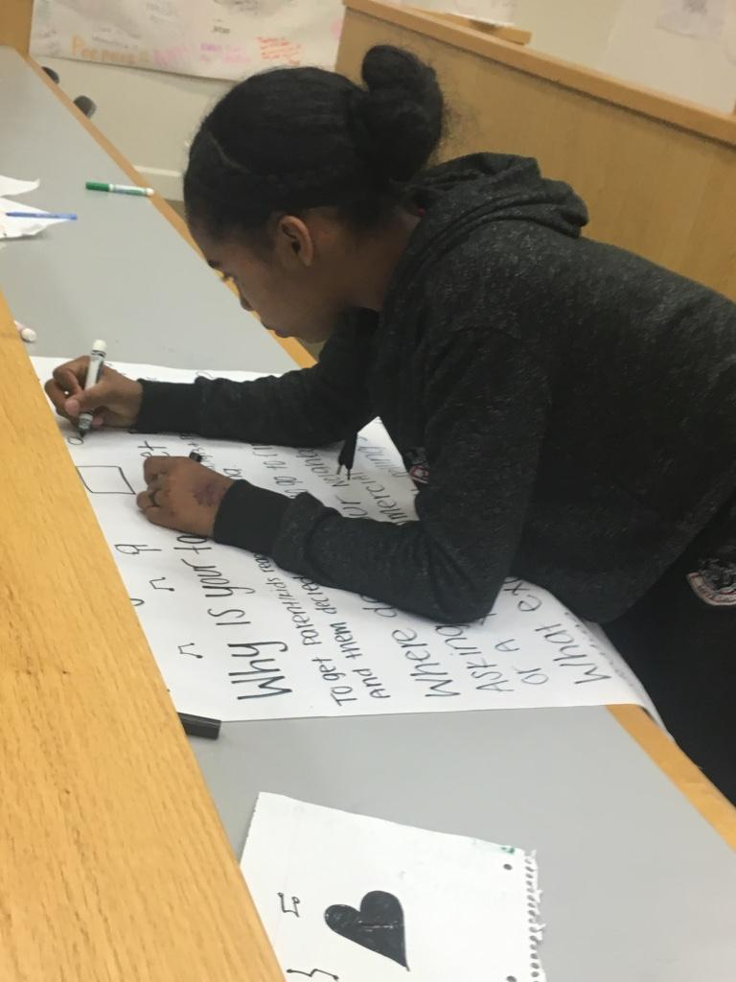
Design a Project Pitch
Design the Best Bank Project Template
https://bit.ly/DesignBanks

Slide 47
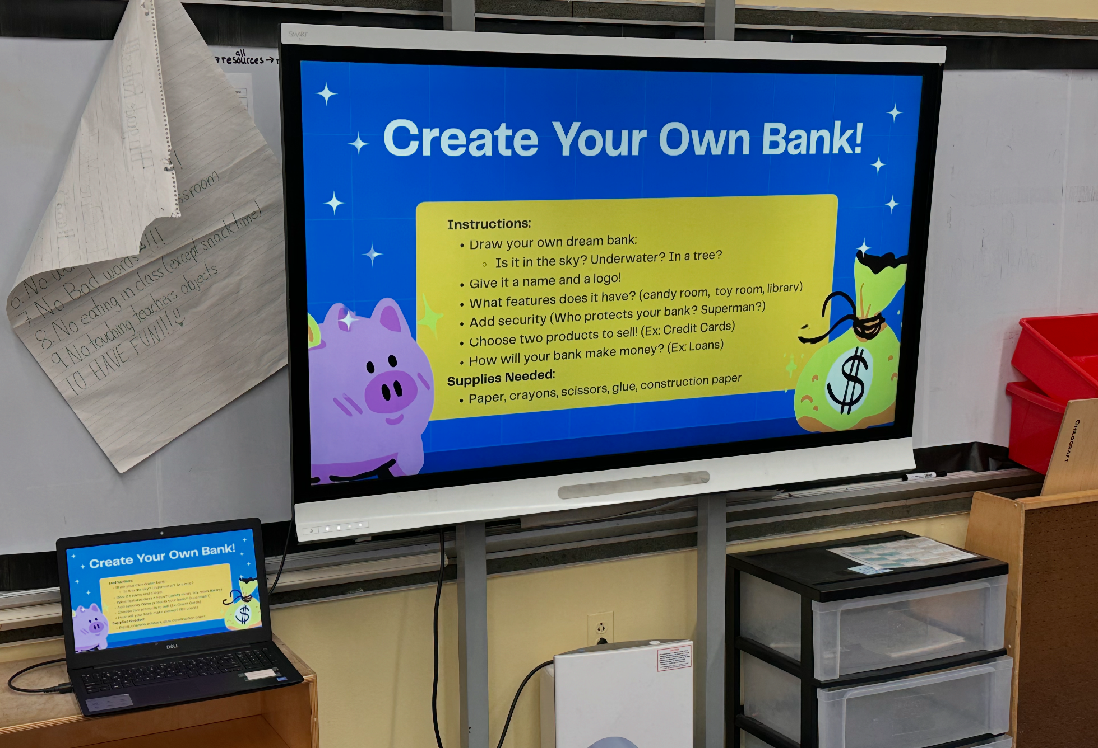

Build a Better Bank
Design the Best Bank Project Template
https://bit.ly/DesignBanks

Slide 48
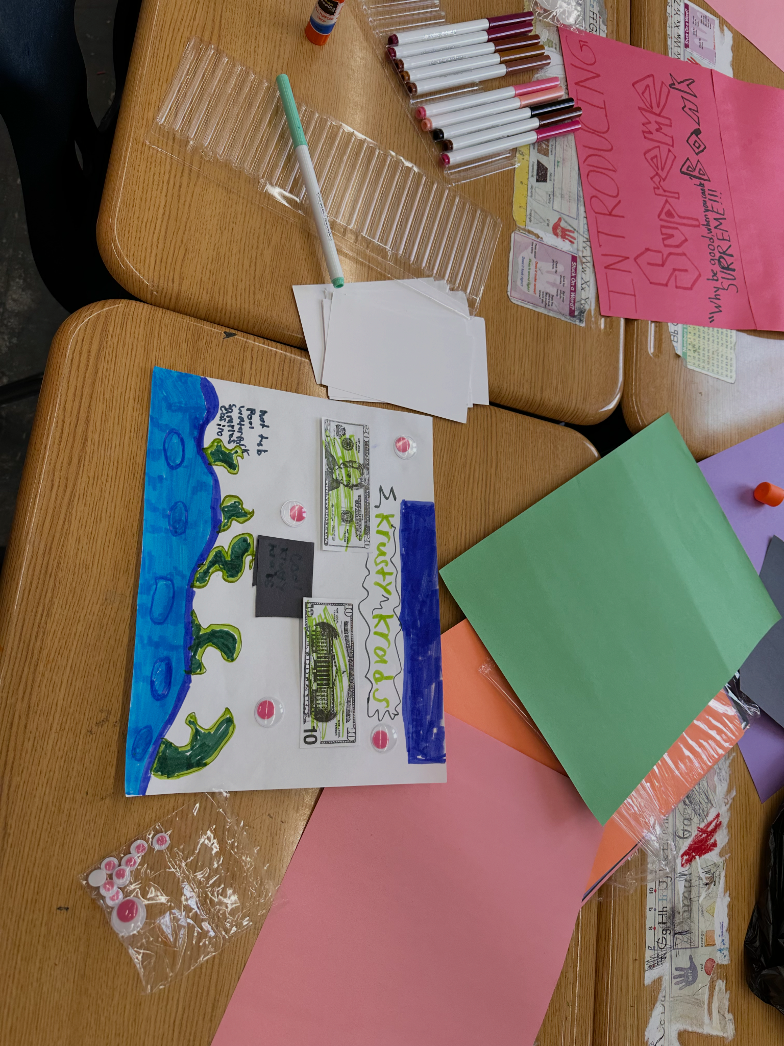
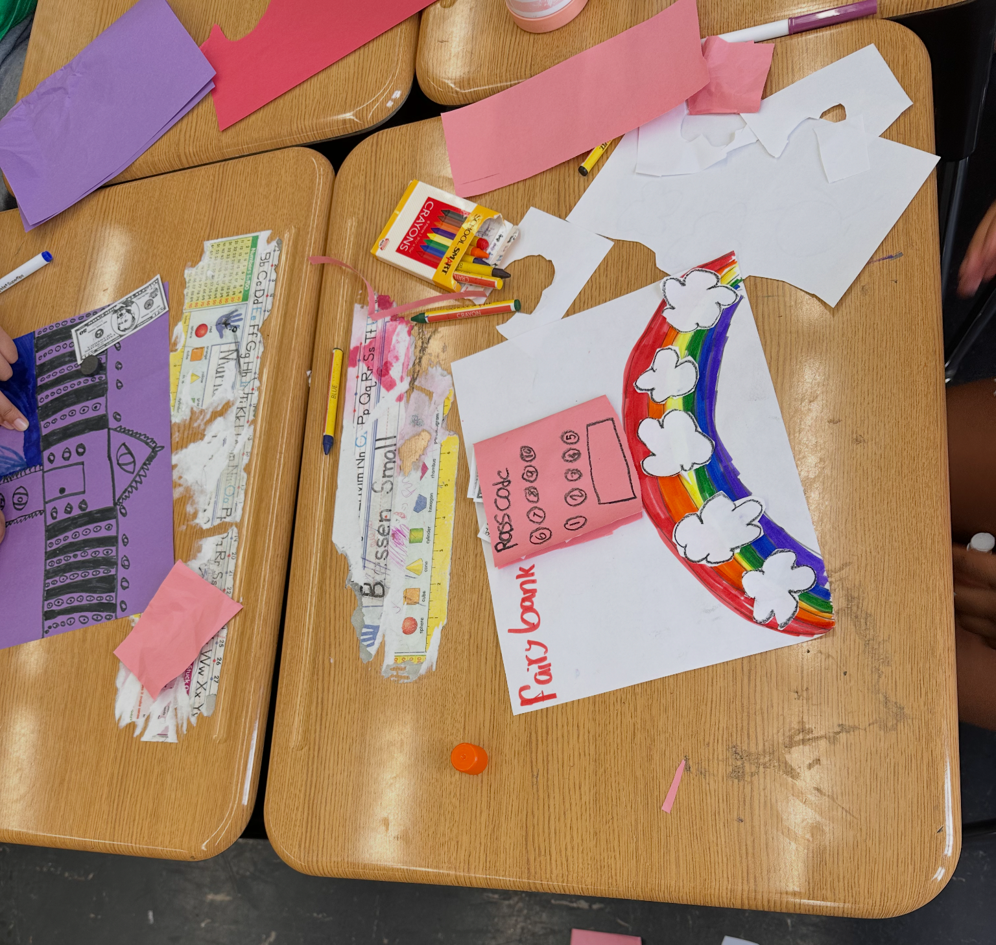
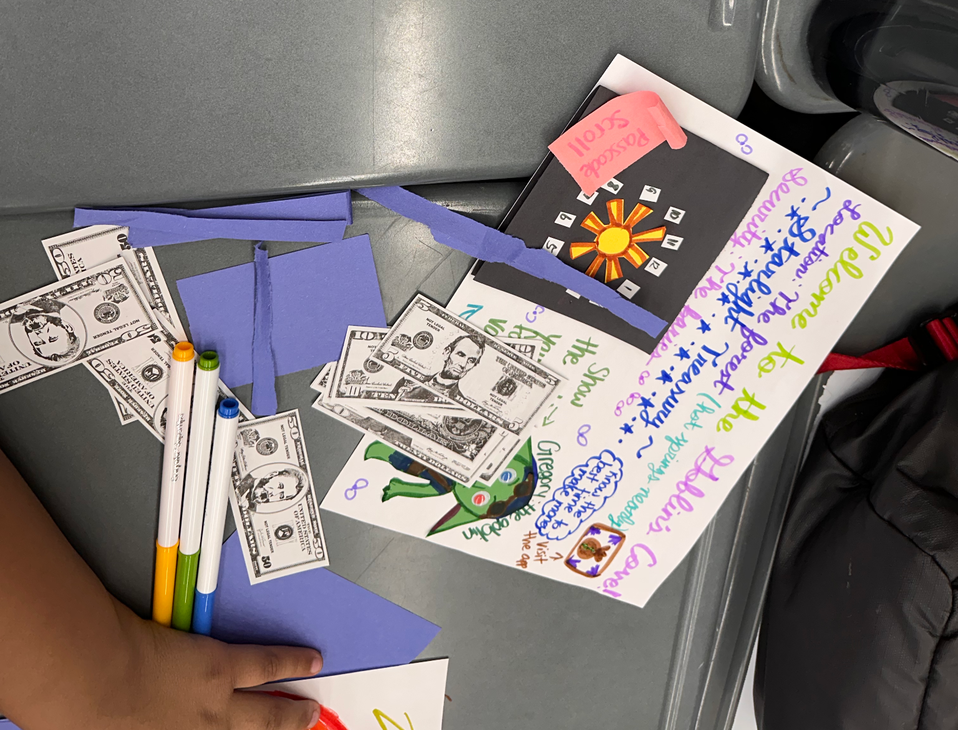
Build a Better Bank
Design the Best Bank Project Template

Slide 49
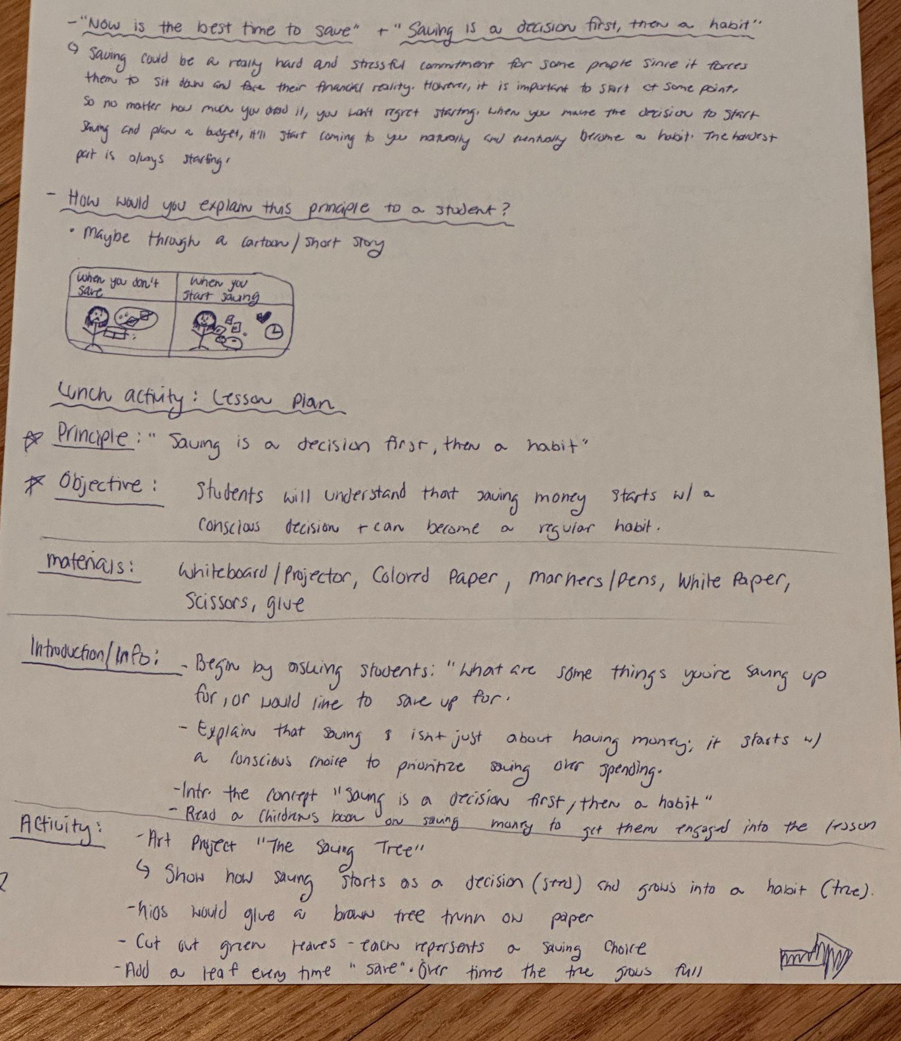
Student-Led Lessons from Design to Implementation

Slide 50
How can you bring creative projects into your class or community?
Get the Slides: https://bit.ly/328ART
Notes:
Money Buddies or share-out depending on group

Slide 51


Slide 52
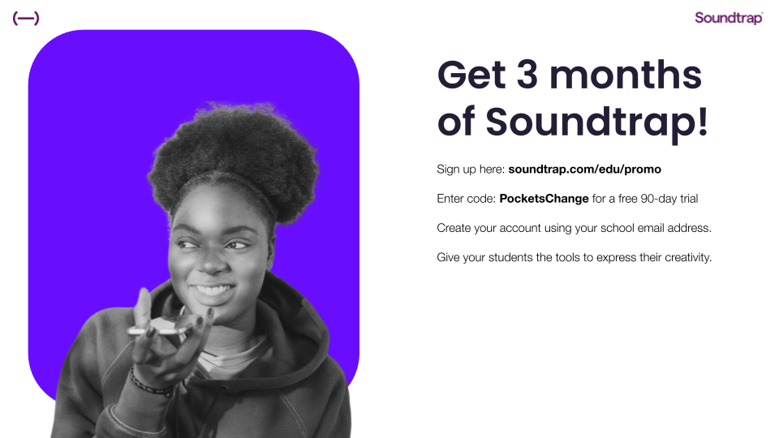
Soundtrap for Education
bit.ly/PCSoundtrap
Notes:
Speaker on panel yesterday - Justin Polk, former Los Angeles Unified educator and currently serves as Customer Success Manager for Soundtrap for Education, bringing a creative and practical lens to student engagement. Learn how audio storytelling, music production, and podcasting can deepen understanding of complex topics, encourage student voice, and foster cross-disciplinary learning.
Teacher Resources:
Getting Started with Soundtrap for Education: [Link]
Teacher Onboarding Guide: [Link]
Lesson Plans Library: [Link]
Soundtrap Certified Educator Course (produced by Young Producers Group): [Link]
Student Resources:
Soundtrap Student Resource Hub: [Link]
"Inside the Studio" Youtube Beginner Tutorials: [Link]
Community and Help:
Soundtrap for Education Community: [Link]
Support and FAQs: [Link]

Slide 53
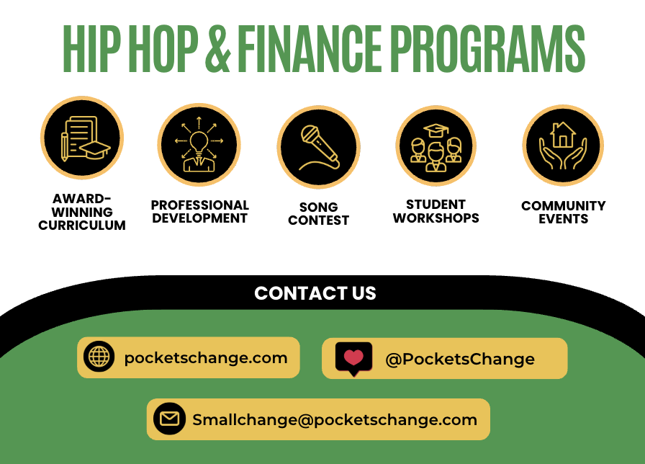

Slide 54
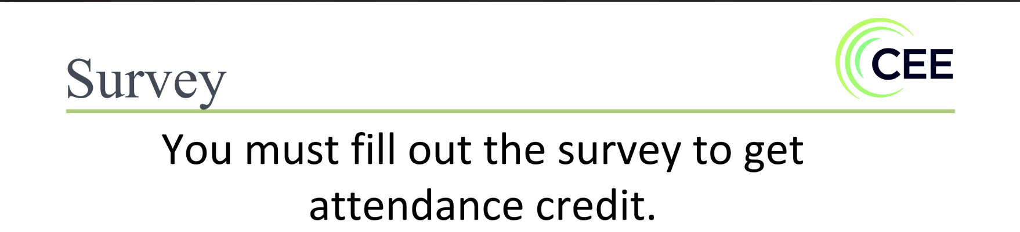

Get the Slides: https://bit.ly/328ART
Notes:
Money Buddies or share-out depending on group

