Slide 1


From TikTok
to Taxes

Slide 2
Certificate Requirements
To earn professional development hours for webinars, you must:
Watch a minimum of 45-minutes and you will automatically receive a professional development certificate via e-mail within 24 to 48 hours.

Slide 3
TikTok to Taxes
Join our dynamic webinar, ”TikTok to Taxes" where teachers are flooded with online financial advice—some helpful, some harmful. This session equips you with engaging, real-world activities that connect students’ digital experiences to essential topics like taxes, budgeting, and long-term planning.
Teachers will be able to:
Bridge digital financial trends with core personal finance skills.
Deliver practical, relatable lessons on taxes and day-to-day money decisions.
Use student-centered activities that boost engagement and financial confidence.

Slide 4
Objectives
You will be able to:
Feel comfortable with a strong foundational understanding a range of financial topics that will come up in a financial literacy classroom
Break down concepts for students of all ages & socioeconomic status, making sure content relates to all demographics
Be able to implement effective and interactive pedagogical strategies for teaching financial literacy

Slide 5
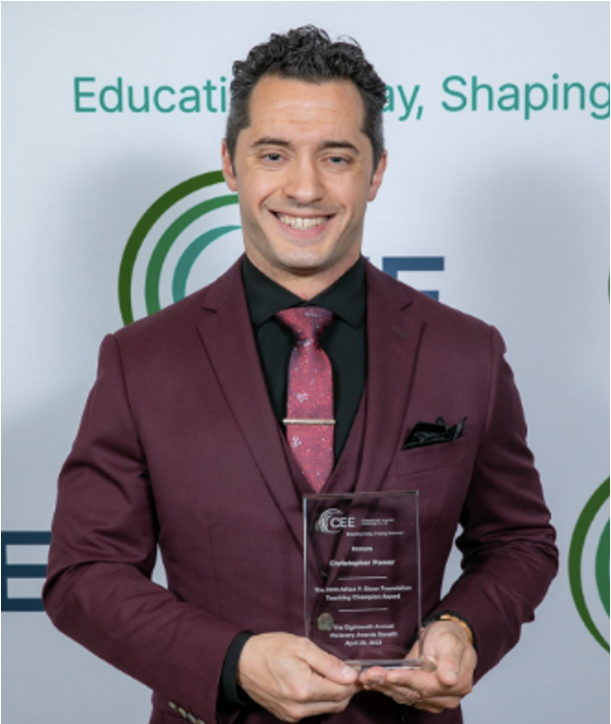
Presenter(s)
Christopher Power teaches economics, virtual enterprise, and technology to grades 9-12 at Francis Lewis High School in Fresh Meadows, NY. Christopher’s passion for finance and economics translates to unique and often loud (but entertaining!) lessons and discussion. Christopher focuses on brining real-world experiences into the classroom. Lessons include building pitch decks, analyzing economic data, calculating mortgage payments, managing money, and more. Christopher’s teaching approach is extremely popular with the students: he has grown the business program from 68 to 306 students per year.
What matters to him most is creating career ready students who are capable of making calculated life and financial decisions. Christopher shared, “Financial literacy and economic education buys freedom. Evidence suggests 80% of people are financially illiterate. So, contrary to popular belief, money is not the root of all evil, the lack of financial literacy is.”
cpower29@gmail.com www.linkedin.com/in/cpower

Slide 6


Session Agenda
Coffee Chat – about what about feelings about TikTok Advice.
Interactive Lessons
Intro: FinTok Fact or Fiction
"Influencer Audit” Gallery Walk: Fact-Checking Financial Advice
The 1099-Tax Simulation
Wealth Showdown Presentation
Resources & Share out best practices

Slide 7
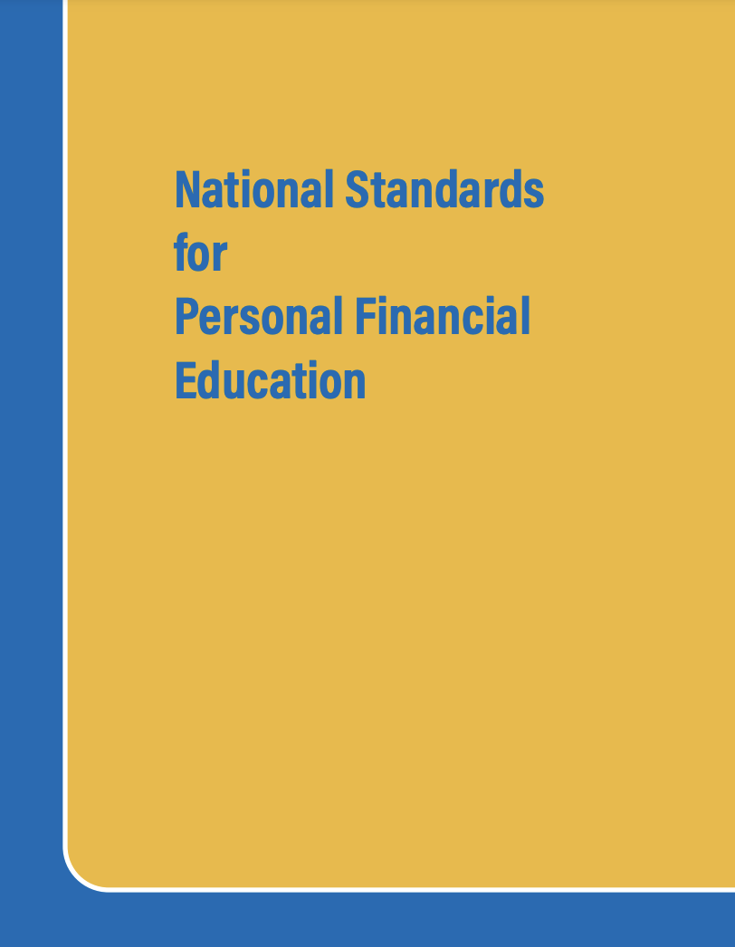
National Standards
Standard 2 Decision Making
Standard 7 Markets & Prices
Standard 10 Institutions
Standard 12 Interest Rates
https://www.councilforeconed.org/policy-advocacy/k-12-standards/

Slide 8

1 - Coffee Chat

Slide 9
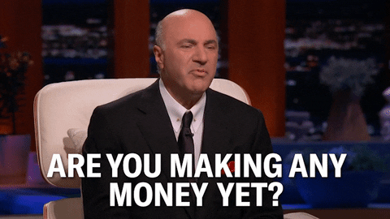
Coffee Chat
What are the students most interested in?
What are you most comfortable teaching?
What is the hardest part about teaching vs Social Media Advice?

Slide 10

Lesson 1
Do Now Lesson
TikTok Fact or Fiction

Slide 11
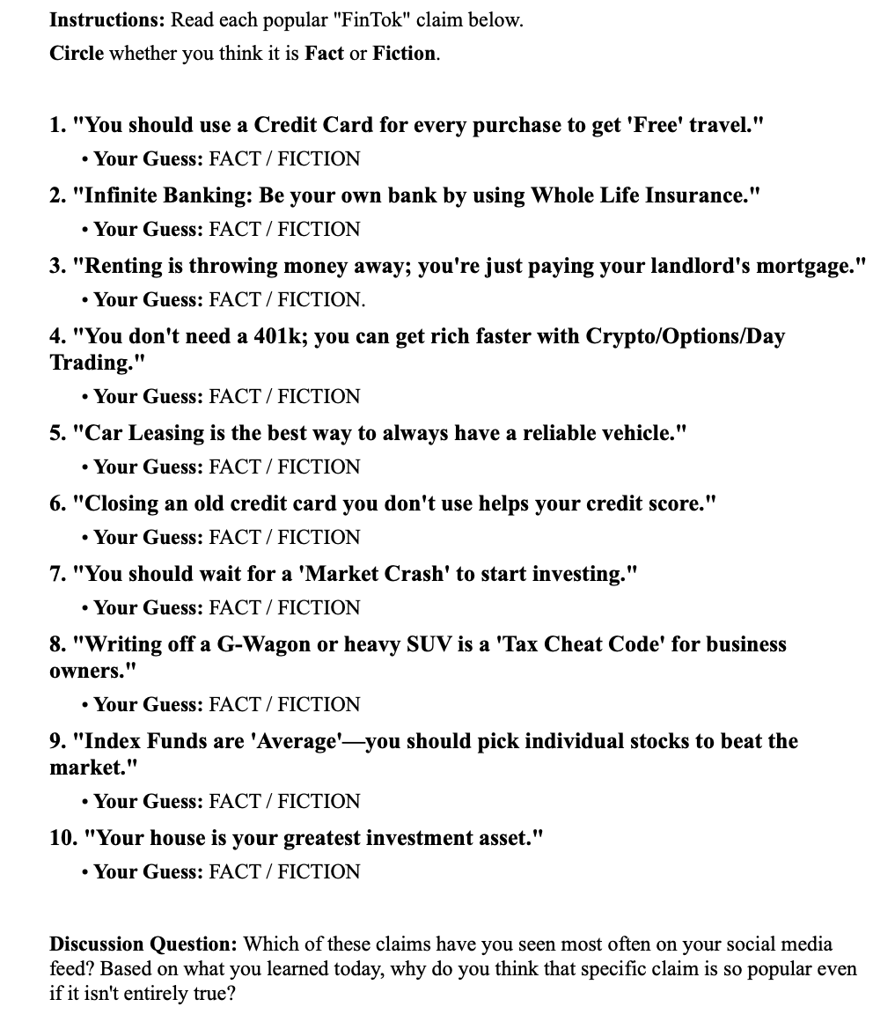
TikTok Facts or Fiction
Do Now Lesson Plan: here
Answers: here
Duration: 15m
Live Poll the Questions using https://pollev.com/cpower

Slide 12

Lesson 2
"Influencer Audit” Gallery Walk: Fact-Checking Financial Advice
This Photo by Unknown Author is licensed under CC BY-SA-NC

Slide 13

Influencer Audit
Lesson Plan: here
Why Gallery Walk:
Provide a way to engage students to a variety of financial topics without it needing to be lecture based
Promotes active participation and engagement and analysis, rather than passive absorption of information
Requirements: Laptops
Modifications: Lengthen the “Gallery Walk” to use a Screen
Duration: 2 Days

Slide 14

Influencer Audit
PD Activity
Breakout Rooms
Each breakout room will be required to find their own Social Media Financial Advice.
Share the links / Screenshare so the group can “audit” the advice being given using the rubric.

Slide 15

Lesson 3
The 1099-Tax Sim
ThePhoto by PhotoAuthor is licensed under CCYYSA.

Slide 16

The 1099-Tax Simulation
Case studies are considered a gold standard in finance education—used extensively at institutions like Harvard Business School—because they bridge the gap between "knowing" a concept and "using" it to make a high-stakes decision.
Lesson Link: here

Slide 17
The 1099-Tax Simulation
PD Activity
Breakout Rooms: (5 rooms)
Section 1
Section 2
Section 3
Section 4
Section 5

Slide 18

Class Activities
The Wealth Showdown
Presentation
ThePhoto by PhotoAuthor is licensed under CCYYSA.

Slide 19

The Wealth Showdown
Student Research:
Students will work in groups of 2, to select a specific investment or investment strategy. The selections must be a “Viral Hack” or a “Long Term Planning” approach.
Students translate their data into a persuasive 3-5-minute pitch to a client who has $20,000 to invest. Client has $70,000 in various investments with little risk. Client has $30,000 in a savings account. Client earns $80,000 gross income per year.

Slide 20
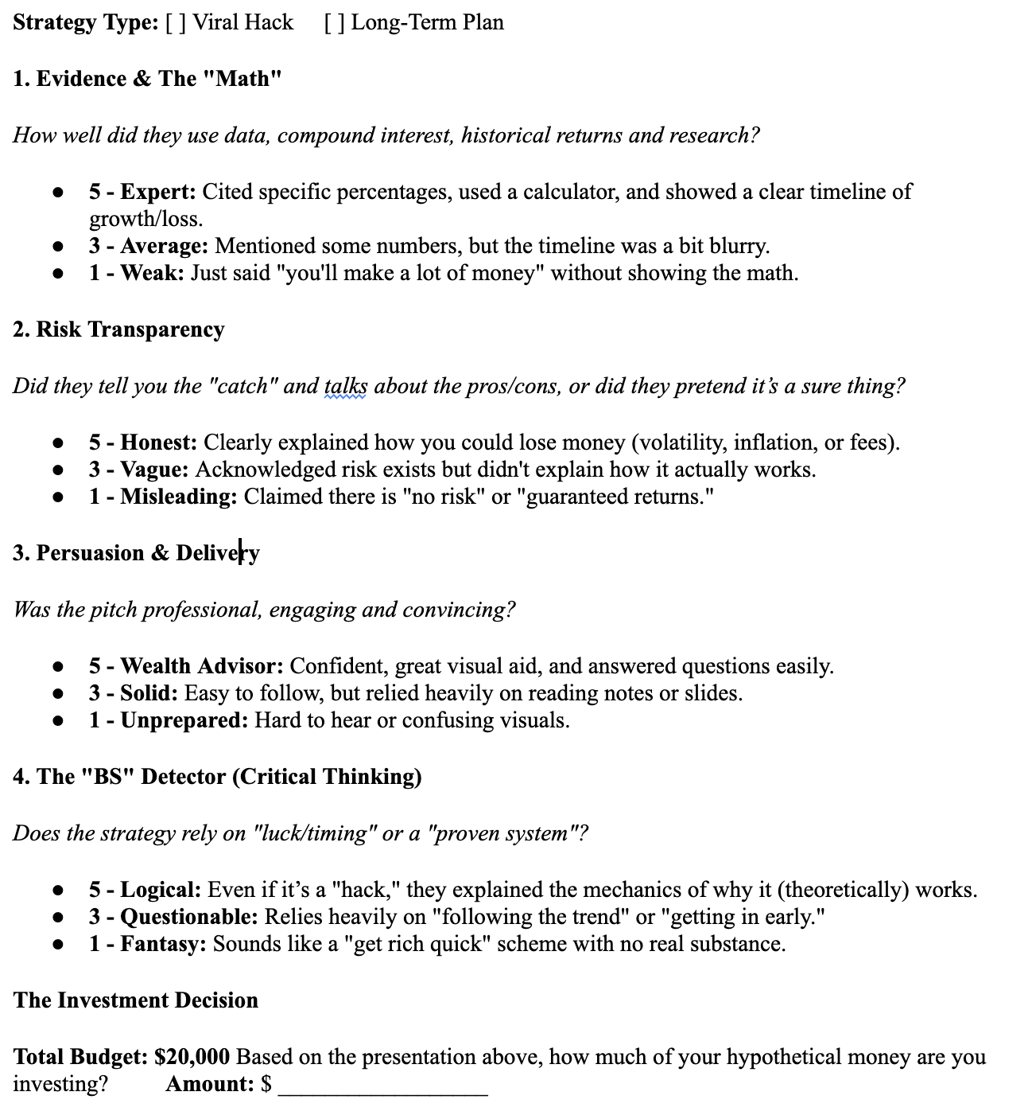
The Wealth Showdown
Pitch Competition:
3-5m Pitch with Q&A.
Voting: Every student has an assessment criteria with $20,000.
Limitation: Cannot invest in your own project.
Opportunity: You can place all of your money into one approach or divide it. You cannot move around any of the other funds you currently have invested.

Slide 21
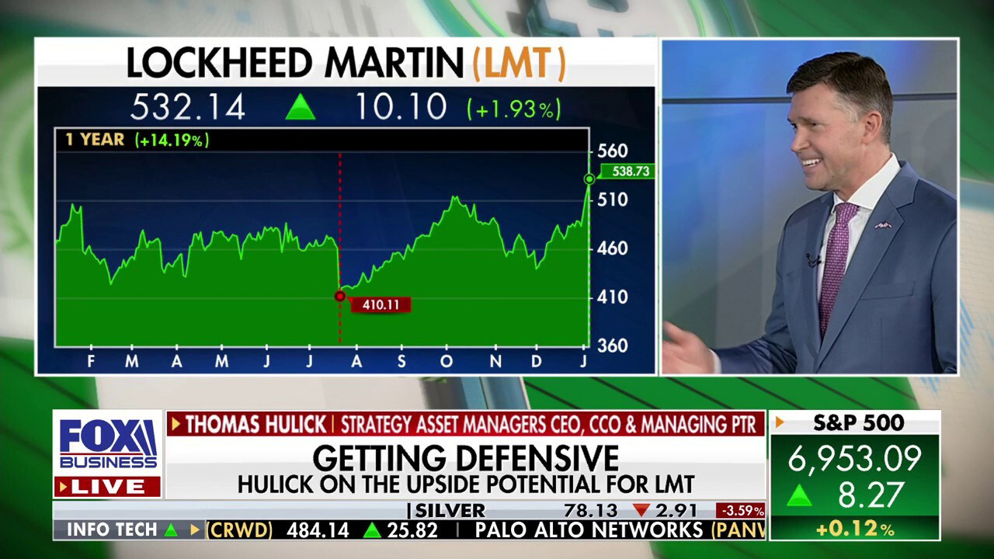
The Wealth Showdown
Breakout Room:
Each room picks an investment “viral / trendy” strategy, or a more conventional strategy.
Come up with 3-5 persuasive arguments
Each Breakout room must present in under 1-2m.

Slide 22












Free Personal Finance Program for High School Girls
Invest in Girls (a program of CEE) invites your high school students to learn about personal finance in a supportive all-girl environment! IIG instructors will teach students the basics of personal finance, how to invest, and help them build professional skills. These programs are online and free to attend.
Share this sign up link with your students
Or visit investingirls.org/for-students/

Slide 23

Thank you
ThePhoto by PhotoAuthor is licensed under CCYYSA.

