Slide 1

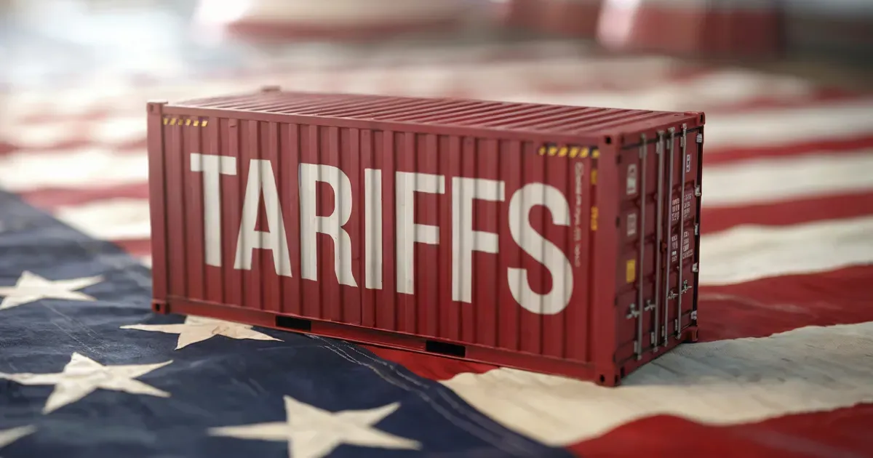

Tariff-ic or Tariff-ying? Economics in the Modern World Through the New Standards

Slide 2
Certificate Requirements
To earn professional development hours for webinars, you must:
Watch a minimum of 75% for all sessions
You will automatically receive a professional development certificate via e-mail within 24 to 48 hours.

Slide 3
Objectives
You will be able to:
Evaluate the real-world economic impacts of tariffs using data, not politics.
Learn the basics of current trade situation in the US and world.
Effectively implement lessons teaching tariffs

Slide 4

Presenter
James Redelsheimer
jred@fee.org
James Redelsheimer, Education Manager at the Foundation for Economic Education (FEE), has 20+ years of AP Economics and Personal Finance teaching experience at the High School level in Minnesota. He is the co-author of Barron’s AP Economics, and holds degrees from St. Olaf College and the University of St. Thomas. James has garnered numerous recognitions for his teaching, including the 3M Minnesota Economics Educator of the Year Award and the Thrivent Personal Finance Educator of the Year Award. James has published curriculum for numerous organizations and regularly shares his expertise on best practices in teaching economics, personal finance, and civil discourse at both local and national events. In his role at FEE, James creates award-winning curriculum for the 15,000 network of teachers at FEE’s Learning Center.

Slide 5

Session Agenda
Understanding Tariffs and Global Trade
What are the effects so far of recent tariffs?
Trade lesson exploration
“Tariff talk” discussion strategy

Slide 6
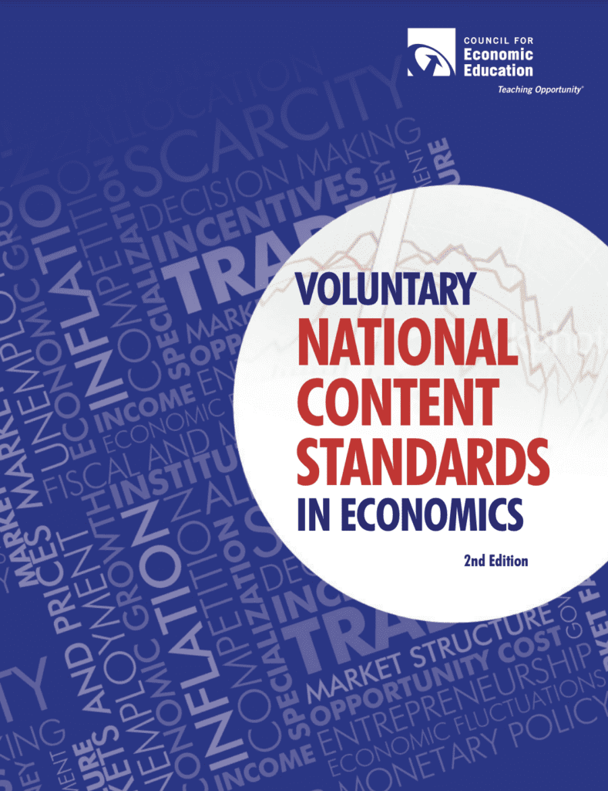
National Standards
Standard 9: International Trade
International trade can increase the total amount of goods and services available, but these gains are not distributed equally between or within countries. Governments use trade policies such as tariffs or subsidies to change trade flows with different countries.
https://www.councilforeconed.org/policy-advocacy/k-12-standards/

Slide 7

National Standards
2. Spending
3. Saving
4. Investing
https://www.councilforeconed.org/policy-advocacy/k-12-standards/

Slide 8
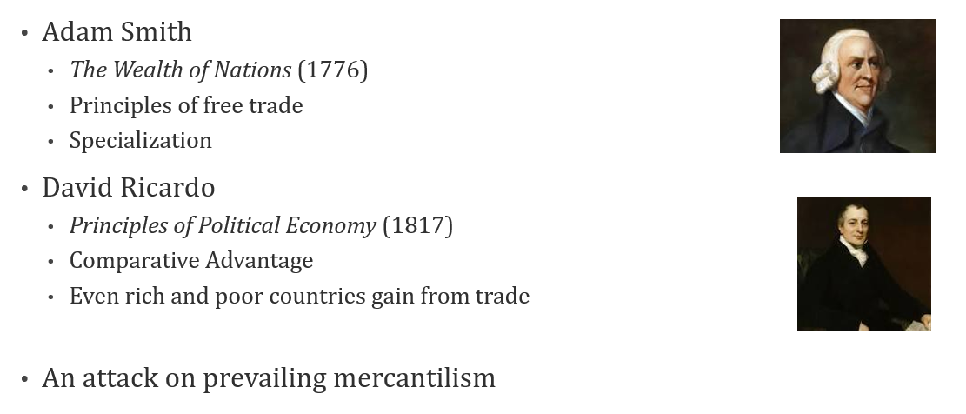
Within a Bigger Story: an Intellectual Revolution

Slide 9
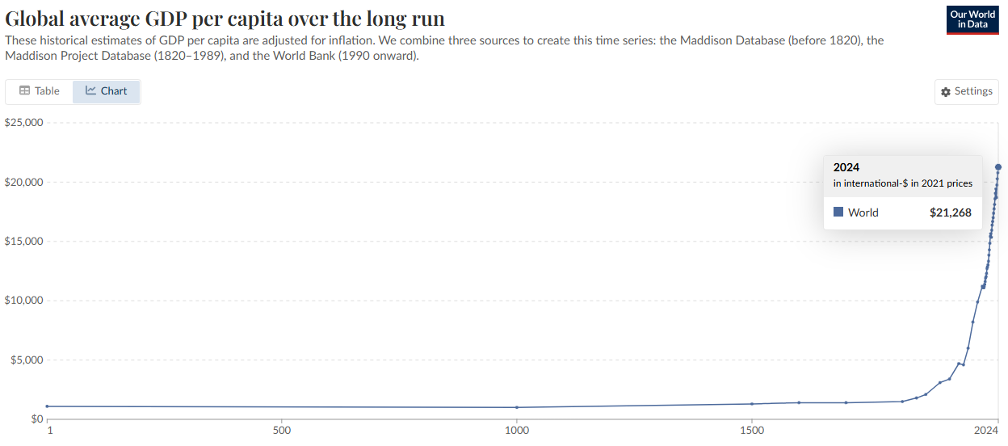
Global average GDP per capita over the long run

Slide 10
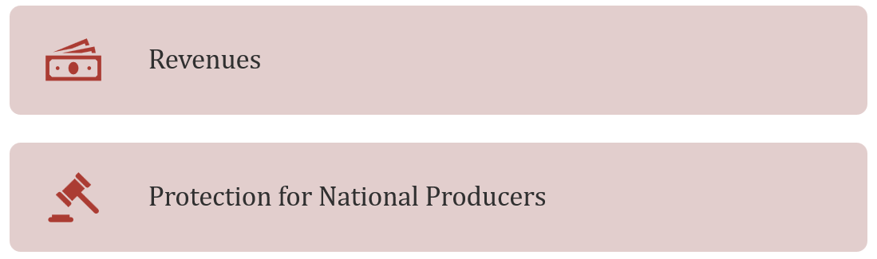
Why Have a Tariff?

Slide 11
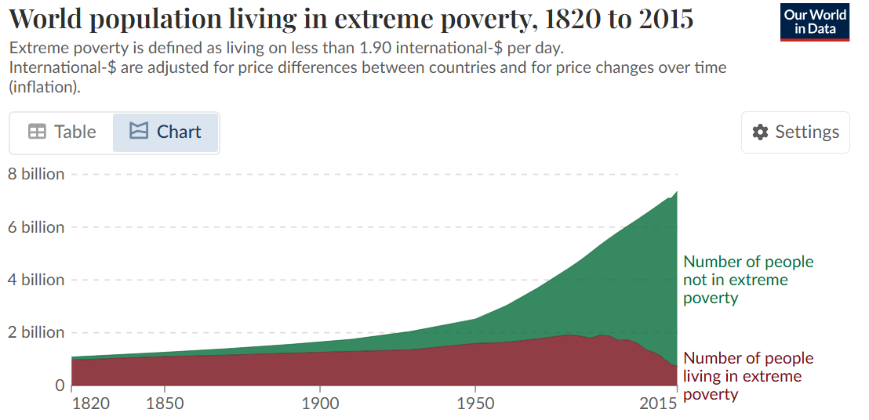
World population living in extreme poverty, 1820 to 2015

Slide 12
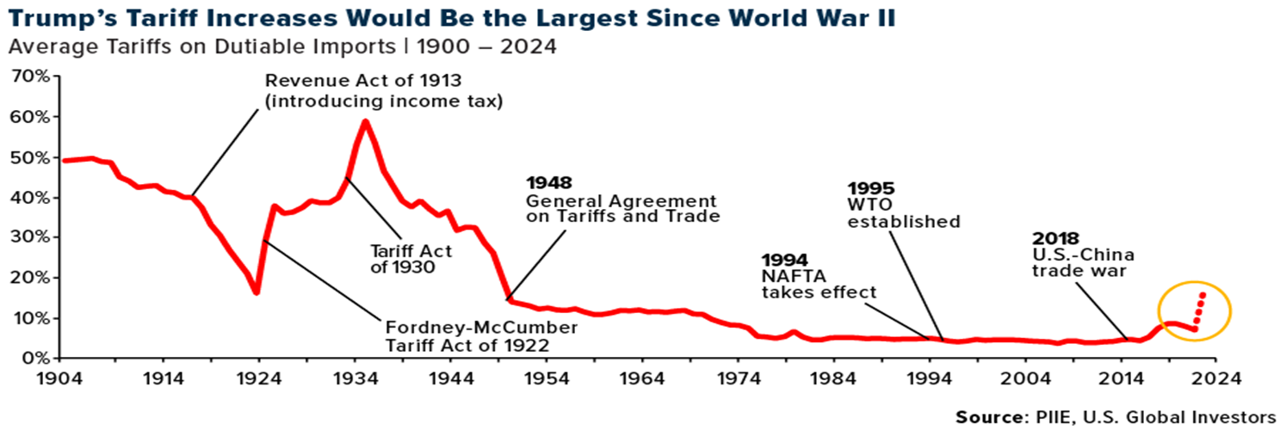
Since World War II …
Bretton Woods (1944)
General Agreement of Trade and Tariffs (GATT)
World Trade Organization

Slide 13
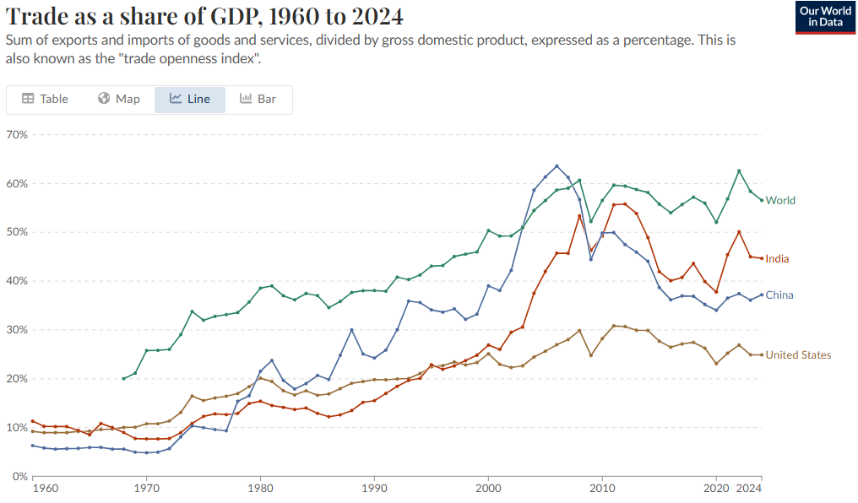
Trade as a share of GDP, 1960 to 2024

Slide 14
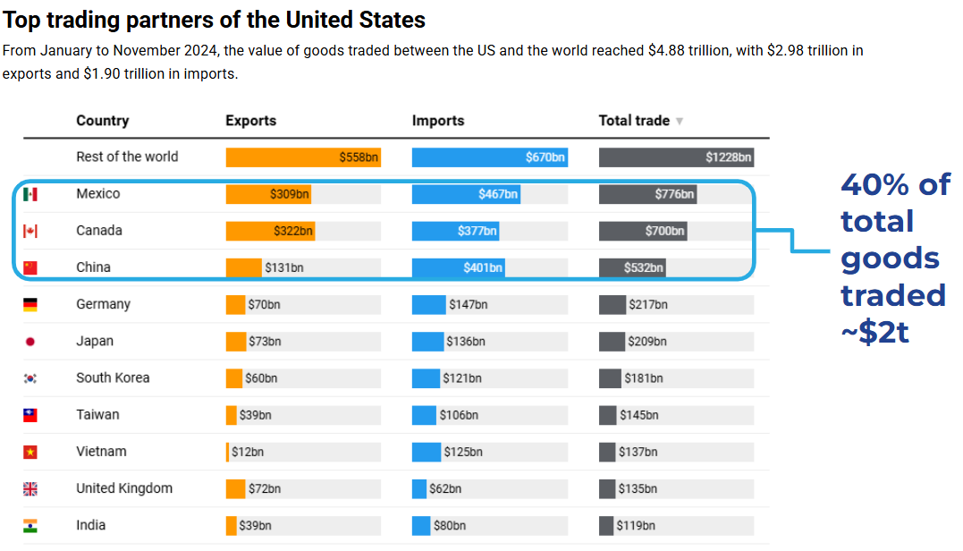
Top US trading partners

Slide 15
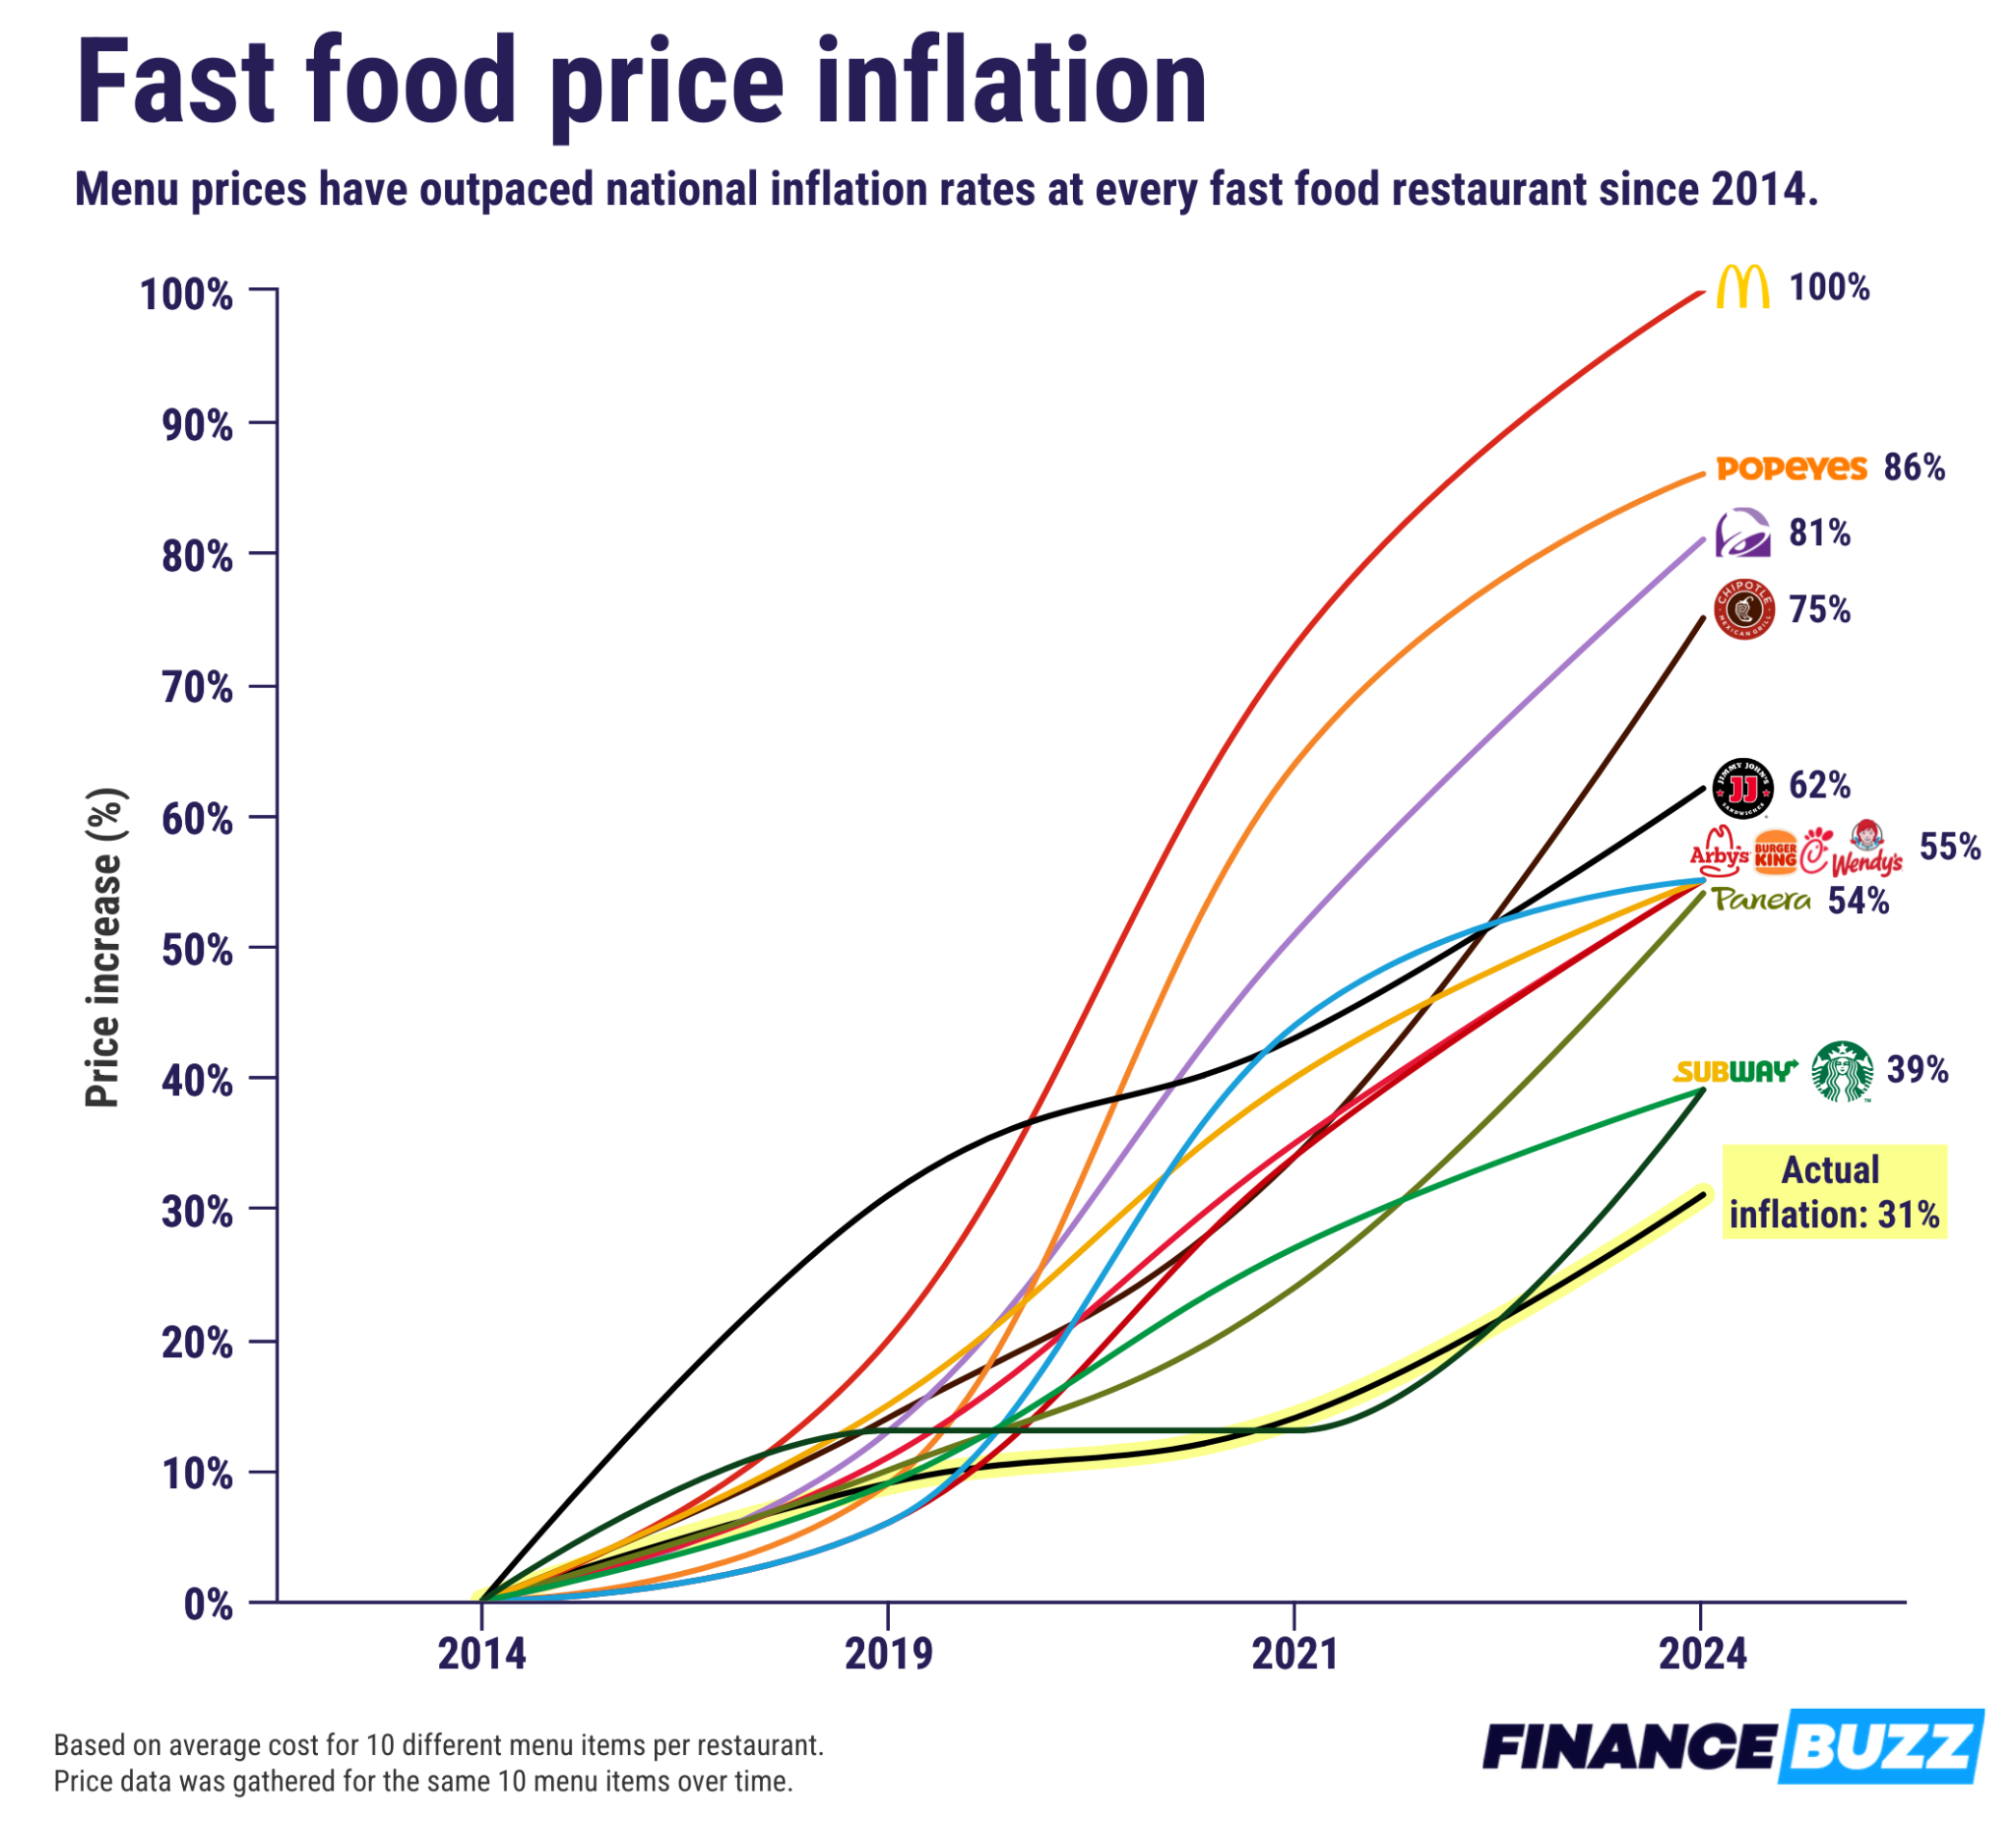
Food Price Inflation Snapshot (April 2025)

Slide 16
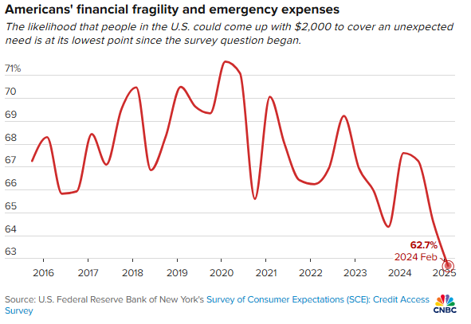
62.7% of Americans believe they could raise $2,000 in an emergency—the lowest level since 2015—highlighting worsening financial resilience amid rising living costs.

Slide 17
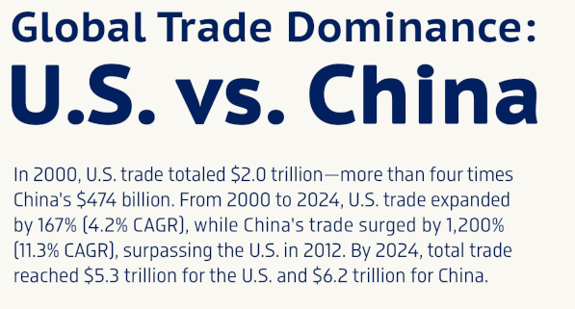
Mapped: How China Overtook the U.S. in Global Trade (2000–2024)

Slide 18
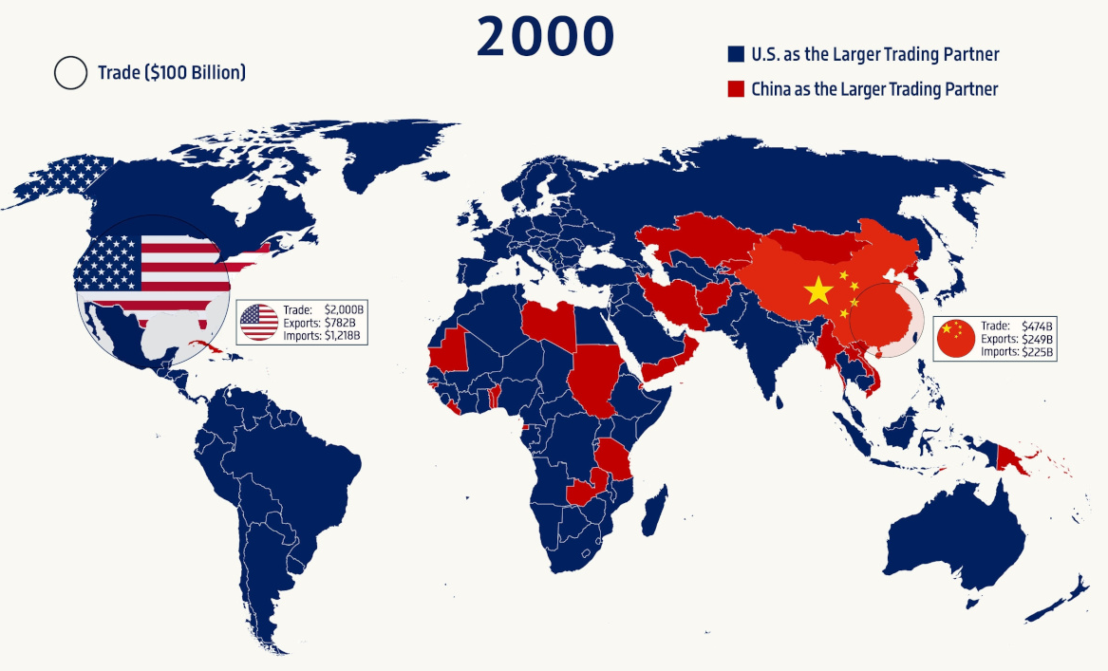
Mapped: How China Overtook the U.S. in Global Trade
(2000–2024)

Slide 19
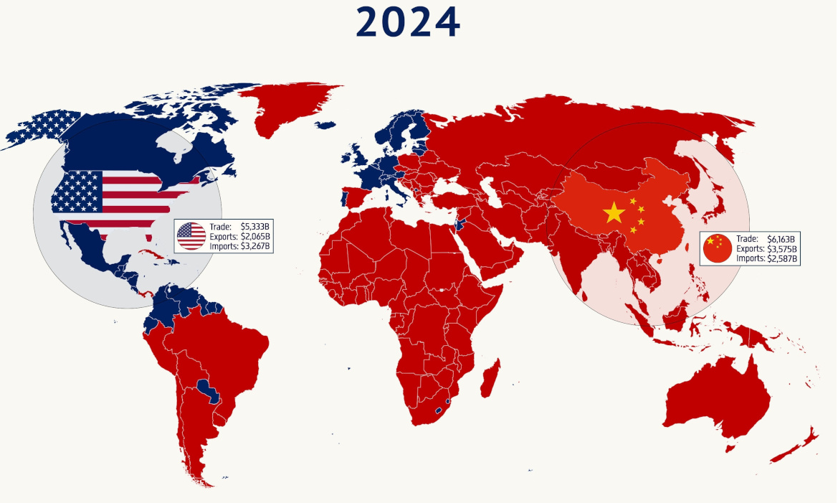
Mapped: How China Overtook the U.S. in Global Trade
(2000–2024)

Slide 20
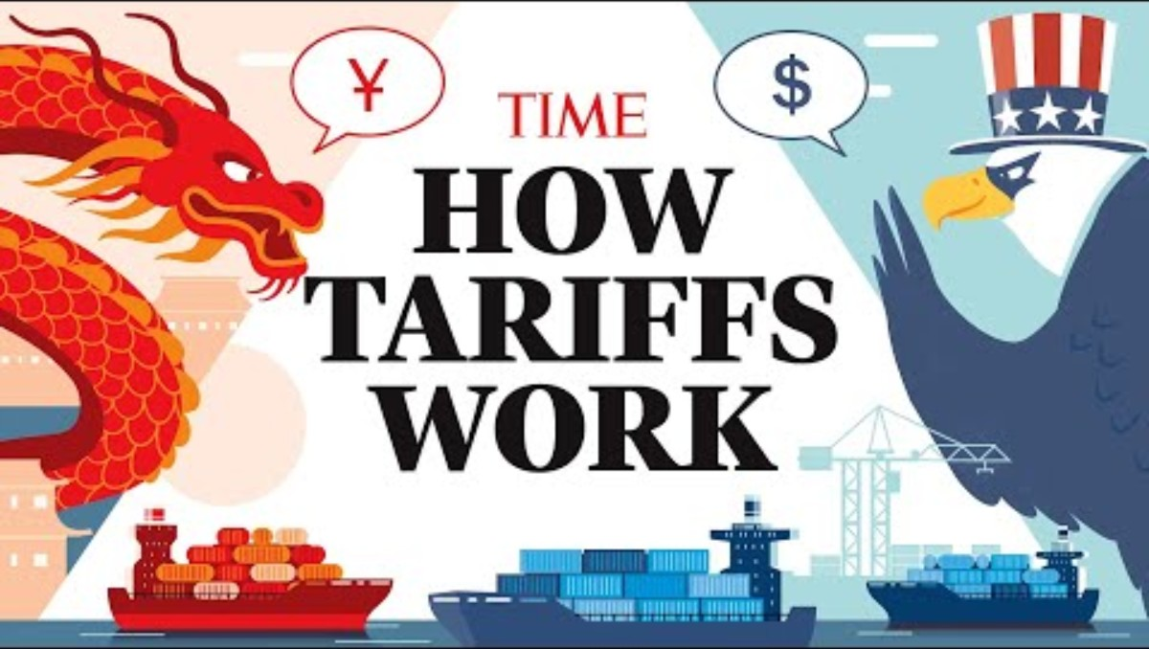

Slide 21
Trump vs. Expert Predictions on Tariffs
Trump’s Promises About Tariffs
More jobs
Manufacturing revival
Higher GDP
Lower trade deficits
Massive government revenue
Foreign countries pay the cost
Economists’ Predictions
Higher inflation
Slower growth
Possible recession
Layoffs
Supply chain disruption

Slide 22
Prediction vs Reality
Let’s examine 6 areas:
Employment
Prices
GDP growth
Tariff revenue
Manufacturing
Trade balance

Slide 23
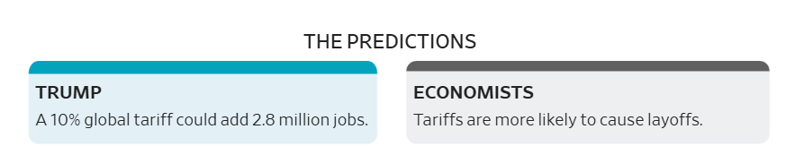
EMPLOYMENT

Slide 24
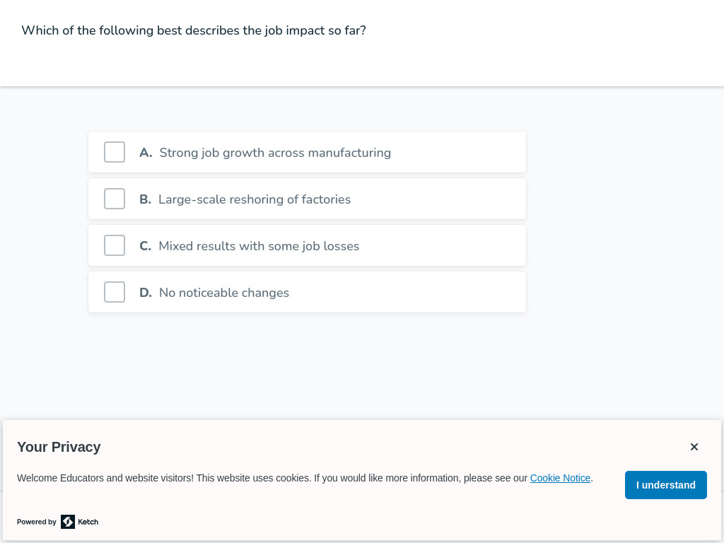
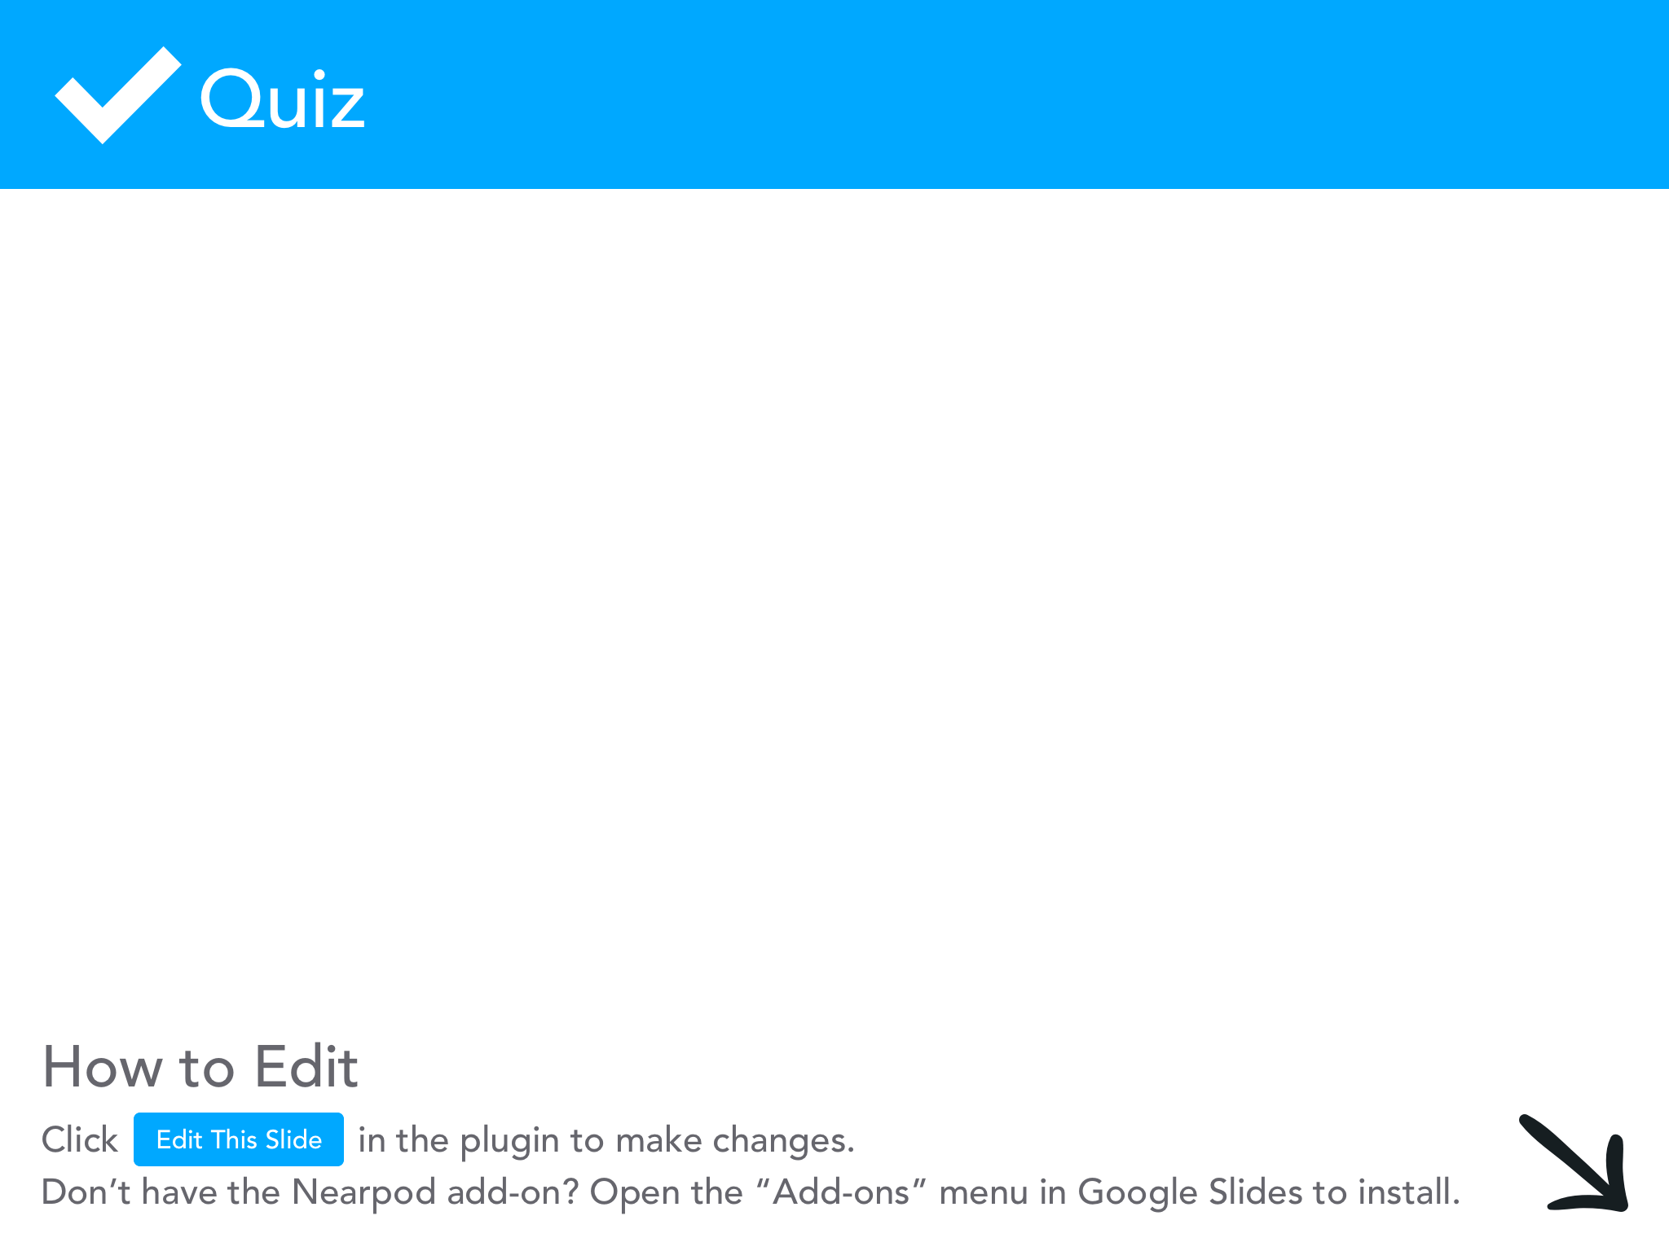

Slide 25
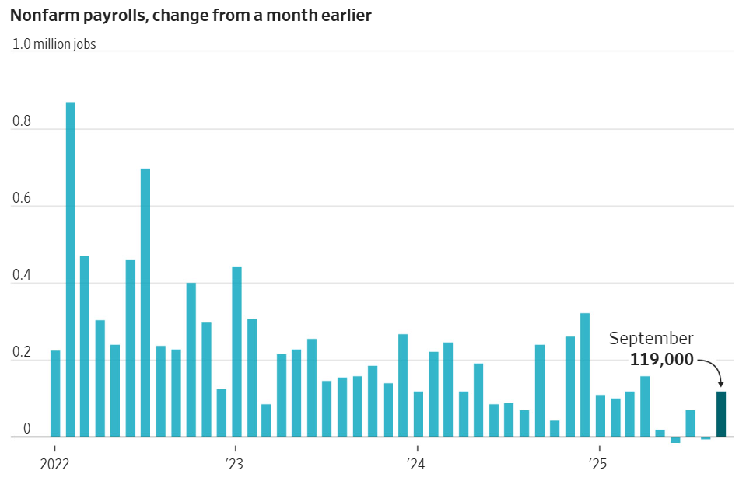
Tariffs have not produced major job gains so far, with mixed employment data and some manufacturing job losses.

Slide 26
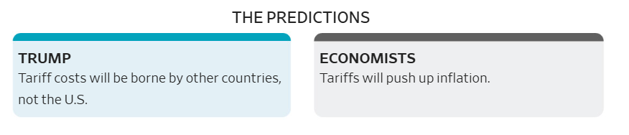
Prices and Inflation

Slide 27
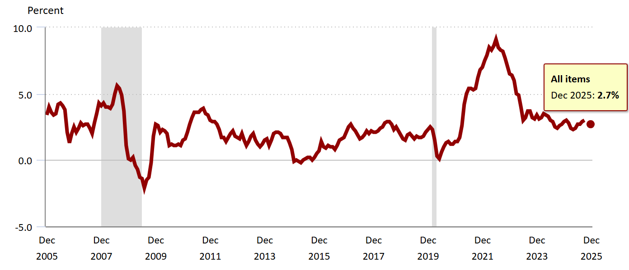
Tariffs raised prices on some goods, but overall inflation
stayed lower than many expected.

Slide 28
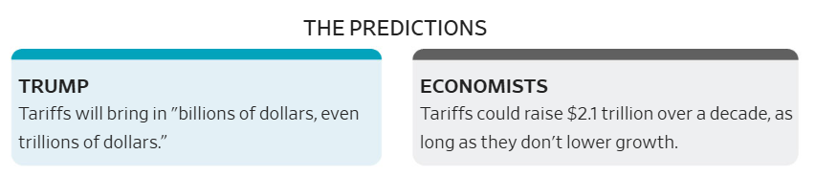
Tariff Revenue

Slide 29
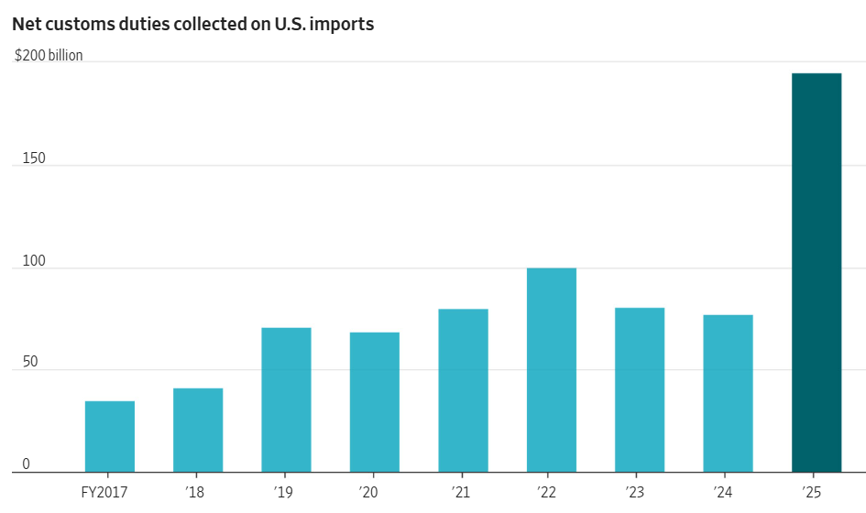
Tariffs generated significant revenue, but nowhere near
enough to replace income taxes.

Slide 30
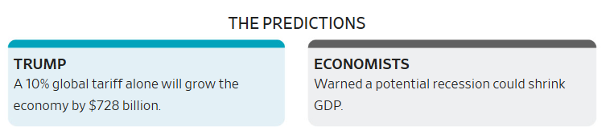
GDP and Economic Growth

Slide 31
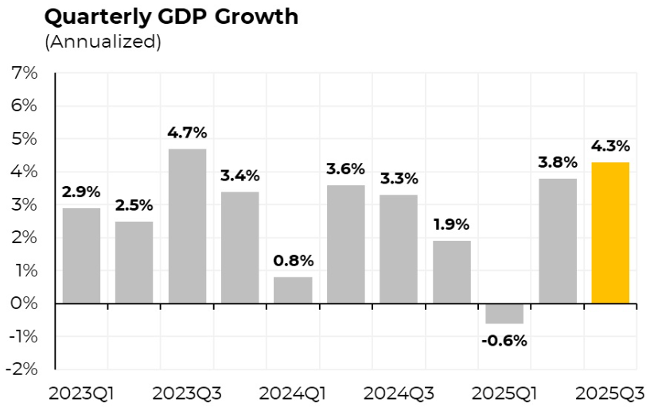
Economic growth remained strong despite tariffs, driven
largely by AI investment and consumer spending.

Slide 32
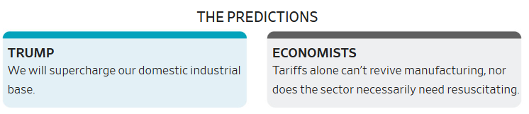
US Manufacturing

Slide 33
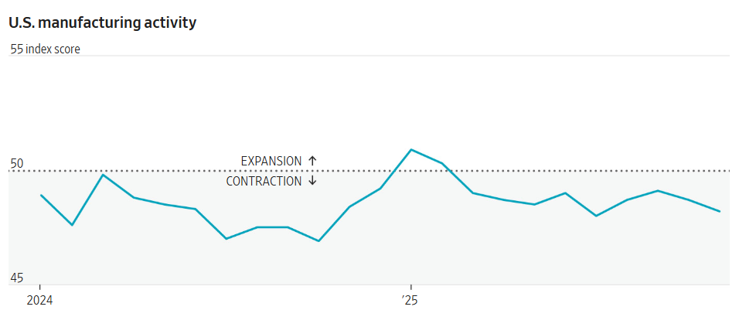
Manufacturing has continued to contract, with tariff uncertainty discouraging investment.

Slide 34
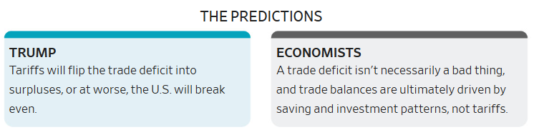
US Trade Balance

Slide 35
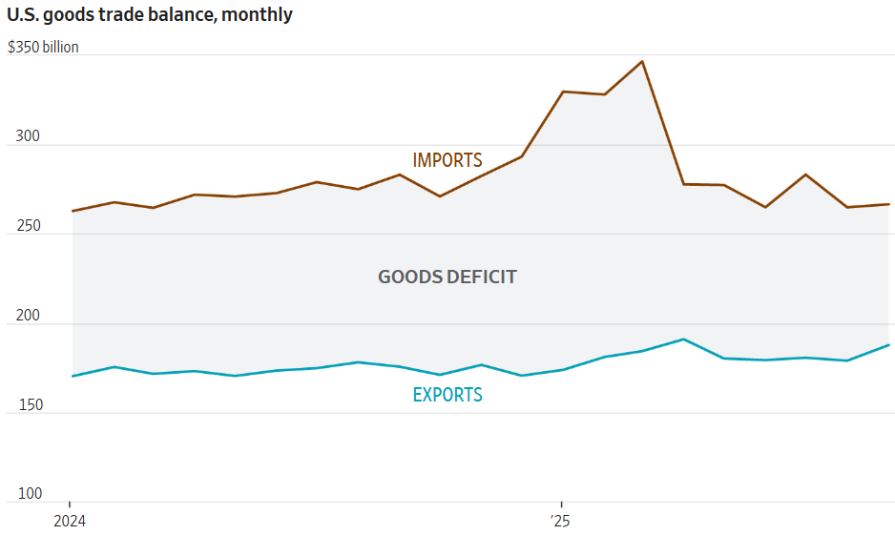
Tariffs caused short-term swings in the trade deficit,
but did not permanently eliminate it.

Slide 36
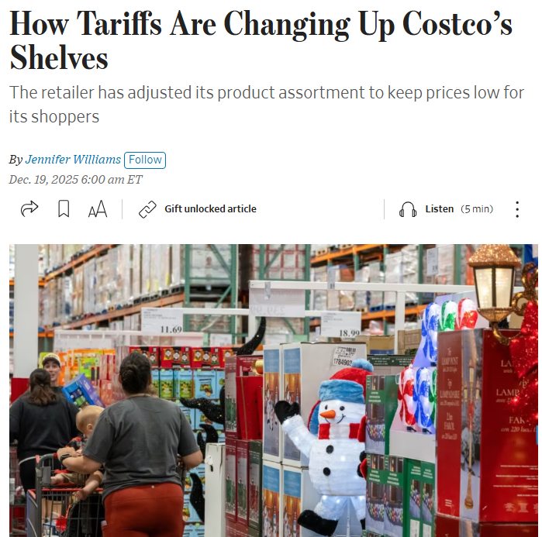
Why Everyone Got It Wrong
Delayed data
Policy reversals
Substitution effects
AI boom
Companies adapting

Slide 37


Slide 38
TRADE LESSON EXPLORATION

Slide 39
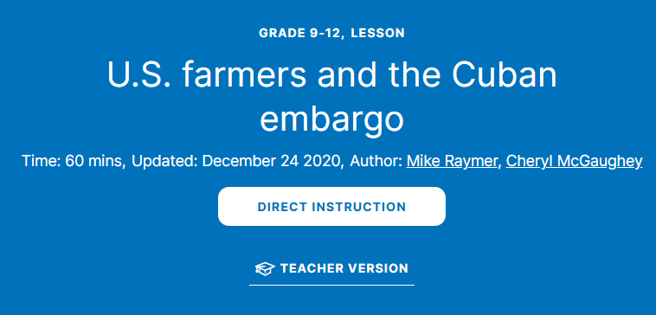
TRADE LESSON #2

Slide 40

TRADE LESSON #1

Slide 41
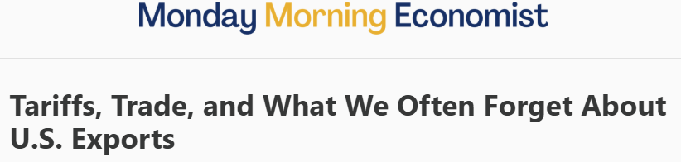
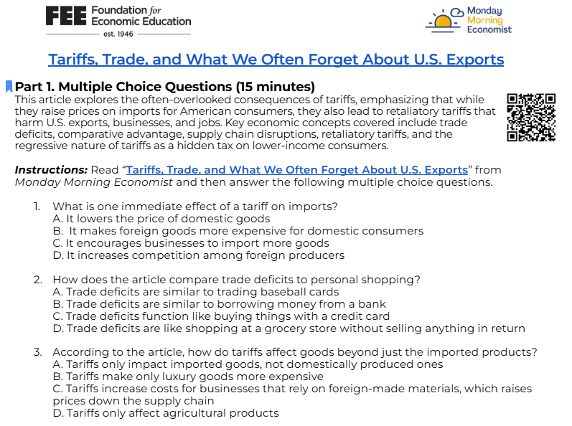
TRADE LESSON #3

Slide 42

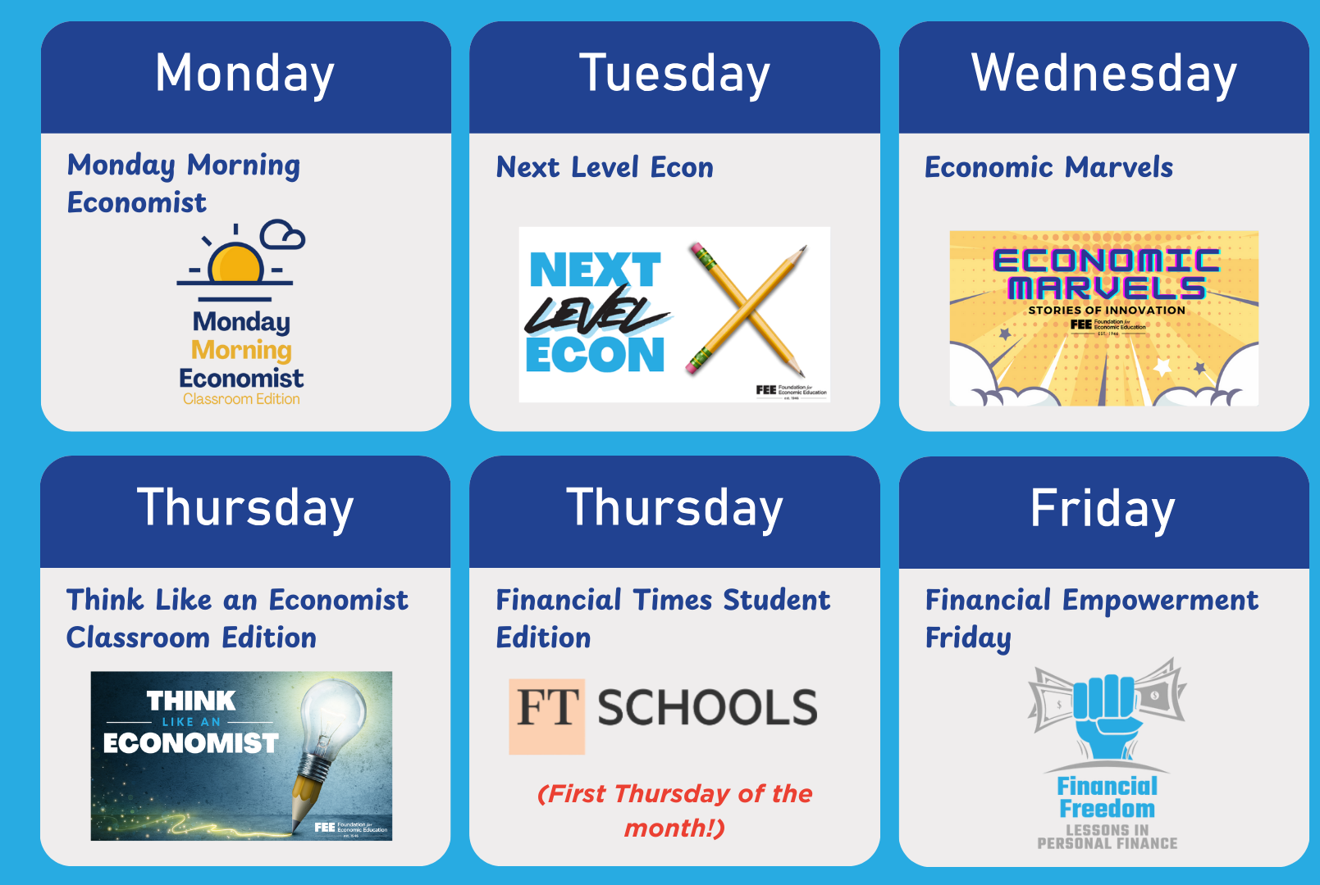

TEACHERS.FEE.ORG
Facebook: @FEELearningCenter | X and IG: @FEE_Learning LinkedIn: @FEE-LC

Slide 43

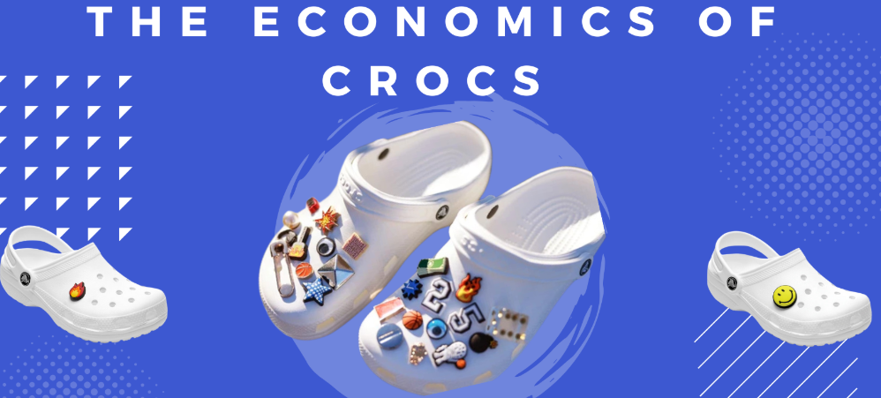


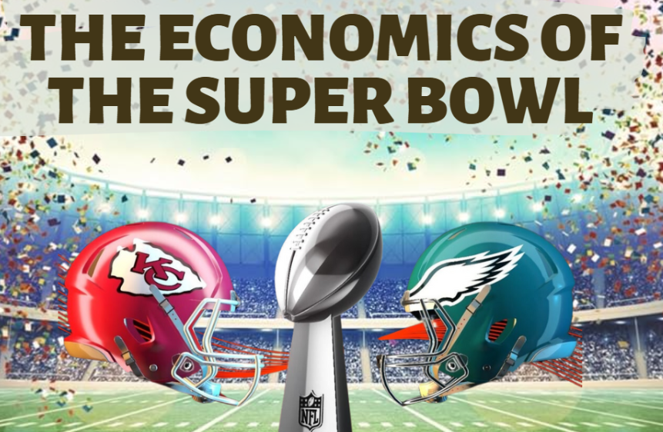

FREE LESSONS EMAILED & POSTED EVERY WEDNESDAY!

Slide 44
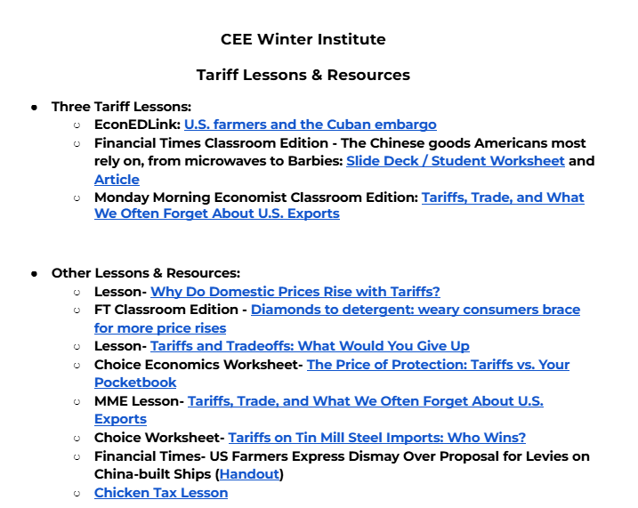
Notes:
https://docs.google.com/document/d/10B3ZLcaUtGEykQlUgJlTy7oEP4_52K3g-wJdh_X-mrk/edit?usp=sharing

Slide 45
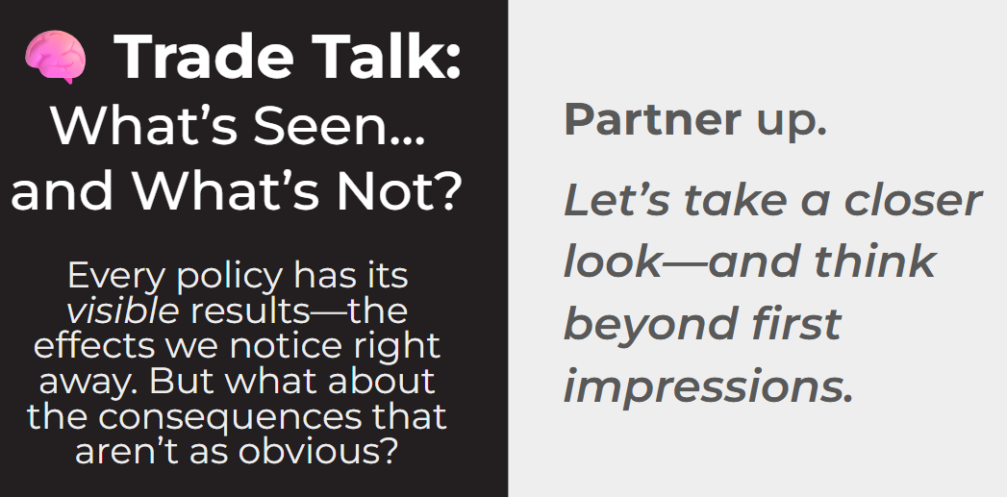
Activity! Trade Talk – Click for link
Notes:
https://docs.google.com/presentation/d/1Jc6gkUlmiKgBmf_HB_7wZQI-S-PNOAaAKJxnjHTlkMw/edit?usp=sharing

Slide 46
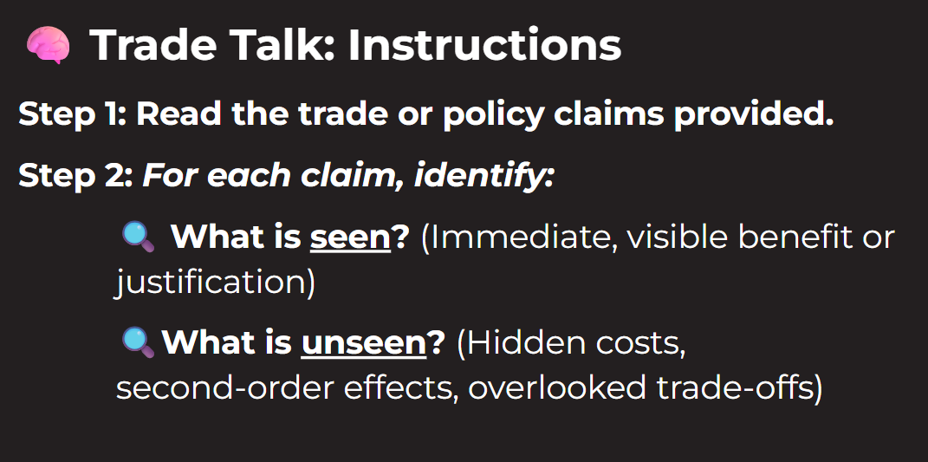
Activity! Trade Talk
Notes:
https://docs.google.com/presentation/d/1Jc6gkUlmiKgBmf_HB_7wZQI-S-PNOAaAKJxnjHTlkMw/edit?usp=sharing

Slide 47
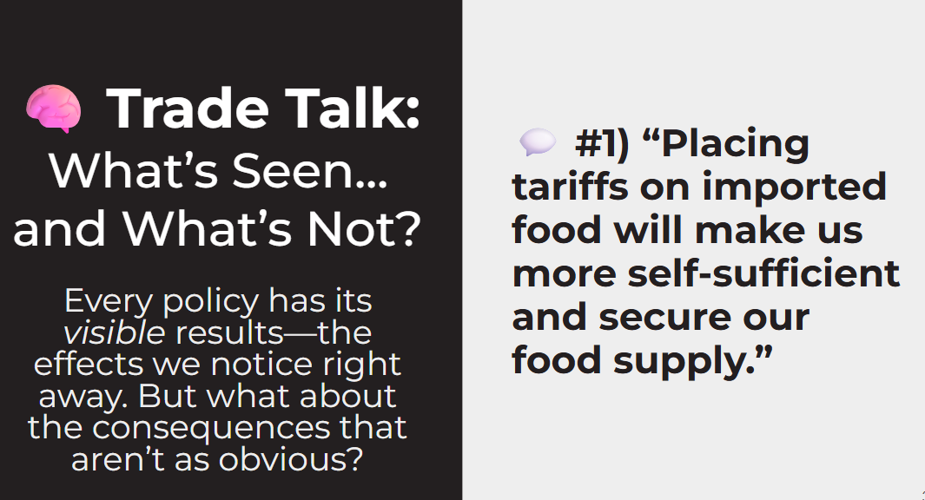
Activity! Trade Talk
Notes:
https://docs.google.com/presentation/d/1Jc6gkUlmiKgBmf_HB_7wZQI-S-PNOAaAKJxnjHTlkMw/edit?usp=sharing

Slide 48
Contact Us
James Redelsheimer
jred@fee.org

Slide 49
Thank you!

