Slide 1

Teaching The Pause - Through The Years
How Mindful Spending
Unlocks Future Financial Confidence
For 9-to 18-Year-Old Students
Council for Economic Education SPRING BOOTCAMP Educator Webinar
Saturday, March 28th, 2026 11:00 am to 1:00 pm EST

Slide 2
Agenda
Share Session Objectives
Introduction to Gifting Sense: an early financial education nonprofit that helps people (parents and educators) teach their kids (9-to 18-year-olds) to think before they buy.
Teachers are our #2 user, only after, of course, young people!
Expository workshop so you can experience what your students will.
Wrap up with easy next steps, to facilitate bringing this content back to your school.
NB: The CEE will upload this deck onto EconEd.
Everything you need to bring mindful spending into your classroom is always free at giftingsense.org. We are permissionless; no registration, login, or paywall.
📩
Notes:
Some of you might recognize our approach, we’re going to quickly give you some context and instructions, and then let you practice.

Slide 3
🧠 Allow you to experience firsthand how and why mindful spending lessons naturally reveal to students that anyone can get and use financial information.
Session Objectives:
⚡ Allow you to experience firsthand how our permissionless
(no paywall, registration, or login), online mindful spending tool
drives deep student engagement.
💡 Reveal why thinking-before-buying workshops are something you can easily deliver to your own students in your own classroom. We’ll show you how.
Notes:
Avoiding disappointment today teaches you how to be good with money tomorrow

Slide 4
Thinking Before Buying
Workshops Are:
Students self-select a possible purchase to assess.
They appreciate agency - being able to work on a problem that matters to them in real-time: “Should I buy this item or experience?”
Engaging
Students discover that it only takes minutes to ask & answer the questions that can help them:
⭐ Avoid Disappointment
⭐ Reduce Waste
⭐ Improve Family Harmony
⭐ Protect the Planet
Powerful
Success always tastes good!
Once you know thinking before buying can help shape your future, why would you ever stop?
Sticky

Slide 5
Post-workshop remarks:
“Best interactive class!”
“You could hear a pin drop when the kids were calculating their DIMS SCORE®.”
“This was a great session. Fun and useful!”
Engaging
“I am SHOCKED of all the smaller things that can happen when you just take some time out to figure out how much what you want is, or if you can use it as much as you think you’re going to, to see if it’s worth the money!”
"Oh wow” Upon discovering the real cost of ‘just’ going to the movies.
Powerful
“After this lesson, I am definitely going to be more careful!”
“At first I didn't believe that this class would help. But after taking it, I benefited a lot. Now I think about all the pros and cons about an item before asking for it. The website that you use to see if an item is good or not is very helpful. You can save a lot of money with it.”
Sticky

Slide 6
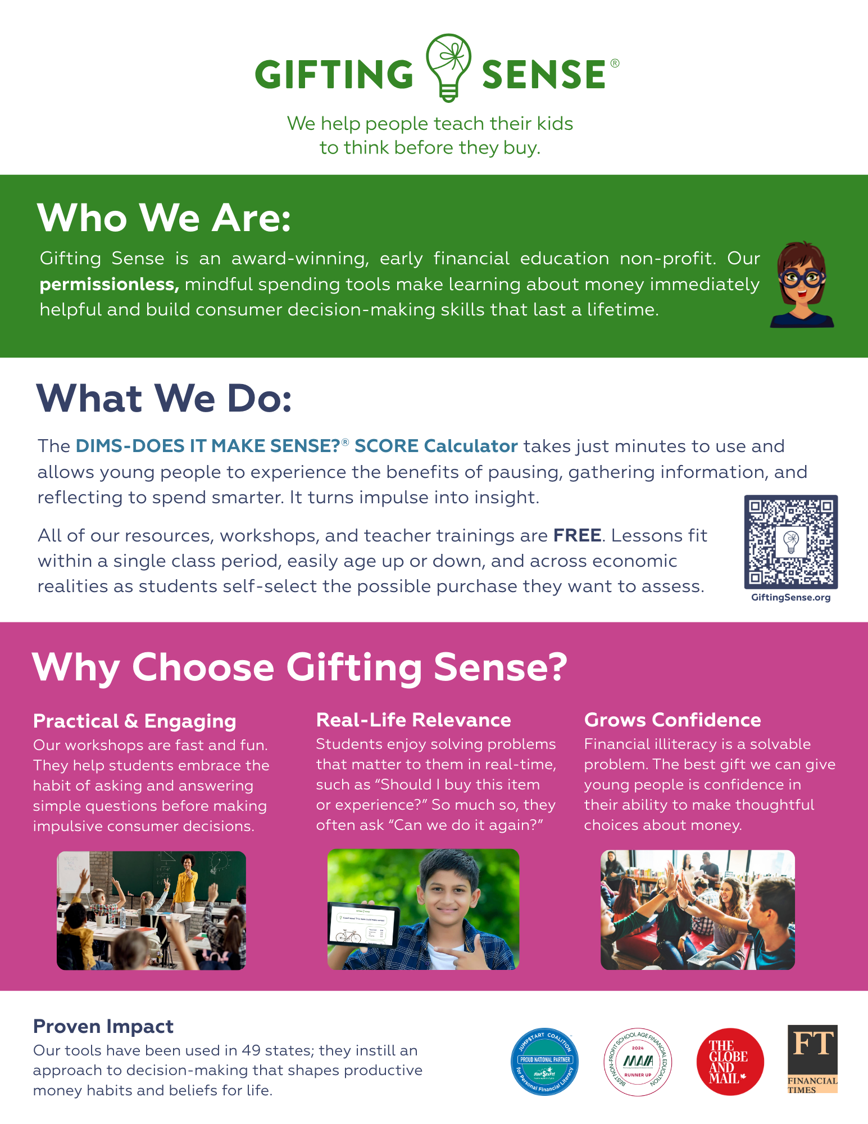
Everything else you might want to know is on the site!

Slide 7
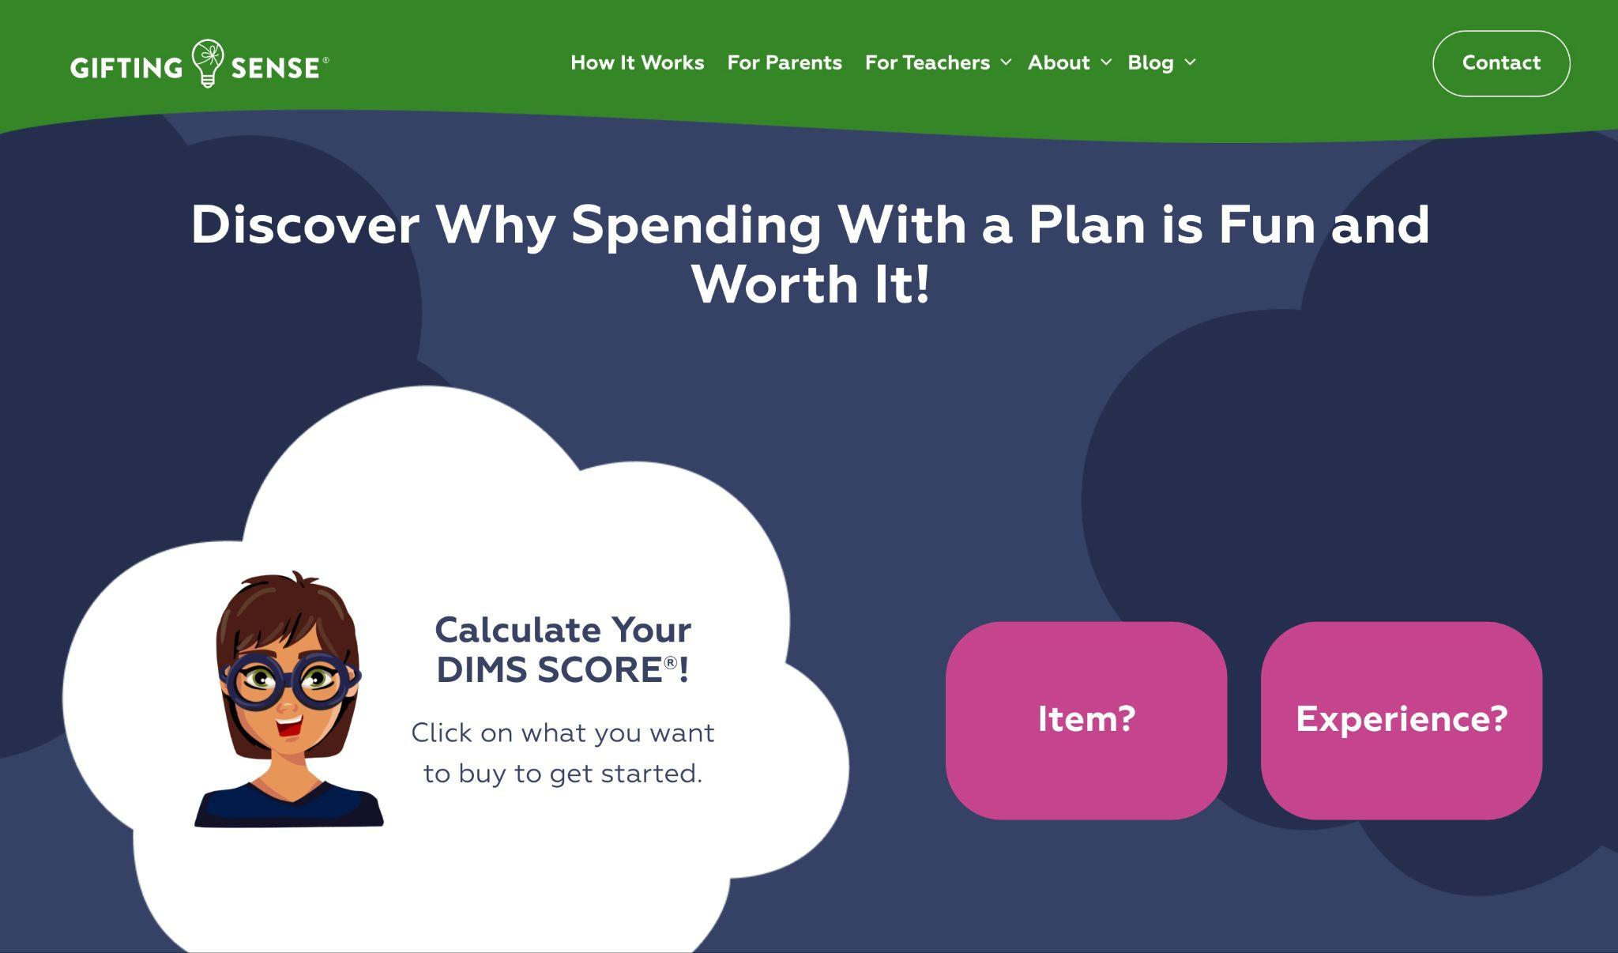
We built resources specifically for Educators!
We also have pages for FAQs, What Drives Us, What Others Say About Us, and a Contact Form which we respond to everyday!

Slide 8

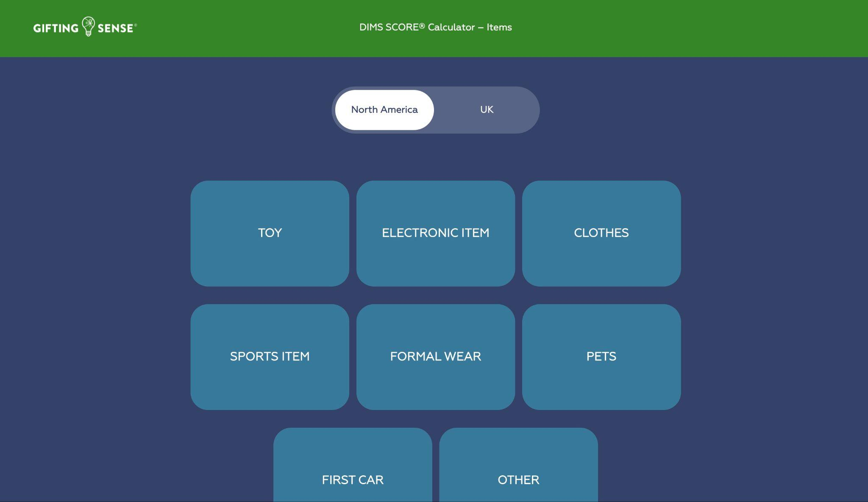
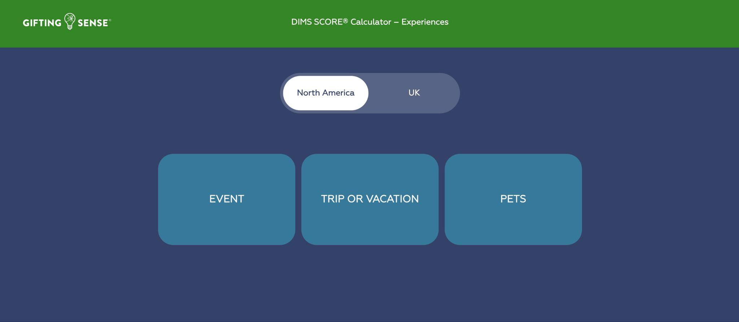
Bootcamp lets us test-drive three
DIMS SCORE Calculators
®
1
2
3
Start with
a toy
Typical purchase for Grades 4 & 5
Move to pro sports match tickets
Typical purchase for Middle & High School
Finish with
first car
Typical purchase for
16+
1
2
3

Slide 9
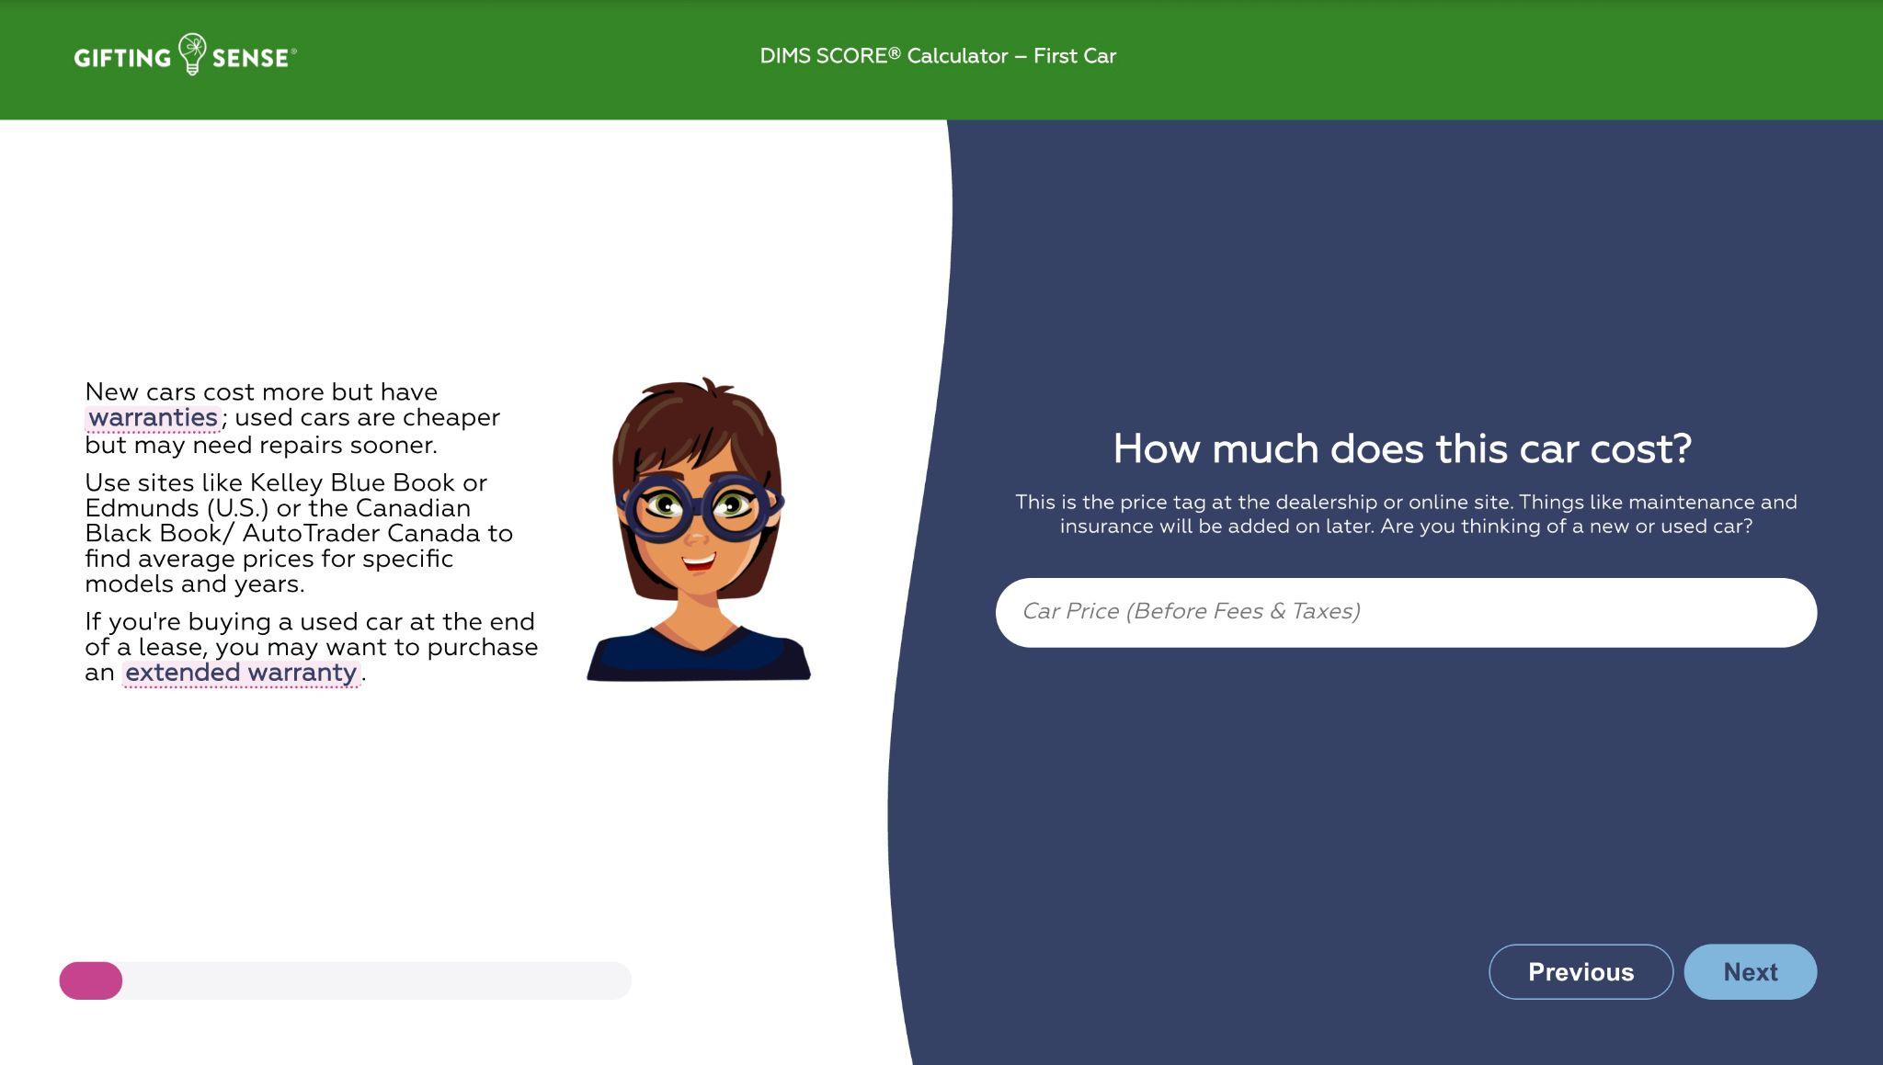
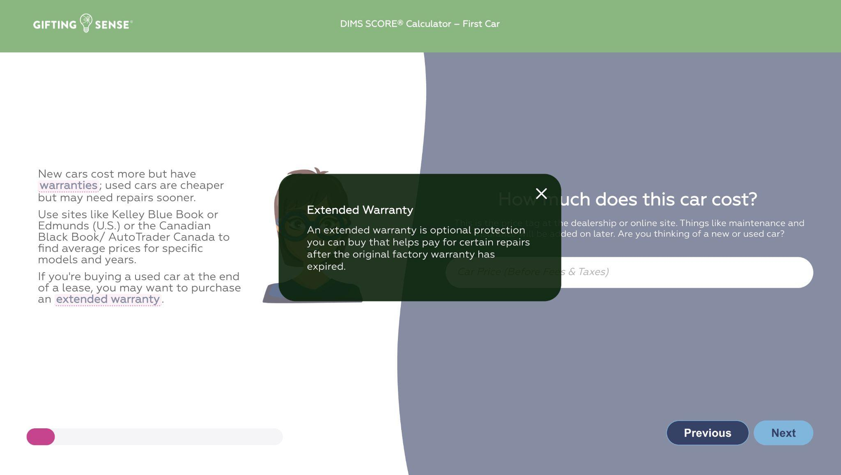
Please Note
Highlighted Terms Are Pop-Up Definitions
…………………………………..
The DIMS SCORE® Calculator demystifies personal finance jargon.

Slide 10
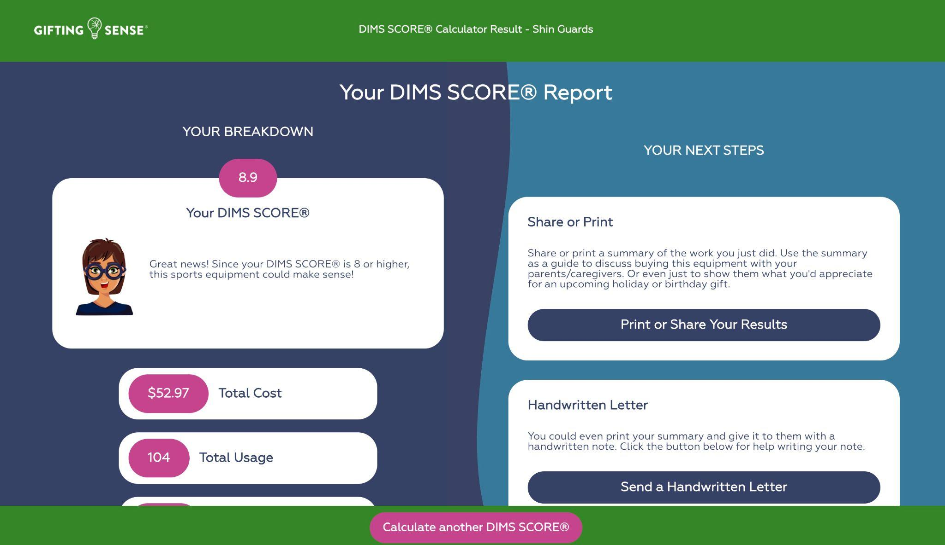
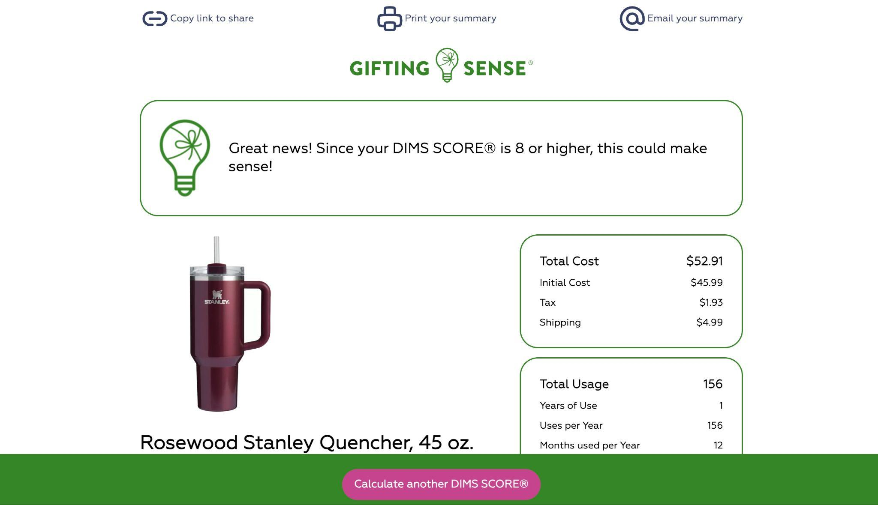
Please Note
DIMS SCORE® Reports can be texted, emailed or printed out.
The reports are designed to serve as the agenda for a fact (versus opinion) based productive conversation about spending, around the kitchen table, or in a classroom.

Slide 11
One last thing…
For the rest of our time together, please take a walk down memory lane and pretend you are your 10-to-18-year-old self.
This Zoom is no longer full of 25-to-60-year old professional educators,
you are now kids!
We need you to think like kids, tweens and teens
and answer our questions like kids, teens and tweens.
I’m a classroom visitor,
and today I’m in your school conducting a
GIFTING SENSE® Mindful Spending Workshop.
Let’s Roll!

Slide 12
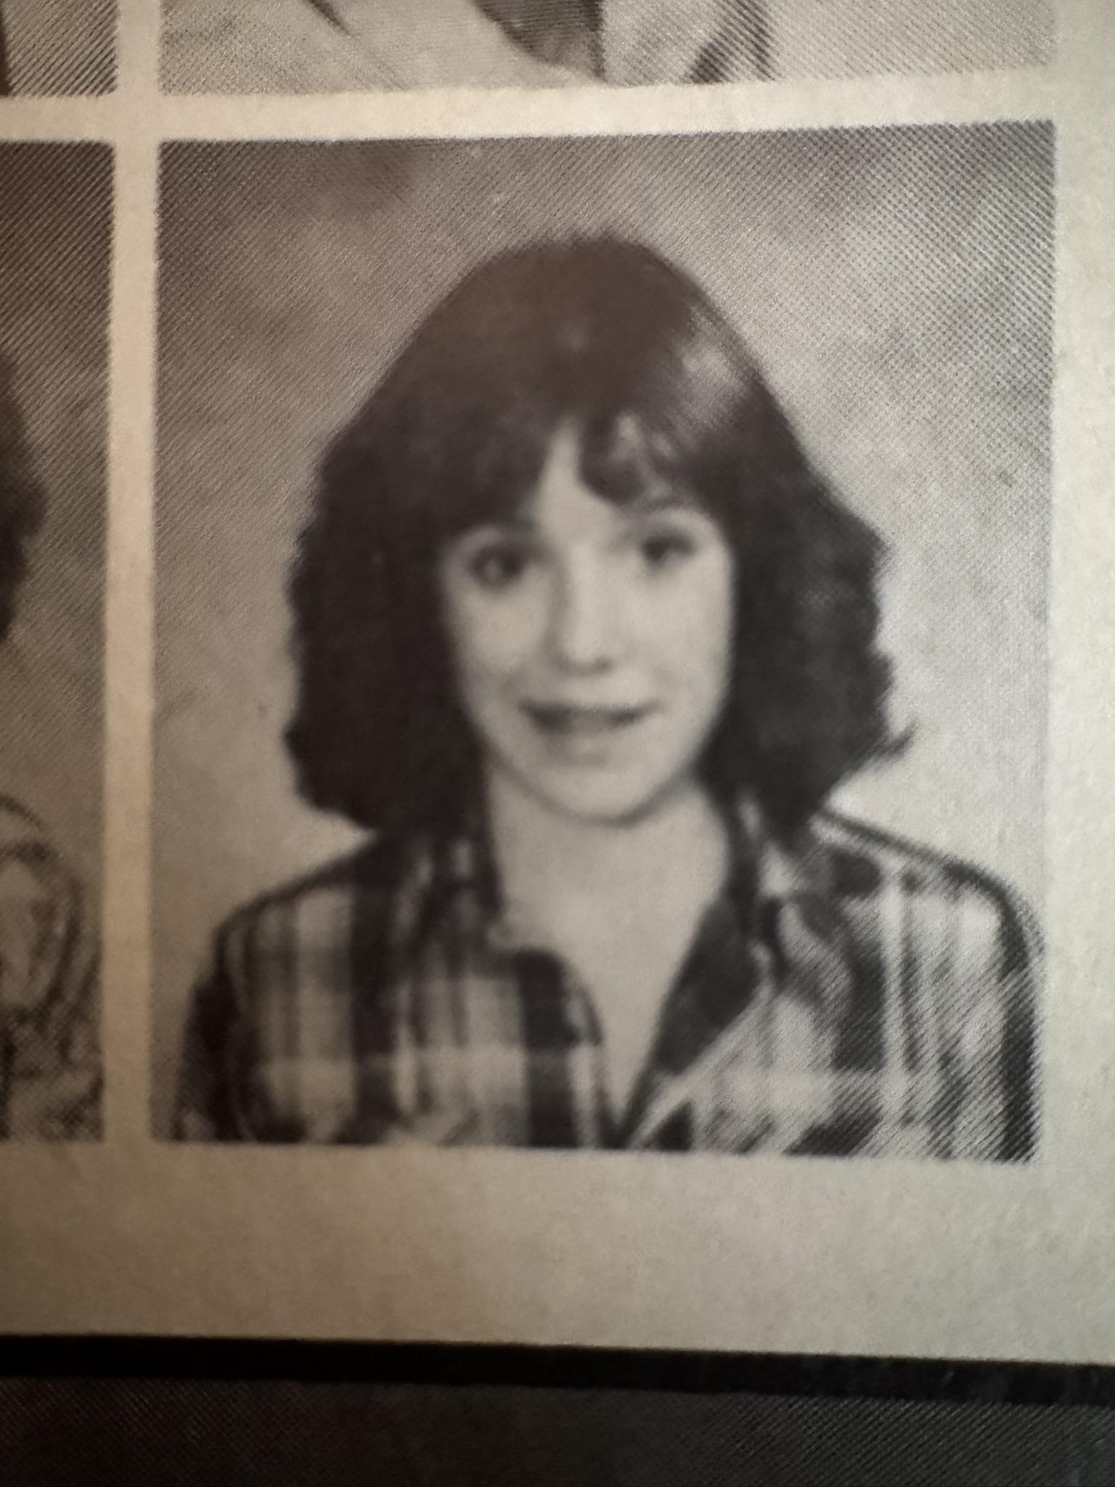
Need inspiration…
1979
to personify your students?

Slide 13

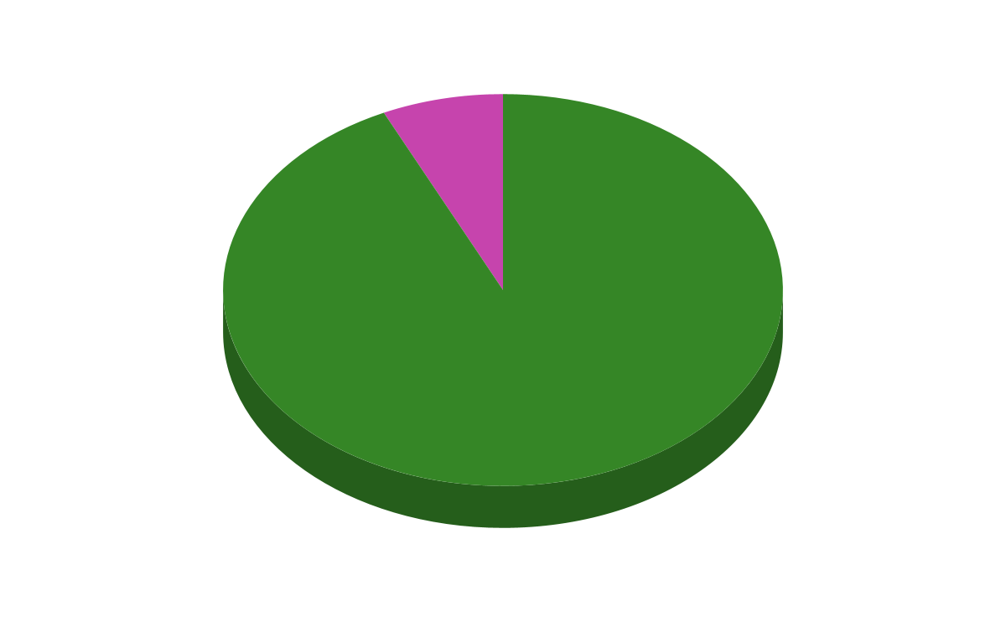
Welcome to Money-Smarts 101!
Question?
“Has anyone here ever received a holiday or birthday gift that wasn’t quiiiiiite what you hoped for?” Who will share?
No: 7%
You are NOT alone!
Yes: 93%
Notes:
Avoiding disappointment today teaches you how to be good with money tomorrow

Slide 14










You are not alone…
Here are the most common answers we’ve received to that question:
Socks
Pajamas
Clothes that are too big/ small
Clothes that aren’t your style
Pierced earrings you can’t use
Books you’ve already read
Toys/ gifts for younger kids
Toys/ gifts that don’t interest you
Toys/ gifts the gift-giver likes
Instruments you cannot play
Out of season sports equipment
Old technology e.g. game consoles
A pet you’re not allowed to keep!
Gift cards to stores you never visit
Unfortunately,
even disappointing gifts cost time & money!
Notes:
Avoiding disappointment today teaches you how to be good with money tomorrow

Slide 15

Good News!
There’s a polite way to plan for what you really want, will use & appreciate…
Yes! It’s called a DIMS SCORE® Report.
You’re going to make one today!
DIMS stands for “Does It Make Sense?”
Notes:
Avoiding disappointment today teaches you how to be good with money tomorrow

Slide 16


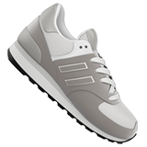



Here’s what they look like:
For bringing home a pet:
https://giftingsense.org/dims-score-result/gtvkdwsi/?print=yes
For a new cell phone:
https://giftingsense.org/dims-score-result/mtqfl8rz/?print=yes
For Air Jordans:
https://giftingsense.org/dims-score-result/3vxg5qmo/?print=yes
For a fancy water bottle:
https://giftingsense.org/dims-score-result/5jh7t3xa/?print=yes
For tickets to FIFA’26:
https://giftingsense.org/dims-score-result/fntbrghy/?print=yes
For a first car:
https://giftingsense.org/dims-score-result/m6fq3alk/?print=yes
Let’s discuss why they matter…

Slide 17





DIMS SCORE® Reports help you:
Show Real Understanding: They’re your opportunity to demonstrate that you get the true cost and effort behind a purchase — something adults appreciate.
Reduce Waste & Regret: They prevent time & money from being spent on gifts that go unused — smarter for you and more considerate to gift givers and the planet!
Crowdfund More Meaningful Gifts: They make it easy for your family to chip in towards a single, more meaningful purchase instead of lots of smaller “so-so” presents. Particularly helpful for a first car.
Bring Families Closer: They’re especially helpful for out-of-town relatives who want to give you something that you’ll really use & enjoy.
Feel Good: You receive something you truly desire/need — and family members feel great knowing their gift really matters/ isn’t wasted.

Slide 18
Ready for a Test Drive?
Let’s Calculate the DIMS - DOES IT MAKE SENSE?® Score for three potential purchases, to understand their full cost, as well as how much we’ll really use and appreciate them, before spending our money, or anyone else’s.
Know that you can use the DIMS SCORE® Calculator an unlimited number of times. It is always accessible, merely by typing “Gifting Sense” into any browser on any device with access to the internet.
The calculators are “permissionless”. There is no registration, login, or paywall required.

Slide 19
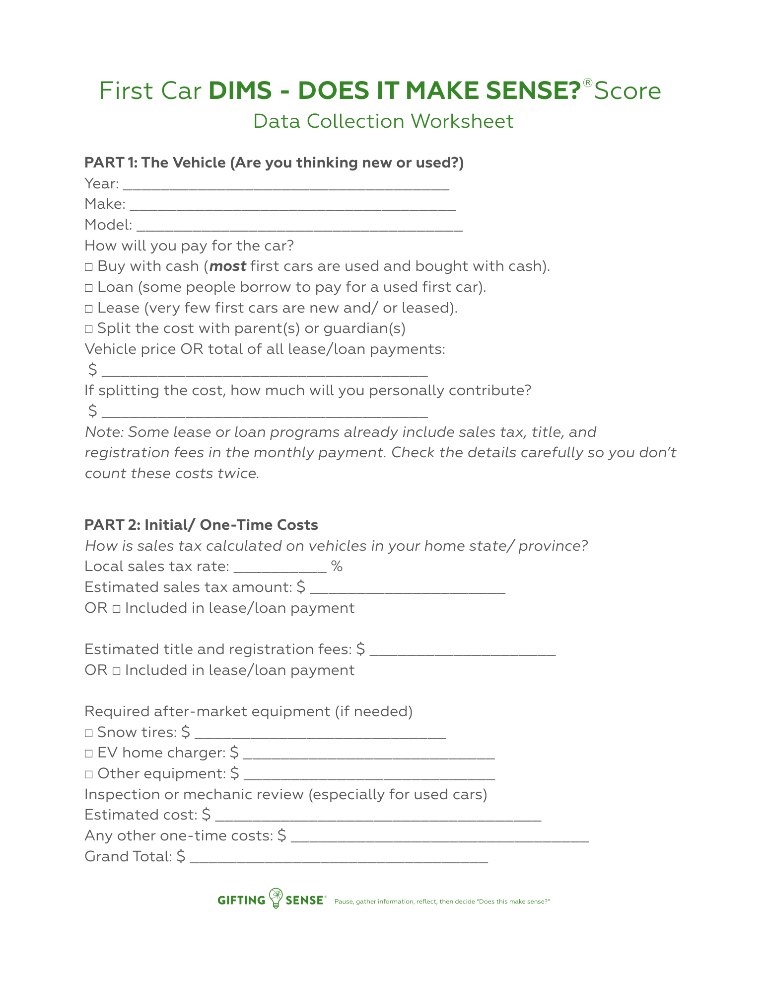
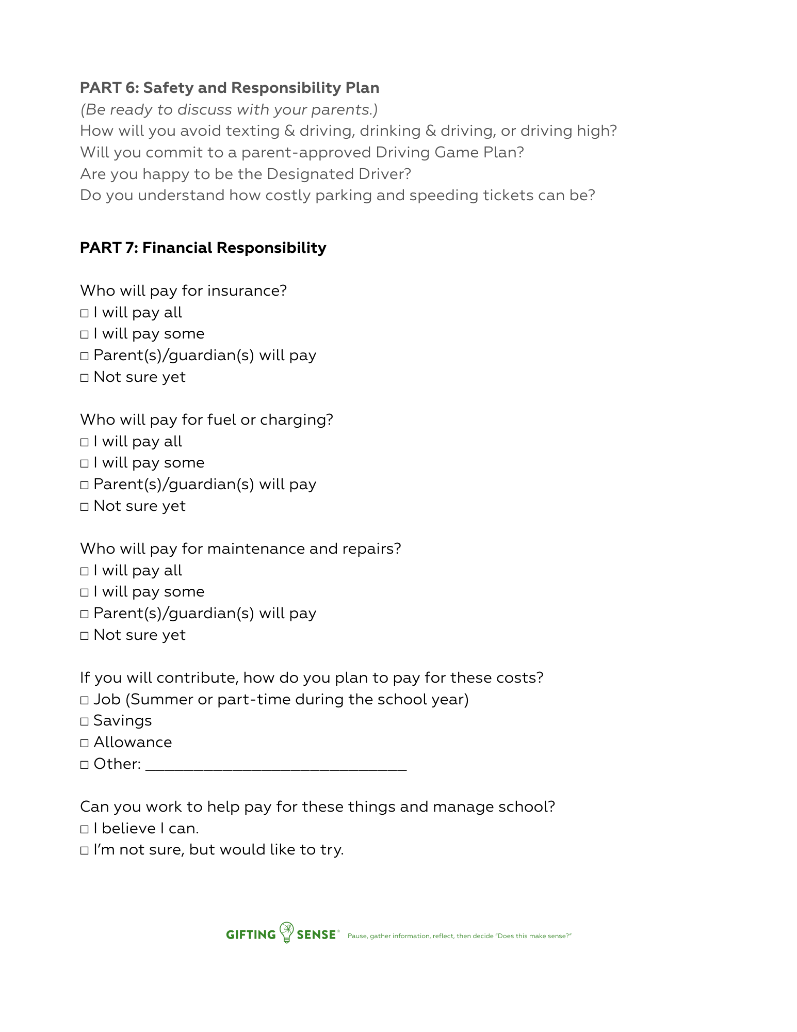
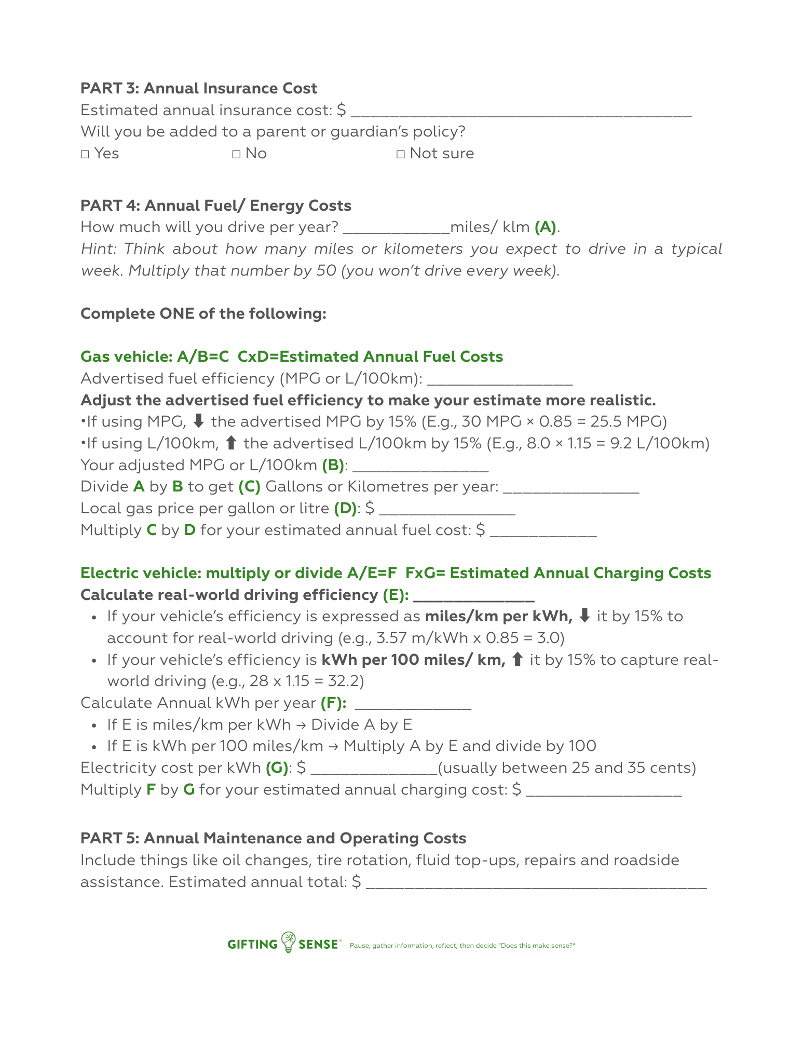
There’s a
First Car Data Collection Worksheet
to help you gather realistic, researched inputs.

Slide 20
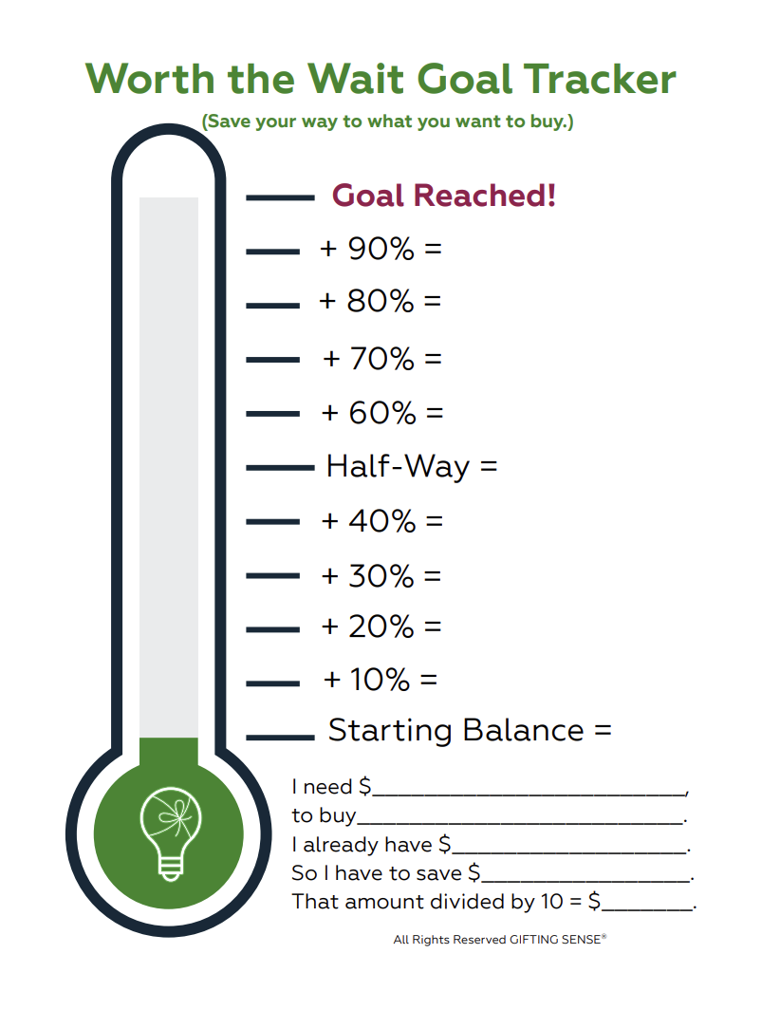
Use this visual goal-tracker to help save for your dream purchase.

Slide 21
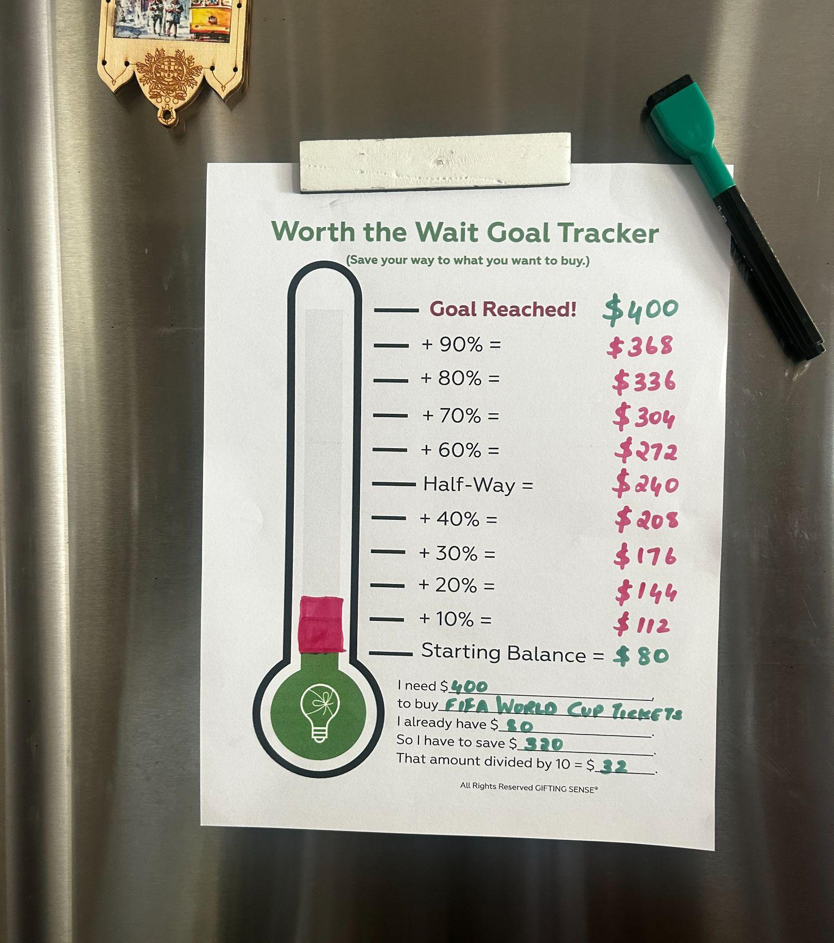
Visualization helps you stick
to your savings goals.
Where do you plan to display your goal tracker?
How can you commit to achieving your goal?
Notes:
The first game of the 2026 FIFA World Cup - taking place in North America this year - is still 30 weeks and 5 days away - so you’ve got time to put a plan in place…Plan beats no plan, every…single…time!

Slide 22

Homework:
Right After Easter, your class will…
REFLECT:
Are you achieving your savings goals?
DISCUSS:
What’s the most difficult part of staying on track?
SHARE:
What are you learning from this experience?

Slide 23
Disappointing gifts don’t just waste time and money…
they have an environmental cost!
Let’s quickly discuss how thinking before buying is the easiest way to be a planet protector!
Notes:
Look at this slide, even it it just filled with words!
When I was a kid – back when dinosaurs roamed the earth, if you went to the store with $5 and something cost $20 – you know what happened? I went home empty handed!

Slide 24



Spending With a Plan Helps Us All Protect the Planet 🌎
Guess where most underappreciated gifts end up?
Have you heard the terms “half-life” or “carbon footprint”?
60MM school-aged children in Canada and the US
Every 10% reduction in underappreciated gifts is
56 NFL football fields* less of garbage in landfills!
*Based on 60 million school-aged children in Canada and the US × 93% reporting at least one underappreciated gift = 55.8 million gifts. A 10% reduction (93% to 83%) = 6 million fewer gifts × 0.1 m² average gift footprint (approximately the size of a standard board game laid flat) = 600,000 m² ÷ 5,353 m² (NFL field including end zones: 109.7m × 48.8m) = 112 NFL football fields. We have chosen to report half this figure (56 NFL football fields) as a deliberately conservative estimate.
Notes:
Look at this slide, even it it just filled with words!
When I was a kid – back when dinosaurs roamed the earth, if you went to the store with $5 and something cost $20 – you know what happened? I went home empty handed!

Slide 25




Thank You
For Your Learning Today!
We hope this session inspires you to
give yourself the best gift ever:
Practice thinking before buying until
it becomes a habit.
At the end of our time together,
we hope you understand how that
helps you, your family,
and the planet!

Slide 26

Teachers! Starting to understand why…
Mindful Spending Lessons = Ideal form of early financial education!
Early success with thinking before buying inspires kids
to seek out the more sophisticated financial knowledge they'll need later,
when it is relevant and helpful, which is how the habit builds confident,
financially literate citizens for life.

Slide 27
Because…spending with a plan
Thinking Before Buying Workshops are…
Students discover that it only takes minutes to ask &
answer the questions that can help them:
⭐ Avoid Disappointment
⭐ Reduce Waste
⭐ Improve Family Harmony
⭐ Protect the Planet
Powerful
protects us from the four main reasons we regret purchases.

Slide 28
Thinking Before Buying
Protects us from
1) Overestimating Use
“How often will I actually use this?”
Anticipating use counters overestimation… of how often you’ll wear orange pants, use a pasta maker, guitar, or gym membership.

Slide 29

Thinking Before Buying
Protects us from
2) Underestimating Cost
“What’s the full cost - not just the price?”
Adding up all the ancillary (e.g., shipping and printer cartridges) and phantom costs (such as pricey alterations for an on-sale dress), gives you the real price before you commit.

Slide 30

Thinking Before Buying
Protects us from
3) Mistaking short-term excitement
for lasting value
“Will I still want this later?”
Thinking before buying counters “temporal bias”, the tendency to overvalue present feelings and undervalue how we’ll feel later. Help your students high-five their future selves!

Slide 31

Thinking Before Buying
Protects us from
4) The frictionless spending environment
“Am I pausing before I pay?”
Pushing the pause button brings back the helpful friction we’ve lost to tap n’ go, one-click, digital payment methods at always-open online retailers.

Slide 32
Thinking Before Buying
Protects us from the four main reasons we regret purchases…
1) Overestimating Use
“How often will I actually use this?”
Anticipating use counters overestimation… of how often you’ll wear orange pants, use a pasta maker, or gym membership.
2) Underestimating Cost
“What’s the full cost - not just the price?”
Adding up all the ancillary (e.g., shipping, parking) and phantom costs (e.g., pricey alterations for an on-sale dress), gives you
the real price before you commit.
in minutes, if not seconds!
3) Mistaking short-term excitement for lasting value
“Will I still want this later?”
Thinking before buying counters the tendency to overvalue present feelings
and undervalue how we’ll feel later.
4) The frictionless spending environment
“Am I pausing before I pay?”
Pausing brings back the helpful friction we’ve lost to tap n’ go, one-click payment methods at always-open online stores.

Slide 33
Which is why we describe
Thinking Before Buying as…
Future Proofing
Acquiring this skill early in life can't help but allow young people to earn, save, share, and invest more as their futures unfold.
Spending Ed
Providing the same foundational skills and awareness that Driver's Ed offers to new drivers.
A Spending
Speed Bump
Speed Bumps don’t stop us from getting anywhere we really want to be,
they just help us get there safely.

Slide 34
Next Steps Can Begin Tomorrow!
TRY the DIMS SCORE® Calculator yourself.
SHOW your class your own example.
MODEL how even you find the tool helpful.
Term Already Planned?
“Bell-Ringer” Activity
Make financial reasoning a habit; end each week with a “Friday 5-Min Financial Sense Check-In” by calculating the DIMS SCORE® for a purchase.
Bonus Assignment
Task students with introducing thinking before buying to their siblings, cousins, or friends as way to avoid disappointment.
Make it Cross-Curricular!
English-Language-Arts
ELA (or ESL) Teachers can follow up by asking students to craft a persuasive hand-written note to accompany their DIMS SCORE® Report.
Science-Geography
STEM Teachers can use the Earth Day
Lesson Plans to discuss how thoughtful consumption is an upstream solution to climate change.

Slide 35
Finally, please 🙏
let us know how it goes!
We treat every syllable of feedback like gold.
karen@giftingsense.org
Or, reach out via the Contact Us form on giftingsense.org

Slide 36

Parting Thought: Every student in your classroom already knows how to want things, items or experiences.
This morning, we’ve test-driven tools
that can transform wanting
into the beginnings
of lifelong financial wisdom.
This is the power of spending with a plan.

Slide 37
Thank You, Teachers
For Your Time Today!
We hope this session inspires you to
give your students the best gift ever:
Practice thinking before buying until
it becomes a habit.
At the end of our time together,
we hope you understand how that
helps them, their families,
and the planet!

Slide 38
Resources
Our permissionless mindful spending tool, the DIMS - DOES IT MAKE SENSE?® SCORE Calculator:
www.giftingsense.org
The How It Works page:
https://giftingsense.org/how-it-works/
The Worth-the-Wait Goal Tracker:
https://giftingsense.org/7-ways-to-score-money-smarts-with-the-2026-fifa-world-cup/
First Car Lesson Plan and Data Collection Worksheet:
https://giftingsense.org/what-does-a-first-car-really-cost/
Additional lesson plans/ activities/ resources available for every quarter of the year
https://giftingsense.org/for-teachers/
Educator FAQs https://giftingsense.org/what-we-have-learned-delivering-workshops/
(Don’t forget FAQs + Extended FAQs)
Feel free to subscribe to our blog: https://giftingsense.org/blog/
Or follow us on LinkedIn, Instagram or Facebook: @giftingsense

