Slide 1

Curated Cinema
Teaching Economics
with Video & Voice

Slide 2

Mr. Harris
The Moral Sciences
A.P. Macroeconomics, A.P. Psychology, Philosophy,
& “Ethics, Economy, & Entrepreneurship”

Slide 3



Education
B.A. History/Psychology
M.Ed. Teacher Leadership
Post-Graduate
Politics, Philosophy, Economics & Law

Slide 4
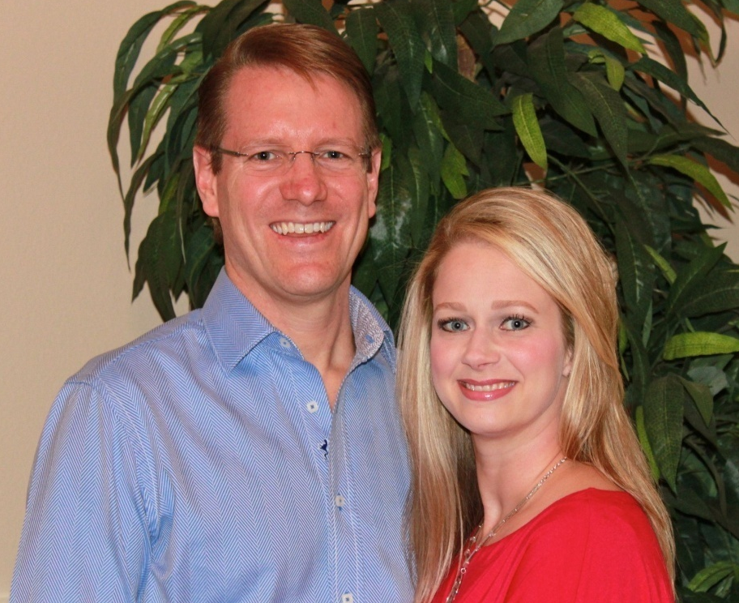
28 years married
30 years together

Slide 5
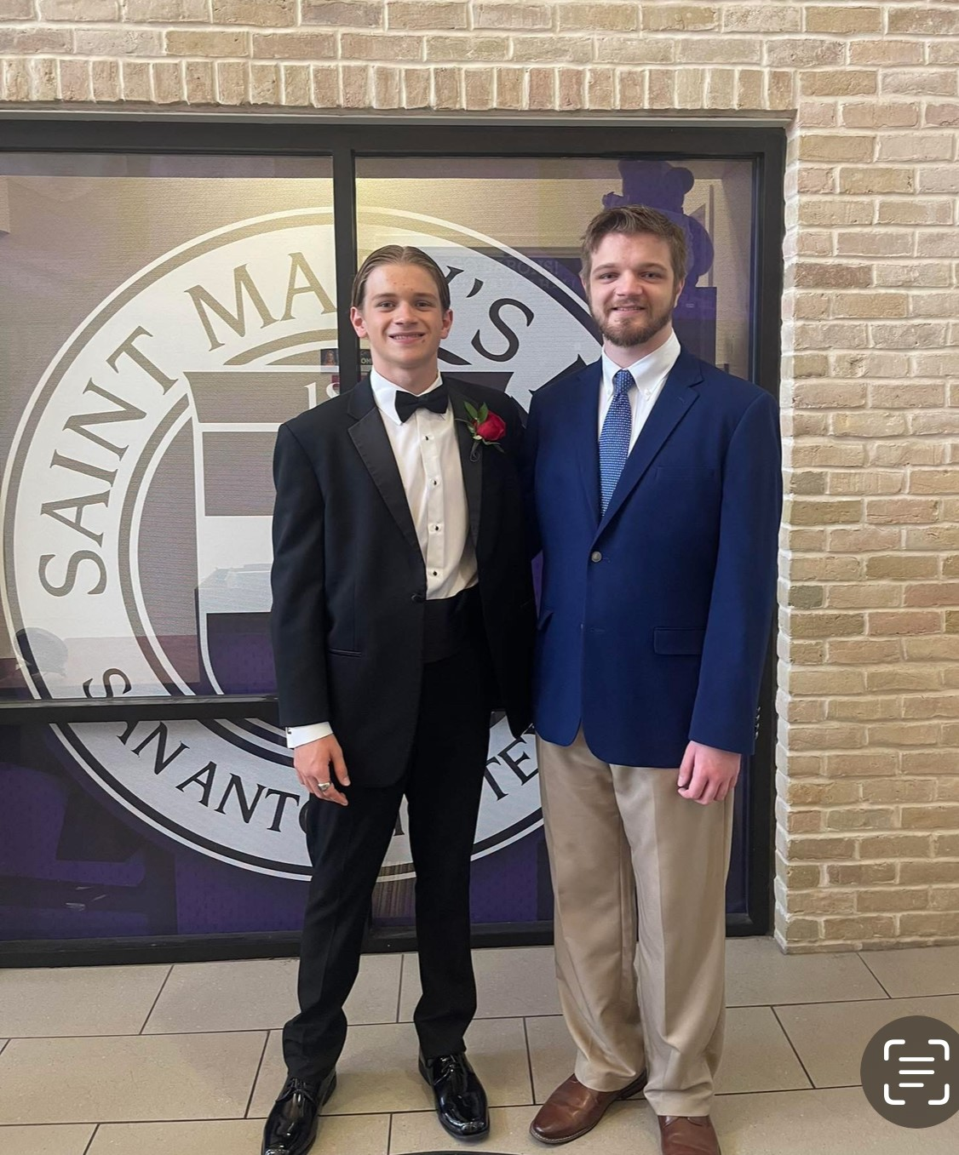
Sons: 18 & 22
Trinity University

Slide 6
36th Year of Teaching
Judson H. S. (12 years)
Reagan H.S. (24 years)
Swim Team
Water Polo Team
U.S. History
World History
Pre-A.P. World History
Psychology
International Baccalaureate’s “Theory of Knowledge”
Lyceum Philosophy Club
Swim Team
Oldthink Philosophy club
U.S. History
World History
Psychology
A.P. Psychology
Philosophy
A.P. Macroeconomics
The League of Extraordinary Gentlemen
Ethics, Economy, & Entrepreneurship

Slide 7



















“Your class prepared/was better/harder”

Slide 8














Consulting (24th year)

Slide 9

www.freetochoose.tv

Slide 10


Slide 11
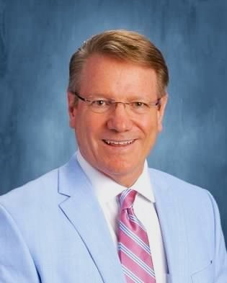




Scott K. Harris, M.Ed.
School email: sharri@neisd.net
Home email: oldthink@neisd.net
Social Handles:
Scottharris@oldthink
Scott K. Harris
Scott Harris
scott_k_harris

Slide 12
Session Agenda
Concept Overview
Video Selection Criteria

Slide 13
Session Agenda
3. Video Usages
a. Introductions
b. Class starters
c. Overview before teaching

Slide 14
Session Agenda
4. Voice
a. Turn & Talk
b. Writing Activities
c. Group Discussions
d. Socratic Seminars

Slide 15
Curated Cinema -- Concept Overview
My background, relevance to selection
Admin approval
Colleague approval

Slide 16
Video: Selection Criteria
Length: 3-15 minutes
Allows for viewing, discussion, activity
Or, with shorter videos, two within one class
Film Fest Friday
Exceptions:
2081 (24:00)
Amazing Invention- This Drone Will Change Everything (21:31)

Slide 17
Video: Selection Criteria
Engagement levels
AP: MRU, Jacob Clifford, Jacob Reed
On-level/Summer School: Unintended Consequences, izzit, MRU

Slide 18
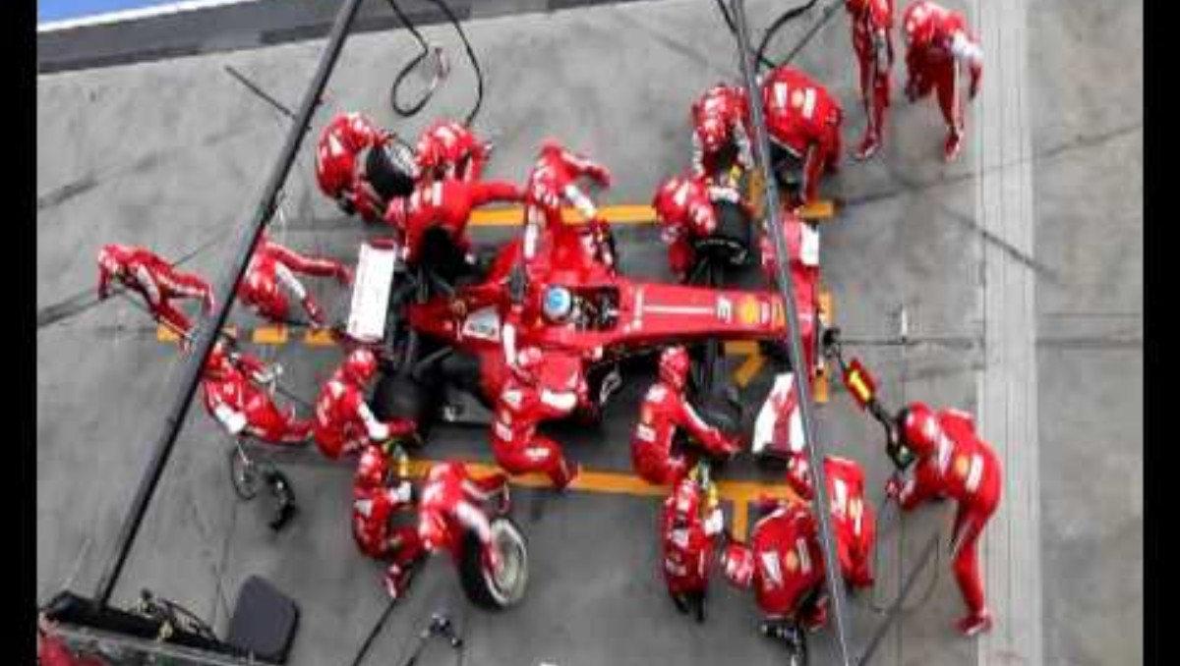
Video: Introductions

Slide 19
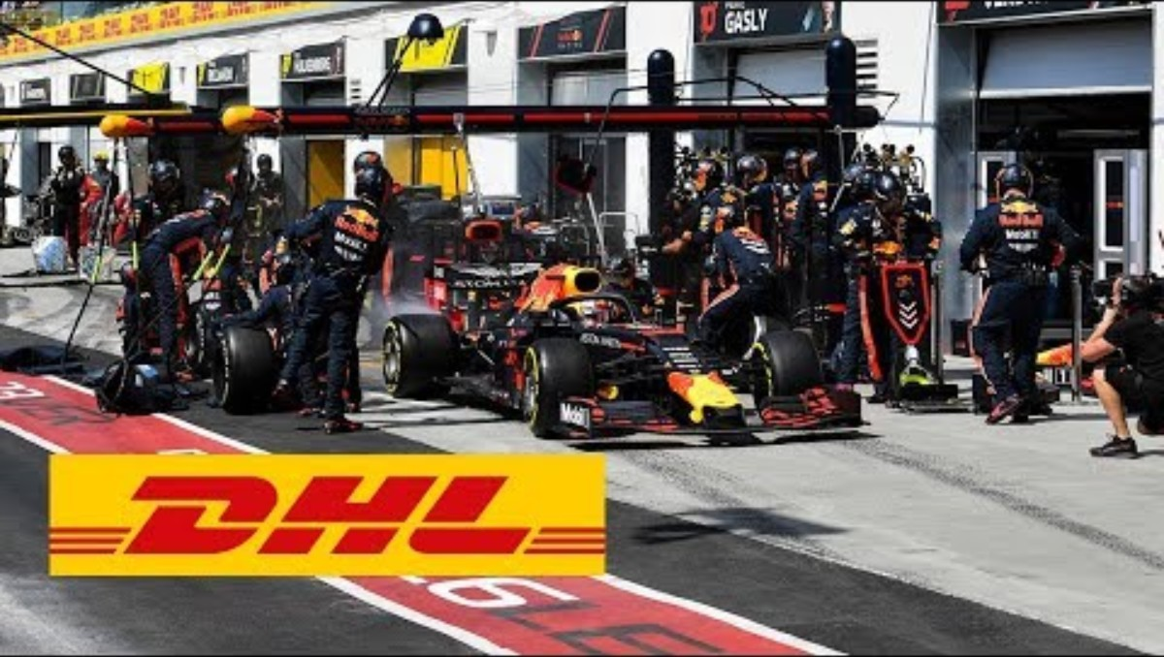
Video: Introductions/Summaries
New Formula 1 Pit Stop World Record: :45 seconds

Slide 20
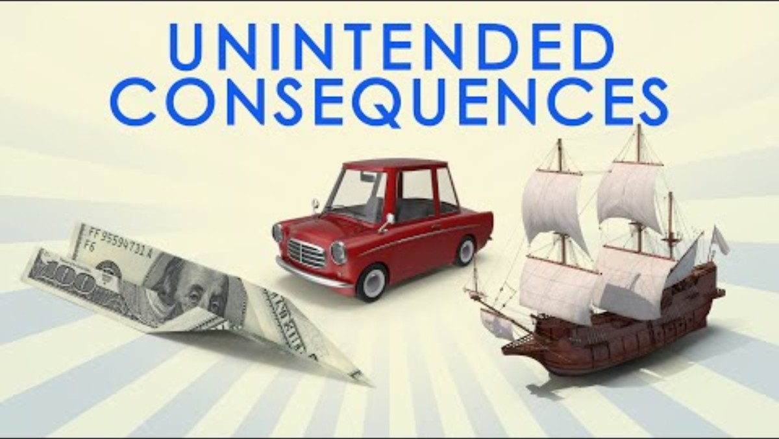
Video: Class starters

Slide 21
Video: Overview before Teaching
Comparative advantage
Benefits of trade

Slide 22
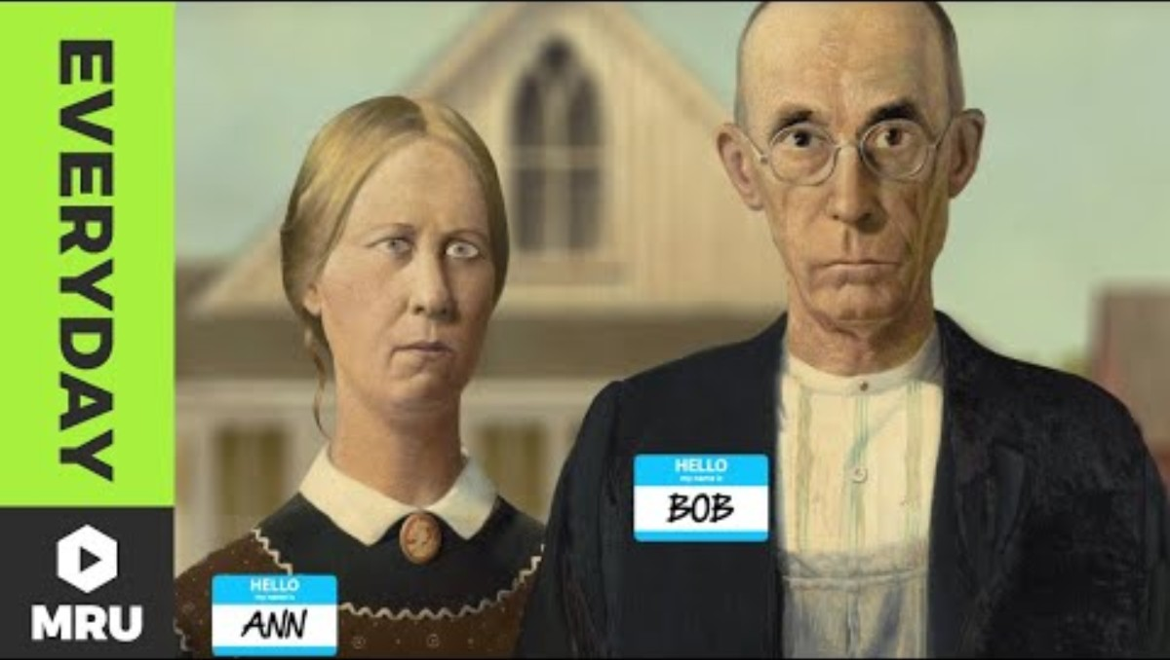

Slide 23
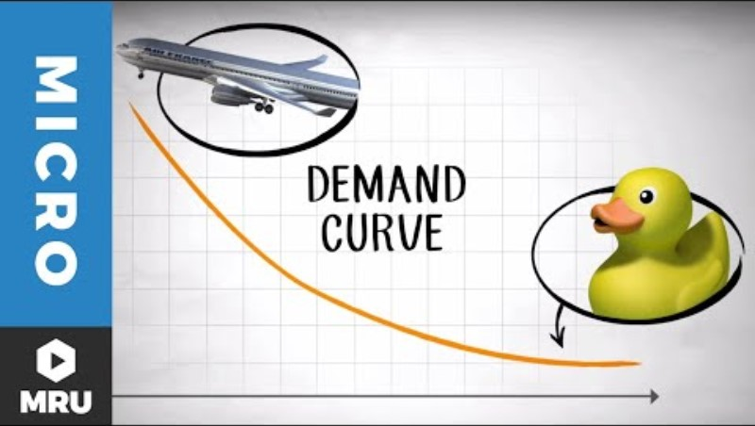
Video: Overview Before Teaching

Slide 24
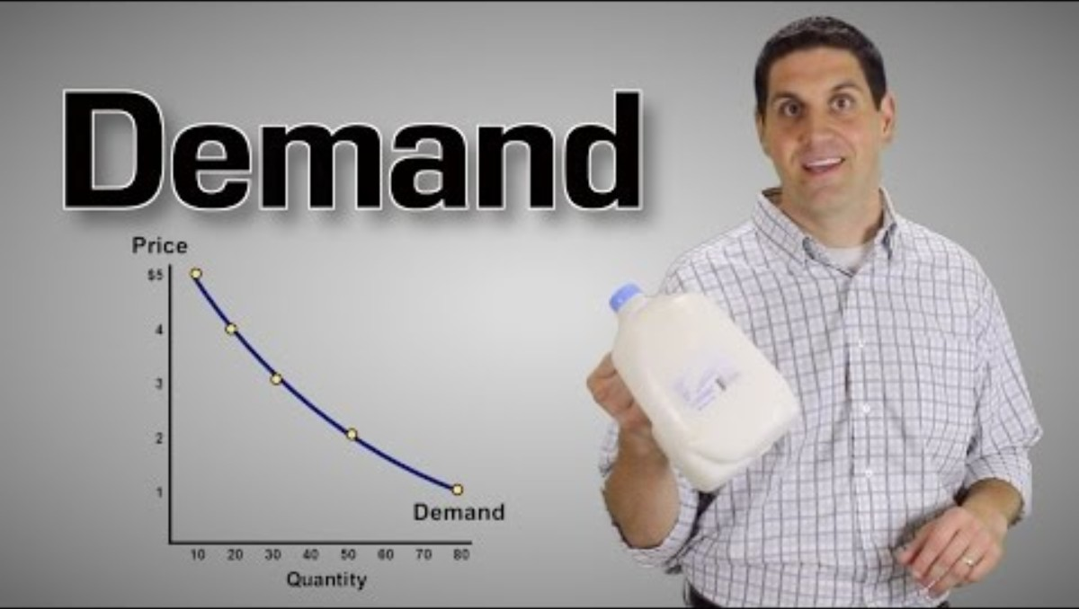

Slide 25
Voice: Turn & Talk Activity
Interaction & engagement
Use of provocative questions
E.g. What’s the most important invention of all time?
E.g. Imagine the ideal government in the form of an animal.
Give specific time constraints for talk time
Longest: 90 seconds
Shortest: 15 seconds
Eavesdrop on groups

Slide 26
Voice: Writing Activities
One-page summary (Syntopicon starter)
4 x 6 cards
3 x 5 cards
10% Summary
4-page Paper
Create a short answer question with an answer

Slide 27
Voice: Group Discussion
Engage students in discussions after video analysis
Foster critical thinking & in-depth understanding
Socratic Seminars

Slide 28
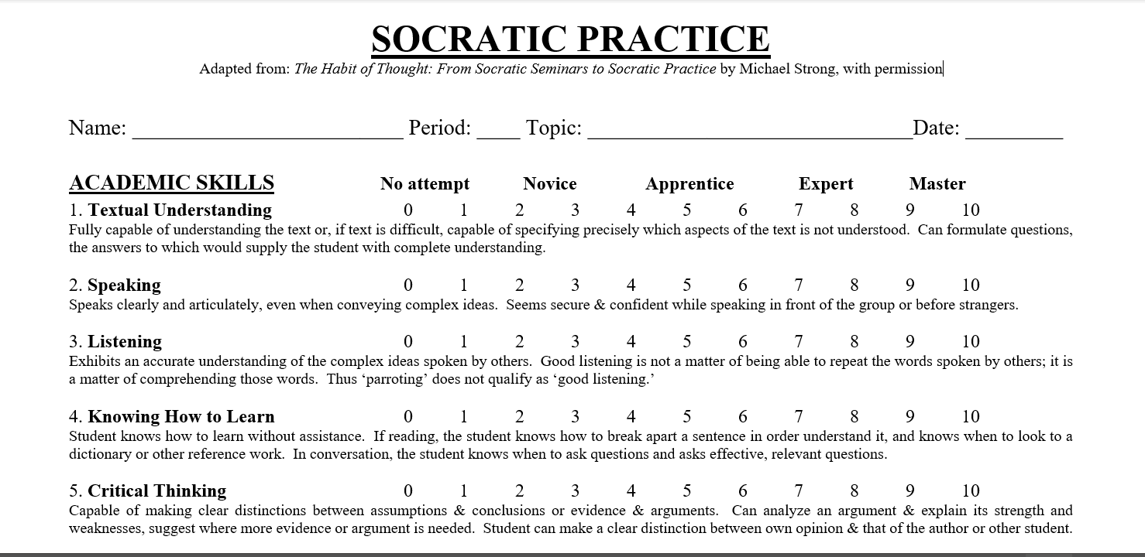

Slide 29
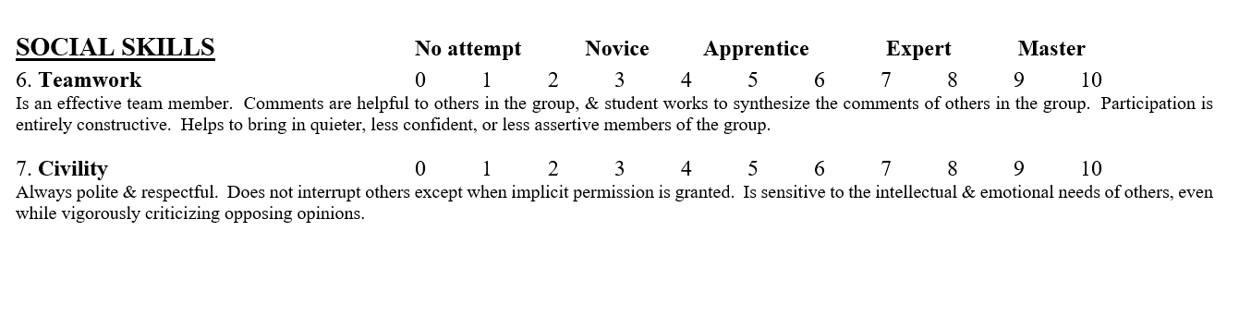

Slide 30
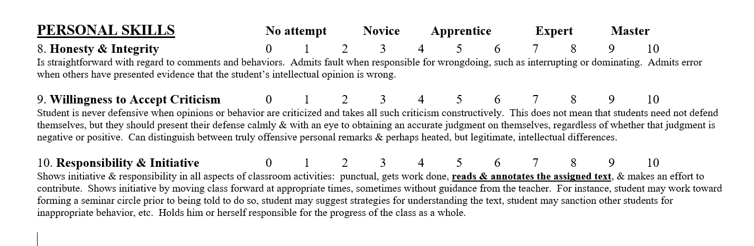

Slide 31
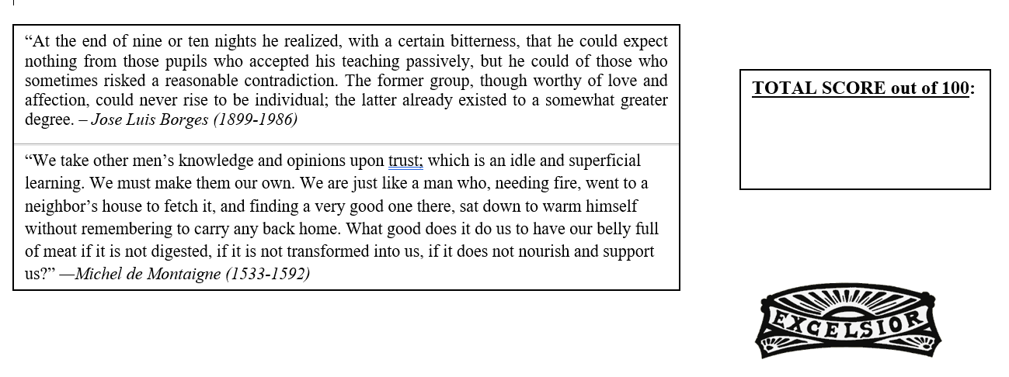

Slide 32
Conclusion
Summary of Key Points
Importance of video selection per class
Engagement strategies to deepen video concepts
Teaching strategies post-viewing
Questions?

Slide 33
Scott K. Harris, M.Ed.
School email: sharri@neisd.net
Home email: oldthink@neisd.net
Social Handles:
Scottharris@oldthink
Scott K. Harris
Scott Harris
scott_k_harris

