Slide 1


From Pop culture to policy: financial education in the news
Amy Kliewer, k-8 program supervisor (FEPPP)
February 10, 2025

Slide 2
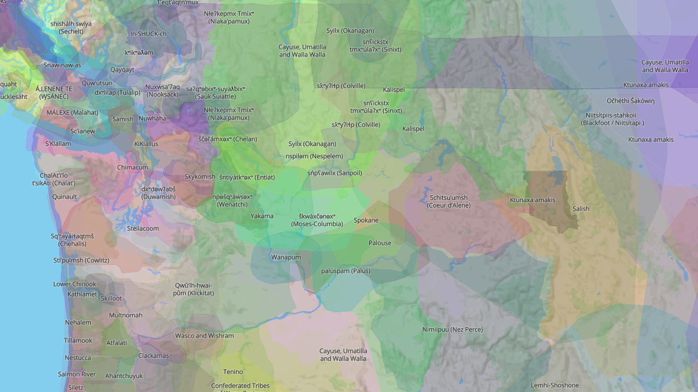
Land Acknowledgement
Native-Land.ca | Our home on native land
Notes:
Native-Land.ca | Our home on native land
Native Land Digital honors the sovereignty of all Indigenous nations, their lands, and their waters. We recognize that these boundaries and territories are representations of the sacred.
We respect the rights of Indigenous data sovereignty, and we are committed to an ongoing process of collaboration, growth, and learning.
We work to update and replace information that is a continuation of trauma caused by theft, injustice, misinformation, and ignorance.
The map is a living document, informed by the contributions of Indigenous communities, Indigenous knowledge holders and their stories. This is an honouring of Indigenous resilience past, present and future.

Slide 3
FEPPP:
A Holistic Approach to Financial Education
K-12 Financial Education
Reading
Social Studies
Social Emotional Learning
Decision-Making
School Counseling
Digital Citizenship
Math

Slide 4


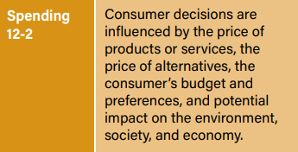
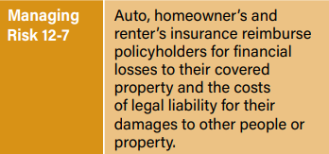
Today’s Professional Development
 | Examine current events for connections to concepts such as consumer behavior, markets, and risk.
Interpret news stories through a personal finance lens to guide meaningful classroom discussions.
Topics Consumers & Color Economics of Sports Climate Disasters & Insurance
Notes:
Consumers & Color
Investigation Menu: Nine options for student inquiry and learning related to consumer behavior
Climate Disasters & Insurance

Slide 5
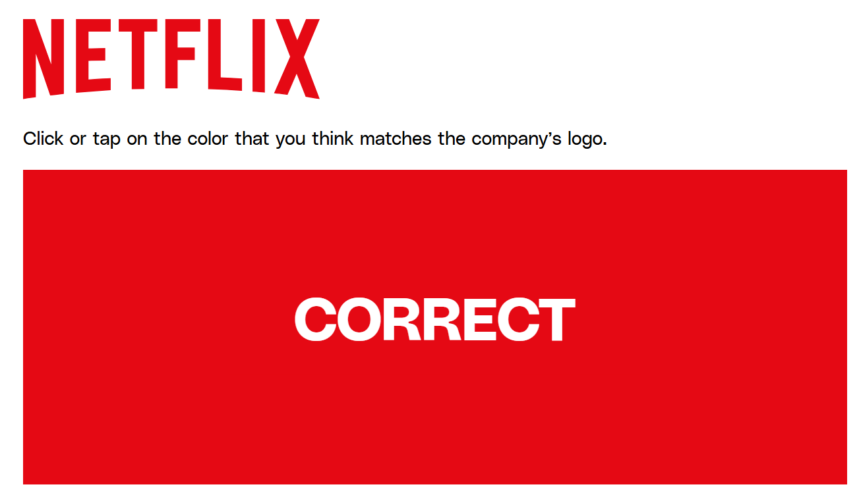
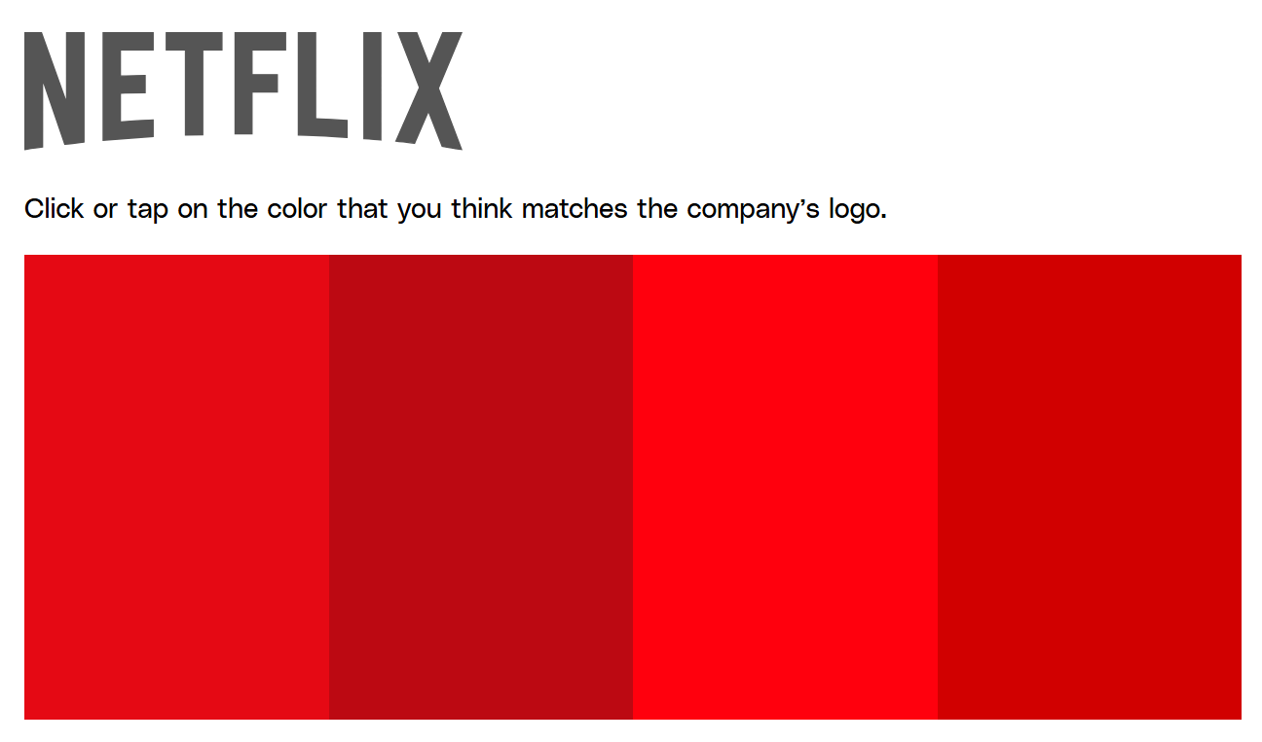

Color Quiz
Can you identify the correct red hue of the company’s logo?
A
B
C
D
A
Notes:
*Source: https://www.theverge.com/c/23589074/color-quiz-test-facebook-reddit-twitter-netflix
Let’s conduct our own experiment…
You may have opened the Netflix app tens of thousands of times…
When a brand alters their logo, consumers can have a strong reaction

Slide 6

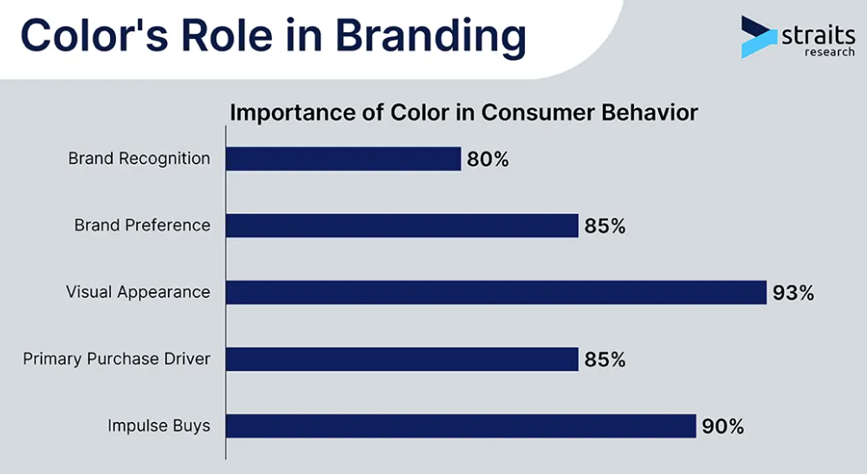
Consumers & Color
calmness | tranquility | relaxation
excitement | energy | warmth
Notes:
*Sources: https://www.sciencedirect.com/science/article/pii/S1877042814060431
https://straitsresearch.com/statistic/role-of-color-in-branding-and-marketing#:~:text=One%20excellent%20example%20is%20Apple%27s,appeal%20in%20the%20Chinese%20market

Slide 7
Color’s Role in Design, Marketing & Retail
Design Careers:
Graphic designer, Product designer, UX/UI Designer
Using color to communicate meaning and emotion
Marketing Careers:
Brand Strategist, Marketing Manager, Creative Director
Using color to influence perception and behavior
Retail Careers:
Visual Merchandiser, Retail Buyer, Store Experience Designer
Using color to shape the shopping experience
Students’ creative instincts, such as use of color, can turn into real-world skills!

Slide 8
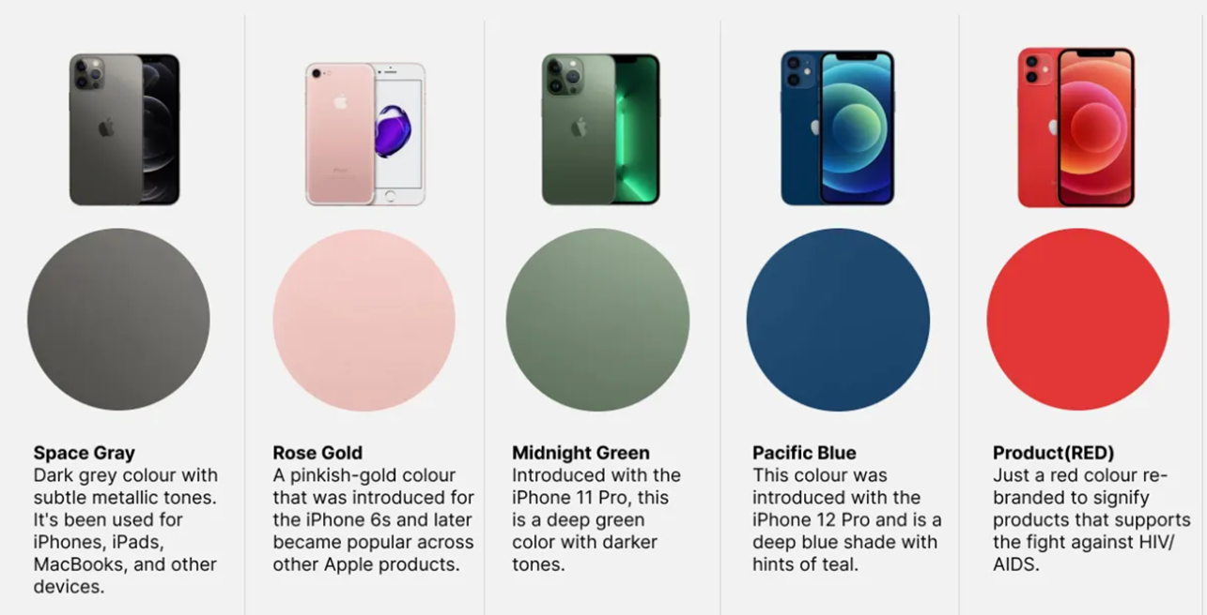




Notes:
1) Products in multiple hues contrasts with clean black and white Apple branding
2) Creative names helped Apple’s differentiation, branding
Consumers engagement through color selection
Hastens obsolescence

Slide 9
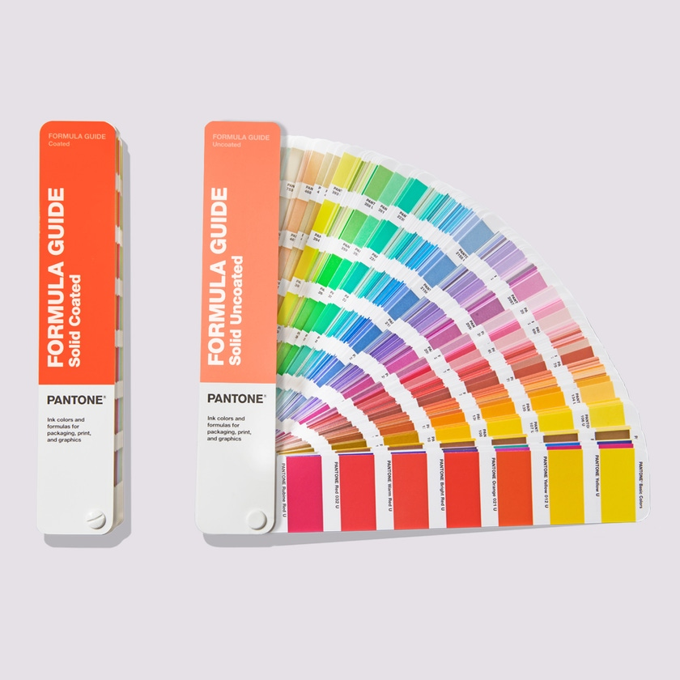
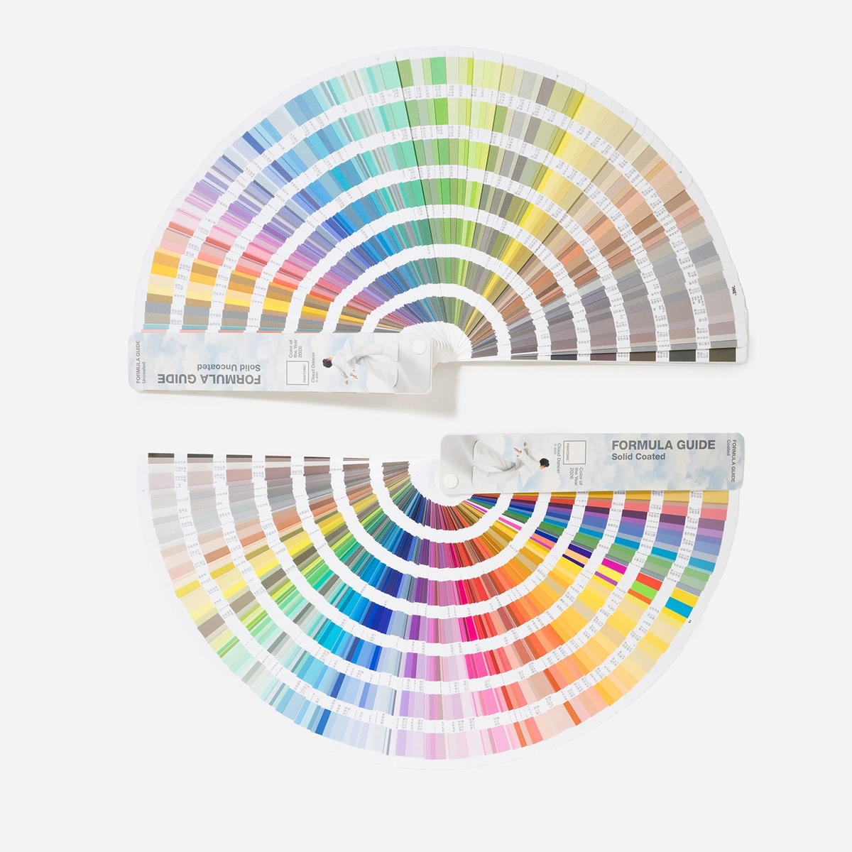

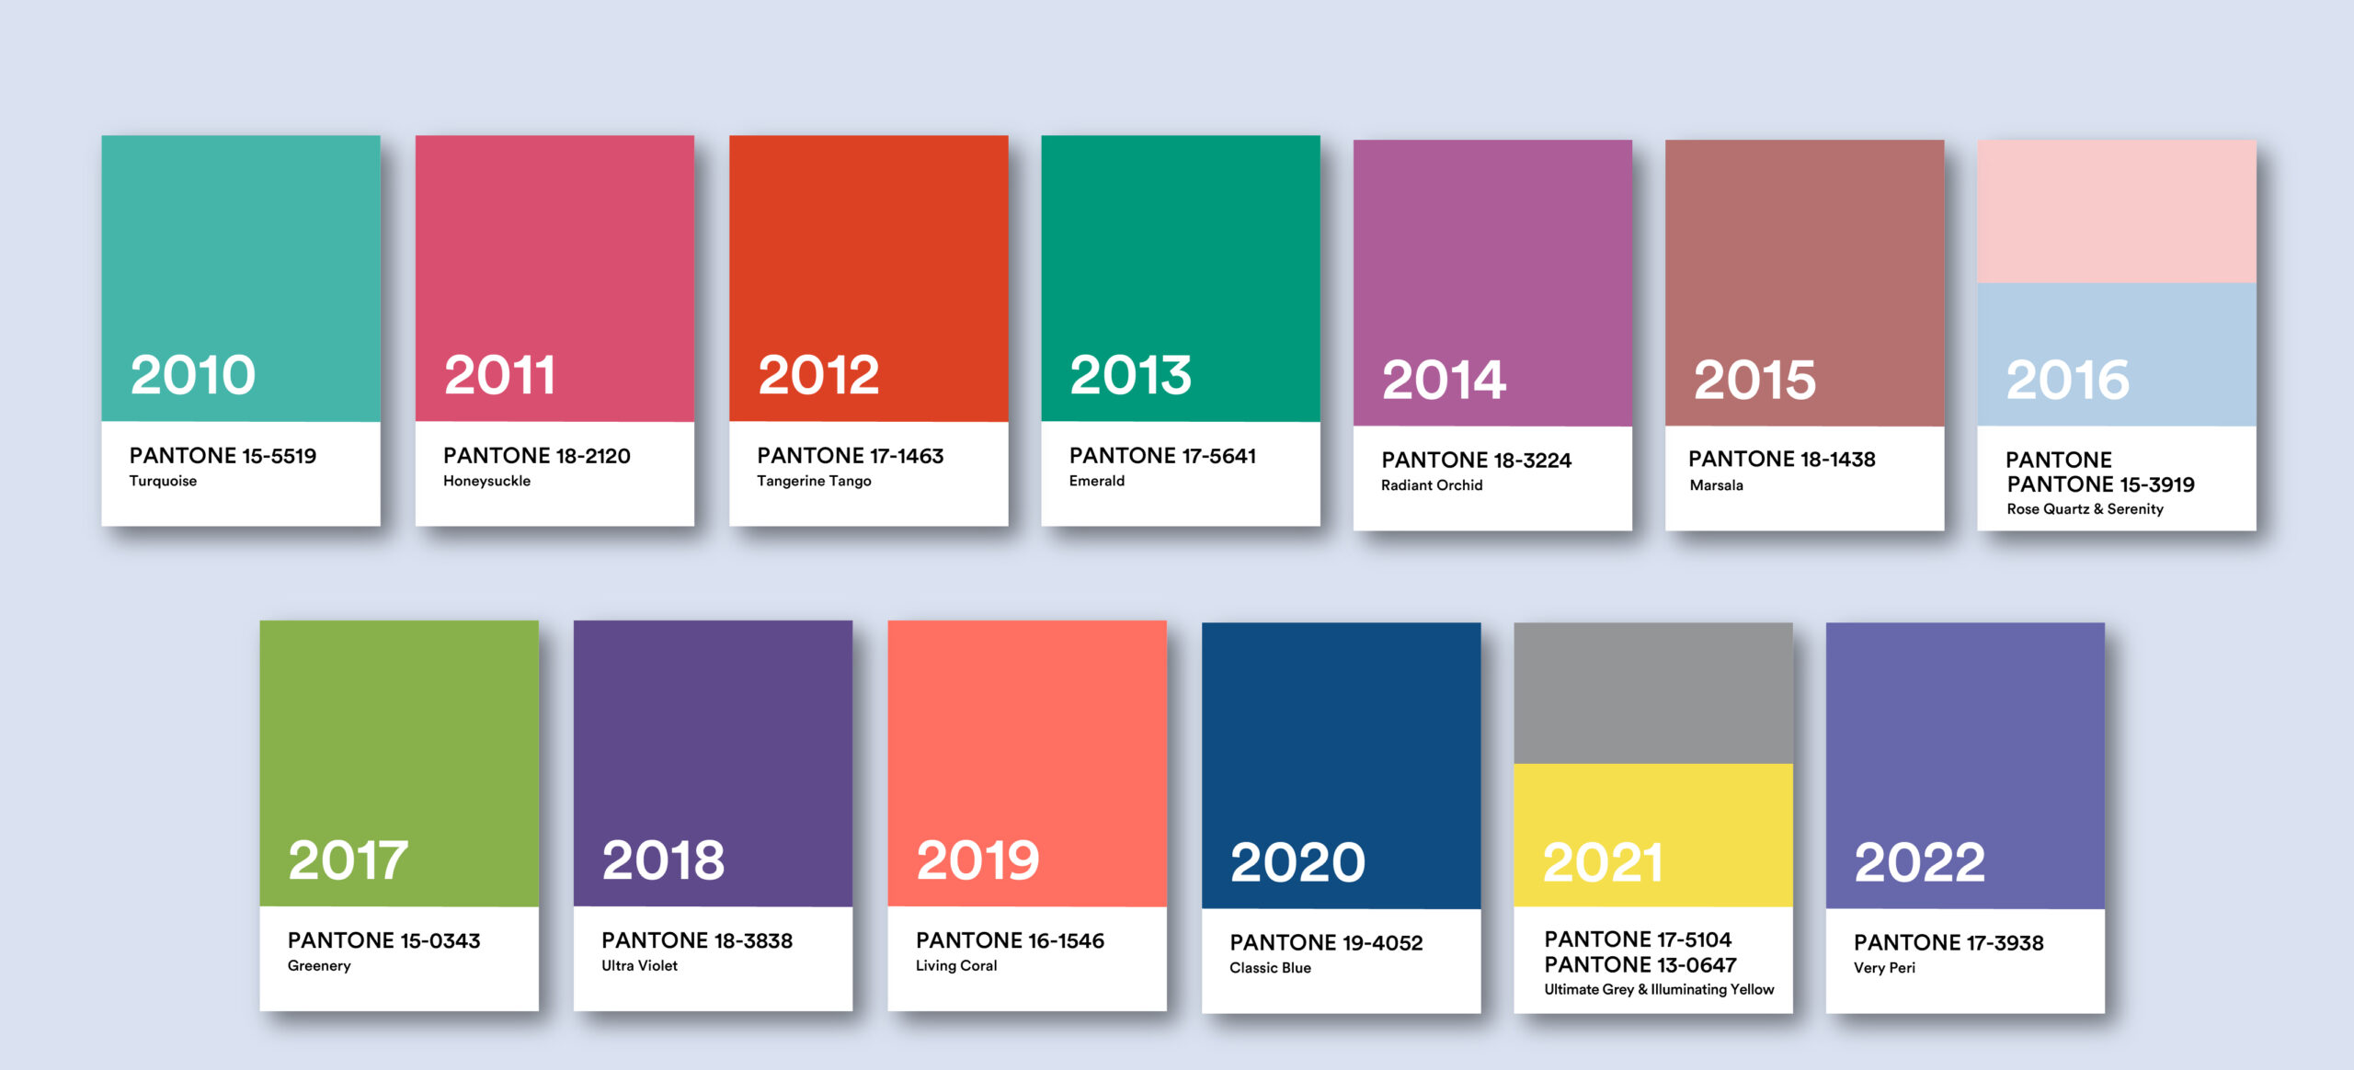
Pantone:
“The World’s Authority on Color”
1960: Printing company
1963: Pantone Matching System (PMS)
  Standardized catalog of colors gave printers and clients ‘shared language’ for accuracy
1986: Founded Color Institute
1999: First Color of the Year (Cerulean Blue)
Notes:
*Sources: From Ink to Influence: The Vibrant Rise of Pantone https://thebrandhopper.com/2025/06/25/from-ink-to-influence-the-vibrant-rise-of-pantone/
about-us – PANTONE https://shoppantone.com/pages/about-us

Slide 10




The Cost of
Color: Pantone Profits
Intellectual property: PMS tools & subscriptions, color development, i.e.,
Brand Popularity: Merchandise, Pantone Hotel
Color of the Year: Licensing agreements
“Over time, Pantone stopped being a commercial printer and became a weird new thing: a company that taxonomizes colors.”
Source: What is Pantone, besides the Color of the Year company?
Notes:
*Source: https://slate.com/business/2021/03/what-is-pantone-color-of-the-year.html

Slide 11

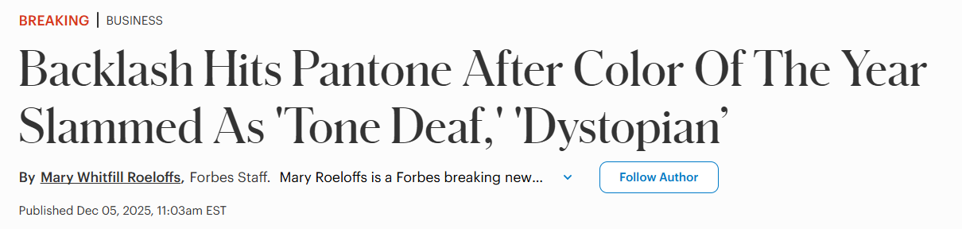

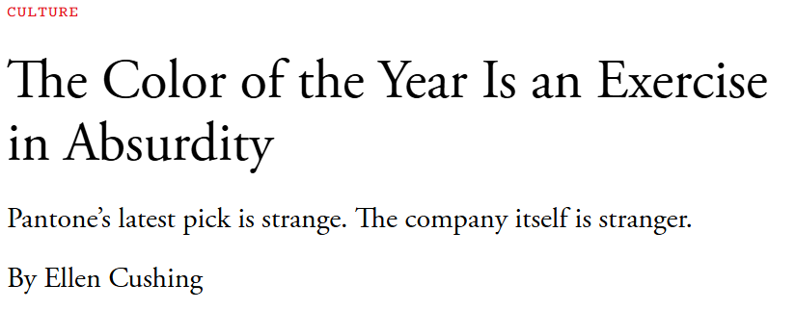

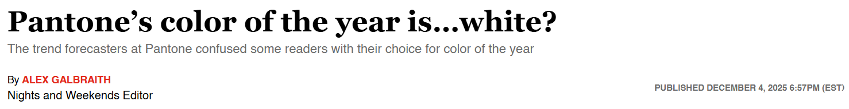

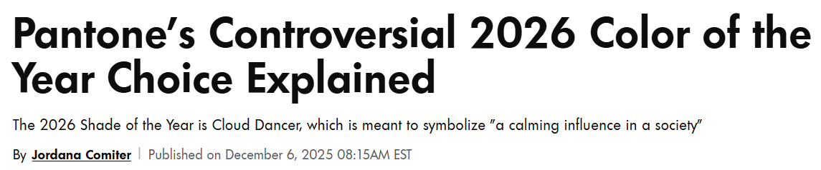

HEADLINES:
Color of the Year 2026: Cloud Dancer
Does this “billowy” white…
Represent the fresh, clean mindset the world is craving?
Miss the mark with a bland or boring (non)color?
[???]
Notes:
*Sources: (From top to bottom)
https://www.forbes.com/sites/maryroeloffs/2025/12/05/backlash-hits-pantone-after-color-of-the-year-slammed-as-tone-deaf-dystopian/
https://www.theatlantic.com/culture/2025/12/pantone-color-of-the-year-cloud-dancer/685316/
https://www.salon.com/2025/12/04/pantones-color-of-the-year-is-white/
https://people.com/pantone-color-of-the-year-controversy-explained-11862972

Slide 12


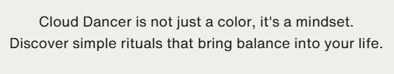


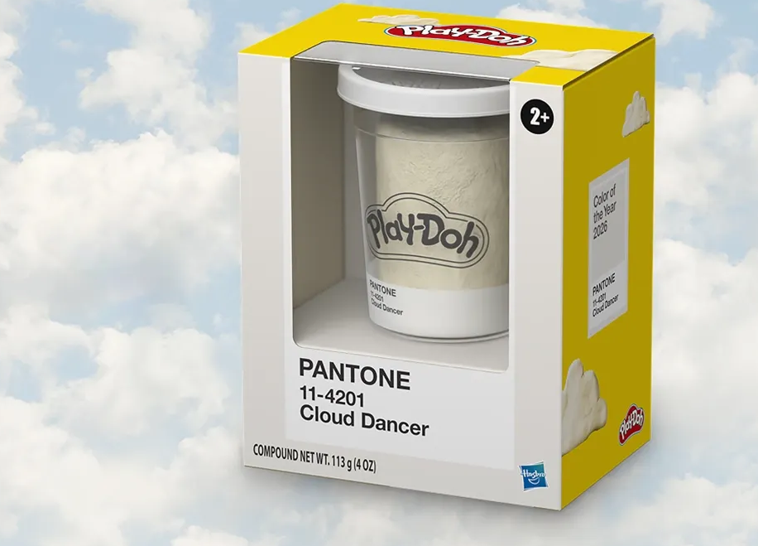
Notes:
*Source: https://www.pantone.com/color-of-the-year/2026

Slide 13
Investigating Consumers & Color: Activity Menu
Ad & Packaging Analysis Focus: Persuasive design Analyze how color influences emotions and choices Identify target audiences through color use Compare the same product with different color schemes | The Pink Tax Focus: Equity & pricing Compare prices of similar products in different colors Investigate whether higher prices reflect real differences Discuss fairness and consumer impact
Brand Identity Case Study Focus: Branding & recognition Research how brands use color consistently Explore trademarks and exclusive color use Predict what might happen if a brand changed its color | Redesign the Product Focus: Value & marketing Redesign a familiar product using new colors Identify a new target audience Decide whether the price should change and why
Opportunity Cost Reflection Focus: Personal finance Examine purchases influenced by color Discuss trade-offs when buying duplicates or collections Connect spending choices to personal values | Ethics Debate or Socratic Seminar Focus: Consumer responsibility Should companies own or trademark colors? Is limited-edition color marketing ethical? When does marketing become manipulation?
Culture & Color Focus: Perspective & inclusion Explore how color meanings vary across cultures Consider how companies adapt colors for different audiences Connect color to community and identity | Color of the Year Alternative Focus: Marketing, consumer influence, & ethics Analyze past “Color of the Year” selections Propose a new color for the upcoming year Justify the choice using consumer trends, emotions, or social context

Slide 14
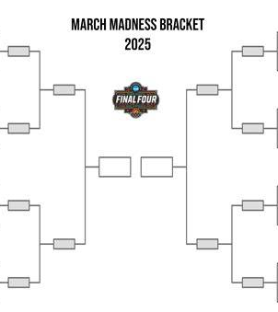








COMING UP:
March Madness Tournaments
NCAA Men’s and Women’s College Basketball Tournaments
Generates $1B+ in revenue
Men’s Tourney: 1 game = $2 million
Women’s Tourney: 1 game = $113,000
Over $15.5M in sports betting (2023)
Notes:
NCAA = National Collegiate Athletic Association

Slide 15
MONEY MATCH:
March Madness (2025)
Match each statement below to the correct number on the right.
Price of a single-game NCAA Tournament ticket this season
College basketball programs involved in corruption case/paying players
Salary for college basketball’s highest paid coach
NCAA’s women’s basketball fund’s 2025 distribution to D1 schools
Amount the players participating in the tournament earn
Difference between average NBA rookie’s salary and D1 men’s athlete basketball scholarship
Annual estimated revenue for the NCAA in 2024
Corporate losses due to unproductive workers during March Madness
$1,300,000,000
$9,600,000
52x
$17,000,000,000
$452.00
$15,000,000
$0
12+
Notes:
Source: WalletHub 2025 March Madness Stats & Facts
https://wallethub.com/blog/march-madness-statistics/11016
NCAA Men’s and Women’s College Basketball Tournaments
Generates $1B+ in revenue
Men’s Tourney: 1 game = $2 million
Women’s Tourney: 1 game = $113,000
Over $15.5M in sports betting (2023)

Slide 16
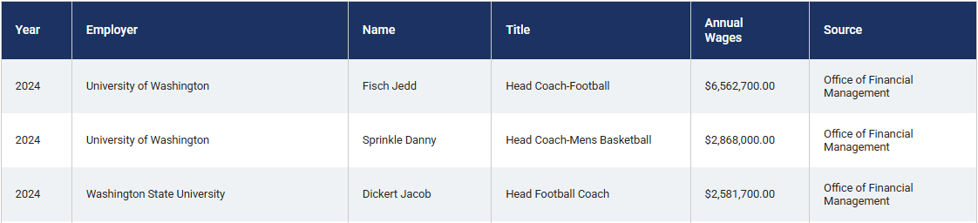
College Sports and State Budgets
Economic Learning Opportunities in Sports:
Unions and contracts
Stadiums and sales tax
Costs and benefits to host cities
State education funding
6-7
13-18
Coaches at public universities are typically state employees
Salaries often funded by state education budgets
Economics costs and benefits

Slide 17

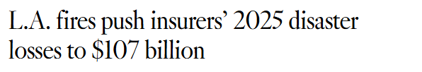


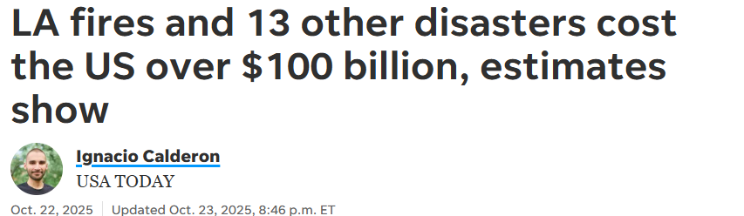

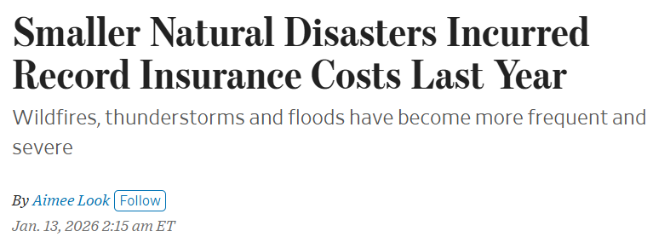

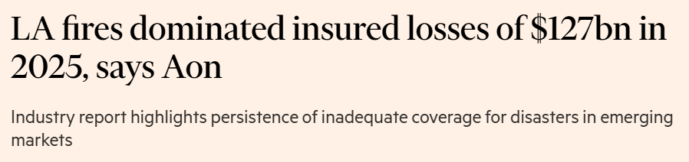

HEADLINES:
Climate Disasters & Insurance
Risk Management Strategies:
Accept the risk
Reduce the risk
Transfer the risk
Avoid the risk
Notes:
https://www.latimes.com/environment/story/2025-12-16/los-angeles-fires-push-insurers-disaster-losses-to-107-billion-for-2025
https://www.usatoday.com/story/news/nation/2025/10/22/weather-disaster-data-cost-government-noaa/86808748007/
https://www.wsj.com/finance/smaller-natural-disasters-incurred-record-insurance-costs-last-year-8f26c59e?msockid=138c59aab488655619964f42b59f6482
https://www.ft.com/content/bc5fa1ea-c11f-47bb-a085-ec85cc6a4448

Slide 18


LESSON
Insurance Video and Quiz
EconEdLink - Insurance Video and Quiz
Grades 9-12
Students will be able to understand the concept of insurance.
Insurance Concept Video (Vimeo)
Insurance Video and Quiz (Kahoot!)

Slide 19
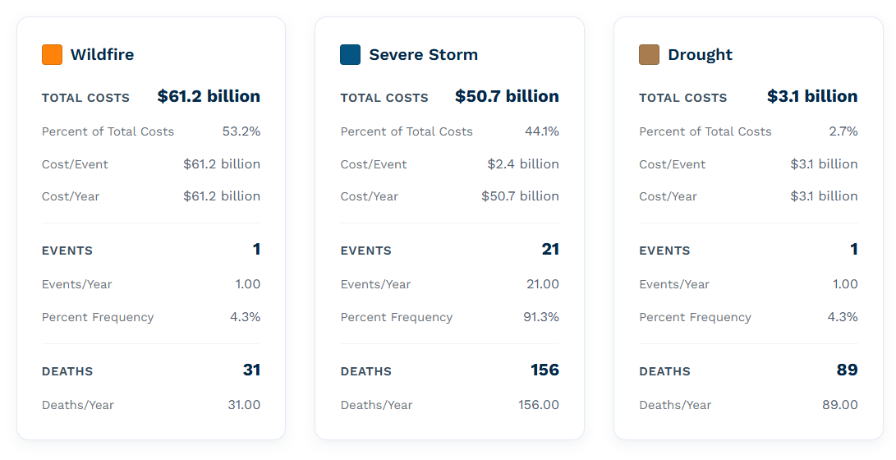
U.S. 2025 Billion-Dollar Weather & Climate Disasters
Events: 23
Deaths: 276
Total costs: $115 billion
No major hurricane
Most destructive fires in history
Notes:
Sources: https://www.climatecentral.org/climate-services/billion-dollar-disasters
How climate change is affecting every U.S. region » Yale Climate Connections
https://yaleclimateconnections.org/2023/11/how-climate-change-is-affecting-every-u-s-region/
Every state faces a climate threat
Alaska and Hawaii
Alaska is threatened by thawing permafrost, shrinking glaciers, and melting sea ice.
Hawai’i and other Pacific Islands face threats from sea level rise, droughts, and heat.
Caribbean islands are threatened by hurricanes, sea level rise, heat, and drought.

Slide 20
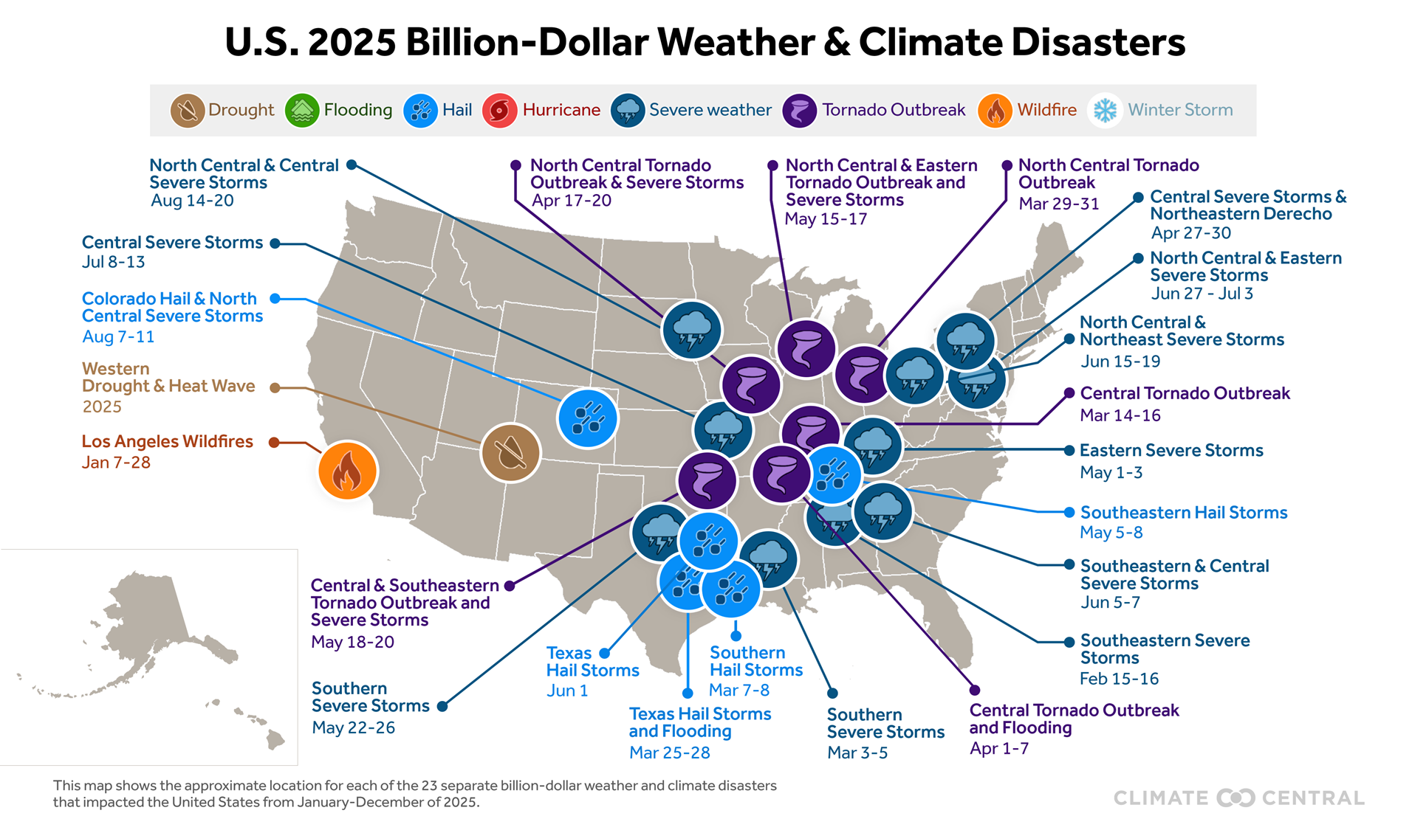
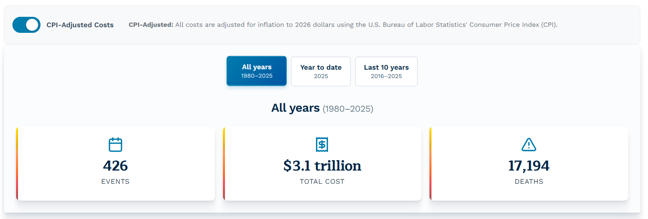
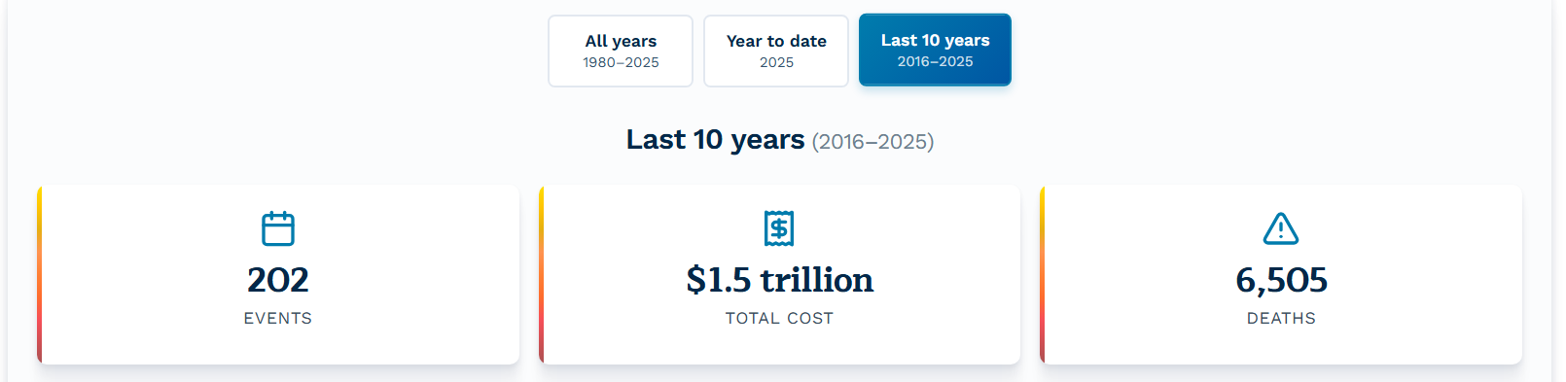

Billion-Dollar Weather & Climate Disasters
Climate Central.org
Policy-neutral 501(c)(3) nonprofit
Climate communication group
Assumed responsibility for billion-dollar disaster database in 2025
Notes:
Source: http://www.climatecentral.org/
Since 1980, the U.S. has sustained 426 billion-dollar disasters, with a total cost exceeding $3.1 trillion
In the last decade, 8/10 most costly years, almost 50% of events, roughly 50% of costs

Slide 21
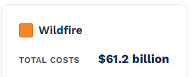


Breaking Down “Total Costs”
Direct property loss | Lost property and possessions Does not cover 100% (“out-of-pocket”)
Housing affordability | Rental costs increase Finite supply and high demand
Insurance markets | Renter and home insurance premiums increase
Health | Hospital costs for fire injuries, smoke inhalation Long-term risks/costs from pollution
Income-Earning Ability | Businesses gone, workforce displaced Without income, people can’t pay bills
Notes:
Source: Economic Impact of the Los Angeles Wildfires | UCLA Anderson School of Management
https://www.anderson.ucla.edu/about/centers/ucla-anderson-forecast/economic-impact-los-angeles-wildfires

Slide 22
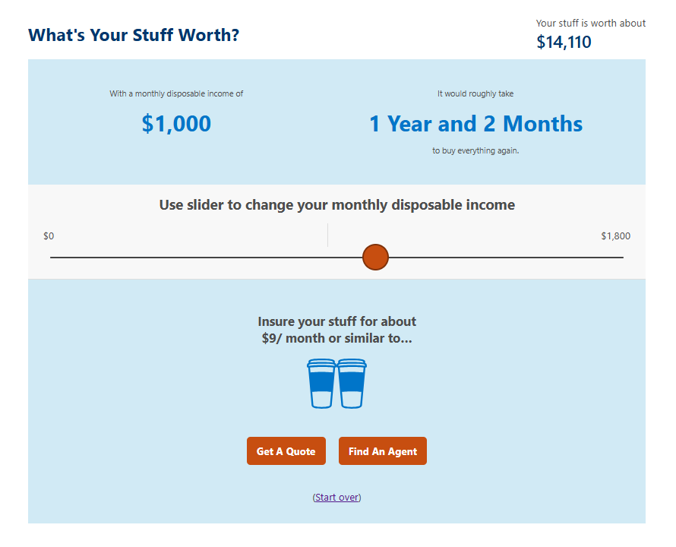
ACTIVITY:
What’s Your Stuff Worth?
Renters insurance protects a renter from perils like fire or theft.
For a monthly premium, it typically covers:
Personal property
Liability (Others on property)
Living expenses (If needed)

Slide 23
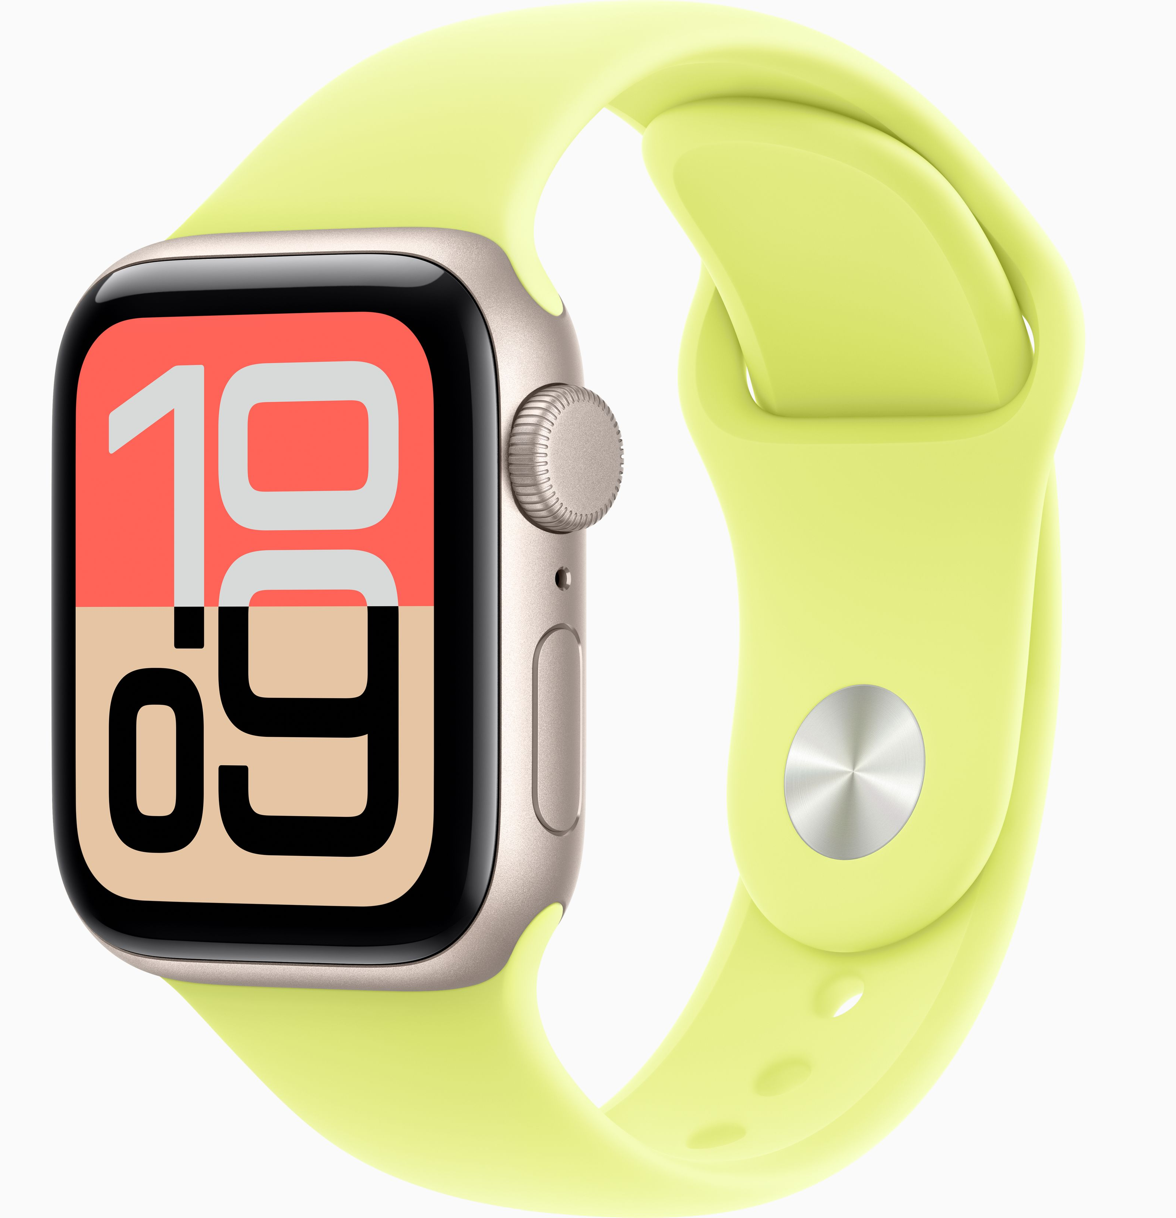
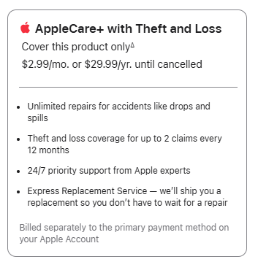
ACTIVITY
Insurance Claim Flowchart
AppleCare+ Analysis
You pay $271.66 for a new Apple Watch SE 3 (GPS, 40 mm).
Owner files insurance claim
Risk Analysis:
Identify the risks or perils associated with this purchase
Can you accept, reduce, or avoid these risks?
Is risk transfer (AppleCare+) the best strategy?
Coverage review:
What risks are covered? How often?
What is the deductible?
Cost/Benefit Analysis:
Total cost of watch replacement with and without AppleCare+
Informed decision on insurance
Notes:
Investigate: Different Apple products and coverage levels
How difficult is it to find deductible information?

Slide 24
ACTIVITY
Insurance Claim Flowchart
The owner pays a $150 monthly premium for home insurance with a $5,000 deductible.
During a storm, the home incurs $170,000 in covered damages.
Owner: $5,000
Insurer: $165,000
The owner pays a $70 monthly premium for home insurance with a $20,000 deductible.
During a storm, the home incurs $170,000 in covered damages.
Owner: $20,000
Insurer: $150,000
Owner files insurance claim
Owner documents damage
Insurance adjustor inspects damage, estimates repair and replacement costs
Coverage review: What is/is not covered, deductible applied
Insurance payments issued, often in stages
Owner decides if/when to repair, rebuild, or replace – often with out-of-pocket costs
Notes:
$170,000 – 5,000 = $165,000
You pay $1,800 per year, plus $5,000 deductible / Insurer pays $165,000
This is when it would be great to bring in insurance agents, brokers, or other community representatives
Teacher tip: This works well as a color-coded flowchart (blue = process, yellow = decisions, red = challenges)

Slide 25
Policy Connections for Engaged Citizenship
City/Local Policies: Disaster risk or preparedness (ex: building standards); Rebuilding who, what, where
Attend city council or planning commission meetings
Tune in to zoning, building codes, and land-use decisions
Support or question investments in resilience projects, i.e., flood control, wildfire mitigation
State Policies: Regulate insurance markets; decisions affect premium pricing, coverage availability, and fairness
Contact state legislators about insurance regulation or consumer protections
Track state insurance commissioner decisions
Participate in public comment on disaster recovery funds or climate resilience plans
After a weather or climate disaster, decisions at the local, state, and federal level can affect rebuilding and insurance options.

Slide 26
Policy Connections for Engaged Citizenship
Federal Policies: Influence who tracks disaster costs, who gets aid, and how risks are communicated; funding decisions affect long-term recovery and preparedness
How to engage
Vote in federal elections
Contact members of Congress about disaster aid, climate data, and insurance programs
Follow agencies that collect and publish disaster data
After a weather or climate disaster, decisions at the local, state, and federal level can affect rebuilding and insurance options.

Slide 27
Investigating Climate Disasters & Insurance: Activity Menu
Disaster Data & Impact Focus: Patterns, scale, & cost Explore Climate Central’s U.S. Billion-Dollar Disaster Database Identify trends in frequency, location, and total costs Discuss what costs are insured vs. uninsured | Learning From the Field Focus: Careers & real-world insight Invite local insurance agents to speak to the class Ask how climate risk affects pricing and coverage Explore careers connected to insurance, risk, and resilience
Managing Risk Focus: Decision-making & prevention Complete EconEdLink: Managing Risk Identify everyday risks and disaster-related risks Connect prevention and preparation to insurance costs | Story & Reflection Focus: Personal impact & empathy Play the Bummer! Game from the NGPF Arcade Complete the Bummer! reflection sheet Research the reasons floods are not covered by home insurance
How Insurance Works Focus: Systems & processes Watch EconEdLink: Insurance Video and Quiz Walk through f insurance decisions with CFPB’s “Understanding How Insurance Works: A Case Study About Lucy” Discuss how insurance priorities will change with age | Risk Pooling in Action Focus: Shared risk & fairness Complete PLAY: Insurance Risk Pooling from NGPF Experience how shared risk lowers individual costs Discuss what happens when risks increase due to climate events

Slide 28
From Pop culture to policy: financial education in the news
Amy Kliewer, k-8 program supervisor (FEPPP)
Amy.Kliewer@k12.wa.us

