Slide 1

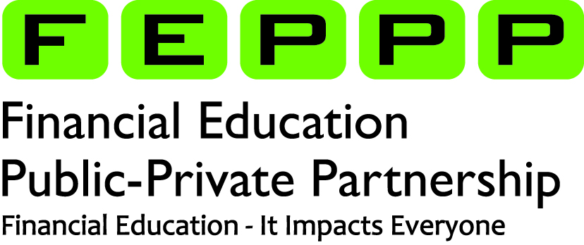
Empowering Students Through culturally responsive teaching in personal finance education
Miladys Garcia
December 15, 2025
Notes:
Good afternoon everyone. Thank you so much for joining our webinar today. This is the last webinar in our 3-part webinar series and today we will be talking about financial inclusion and we will be joined by two guest speakers from local credit unions that are doing amazing work to support financial education with in-classroom presentations.

Slide 2

Miladys Garcia Special Populations Program Supervisor miladys.garcia@k12.wa.us
Born and raised in Santo Domingo, Dominican Republic
Graduated with Honors, New York University
Early Childhood Education
Early Childhood Special Education
Spanish Literature- Latin American Studies
Prior experience
Interpreter
Translator
Early intervention Specialist
Avid book reader, love the outdoors
Passionate about supporting financial education in underserved communities
Family values and life experiences have shaped my Money Culture 😊
Notes:
It is my absolute joy and honor to serve as the special populations program supervisor for the Financial Education Public-Private Partnership. The two things that have influenced my money culture, how I think, feel about and use money have been my grandmother, who was very frugal and focused on saving and my life experiences.

Slide 3
Learning Objectives
Discover the different factors that influence an individual’s money culture.
Learn about the diverse student population of Washington state
Explore financial education instructional materials to empower all students to reach financial goals regardless of race, socioeconomic status or ability.

Slide 4
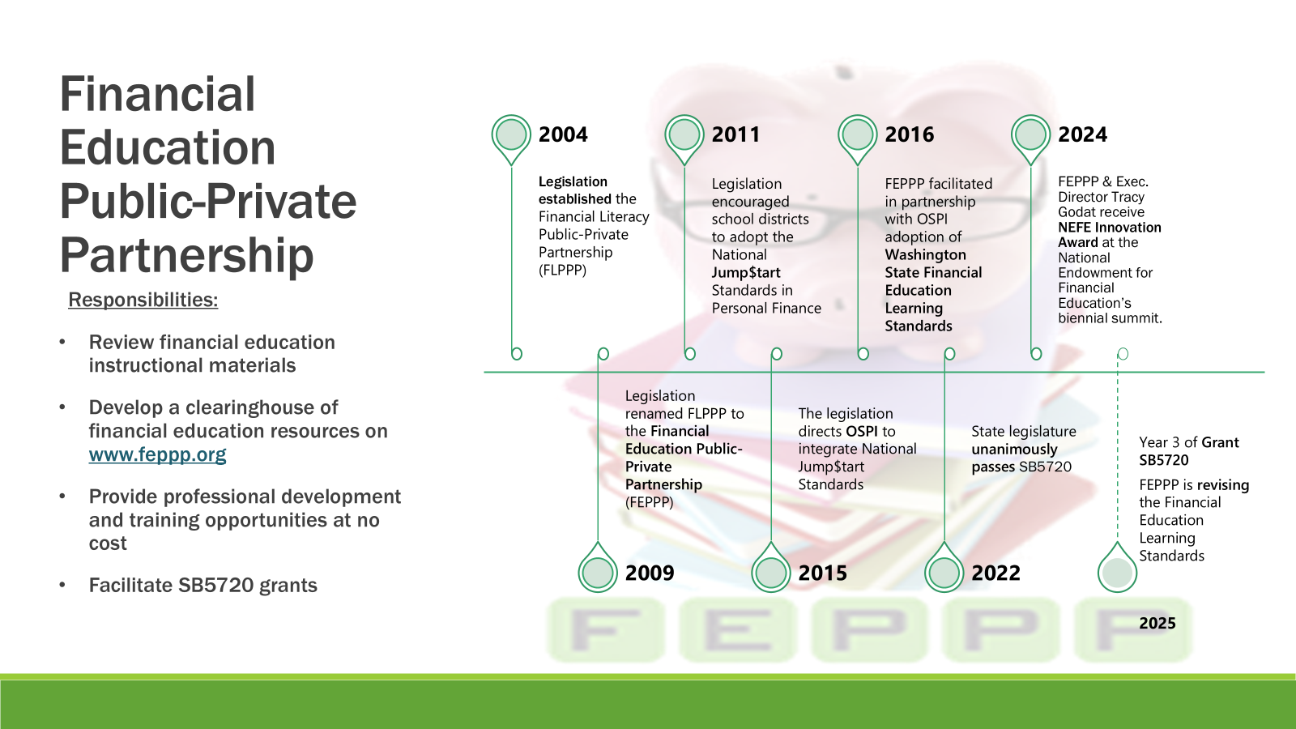

Financial Education Public-Private Partnership
2004
Legislation established the Financial Literacy Public-Private Partnership (FLPPP)
2009
Legislation renamed FLPPP to the Financial Education Public-Private Partnership (FEPPP)
2011
Legislation encouraged school districts to adopt the National Jump$tart Standards in Personal Finance
2015
The legislation directs OSPI to integrate National Jump$tart Standards
2016
FEPPP facilitated in partnership with OSPI adoption of Washington State Financial Education Learning Standards
2022
State legislature unanimously passes SB5720
2024
Year 3 of Grant SB5720
2025
FEPPP & Exec. Director Tracy Godat receive NEFE Innovation Award at the National Endowment for Financial Education’s biennial summit.
Responsibilities:
Review financial education instructional materials
Develop a clearinghouse of financial education resources on www.feppp.org
Provide professional development and training opportunities at no cost
Facilitate SB5720 grants

Slide 5

Today’s Big Why
(C)elebrate diversity
(E)xpand understanding
(E)mpower educators
Center the learner
Notes:
I want us to approach cultural diversity with excitement and curiosity. Honoring the impact of culture on all students to create an environment in the classroom where everyone feels valued.
My hope is that you leave this webinar with a greater understanding of the different factors that impact how individuals make financial decision, and today we are going to focus specifically on how culture can impact financial decision-making.
I will be sharing some amazing culturally relevant financial education resources to empower educators to practice culturally responsive teaching.
And the main goal today is to center the learner by sharing resources and approaches that can benefit all students regardless of race or socioeconomic background by making instruction relevant to their lived experiences.

Slide 6
Makings of an Individual’s Money Culture
Collective Culture: Social and ethnic heritage
Personal Culture: Continuous growth and experiences
Financial Education: Financial knowledge and skill
Collective Culture
Money Culture and Financial Decisions
Financial Education
Personal Culture
Money Culture
Intersects personal culture and collective cultures
Determines how you feel, think about and use money
Notes:
A person’s money culture is the unique set of beliefs, values, habits, and social influences that shape how they think about and use money. It’s essentially the “cultural lens” through which someone approaches financial decisions.
It is important to recognize that, while culture and socioeconomic background influence financial decisions and values, every individual also has experiences that make a person unique, that also impact financial decisions and how they feel, think about and use money.

Slide 7
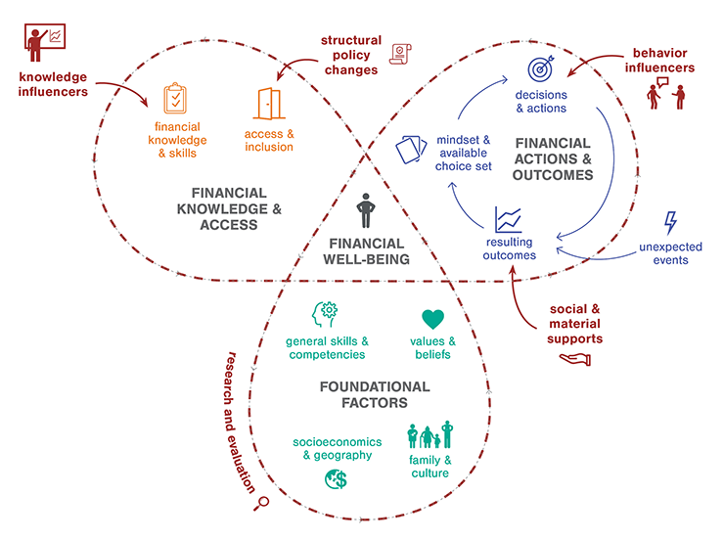
Instructional Materials
Social Emotional Learning
Personal Finance Ecosystem
Factors that Influence
Money Culture
Cultural Relevance
Defining the Personal Finance Ecosystem and Visual Roadmap| NEFE
Notes:
This visual was created by the National Endowment for Financial Education, and it covers many of the factors that impact financial decision-making and what I refer to as an individual’s money culture, which is a combination of how collective culture, meaning your ethnic background as well as family and community values, your personal experiences, as well as exposure to financial education, tools and resources influence how you feel, think about and use money.

Slide 8
Your Money Culture – Your Money Story
Think back to your first financial experience…
How did your culture and family values influence that experience?
Please share in the chat 😊
Notes:
Think back to your first financial decision — maybe saving allowance, buying something small, or helping family.
ME – I remember that when family would come over from the U.S. to the D.R, they would always give me a dollar and I would go to a store to exchange it for Dominican dollars and it would be more money. I learned at an early age that the dollar was more valuable than the Dominican peso. remark on similarities and differences of participant responses. Ask participants to come off mute and share with the group if they feel comfortable.

Slide 9
Lessons Learned Along the Way
Think of a recent financial experience…
How has your own personal growth and individual identity influenced that experience?
Please share in the chat 😊
Notes:
Our money culture is a combination of both ethnic culture and personal identity.

Slide 10
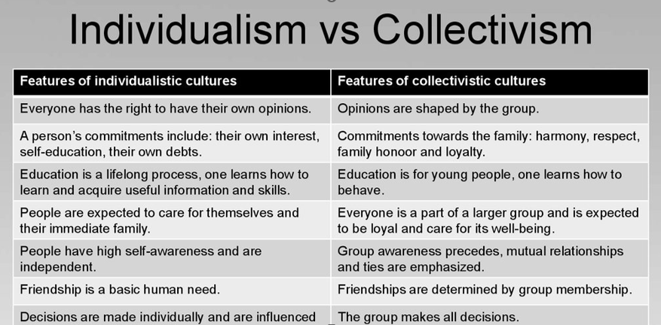
Notes:
Geert Hofstede, a social psychologist created a cultural dimensions theory. According to this theory, which he formulated using date from over 70 countries, he determined that about 20% of nations have an individualistic culture, while the other 80% have a collectivistic culture. This impacts our social interactions as well as financial decisions. Collectivistic cultures tend to make financial decisions considering the wellbeing of the community and the sharing of resources, while individualistic cultures consider nuclear family and financial independence.
However, it is important to remember that, while cultural beliefs, habits and values, impact financial decisions, there are other factors that are also impactful, like personality and having this understanding can help us practice culturally responsive teaching in the most effective way possible, where we are teaching the whole student.
Geer Hosftede created a cultural Dimension Index on a scale from 1 to 100 to determine how individualistic countries were. So, if you all had to guess, on a scale of 1 to 100, 1 being the least individualistic and 100 being the most individualistic, what number do you think the U.S. is on this scale. Again, from 1 to 100, 1 being the least individualistic and 100 being the most individualistic. Please put your answers in the chat.

Slide 11
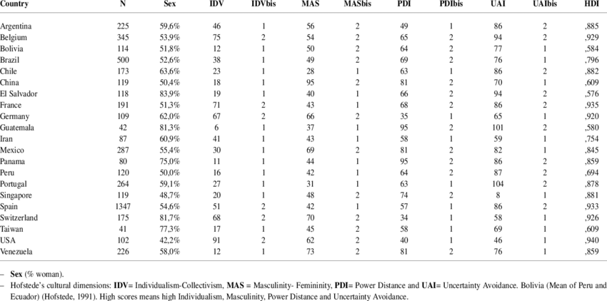


Notes:
According to Geert Hofstede, the U.S. is a very individualistic country. He gave the U.S. a score of 91 on this scale. I am wondering if you agree with this measure.
The cultural Dimensions Index was created by cultural psychologist, Geert Hofstede. Countries are evaluated on a 100-point scale in seven dimensions. At the high end of the scale are extremely individualist cultures (self-oriented, individual effort favored in business and learning, competition over cooperation) while a lower number signals a more collectivist culture (group orientation, relationships essential to business and learning, and cooperation over competition.)

Slide 12

Culturally Responsive Teaching
A look at Washington’s students
Culturally relevant resources
Notes:
Since we have laid the foundation in understanding the different factors that influence money culture, we are going to look

Slide 13
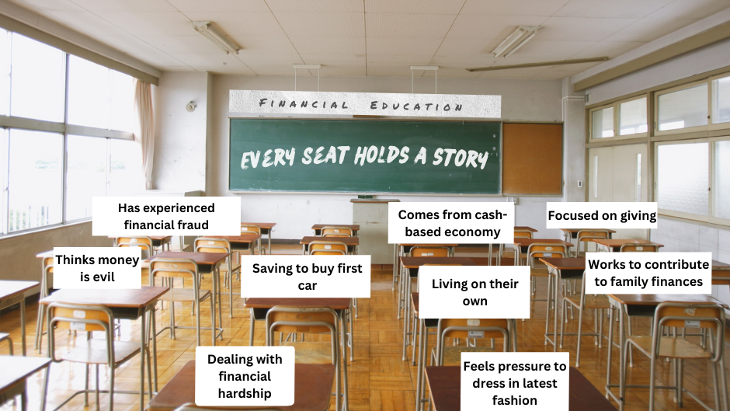
Notes:
Our students show up to our classrooms with formed money habits that have been shaped by many different factors, which is why culturally responsive teaching can be so impactful by making financial education relevant to all students.

Slide 14
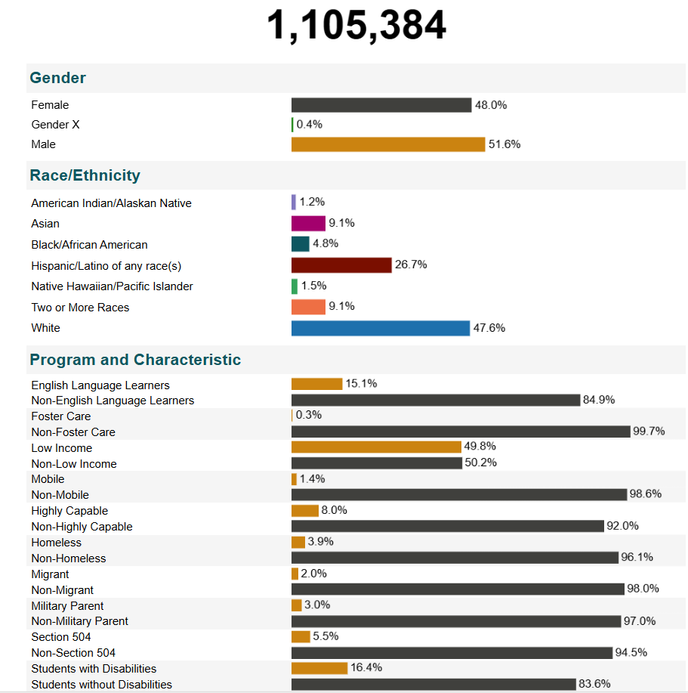
Washington State’s Student Body
52.4% ethnicity other than white
49.8% low income
15.1% English learners
Over 25% special populations
Report Card - Washington State Report Card
Notes:
Washington has a very diverse student body in terms of ethnicity and socioeconomic background.
52.4% ethnicity other than white
49.8% low income
15.1% English learners
Over 25% special populations- Over 276,346 students
California has about 17% of students as English learners and 80% identifying as non-white and New York has 12% of English learners and 61% non-white student population.

Slide 15
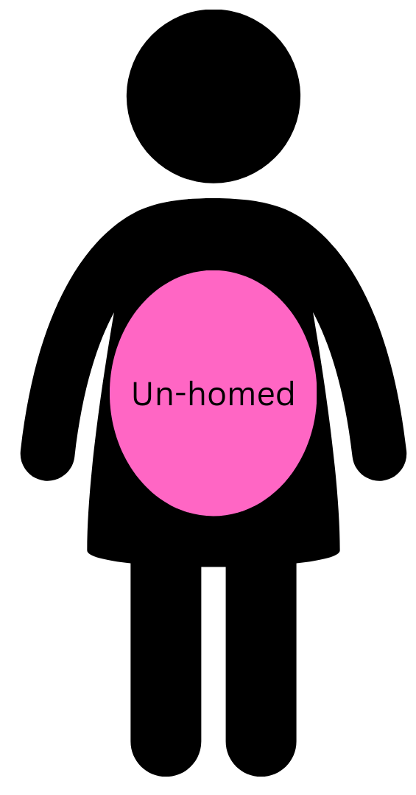




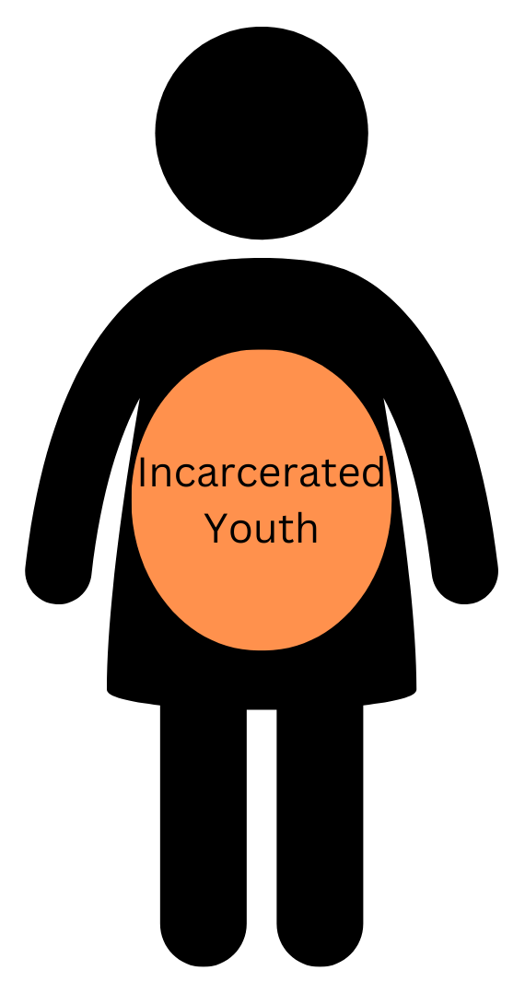
Special Populations students face barriers to access education and resources other students access with ease.
25% drop-out rate
47% drop out rate
26% drop out rate
21% drop out
20% drop-out rate
95% drop out rate
Report to the Legislature-2024
WA high school graduation rates-2023
15
Notes:
In the previous slide there was a statistic showing that 25% of students in Washington fall under the category of special populations. This term refers to students that face barriers to access education and resources other students access with ease. Many of these students also contend with barriers that lead them to experience financial exclusion, as they often cannot meet the criteria needed to open a bank account or access credit, which is crucial to financial wellbeing in our financial system.
Teaching financial education in a way that all students can benefit from, when you have a classroom with students from diverse backgrounds and experiences, can feel like a challenge. I am going to share some strategies that can help make personal finance concepts relevant to all students.

Slide 16
Financial Foundations Made Relevant
Financial Education Competencies
1. Spending and Saving
2. Credit and Debt
3. Employment and Income
4. Investing
5. Risk Management and Insurance
6. Financial Decision-Making
Financial Concepts
1. Budgeting
2. Credit scores and credit reports
3. Paychecks and deductions
4. Compound interest
5. Identity theft protection
6. Financial goal setting

Slide 17
Connecting to all Money Cultures
Rename Budget to reflect financial prioroties
Credit is your financial reputation and ability to borrow
Understand income and deductions from your paycheck
The right time to invest
Notes:
Framing financial education concepts is a powerful way to connect with all money cultures. Renaming a budget, which a lot of people are calling a spending plan or a savings plan, since the term budget can be triggering for individuals that are experiencing financial hardship, can help students feel more compelled and invested in making a budget, or whatever they want to call it (maybe it’s ‘getting my own wheels plan, for students who want to save for their first car, or getting my degree plan, for students saving for higher education), the point is to encourage students to come up with a financial goal that is personal and naming their budget after this goal.

Slide 18
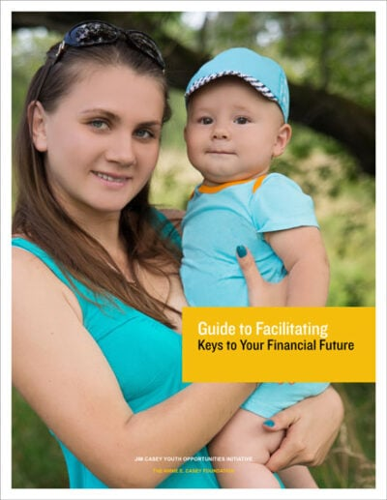

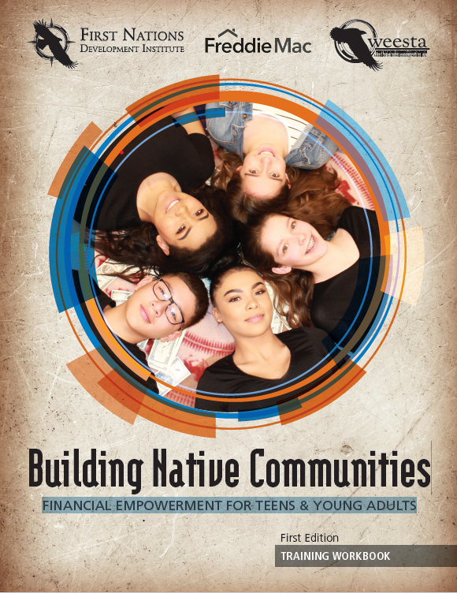
Culturally Relevant Resources for Students in k-12
Keys to your Financial Future
SmartPath
Financial Empowerment for Native Teens

Slide 19
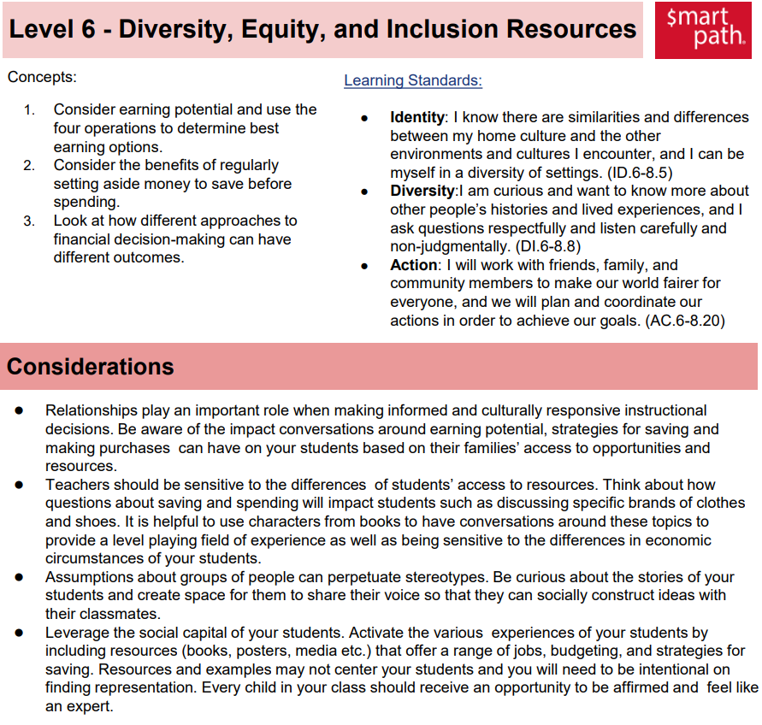

Free, K-8
DEI materials
Available in English and Spanish
Lessons modified for disabled students
Award winning!
Notes:
A free, interactive curriculum created by the Alpaugh Family Economics Center at the University of Cincinnati, designed for elementary and middle school students
Award-winning: recipient of multiple national financial literacy education awards and Emmy awards for its video content.
modified materials tailored for students with developmental disabilities, with lessons scaffolded by complexity levels and supporting tools like matching cards and visual supports
Registration is required for educators
Features grade-leveled units (K–8) with story-based scenarios to teach key concepts. [economicscenter.org], [smartpathl...arning.com] Each lesson includes: Interactive games and quizzes;
Videos (e.g., puppet clips) to engage students;
Embedded assessments (pre‑ and post‑tests);
Teacher tools for grading, tracking progress, and homework extensions.
Additionally, this curriculum includes a DEI materials educators can integrate into core units. The lessons in the DEI materials address racial and social justice as part of financial education, giving guidance to the educator on how to encourage students to discuss their backgrounds and cultures and how their families make financial decisions with appreciation and curiosity for how others make financial decisions.

Slide 20

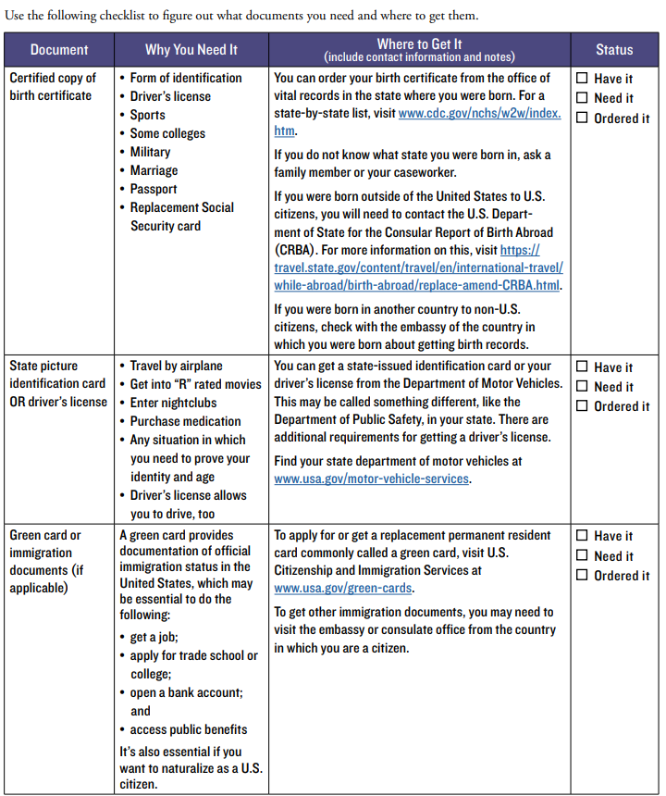
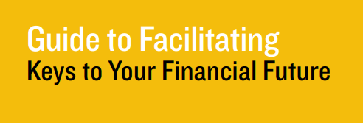

Free, 9-12
For systems impacted youth
Facilitator guide
Participant guide
No registration required
Notes:
This material is structured in 8 modules (or keys) that cover essential financial topics applicable to all young adults, but with references that could benefit systems impacted youth, like youth transitioning out of foster care. This resource was created by economists, social workers and former foster youth that shared what they wished they had known about finances as they transition into adulthood, so it has that element of youth co-design that makes the content very relevant to the experiences of youth entering adulthood. Lessons include worksheets, activities, PPT slide deck and a facilitator guide. The curriculum also has one of the most comprehensive modules on credit I have come across. So if you are interest on teaching the topic of credit, consider looking into this curriculum, because it covers all the important details we want students to understand about credit. It specifies the importance of checking your credit report if you experience involuntary mobility, as foster youth and other highly mobile student populations have greater chance of getting their identity stolen, which leads to incurring debt that is not actually theirs, making it extremely difficult to achieve financial wellness.

Slide 21
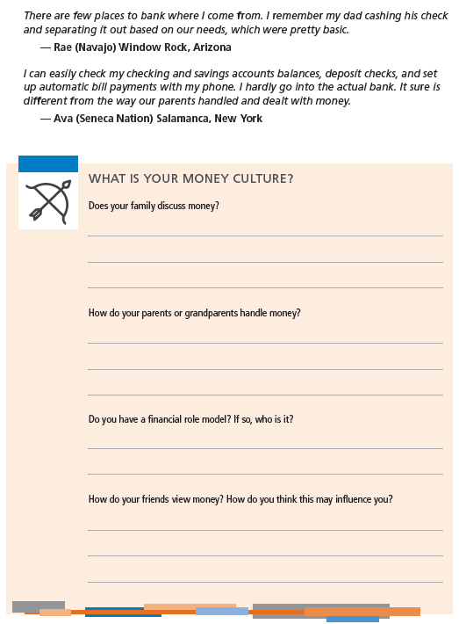


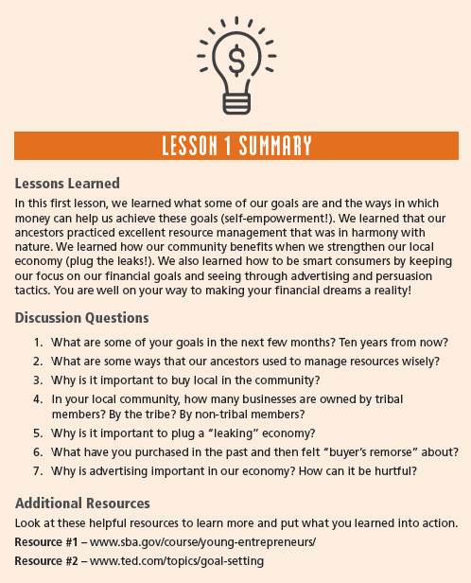
9-12 grade band
Costs $30.00 per curriculum
$25 for instructor guide
Integrates cultural values
Notes:
This curriculum was created by Oweesta, a national non-profit organization committed to supporting economic development in native communities.
This material integrates the cultural values and community-based approaches into financial education to make the content relevant to tribal students. The curriculum has 7 core lessons and two supplemental modules that cover student loans and per capita payments.
In addition to providing curriculum, Oweesta also leads professional development through which individuals can become certified trainers to deliver this content. I am happy to share I am a certified trainer in this curriculum and it was one of the best professional development experiences I have ever had.

Slide 22
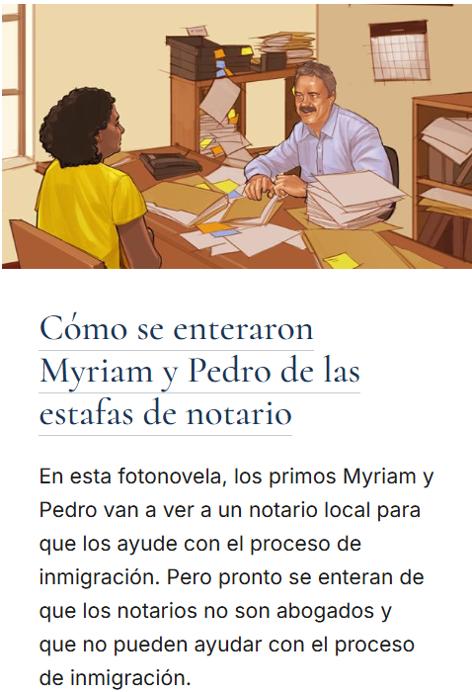


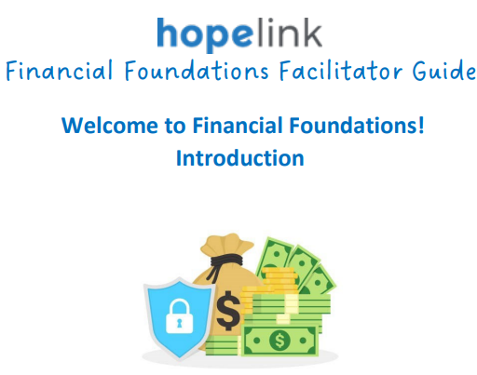
Culturally Relevant Resources for Students in k-12
Hopelink
Immigrants and Refugees
FTC – Consumer.gov

Slide 23
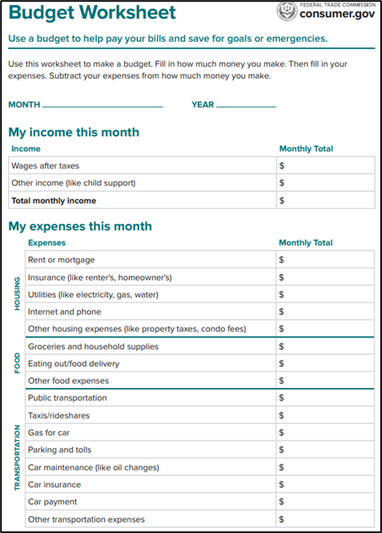

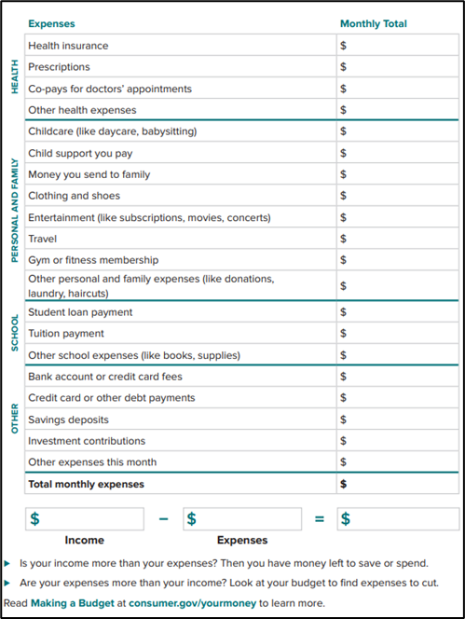
Free, 9-12 and adults
English Learners
Available in 5 languages
No registration required
Notes:
This resources was created by the Federal Trade Commission specifically for English learners. It can be used in classrooms, workforce development settings and community based program.
Financial concepts are explained simply and in a very non-threating manner. It includes articles, worksheets and short videos.

Slide 24
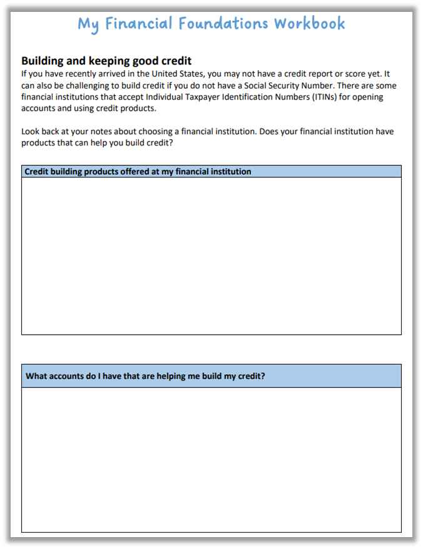
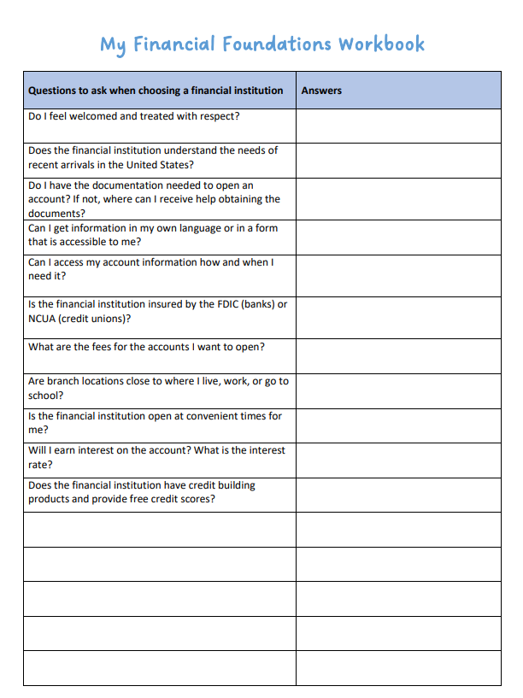
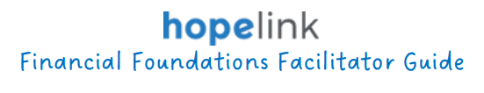
Free, 9-12 and adults
For immigrants and refugees
Registration required
Participant workbook in 12 languages!
Facilitator guide in English and Spanish
Notes:
This resources is made up of 4 modules and emphasizes a trauma informed approach to financial education for recently arrived individuals learning how to navigate our financial system.
IT was developed in collaboration with immigrant and refugee communities and local providers. The facilitator guide offers incredible insights and considerations on facilitating financial education instruction for individuals from different cultural backgrounds. When I reviewed this material I was so pleased to see how much thought and sensitivity was put into the approaches utilized when discussing the different financial topics. The modules cover managing your money, banking in the United States, understanding credit and consumer protection.

Slide 25
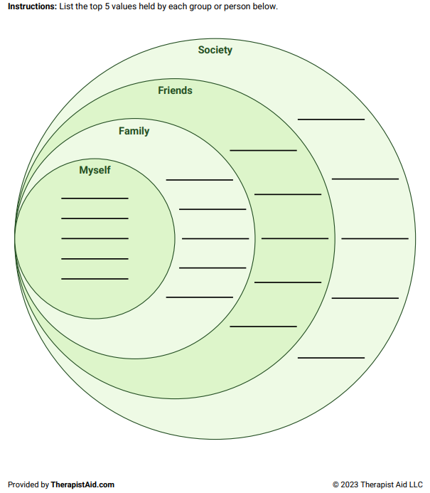
Financial Values: Circles of Influence
“Values are the things you cherish most in life. They play a role in shaping your goals, priorities, and identity. Values are influenced by your own beliefs, as well as by your family, friends, and society. Staying true to your values can help you express your most authentic self.”
Notes:
This is an activity from TherapistAid.com, that can very easily be adapted to help individuals reflect on how society, friends, family and their personal identity have influenced their financial values. This is a free, downloadable resource and it is available in English and Spanish.
Have them go through this activity if you have time. Share the link in the chat. Also, mention it is available in English and Spanish.

Slide 26
Questions?
Notes:
We are about to hear from one of our partners. IT is my pleasure to introduce to you, Jon Maroni, financial engagement manager from Numerica credit union. Jon, thank you so much for joining us today.

Slide 27













It Takes a Village.
Who’s Part of YOUR Village?
Financial Institutions
Government Agencies
Legislators
Educators
Non-Profits
K-12 Programs

Slide 28
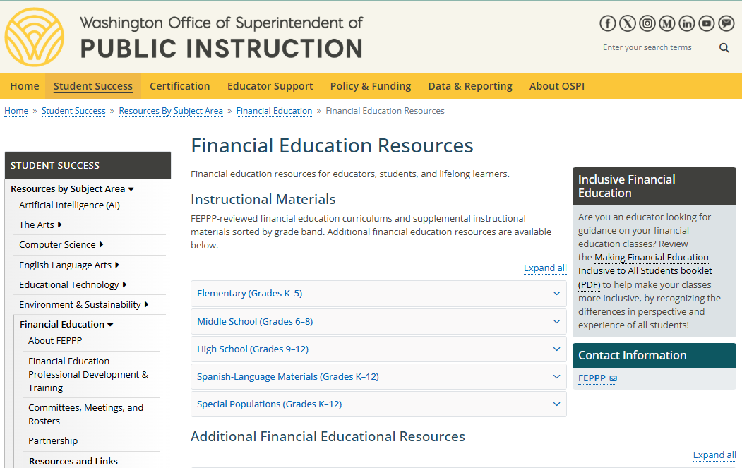

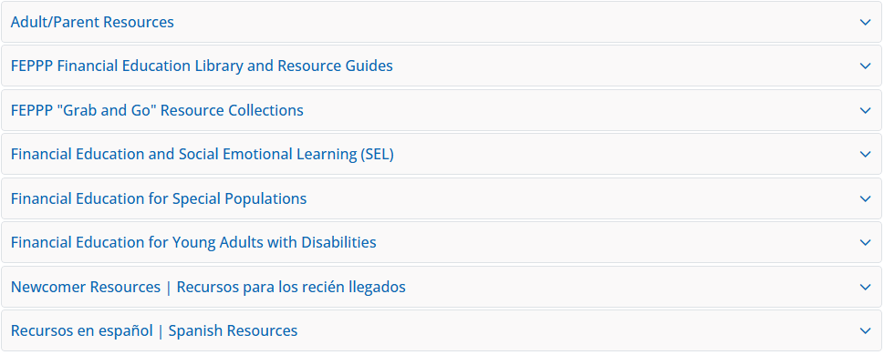

Feppp.org
Financial Education resources for k-12
Visit our website to learn about resources for teaching financial education and webinar recordings
Spanish!! Some webinars are available in
Resources for Special Populations!

Slide 29


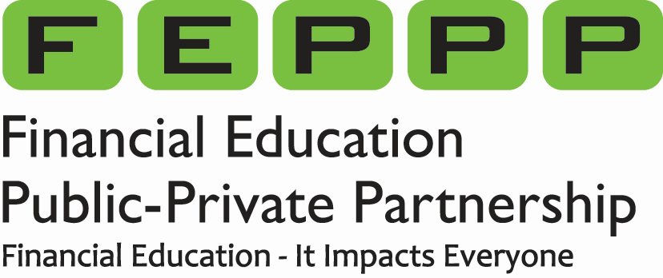



Webinar Resources and Links
SmartPath
Report Card - Washington State Report Card
Financial Empowerment for Native Teens
Report to the Legislature-2024
WA high school graduation rates-2023
Hope link-Immigrants and Refugees
Financial Education Resources
FTC – Consumer.gov
Personal Values: Circles of influence | Worksheet | Therapist Aid
Keys to your Financial Future

Slide 30

Thank You!! Questions? Miladys.Garcia@k12.wa.us feppp.org
Notes:
Thank so much for being part of this webinar. It has been a pleasure to lead this series. I look forward to Part two of the Everyone Has a Story Webinar Series. Please stay tuned and subscribe to our FEPPP newsletter if you haven’t done so already for more information on when we will be bringing you that series. I hope you all enjoy the rest of your day!

