Slide 1
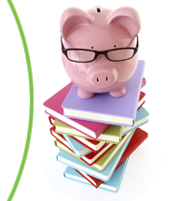

Pop Culture Meets Personal Finance: Trends, Toys, Music and the Power of Hype
Amy Kliewer, k-8 program supervisor (FEPPP)
December 10, 2025

Slide 2
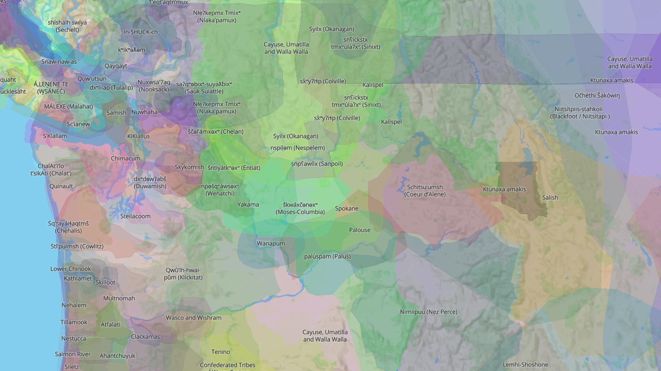
Land Acknowledgement
Native-Land.ca | Our home on native land
Notes:
Native-Land.ca | Our home on native land
Native Land Digital honors the sovereignty of all Indigenous nations, their lands, and their waters. We recognize that these boundaries and territories are representations of the sacred.
We respect the rights of Indigenous data sovereignty, and we are committed to an ongoing process of collaboration, growth, and learning.
We work to update and replace information that is a continuation of trauma caused by theft, injustice, misinformation, and ignorance.
The map is a living document, informed by the contributions of Indigenous communities, Indigenous knowledge holders and their stories. This is an honouring of Indigenous resilience past, present and future.

Slide 3

Amy Kliewer amy.kliewer@k12.wa.us
Honored to serve as K-8 Program Supervisor at FEPPP
Born, raised, and educated in the Pacific Northwest
  B.A. Communication Studies (University of Portland)
  Masters in Education (Eastern Washington University)
10+ years in the classroom
  English (ESL) Instruction: PK-7th Grade, Adult (Spain)
  5th Grade; 7th Grade Math, Social Studies, SEL
  Peer-to-Peer Instructional Coaching

Slide 4
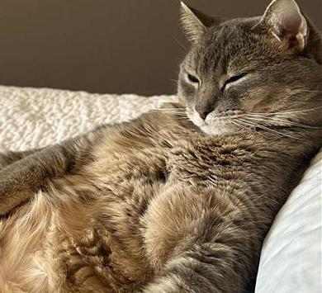




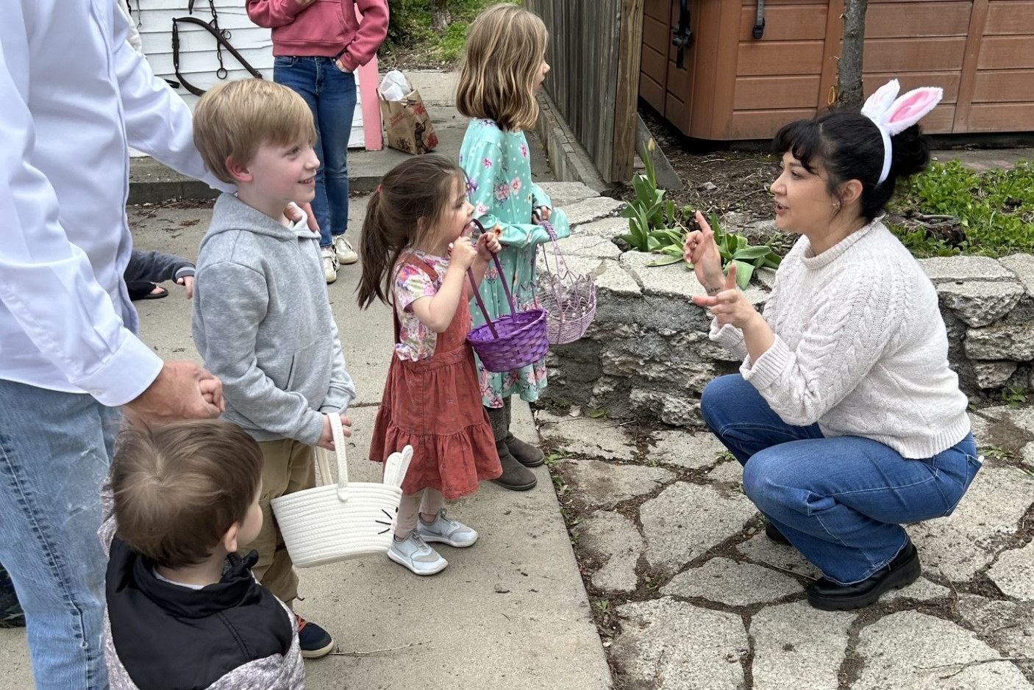


Slide 5

Financial Education Public-Private Partnership
2004
Legislation established the Financial Literacy Public-Private Partnership (FLPPP)
2009
Legislation renamed FLPPP to the Financial Education Public-Private Partnership (FEPPP)
2011
Legislation encouraged school districts to adopt the National Jump$tart Standards in Personal Finance
2015
The legislation directs OSPI to integrate National Jump$tart Standards
2016
FEPPP facilitated in partnership with OSPI adoption of Washington State Financial Education Learning Standards
2022
State legislature unanimously passes SB5720
2024
Year 3 of Grant SB5720
FEPPP is revising the Financial Education learning standards
2025
FEPPP Exec. Director Tracy Godat receives Innovation Award at the National Endowment for Financial Education (NEFE) biennial summit.
Review financial education instructional materials
Maintain a clearinghouse of financial education resources at www.feppp.org
Provide in-person and online professional development and training opportunities at no cost
Facilitate SB5720 grants with Washington districts

Slide 6
FEPPP:
A Holistic Approach to Financial Education
K-12 Financial Education
Reading
Social Studies
Social Emotional Learning
Decision-Making
School Counseling
Digital Citizenship
Math

Slide 7

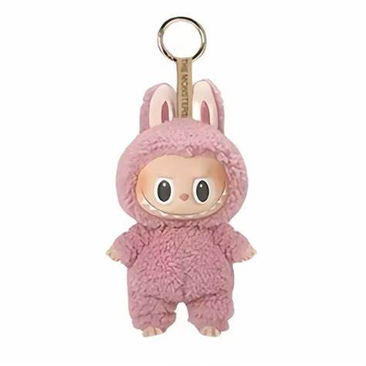
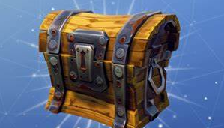
Today’s Professional Development
 | Ground financial education in today’s digital realities
Use pop culture to make consumer skills meaningful
 | Reveal the financial systems present in every headline!
Learning Objectives
Identify how pop culture connects to personal finance and economic concepts
Facilitate discussions using pop culture examples to help students recognize financial decision-making in everyday life
Notes:
Identify how pop culture connects to personal finance and economic concepts such as consumer behavior, scarcity, and marketing influence
Facilitate discussions that use pop culture examples to help students recognize financial decision-making in everyday life.

Slide 8
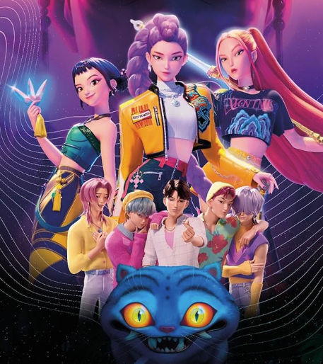
KPop Demon Hunters
Animated action-musical
Korean pop music (K-pop)
Released on Netflix on June 20, 2025
Most-watched movie ever: 325,100,000 views
Soundtrack achieved platinum certification
Source: Tudum by Netflix, accessed 12/2/25
Notes:
Views: 325,100,000
Runtime: 1:40
Estimate the total hours viewed: 541,800,000

Slide 9

The Appeal of KPop Demon Hunters
Genre-blending, family-friendly, coming-of-age story
Popularity of Korean culture, $1B K-pop industry
Catchy pop music from HUNTR/X and Saja Boys
Visuals reflect $100 million production budget
The “rewatchable” vibe
Oct 25 earnings report:
Significant engagement and growth
Highest quarterly view share ever in U.S.
Source: Top Streaming Statistics in 2025 (Forbes.com)
Notes:
K-Pop is a billion dollar industry

Slide 10
How Sony Fumbled ‘Demon Hunters’
Developed at Sony Animation in 2021
Sony signed a major deal with Netflix
  Netflix got first look at new projects
  Netflix guaranteed several Sony film greenlights
  Sony earned a budget premium capped at $20 million per film.
Netflix assumed production costs, kept all rights
Netflix’s happy surprise: “Frozen-level” intellectual property for the bargain price of $20,000,000
“Back in 2021, this was a good deal for both sides. Remember, most movie theaters were still closed due to the pandemic, decimating the theatrical business.”
Source: KPop Demon Hunters: Sony's $100 Million Budget & Theatrical Release Potential
Notes:
Seven years to make, four years for sequel

Slide 11

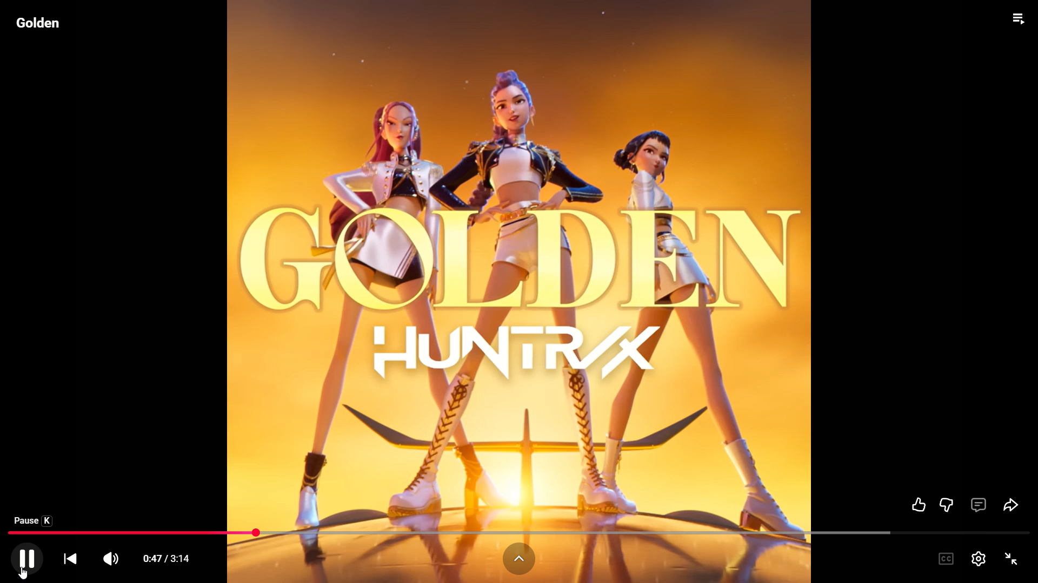
Consumer Math: Music Streaming
If the soundtrack length is 37 minutes, 50 seconds, what percentage does Golden represent?
Calculate the total listening time in seconds and minutes.
If one person listened to the song on loop, how long would it take them to hear it 1,070,670 times?
If a user subscribes to a Premium Spotify subscription to listen to Golden 1,070,670 times non-stop, how much would they pay in total?
The Golden single sells for $1.29 on Apple Music. How much would you pay to listen to the song 1,070,670 times?
Spotify pays an average of $3.00 per 1,000 streams. How much money has Golden earned to-date?
“Golden”
Plays: 1,070,670
Time: 3:15
Cost: $11.99/month
for Premium subscription

Slide 12
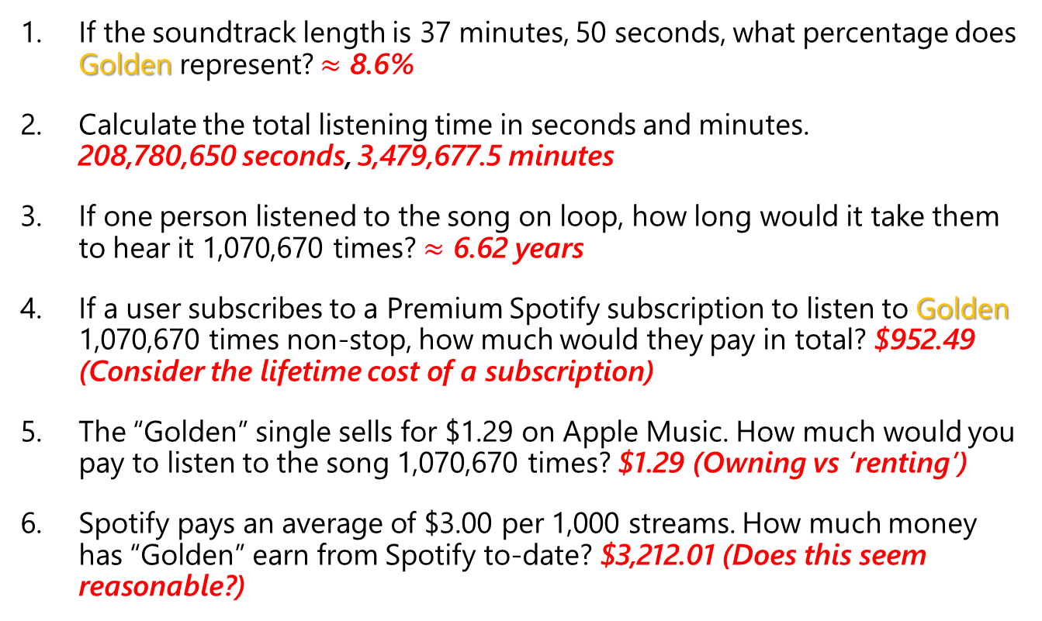
Consumer Math: Music Streaming
Answers
If the soundtrack length is 37 minutes, 50 seconds, what percentage does Golden represent? $≈$ 8.6%
Calculate the total listening time in seconds and minutes. 208,780,650 seconds, 3,479,677.5 minutes
If one person listened to the song on loop, how long would it take them to hear it 1,070,670 times? $≈$ 6.62 years
If a user subscribes to a Premium Spotify subscription to listen to Golden 1,070,670 times non-stop, how much would they pay in total? $952.49 (Consider the lifetime cost of a subscription)
The “Golden” single sells for $1.29 on Apple Music. How much would you pay to listen to the song 1,070,670 times? $1.29 (Owning vs ‘renting’)
Spotify pays an average of $3.00 per 1,000 streams. How much money has “Golden” earn from Spotify to-date? $3,212.01 (Does this seem reasonable?)
“Golden”
Plays: 1,070,670
Time: 3:15
Cost: $11.99/month
for Premium subscription
Notes:
Presentation Slide – Mixed Problems

Slide 13


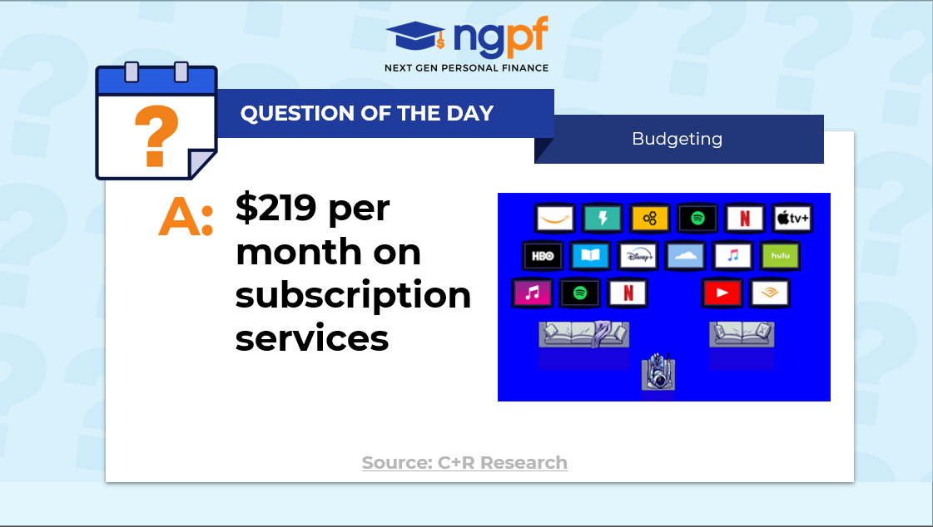
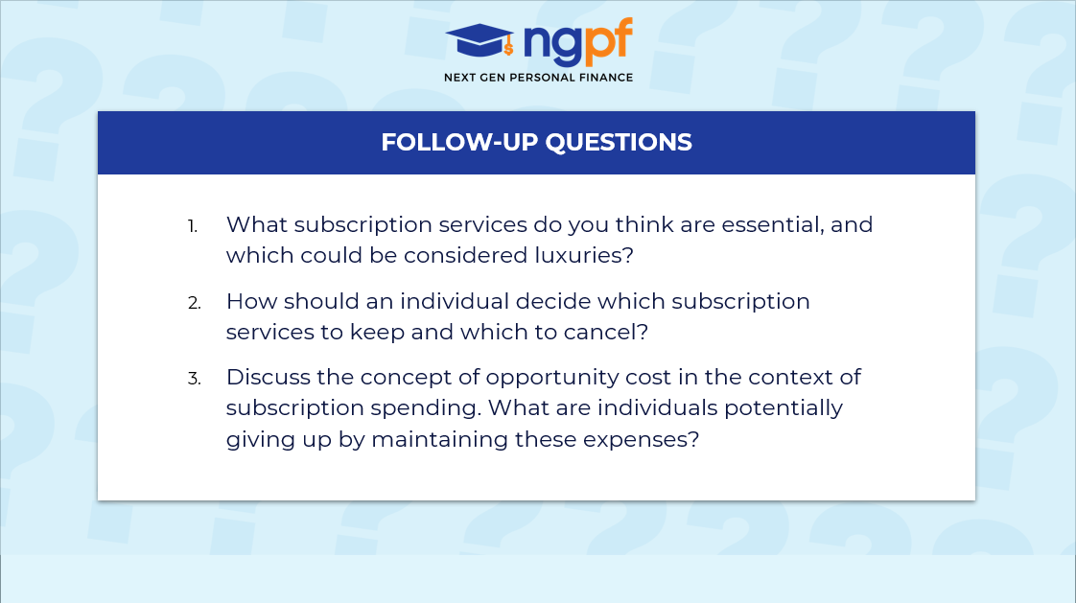

QUESTION OF THE DAY
Budgeting
Q:
How much does the average consumer spend per month on subscription services?
View blog post
ngpf.org 1/23/2024
How much does the average consumer spend on subscriptions? - Blog
Notes:
Guess first
Resource

Slide 14

Financial Education: Subscriptions
Business Benefits
Predictable “recurring revenue”
High lifetime value
Built-in price increases
Data collection
Subscription models have evolved and exploded, particularly in:
  Online learning
  Streaming entertainment
  Beauty and health products
  Food and beverage
Consumers underestimate number and total monthly costs
Market is saturated, consumers hitting limits
Example: Watching all 285 NFL games requires five streaming services
Notes:
Forbes found Americans average $552/year on streaming subscriptions
To recap, you'll need YouTube TV, NFL Sunday Ticket, Peacock, Prime Video, and Netflix at various points to watch every second of the remainder of the 2025-2026 NFL season.
That isn't going to be cheap, but it's at least cheaper than getting season tickets for your local NFL team. Well, unless your team is awful.
TOTAL: $347.91

Slide 15
Consumer Awareness: Subscriptions
Keep track of subscriptions!
    List subs and payment dates
    Set calendar reminders to cancel free trials
    Be aware of features you use
    Don’t be afraid to cancel
Be aware of overlapping services
    Music + games + streaming + apps + cloud storage + fitness = the costs stack up fast.
Calculate long-term costs
    A $7.99 monthly fee sounds small, but over a year it’s $96. Over five years, it’s nearly $500!

Slide 16



Classroom Resources: Subscriptions
Budgeting lessons that include streaming:
CFPB: Creating a monthly household budget
CFPB: Budgeting for needs and wants
NGPF PLAY: The Bean Game
EconEdLink - Thinking on the Margin
Question of the Day: What is the most popular way to consume TV content: broadcast, streaming or cable?
Investing QoD #11: If you invested $1,000 in Netflix stock ten years ago, what would it be worth now?
FinCap Friday: News From Netflix

Slide 17
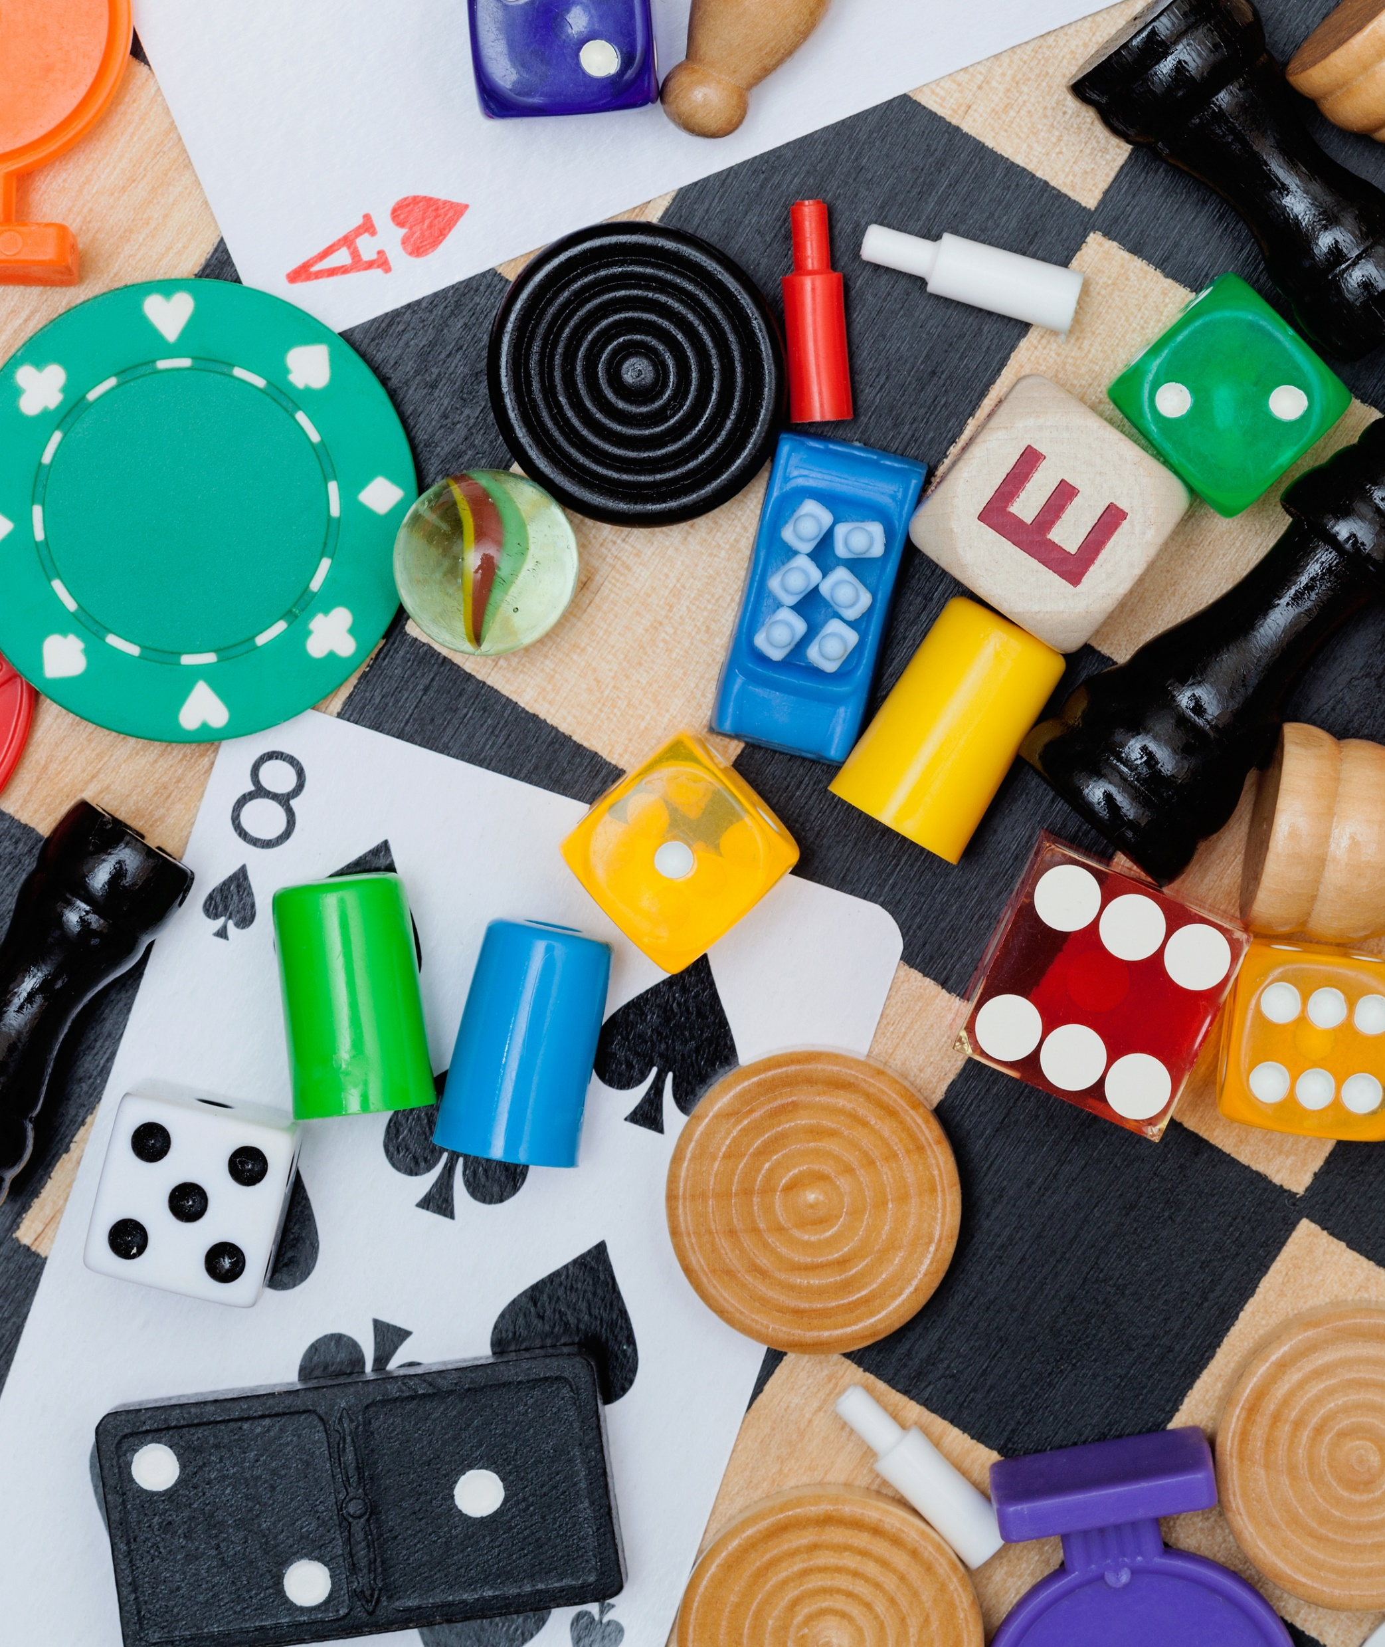
Gaming or Gambling?
Raffle ticket at the school auction
Weekly $10 NFL office pool
BINGO at the community center
Poker night with friends
In-app purchase for free game

Slide 18
Define: Gambling
Casino gambling: Play against the house
The house always has the edge
Sports gambling and lotteries: Play against other bettors
The number of players helps determine the odds
Betting or staking of something of value
Awareness of risk and hope of gain
Dependent on the outcome of an uncertain event
Notes:
Raffle ticket at the school auction
Weekly $10 NFL office pool
BINGO at the community center
Poker night with friends
In-app purchase for free game

Slide 19
Student Activity: Gaming vs Gambling
 | GAMING | GAMBLING
Identify the PURPOSE | Entertainment, relationship building, skill development | Winning money or something of monetary value
The roll of FINANCIAL STAKES | Money is not required to play Entry fees may be required | Integral component
The rolls of CHANCE and SKILL | Outcome predominantly determined by player(s) skill and/or strategy | Outcome predominantly determined by chance. (Skill/ strategy can be a factor)
 | GAMING | GAMBLING
Identify the PURPOSE
The roll of FINANCIAL STAKES
The rolls of CHANCE and SKILL
Notes:
Purpose
Financial Stakes
Chance vs. Skill

Slide 20
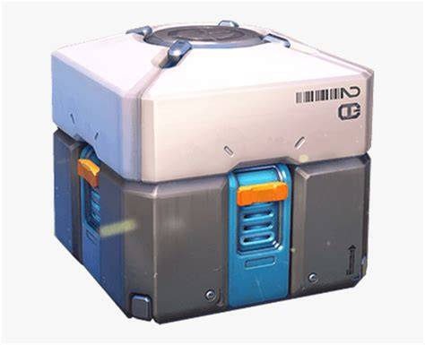
Gaming or Gambling: Loot Boxes
A loot box is a virtual item in a game
Players purchase for in-game or real currency
Receive randomized “loot”
Game developers/publishers love loot boxes!
  Generate ongoing revenue
  Monetize free-to-play games
  Keep players interested
$15 billion in revenue (2020)
Notes:
Loot box, loot crate, or prize crate
Loot can be cosmetic or necessary to win the game

Slide 21

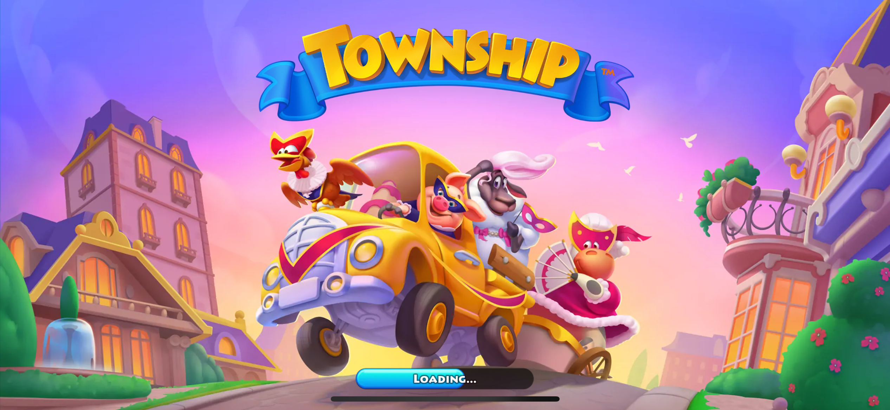
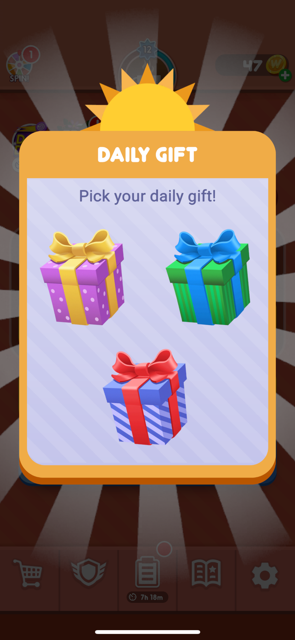
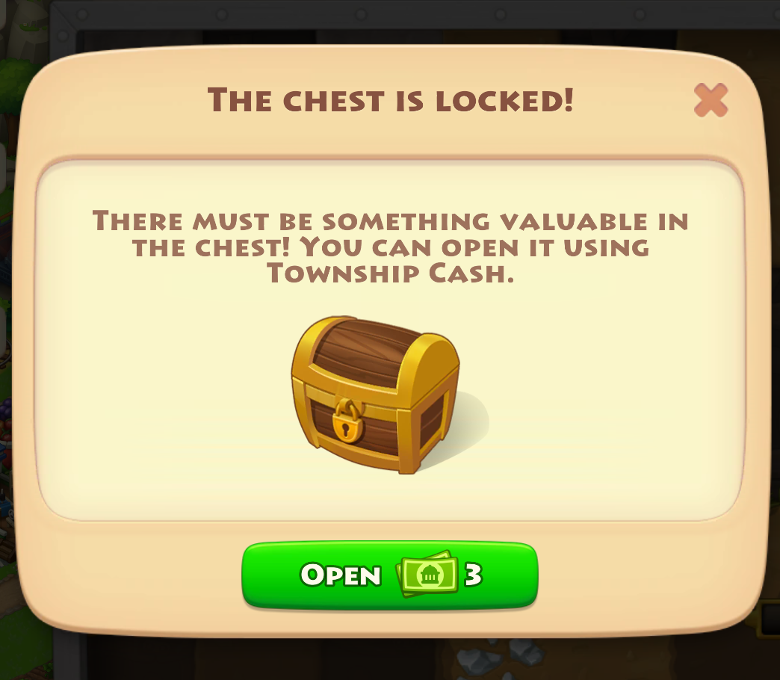
Loot Boxes: Outside Video Games
Loot boxes are found in:
  40% of popular PC (Steam) games
  60% of popular smart phone games
Operate on variable-ratio reinforcement
  Each loss is one step closer to a win
  Reverse Pavlovian response
Colors and sounds mirror slot machines
Source: Cited in slide notes
Notes:
Drummond, A., Hall, L.C. & Sauer, J.D. Surprisingly high prevalence rates of severe psychological distress among consumers who purchase loot boxes in video games. Sci Rep 12, 16128 (2022). https://doi.org/10.1038/s41598-022-20549-1

Slide 22
Research on Loot Boxes
Can buying loot boxes cause gambling addiction?
Adolescents are most strongly connected to loot boxes
People who purchase loot boxes may have higher risk of developing gambling problems (and vice versa)
One study found approximately 1.87 times higher risk of severe psychological distress for loot box purchasers
20% of gamblers said loot boxes were their first introduction to gambling (UK)
80% started buying loot boxes before age 18 (UK)
Canadian research found loot boxes “opened the gambling floodgates” among young adult video gamers
Sources: Cited in slide notes
Notes:
Sources:
Brooks, G. A., & Clark, L., The gamblers of the future? Migration from loot boxes to gambling in a longitudinal study of young adults. Computers in Human Behavior, Vol. 141, No. 107605 (2023). https://doi.org/10.1016/j.chb.2022.107605
Drummond, A., Hall, L.C. & Sauer, J.D. Surprisingly high prevalence rates of severe psychological distress among consumers who purchase loot boxes in video games. Sci Rep 12, 16128 (2022). https://doi.org/10.1038/s41598-022-20549-1
Spicer, S. G., et al.. Loot boxes and problem gambling: Investigating the “gateway hypothesis.” Addictive Behaviors, Volume 131, 107327 (2022). https://doi.org/10.1016/j.addbeh.2022.107327

Slide 23
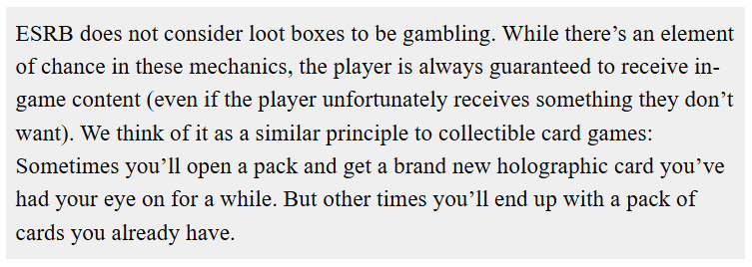
Evaluating the Opportunity Costs
Industry | Consumer Advocates
Loot boxes enhance, complement gameplay | Loot boxes are unregulated gambling
Improve player performance | 50-70% of game revenue comes from 1-2% of players
Product design enhances engagement | Can lead to overspending, negative financial and health consequences
Notes:
Entertainment Software Rating Board (ESRB) spokesperson: Oct 2017
“ESRB does not consider loot boxes to be gambling,” said an ESRB spokesperson in an e-mail to Kotaku. “While there’s an element of chance in these mechanics, the player is always guaranteed to receive in-game content (even if the player unfortunately receives something they don’t want). We think of it as a similar principle to collectible card games: Sometimes you’ll open a pack and get a brand new holographic card you’ve had your eye on for a while. But other times you’ll end up with a pack of cards you already have.”

Slide 24
Youth & Problem Gambling
Estimated 2.5 million U.S. adults (1%) meet the criteria for a severe gambling problem
  2-7% of youths develop a gambling disorder
  Students with parents who gamble are more likely to have a problem
Children introduced to gambling by age 12 are four times more likely to develop a problem
  40% of adolescents have played simulated gambling games
Problem Gambling: Gambling behavior that is damaging to a person or their family, often disrupting their daily life and career.
An emotional problem that has financial and other consequences
Also called gambling addiction or gambling disorder
Sources: National Council on Problem Gambling, Know the Odds | Gambling Addiction Assistance
Notes:
Another 5-8 million would have mild or moderate gambling problems
Yale: It’s estimated that a gambling disorder’s development is 50 percent due to genetic factors and 50 percent due to environmental factors.
National Council on Problem Gambling
Know the Odds

Slide 25
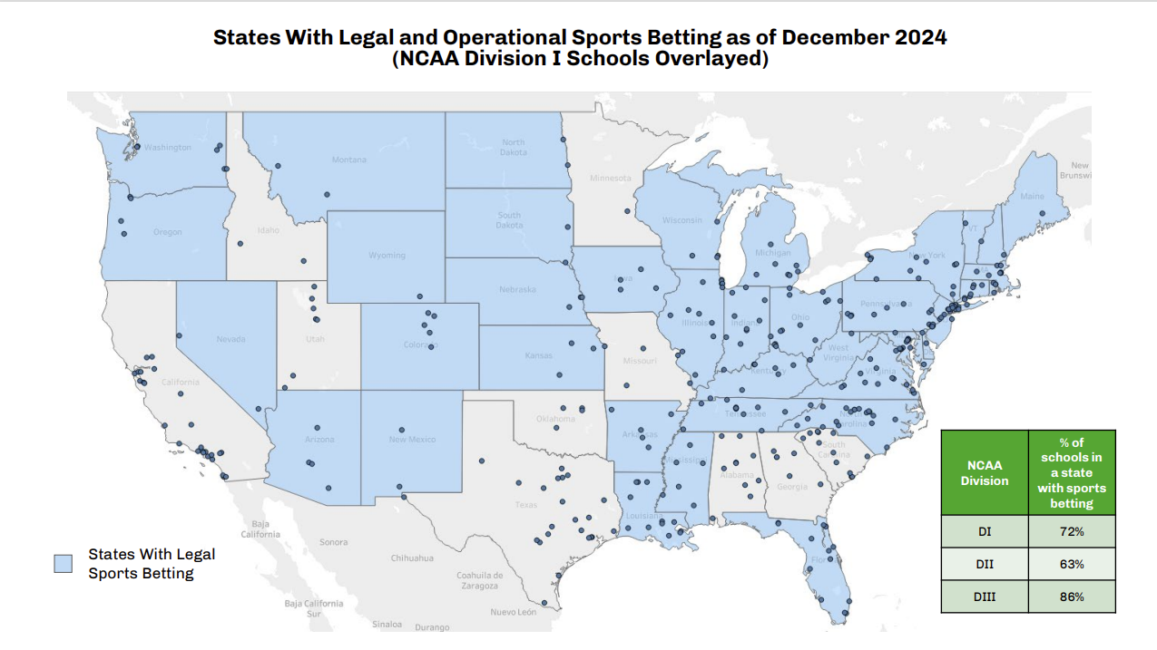
Sports Betting Changed the Game
May 2018 Supreme Court decision, Murphy v National Collegiate Athletic Association
"Congress can regulate sports gambling directly, but if it elects not to do so, each State is free to act on its own."
Sportsbooks expanded from 1 to 38 states
Recorded wagers increased by $116 billion+ between 2017-2023
“Substantial” national increase in online searches for gambling addiction
“Pronounced” increase in states that introduced online sports books
Source: Cited in slide notes
Notes:
Yeola A, Allen MR, Desai N, Poliak A, Yang KH, Smith DM, Ayers JW. Growing Health Concern Regarding Gambling Addiction in the Age of Sportsbooks. JAMA Intern Med. 2025 Apr 1;185(4):382-389. doi: 10.1001/jamainternmed.2024.8193. PMID: 39960737; PMCID: PMC11833657.

Slide 26
Classroom Resources:
Gaming or Gambling
Resources for Problem Gambling
National Council on Problem Gambling
Know the Odds: Gambling Addiction Assistance
Article: What Parents of Teens Should Know About Online Gambling
EconEdLink - Risky Spending and Teen Gambling
Gambling and Sports Betting Mini Unit
FinCap Friday: Fretting Over Online Betting
ANALYZE: Sports Betting Advertisements Docs
CASE STUDY: Gambling vs. Investing

Slide 27
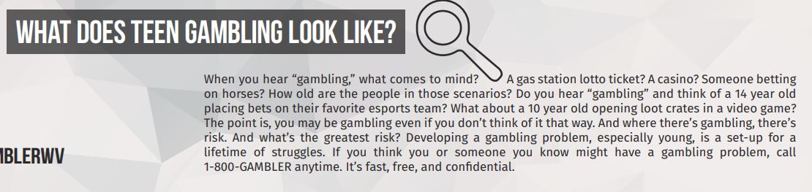
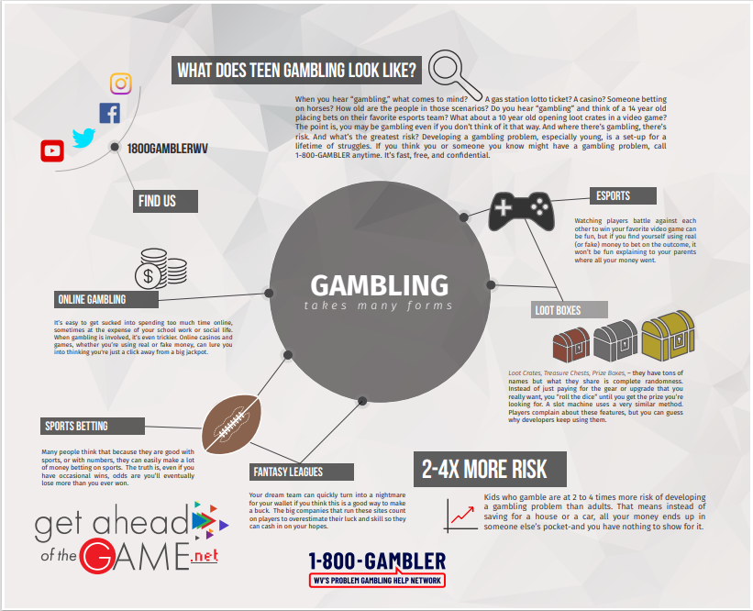
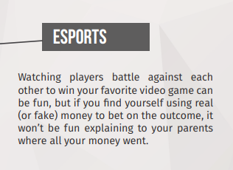
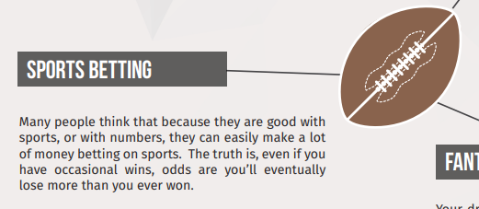
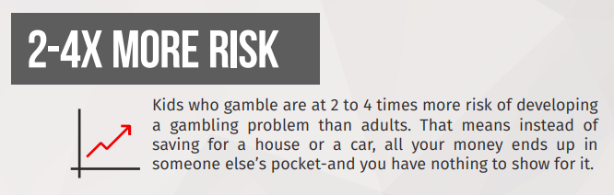

Slide 28
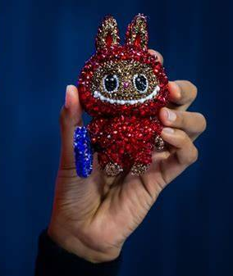
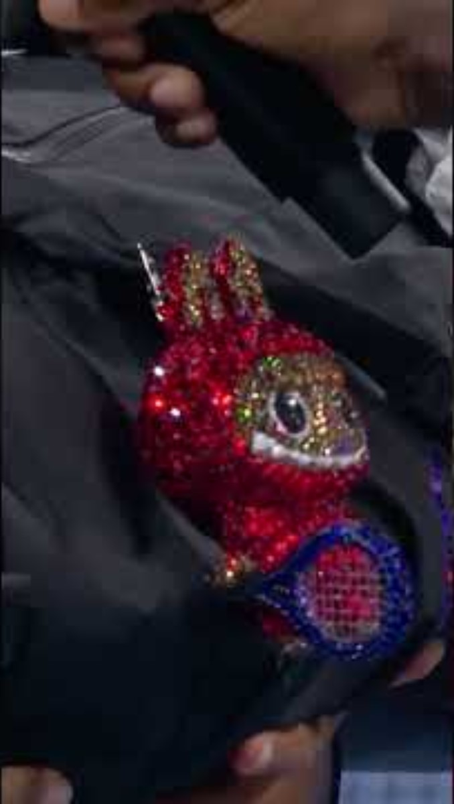
The Power of Hype: Collectibles
Can you identify the 2025 pop culture moment to the left?
Notes:
Naomi Osaka’s deep run in the 2025 U.S. Open
Her outfits (Nike) and Labubu dolls were media darlings
Billie Jean Bling, Andre Swagassi

Slide 29

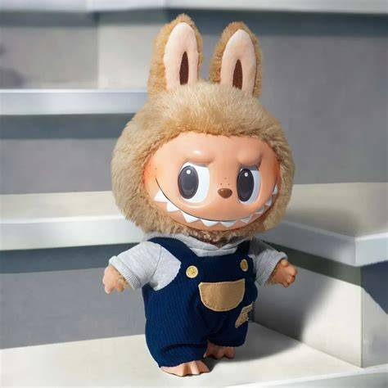
PopMart Labubu Dolls
Monster character originally created by artist Kasing Lung
Plush dolls ranging in size
Retail prices $27.99
Strong secondary market
Estimated $1 billion in toys sold
Revenue has increased 670% over LY
Source: Labubu Is a Bubble Just Waiting to Burst - Business Insiderslide notes
Notes:
Around since 2019, the keychains really kicked off the current trend

Slide 30
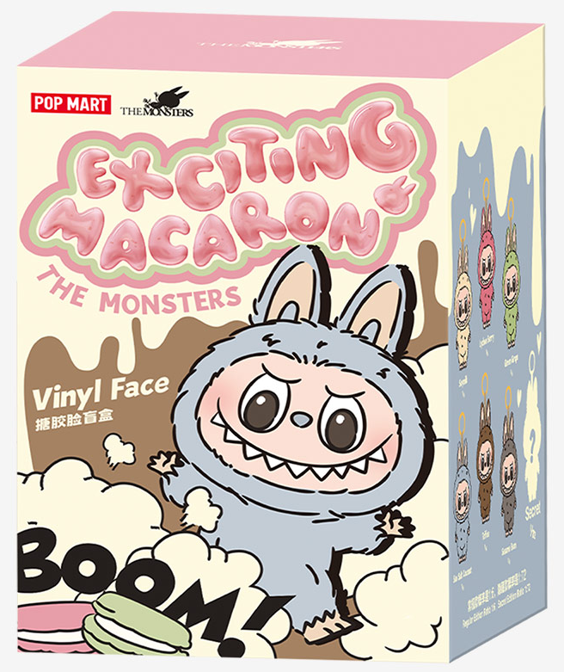
Money Match Activity: Labubu Dolls
170,000
2-10
27.99
3,000
20,000,000
300-700
299.90
Number of hand-applied crystals on Billie Jean Bling
Cost of the most expensive doll on Pop Mart website
Common resale range for rare or limited-edition dolls
Highest known resale price for a rare Labubu figure at auction
Approximate number of Pop Mart blind boxes sold per year
Percentage odds of pulling a “secret/rare” Labubu from a blind box
Retail price of this Exciting Macaron blind box

Slide 31

Money Match Activity: Labubu Dolls Answers
Number of hand-applied crystals on Billie Jean Bling: 3,000
Cost of the most expensive doll on Pop Mart website: $299.90
Common resale range for rare or limited-edition dolls: $300-700
Highest known resale price for a rare Labubu figure at auction: $170,000
Approximate number of Pop Mart blind boxes sold per year: 20,000,000
Percentage odds of pulling a “secret/rare” Labubu from a blind box: 2-10%
Retail price of this Exciting Macaron blind box: $27.99

Slide 32
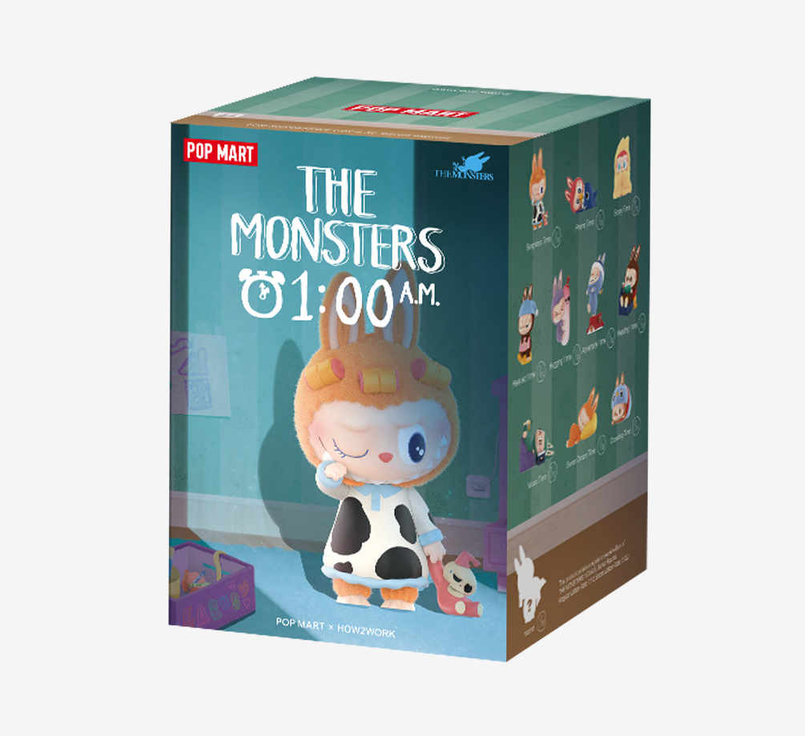
Marketing Strategies: Labubu
“Blind box” packaging keeps contents a mystery, builds excitement, scarcity
Limited drops, themes, and special editions
Celebrities and influencers made it a status item
Unboxing, displaying, and trading with community is part of the appeal
High prices on secondary market create illusion of “investment”
Student Discussion:
  What other goods come packaged in “blind boxes”
  What is the appeal?
  What are the risks?
Notes:
“Blind-box” sales build excitement and scarcity. Labubus are usually sold in blind boxes — buyers don’t know which design or “version” they’ll get until they open the box. That element of surprise + uncertainty motivates people to buy multiple boxes, hoping to get rare or “secret” variants.

Slide 33
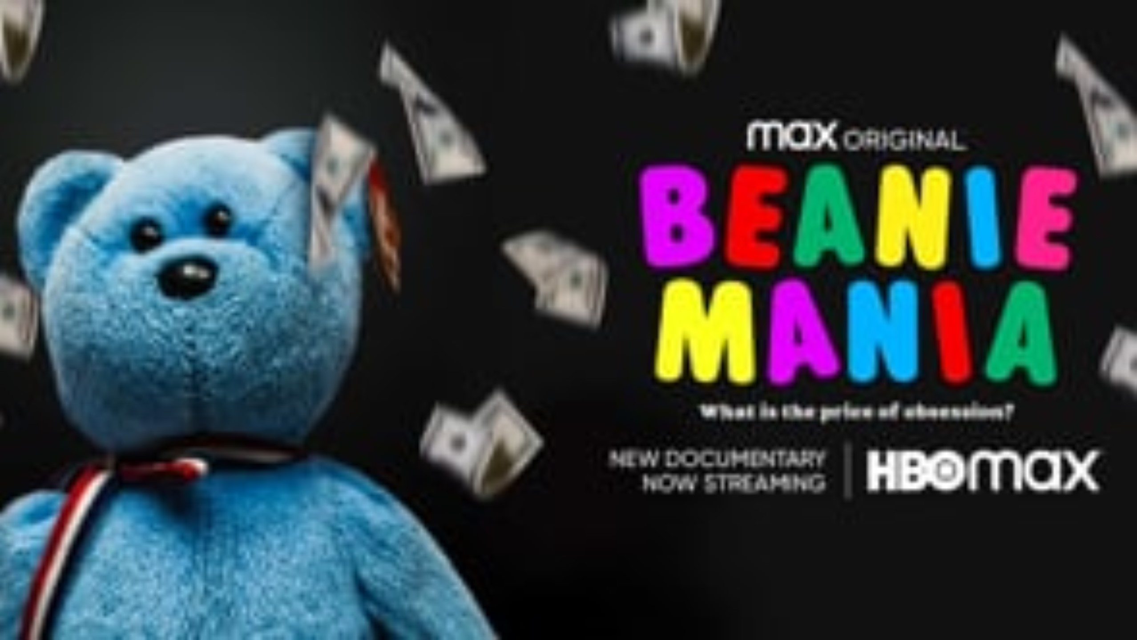

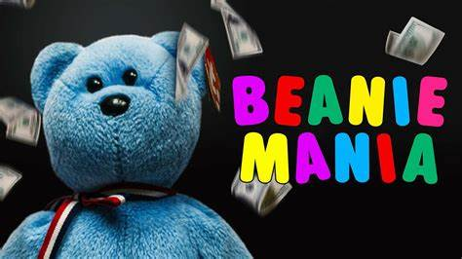
Beanie Babies
Created by Harold Ty Warner (Ty, Inc.)
Cute, affordable, appealing
No traditional advertising
Hype built by fans/entrepreneurs
“Retirement” strategy creates scarcity, urgency
Marketed as collectibles, investments
Notes:
Note the irony: Recommending a video available on a streaming service
Beanie Mania (2021)
Directed by Yemisi Brookes
TV-PG 1h 20m
Streaming on HBOMax

Slide 34
Consumer Awareness: Collectibles
Popular doesn’t always mean valuable
    Beanie Babies felt like “the next big investment” … until the market collapsed.
    Labubu dolls are hugely popular right now, but demand can change fast.
    Just because something is trending doesn’t mean it will hold its value. Popularity does not equal profit.
Scarcity can be created
    Both Beanie Babies and Labubus became popular because they were “hard to get.”
    But companies often manufacture scarcity (limited drops, special editions, retirements) to create consumer urgency.
    Ask yourself, “Is this rare because it’s truly limited, or because the company made it feel rare?”

Slide 35
Consumer Awareness: Collectibles
  Fear of Missing Out (FOMO) can lead to overspending
    Kids (and parents!) in the 90’s bought Beanie Babies believing they would be worth thousands in the future.
    Social media is full of collectors desperately chasing down Labubu dolls
    FOMO is a real, psychological phenomenon that drives consumer behavior. Slow it down by taking 24 hours to consider a purchase.
A collectibles’ value comes from the buyer, not the object
    Value is based on demand. Scarcity and hype can distort value.
    Both Beanie Babies and Labubu dolls only have value if someone else is willing to pay for them.
    It’s okay to collect for joy, not profit. Increase in value should be a bonus, not a plan.

Slide 36
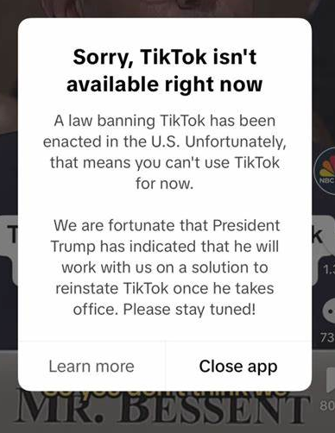
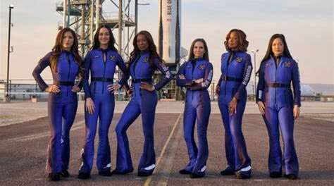

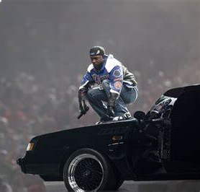

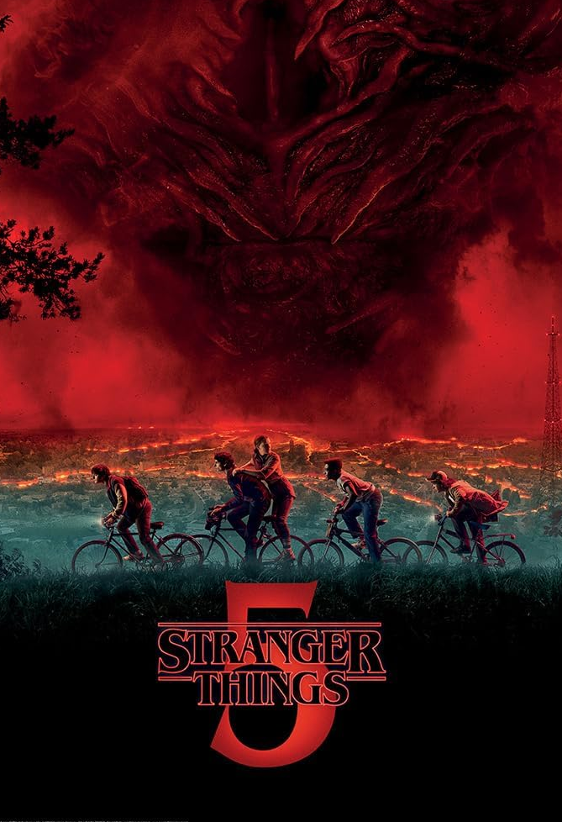

Financial Skills Over Fads
Trends come and go, but healthy financial habits like budgeting, comparison shopping, and avoiding impulse buys are useful forever!
Notes:
January: U.S. TikTok ban
February: Kendrick Lamar’s Super Bowl halftime show
April: Blue Origin all-female space flight
June: Bezos-Sanchez wedding in Venice
August: The Coldplay kiss-cam couple
Aug/Oct: Taylor Swift engagement and album
October: The Louvre robbery
November: Stranger Things

Slide 37
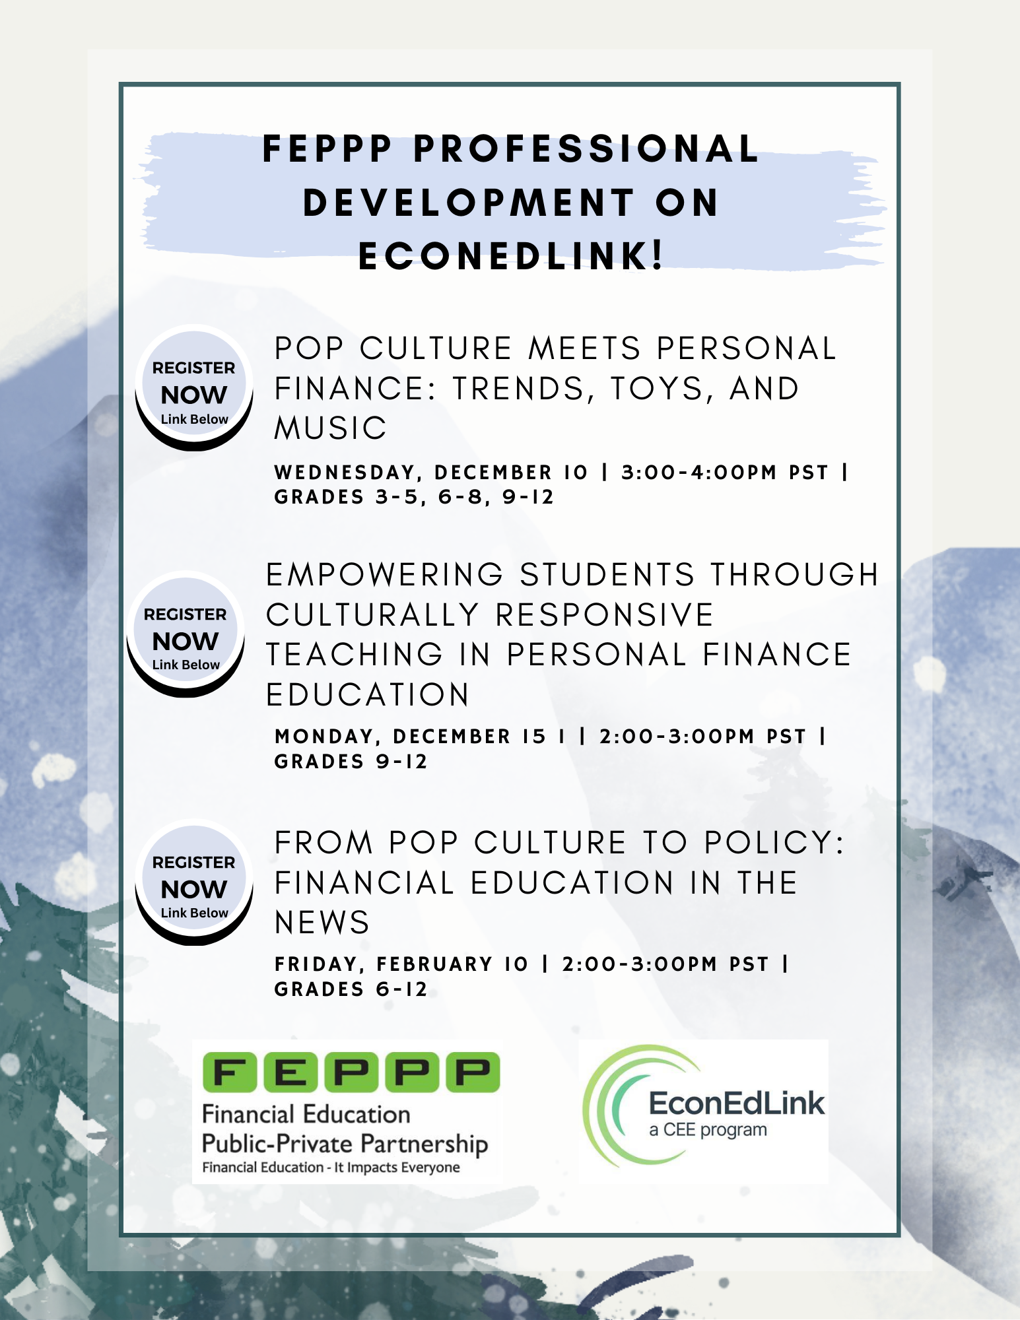


Thank you!
Sign up for FEPPP’s weekly e-newsletter!
Notes:
One year after the CA fires – Climate change and insurance
PR and Stocks – Tesla
March Madness
Holiday Spending

Slide 38
Pop Culture Meets Personal Finance: Trends, Toys, Music and the Power of Hype
Amy Kliewer, k-8 program supervisor (FEPPP)
Amy.Kliewer@k12.wa.us | www.feppp.org

