Slide 1
Investigating Consumers & Color: Activity Menu
Ad & Packaging Analysis Focus: Persuasive design Analyze how color influences emotions and choices Identify target audiences through color use Compare the same product with different color schemes | The Pink Tax Focus: Equity & pricing Compare prices of similar products in different colors Investigate whether higher prices reflect real differences Discuss fairness and consumer impact
Brand Identity Case Study Focus: Branding & recognition Research how brands use color consistently Explore trademarks and exclusive color use Predict what might happen if a brand changed its color | Redesign the Product Focus: Value & marketing Redesign a familiar product using new colors Identify a new target audience Decide whether the price should change and why
Opportunity Cost Reflection Focus: Personal finance Examine purchases influenced by color Discuss trade-offs when buying duplicates or collections Connect spending choices to personal values | Ethics Debate or Socratic Seminar Focus: Consumer responsibility Should companies own or trademark colors? Is limited-edition color marketing ethical? When does marketing become manipulation?
Culture & Color Focus: Perspective & inclusion Explore how color meanings vary across cultures Consider how companies adapt colors for different audiences Connect color to community and identity | Color of the Year Alternative Focus: Marketing, consumer influence, & ethics Analyze past “Color of the Year” selections Propose a new color for the upcoming year Justify the choice using consumer trends, emotions, or social context

Slide 2
MONEY MATCH: March Madness (2025)
Match each statement below to the correct number on the right.
Price of a single-game NCAA Tournament ticket this season
College basketball programs involved in corruption case/paying players
Salary for college basketball’s highest paid coach
NCAA’s women’s basketball fund’s 2025 distribution to D1 schools
Amount the players participating in the tournament earn
Difference between average NBA rookie’s salary and D1 men’s athlete basketball scholarship
Annual estimated revenue for the NCAA in 2024
Corporate losses due to unproductive workers during March Madness
$1,300,000,000
$9,600,000
52x
$17,000,000,000
$452.00
$15,000,000
$0
12+
Notes:
Source: WalletHub 2025 March Madness Stats & Facts
https://wallethub.com/blog/march-madness-statistics/11016
NCAA Men’s and Women’s College Basketball Tournaments
Generates $1B+ in revenue
Men’s Tourney: 1 game = $2 million
Women’s Tourney: 1 game = $113,000
Over $15.5M in sports betting (2023)

Slide 3
MONEY MATCH: March Madness (2025) Answers
Price of a single-game NCAA Tournament ticket this season: $452.00
College basketball programs involved in corruption case/paying players: 12+
Salary for college basketball’s highest paid coach: $9,600,000
NCAA’s women’s basketball fund’s 2025 distribution to D1 schools: $15,000,000
Amount the players participating in the tournament earn: $0
Difference between average NBA rookie’s salary and D1 men’s athlete basketball scholarship: 52x
Annual estimated revenue for the NCAA in 2024: $1,300,000,000
Corporate losses due to unproductive workers during March Madness: $17,000,000
Notes:
Source: WalletHub 2025 March Madness Stats & Facts
https://wallethub.com/blog/march-madness-statistics/11016
2. The highest paid coach in college basketball is Bill Self, who coaches the University of Kansas men’s team. His salary is $8,803,800 with maximum bonus of $800,000. In contrast, the University of Kansas’ chancellor and the state’s governor have a combined salary of $891,000.
6. The average NBA rookie’s salary is $4,100,000. The average D1 men’s athlete basketball scholarship for a year costs $71,400.
4. ‘Everyone watches women’s sports!’ 2025 was the first year that NCAA women’s basketball shared profits from the NCAA women’s tournament, splitting $15 million among the D1 participants. In the men’s tournament, which is massively profitable for the NCAA, each athletic conferences receive a share of the NCAA revenue based on their teams' performance. In 2023, each game played by a conference's team earned a “unit” worth about $2 million (paid out over six years). This has concentrated resources around several ‘power’ conference schools. For example, this year the SEC entered the men’s NCAA tournament with 14 teams, and only four conferences will be represented in the Sweet 16.

Slide 4
MONEY MATCH: Super Bowl, Super Spending
Match each statement below to the correct number on the right.
1 | Average price of Super Bowl LX ticket (Jan 27, 2026)
2 | Number of Americans expected to watch the Super Bowl
3 | Amount paid to Super Bowl Halftime Show performers
4 | Bonus paid to players on the losing Super Bowl team (2025)
5 | Predicted total U.S. spending for Super Bowl Sunday (2026)
6 | Cost for a 30-second Super Bowl TV ad (2026)
7 | Amount the U.S. is projected to legal gamble on SBLX
8 | Number of albums* sold by SBLX Halftime performer Bad Bunny
$0
123,100,000
$8,000,000
$20,200,000,000
$1,760,000,000
231,000,000
$6,652
$96,000
Notes:
Albums or album equivalents

Slide 5
MONEY MATCH: Super Bowl, Super Spending Answers
Match each statement below to the correct number on the right.
1 | Average price of Super Bowl LX ticket (Jan 27, 2026)
2 | Number of Americans expected to watch the Super Bowl
3 | Amount paid to Super Bowl Halftime Show performers
4 | Bonus paid to players on the losing Super Bowl team (2025)
5 | Predicted total U.S. spending for Super Bowl Sunday (2026)
6 | Cost for a 30-second Super Bowl TV ad (2026)
7 | Amount the U.S. is projected to legal gamble on SBLX
8 | Number of albums* sold by SBLX Halftime performer Bad Bunny
$6,652
231,000,000
$0
$96,000
$20,200,000,000
$8,000,000
$1,760,000,000
123,100,000
Notes:
Albums or album equivalents

Slide 6
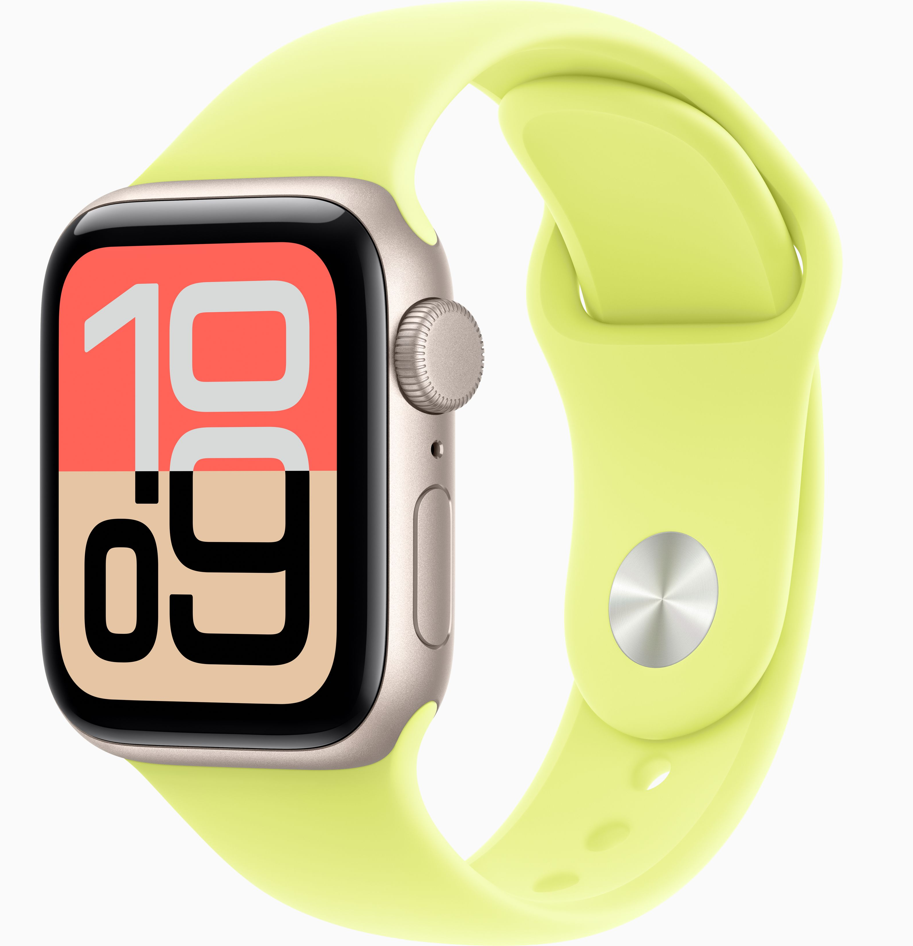
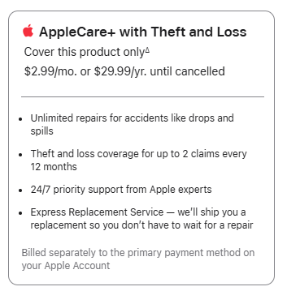
ACTIVITY Insurance Claim Flowchart
AppleCare+ Analysis
You pay $271.66 for a new Apple Watch SE 3 (GPS, 40 mm).
Owner files insurance claim
Risk Analysis:
Identify the risks or perils associated with this purchase
Can you accept, reduce, or avoid these risks?
Is risk transfer (AppleCare+) the best strategy?
Coverage review:
What risks are covered? How often?
What is the deductible?
Cost/Benefit Analysis:
Total cost of watch replacement with and without AppleCare+
Informed decision on insurance
Notes:
Investigate: Different Apple products and coverage levels
How difficult is it to find deductible information?

Slide 7
ACTIVITY Insurance Claim Flowchart
The owner pays a $150 monthly premium for home insurance with a $5,000 deductible.
During a storm, the home incurs $170,000 in covered damages.
Owner: $5,000
Insurer: $165,000
The owner pays a $70 monthly premium for home insurance with a $20,000 deductible.
During a storm, the home incurs $170,000 in covered damages.
Owner: $20,000
Insurer: $150,000
Owner files insurance claim
Owner documents damage
Insurance adjustor inspects damage, estimates repair and replacement costs
Coverage review: What is/is not covered, deductible applied
Insurance payments issued, often in stages
Owner decides if/when to repair, rebuild, or replace – often with out-of-pocket costs
Notes:
$170,000 – 5,000 = $165,000
You pay $1,800 per year, plus $5,000 deductible / Insurer pays $165,000
This is when it would be great to bring in insurance agents, brokers, or other community representatives
Teacher tip: This works well as a color-coded flowchart (blue = process, yellow = decisions, red = challenges)

Slide 8
Investigating Climate Disasters & Insurance: Activity Menu
Disaster Data & Impact Focus: Patterns, scale, & cost Explore Climate Central’s U.S. Billion-Dollar Disaster Database Identify trends in frequency, location, and total costs Discuss what costs are insured vs. uninsured | Learning From the Field Focus: Careers & real-world insight Invite local insurance agents to speak to the class Ask how climate risk affects pricing and coverage Explore careers connected to insurance, risk, and resilience
Managing Risk Focus: Decision-making & prevention Complete EconEdLink: Managing Risk Identify everyday risks and disaster-related risks Connect prevention and preparation to insurance costs | Story & Reflection Focus: Personal impact & empathy Play the Bummer! Game from the NGPF Arcade Complete the Bummer! reflection sheet Research the reasons floods are not covered by home insurance
How Insurance Works Focus: Systems & processes Watch EconEdLink: Insurance Video and Quiz Walk through f insurance decisions with CFPB’s “Understanding How Insurance Works: A Case Study About Lucy” Discuss how insurance priorities will change with age | Risk Pooling in Action Focus: Shared risk & fairness Complete PLAY: Insurance Risk Pooling from NGPF Experience how shared risk lowers individual costs Discuss what happens when risks increase due to climate events

