Slide 1

WELCOME!

Slide 2



Meet the Team
Dr. Chris Cannon
Associate Director
GCEE
Triza Cox
Program Manager
TeachRock
Princeton Williams
Outreach Senior Advisor
Federal Reserve Bank of Atlanta

Slide 3


Slide 4


Slide 5
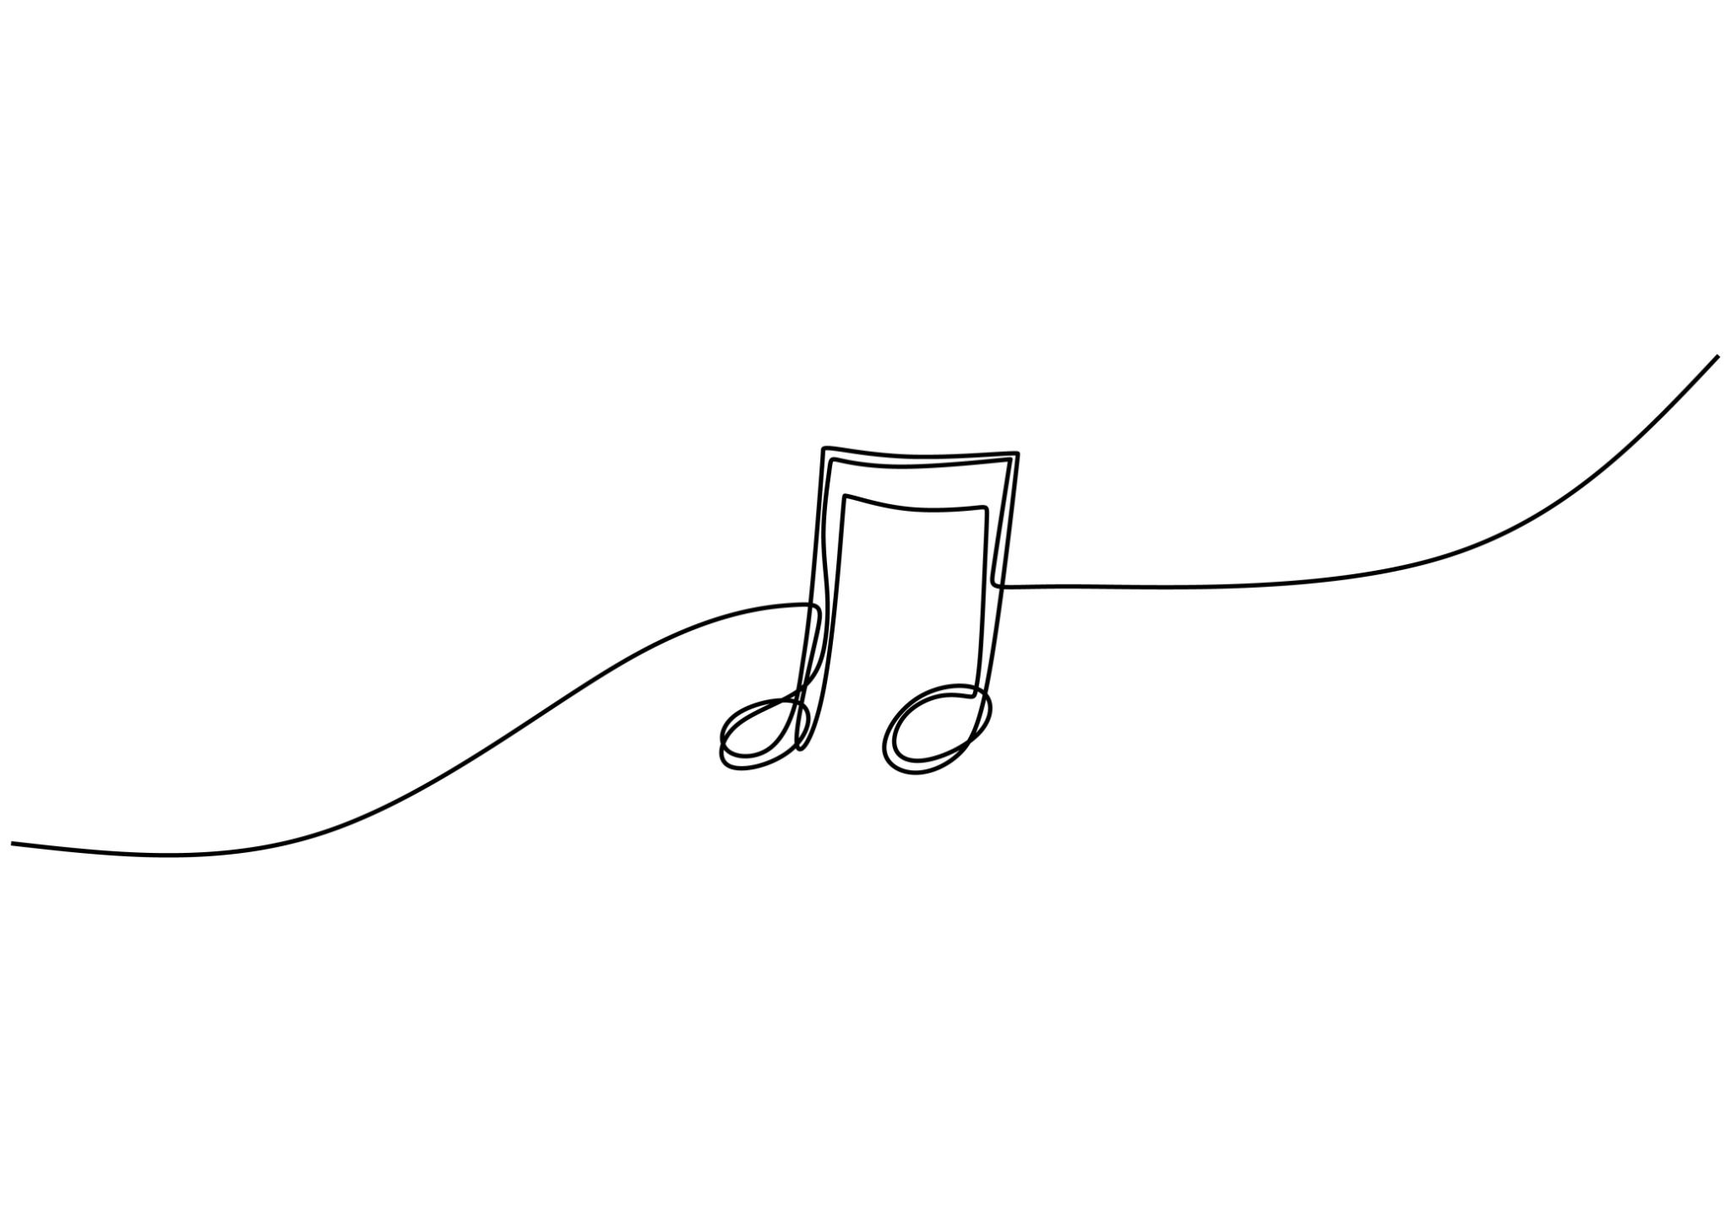
Workshop Goals
Cross-curricular material
Economic themes as guide
Lesson demos
Critical Thinking
Exposure to new resources

Slide 6
Lesson topics in Crossroads Series
Copyright (Economics-based)
Copyright (History-based)
Labor Unions/Economic Interdependence
Vinyl and Sustainability
Urban Sprawl
Coming fall 2026:
  A.I. and music
  Incentives through the Edmund Fitzgerald
  Introducing Personal Finance with Music

Slide 7
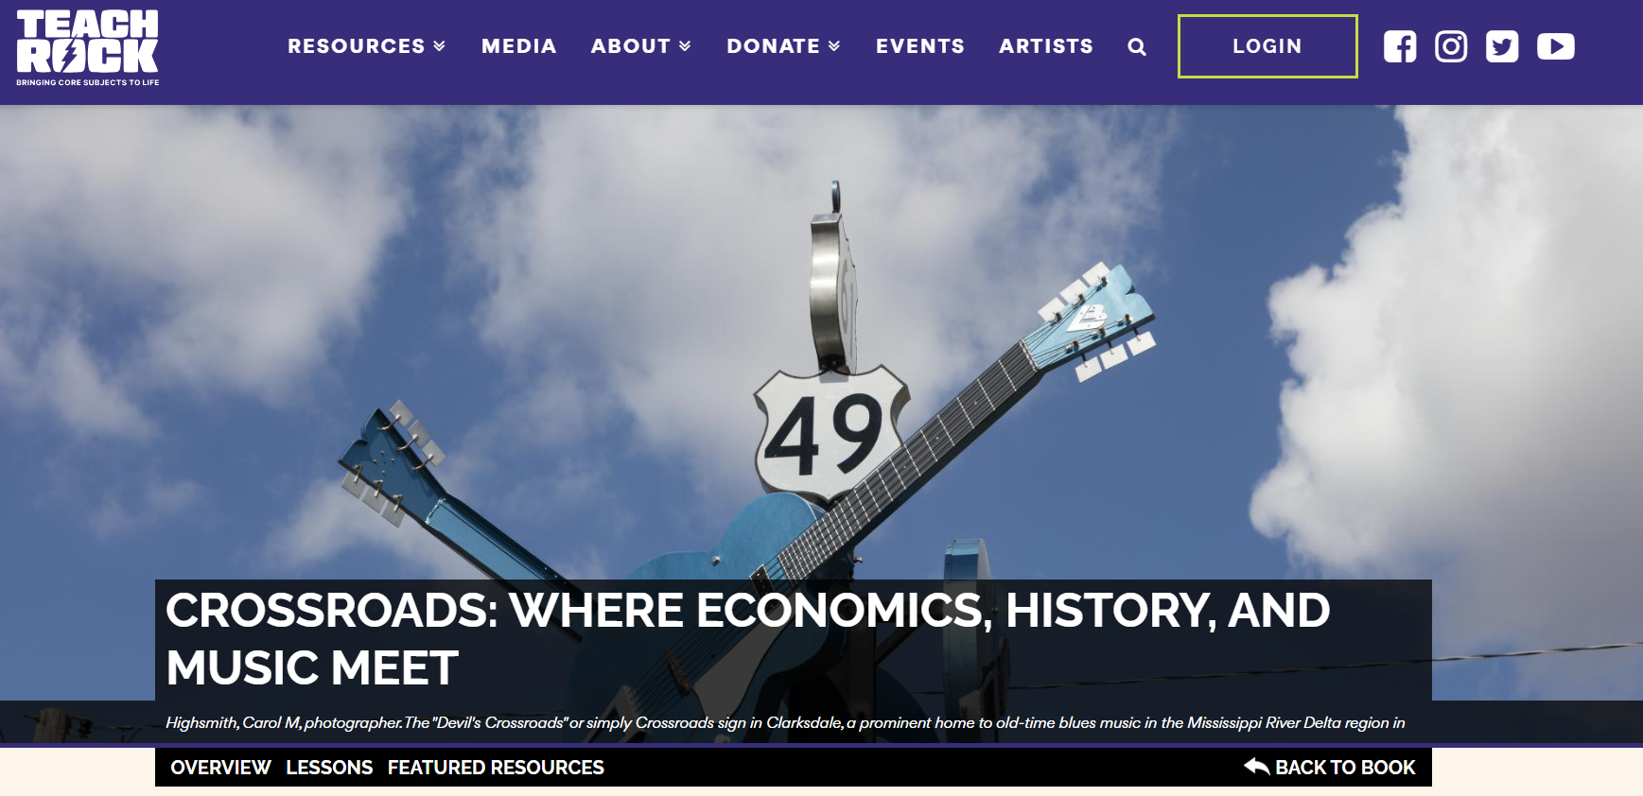
Crossroads Lessons Collection

Slide 8
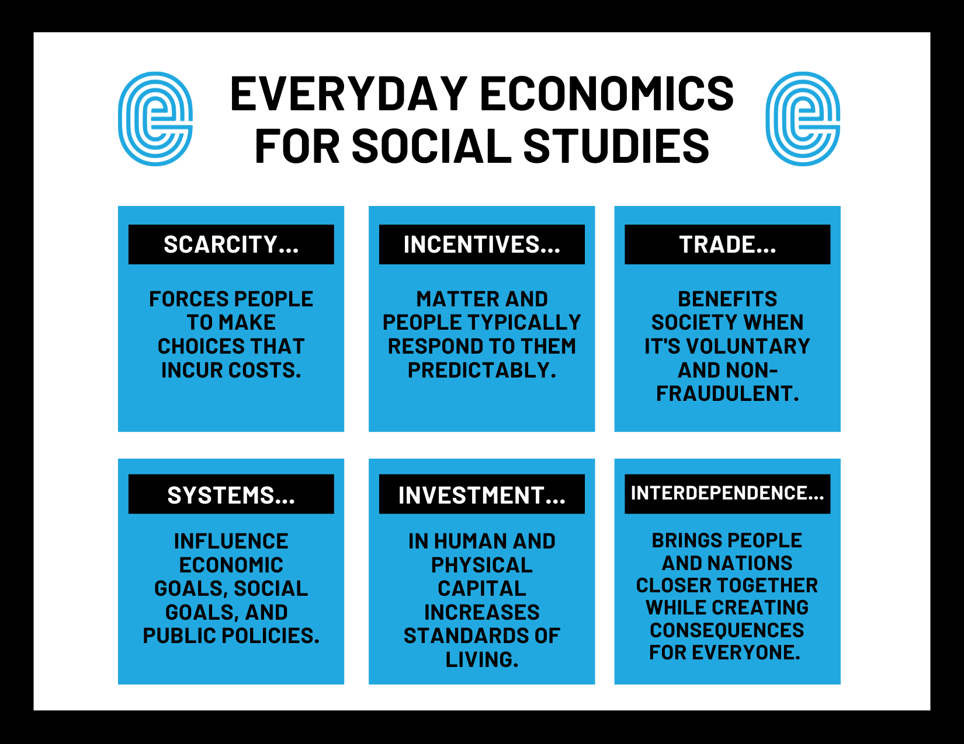

Slide 9
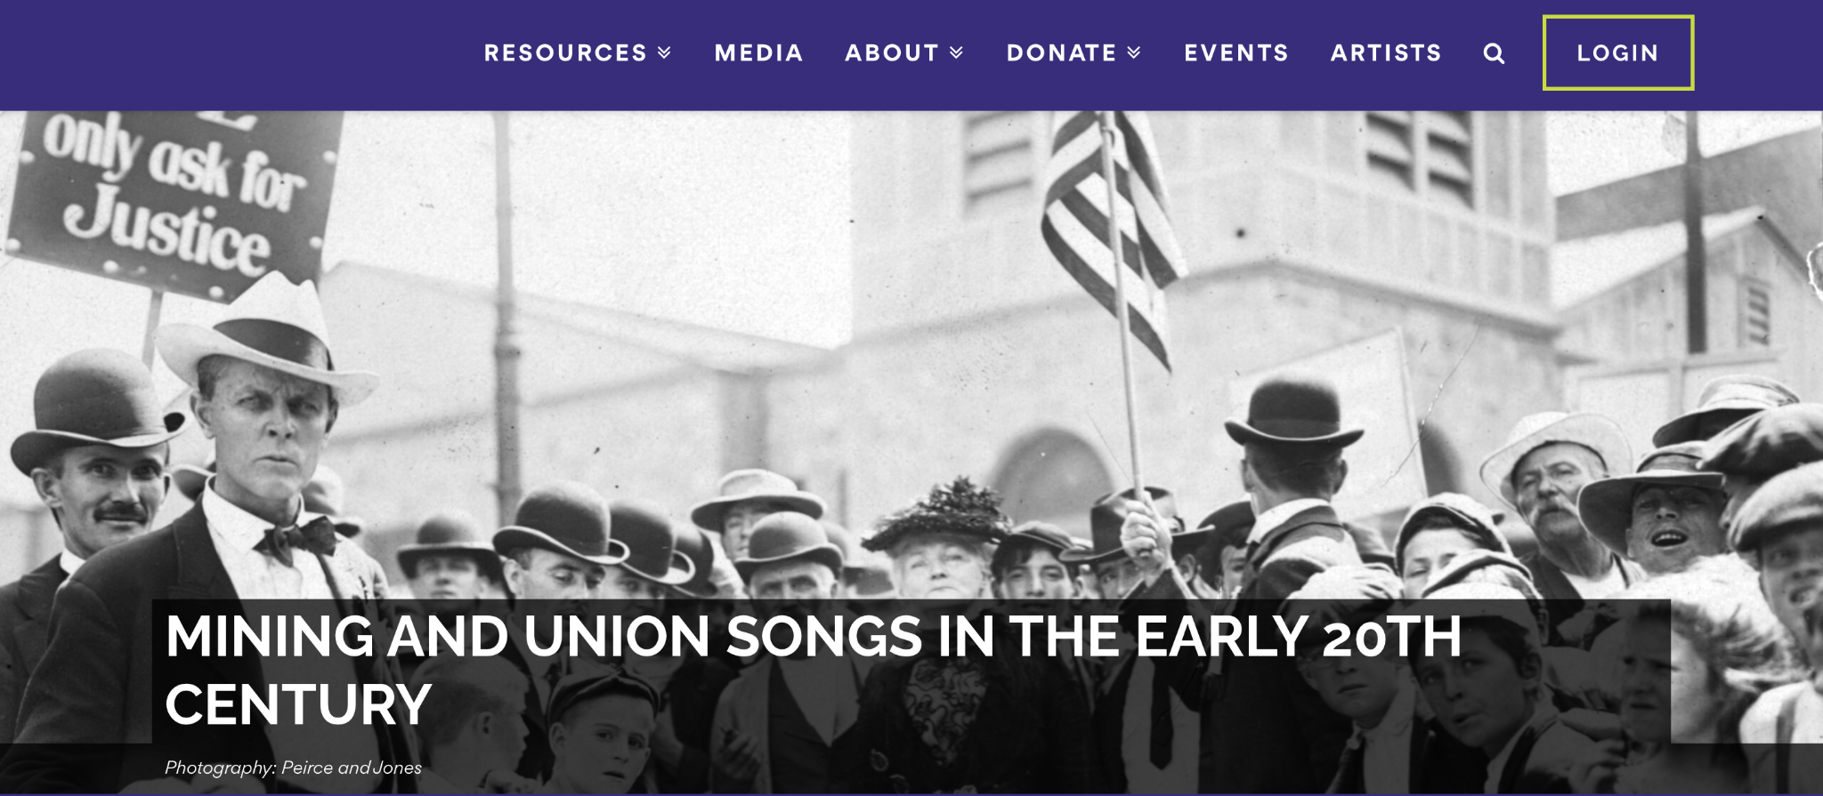

Slide 10
Mastery Objective:
Students will be able to articulate the relationships between workers, businesses owners, and the federal government from the late 1800s to the 1940s by watching and discussing the work of musician Nimrod Workman.

Slide 11



Slide 12


Slide 13
“42 Years” Lyrics
For 42 years, is a mighty long time
For to labor and toil down in that coal mine
But down in that dark hole where the bright lights did go
Back in a dark room, I were spadin’ up coal
My bones they did ache me and my kneecaps got bad
Down on that hard rock on a set of knee pads
The motors were shiftin’, I got sand in my hair
Both lungs were broke down from breathin’ bad air
Now went to Columbus for to find a new job
They sent me to my boss man and I heard him say
“The company don’t want you, compensation won’t pay
For the doctors they told us, coal dust didn’t get you this way.”

Slide 14
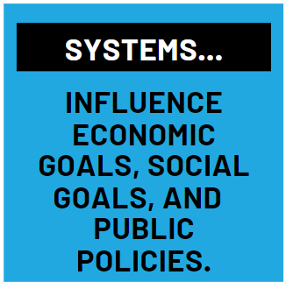
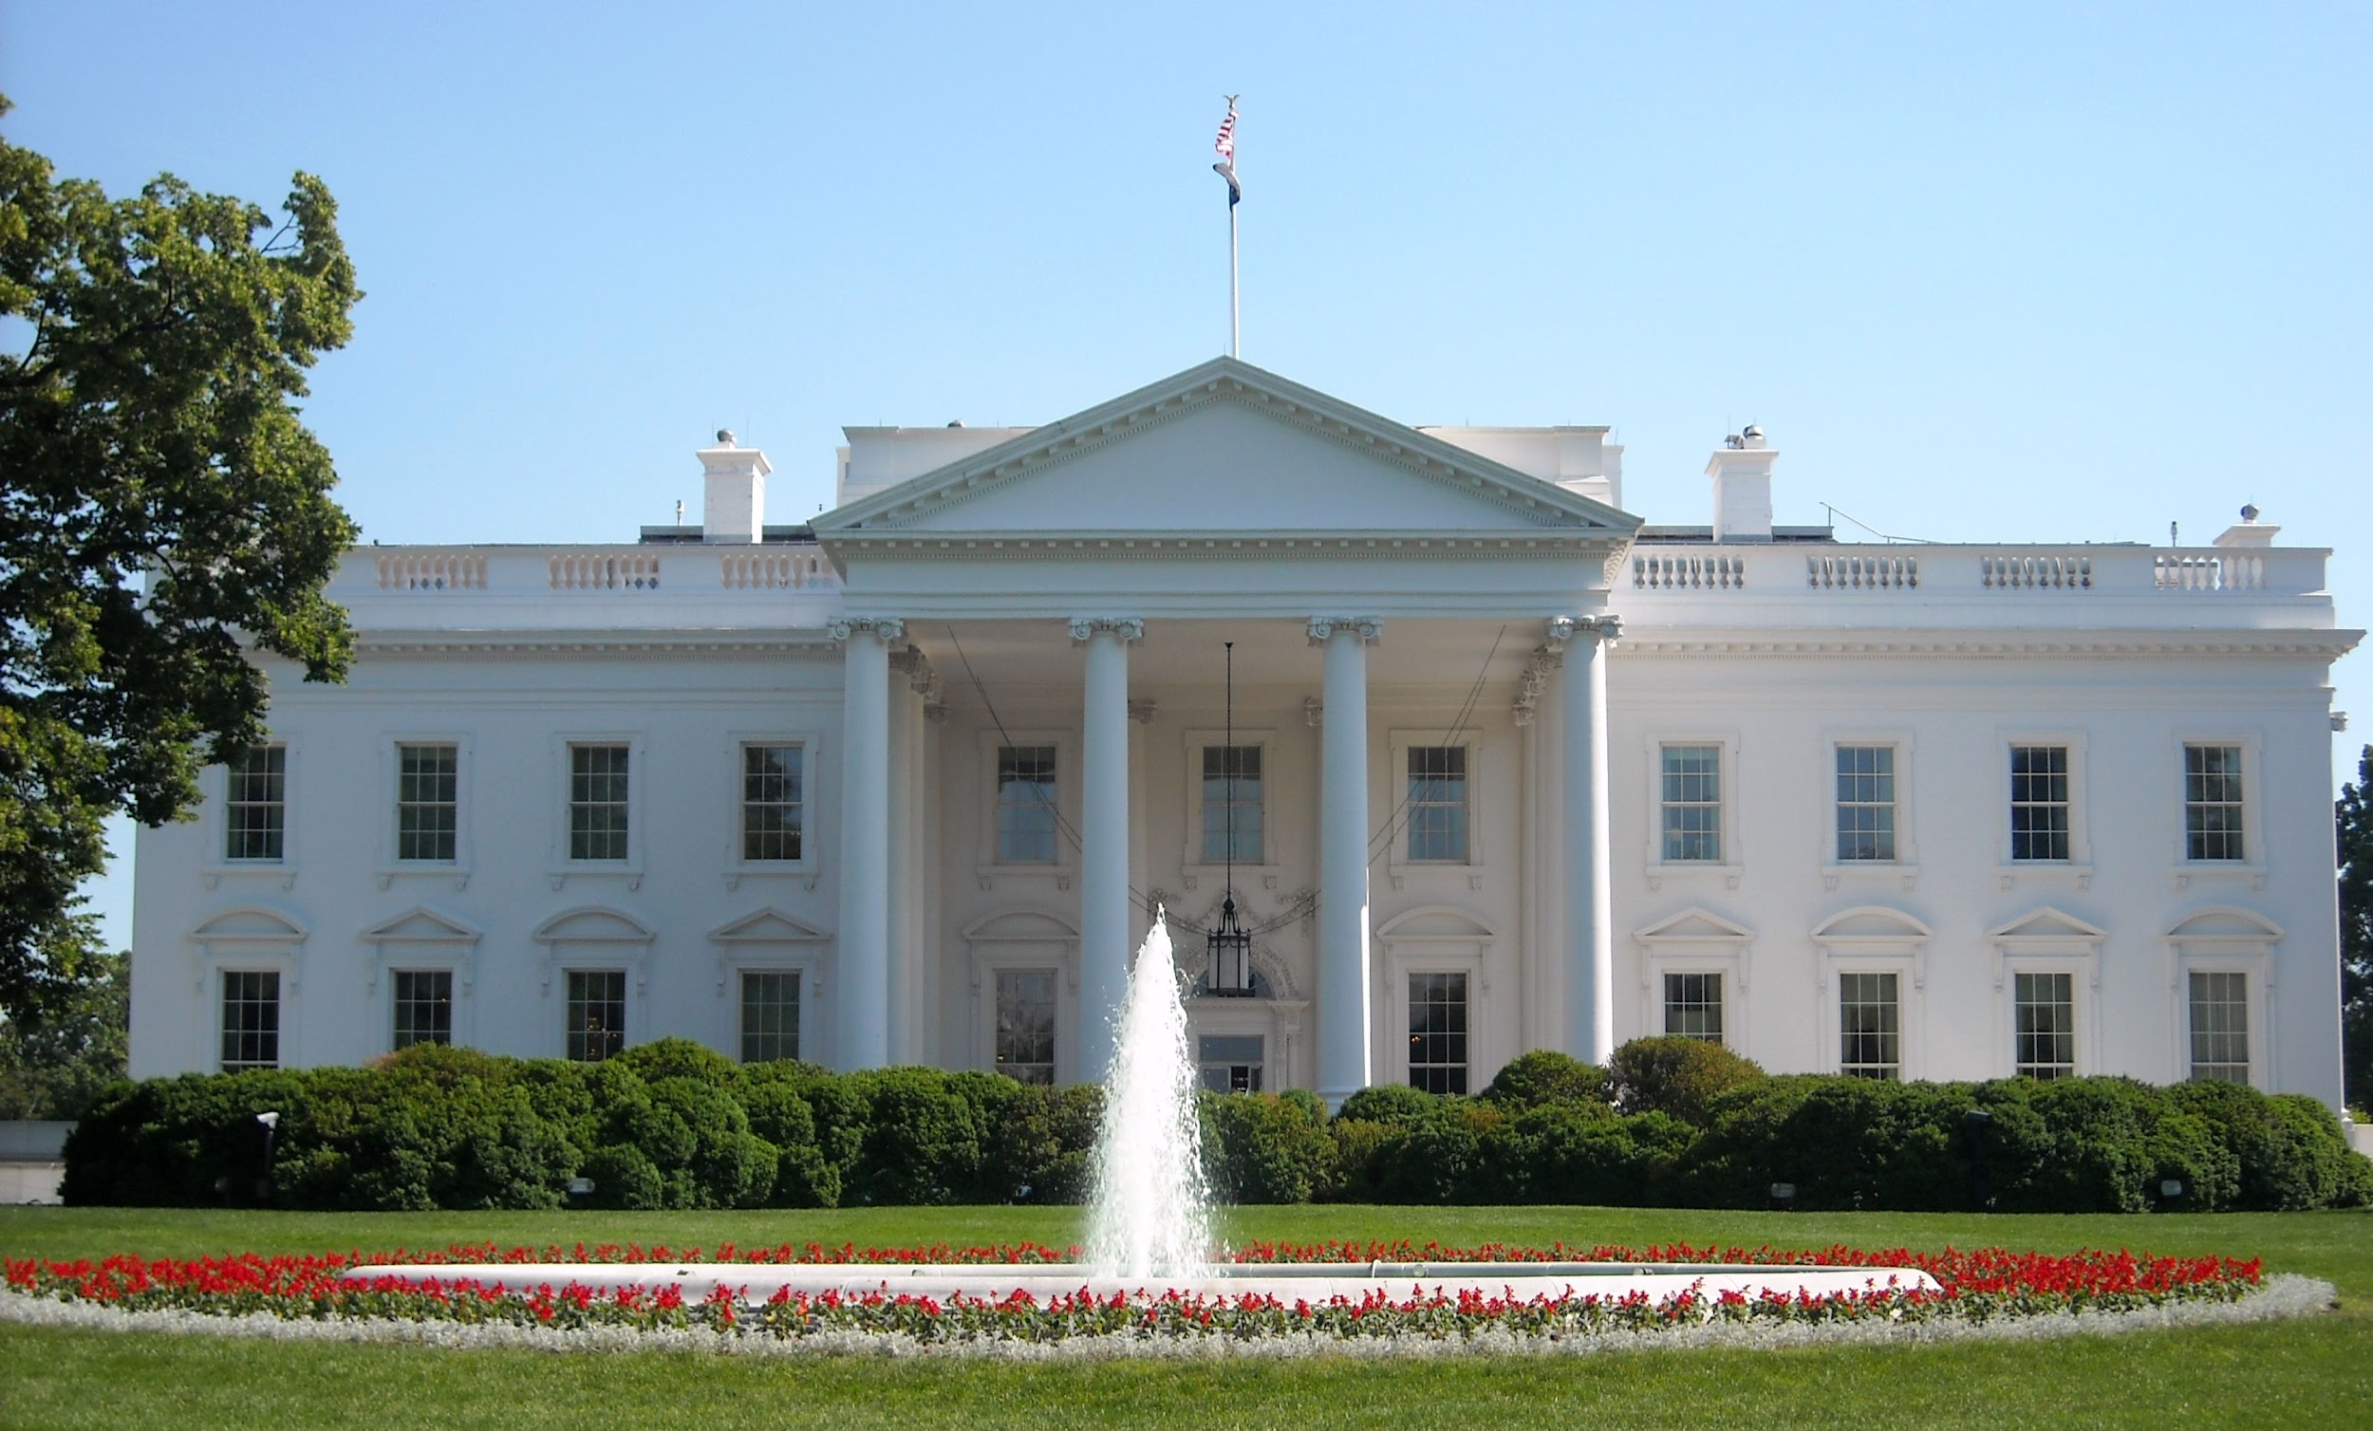




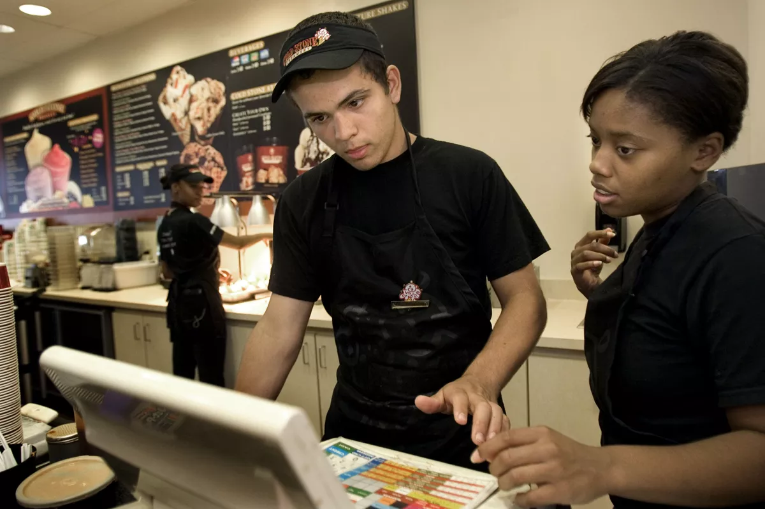


Slide 15


Slide 16
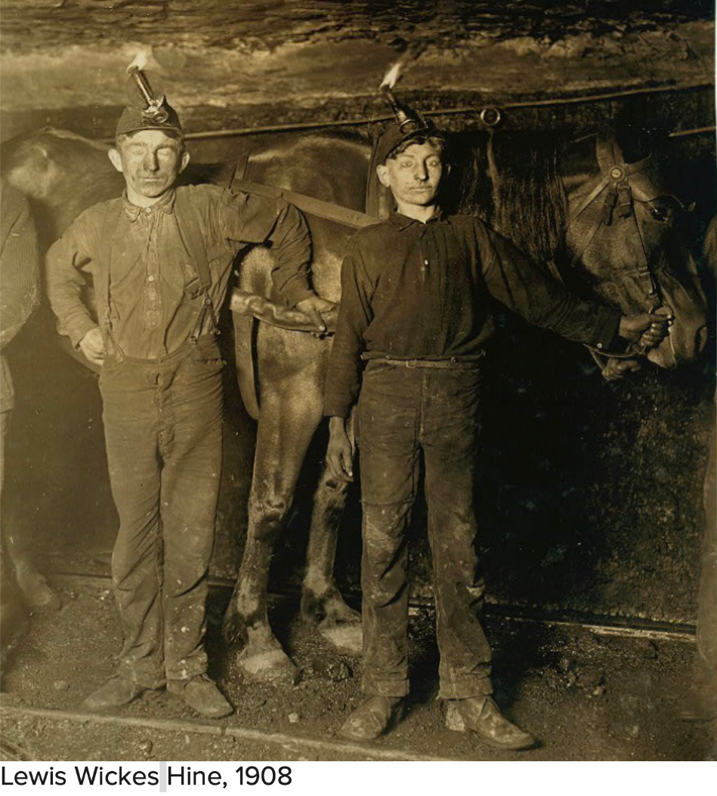

Slide 17
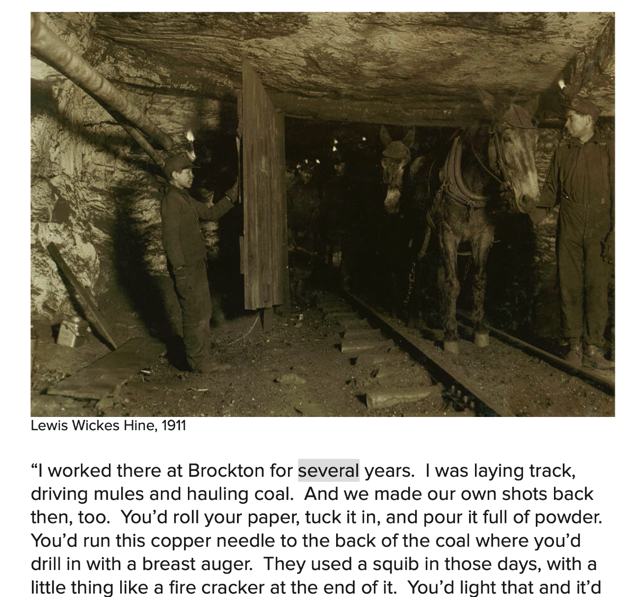

Slide 18
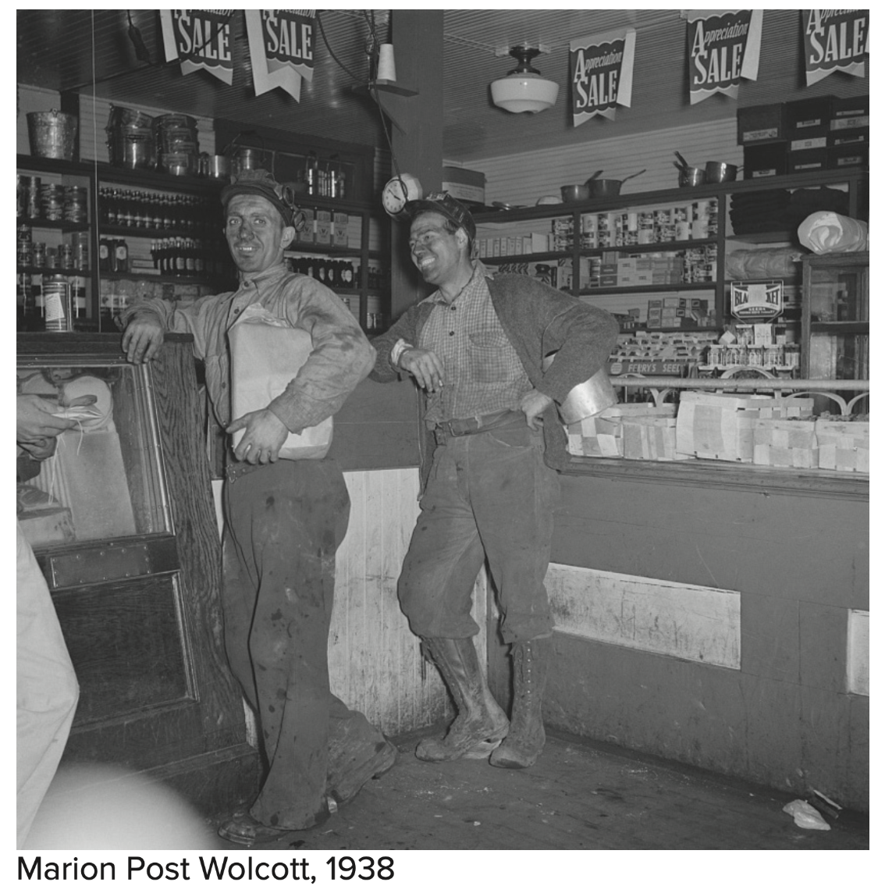

Slide 19
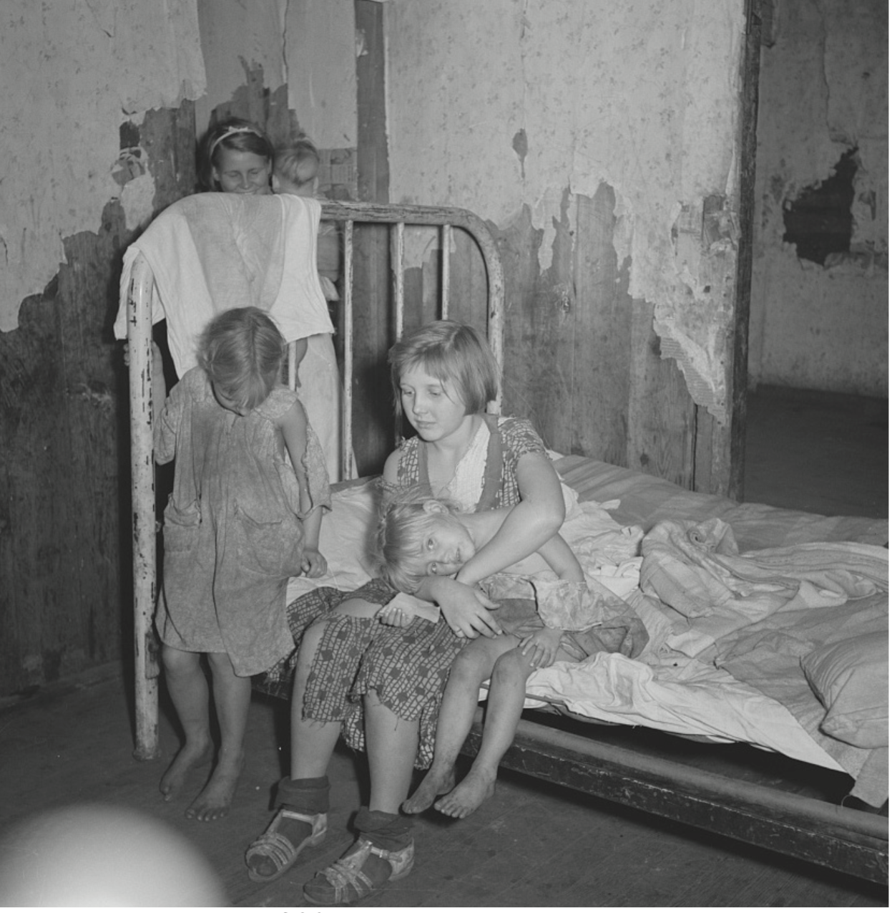

Slide 20
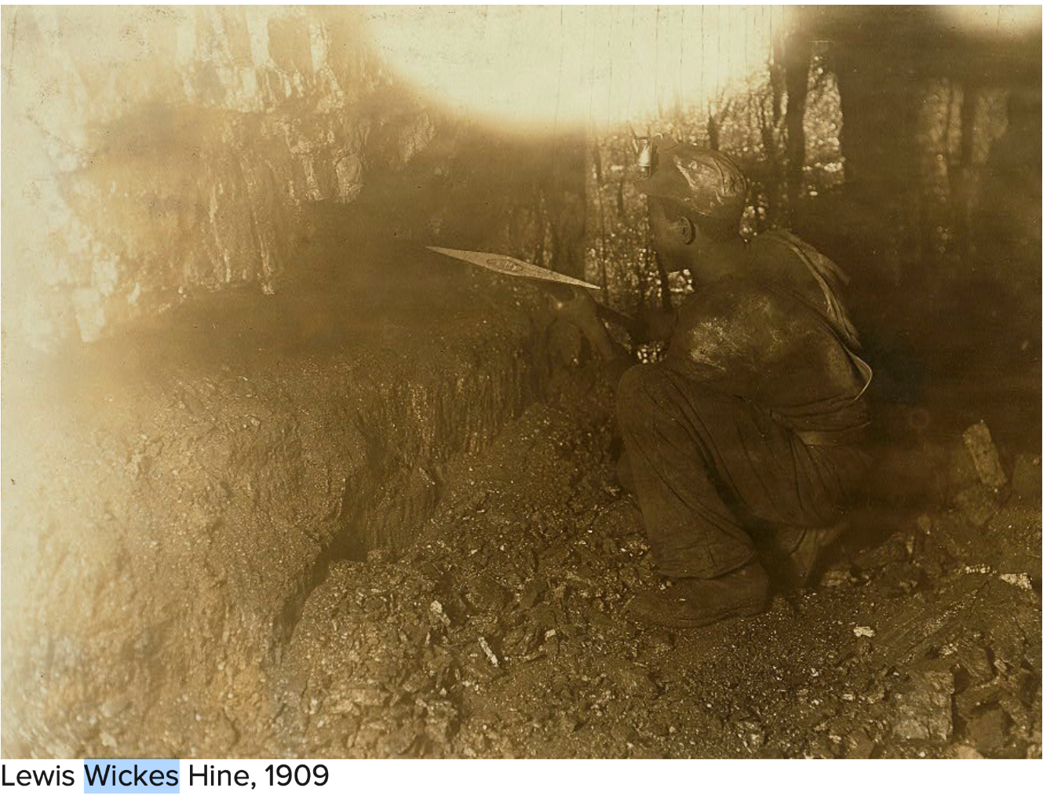

Slide 21
Low Pay
Child Labor
Labor
Long Hours
Work Supplies
MINING COMPANIES
Owned by the mining company
Company Store
Housing
Inadequate
Scrips
Household goods
Medical Care
Claims Denied

Slide 22
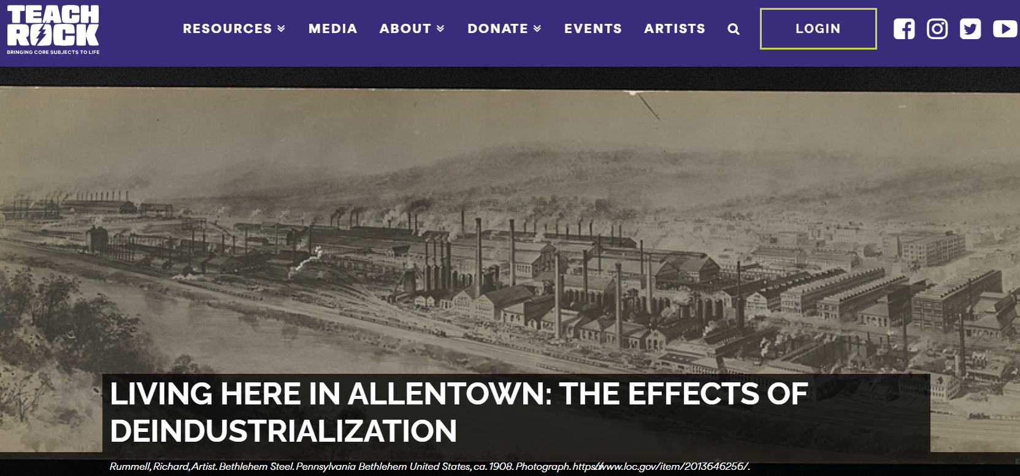
Allentown and De-industrialization

Slide 23
Standards
Personal Finance and Economics
*Interdependence as a general theme
SSEMA1b Explain the differences between seasonal, structural, cyclical, and frictional unemployment.
SSEMI1 Describe how households and businesses are interdependent and interact through flows of goods, services, resources, and money.
US History
SSUSH11.e Discuss the origins, growth, influence, and tactics of labor unions including the American Federation of Labor.

Slide 24
Deindustrialization
What is it?
Deindustrialization: The progressive closure or downsizing of manufacturing industries in a place, city or region.
(Oxford Dictionary of Human Geography)

Slide 25
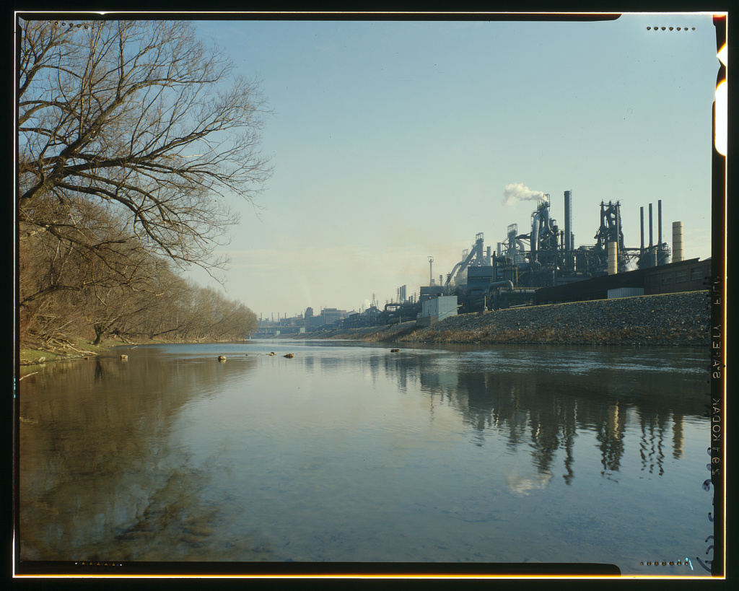
Notes:
Bethlehem Steel Plant 1963

Slide 26
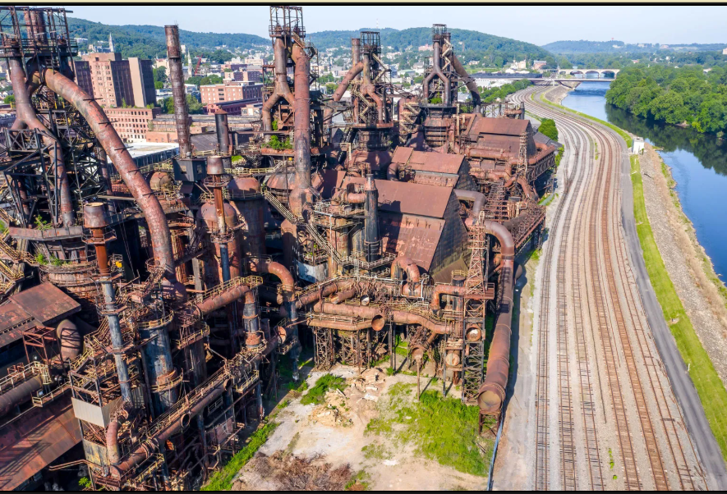
Notes:
Bethlehem Steel Plant in 2023

Slide 27
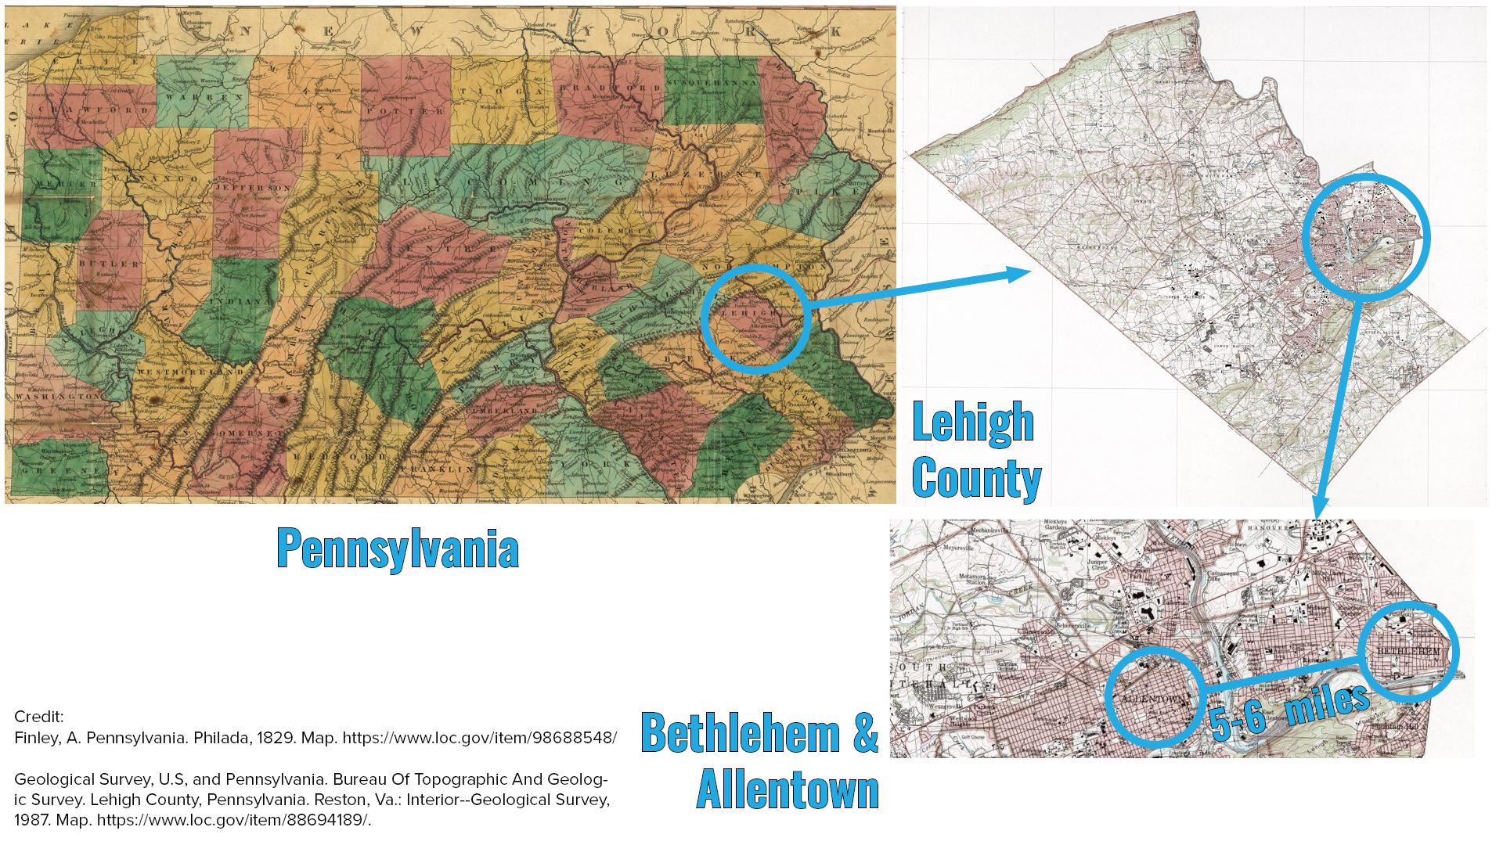

Slide 28
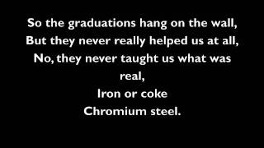
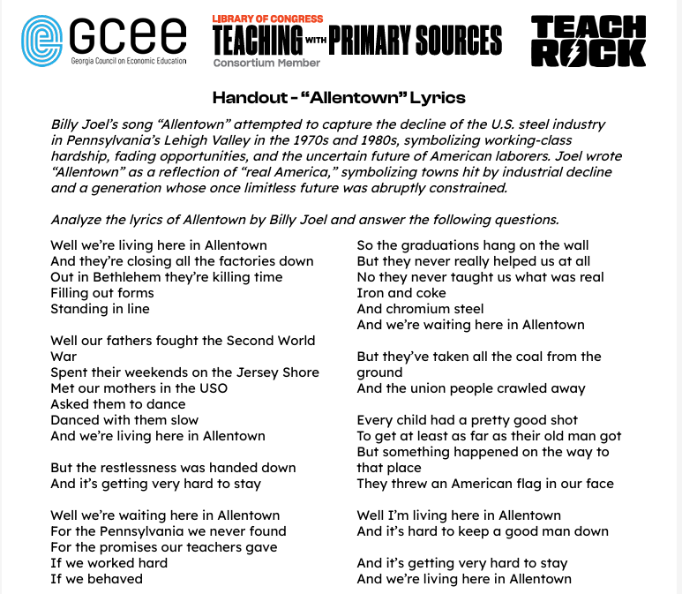
Let’s learn about “Allentown”

Slide 29
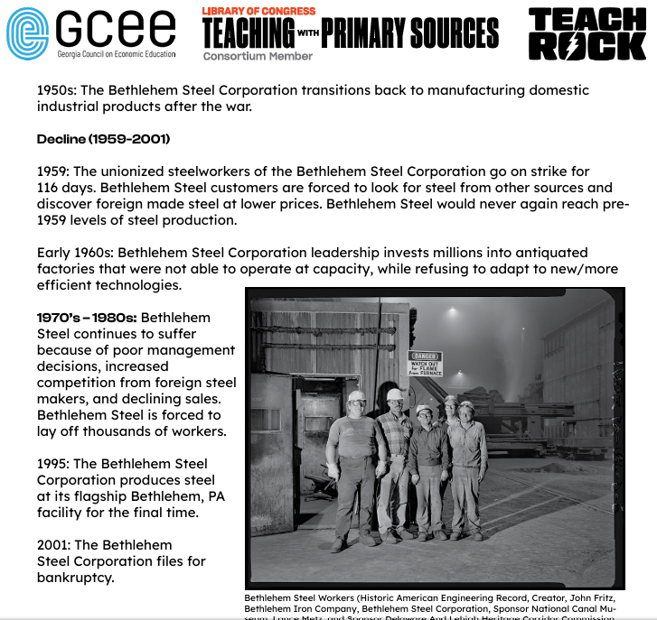
Bethlehem Steel Timeline Activity

Slide 30

Gallery Walk Activity

Slide 31
“Allentown”
Revisit the lyrics.

Slide 32
Conclusion Discussion Questions
In what way does this story influence the way you view labor unions?
Why does the closing of a major industry in a city have the potential to do so much damage to a local economy?
What type of unemployment would most of the steel workers have been experiencing? What about the other workers that lost jobs?
What steps would the former steel workers of Bethlehem Steel have had to take to find new employment?
How might deindustrialization affect other cities? What happens when deindustrialization spreads across a country?

