Slide 1
Discrimination and the Financial System

Slide 2
Standards (State Example)
SSEPF9c Explain the primary purpose of important consumer legislation (i.e., the Truth in Lending Act, Fair Debt Collection Practices Act, Fair Credit Reporting Act, the Equal Housing Act, and the Dodd-Frank Act).
SSUSH21.b Connect major domestic issues to their social effects including the passage of civil rights legislation and Johnson's Great Society, following the assassination of John F. Kennedy.

Slide 3

Standards
Standard 14: Banks, Interest Rates, and Financial Markets
Standard 7: Role of Government

Slide 4
01
What is the financial “system?”

Slide 5

Activity 1
In your group, create a visual (chart, diagram, mind-map) that shows what your group considers to be the financial “system” of the United States.

Slide 6


Slide 7
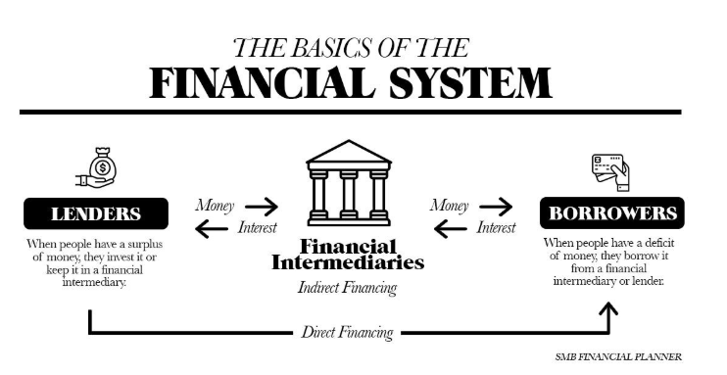

Slide 8
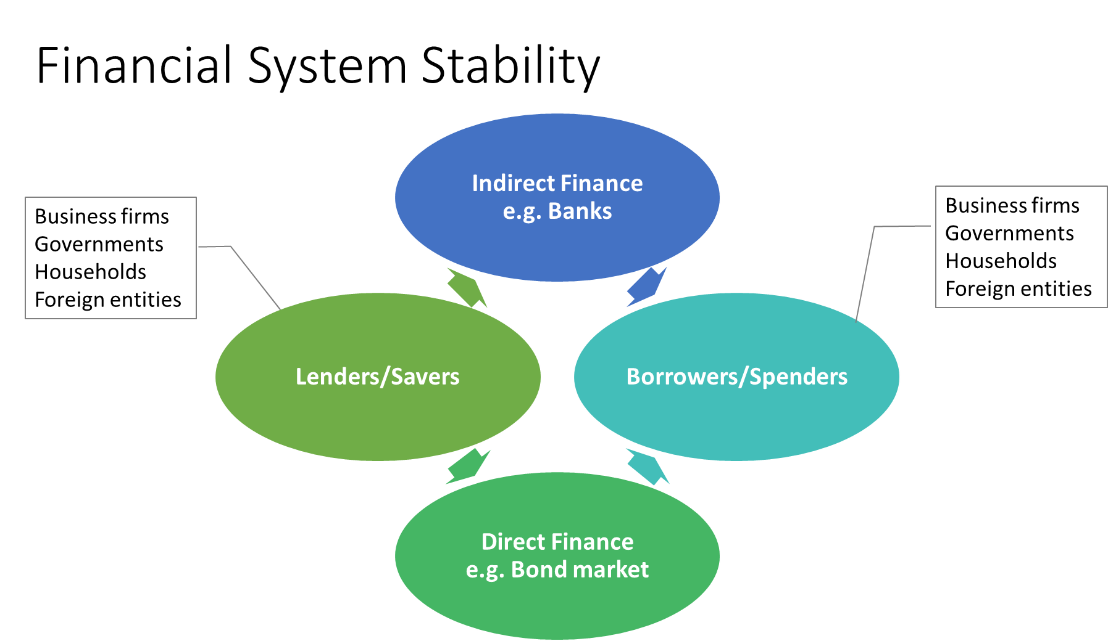

Slide 9
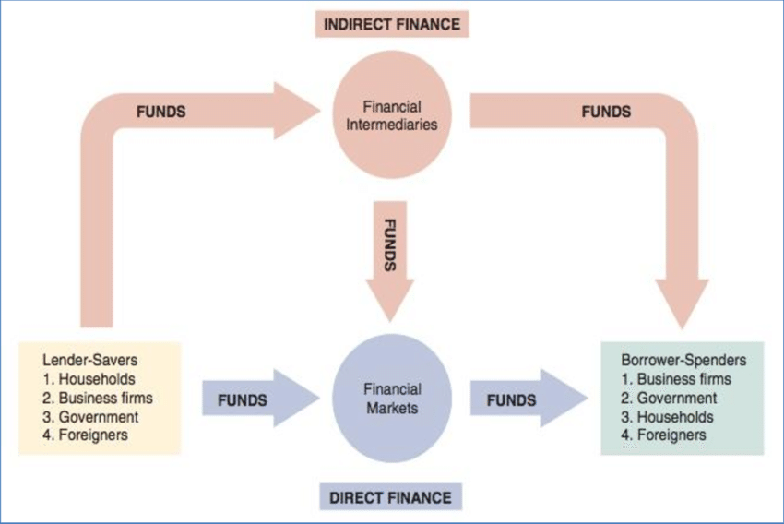

Slide 10
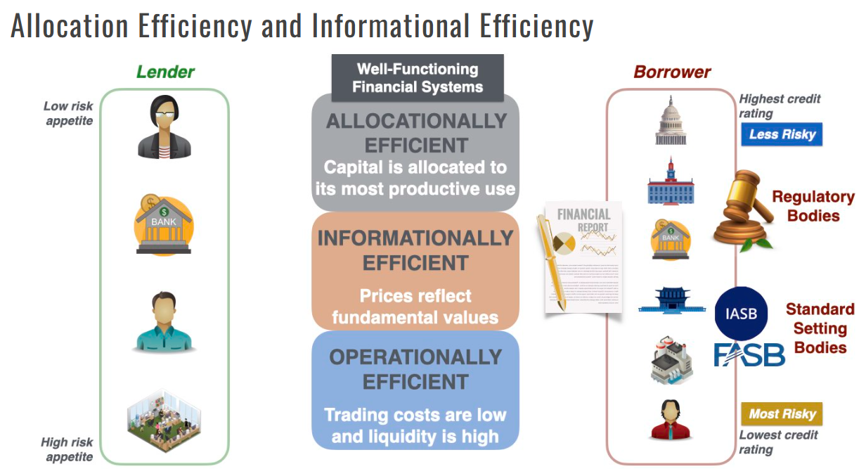

Slide 11
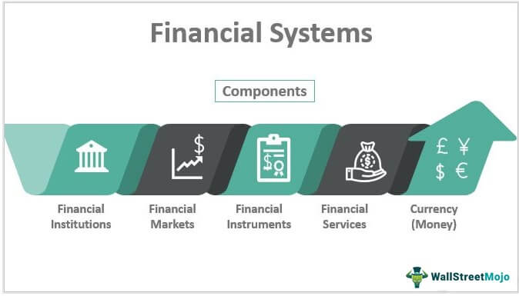

Slide 12


Slide 13
Checking accounts (personal and business)
Savings accounts
Cash services
Banking
Credit
Personal loans
Business loans
Accurate credit history
Investment
Retail stock/bond trading
Commercial help with IPOs or Corporate bonds
Insurance
Personal and business asset protection
Life insurance
Wealth management
Retirement Planning
Tax help
Financial Advisory Services
5 Components of the “Financial System”
(Specific to this lesson)

Slide 14
02
Who is affected and how?

Slide 15
Were you denied?
Everyone who thinks they should have access to the financial system stand up. As a group of people displays on the screen, you will have a seat if it applies to you.
WOMEN
MINORITIES & IMMIGRANTS
Up until the Equal Credit Opportunity Act (ECOA) was passed in 1974, it was common practice for banks in the United States to require women, even those with their own income, to have a male co-signer — often a father or a husband — to obtain a loan or credit card.
In the mid-19th century, many Irish immigrants in New York City faced significant discrimination from established financial institutions, which were often unwilling to provide them with banking services.
Non-LAND OWNERS
NON-EPISCOPALIAN CHURCH MEMBERS
In 17th century America, the ability to obtain loans or other financial services was heavily dependent on owning land - often used as collateral for securing a debt. This practice excluded non-landowners, who were predominantly indentured servants, laborers, or new settlers without any property.
In the 19th century and early 20th century, many private banks in the U.S. were closely linked with mainstream Protestant church leaders. Members of other denominations, particularly Catholics, Jews, and other non-Protestants, sometimes found it challenging to secure loans or business credit with favorable terms.

Slide 16
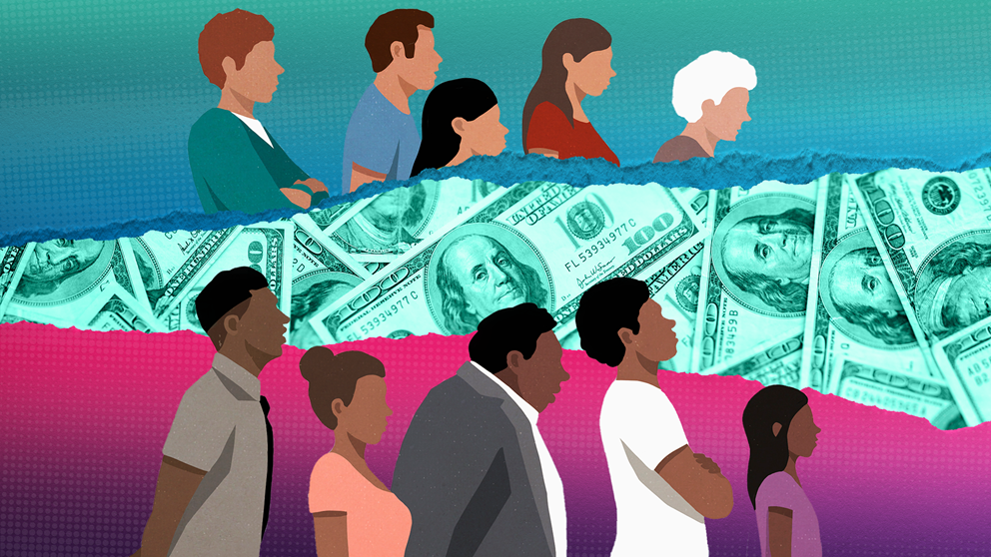
If access to the financial system compounds over time…
what happens when exclusion is not temporary—but persistent?
*And targeted at one group?

Slide 17
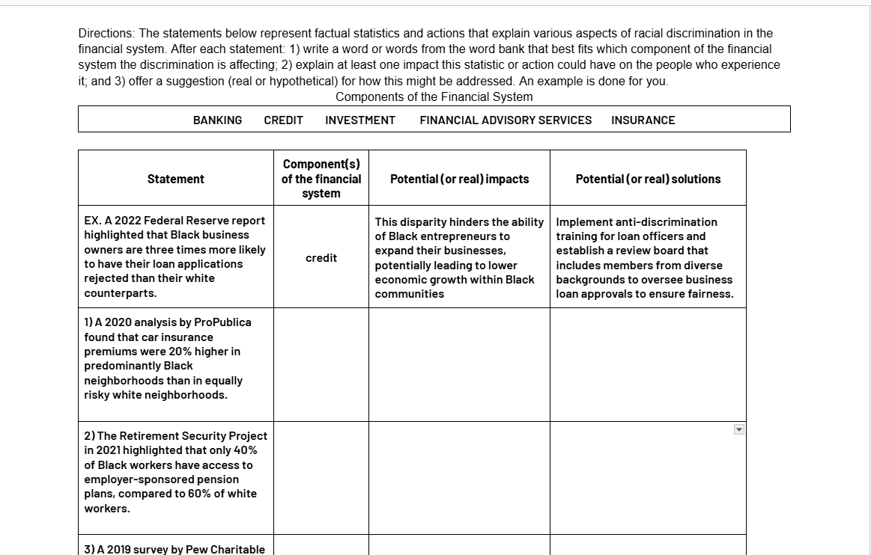
Activity 2
With a partner or two, discuss the statements on the handout. Indicate which component of the financial system you feel is at play, impacts and solutions.
**NOTE: Stats may show choices or policies related to discrimination

Slide 18
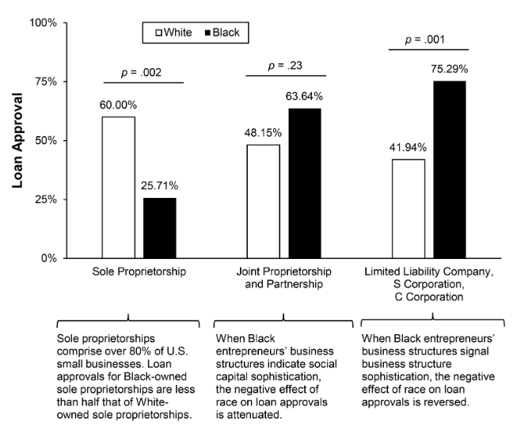
Notes:
Link to article: https://drive.google.com/file/d/1D9Cv1C8OTSXjhKEqj1qsM_TWC4yw4R6t/view?usp=sharing

Slide 19
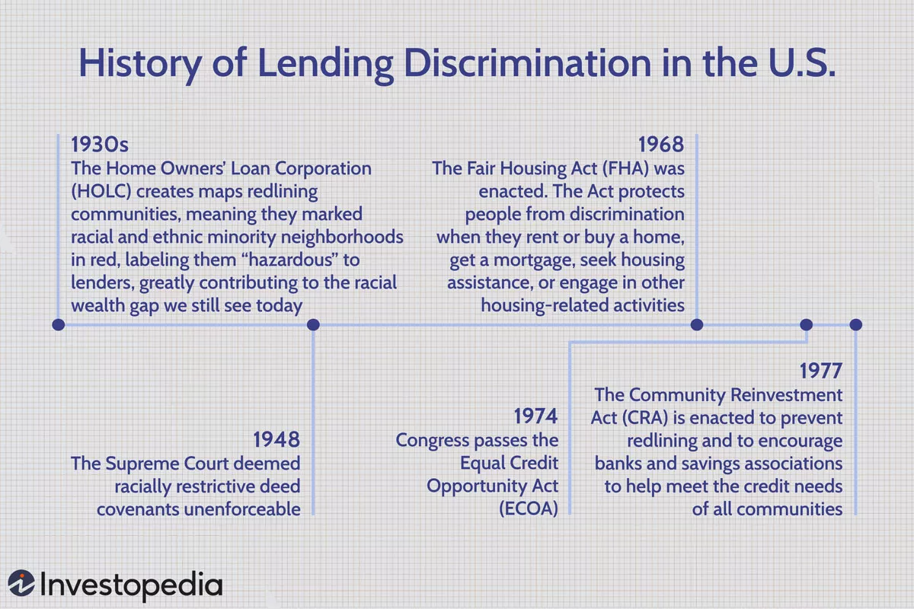

Slide 20
03
Responses?

Slide 21
Laws/Agencies
Fair Housing Act (1968)
Equal Credit Opportunity Act (ECOA) (1974)
Community Reinvestment Act (CRA) (1977)
Consumer Financial Protection Bureau (CFPB) (2010)
GCEE has a nifty lesson about this topic! Click here!

Slide 22
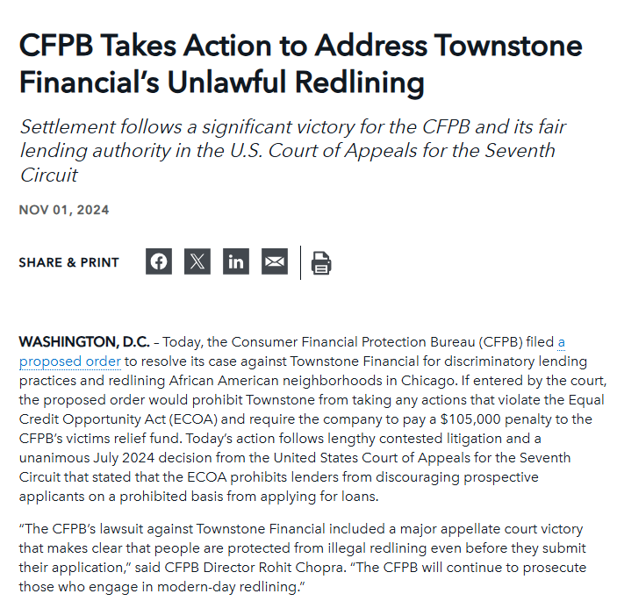

Slide 23

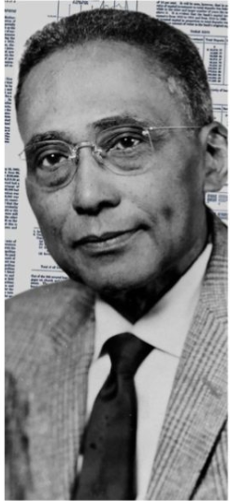
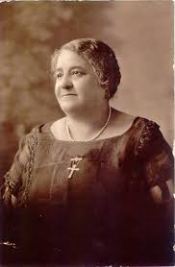

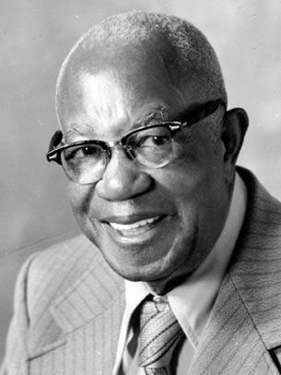

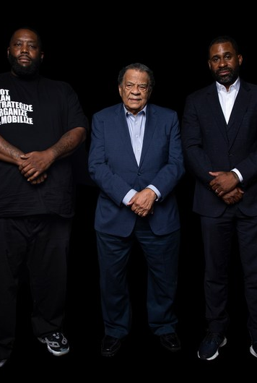

04
05
Maggie Lena Walker
Norman McGhee Sr.
Arthur G. Gaston
Greenwood Digital Bank
Marsha Barnes
Pioneer of Black banking and economic empowerment.
Founder of the first Black-owned brokerage firm in the U.S. and civil rights supporter.
A modern take on Black-banking and community investment
Innovative financial therapist
Founder of Booker T. Washington Insurance Co. and owner of the historic Gaston Motel, a key site for civil rights leaders.
Historical and Modern Leaders in
Black Finance
Click HERE for BIOs

Slide 24

Specific Firms

Slide 25
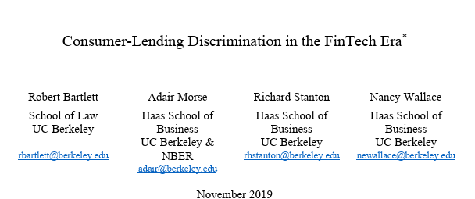
Tech usage
New (ish) research indicates Fin-Tech algorithms discriminate around 40% less than face to face lenders
Notes:
https://faculty.haas.berkeley.edu/morse/research/papers/discrim.pdf

Slide 26
Takeaways
Enduring Financial Gaps: Despite progress, significant disparities in financial access for Black communities persist.
Need for Comprehensive Solutions: Addressing systemic racial issues in finance requires broad, structural changes.
Critical Role of Advocacy: Ongoing advocacy and education are essential to drive financial literacy and empowerment.
Legislative Impact: Effective legislation and regulation are key to combating financial discrimination and protecting rights.
Educators as Change Agents: YOU can empower the next generation by integrating financial literacy and historical context into your lessons.

Slide 27
THANK YOU

