Slide 1
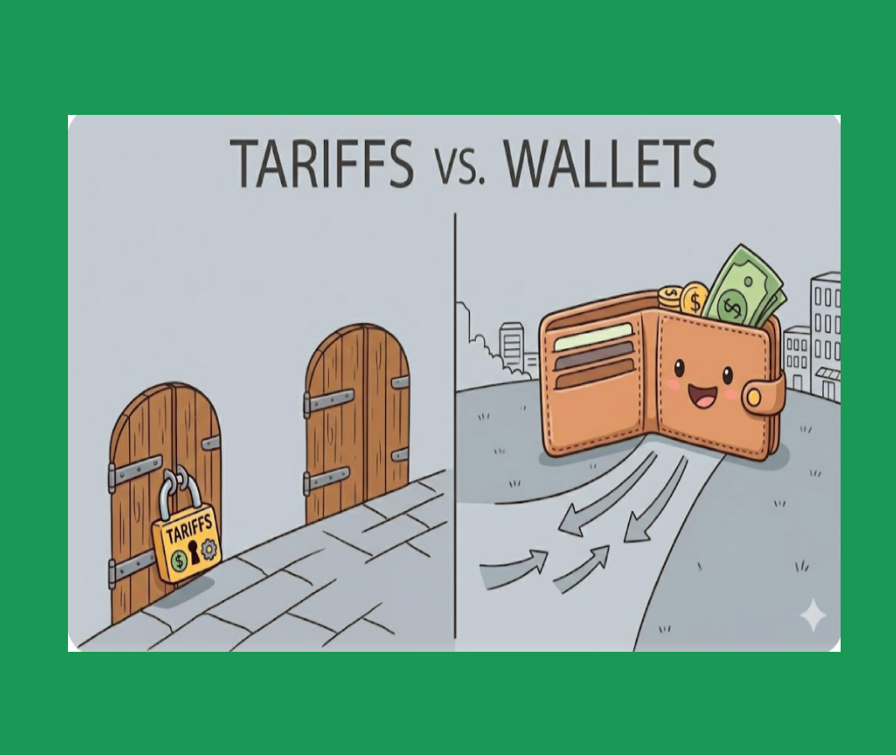
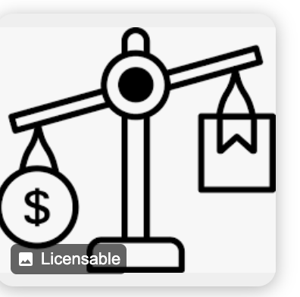

The Hidden Cost of Tariffs:
What They Mean
for Your Wallet

Slide 2
Certificate Requirements
To earn professional development hours for webinars, you must:
Watch a minimum of 75% for all sessions
You will automatically receive a professional development certificate via e-mail within 24 to 48 hours.

Slide 3
Objectives
You will be able to:
Define words associated with tariffs
Investigate various types of tariffs
Examine the economic impact of certain tariffs on consumers
Calculate costs associated with tariffs

Slide 4

Presenter(s)
Maria Michelsson
mcsmcm@gmail.com
www.linkedin.com/in/michelsson-maria

Slide 5
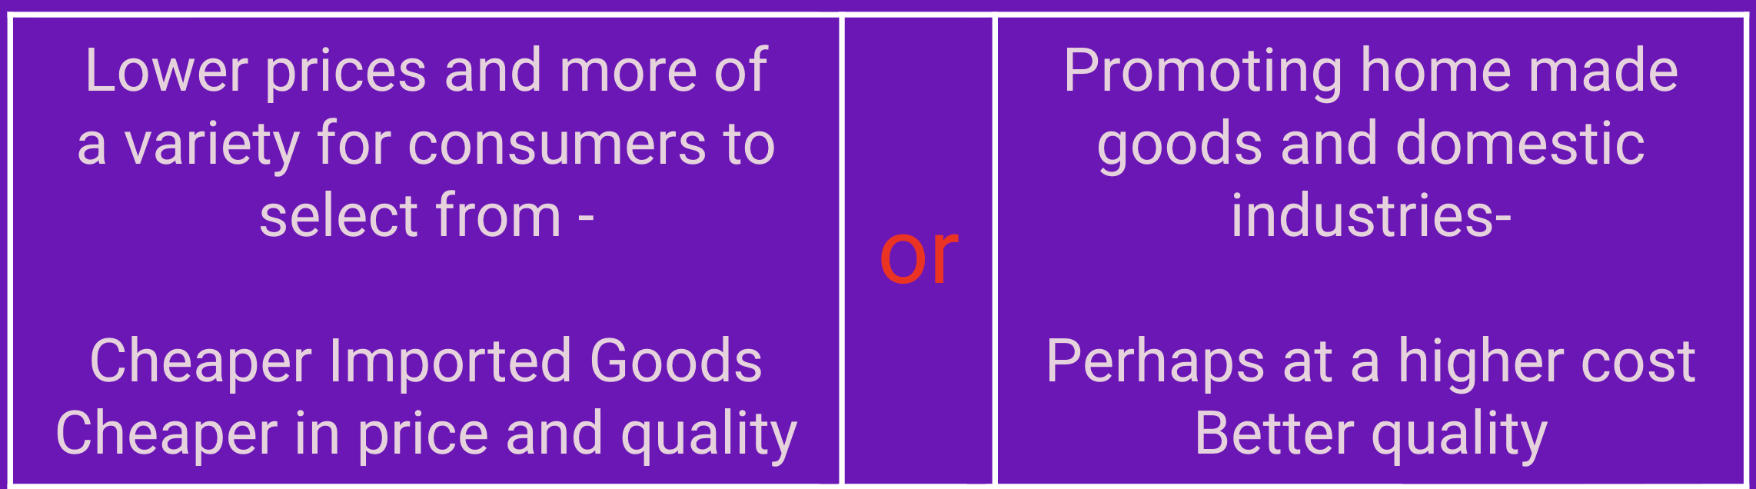
First: Think about this question:
Which Would You Rather Have
And Why?
Notes:
Maybe suggest discussing with a partner - 2 minutes

Slide 6
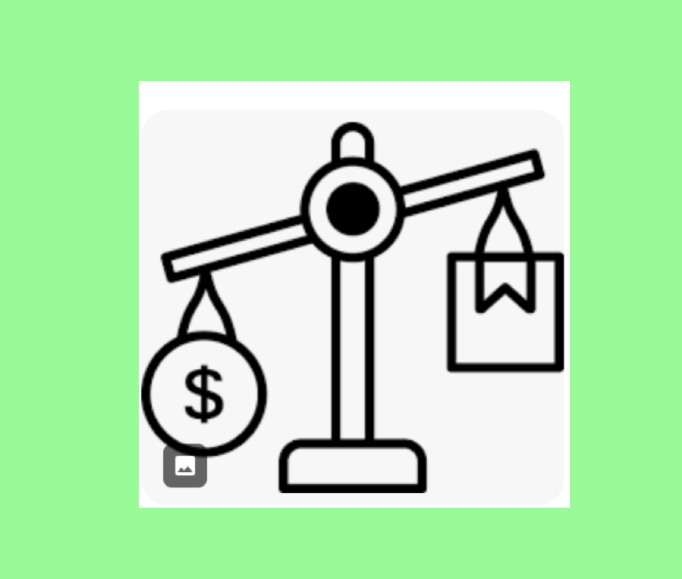
Session Agenda
Important definitions
Computing the effect of various tariffs
on buying goods - Examples
Analyze the direct and Indirect effect of tariffs
on buying goods
What additional questions can raised?
Notes:
Agenda - go over each section lightly

Slide 7

National Standards
(Standard 8-2): Focuses on how taxes and government policies change the "all-in" price of goods.
Standard 12-2: Consumer decisions are influenced by the price of products, alternatives, budget and impact on the economy
(Standard 12-4): Students must understand that when prices rise (due to tariffs), the "real value" of the money in their wallet decreases, meaning their savings won't buy as much as they used to.
(Standard 12-8): Requires the analyzation how federal regulations (like tariffs) create ripple effects throughout the marketplace.e.
https://www.councilforeconed.org/policy-advocacy/k-12-standards/
Notes:
Standards - link provided

Slide 8
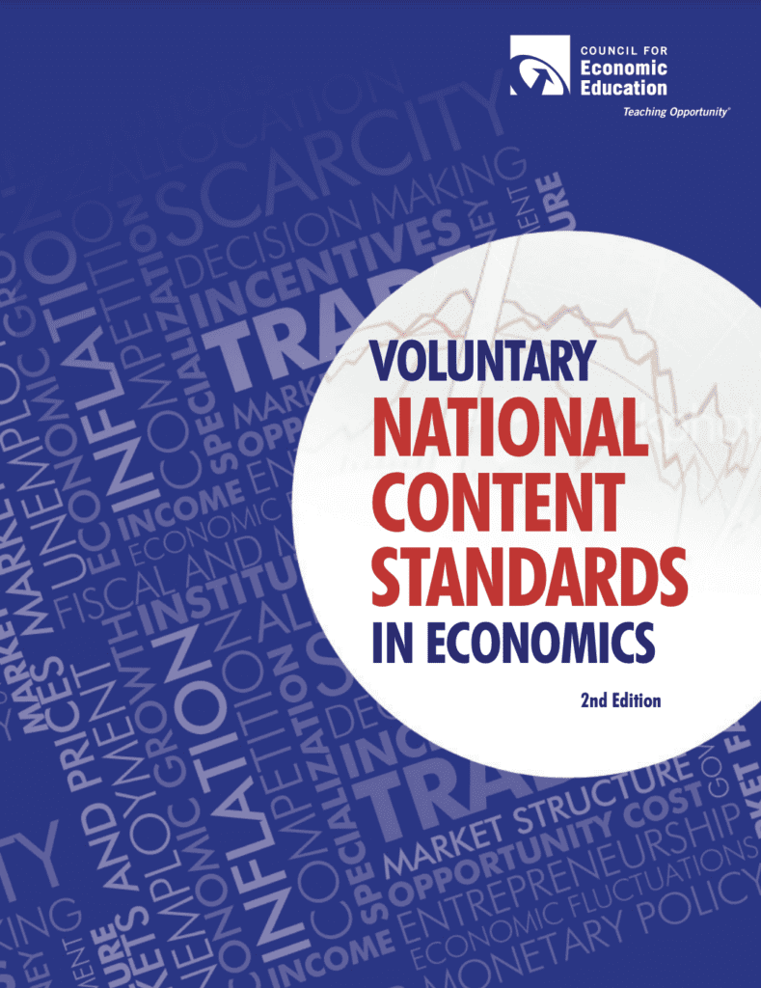
National Standards
Standard 5: Voluntary Exchange
The Overarching Goal: Students should be able to "compare the benefits and costs of policies that alter trade barriers between nations, such as tariffs and quotas.
Standard 16: Role of Government and Market Failure
The Overarching Goal: Students learn that government policies can sometimes lead to outcomes where "social goals other than economic efficiency are being pursued.
https://www.councilforeconed.org/policy-advocacy/k-12-standards/
Notes:
Standards - link provided

Slide 9


1 - Definitions:
What are Tariffs
Types of Tariffs
Notes:
In this section - discussion about what are tariffs and the 3 major types

Slide 10
Definition:
What Are Tariffs?
Tariffs are taxes imposed on imported goods,
making them more expensive to bring into the country.
Notes:
tariffs parallel placing taxes on items

Slide 11
A Key Fact:
The average effective U.S. tariff rate increased from
2.4% at the beginning of 2025 to
approximately 12% by August 2025.
As of April 2026, the average effective U.S. tariff rate has settled at approximately 11.0% (pre-substitution) -
[This is the "sticker price" calculating revenue based on historical import volumes].
or 9.6% (post-substitution) [accounts for businesses shifting their supply chains to different countries or domestic suppliers to dodge the highest duties]
Notes:
point out the change un the percentages

Slide 12
Universal Tariff:
10% baseline on all trading partners
Reciprocal Tariffs:
Country-specific rates (China 32-140%, Canada 35%, EU 15-30%)
Sector-Specific:
Steel/Aluminum 50%, Auto 25%, Electronics up to 100%
Types of Tariffs in 2025-2026
Notes:
three types of tariffs - will explore each

Slide 13
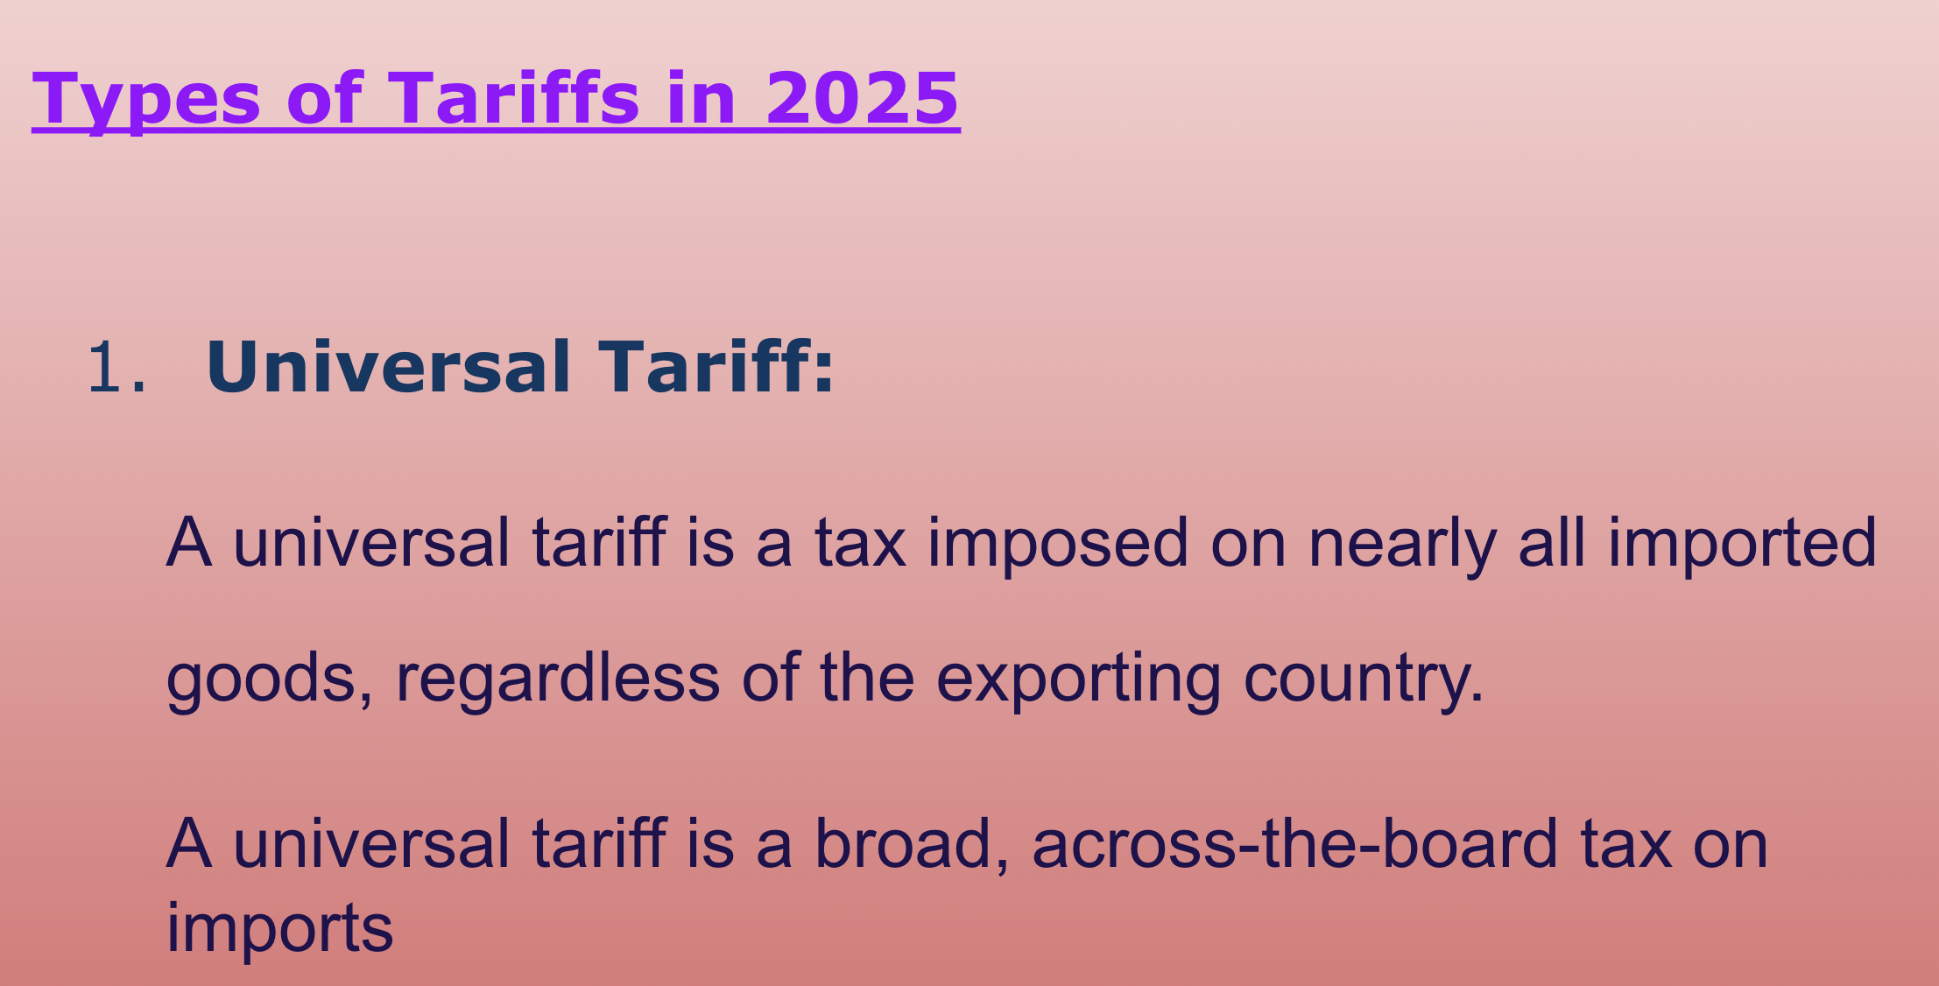
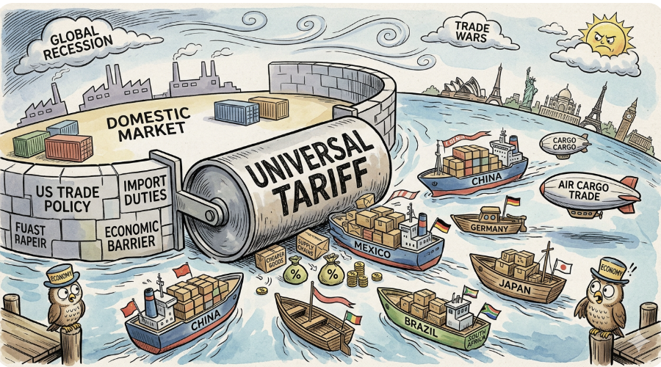

Slide 14

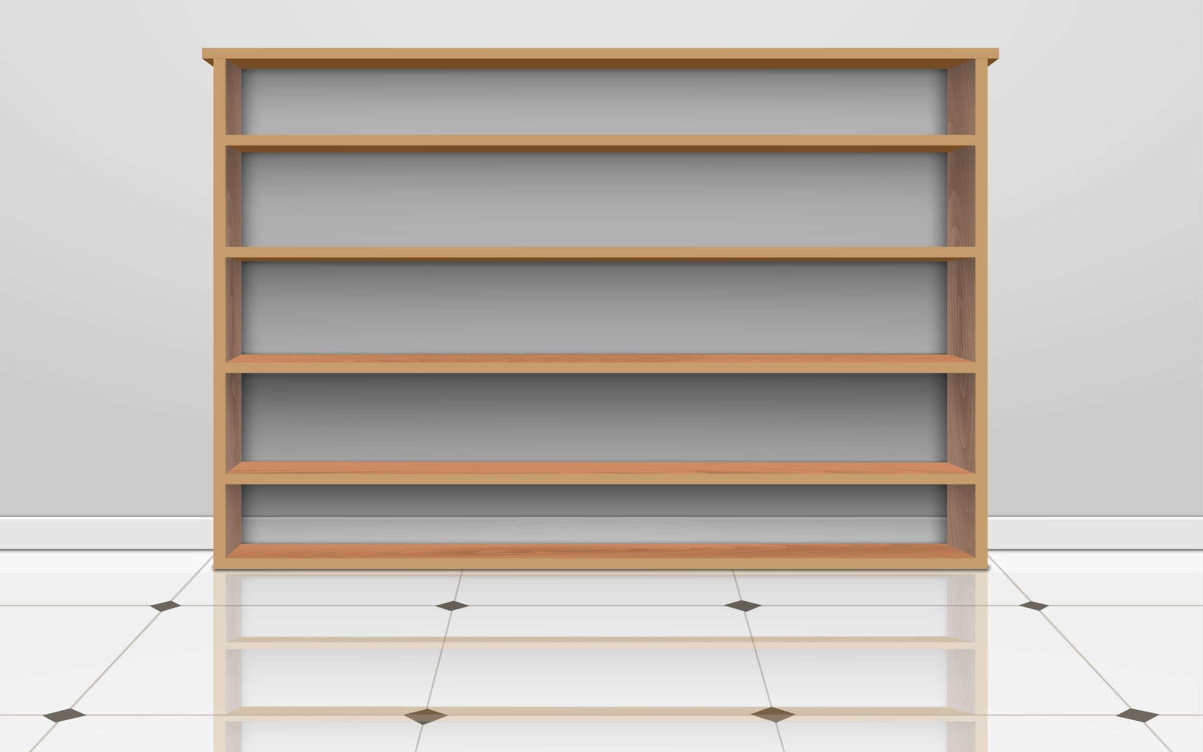
A GREAT EXAMPLE OF A UNIVERSAL TARIFF
A specific item currently subject to the 10% universal tariff is a standard piece of wooden furniture,
such as a dining room chair or a bookshelf.
Notes:
example

Slide 15
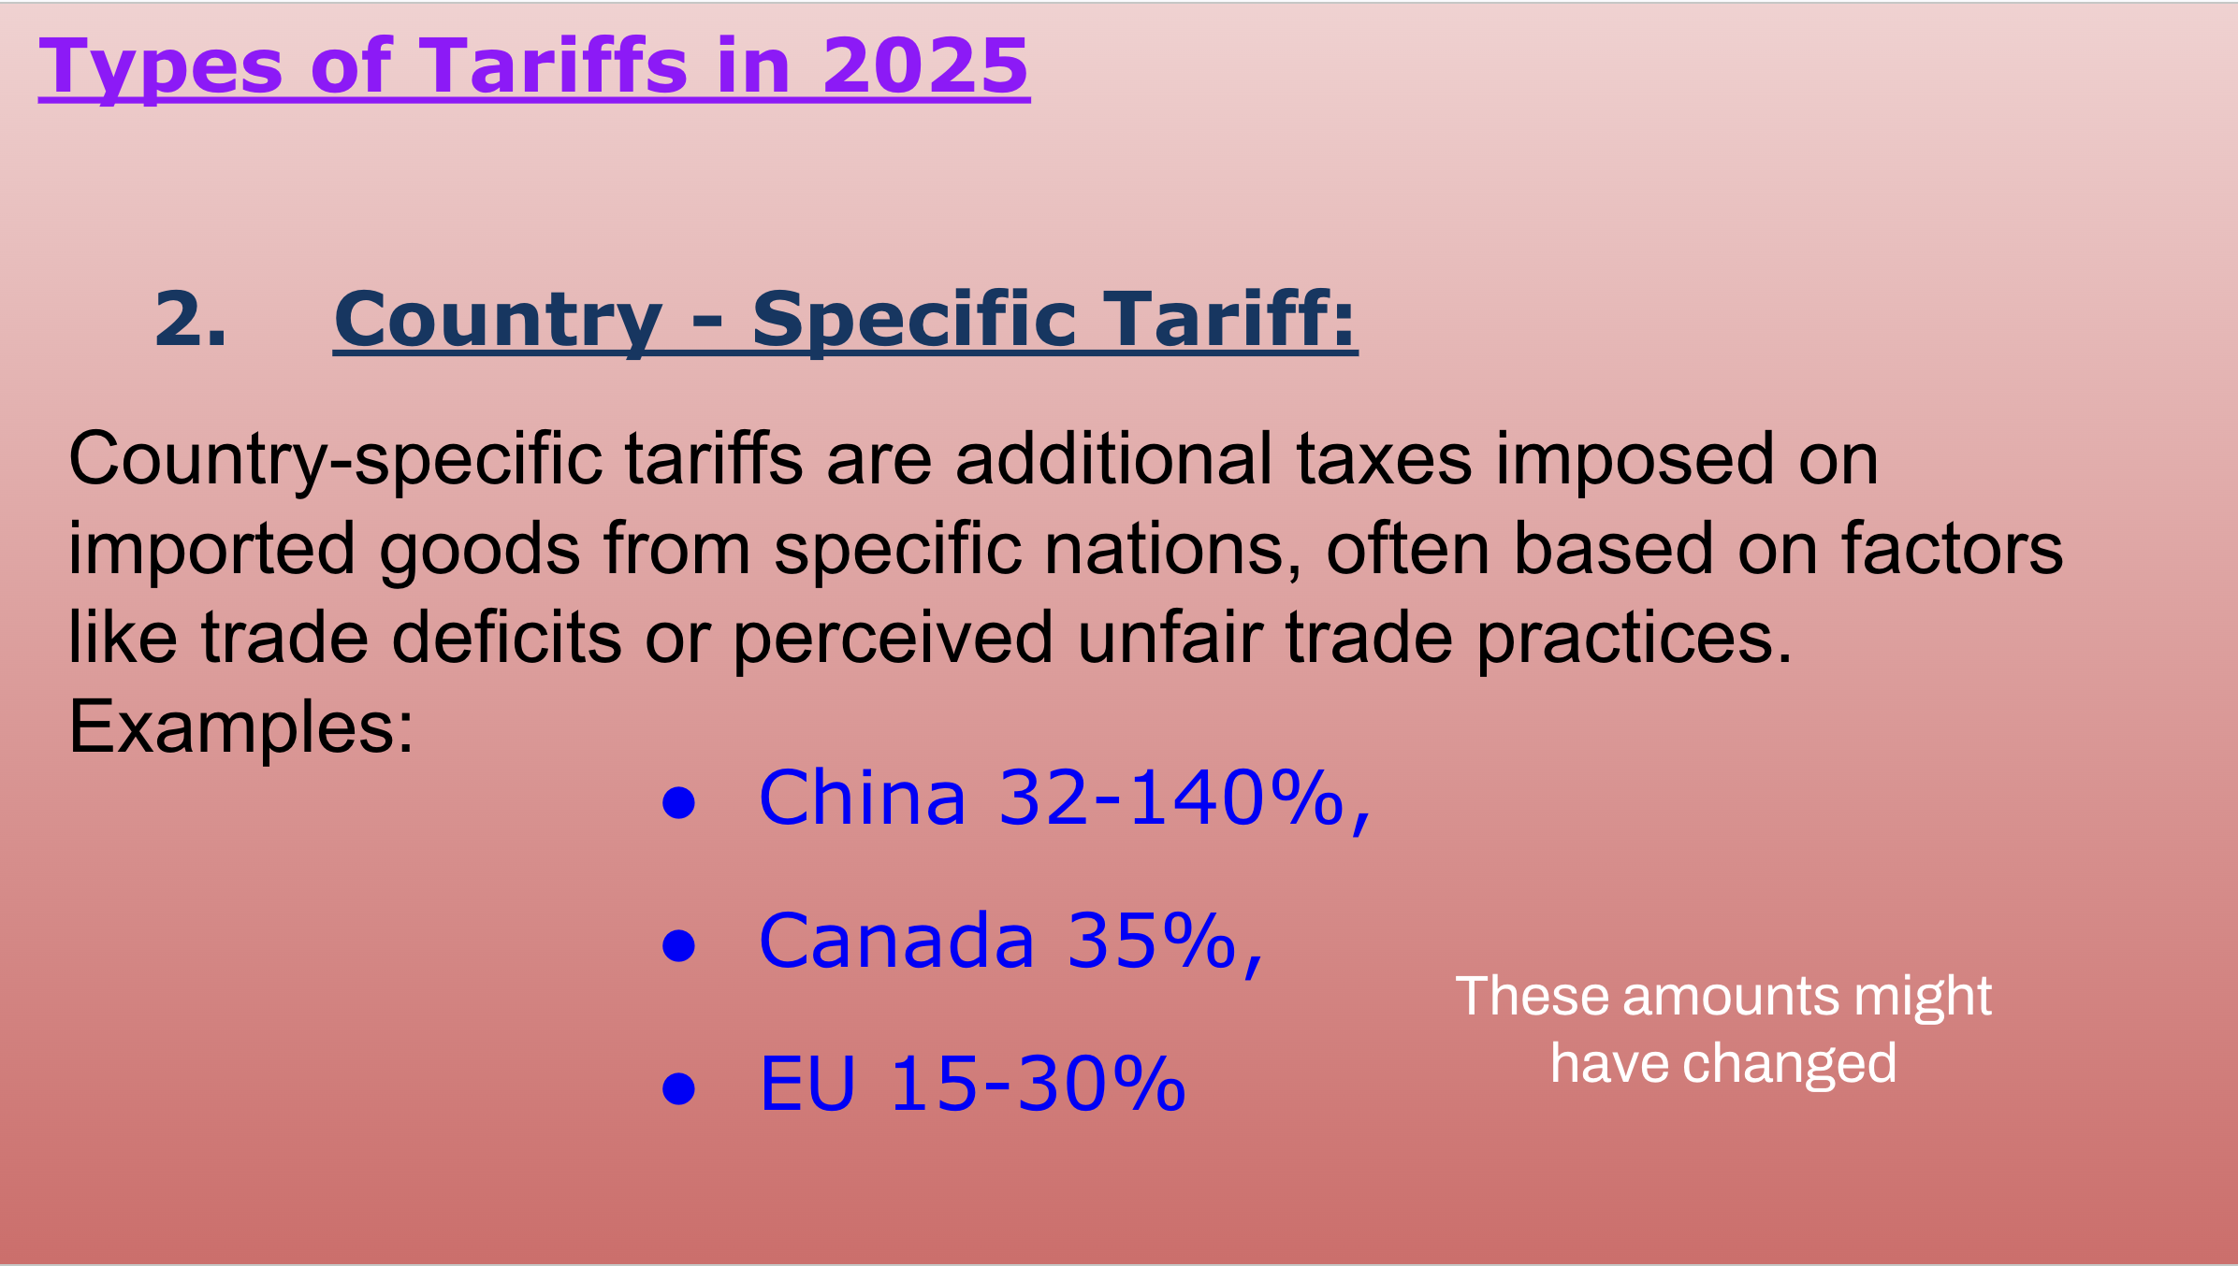
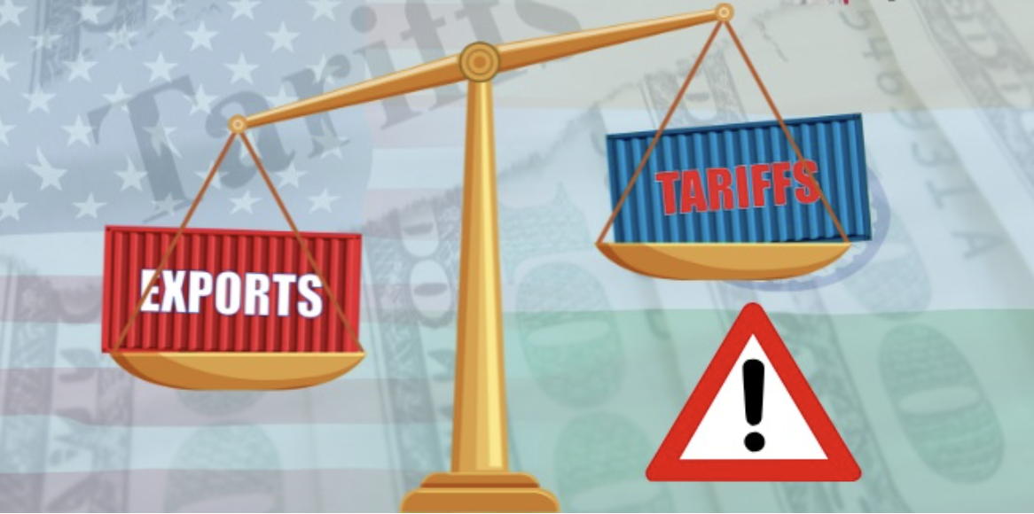

Slide 16
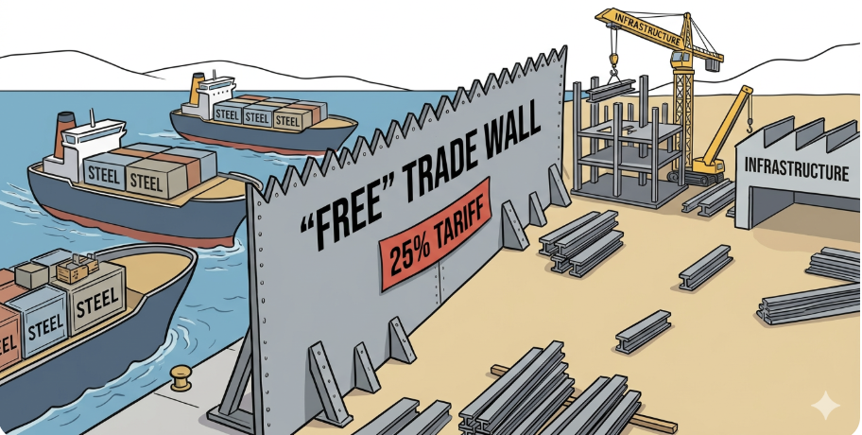
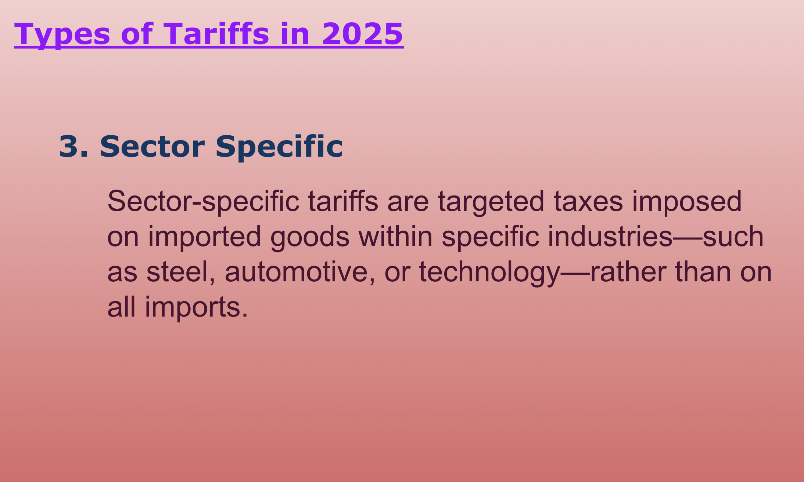

Slide 17

Tariffs
Notes:
short video

Slide 18
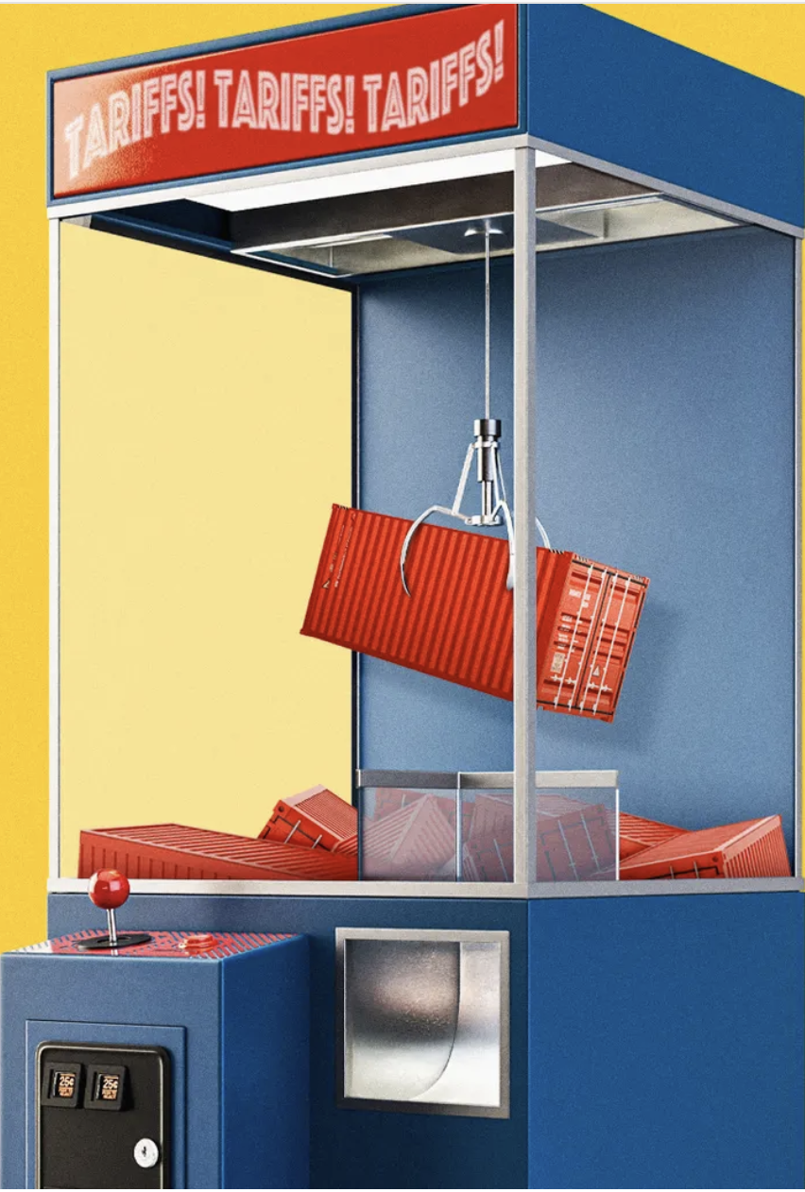
2 - How Do Tariffs
Impact Spending?
Look at Some Examples
Notes:
ask about ideas

Slide 19
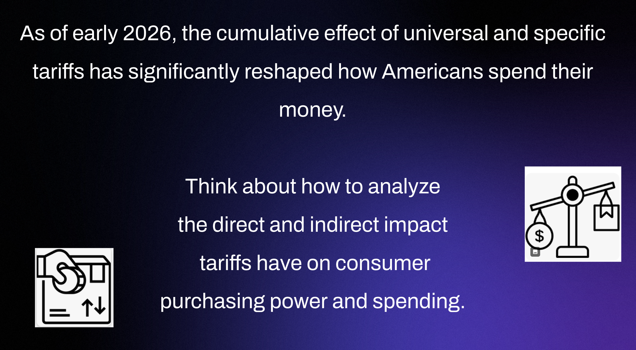

Slide 20
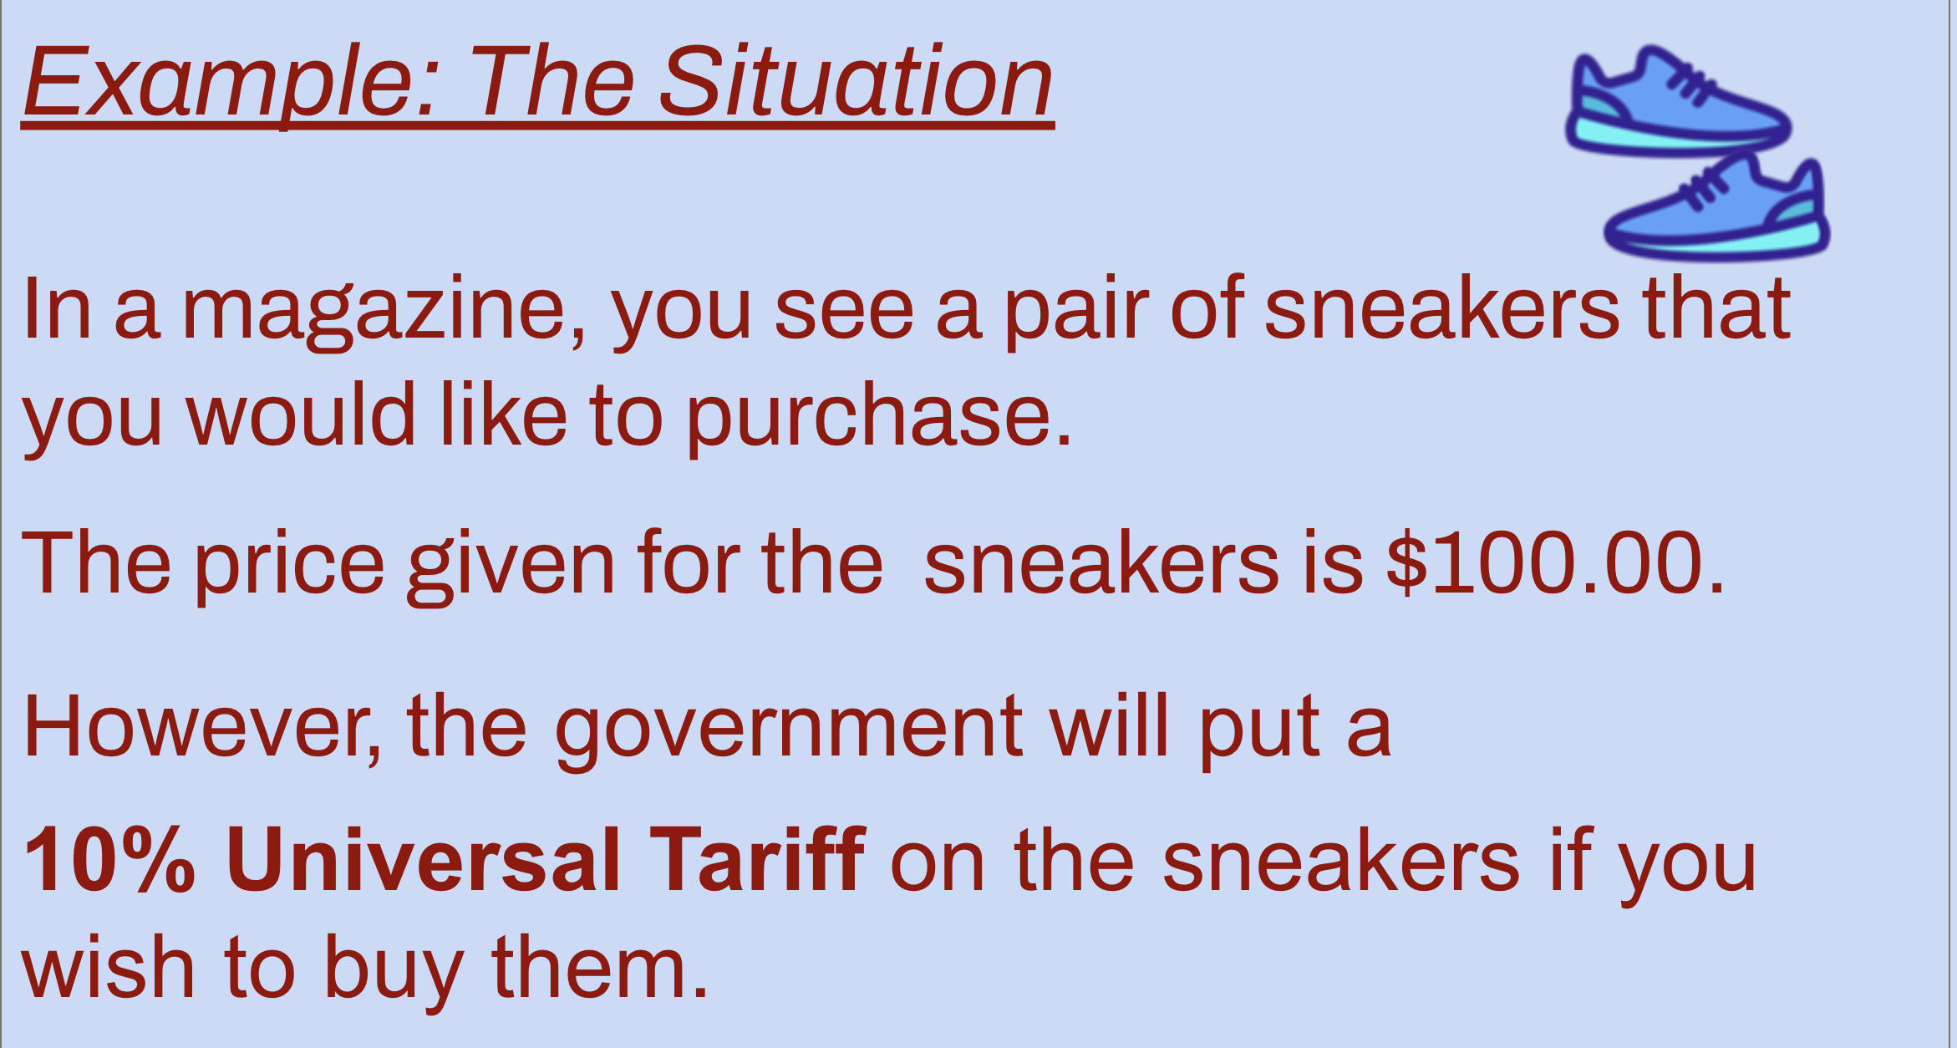

Slide 21
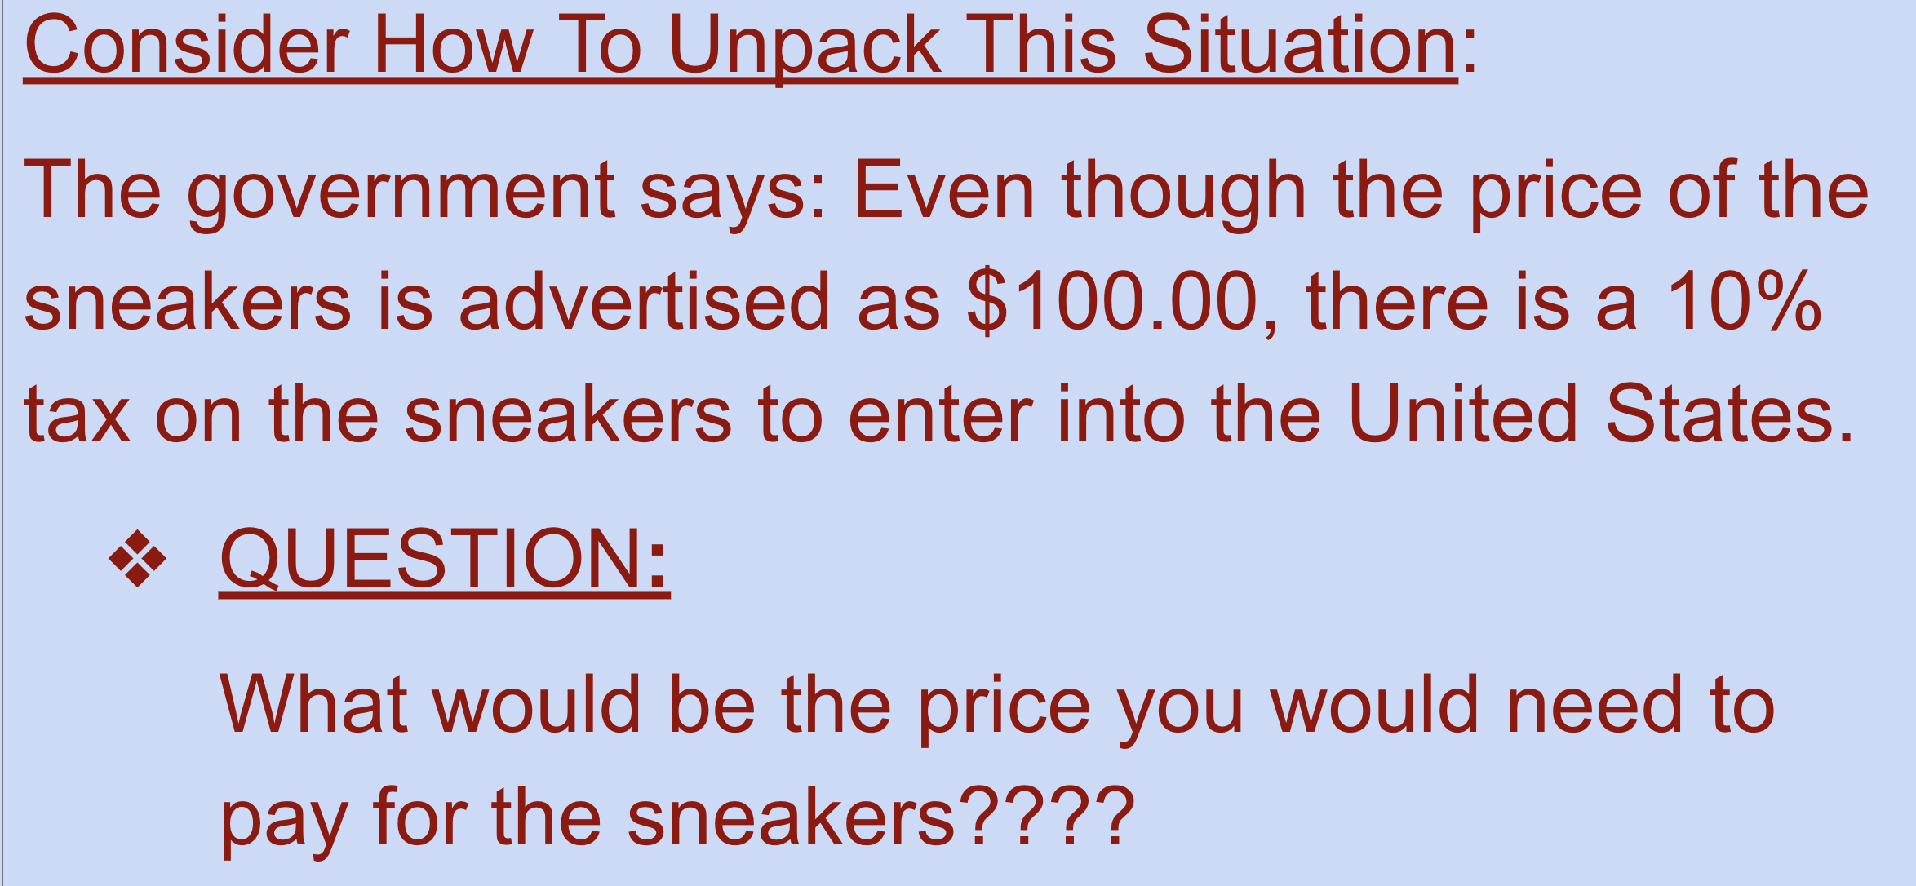


Slide 22
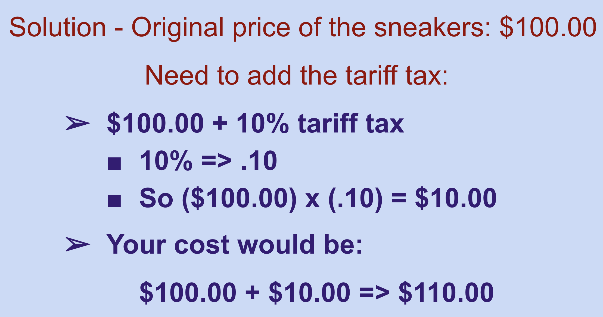

Slide 23
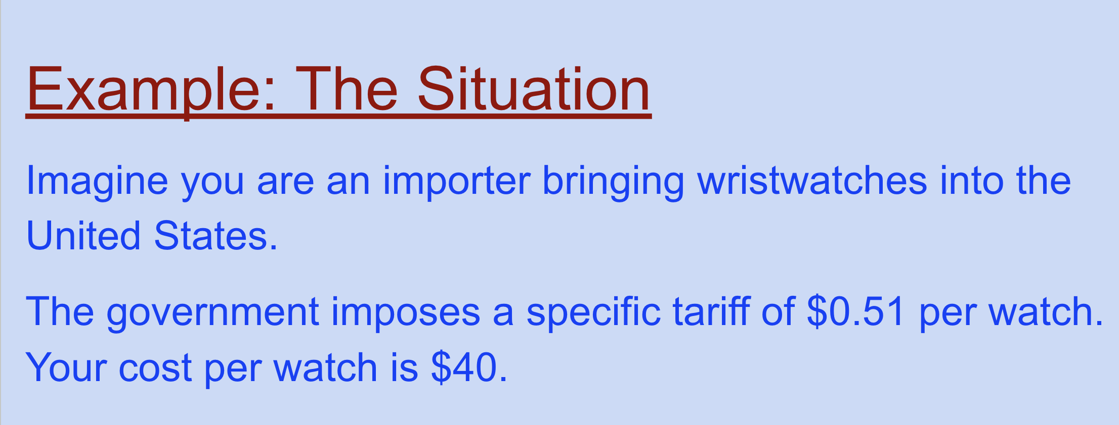


Slide 24
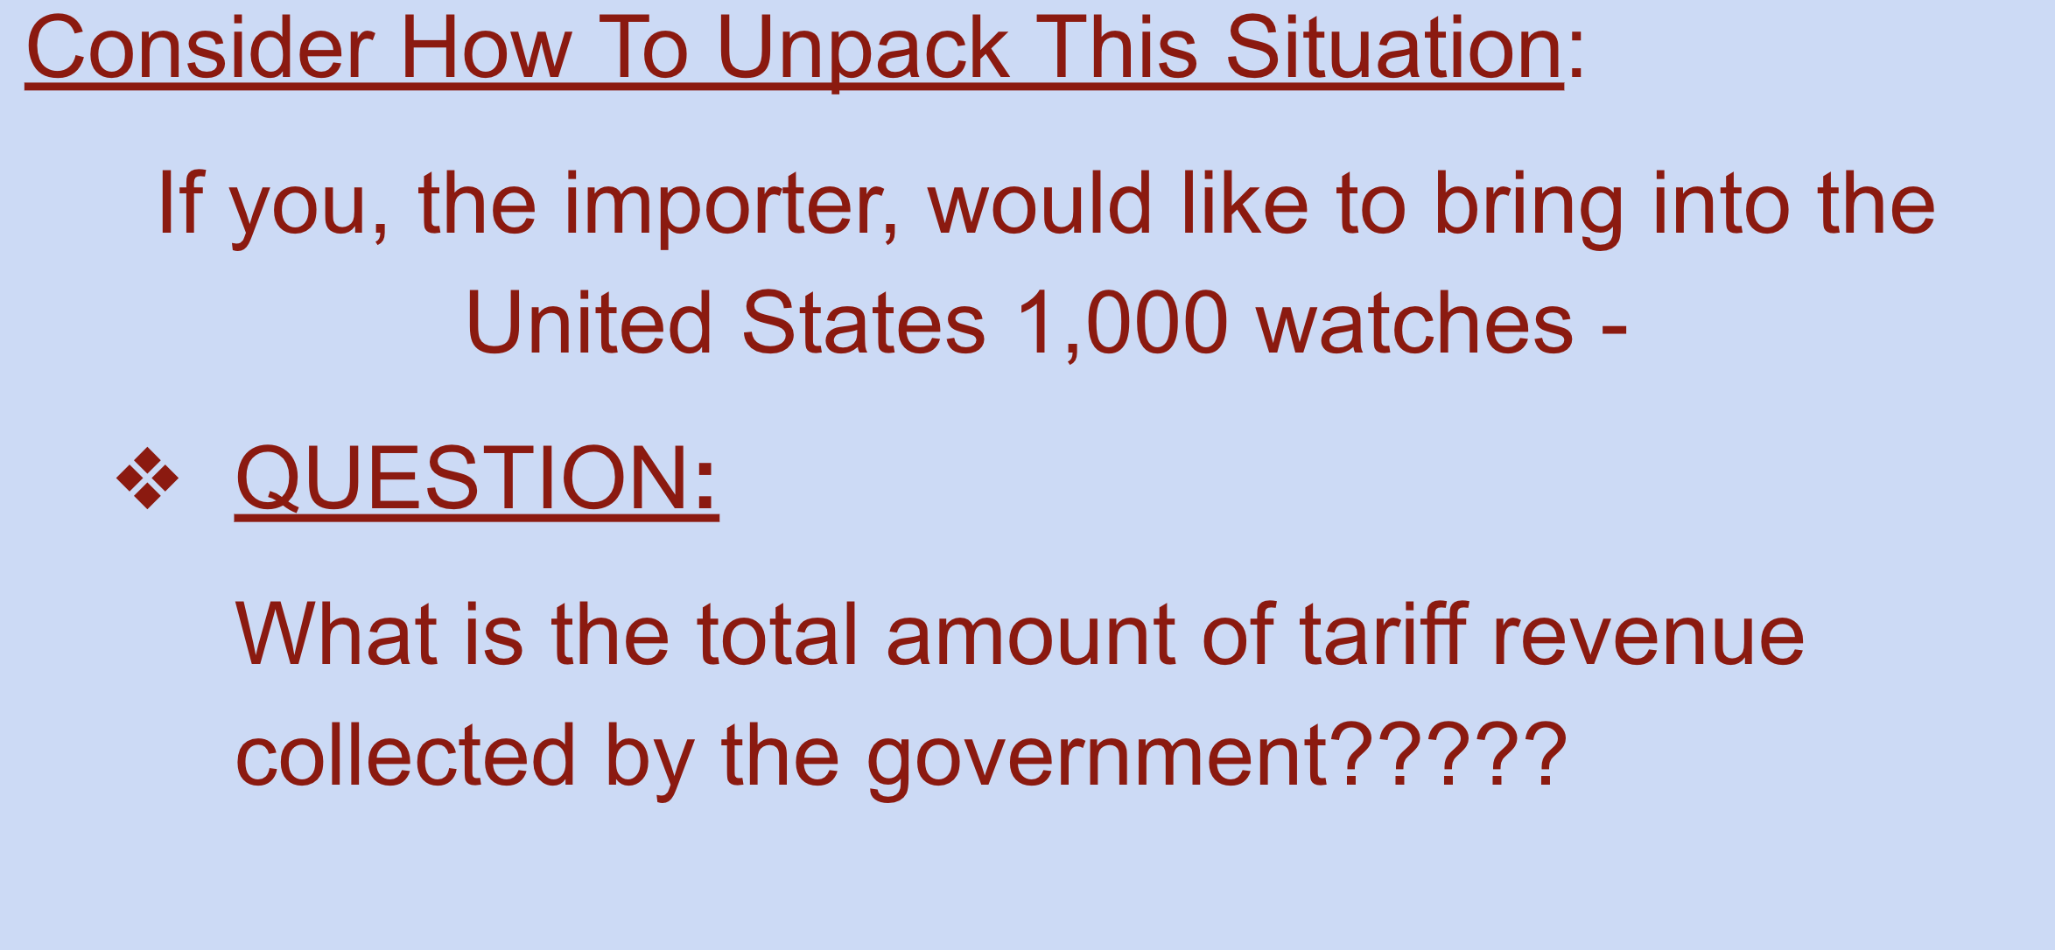
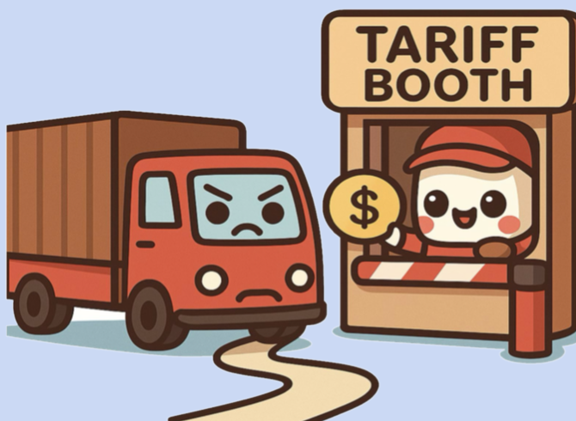

Slide 25
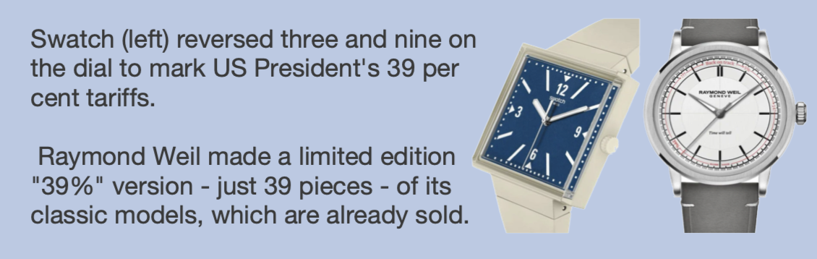
Interesting Fact:

Slide 26
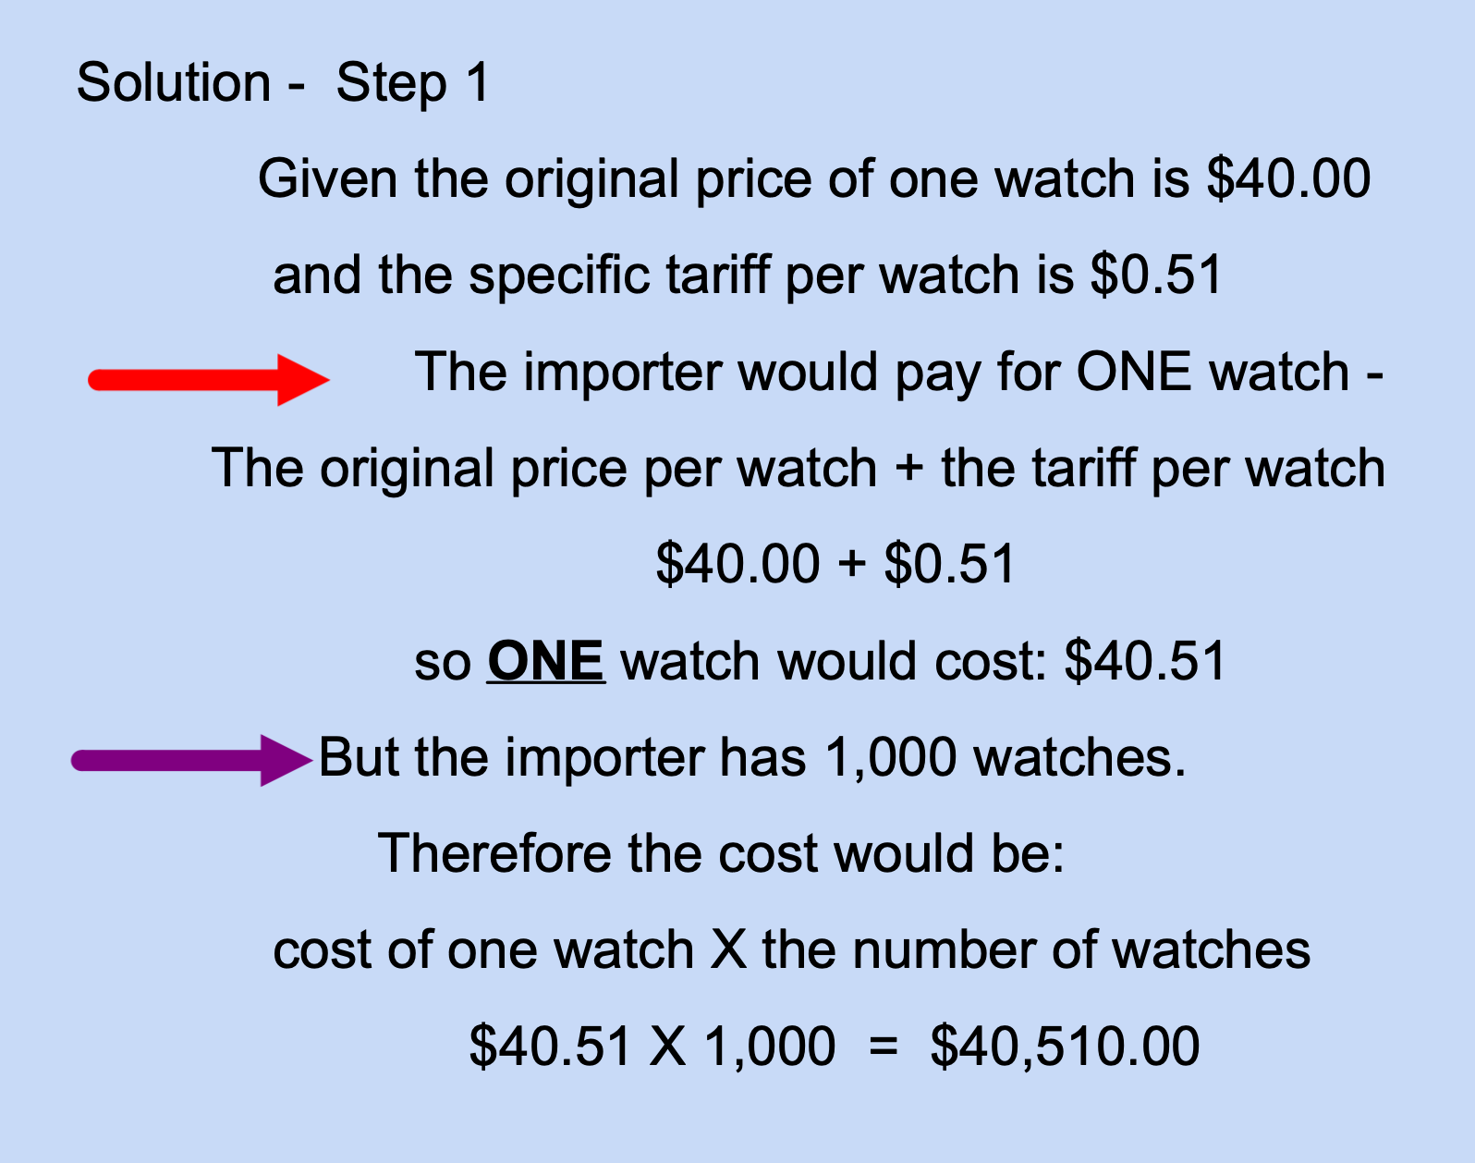

Slide 27
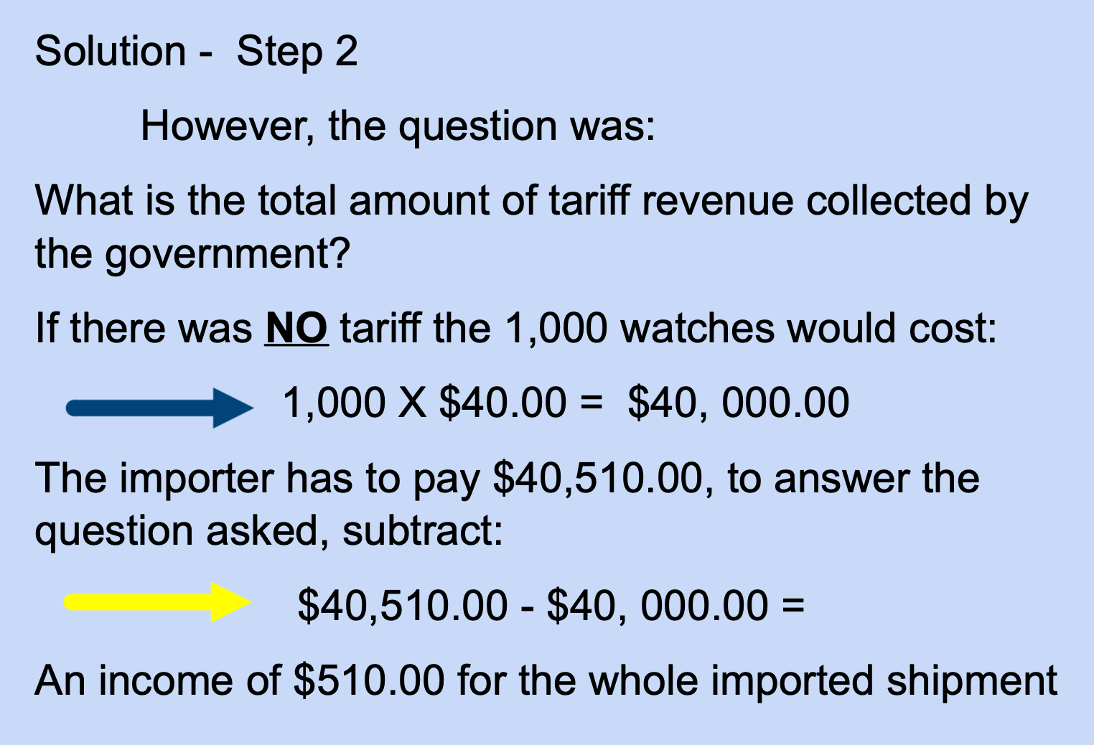

Slide 28
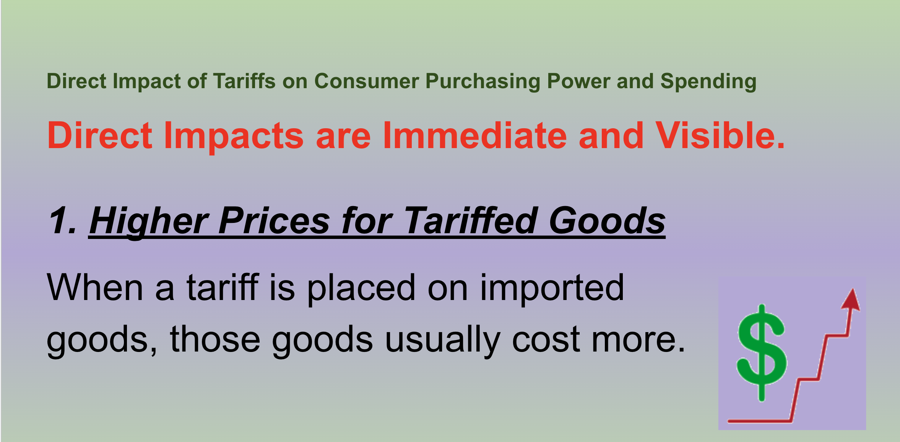

Slide 29
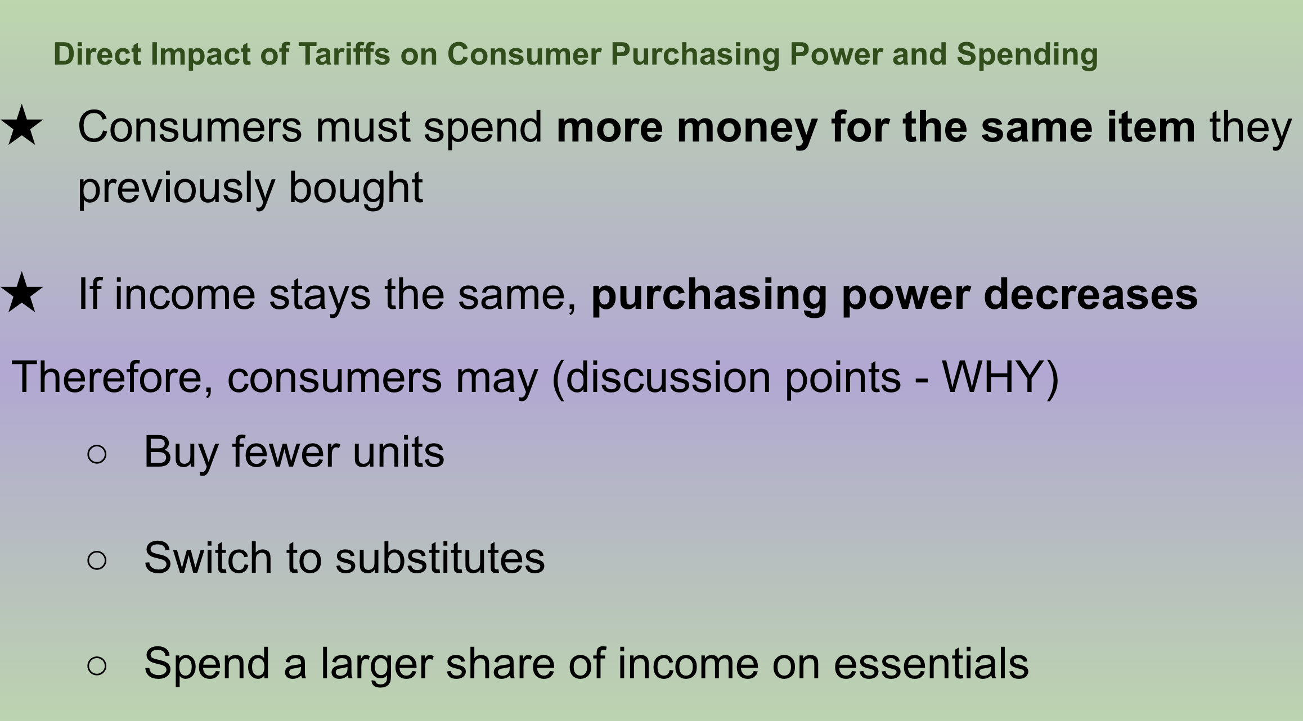

Slide 30
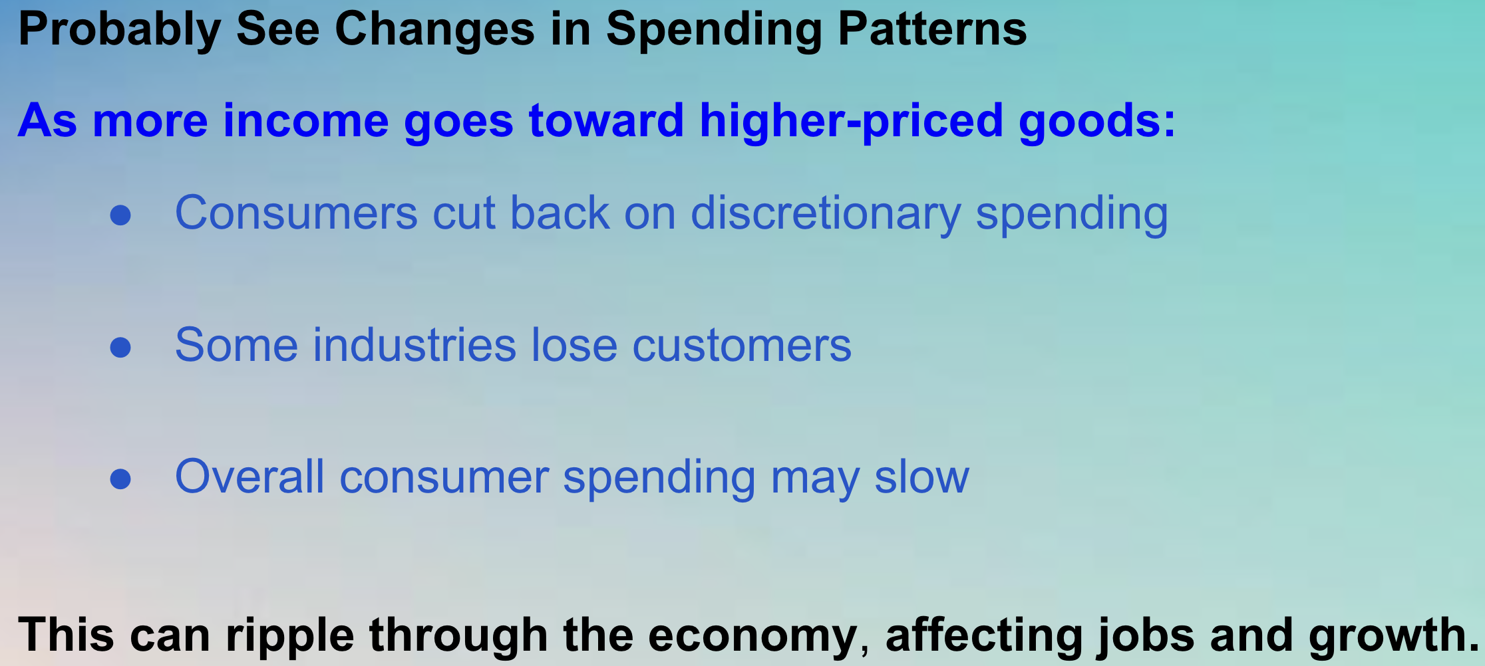

Slide 31
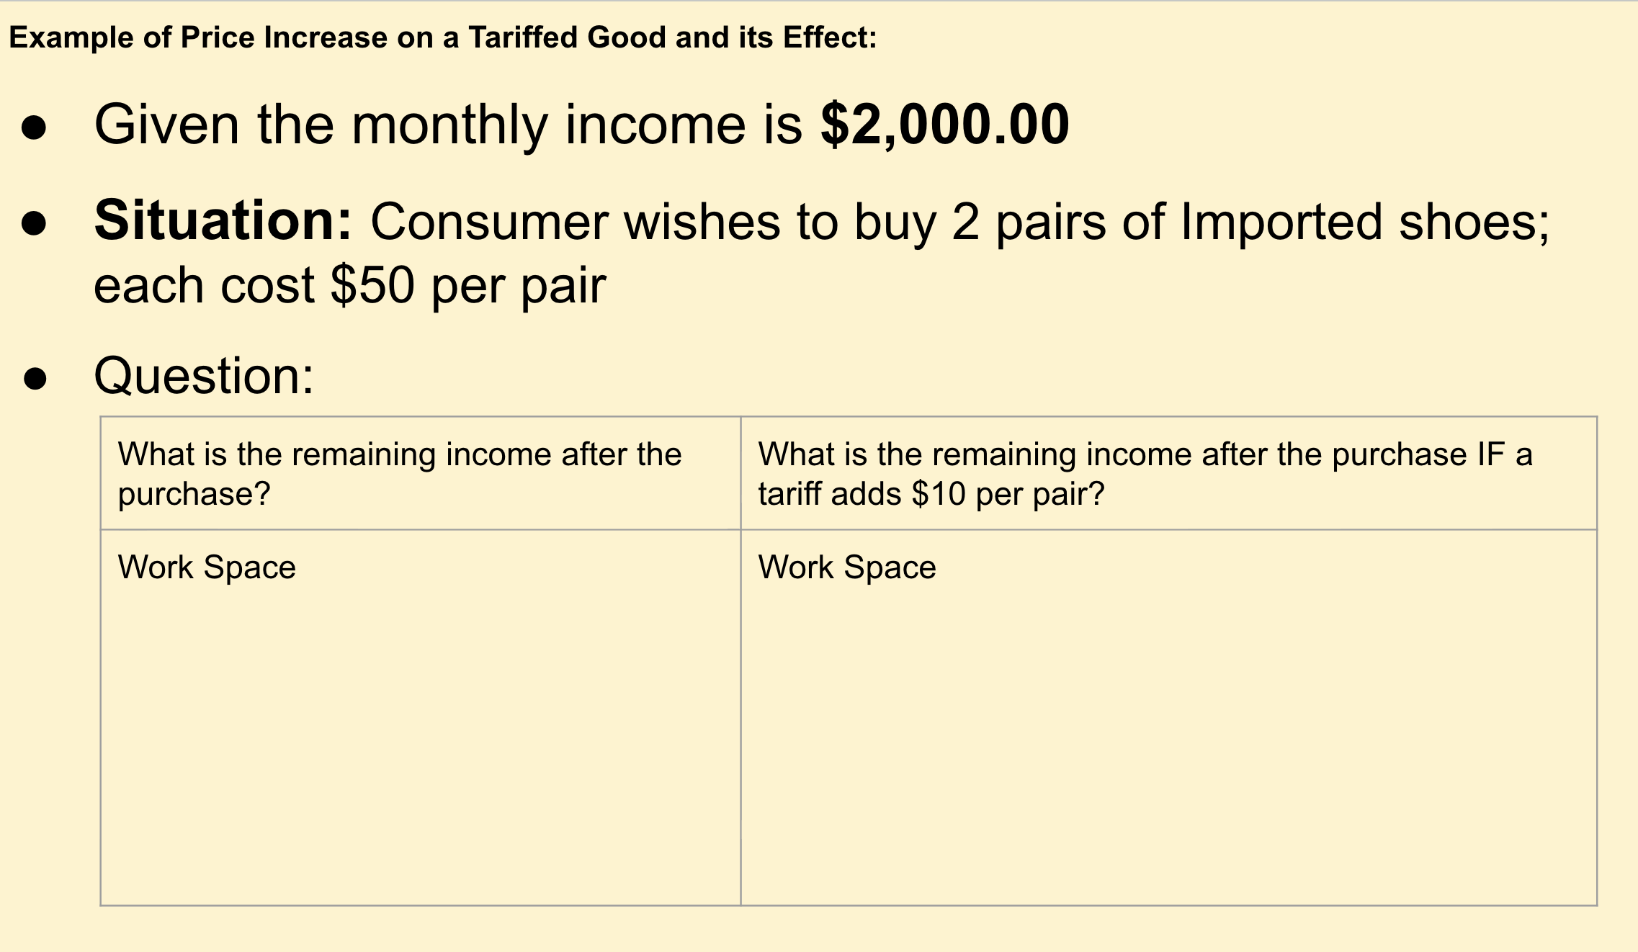

Slide 32
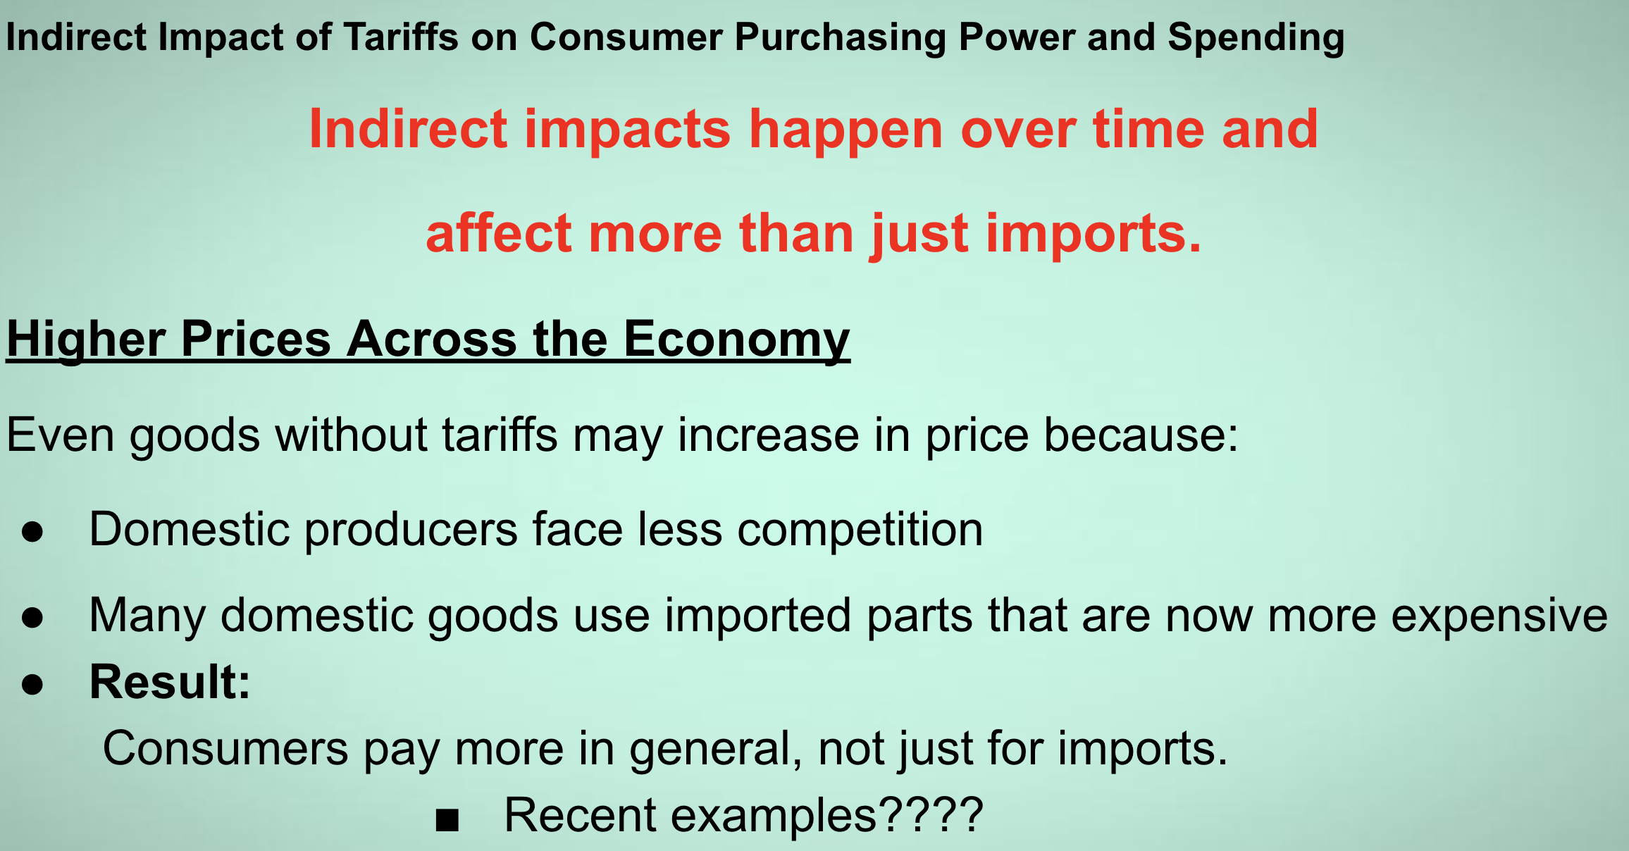

Slide 33
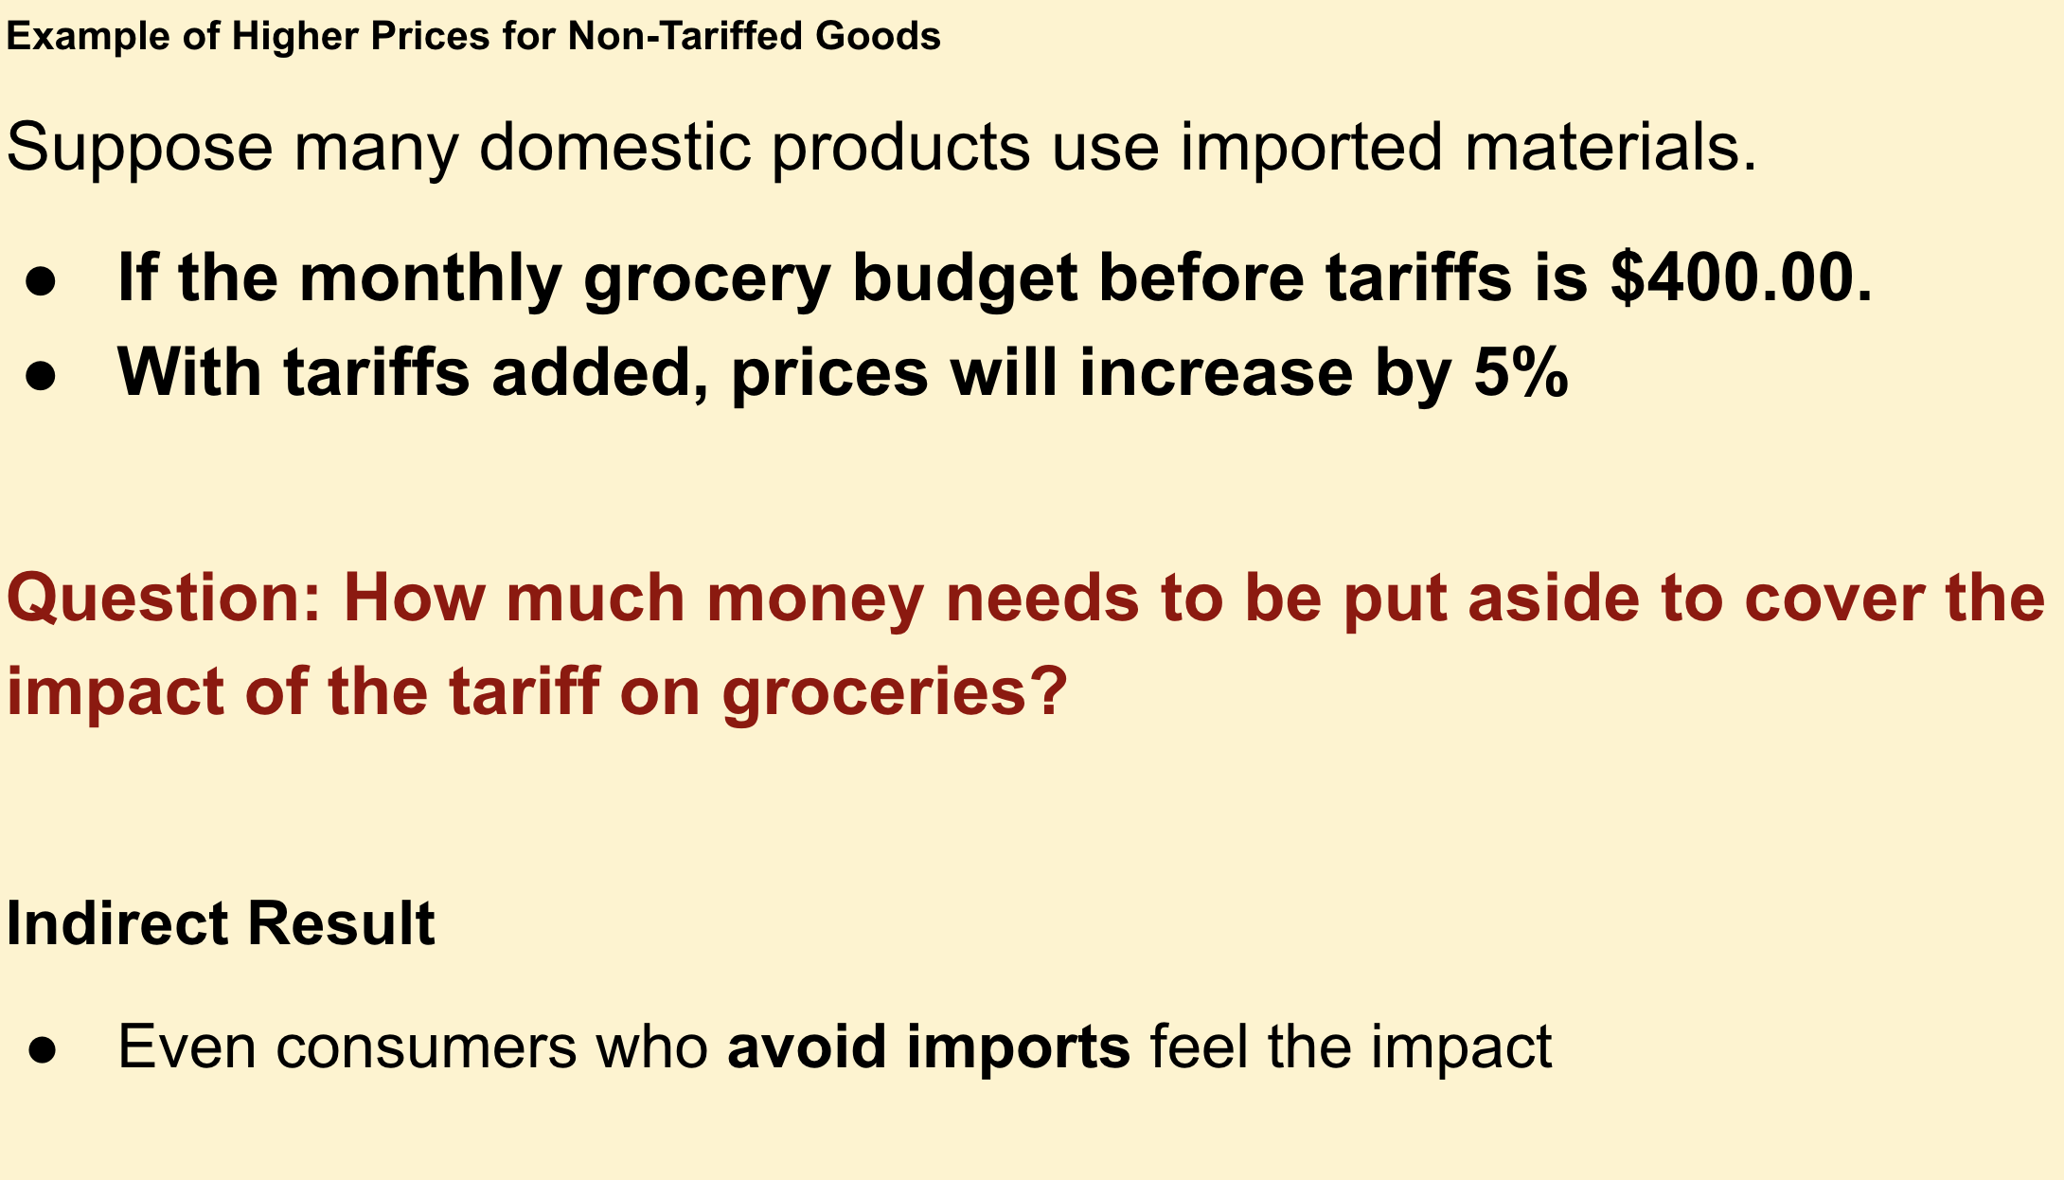

Slide 34
Some Follow Up Questions:
How do tariffs change what people can afford to buy with the same income?
Who is most affected when prices rise due to tariffs—and why might the impact be different for different households?
If everyone pays higher prices, does that mean the impact is equal for everyone? What makes it unequal?
How might higher prices on basic goods affect spending choices for families with limited incomes?
Who might benefit from tariffs even if consumers lose purchasing power—and what trade-offs does that create?
Notes:
discuss with students possible answers

Slide 35
Possible answers:
How do tariffs change what people can afford to buy with the same income?
Tariffs raise prices on certain goods. When income stays the same but prices increase, people can buy fewer goods and services than before. This means purchasing power decreases, even though the amount of money earned does not change.
Who is most affected when prices rise due to tariffs—and why might the impact be different for different households?
Lower-income households are generally more affected because they spend a larger share of their income on necessities like food, clothing, and household goods. Higher-income households have more flexibility to absorb higher prices or change spending without giving up essentials.
If everyone pays higher prices, does that mean the impact is equal for everyone? Why or why not?
No, the impact is not equal. Paying an extra let’s say $40 per month represents a much larger burden for someone with a tight budget than for someone with more disposable income. The same price increase takes up a larger percentage of income for lower-income consumers.

Slide 36

Possible answers:
How might higher prices on basic goods affect spending choices for families with limited incomes?
Families with limited incomes may have to:
Cut back on non-essential spending
Reduce savings
Delay purchases or choose lower-quality alternatives
In some cases, they may be forced to reduce spending on important needs, which increases financial stress and economic inequality.

Slide 37
Possible answers:
Who might benefit from tariffs even if consumers lose purchasing power—and what trade-offs does that create?
Domestic producers and workers in protected industries may benefit from reduced foreign competition. Governments may also gain tariff revenue. The trade-off is that consumers pay higher prices, and the burden falls more heavily on those with less income.
Tariffs tend to reduce consumer purchasing power overall, but their impact is uneven, placing a greater burden on lower-income households while potentially benefiting certain producers or industries.

Slide 38
Possible Lesson Plan
Opening Activity: Have students check the labels on their own items—shoes, shirts, phones, or backpacks.
Discussion:
Which countries appear most often?
What happens to your wallet if the U.S. government adds a 25% tax to every item from those countries?
Body of the Lesson:
Define various tariffs
Define terms associated with tariffs
Provide examples that show the effect of certain tariffs on goods
Student Exercise and Further Discussion:
Situation: Two friends want to trade potato chips for cookies
The teacher announces that for any trade, you must pay me $1.00
Have students discuss the advantages and disadvantages of the trade
Assessment Activity
Have students play Tic - Tac -Toe - Tariff
https://www.fte.org/wp-content/uploads/Tic-Tac-Toe-Tariff-.pdf

Slide 39
Possible Assessments:
Do students understand how certain tariffs work?
Example of Exit Tickets
TYPE 1: An American company imports a smartphone from another country. The original price is $200. The U.S. government imposes a 25% tariff on this item. A) How much is the tariff in dollars? B) What is the new total price of the phone? | TYPE 2: Use the 3-2-1 Strategy: Write down 3 things you learned about how tariffs are calculated, Write 2 questions you still have, and 1 way tariffs might affect your personal budget

Slide 40
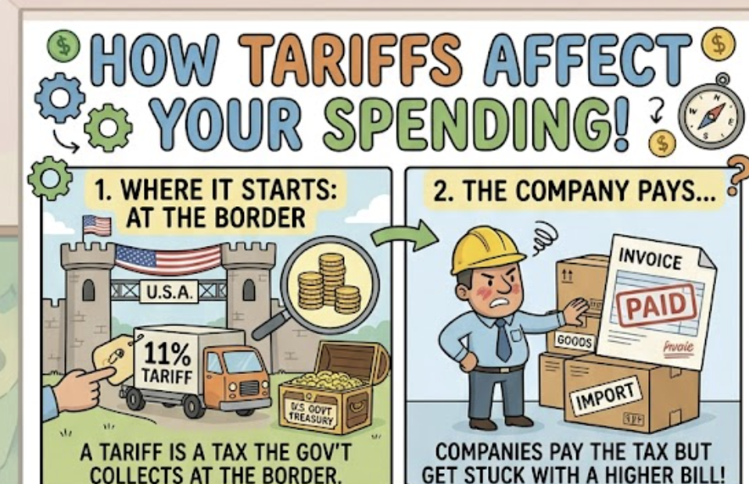
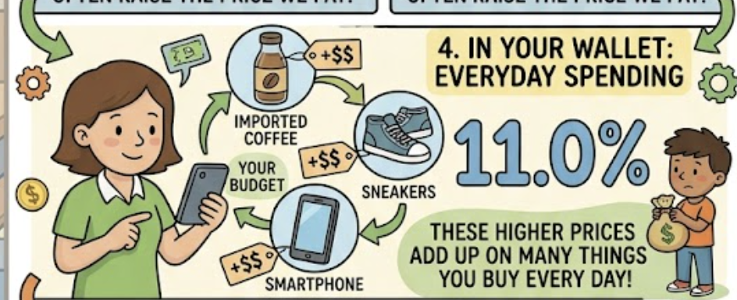
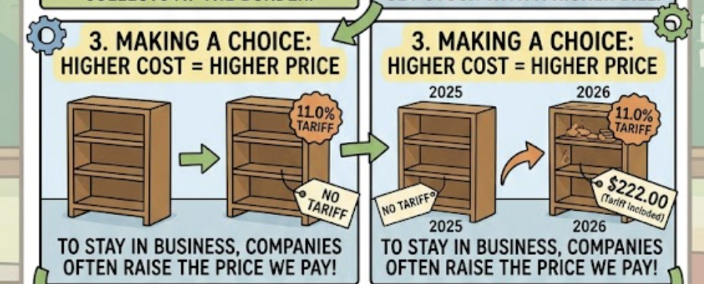
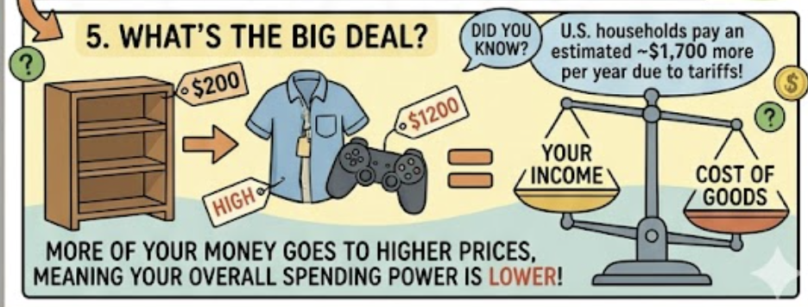
Summary
Notes:
example of a poster

Slide 41
Thank you

