Slide 1



Social Media Financial Advice
The Good
The Bad
The Bizarre
Dr. Chris Cannon
Associate Director
Georgia Council on Economic Education
ccannon11@gsu.edu

Slide 2
Topics
Empathy
Who? What? Where?
Criteria for Good/Bad?
Application
Wrap-up/Survey

Slide 3
Remember Empathy!

Slide 4

Watch Your Language
Reduce extremes
Not everything is good/bad
Embrace gray areas
Emphasize the importance of DECISION-MAKING
Notes:
Talking points: Things like “debt”, “being rich”, “payday lenders” are not good or bad, but they have costs/benefits that people need to understand.

Slide 5

BE REAL
According to some studies, using real numbers and real stories has a greater impact on retention
Encourage personal sharing if comfortable
Notes:
What does it mean to be “dirt poor?” What is “filthy rich?”. Instead of hypotheticals, real stories have more impact. https://www.scip.org/news/697354/The-Intelligence-of-Storytelling-How-Narratives-Shape-Human-Understanding-.htm?utm_source=chatgpt.com

Slide 6

playspent.org is a good example of a resource that uses very real situations to help students see everyone may not be like them
Notes:
An example of taking some hypothetical situations and putting them into a cohesive story in a game with realistic numbers.

Slide 7

Withhold Judgment
It’s PERSONAL finance, not universal finance
“If it’s in your budget, don’t judge it”
Build empathy while pushing towards more positive choices
Notes:
Instead of judging or critiquing, trying to understand the origin of a decision has more impact with students. A “poor” choice to one person my not seem that way to someone else. People have different goals, ambitions, wants, etc.

Slide 8

Once vs. Repeated
Everyone makes “mistakes”
One (or even a few) unhealthy choices will not likely permanently ruin your financial health
Students have the benefit of TIME!!!!
Notes:
Healthy vs. unhealthy choices instead of good/bad. The idea here is to think about the long term goals a person has and not get too bogged down on short-term, one-off choices that may be made for more immediate reasons.

Slide 9
Who? What? Where?

Slide 10
Survey of representative sample 2,000 adults along with a financial literacy test
Capital One Study
https://www.capitalone.co.uk/blog/social-media-finance-report
Presentation Title
Slide Title

Slide 11
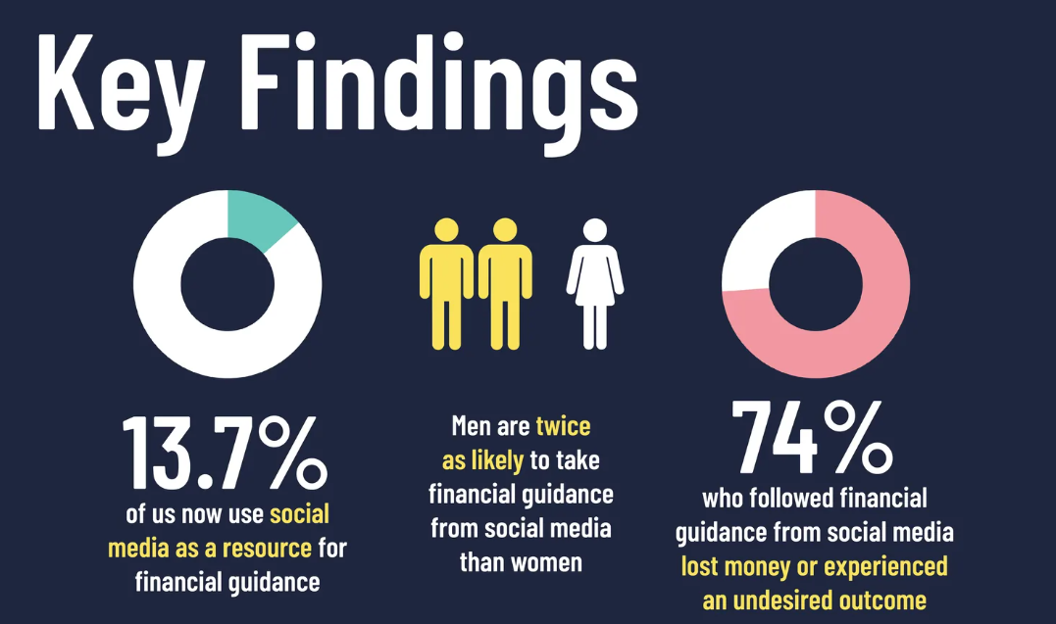
Soc. Media Fin Advice
Capital One Study 2
Notes:
https://www.capitalone.co.uk/blog/social-media-finance-report

Slide 12
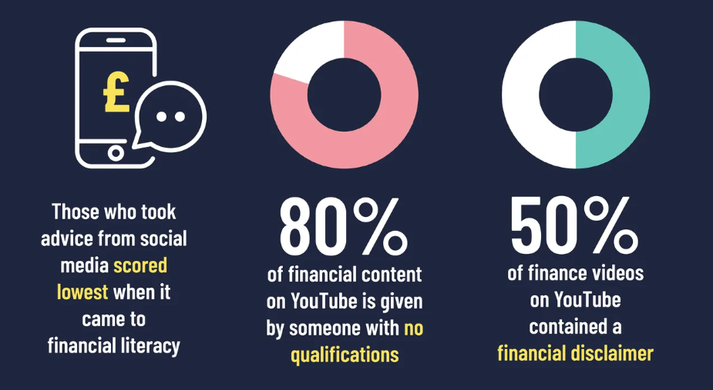
Soc. Media Fin Advice
Capital One Study 3
Notes:
https://www.capitalone.co.uk/blog/social-media-finance-report

Slide 13
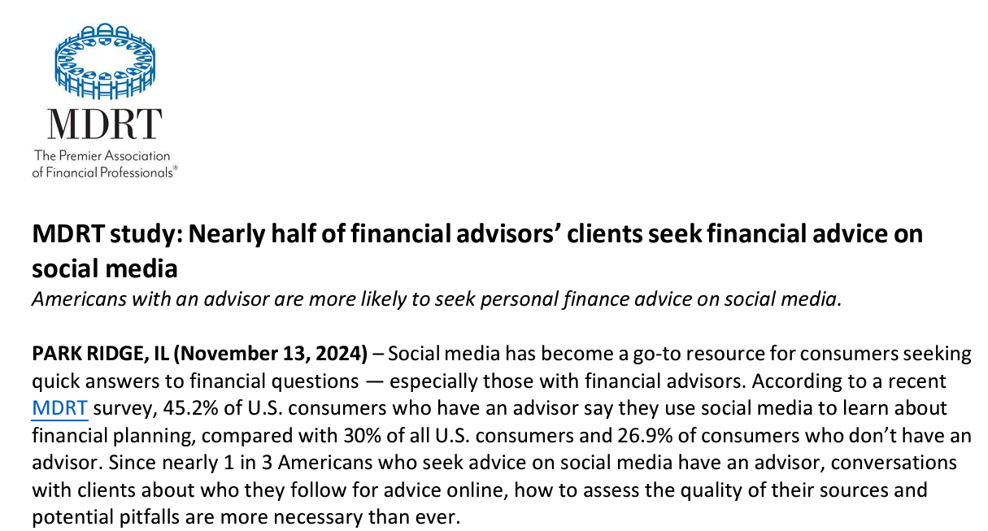
Notes:
https://members.mdrt.org/globalassets/digizuite/34839-en-using-social-media-for-financial-advice-press-release.pdf

Slide 14
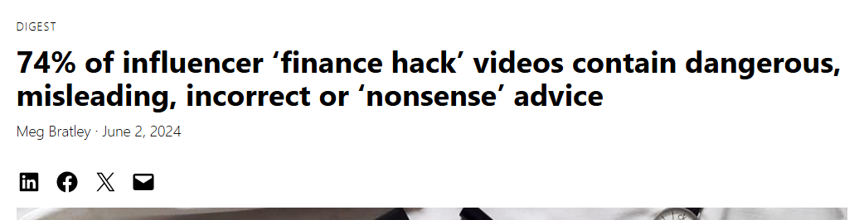
https://ifamagazine.com/74-of-influencer-finance-hack-videos-contain-dangerous-misleading-incorrect-or-nonsense-advice/
Notes:
https://ifamagazine.com/74-of-influencer-finance-hack-videos-contain-dangerous-misleading-incorrect-or-nonsense-advice/

Slide 15
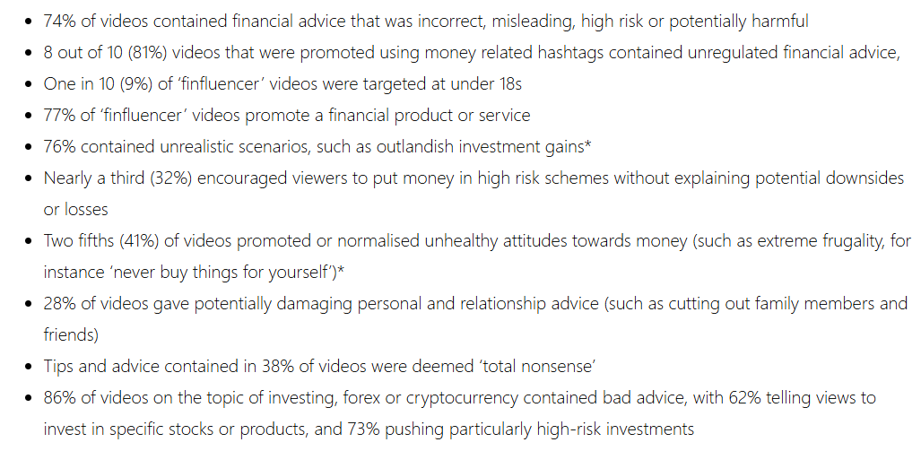
After reviewing 350 videos, IFA found…

Slide 16
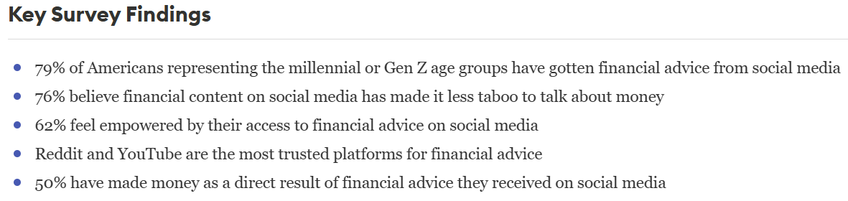
Forbes Study of Millenials/Gen Z
Notes:
https://www.forbes.com/advisor/investing/financial-advisor/adults-financial-advice-social-media/

Slide 17
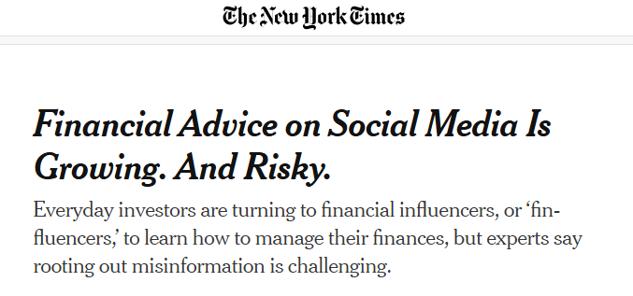
Notes:
https://www.nytimes.com/2025/01/25/business/financial-advice-social-media-influencers.html

Slide 18

PBS Newshour Clip
Notes:
https://www.youtube.com/watch?v=QrWlptvHm3g&t=173s

Slide 19
Criteria?
What makes advice good (healthy) or bad (unhealthy)?
Notes:
Before revealing the next slide, ask participants the questions on the screen one at a time. “In your life experience, when have you gotten advice that you considered good/healthy/useful? What characteristics made it so?” (Repeat for bad/unhealthy/not useful advice).

Slide 20
What to look for (tools for analysis)
Soc Med Financial Adv
Look Fors
Accurate and Evidence-Based: Backed by facts, research, or sound financial principles
Encourages Financial Literacy: Helps the audience understand underlying concepts, not just what to do.
Applicable and Realistic: Fits the audience’s financial situation and goals.
Empowering, Not Fear-Based: Inspires action without pressuring or scaring the audience.
Customized, Not Generic: Acknowledges that personal finance is personal and avoids one-size-fits-all solutions.
Promotes Sustainable Habits: Encourages long-term financial health rather than quick fixes or fads.
Notes:
As we evaluate social media advice in the following slides, let’s look for elements of these things.

Slide 21
Application

Slide 22
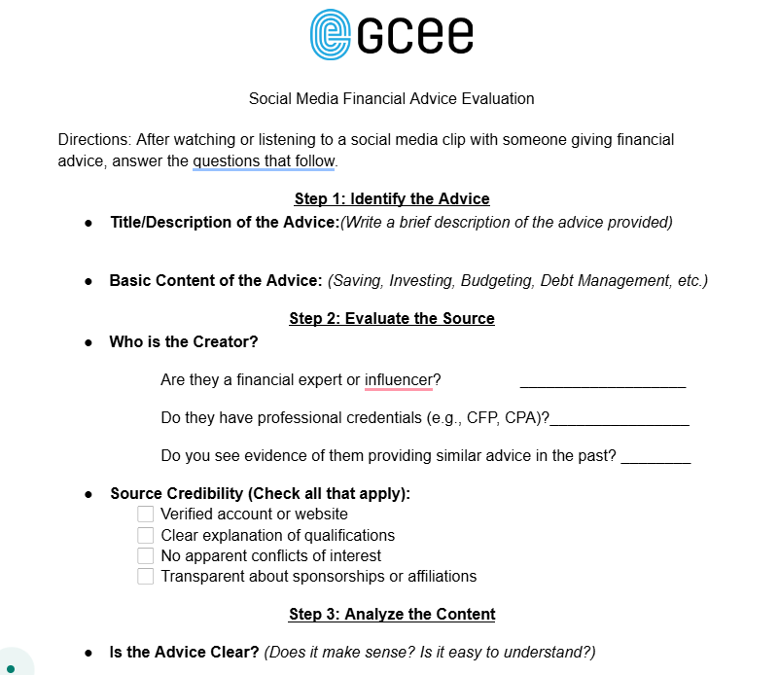
Student Handout
Notes:
The student handout is to be used as a repeatable tool for evaluating advice. Think of this handout like a tape measure or scale that can be used over and over. Go over each section with students to make sure they know what they are looking for. NOTE: In a short workshop, Step 2 is difficult to accomplish. This takes a little research time to search people online, look up reviews, find bios/linkedin pages etc. Steps 3-5 are mostly subjective in nature, but should generate rich discussions. The following slides are potential examples, but feel free to use your own.

Slide 23
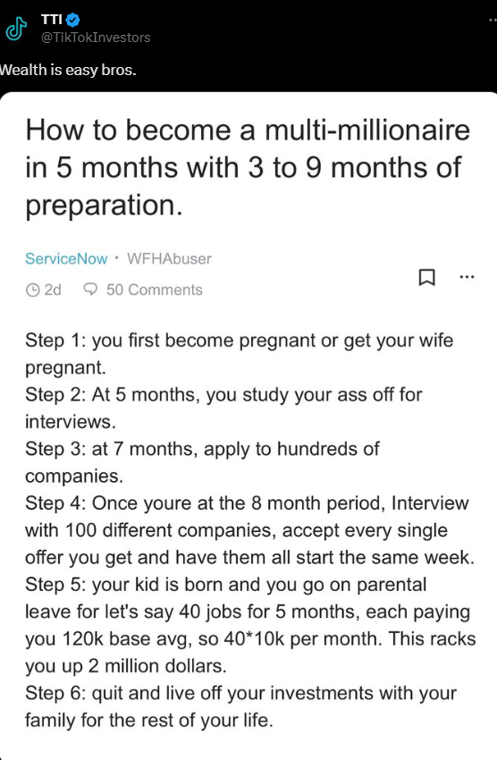
Notes:
This one is a pretty egregious example of a “silly” post, but there might be students out there who would at least think about the feasibility of this. Talking points for step 3: Clear? Yes in the sense that it’s a step-by-step plan, but less clear in the action items (how to find company’s that pay this etc…). Realistic? Even step 1 is not realistic for many people. The 100 jobs and pay scale is also not realistic. Evidence-based? No. Ethical? Subjective, but there’s elements of fraud and deception here, to say nothing of the ethics behind possibly just having a child to “get rich.”

Slide 24

Pay Off Credit Card Debt Fast- Break Out Of Debt With These Tips
Notes:
Laina has a bio on her YouTube page where you can model some of the source analysis. She has a disclaimer that she’s not a financial advisor (which is a positive that she tells people that up front), she has a little of her background, and links to places you can see other stuff. This video is long and I rarely play the whole thing in a workshop, but if you fast forward through it, it is very factually accurate, clear, easy to follow, and makes no ethical judgements one way or another. I use this as an example of a mostly positive advice with few negatives.

Slide 25

If You Borrowed Money For It, You Couldn't Afford It - YouTube
Notes:
This may seem like a “cherry picked” clip to make Dave Ramsey seem aggressive or rude or something. He has this posted to his own site in this format so he’s putting it out there himself and it’s not like its been edited to make him seem worse. This one is interesting to discuss because the advice is clear and somewhat evidence-based, but discussions about how realistic this is runs a wide gamut. Also, the delivery and tone of the delivery can be an interesting discussion point. Are you more or less likely to take advice from someone who calls you stupid? Is it just tough love? Or off-putting to a point where you question other advice he might give?

Slide 26

Notes:
This one is a good example of the “finfluencer” mentality. Looking for a hack, short-cut, “something anyone can do” etc. This is pretty much fraud 101 and just realistic enough that students might think it’s feasible.
https://x.com/TikTokInvestors/status/1671513512236163073?ref_src=twsrc%5Etfw%7Ctwcamp%5Etweetembed%7Ctwterm%5E1671513512236163073%7Ctwgr%5E5313a2a51d54c4cc5a43a6721b0d7574692a4af6%7Ctwcon%5Es1_c10&ref_url=https%3A%2F%2Fwww.whitecoatinvestor.com%2Fbad-financial-advice-social-media%2F

Slide 27

Notes:
I use this as an example of someone who is really strong with content, but the delivery won’t be for everyone. The advice is clear, evidence-based, and pretty realistic.

Slide 28

Can also evaluate “Economic Content”
Notes:
An example of using this concept to evaluate “economic” content. I use this to point out her content is strong and to discuss the type of person that might need this kind of video. Also, calling Jerome Powell “fed daddy” is pretty funny.

Slide 29
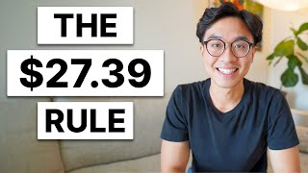
How To Save $10K Effortlessly: 6 Saving Tips

Slide 30
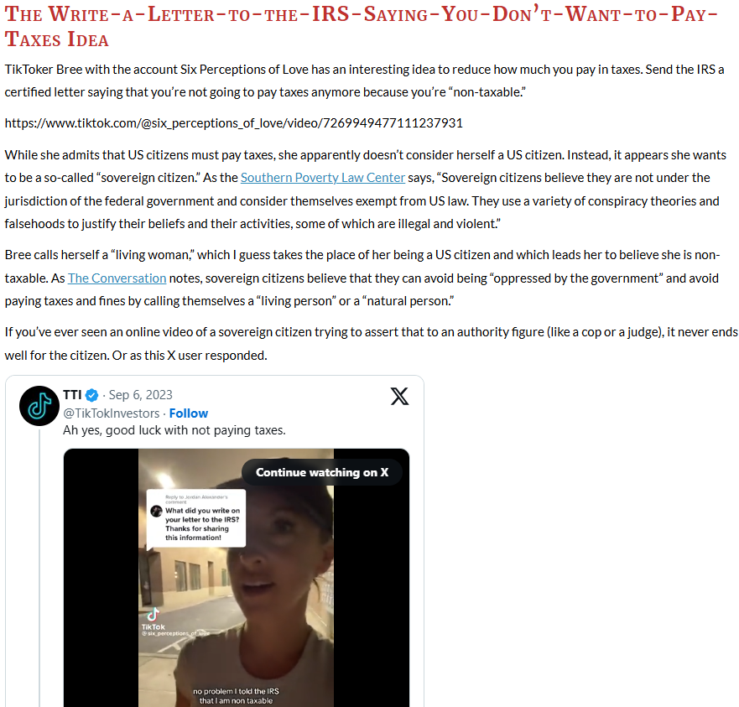
https://twitter.com/i/status/1699597613727883455
https://www.whitecoatinvestor.com/bad-financial-advice-social-media/
Notes:
A series of links to some more examples.

Slide 31

https://youtube.com/shorts/0m1QnekDFzs?si=ZvMf5WX0dIwlVdv7
Notes:
A fantastic way to end the session with this parody video!

Slide 32
Social Media Financial Advice is everywhere!
Critical thinking and CONTENT are essential for evaluation
(YOU MATTER)
Guided by empathy
Key Points
Soc Med Fin Adv
Key Points
Notes:
The “YOU” highlighted here refers to the teachers in a PD. They matter because they can help students navigate this advice-laden world.

Slide 33
Other Sources:
https://dfpi.ca.gov/news/insights/social-media-finfluencers-who-should-you-trust/
Presentation Title
Slide Title

