Slide 1


Georgia Council on Economic Education
Georgia’s
Personal Finance Challenge Finals: Case Study

Slide 2
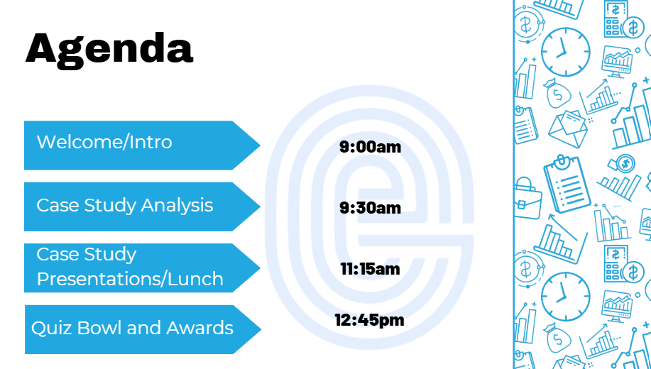

Overview of the Day

Slide 3



Overview
You will analyze a ficitional family’s financial situation
Your task: create an 8-minute presentation on how the family could maintain any positive behaviors and/or improve their situation
You have freedom to choose what you wish to address, some suggestions are provided
90 minutes

Slide 4
Rules/Guidelines
ONLY communicate with your team members. No communication with other teams or with your teacher/coach until your analysis is over
Presentation must be produced using the Google Slides link provided. You may use outside materials during the analysis phase, but only the google slides will be shown during the presentation (You may bring in written notes)
You mask ask GCEE staff questions, but not judges

Slide 5
Tips from past winners
Don’t try to cover everything, choose the material you know the best and feel the most comfortable
Keep your slides interesting, use more than just words
Double check your math and use accurate terminology
Rehearse and time yourself
Answer judges questions directly

Slide 6

Sample Case Studies
2022
2024
2025

Slide 7

Key Considerations
Technology Use
Time management
Financial analysis level
Important factors for a successful competition experience

