Slide 1
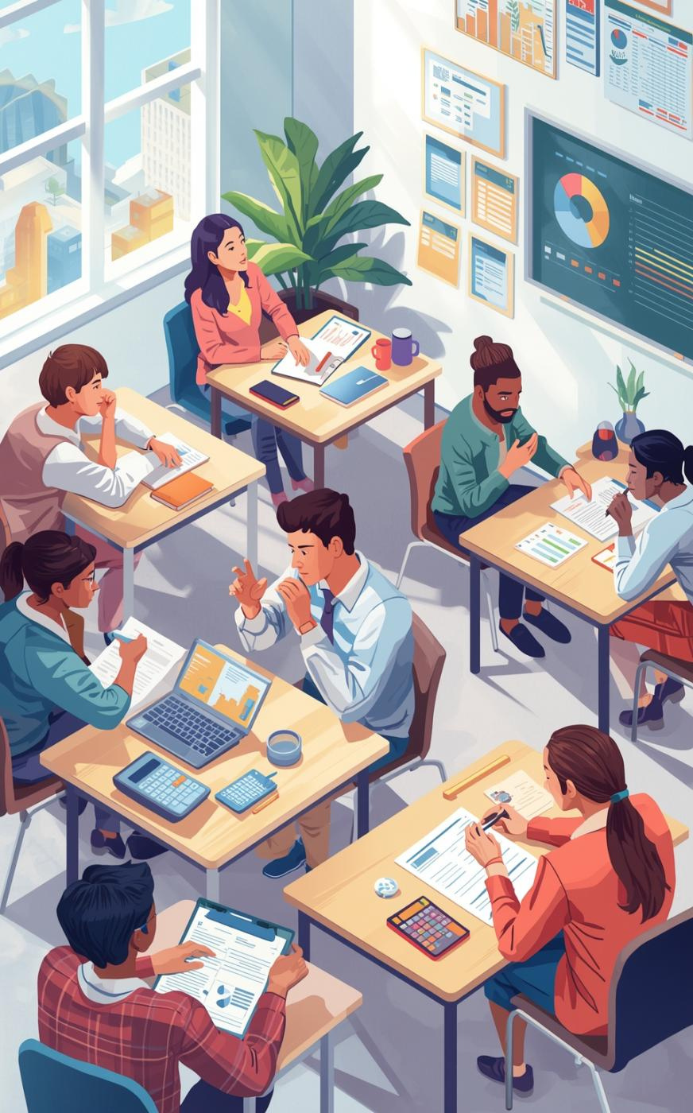

Georgia Council on Economic Education
Georgia’s
Personal Finance Challenge Finals: Quiz Bowl

Slide 2
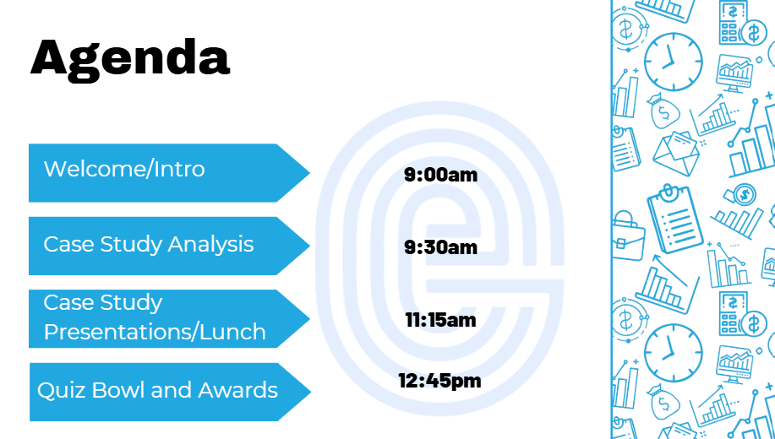

Overview of the Day

Slide 3

QUIZ BOWL

Slide 4

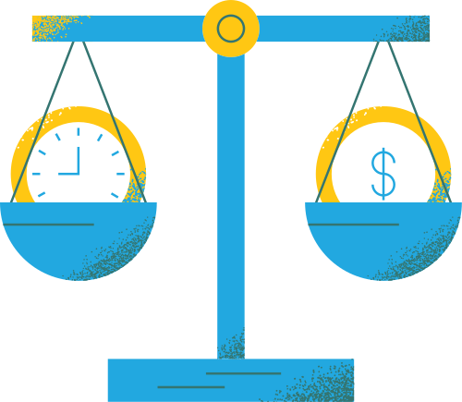

Quiz Bowl Rules
Questions will be read aloud, teams will write their answers on their dry-erase board
After a question is read, teams have 20 seconds to write their answer
Teams will not buzz in
After the question is read it will be displayed on the screen
After 20 seconds, the moderator will call on both teams to state their answer
In the event of a discrepancy, the written answer will be judged

Slide 5
Quiz Bowl Rules (pt. 2)
Competing students (and ONLY students) may challenge an answer before the next question is read. Once the next question has begun, no challenges will be entertained
The Quiz Bowl is over when one team leads by more points than there are questions remaining
In the event of a tie, up to 5 tiebreaker questions will be read.
NOTE: Tiebreaker questions will not be displayed on screen

Slide 6
QUESTIONS?

Slide 7



Slide 8
QUESTION 1

Slide 9

Question 1
Payroll tax is directly deducted from a worker’s paycheck to fund what two federal programs?

Slide 10
Question 1
Payroll tax is directly deducted from a worker’s paycheck to fund what two federal programs?
Answer: Social Security and Medicare

Slide 11
QUESTION 3

Slide 12
Question 3
If you suspect identity theft and want to prevent new credit accounts from being opened in your name, what are the names of the three major credit bureaus you must contact to freeze your credit?

Slide 13
Question 3
If you suspect identity theft and want to prevent new credit accounts from being opened in your name, what are the names of the three major credit bureaus you must contact to freeze your credit?
Answer: Equifax, Experian, and TransUnion

Slide 14
QUESTION 4

Slide 15
Question 4
According to historical data from the Bureau of Labor Statistics, during a recession, which of the following individuals is least likely to be unemployed?
● Taylor, a software engineer with a master’s degree in computer science
● Casey, a retail manager with a high school diploma
● Alex, a freelance photographer with a bachelor’s degree in fine arts

Slide 16
Question 4
According to historical data from the Bureau of Labor Statistics, during a recession, which of the following individuals is least likely to be unemployed?
● Taylor, a software engineer with a master’s degree in computer science
● Casey, a retail manager with a high school diploma
● Alex, a freelance photographer with a bachelor’s degree in fine arts
Answer: Taylor

Slide 17
QUESTION 8

Slide 18
Question 8
Jamie pays two points at closing on a $250,000 mortgage. What is the dollar cost of these points?

Slide 19
Question 8
Jamie pays two points at closing on a $250,000 mortgage. What is the dollar cost of these points?
Answer: $5,000 (2%×250,000=$5,000)

Slide 20
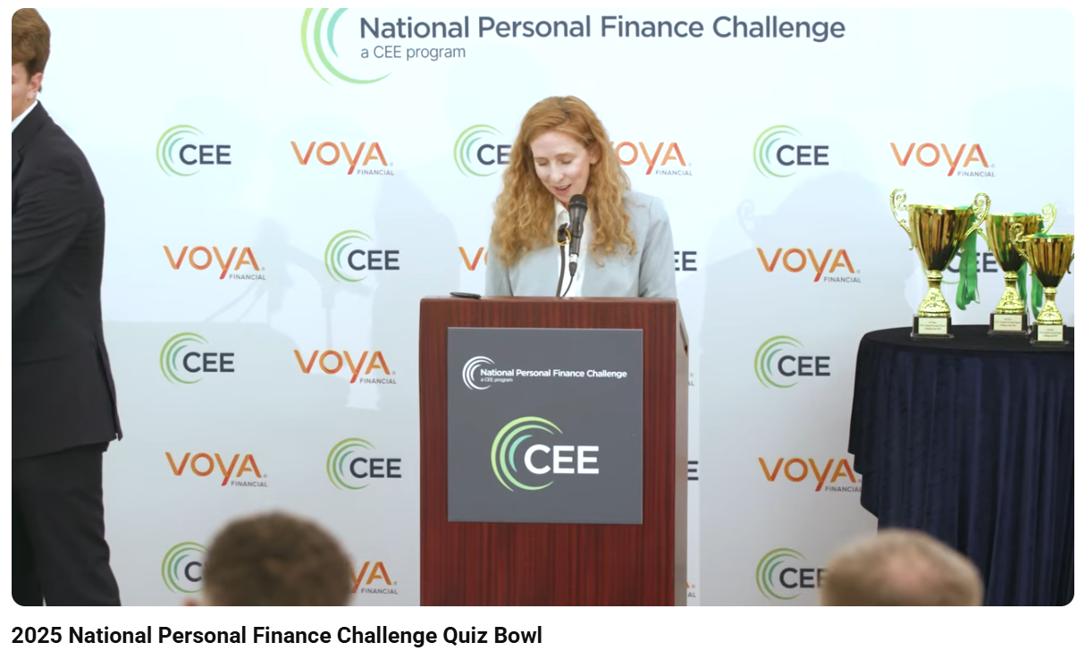
Example of a challenge...
LINK TO 2025 NATIONAL FINALS VIDEO: https://youtu.be/iSCF-7Z1jnw?si=dLhWAoRtjxEumHw6&t=85

Slide 21

Key Considerations
Be specific in answers
Write neatly
Careful not to blurt out answers
Don’ t be afraid to challenge
Important factors for a successful competition experience

