Slide 1
National Economics Challenge Overview of the Critical Thinking Round
Nicholas Moellman, PhD

Slide 2
About Me
Associate Professor of Economics at Winthrop University (Rock Hill, SC)
Primary areas of teaching-introductory economics, principles of microeconomics, intermediate microeconomics, upper division electives (poverty, labor, health, public, etc.)
Primary areas of research-poverty and program participation, healthcare and food insecurity, economic education.
Director of the Stone Center for Economic Education at Winthrop University
Five years working with the Council for Economic Education on the National Economics Challenge
Judging Chinese Critical Thinking Round finals 2021-2026
Judging US Critical Thinking Round finals 2023-2026
Judging Chinese, US, and International Quiz Bowl 2023-2026
Question writer, Critical Thinking Round, Quiz Bowl, Chinese, US, International 2023-2026

Slide 3
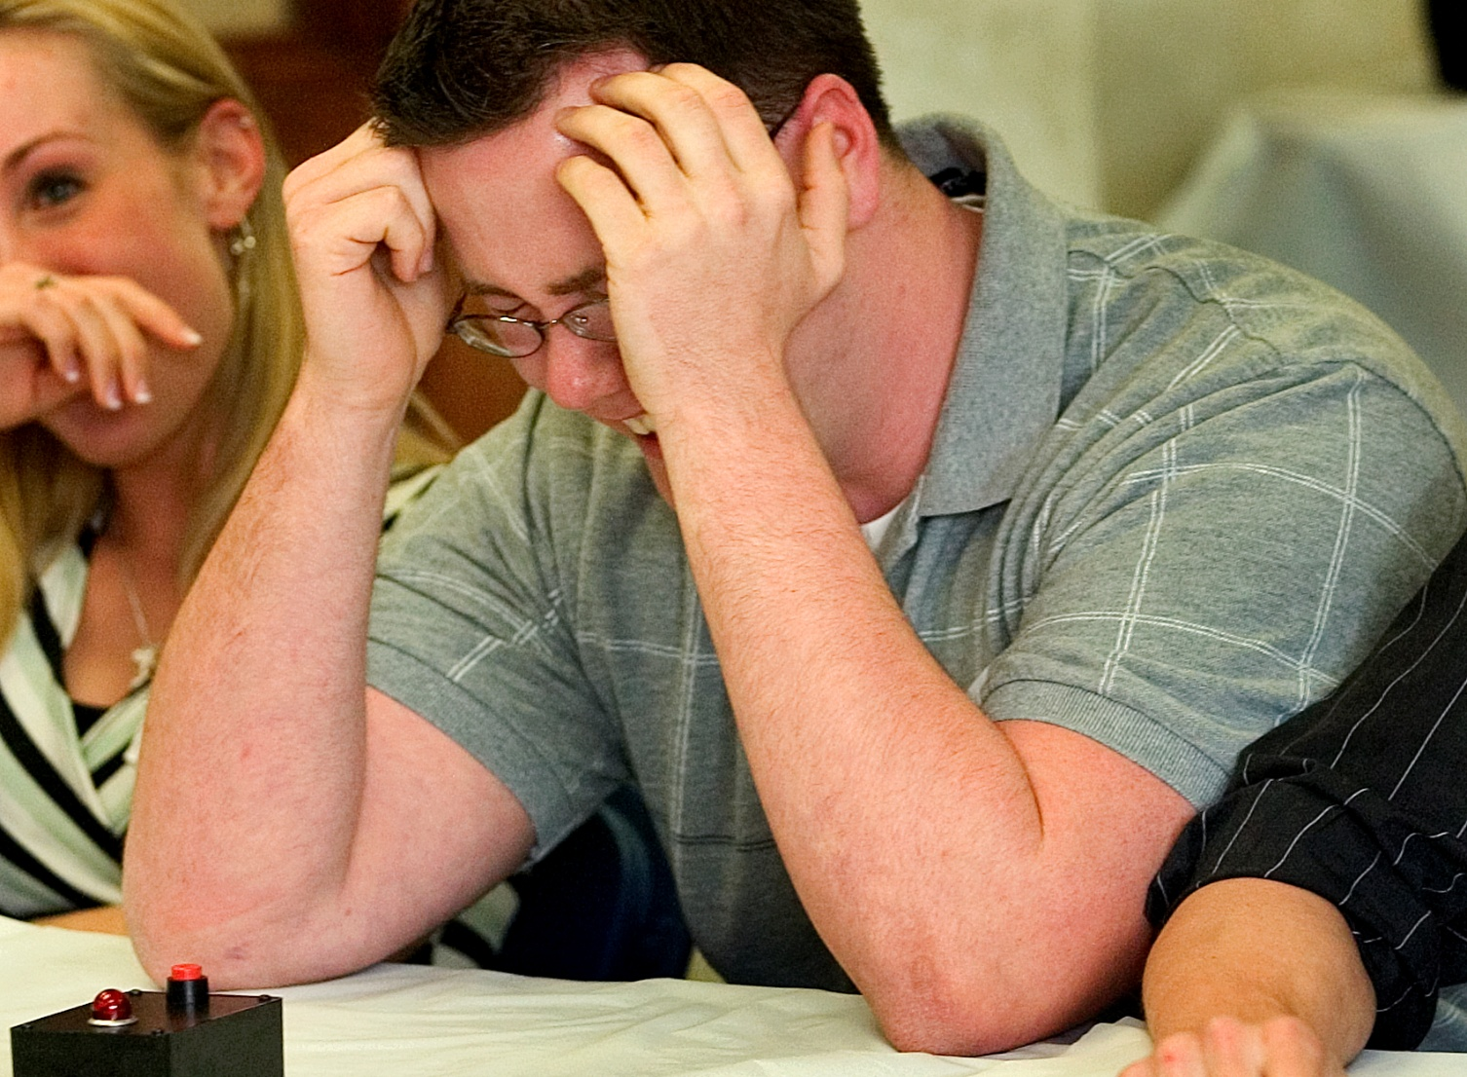
About Me
2006 Oklahoma state-level economics challenge runner up (loser)
From the Oklahoman, after I accidentally buzzed in as soon as the question was read and was required to answer

Slide 4
Critical Thinking Round Overview
Students arrive early for breakfast and orientation.
In batches, students are given the prompt and 25 minutes to prepare a presentation for the judges.
Students present to the judges for 12 minutes.
8 minutes for Q&A with judges.
Students relax and enjoy the rest of the day!
Top four teams are announced at the end of the day and move on to compete in the Quiz Bowl.

Slide 5
Critical Thinking Round Questions
Typical components of Critical Thinking Round questions
Specific economic phenomenon to be evaluated
Policy relevant
May be in specific subfield but…
Lends itself to analytical methods covered in BOTH macro- and microeconomics
May include brief relevant background/data/supporting information
No “correct” answer to prompt
Sections:
The Issue-contextualizing the topic
The Problem-framing the economic topic to be addressed
Your Team’s Task-describing team deliverable

Slide 6
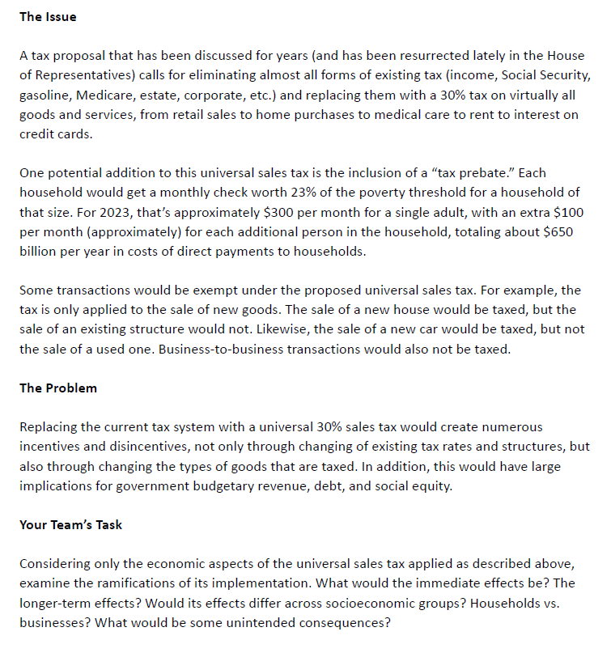
Critical Thinking Round Example

Slide 7
Critical Thinking Round Judging Criteria

Slide 8
Critical Thinking Round Judging Process
At least three judges evaluating all 8 teams presenting in a given division.
Goal 1: create an internally consistent, numerical (but primarily ordinal) ranking of all 8 teams.
Goal 2: clearly identify the top 4 teams to advance to the Quiz Bowl.
Goal 3: provide constructive comments for teams.
Judges evaluate teams specifically on rubric.
Judges ask consistent questions to all teams during Q&A.
Judges confer after each presentation and establish a team score.
Judges confer after evaluating all 8 teams, review scores and rankings, and provide final rankings and scores to CEE staff.

Slide 9
Critical Thinking Round Judging Process
Typical sequence of events
Team is provided the prompt and given time to prepare in separate space.
Team is directed towards judging room.
Judges welcome team, introduce themselves and staff, explain the process, ask team to introduce themselves, asks students if they have questions.
Simultaneously, team provides presentation to staff (USB, etc.) and loads it for presentation.
Timekeeper starts clock, team is given exactly 12 minutes to present.
Timekeeper keeps track of all time, has definitive say on start and stop time.
When time is up, team immediately stops presentation regardless of place in presentation.
Timekeeper starts clock for Q&A, team is given exactly 8 minutes for Q&A.
Judges thank team, team leaves judging room.
Judges confer and set score.

Slide 10
Critical Thinking Round Tips and Strategies
Addressing the problem (25%)
In “Your Team’s Task” section of prompt, students should address all specifically enumerated points.
Organize your thoughts, synthesize.
Modeling is important.
Background Knowledge (15%)
Important, but students frequently spend too much time here at the expense of applying models.
Economic Analysis and Insights (25%)
IMHO-lynchpin of presentation.
Hard to get points without specific, appropriate, and correct models and analysis presented.

Slide 11
Critical Thinking Round Tips and Strategies
Presentation (20%)
We understand that 25 minutes isn’t much time to prepare-it’s OK if it’s not pretty but gets the job done.
Make sure all team members participate!
Often, less is more. 12 minutes isn’t much time to present, especially if you have 30 slides.
In graduate school, I was told 1 slide=2 minutes. Teams are trying to fit a lot of information into a little window of time, but if we can’t remember it we can’t give you points.
Clarity is key! You’re telling a story that you want the judges to remember.
Responses to Judge’s Questions (15%)
It’s OK to take a minute to think about the question!
There will be approx. 3 questions. Every team member should answer, but not every team member should answer every question.
Incorporate economic theory/models into your responses!

Slide 12
Thank You!
Questions?

