Slide 1
Wednesday March 11th, 2026
Time: 3:00- 4:00 PM ET
Dr. Ruben Rivera, Senior Director, Academic programs, CEE
Dr. Chris Cannon, Associate Director and Chief Program Officer at the GCEE
NPFC Case Study Masterclass — “Personal Finance Decisions that Win”
Notes:
2 mins

Slide 2
Agenda
Welcome, Intro, and Teacher Objectives
National Personal Finance Challenge Review
NPFC Case Study Review Teacher Toolkits and Resources
Take aways
Q&A

Slide 3


Introductions
Chris Cannon, PhD
Associate Director and Chief Program Officer
Georgia Council on Economic Education
Senior Director of National Academic Programs
Council for Economic Education

Slide 4
Objectives
Teachers will be able to:
Coach students to analyze NPFC case studies effectively, using data and financial reasoning to develop clear, concise recommendations aligned to competition expectations.
Apply the official NPFC Case Study Presentation Rubric to guide student preparation, evaluate practice presentations, and strengthen scoring potential at the national level.
Prepare state champion teams to compete nationally, using proven strategies to refine structure, delivery, and teamwork in order to advance to the Round of 16 Quizbowl competition.
Notes:
[RR]

Slide 5
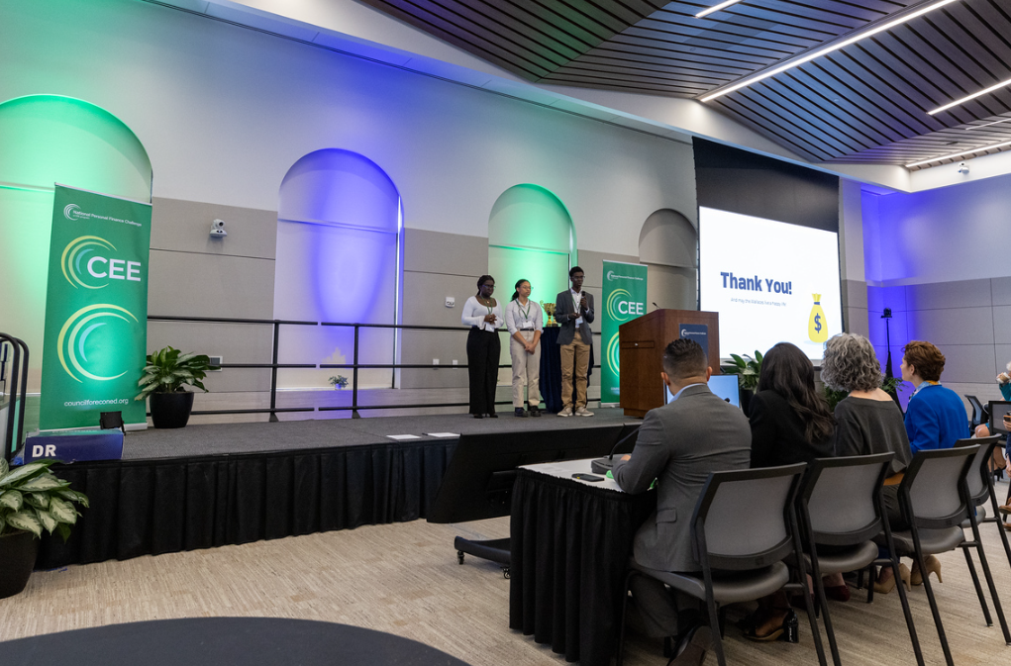
National Personal Finance Challenge
Notes:
2:30 mins
[HE]
Recap Video -
NPFC:

Slide 6
Competition Format – National Personal Finance Challenge (NPFC)
State Competitions
National Finals
The winning team from each state (plus access zone teams) moves on to the National Finals.
The competition begins in your classroom at the state level where students work with their classmates and peers mentored by coaches and instructors.
States host a competition in the format of their choice (online multiple choice test only, online test and in person quiz bowl, in person case study, etc)
Finals consist of a Family Scenario case study where teams present to a panel of judges. The top 16 teams move on to a qualifying quiz bowl round before competing in the final quiz bowl for cash prizes.
Accommodations and meals are covered for all participants and one coach. Teams must cover travel to and from Finals.
Notes:
[HE]
Nationwide competition that allows high school students to build and demonstrate their knowledge of money management. Teams showcase expertise in the concepts of earning income, spending, saving, managing credit, investing, and managing risk.
The competition begins at the state level where students work with their classmates and peers mentored by coaches and instructors.
The winning team from each state moves on to the National Finals. Finals consist of a family scenario case study where teams are given information about a family and their expenses, # of children, home and car payments, credit debt, and many other variables as well and they are tasked with formulating a strategy of recommendations for the family. They present their recommendations to a panel of judges and compete for cash prizes.
High level:
Teams of 3-4 students
Each state manages its state contest and selects a winning team
All state champs advance to Nationals for a case study competition
Top 4 teams participate in Final case study round

Slide 7


2026 Competition Dates
National Personal Finance Challenge:
Sunday May 31st & Monday June 1st, 2026
State Registration Deadline: April 15th, 2026
Location: Federal Reserve Bank of Atlanta
Atlanta, GA

Slide 8
CONGRATULATIONS!
You have won your State Competition
and are now preparing to compete in the
National Personal Finance Challenge

Slide 9
National Personal Finance Challenge (NPFC) –
Case Study Team Groupings
At the National Personal Finance Challenge, 30 - 36 teams will be split amongst 8 judging rooms in the case study round:
Example Team Presentation Schedule
Room: | R1 | R2 | R3 | R4 | R5 | R6 | R7 | R8
10:00 - 10:20 AM | 1. Random HS | 2. Random HS | 3. Random HS | 4. Random HS | 5. Random HS | 6. Random HS | 7. Random HS | 8. Random HS
10:20 - 10:40 AM | 9. Random HS | 10.Random HS | 11. Random HS | 12.Random HS | 13. Random HS | 14. Random HS | 15. Random HS | 16.Random HS
10:40 - 11:00 AM | 17. Random HS | 18.Random HS | 19. Random HS | 20. Random HS | 21. Random HS | 22. Random HS | 23. Random HS | 24.Random HS
11:00 - 11:20 AM | 25. Random HS | 26.Random HS | 27. Random HS | 28.Random HS |  | 29. Random HS | 30. Random HS | 31.Random HS
Notes:
[HE]
Nationwide competition that allows high school students to build and demonstrate their knowledge of money management. Teams showcase expertise in the concepts of earning income, spending, saving, managing credit, investing, and managing risk.
The competition begins at the state level where students work with their classmates and peers mentored by coaches and instructors.
The winning team from each state moves on to the National Finals. Finals consist of a family scenario case study where teams are given information about a family and their expenses, # of children, home and car payments, credit debt, and many other variables as well and they are tasked with formulating a strategy of recommendations for the family. They present their recommendations to a panel of judges and compete for cash prizes.
High level:
Teams of 3-4 students
Each state manages its state contest and selects a winning team
All state champs advance to Nationals for a case study competition
Top 4 teams participate in Final case study round

Slide 10
National Personal Finance Challenge (NPFC) –
Case Study Structure
Case Study Round Overview
Teams receive a fictional family financial scenario
Examples may include:
Managing debt
Planning for retirement
Insurance decisions
Education savings
Budgeting and investments
Teams will have:
75 minutes to prepare their plan
Then:
8 minute presentation
7 minutes of judge questions
Notes:
[HE]
Nationwide competition that allows high school students to build and demonstrate their knowledge of money management. Teams showcase expertise in the concepts of earning income, spending, saving, managing credit, investing, and managing risk.
The competition begins at the state level where students work with their classmates and peers mentored by coaches and instructors.
The winning team from each state moves on to the National Finals. Finals consist of a family scenario case study where teams are given information about a family and their expenses, # of children, home and car payments, credit debt, and many other variables as well and they are tasked with formulating a strategy of recommendations for the family. They present their recommendations to a panel of judges and compete for cash prizes.
High level:
Teams of 3-4 students
Each state manages its state contest and selects a winning team
All state champs advance to Nationals for a case study competition
Top 4 teams participate in Final case study round

Slide 11
National Personal Finance Challenge (NPFC) –
Case Study Structure Cont.
Case Study Round Rules:
Teams must begin with a blank presentation template in Google Slides, PowerPoint, or similar software.
Pre-filled templates or materials are not permitted.
Students may use the internet for research during the preparation period.
However, the following are strictly prohibited:
Artificial intelligence tools or chatbots
Messaging platforms or social media
Books, printed notes, or outside reference materials
Any pre-written or pre prepared content
All work must be created during the 75-minute preparation period.
Students caught breaking any of these rules will be immediately disqualified no questions asked!
Notes:
[HE]
Nationwide competition that allows high school students to build and demonstrate their knowledge of money management. Teams showcase expertise in the concepts of earning income, spending, saving, managing credit, investing, and managing risk.
The competition begins at the state level where students work with their classmates and peers mentored by coaches and instructors.
The winning team from each state moves on to the National Finals. Finals consist of a family scenario case study where teams are given information about a family and their expenses, # of children, home and car payments, credit debt, and many other variables as well and they are tasked with formulating a strategy of recommendations for the family. They present their recommendations to a panel of judges and compete for cash prizes.
High level:
Teams of 3-4 students
Each state manages its state contest and selects a winning team
All state champs advance to Nationals for a case study competition
Top 4 teams participate in Final case study round

Slide 12
National Personal Finance Challenge (NPFC) –
Case Study Rubric
Case Study Judging Criteria
Judges evaluate teams in three areas:
Financial Analysis and Content (80%)
Accuracy of financial concepts, realistic recommendations, prioritization of financial decisions, and use of evidence from the case study.
Teamwork (10%)
Balanced participation among team members and effective collaboration during the presentation and Q&A.
Presentation and Communication (10%)
Clear organization, professional delivery, and the ability to respond thoughtfully to judges’ questions.
Notes:
[HE]
Nationwide competition that allows high school students to build and demonstrate their knowledge of money management. Teams showcase expertise in the concepts of earning income, spending, saving, managing credit, investing, and managing risk.
The competition begins at the state level where students work with their classmates and peers mentored by coaches and instructors.
The winning team from each state moves on to the National Finals. Finals consist of a family scenario case study where teams are given information about a family and their expenses, # of children, home and car payments, credit debt, and many other variables as well and they are tasked with formulating a strategy of recommendations for the family. They present their recommendations to a panel of judges and compete for cash prizes.
High level:
Teams of 3-4 students
Each state manages its state contest and selects a winning team
All state champs advance to Nationals for a case study competition
Top 4 teams participate in Final case study round

Slide 13
National Personal Finance Challenge (NPFC) –
Case Study Rubric Cont.
FINANCIAL ANALYSIS | TEAMWORK | PRESENTATION
80% | 10% | 10%
Accuracy of financial concepts | Participation from all team members | Organization and logical structure
Quality of recommendations | Clear roles among team members | Clarity of explanations
Prioritization of financial decisions | Collaboration during analysis and presentation | Professional delivery
Sound reasoning and justification |  | Ability to respond to judge questions
Notes:
[HE]
Nationwide competition that allows high school students to build and demonstrate their knowledge of money management. Teams showcase expertise in the concepts of earning income, spending, saving, managing credit, investing, and managing risk.
The competition begins at the state level where students work with their classmates and peers mentored by coaches and instructors.
The winning team from each state moves on to the National Finals. Finals consist of a family scenario case study where teams are given information about a family and their expenses, # of children, home and car payments, credit debt, and many other variables as well and they are tasked with formulating a strategy of recommendations for the family. They present their recommendations to a panel of judges and compete for cash prizes.
High level:
Teams of 3-4 students
Each state manages its state contest and selects a winning team
All state champs advance to Nationals for a case study competition
Top 4 teams participate in Final case study round

Slide 14
CASE STUDY ANALYSIS

Slide 15
Case Study Completed.
Judges Deliberate!

Slide 16
National Personal Finance Challenge (NPFC) –
What Happens Next?
After the case study rounds conclude, judges will deliberate and the top two from each case study room will move on to the next round of the competition – Only 16 Teams move forward to the R16 Quizbowl
Example Team Presentation Schedule
Room: | R1 | R2 | R3 | R4 | R5 | R6 | R7 | R8
10:00 - 10:20 AM | 1. Random HS | 2. Random HS | 3. Random HS | 4. Random HS | 5. Random HS | 6. Random HS | 7. Random HS | 8. Random HS
10:20 - 10:40 AM | 9. Random HS | 10.Random HS | 11. Random HS | 12.Random HS | 13. Random HS | 14. Random HS | 15. Random HS | 16.Random HS
10:40 - 11:00 AM | 17. Random HS | 18.Random HS | 19. Random HS | 20. Random HS | 21. Random HS | 22. Random HS | 23. Random HS | 24.Random HS
11:00 - 11:20 AM | 25. Random HS | 26.Random HS | 27. Random HS | 28.Random HS |  | 29. Random HS | 30. Random HS | 31.Random HS
Notes:
[HE]
Nationwide competition that allows high school students to build and demonstrate their knowledge of money management. Teams showcase expertise in the concepts of earning income, spending, saving, managing credit, investing, and managing risk.
The competition begins at the state level where students work with their classmates and peers mentored by coaches and instructors.
The winning team from each state moves on to the National Finals. Finals consist of a family scenario case study where teams are given information about a family and their expenses, # of children, home and car payments, credit debt, and many other variables as well and they are tasked with formulating a strategy of recommendations for the family. They present their recommendations to a panel of judges and compete for cash prizes.
High level:
Teams of 3-4 students
Each state manages its state contest and selects a winning team
All state champs advance to Nationals for a case study competition
Top 4 teams participate in Final case study round

Slide 17
National Personal Finance Challenge (NPFC) –
Final Tips
Please note: Once the 75 minutes are up, students may NOT open their computers to rehearse and review the material.
Students May not use hardware during the 75 minutes (AI Glasses, Apple Watches or other wearables)
Students must complete the assignment within the 75-minute window!
Prioritize Decisions
Time Manage (save at least 10 minutes to rehearse and practice)
Double check your math!
Answer clearly
Pick a strategy, and maximize it! Don't try to answer everything.
Notes:
[HE]
Nationwide competition that allows high school students to build and demonstrate their knowledge of money management. Teams showcase expertise in the concepts of earning income, spending, saving, managing credit, investing, and managing risk.
The competition begins at the state level where students work with their classmates and peers mentored by coaches and instructors.
The winning team from each state moves on to the National Finals. Finals consist of a family scenario case study where teams are given information about a family and their expenses, # of children, home and car payments, credit debt, and many other variables as well and they are tasked with formulating a strategy of recommendations for the family. They present their recommendations to a panel of judges and compete for cash prizes.
High level:
Teams of 3-4 students
Each state manages its state contest and selects a winning team
All state champs advance to Nationals for a case study competition
Top 4 teams participate in Final case study round

Slide 18
Thank you!
How to Contact us:
  Dr. Ruben Rivera, Senior Director, National Academic Programs rrivera@councilforeconed.org
  Dr. Chris Cannon, Associate Director and Chief Program Officer, ccannon11@gsu.edu

