Slide 1





Thank you:
Teach a Kid to Save:
A Fun, Hands-on Approach to Building Smart Money Habits

Slide 2
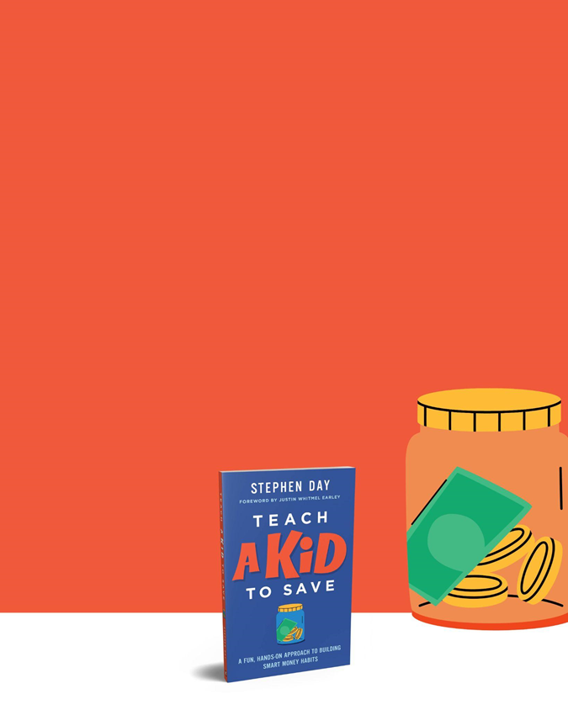
The Mini-Economy
What is it?!
(Origin story)
Drstephenday.com
Notes:
Tell the stories of Manuela, the TV-watching kids, and the Maya.
Discuss the origins of Mini-Economy and Mini-Economy at Home. (Pandemic, etc.)

Slide 3
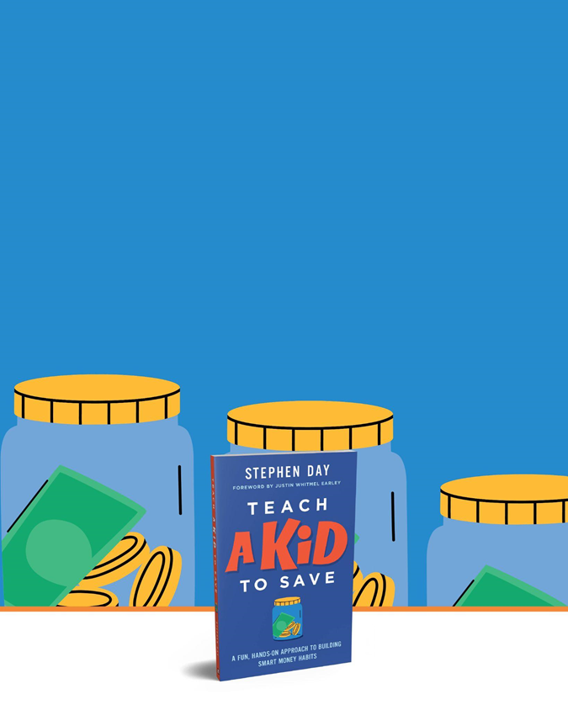
Mini-Economy Quick-Start Guide
Decide what items and privileges the family can buy
Design and print the money
Assign jobs to everyone in the family
Make a budget: Share-Save-Spend
Do the Store
Optional but worth it: Set up businesses
Do it!

Slide 4
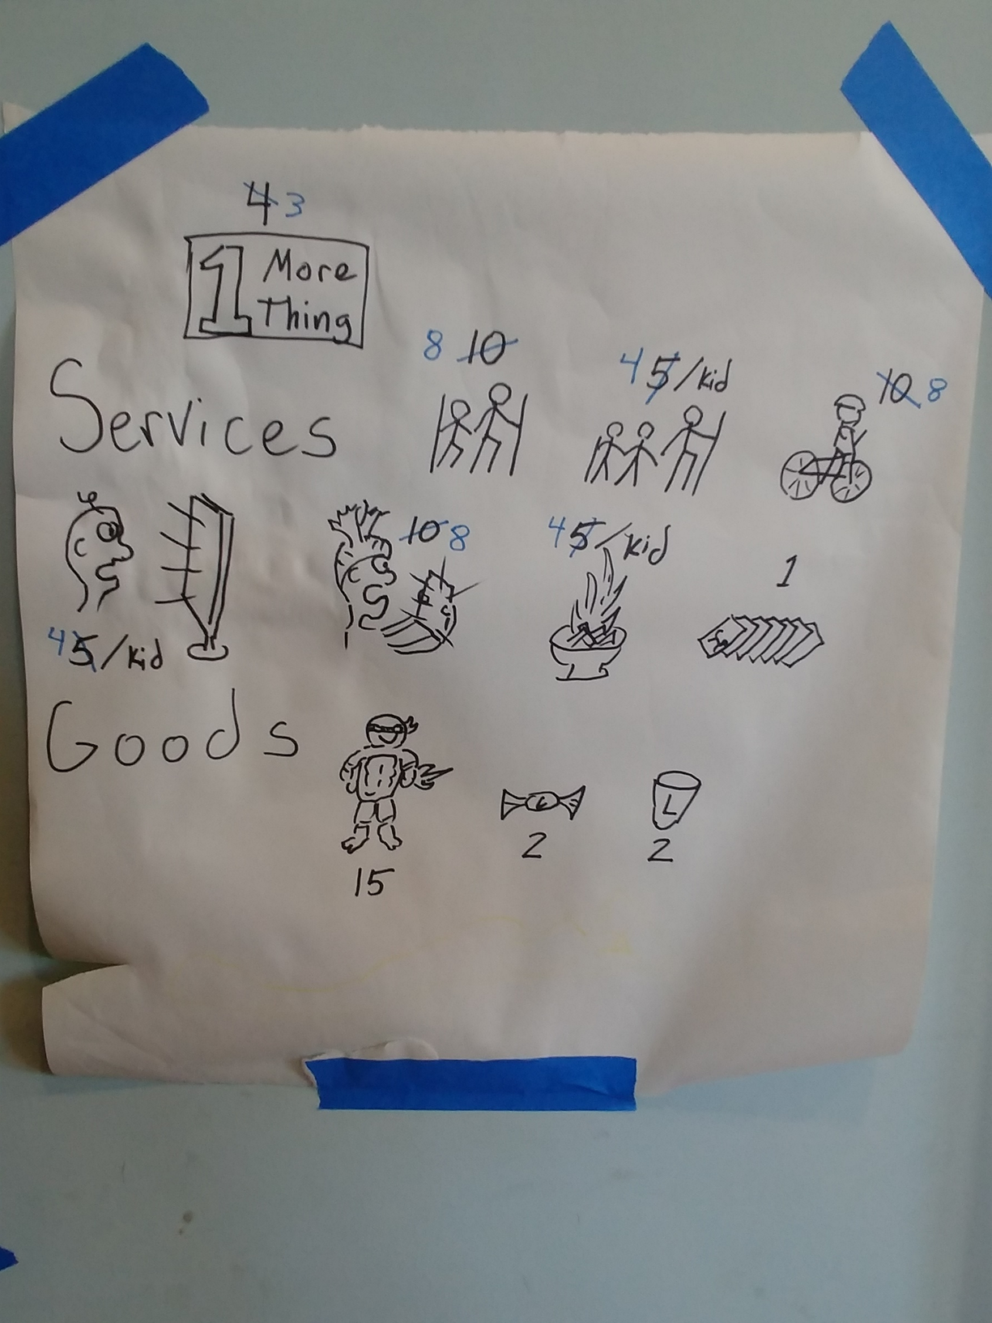
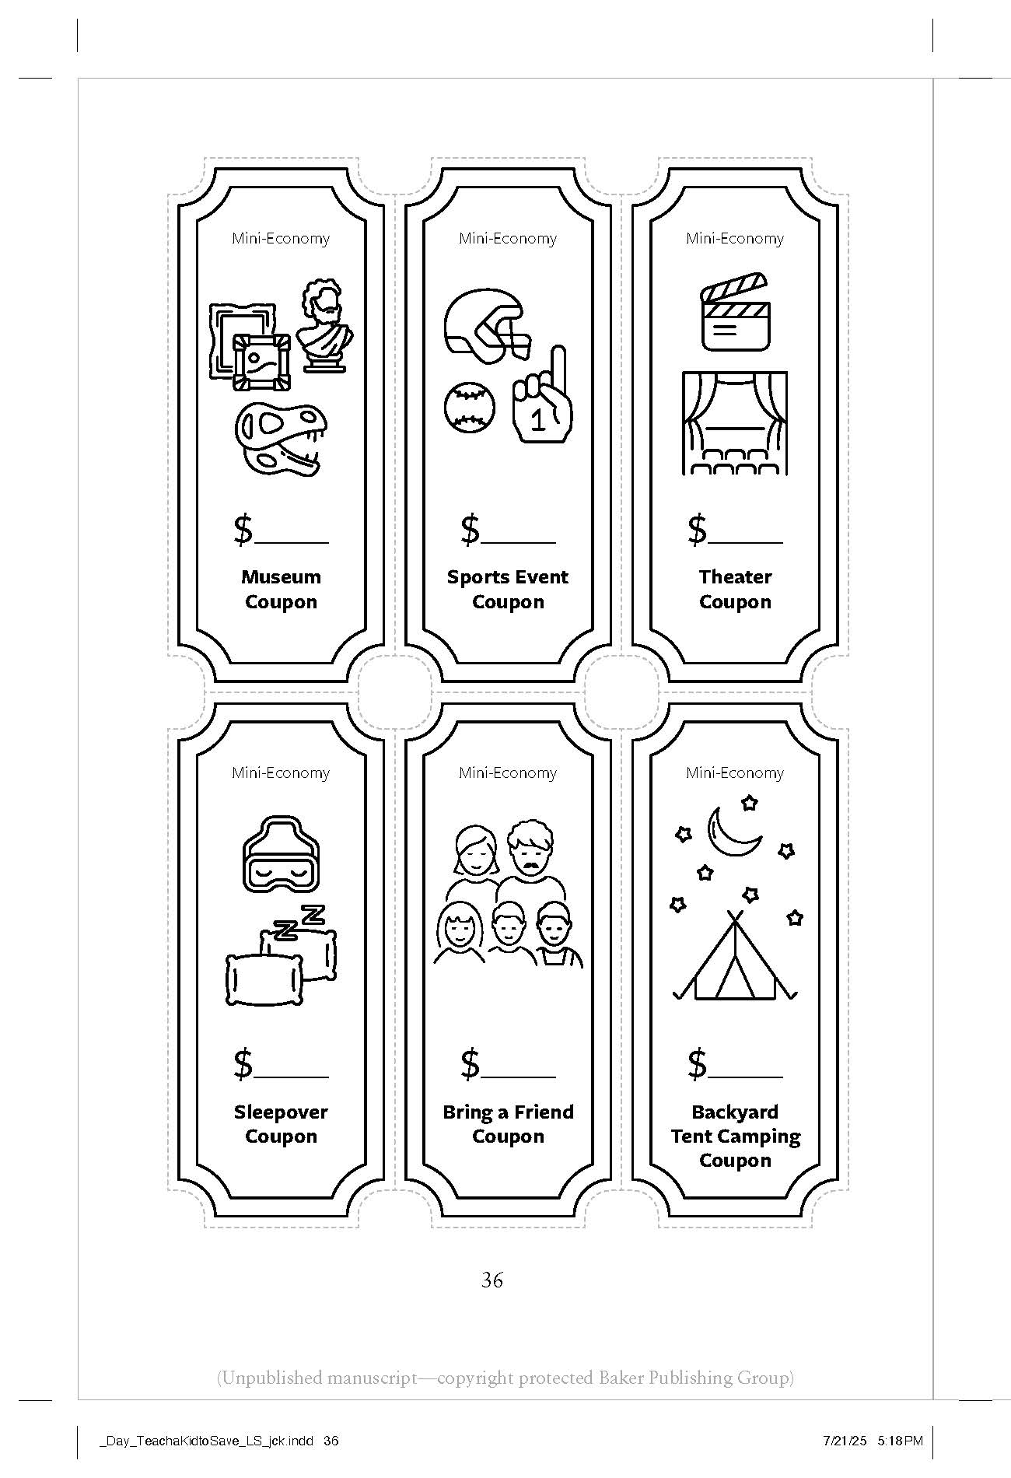
1. Decide what items and privileges the money will buy.

Slide 5
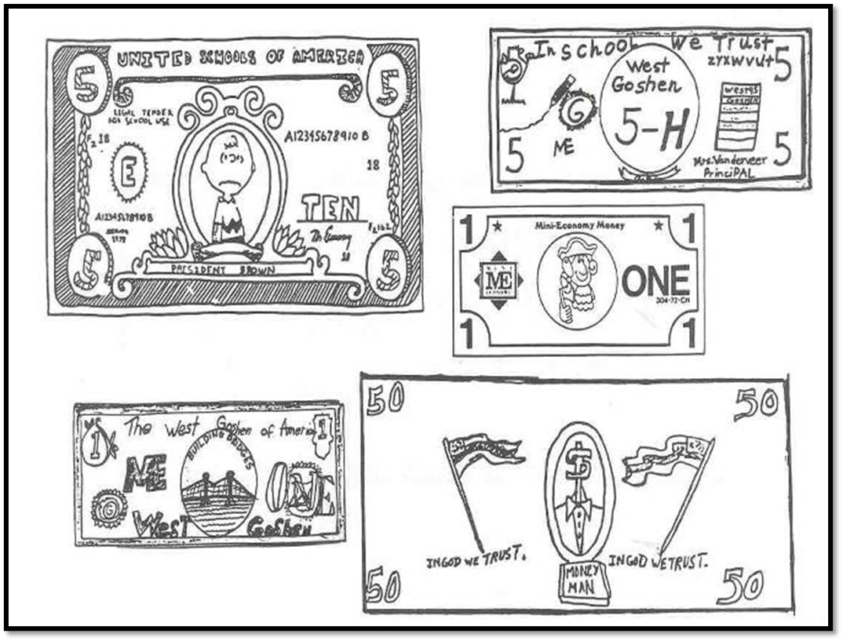
2. Design and print the money.

Slide 6
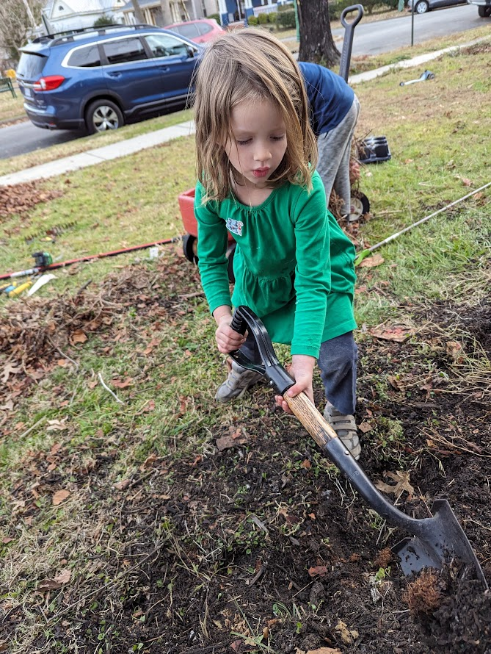
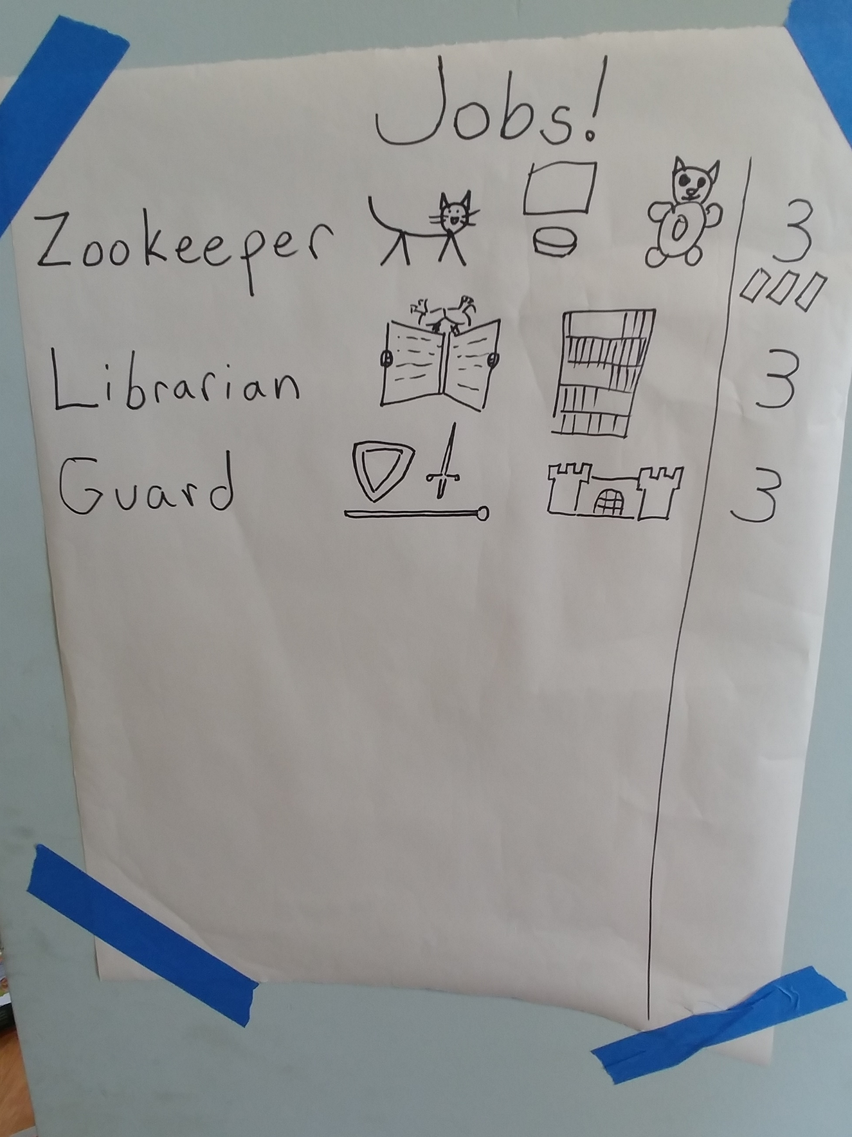
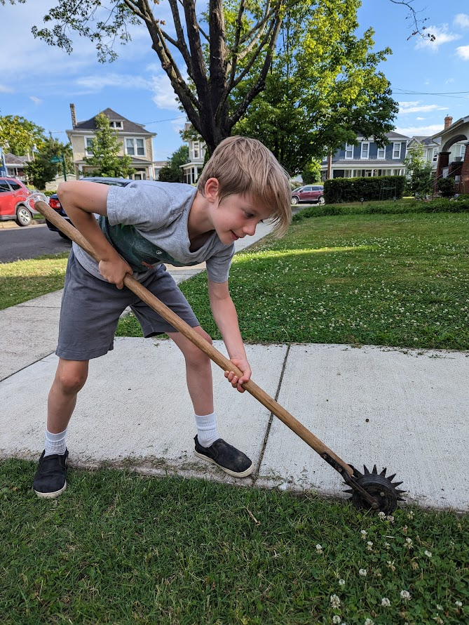
3. Assign jobs to everyone in the family.

Slide 7
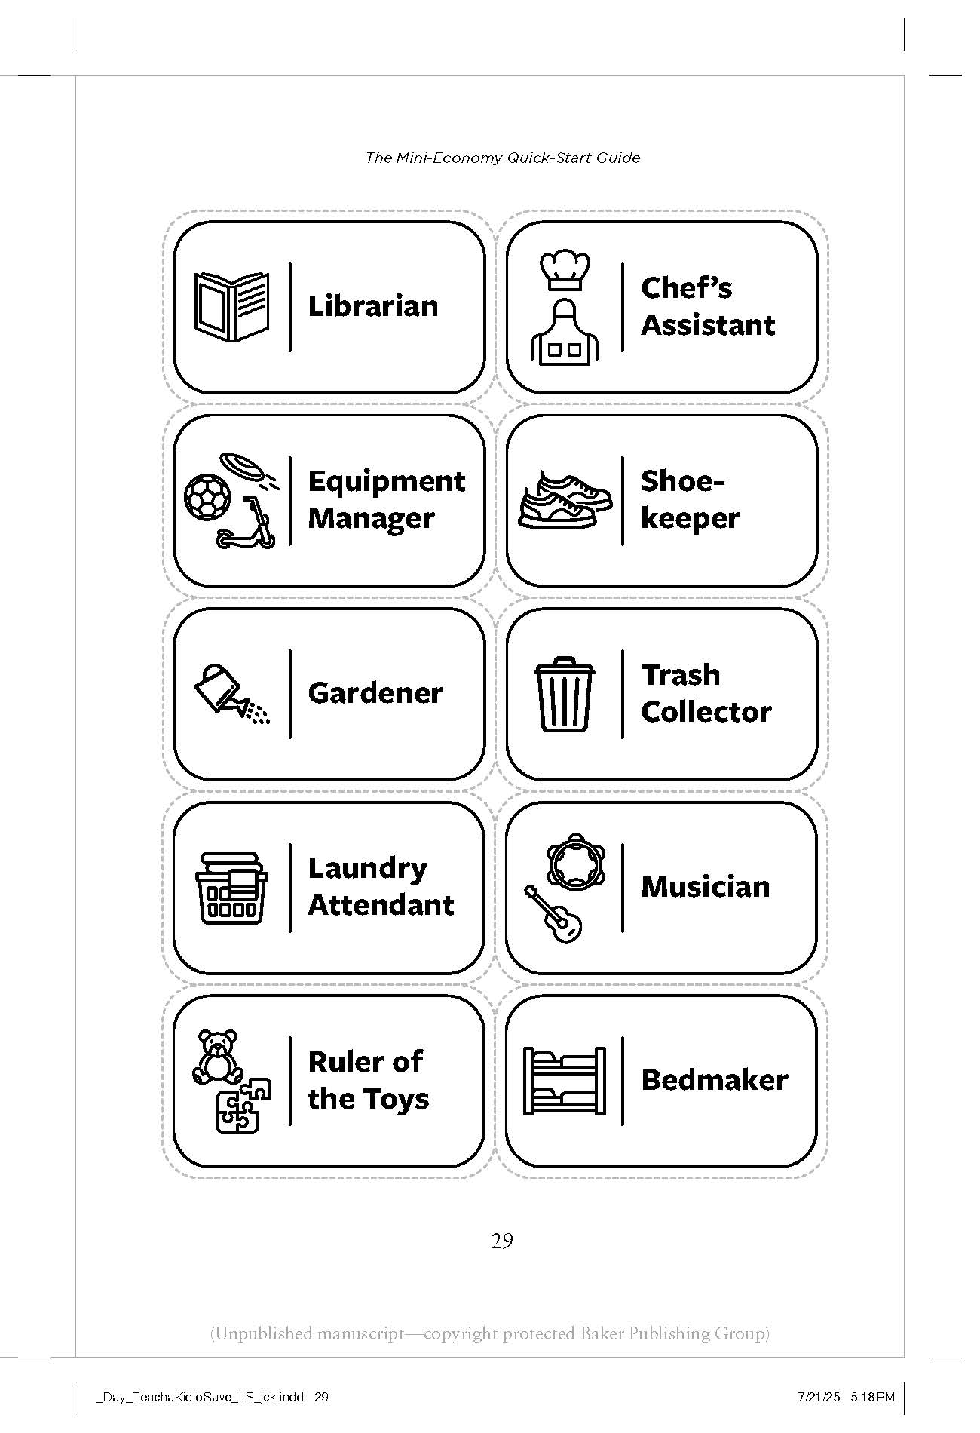
3. Assign jobs to everyone in the family.
Other jobs:
•Guard / sentry
•Zookeeper
•Librarian
•Architect / builder
•Gardener
•Sanitation worker / garbage collector
•Janitor
•Banker
•Accountant
•Server
•Busboy/girl
•Historian
•Job checker
•Money cutter
•Flag maker
•Hairdresser
•Interior decorator
•Physical trainer

Slide 8
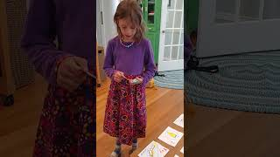
4. Make a budget: Share-Save-Spend.

Slide 9
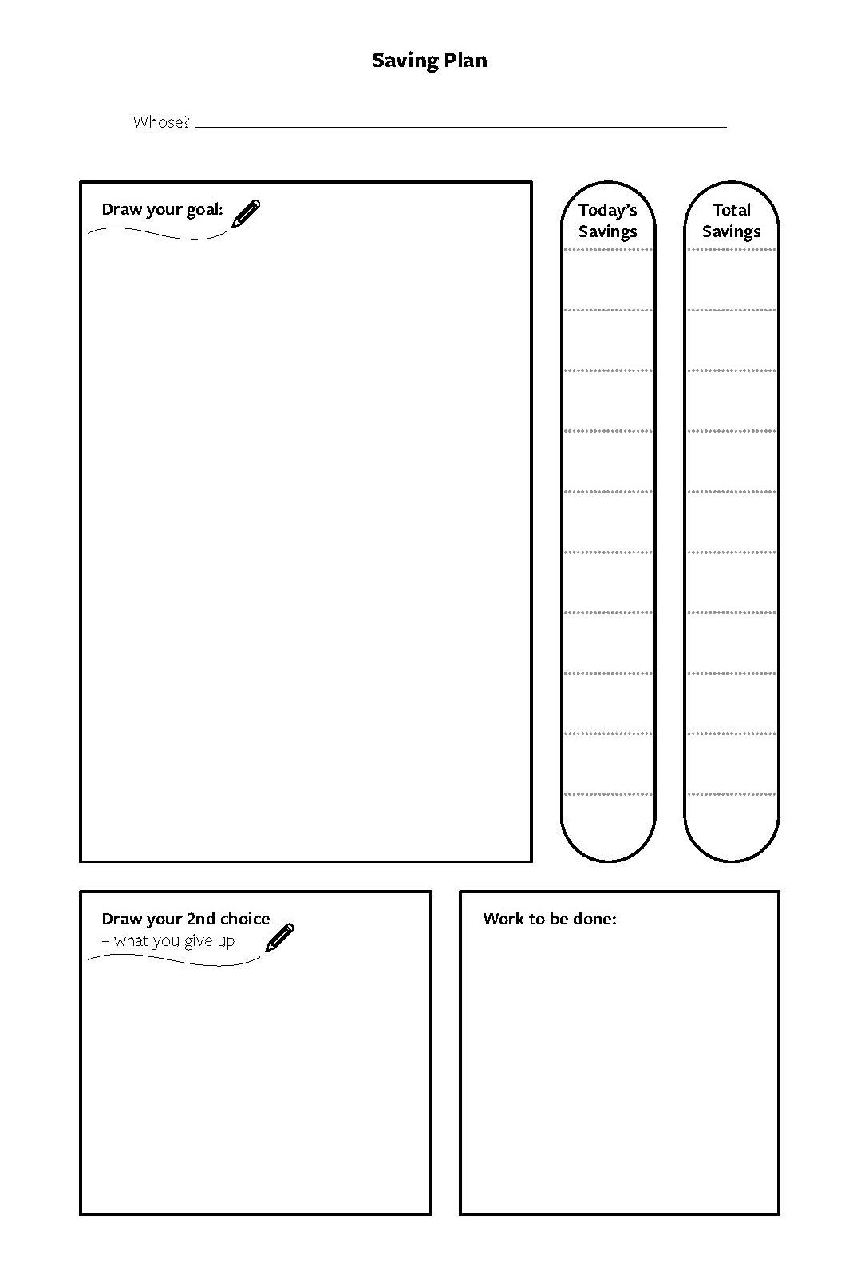
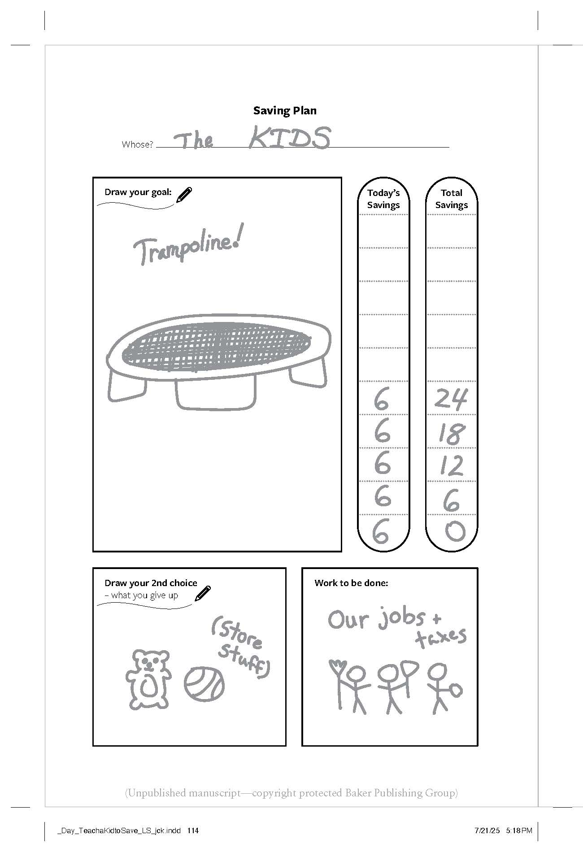
4. Make a budget: Share-Save-Spend.

Slide 10
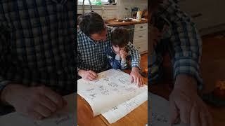
4. Make a budget: Share-Save-Spend.

Slide 11
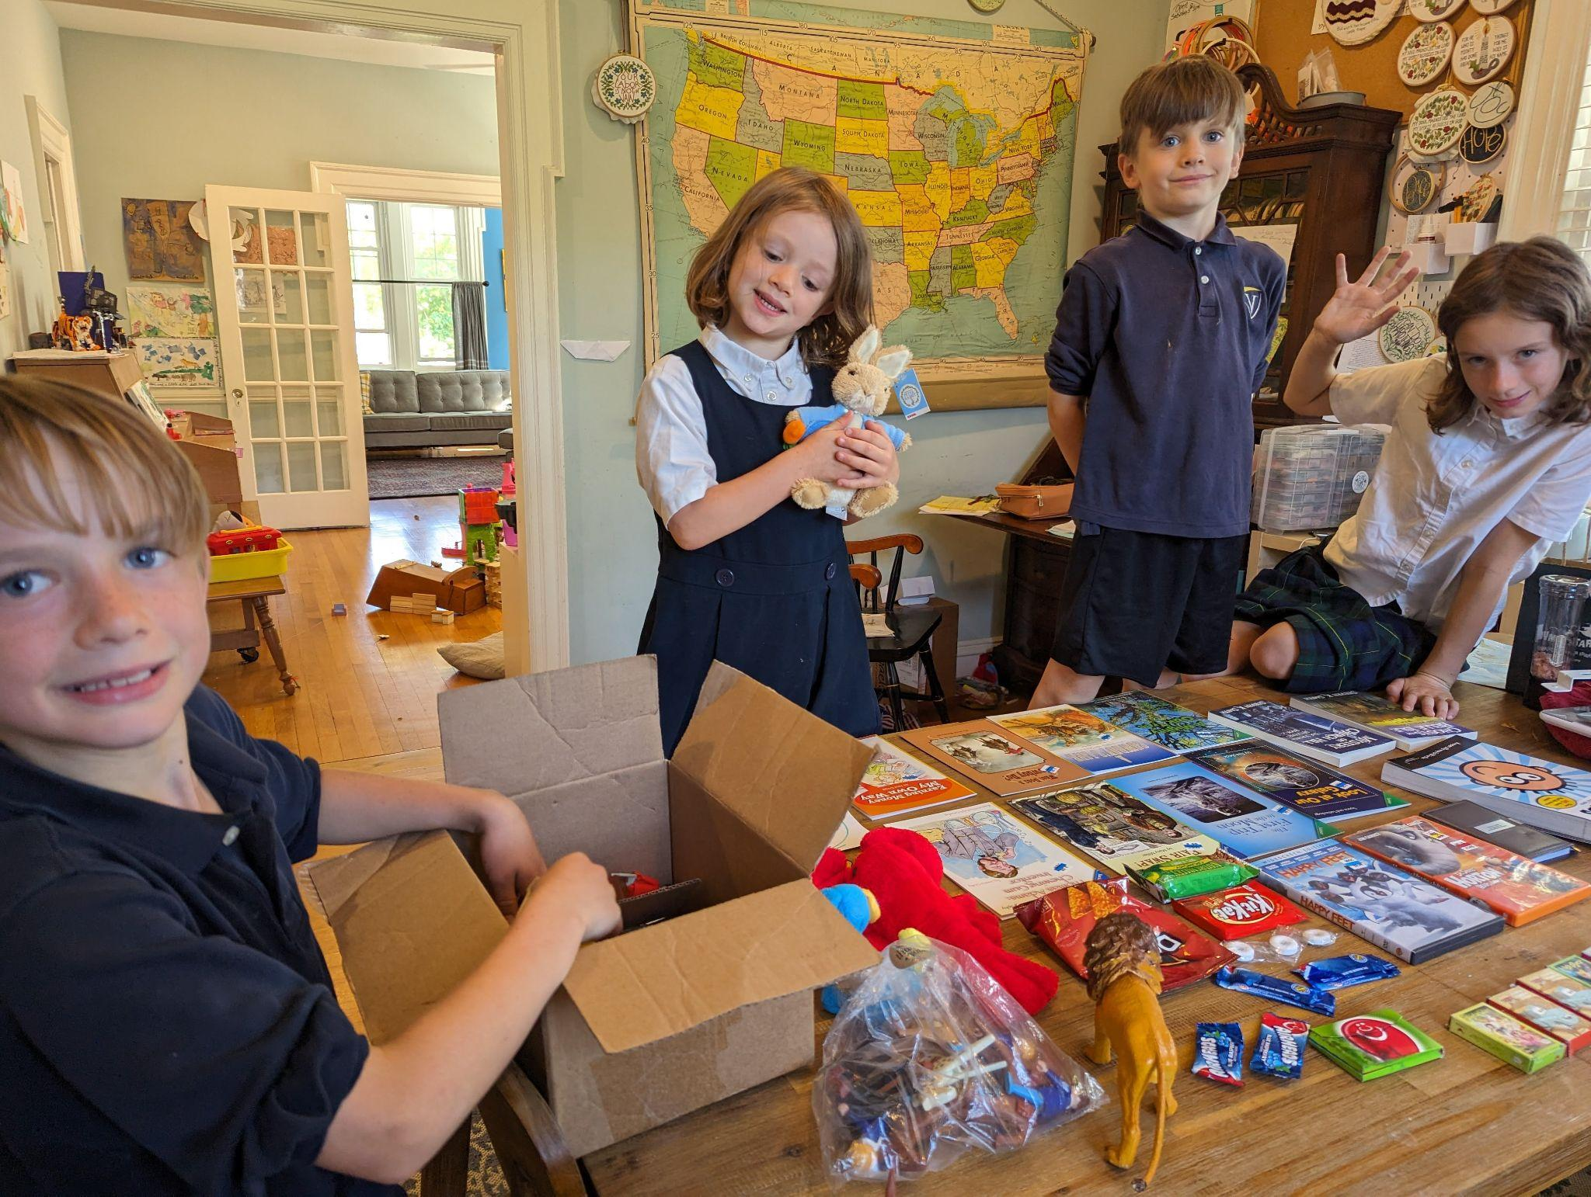
5. Have Store Day.

Slide 12
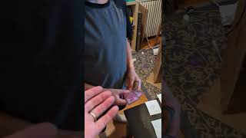
6. Optional but worth it: Set up businesses.

Slide 13
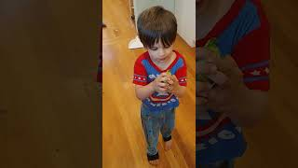
7. Do it!

Slide 14

To be published on January 13, 2026

Slide 15
Thank you:
PART 2

Slide 16

What should kids learn?
Questions for parents:
1. What did you learn about money from your family when you were a child?
2. When you envision a “good financial life,” what do you think of?
Questions for children:
1. When you get money, what do you like to do with it?
2. Do you know about any of the choices your parents have to make about money?

Slide 17
What should kids learn?
Lessons for children:
1. I can produce.
2. I can save.
3. I can learn new things.
4. I can trade.
5. I can get better.
6. I should ask questions like:
What’s good about this choice?
What’s bad about this choice?
What opportunities do I give up?
What could I do instead?
What’s my next best choice?
7. My choices MATTER!

Slide 18

When should kids learn?

Slide 19
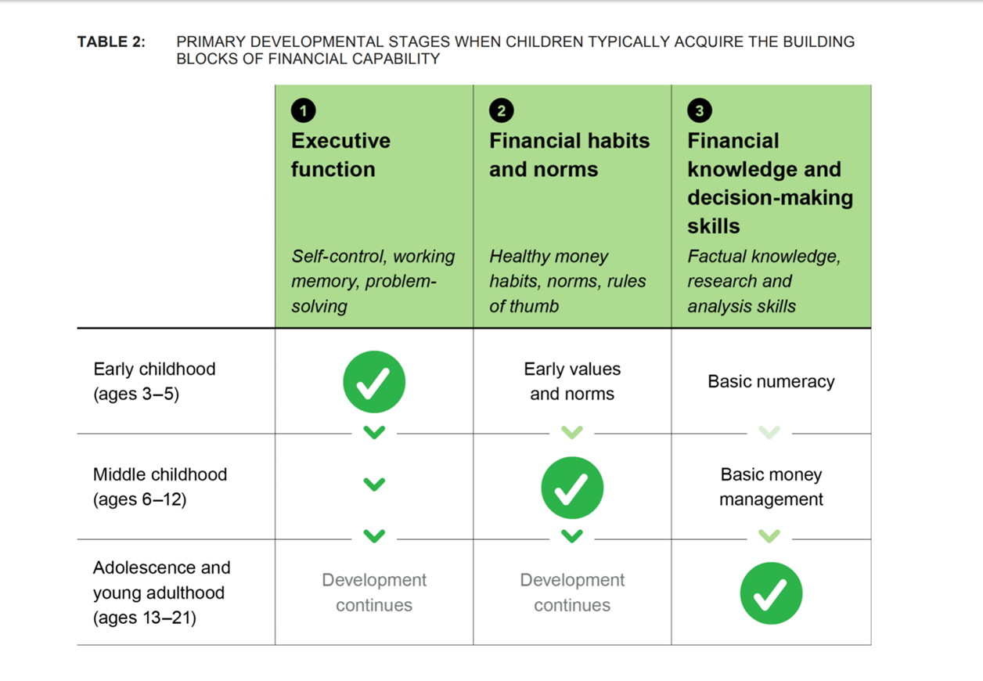

Slide 20
When should kids learn?
Questions for Parents
1. At what age should children start learning about money?
2. How can you involve your children in family financial decisions?
Questions for Children
1. What do you think our family does when we get money?
2. What is one reason to save money before spending it?
6. What are two good reasons we might want to wait for something? Isn’t it better to get everything we want now?

Slide 21
When should kids learn?
Lessons for Children
1. We can choose to get small things now or big things later.
2. Sometimes the first thing we feel like doing isn’t the best idea.
3. Everyone has to wait to get things they want, even grown-ups. (“Here’s a time I had to wait...”)
4. We make the best plans we can, but sometimes things don’t work out like we thought they would.

Slide 22
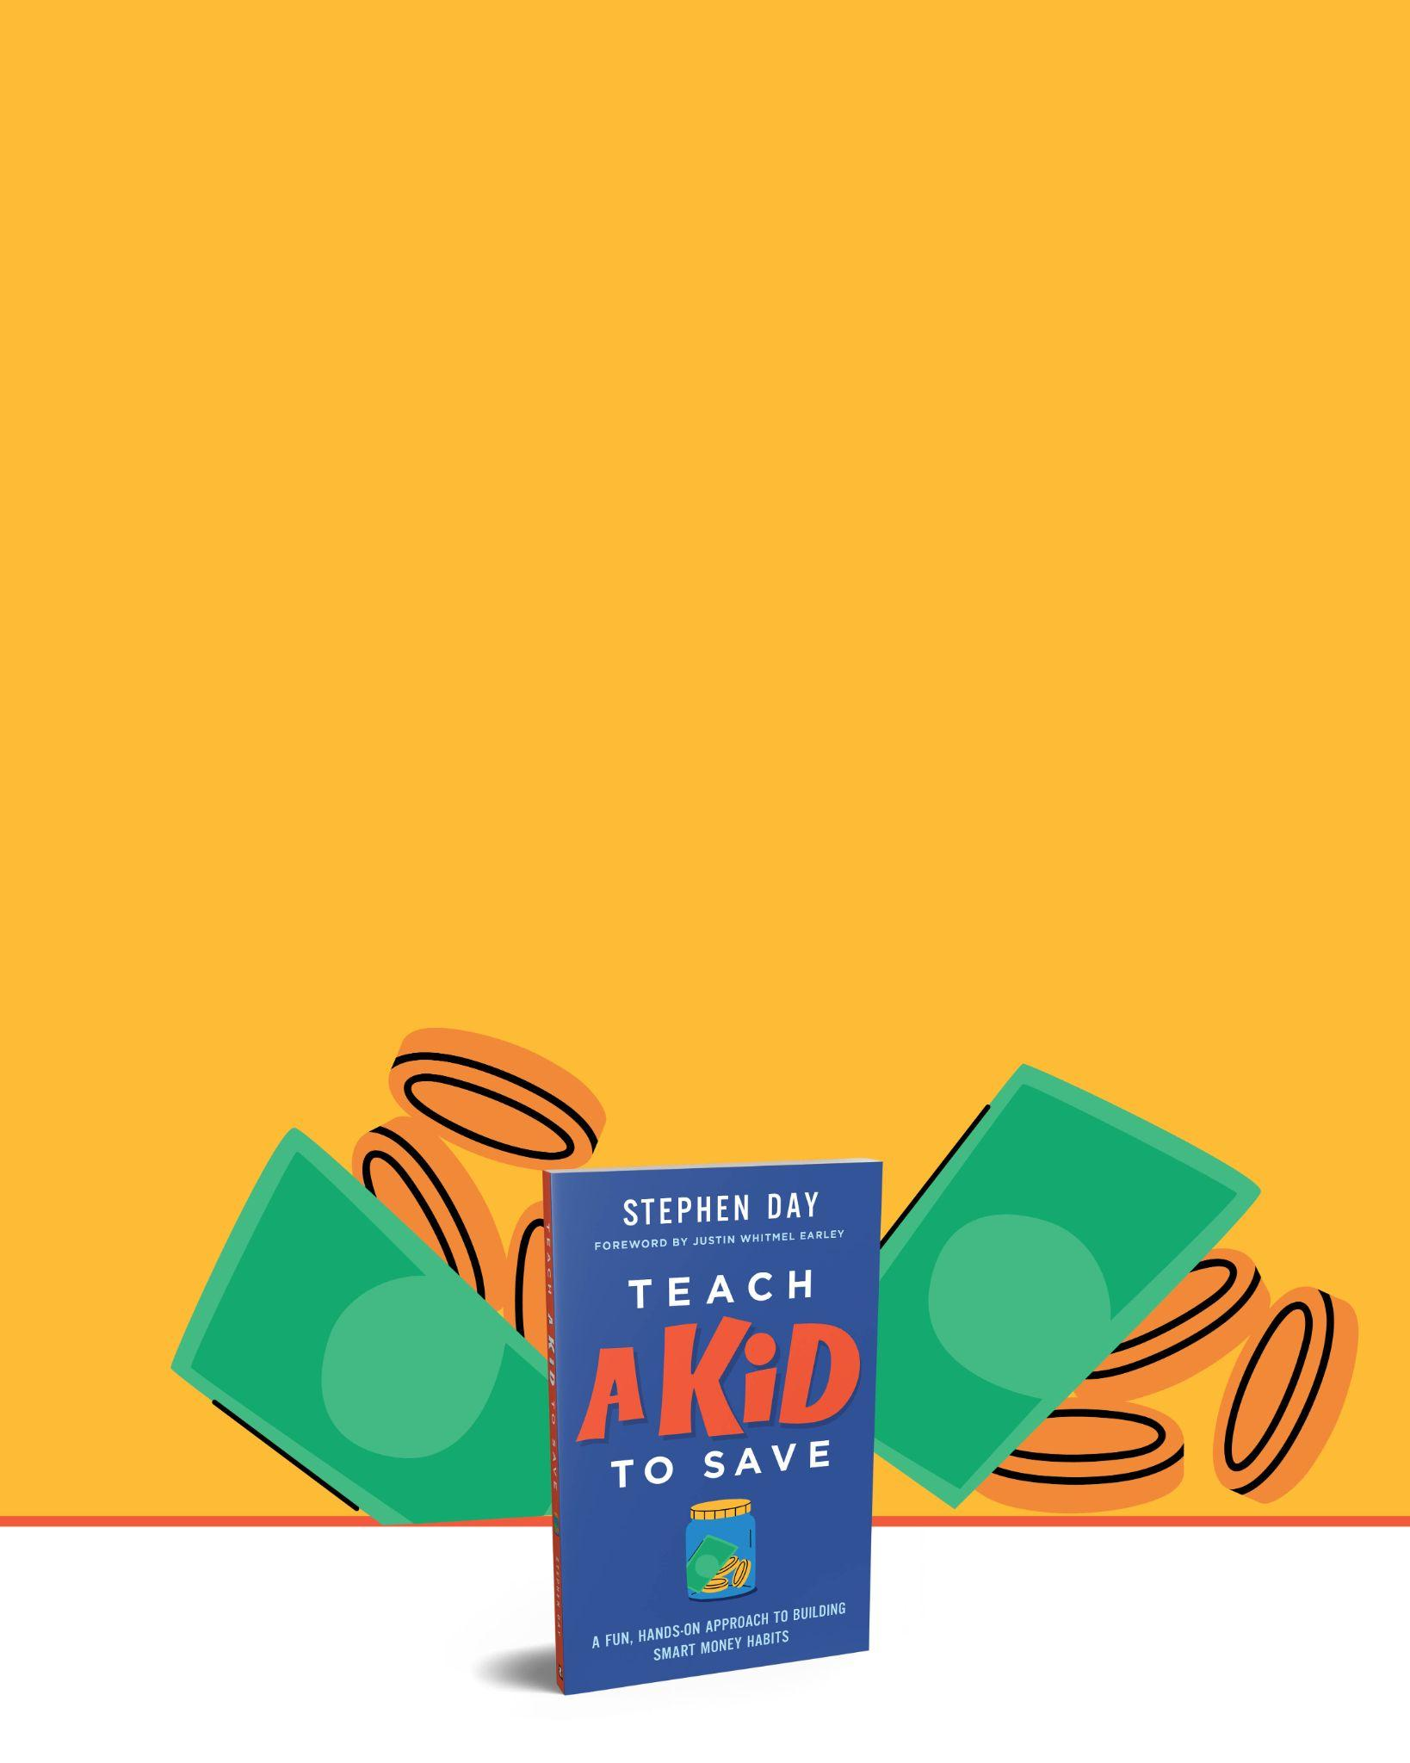
Should kids be paid to do chores?
Answer:
YES for their jobs,
NO for family work or service work.
(Kids know how to think in categories)
(Click here for complicated diagram about motivation)

Slide 23
To be published on January 13, 2026

Slide 24



Paper Robots
Family Economics in "Bluey"
A deeper look into our buying impulses
https://www.drstephenday.com/p/family-economics-in-bluey

Slide 25
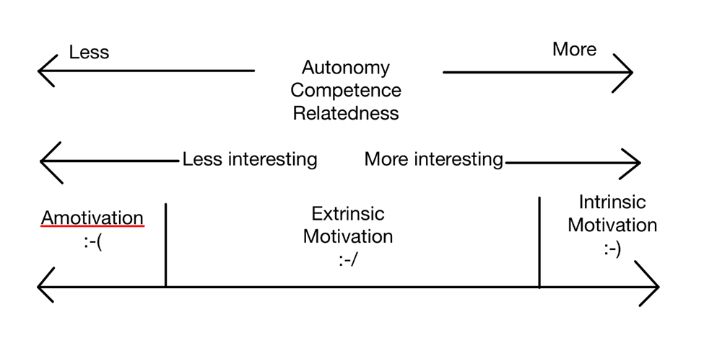
Does getting paid hurt motivation? (Lessons from Self Determination Theory)
Back

