Slide 1

[INSERT FEATURED IMAGE OF WEBINAR SESSION]
AP MACROECONOMICS
POST-EXAM ANALYSIS
©2026 College Board
DISCLAIMER: This presentation is not sponsored by the College Board and only reflects the presenter’s analysis of the 2026 AP Macro free response questions.

Slide 2
Certificate Requirements
To earn professional development hours for webinars, you must:
Watch a minimum of 45-minutes and you will automatically receive a professional development certificate via e-mail within 24 to 48 hours.

Slide 3
Objectives
Review the 2026 AP Macroeconomics Free- Response Questions (FRQ’s).
Learn effective strategies for teaching content that is tested on the FRQ portion of the AP exam.

Slide 4
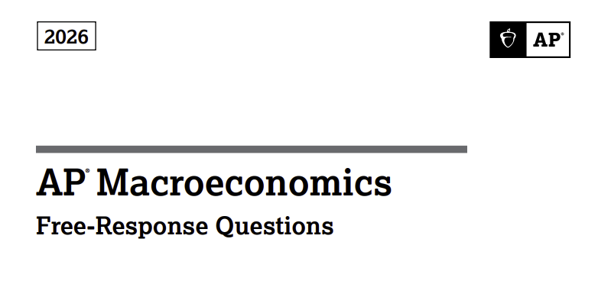


Slide 5
Question 1- Part A
LRAS
The economy of Micanapy is in short-run equilibrium and is experiencing an inflationary gap.
Part A
Draw a correctly labeled graph of the aggregate demand, short-run aggregate supply, and long-run aggregate supply curves for Micanapy, and show each of the following.
i. The current equilibrium real output and price level, labeled Y1 and PL1, respectively
ii. The full-employment real output, labeled YF
Price Level
SRAS
PL₁
AD
Y_{F}
Y₁
RGDP
5

Slide 6
Question 1- Part B
LRAS
The economy of Micanapy is in short-run equilibrium and is experiencing an inflationary gap.
Part B
Assume that policymakers take no action to close the inflationary gap. Explain how Micanapy’s economy will self-adjust to full employment in the long run.
In the long run, resource prices and wages will increase, shifting the SRAS to the left until RGDP decreases to the full employment level and the inflationary gap is closed.
Price Level
SRAS
PL₁
AD
Y_{F}
Y₁
RGDP
6

Slide 7
Question 1- Part C
The economy of Micanapy is in short-run equilibrium and is experiencing an inflationary gap.
Part C
Suppose instead that Micanapy’s central bank is considering using monetary policy to close the inflationary gap in the short run. The banking system in Micanapy has limited reserves.
i. Identify a specific open-market operation that the central bank of Micanapy would implement to close the inflationary gap in the short run.
Sell bonds.
ii. Draw a correctly labeled graph of the money market in Micanapy, and show the effect of the open-market operation identified in part C (i) on the nominal interest rate.
Nominal Interest Rate
MS₂ MS₁
i₂
i₁
MD
Q₂
Q₁
Qmoney
7

Slide 8
Question 1- Parts D and E
Part C
Based solely on the interest rate change shown on your graph in part C (ii), will each of the following increase, decrease, or remain the same in the short run?
International financial capital flows into Micanapy. Explain.
Increase. The increase in the nominal interest rates will incentivize international investors to seek higher returns which increases the financial capital flows into Micanapy.
ii. The price of previously issued bonds in Micanapy. Decrease
iii. Private domestic investment spending in Micanapy. Decrease
Part D
Based solely on the change in private domestic investment spending identified in part D (iii), will the unemployment rate in Micanapy increase, decrease, or remain the same in the short run? Explain.
Unemployment rate will increase because investment is a component of Aggregate Demand and when investment decreases, aggregate demand decreases, decreasing RGDP and increasing unemployment.

Slide 9
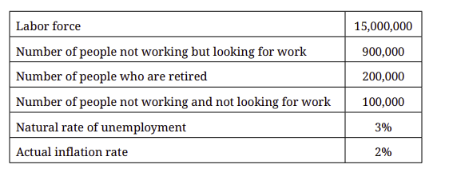
Question 2- Parts A and B
The economy of Foxhound is in short-run equilibrium with the macroeconomic data shown in the table.
Part A
How many people are employed in Foxhound?
Employed = Labor Force - # not working but looking for work
Employed = 15,000,000- 900,000
= 14,100,000
Part B
Calculate the actual unemployment rate in Foxhound. Show your work.
Unemployment Rate = (Unemployed/Labor Force) x100
= (900,000/15,000,000) x 100
= 6%

Slide 10
Question 2- Parts C and D
Part C
Draw a correctly labeled graph of the short-run and long-run Phillips curves for the economy of Foxhound and label the short-run equilibrium point as X. Plot the relevant numerical values on your graph.
Part D
If some individuals who are counted as employed in Foxhound retire, will the unemployment rate increase, decrease, or remain the same? Explain.
Increase. The denominator of the unemployment rate (the labor force) will decrease when people retire. The numerator (unemployed) will not be affected, since people who retire are neither unemployed nor looking for work. Consequently, the UE rate increases.
Example: 4/10 = 40%, 4/8 = 50%
LRPC
Inflation %
X
2%
SRPC
3% 6%
UE%
10

Slide 11
Question 3- Part A
Lizland is a small island nation, and its currency is the Lizland crown (LIZ). The economy of Lizland is in short-run macroeconomic equilibrium with a 600 million crown recessionary gap.
Part A
Policymakers in Lizland are considering taking action to close the recessionary gap in the short run.
i. The central bank of Lizland is considering implementing monetary policy. The banking system of Lizland has ample reserves. Identify a specific monetary policy action the central bank of Lizland would implement to close the recessionary gap in the short run.
Decrease the interest on reserves (or administered/policy rates).
ii. The government of Lizland is also considering changing its spending, and the marginal propensity to consume is 0.75. Calculate the minimum change in government spending and identify the direction of the change required to fully close the 600 million crown recessionary gap in the short run. Show your work.
Multiplier = 1/(1-MPC) = 1/.25 = 4 Change in RGDP = 4 (Change in Gov Spending)
600 million = 4 ( Change in Gov Spending)
150 million crown = Change in Gov Spending

Slide 12
Question 3- Parts B and C
Part B
Assume that the government of Lizland decides to change its spending as calculated in part A (ii). Based solely on this change, will the price level in Lizland increase, decrease, or remain the same in the short run? Explain.
Increase. The increase in government spending results in a shift to the right of the AD curve intersecting the SRAS at a higher price level.
Part C
The nations of Lizland and Andoh are trading partners with flexible exchange rates. The currency of Andoh is the Andoh note (AND). Draw a correctly labeled graph of the foreign exchange market for the Lizland crown (LIZ). Based solely on the change in the price level in part B, show the change in the international value of the Lizland crown on your graph. (A decrease in demand for the Liz crown by Andoh is also acceptable.)
AND/LIZ
Lizland Crown
Market
S
er_{e}
S₁
er₁
D
Q_{e}
Q₁
Quantity of LIZ
LIZ DEPRECIATES

