Slide 1

[INSERT FEATURED IMAGE OF WEBINAR SESSION]
AP MICROECONOMICS
POST-EXAM ANALYSIS
©2025 College Board
DISCLAIMER: This presentation is not sponsored by the College Board and only reflects the presenter’s analysis of the 2026 AP Micro free response questions.

Slide 2
Certificate Requirements
To earn professional development hours for webinars, you must:
Watch a minimum of 45-minutes and you will automatically receive a professional development certificate via e-mail within 24 to 48 hours.

Slide 3
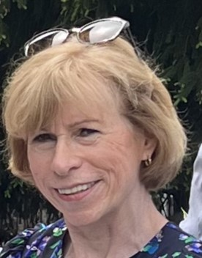
Presenter
Name: Kathleen Brennan
Email Address: kmbrennan108@gmail.com
Social Handles X : @econkate
Instagram: @kmbrennan108

Slide 4
Objectives
Review the 2026 AP Microeconomics Free- Response Questions (FRQ’s).
Learn effective strategies for teaching content that is tested on the FRQ portion of the AP exam.

Slide 5

Session Agenda
FRQ Analysis
2. Discussion
© 2026 College Board

Slide 6
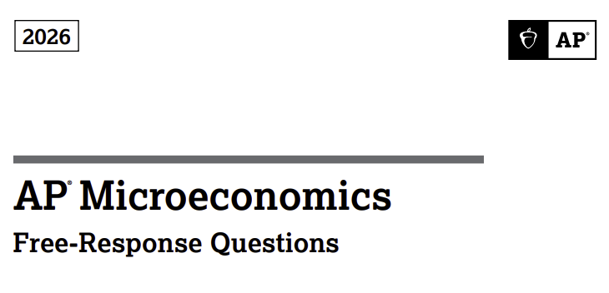

Slide 7
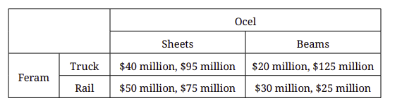
Question 1
Feram and Ocel are the only two steel manufacturers in the region. Feram is deciding whether to transport its steel with Truck or Rail. Ocel is deciding whether to produce its steel as Sheets or Beams. The payoff matrix shows the payoffs for each combination of strategies. The first entry in each cell shows Feram’s profit, and the second entry shows Ocel’s profit. Each firm independently and simultaneously chooses its strategy. Assume that Feram and Ocel know all the information in the matrix and do not cooperate.

Slide 8

Question 1- Part A
What is Feram’s most profitable strategy if Ocel chooses to produce sheets?
Feram should transport by rail. ($50 mil >$40 mil)

Slide 9
Question 1- Part B
..
Does Ocel have a dominant strategy? Explain using numbers from the payoff matrix.
No. If Feram transports by Truck, Ocel should produce Beams since $125 mil> $95 mil. If Feram transports by rail, Ocel should produce sheets since $75 mil> $25 mil. What is most profitable for Ocel depends on what Feram chooses, Ocel does not have a dominant strategy.

Slide 10
Question 1- Part C
Identify the Nash equilibrium (or equilibria) for this game, or state that none exists.
If Ocel produces sheets, Feram should transport by rail ($50mil >$40mil). If Ocel produces beams, Feram should transport by rail ($30mil>$20mil).
If Feram transports by truck, Ocel should produce beams ($125mil>$95 mil). If Feram transports by rail, Ocel should produce sheets ($75mil>$25 mil)
One Nash equilibrium --- Feram transports by rail and Ocel produces sheets. (No regrets equilibrium)

Slide 11
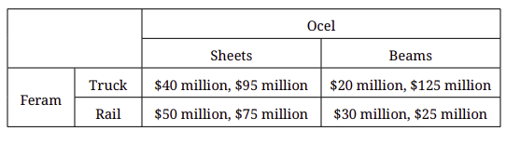


Question 1- Part D
Suppose Feram incurs a $20 million increase in the cost of Rail transport, with no change in the cost of Truck transport. Redraw the payoff matrix, including the firms, strategies, and payoffs, showing how the $20 million increase in the cost of Rail transport affects the payoff matrix.
$20 million $10 million

Slide 12




Question 1 – Part E
Suppose instead that Feram and Ocel now cooperate and merge into one new firm, Acier, which is now the only producer of steel in the region. Acier produces the profit-maximizing quantity of steel and is earning positive economic profit. Draw a correctly labeled graph for Acier, and show each of the following.
i. Acier’s profit-maximizing quantity, labeled Q1
ii. Acier’s profit-maximizing price, labeled P1
iii. The average total cost curve, labeled ATC, consistent with Acier earning positive economic profit
iv. The area of deadweight loss, shaded completely
P/$
MC
ATC
P1
.
D= AR= P
Q1
Q
MR

Slide 13
Question 1- Part F
Government regulators impose a lump-sum tax on Acier. In the short run, will Acier’s profit maximizing price of steel increase, decrease, or remain the same as a result of the lump-sum tax? Explain.
Remain the same. Lump sum taxes only affect the ATC and have no impact on the MC. Thus, the intersection of MR and MC occurs at the same profit maximizing quantity. Since demand has not changed, the price associated with that profit maximizing quantity is also the same.

Slide 14
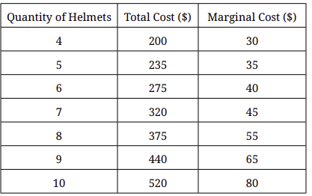
Question 2
The table shows Protecto’s short-run cost schedule of producing helmets.
Part A
Identify the market structure in which Protecto sells helmets.
Perfect competition (It can sell all the helmets it wants at the market price.)
Part B
Calculate Protecto’s average variable cost when it produces 4 helmets. Show your work.
TC-FC= VC
200-80 = 120 AVC= VC/Q = 120/4 = $30
Part C
Calculate Protecto’s economic profit when it sells 5 helmets. Show your work.
TR –TC= Economic Profit
5($60) – 235 = 300- 235 = $65
Protecto produces and sells as many helmets as it wants at a market price of $60 each, and Protecto’s fixed cost is $80.

Slide 15
Question 2
The table shows Protecto’s short-run cost schedule of producing helmets.
Part D
Identify Protecto’s profit-maximizing quantity of helmets. Explain your answer using marginal analysis.
Profit maximization occurs where MR =MC. At 8 helmets, Protecto’s MR exceeds its MC ($60>$55) while at 9 helmets its MR< MC ($60<$65). Since Protecto can’t produce fractional helmets, it will produce 8 helmets since producing the ninth will result in MR <MC.
Part E
Protecto is earning positive economic profit in the short run. As the market for helmets adjusts to the long-run equilibrium, will the market price of helmets increase, decrease, or remain the same? Explain.
Decrease. Positive economic profit incentivizes new firms to enter the industry. Since there are no barriers to entry, firms will enter, shifting the market supply curve to the right, leading to a lower market price until economic profits return to zero.
Protecto produces and sells as many helmets as it wants at a market price of $60 each, and Protecto’s fixed cost is $80.

Slide 16
Question 3
In Gurkeland, the domestic market for cucumbers is characterized by a downward-sloping demand curve and an upward-sloping supply curve, and the market for cucumbers is currently in equilibrium at a price of $20 per bushel.
Part A
Draw a correctly labeled graph of the market for cucumbers and show the equilibrium price, labeled $20, and the equilibrium quantity, labeled Q1.
Part B
Suppose that Gurkeland engages in free trade with other countries and that the world price of cucumbers is $10 per bushel.
i. On your graph in part A, show the world price of cucumbers, labeled $10, and the quantity of cucumbers sold by domestic producers, labeled Q2.
ii. Will total economic surplus in Gurkeland increase, decrease, or remain the same after engaging in free trade?
P
SDomestic
$20
Pworld
$10
DDomestic
Q2
Q1
Q cucumbers

Slide 17
Question 3
Part C
Now suppose that the government of Gurkeland imposes a $5 tariff per bushel on the import of cucumbers.
i. On your graph in part A, show the new quantity of cucumbers, labeled Q3, that will be sold by domestic producers as a result of the $5 tariff imposed on the import of cucumbers.
ii. As compared with the free trade described in part B, will domestic producer surplus in the market for cucumbers increase, decrease, or remain the same as a result of the $5 tariff imposed on the import of cucumbers? Explain.
Domestic producer surplus will increase since the area above the domestic supply curve and beneath the price with the tariff increases. (Domestic consumer surplus decreases and total economic welfare decreases.)
P
SDomestic
$20
Pworld + tariff
$15
Pworld
$10
DDomestic
Q2
Q3
Q1
Q cucumbers

Slide 18
Nash Equilibrium
No person has an incentive to change their behavior or strategy, unless someone else changes their behavior or strategy.

Slide 19
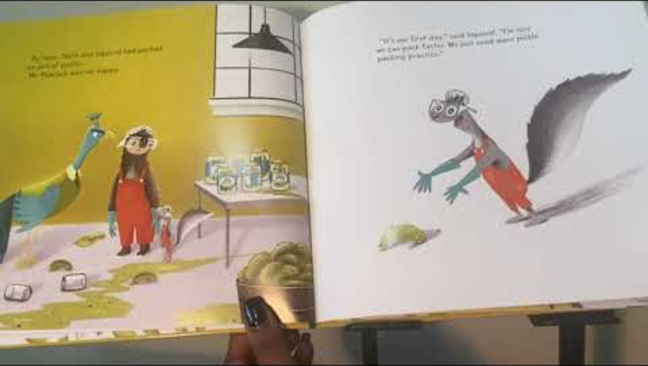
Embed Videos
[Insert URL] https://www.youtube.com/watch?v=lpwVwa8GaxI​

Slide 20
Contact Information
Name: Kathleen Brennan
Email Address: kmbrennan108@gmail.com
Social Handles X : @econkate
Instagram: @kmbrennan108

