Slide 1

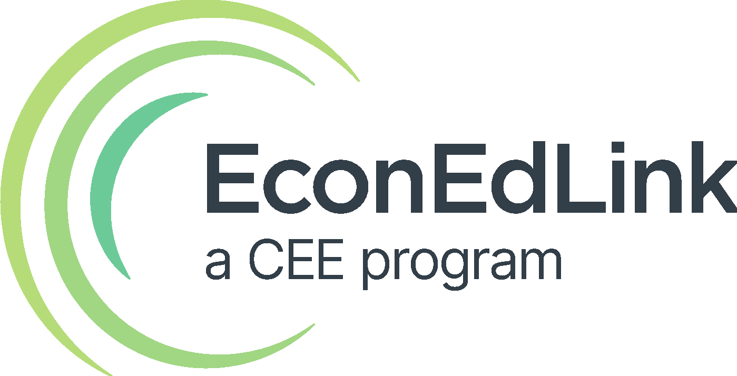
Creative Ways to Teach Investing

Slide 2
Certificate Requirements
To earn professional development hours for webinars, you must:
Watch a minimum of 75% for all sessions
You will automatically receive a professional development certificate via e-mail within 24 to 48 hours.

Slide 3
Objectives
You will be able to:
Analyze and apply interactive, classroom-tested strategies, including simulations and hands-on activities, to make key investing concepts like compounding, time, and consistent saving understandable and engaging for students
Design or adapt lesson components that incorporate tax-advantaged investment options, such as Roth IRAs, 401(k)s, 529 plans, and youth investment accounts, to help students build a practical roadmap toward long-term wealth and financial independence

Slide 4
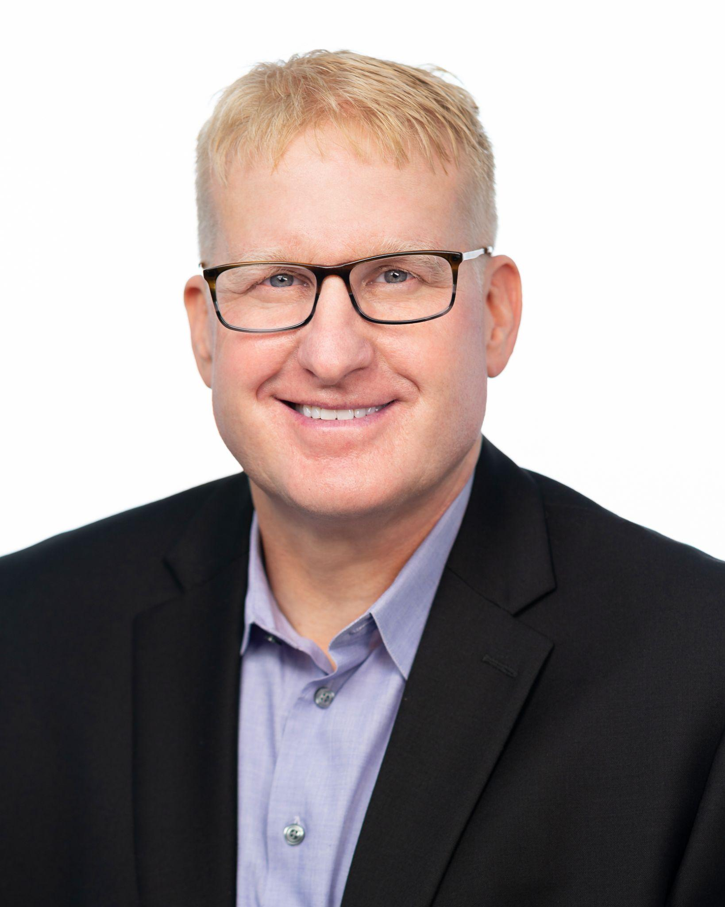
Presenter
James Redelsheimer
jred@fee.org
James Redelsheimer, Education Manager at the Foundation for Economic Education (FEE), has 20+ years of AP Economics and Personal Finance teaching experience at the High School level in Minnesota. He is the co-author of Barron’s AP Economics, and holds degrees from St. Olaf College and the University of St. Thomas. James has garnered numerous recognitions for his teaching, including the 3M Minnesota Economics Educator of the Year Award and the Thrivent Personal Finance Educator of the Year Award. James has published curriculum for numerous organizations and regularly shares his expertise on best practices in teaching economics, personal finance, and civil discourse at both local and national events. In his role at FEE, James creates award-winning curriculum for the 15,000 network of teachers at FEE’s Learning Center.

Slide 5

Session Agenda
Introduction to the Big Picture of Investing
Kahoot!
Key Investing Concepts
“Investing Talk” Discussion Questions
Lesson Ideas

Slide 6

National Standards
4. Investing
https://www.councilforeconed.org/policy-advocacy/k-12-standards/

Slide 7



TEACHERS.FEE.ORG

Slide 8

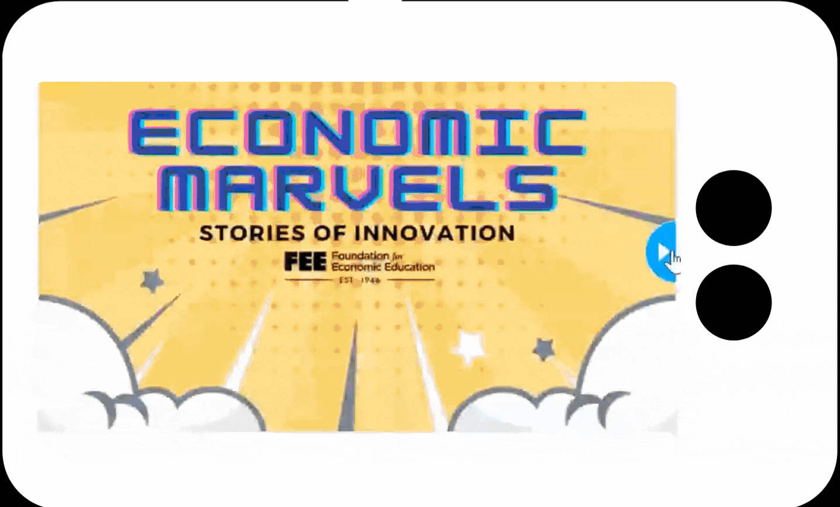

Unlock Student Engagement:
Slide Decks Reimagined with Nearpod

Slide 9


Slide 10

teachers.fee.org
FREE Resources, Webinars,
and On-Demand PD!
FREE Instructional Resources!

Slide 11
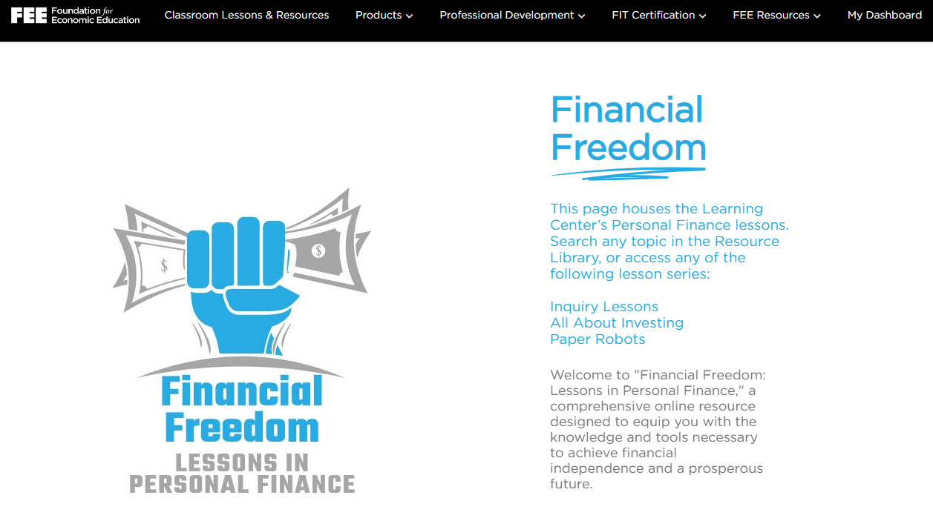

Slide 12



Do not edit
How to change the design
When you hear the word "investing," what's the first word that comes to mind?
Presenting with animations, GIFs or speaker notes? Enable our Chrome extension
Notes:
📣 This is Slido interaction slide, please don't delete it.
✅ Click on 'Present with Slido' and the poll will launch automatically when you get to this slide.

Slide 13

Do not edit
How to change the design
What is the biggest challenge you face when teaching investing?
Presenting with animations, GIFs or speaker notes? Enable our Chrome extension
Notes:
📣 This is Slido interaction slide, please don't delete it.
✅ Click on 'Present with Slido' and the poll will launch automatically when you get to this slide.

Slide 14
Do not edit
How to change the design
What investing topic would you most like to learn more about?
Presenting with animations, GIFs or speaker notes? Enable our Chrome extension
Notes:
📣 This is Slido interaction slide, please don't delete it.
✅ Click on 'Present with Slido' and the poll will launch automatically when you get to this slide.

Slide 15
Do not edit
How to change the design
How confident are you teaching investing?
Presenting with animations, GIFs or speaker notes? Enable our Chrome extension
Notes:
📣 This is Slido interaction slide, please don't delete it.
✅ Click on 'Present with Slido' and the poll will launch automatically when you get to this slide.

Slide 16

Notes:
https://create.kahoot.it/details/cee-investing-summer-institute/6f6b5a9a-a510-4f96-839e-2e7fca6c2203?drawer=

Slide 17

Three Ingredients to Build Wealth With Compound Interest
Mix these three together and let compounding interest do the cooking
Time
Savings
Interest
The earlier you start, the longer your money works for you
Your future wealth starts with what you save today
The growth your money earns when invested.

Slide 18
Would you rather?
Get a Million dollars today?
Get a penny that doubles every day for 30 days?

Slide 19
If you double a penny every day, how much $ will you have in 30 days?
Day 1: $.01
Day 2: $.02
Day 3: $.04
Day 4: $.08
Day 5: $.16
Day 6: $.32
Day 7: $.64
Day 8: $1.28
Day 9: $2.56
Day 10: $5.12
Day 11: $10.24
Day 12: $20.48
Day 13: $40.96
Day 14: $81.92
Day 15: $163.84
Day 16: $327.68
Day 17: $655.36
Day 18: $1,310.72
Day 19: $2,621.44
Day 20: $5,242.88
Day 21: $10,485.76
Day 22: $20,971.52
Day 23: $41,943.04
Day 24: $83,886.08
Day 25: $167,772.16
Day 26: $335,544.32
Day 27: $671,088.64
Day 28: $1,342,177.28
Day 29: $2,684,354.56
Day 30: $5,368,709.12!!!

Slide 20
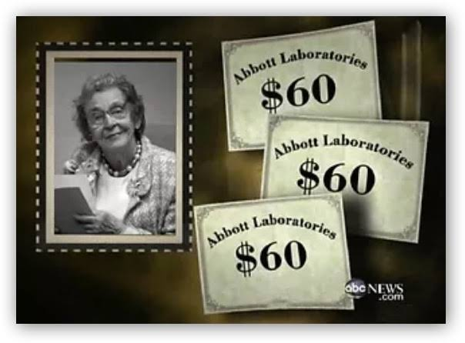

Meet Grace Groner
The secret millionaire who never tried to beat the market
In 1935, at age 26, Grace, who was an orphaned secretary bought three shares of Abbott Labs stock for $180.
She reinvested every dividend and never sold a single share. She lived past 100, dying in 2010.
$180
invested in 1935
compounded return across 75 years
Notes:
Grace Groner: born 1909, died 2010 past age 100. Bought 3 shares of Abbott Labs for $180 in 1935, age 26, during the Depression. Reinvested dividends, never sold. $180 grew to $7.2M, about 15% a year for 75 years. Friends thought she was poor; she left millions to her college.

Slide 21
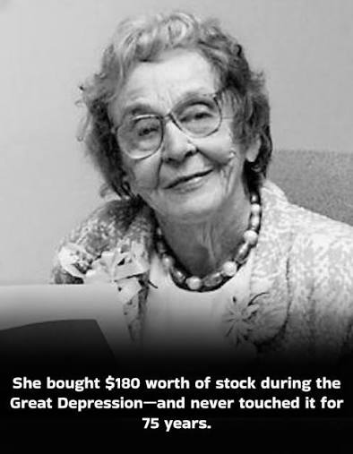


Meet Grace Groner
The secret millionaire who never tried to beat the market
$180
invested in 1935
She lived a modest life. The shock came after she died: millions left to her alma mater, Lake Forest College.
$7.2M
value by the time she died in 2010
~15% / yr
compounded return across 75 years
Notes:
Grace Groner: born 1909, died 2010 past age 100. Bought 3 shares of Abbott Labs for $180 in 1935, age 26, during the Depression. Reinvested dividends, never sold. $180 grew to $7.2M, about 15% a year for 75 years. Friends thought she was poor; she left millions to her college.

Slide 22

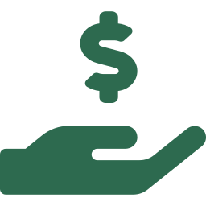

Her secret was not brilliance. It was habits.
No research, no trading, no clever calls. Just four behaviors any student can copy.
Start young
Reinvest the dividends
She began at 26. Decades of compounding did the heavy lifting.
Every payout bought more shares, so the growth grew on itself.
Set it and forget it
Stay the course
She bought once and left it alone. No trading, no tinkering.
Through every crash she held on, so she got paid for the risk.

Slide 23

What comes to mind first when you hear the word "investing"? Excitement, anxiety, confusion, and why?
Student Guided Notes
Notes:
Guided Notes

Slide 24
Saving Early is a Million Dollar Decision!
Student Guided Notes
Notes:
Guided Notes

Slide 25
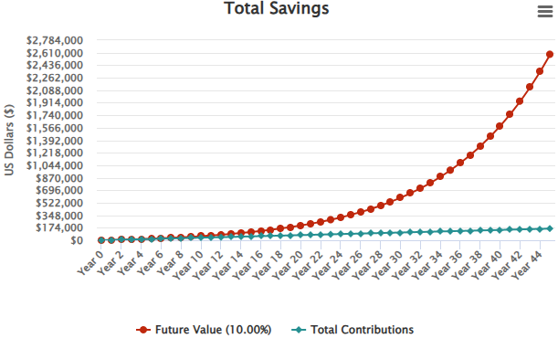
The Secret Sauce: The Exponential Growth of Compounding Interest:
Earning interest on your interest, where your money makes more money, and that money makes more money…and so on!
$300 a month for 45 years, earning 10%
Notes:
Compounding Interest Calculator

Slide 26

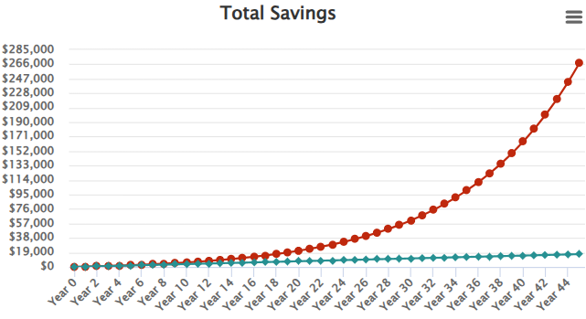
Time: It’s Your Money’s Superpower
If someone saves a dollar a day for 45 years, how much money will they have at age 65? (10% annual return)
Notes:
Compounding Interest Calculator

Slide 27

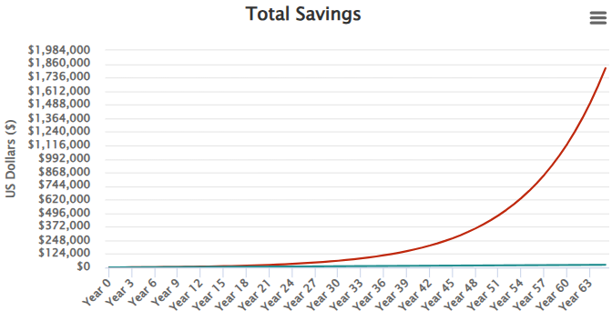
Time: It’s Your Money’s Superpower
If someone saves a dollar a day for 65 years, how much money will they have at age 65? (10% annual return)
Notes:
Compounding Interest Calculator

Slide 28
Time: It’s Your Money’s Superpower
Starting 20 years earlier resulted in $1,555,027 more money!
$1 a day for 65 years | $1,820459
$1 a day for 45 years | $267,432
Difference | $1,555,027
Notes:
Compounding Interest Calculator

Slide 29
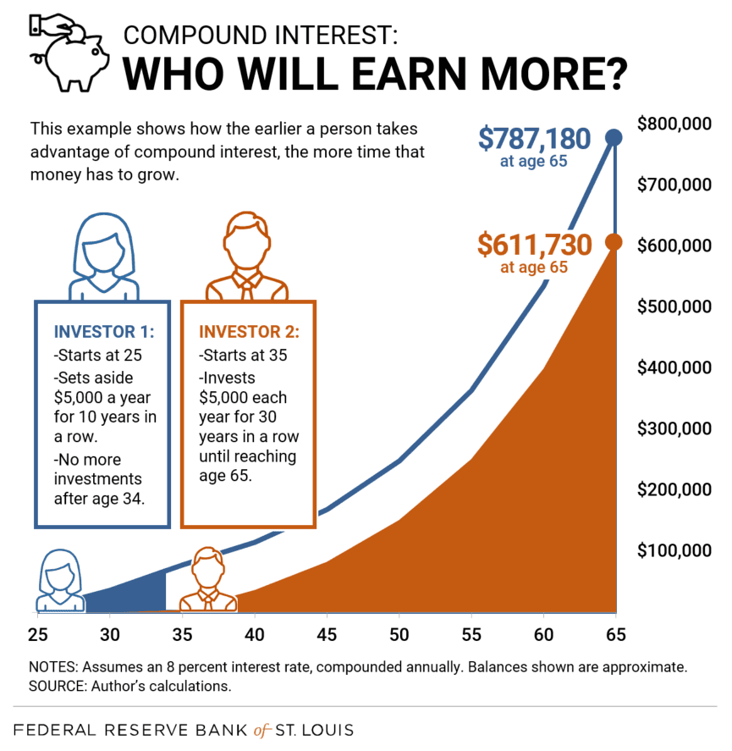
Time: It’s Your Money’s Superpower
Notes:
Compounding Interest Calculator

Slide 30
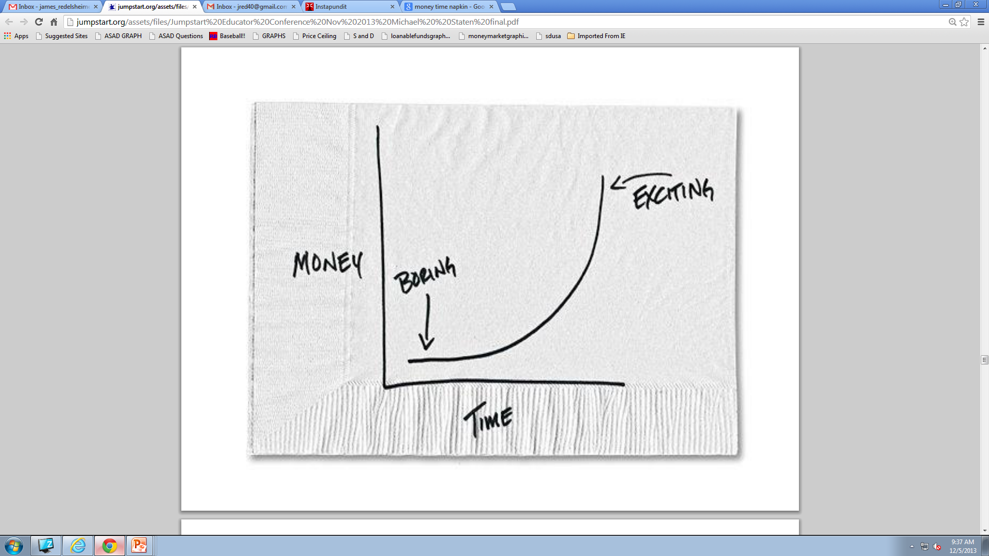
Time: It’s Your Money’s Superpower

Slide 31
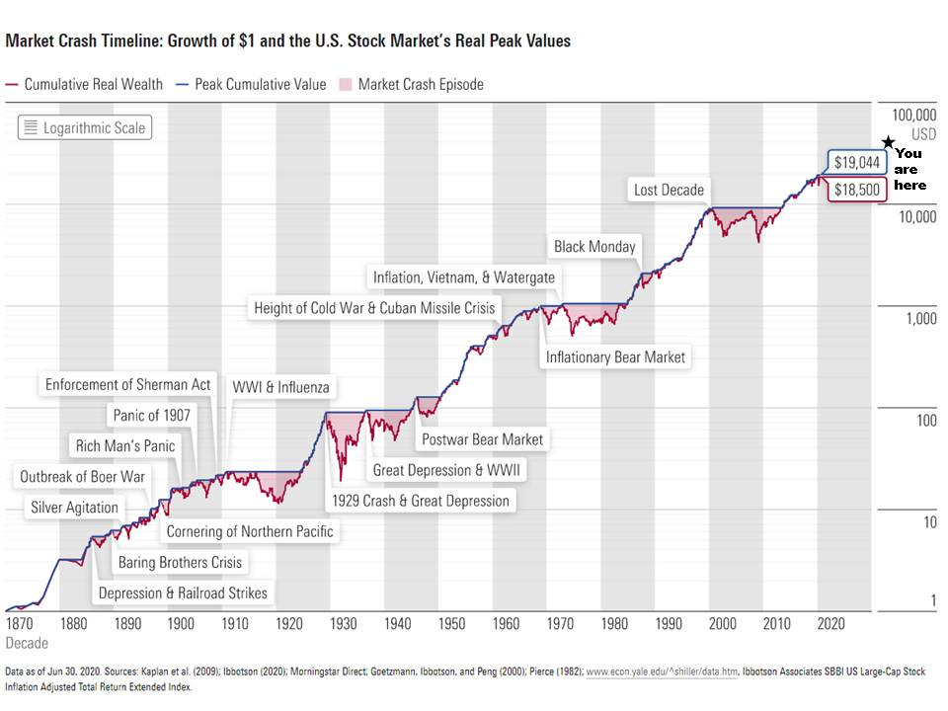

Slide 32
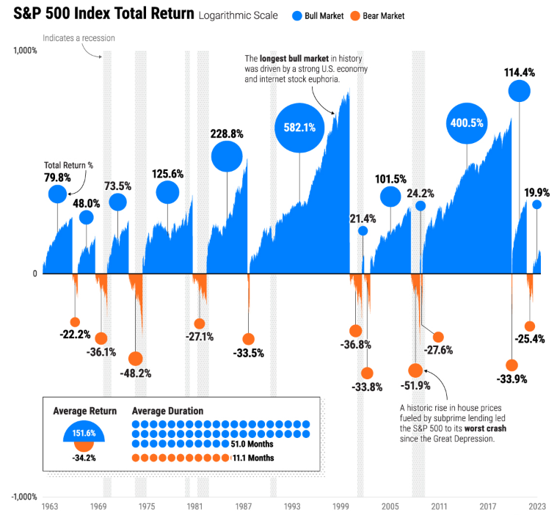

Slide 33
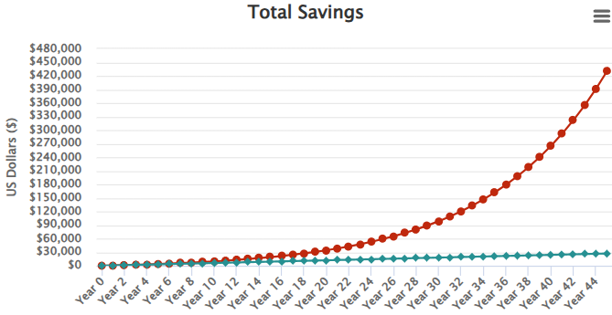
2. Savings: Fuel for Your Financial Future
If someone saves $50 a month from age 20 to 65, how much money will they have at age 65? (10% annual return)
Notes:
https://www.investor.gov/financial-tools-calculators/calculators/compound-interest-calculator

Slide 34

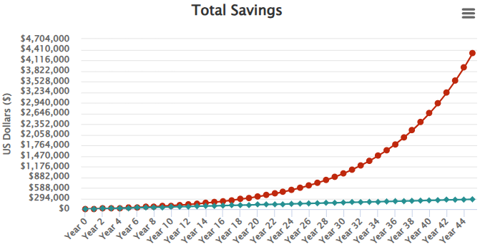
2. Savings: Fuel for Your Financial Future
If someone saves a $500 a month from age 20 to 65, how much money will they have at age 65? (10% annual return)
Notes:
https://www.investor.gov/financial-tools-calculators/calculators/compound-interest-calculator

Slide 35
2. Savings: Fuel for Your Financial Future
Saving $500 vs.$50 a month for 45 years = $3,882,087 more money!
$500 a month for 45 years | $4,313,429
$50 a month for 45 years | $431,342
Difference | $3,882,087
Notes:
https://personalfinanceclub.com/dont-wait-to-start-investing/

Slide 36
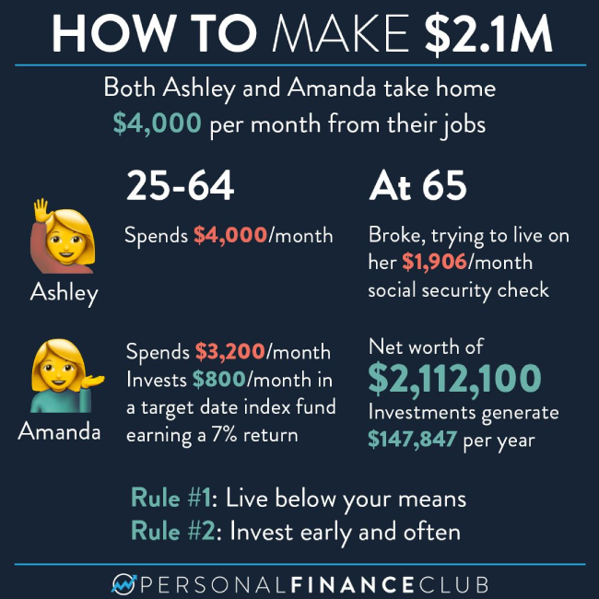
2. Savings: Fuel for Your Financial Future
You can’t earn compound interest with zero savings
Notes:
https://personalfinanceclub.com/whats-the-secret-to-getting-rich-2/

Slide 37
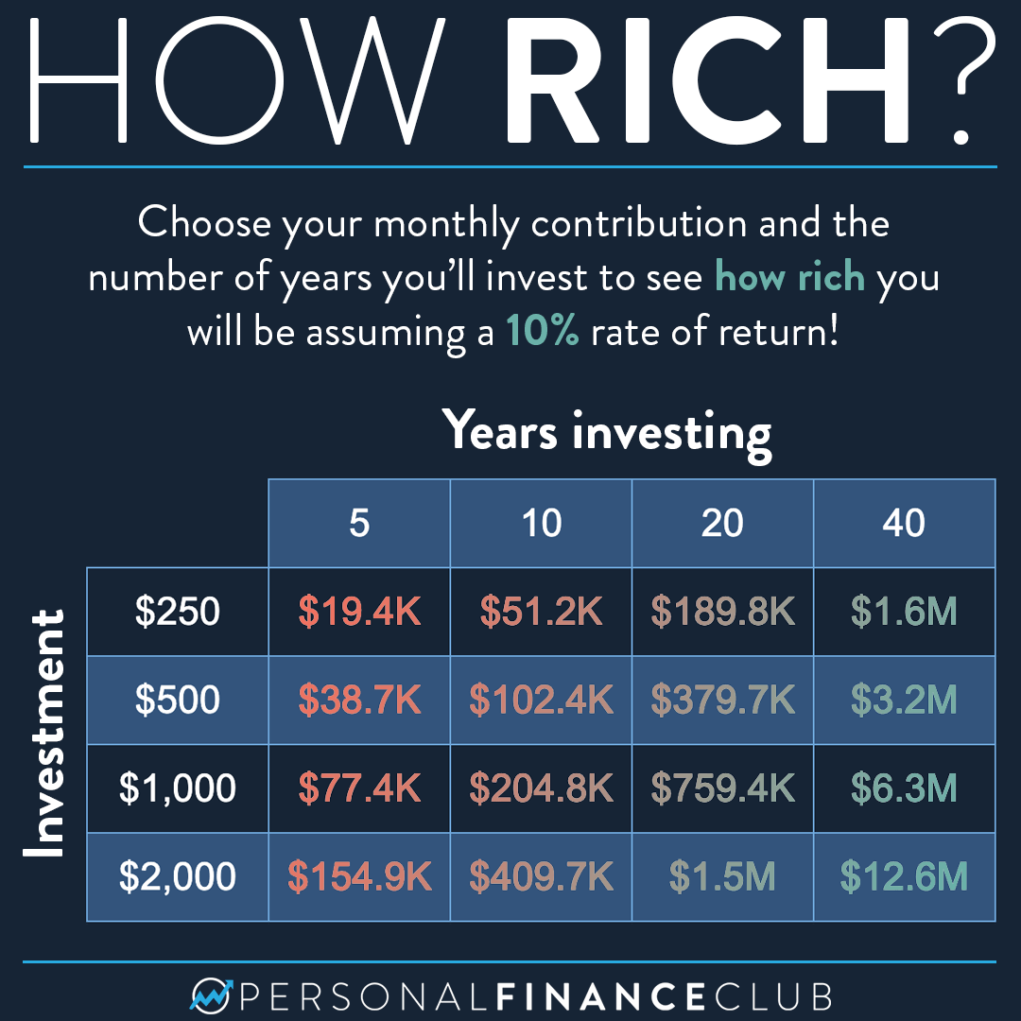
2. Savings: Fuel for Your Financial Future
Notes:
https://personalfinanceclub.com/heres-a-table-to-determine-how-rich-you-will-be/

Slide 38

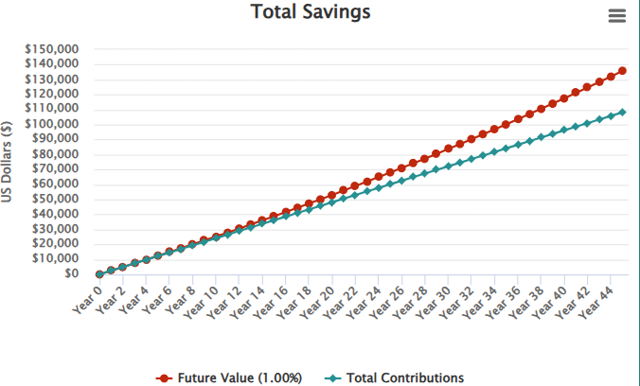
3. Interest: Your Rate of Return Matters
If someone saves a $200 a month from age 20 to 65, with a 1% return, how much money will they have at age 65?
Notes:
https://www.investor.gov/financial-tools-calculators/calculators/compound-interest-calculator

Slide 39

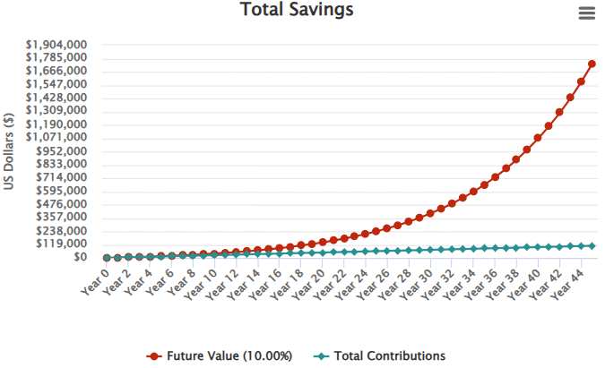
3. Interest: Your Rate of Return Matters
If someone saves a $200 a month from age 20 to 65, with a 10% return, how much money will they have at age 65?
Notes:
https://www.investor.gov/financial-tools-calculators/calculators/compound-interest-calculator

Slide 40
3. Interest: Your Rate of Return Matters
Earning 10% vs 1% for 45 years = $1,604,081 more money!
$200 a month for 45 years @ 1% | $135,868
$200 a month for 45 years @ 10% | $1,739,949
Difference | $1,604,081
Notes:
https://personalfinanceclub.com/dont-wait-to-start-investing/

Slide 41
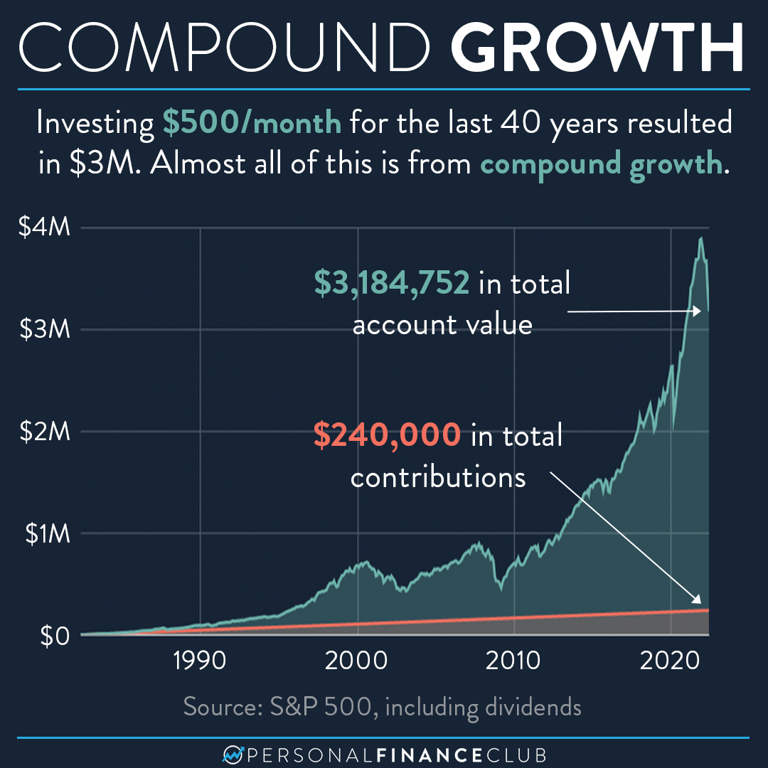
3. Interest: Your Rate of Return Matters
Notes:
https://www.instagram.com/p/DMJOCljP5Rt/

Slide 42
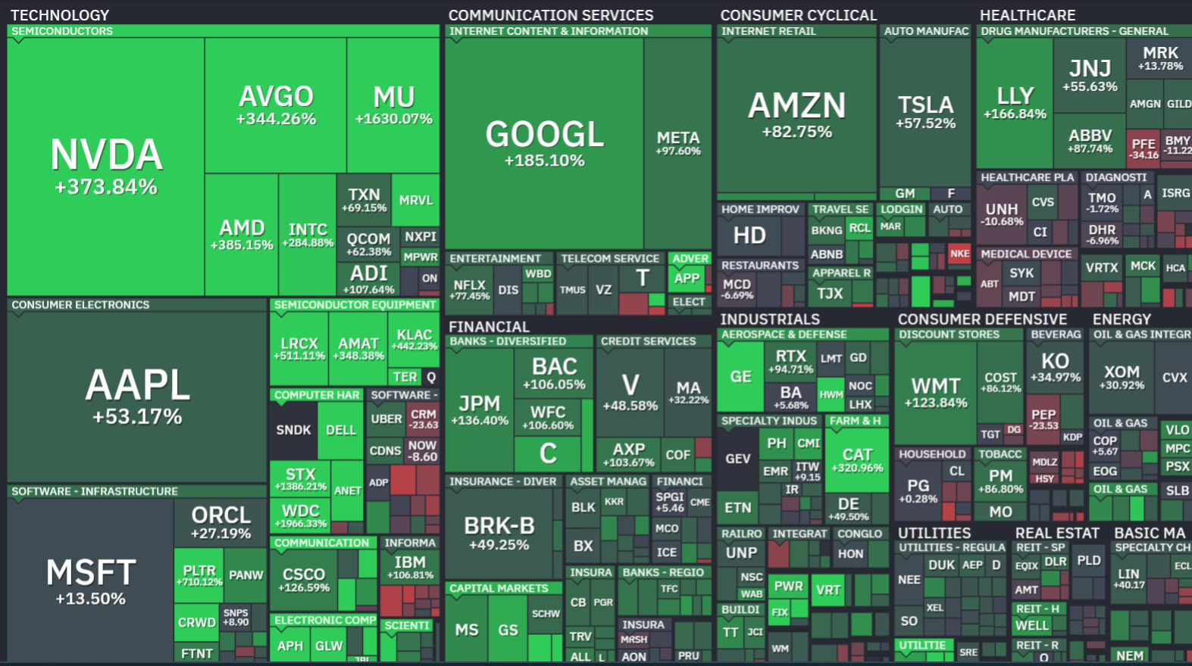
The Stock Market in One Chart
Step 1: Go To FinViz.com
Step 2: Click on maps at top of page
Notes:
https://finviz.com/map.ashx
Let’s jump right into it...this is the stock market in one chart. I want to give you the next five minutes to work with a partner to review this resource. Let’s first each pull up this chart by going to finviz.com and clicking on the chart. Take a minute to do that now.

Slide 43
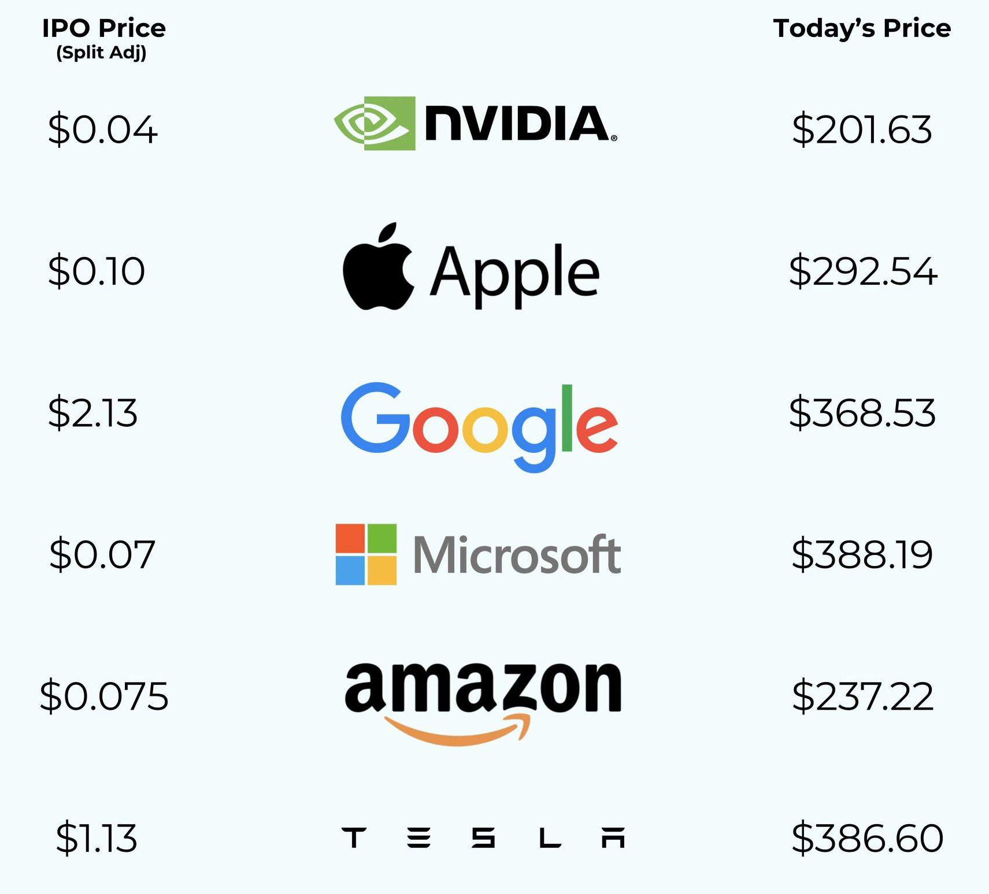
With an S&P 500 Index Fund, You Own The Biggest & Best!
Notes:
https://www.instagram.com/p/DMJOCljP5Rt/

Slide 44
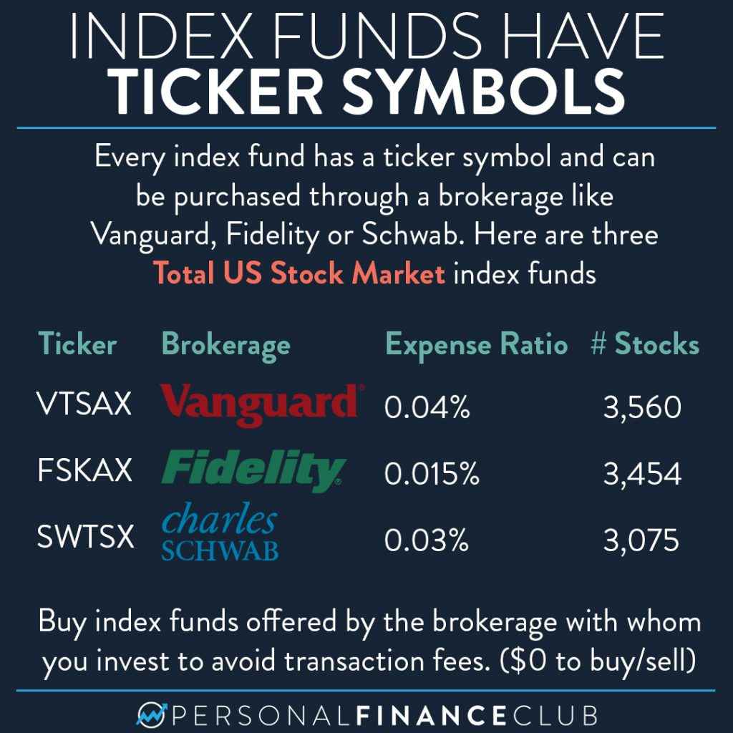

Slide 45
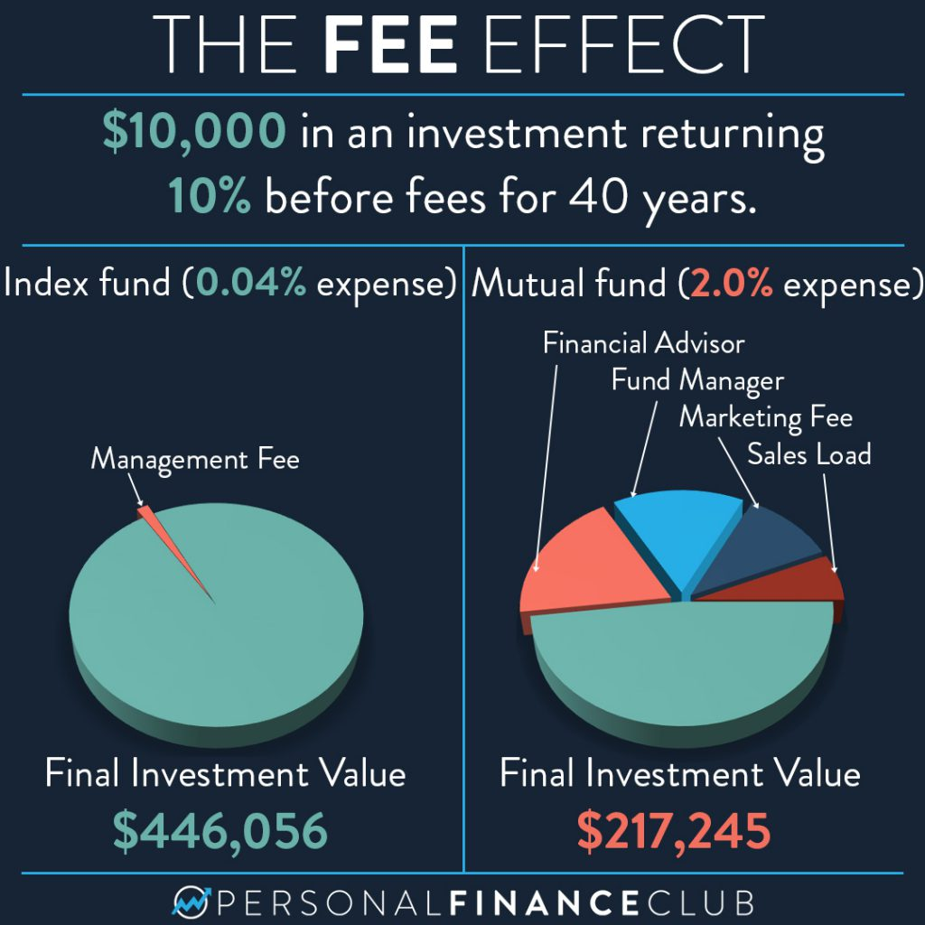

Slide 46
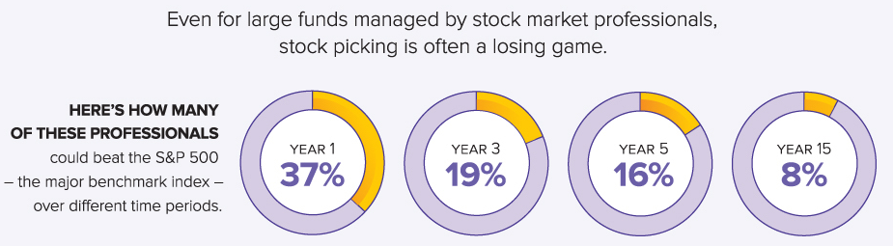
Can most pro investors beat the S&P 500? NO!

Slide 47

Only 8% of investment pros “beat the market” over a 20 year period!!
2024
Click here for more info on this topic (p.10)
Notes:
https://www.spglobal.com/spdji/en/documents/spiva/spiva-us-year-end-2024.pdf

Slide 48
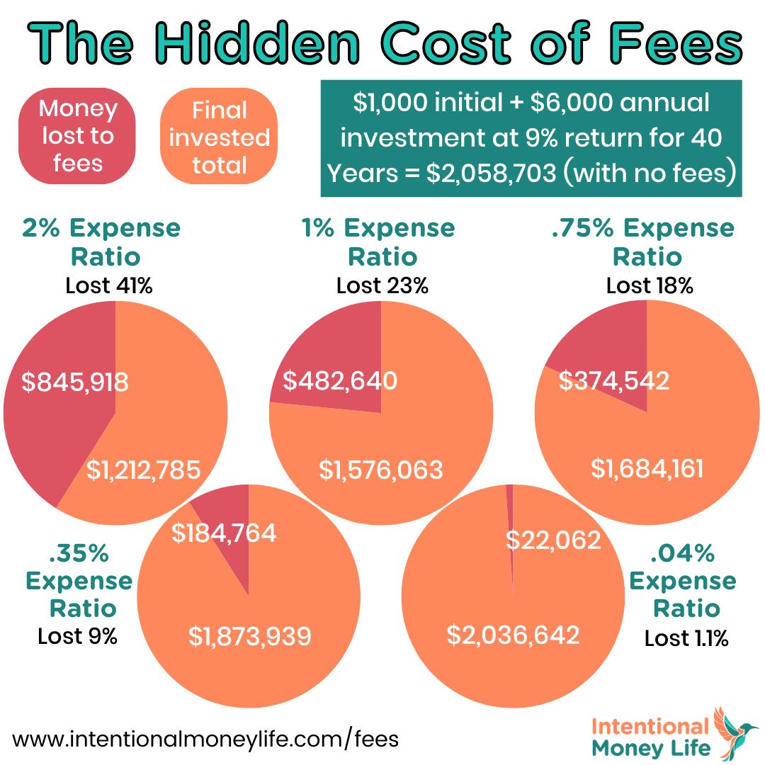

Slide 49
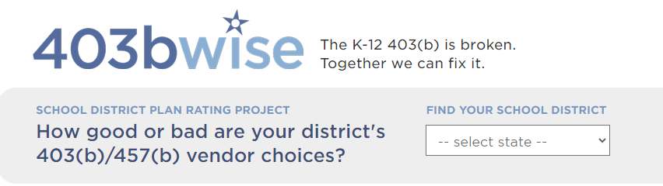

Notes:
https://403bwise.org/

Slide 50
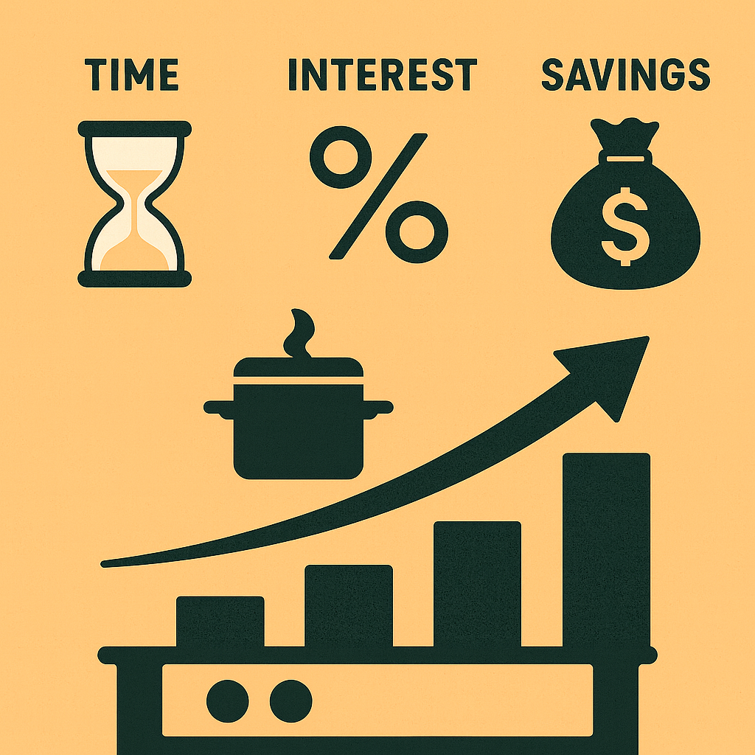

In Conclusion
Time × Savings × Interest = Wealth by Compound Interest!
Leave one ingredient out and the recipe fails!

Slide 51

Investing Breakout Room Discussion Questions
01
What real-world examples, stories, or analogies have been most effective in helping students understand compounding, time, and long-term investing?
02
Many students believe investing is only for wealthy people. How can we help students see that investing is accessible to almost everyone, even if they start with very small amounts?
03
What investing misconceptions do you hear most often from students?
04
Looking at everything we've discussed today, what is one investing activity, simulation, or discussion you'll use in your classroom this year, and why do you think it will resonate with students?

Slide 52
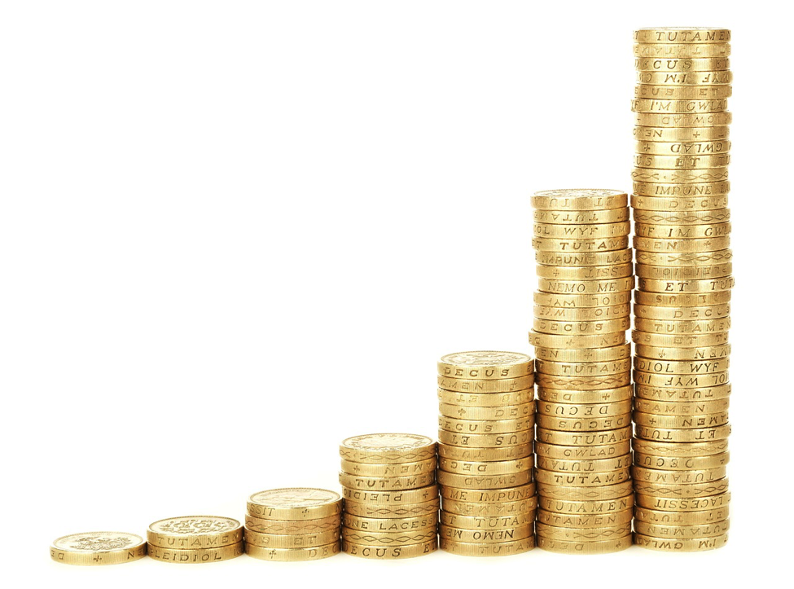

Compounding Magic: Unlocking the Exponential Power of Compounding Interest!
Notes:
Here is the link for the teacher instructions

Slide 53
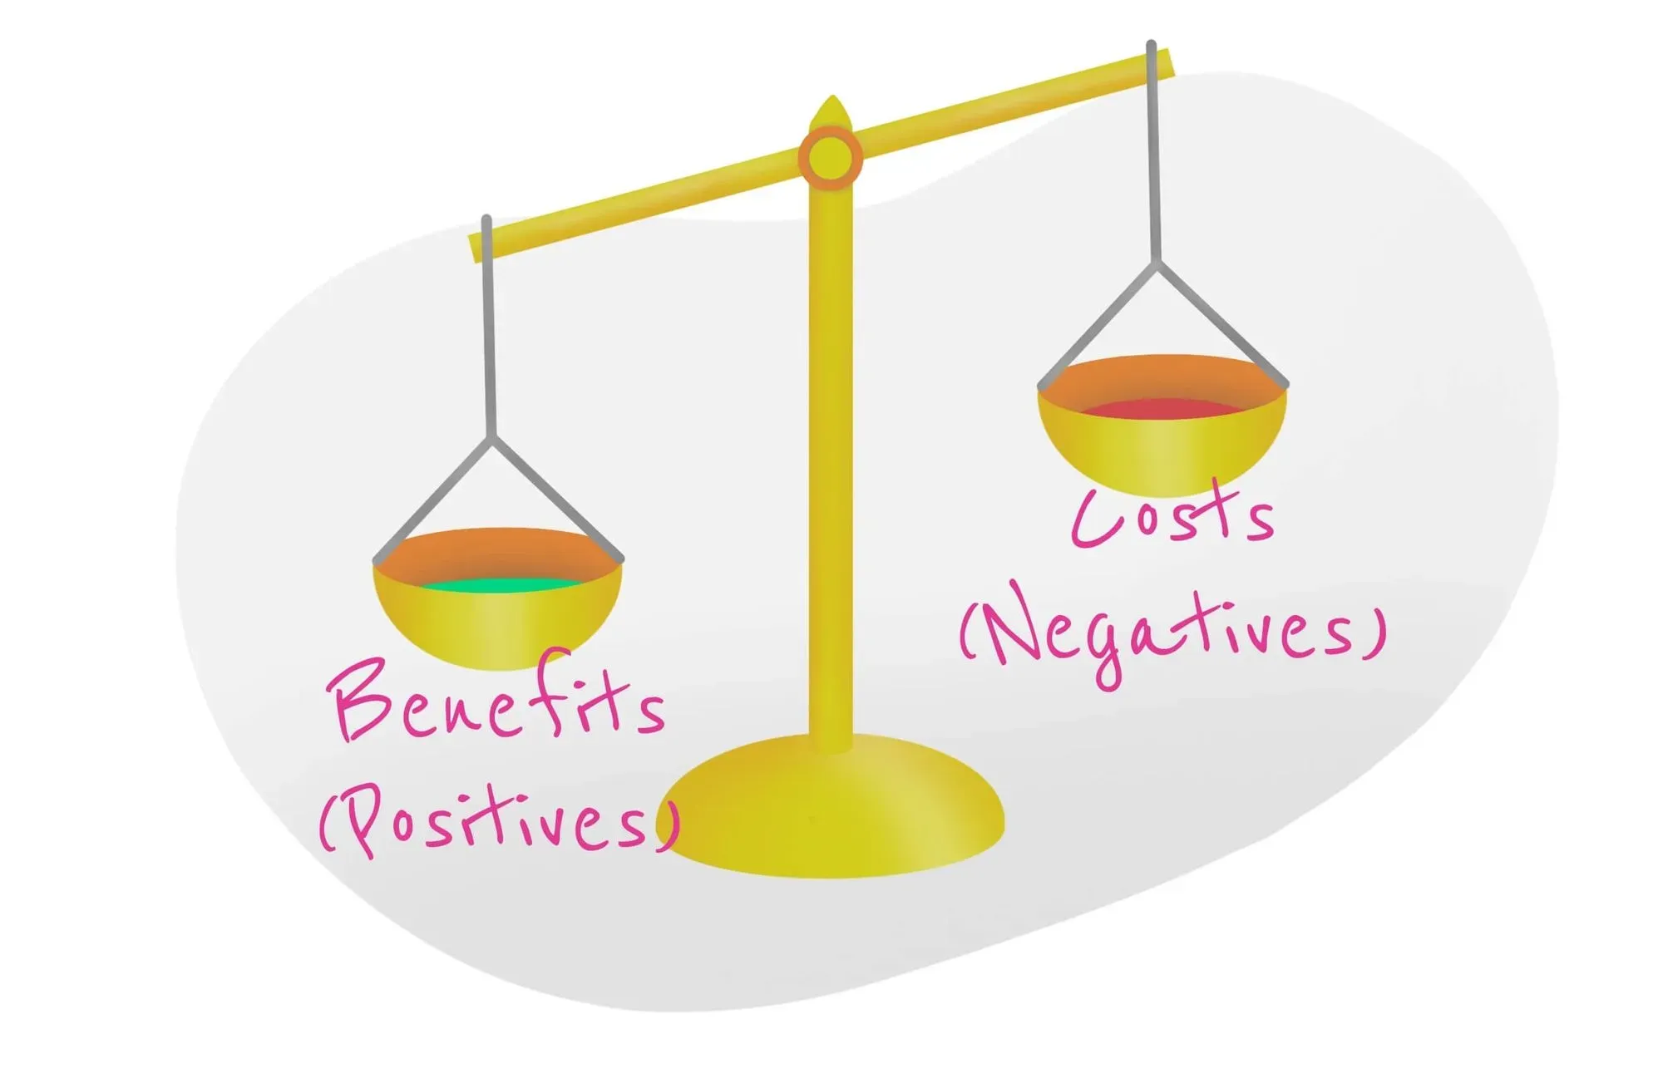
People prefer benefits now,
rather than later
People prefer costs later, rather than now.

Slide 54
This is one reason saving is difficult.
But there’s a big reward for saving…
Notes:
Here is the link for the teacher instructions

Slide 55
This is one reason saving is difficult.
But there’s a big reward for saving…
Notes:
Here is the link for the teacher instructions

Slide 56
INTEREST!
Save $4000 a year between age 16 and 20, a 10% return, and have $1,000,000 by age 65.
Notes:
Here is the link for the teacher instructions

Slide 57
Addition vs. Compounding
8+8+8+8+8+8+8+8 =
64
Notes:
Here is the link for the teacher instructions

Slide 58
Addition vs. Compounding
8x8x8x8x8x8x8x8 =
$16,777,216
Notes:
Here is the link for the teacher instructions

Slide 59

With compounding interest, the choice is not between one car now and one car later.
Notes:
Here is the link for the teacher instructions

Slide 60

If you saved the money as opposed to buying a car today, and invested and earned 8% a year…you could have…
two cars in 9 years.
Notes:
Here is the link for the teacher instructions

Slide 61


A car today or in 18 years…
Notes:
Here is the link for the teacher instructions

Slide 62




A car today or in 27 years…
Notes:
Here is the link for the teacher instructions

Slide 63

Or a house… or a down payment
Notes:
Here is the link for the teacher instructions

Slide 64
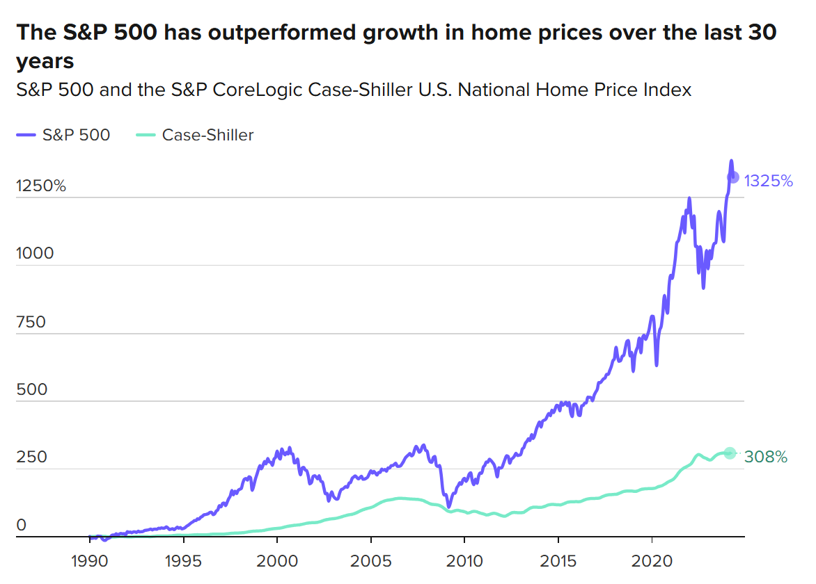
Notes:
Here is the link for the teacher instructions

Slide 65
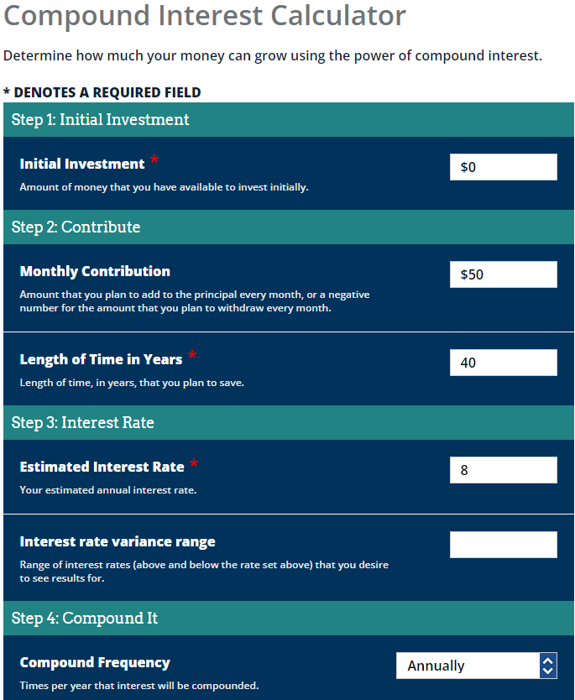

Leave as $0
Round answers to the nearest dollar.
Leave blank
Annually
Notes:
Tell students to fill in “initial investment” as $0, Leave “interest rate variance range” blank, and use annual compound frequency.

Slide 66
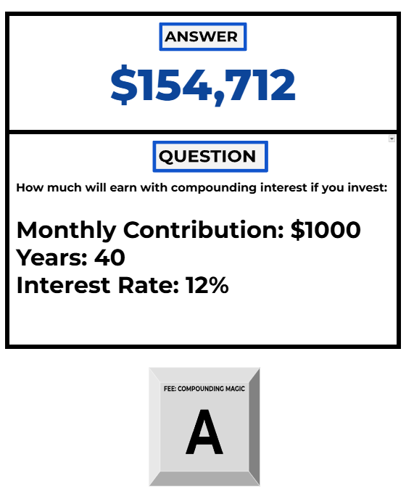
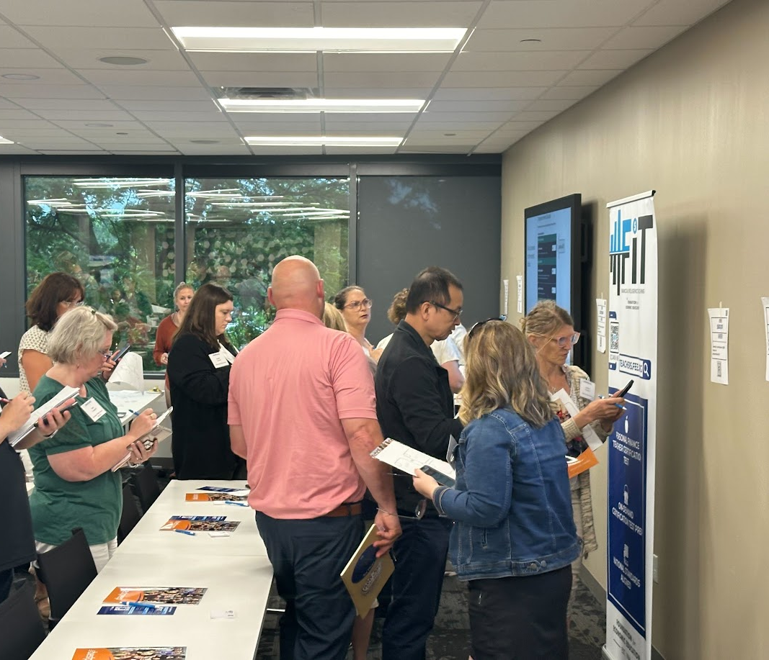

Slide 67
What did you notice in the numbers?
$1000 @ 12% for 40 years?
$9,205,097
What three factors determines your investment returns?
$586,636
$1000 @ 1% for 40 years?
$200 @ 10% for 40 years?
$1,062,222
$100 @ 10% for 40 years?
$531,111
Savings rate
Interest
Time
$500 @ 8% for 40 years?
$1,554,339
$500 @ 8% for 15 years?
$162,913
$200 @ 10% for 50 years?
$2,793,380
$200 @ 1% for 50 years?
$154,712

Slide 68

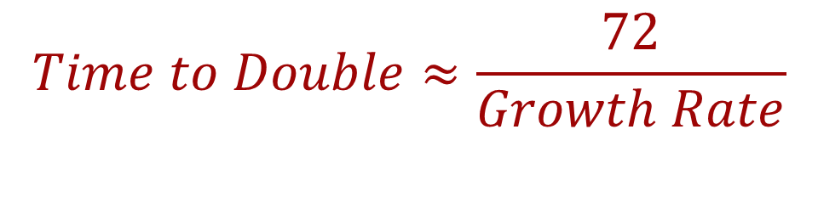
Rule of 72
How long it takes for a value to double in size.

Slide 69
Types of Tax-Advantaged Savings Accounts

Slide 70

Notes:
https://personalfinanceclub.com/i-opened-a-trump-account-heres-how-to-do-it-and-eight-things-you-should-know/

Slide 71
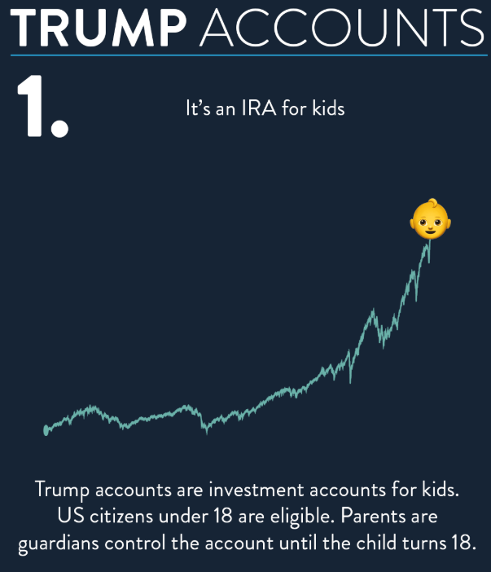

Slide 72
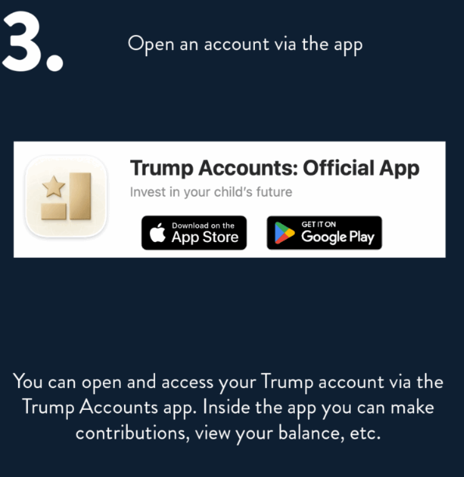

Slide 73
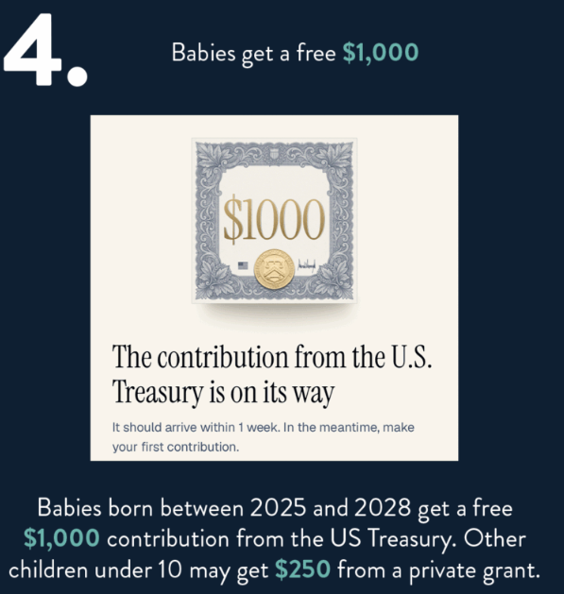

Slide 74
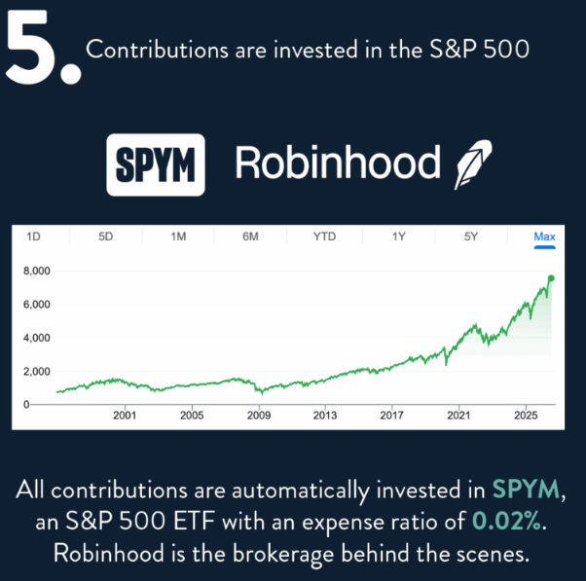

Slide 75
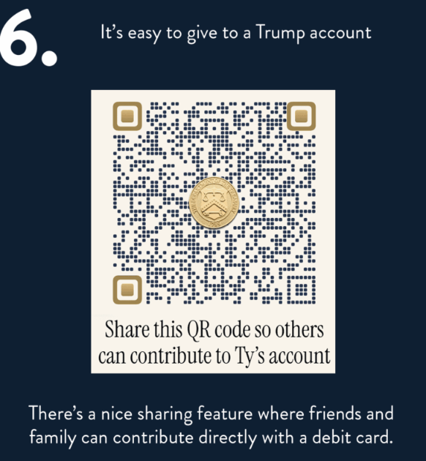

Slide 76
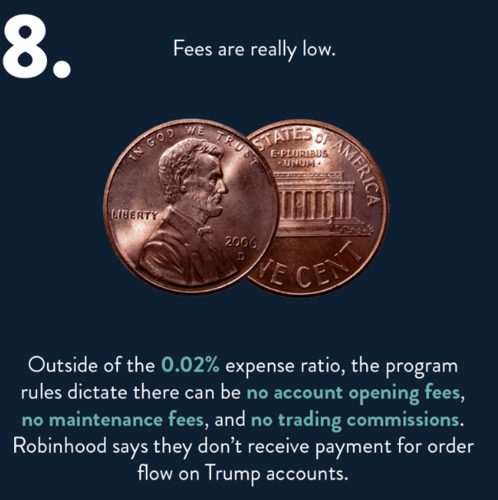

Slide 77

Video: Trump Accounts
Notes:
https://www.youtube.com/watch?v=GdF42p-x7SE

Slide 78
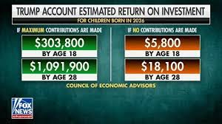
How might Trump Accounts potentially impact the wealth gap?
Notes:
After students have a chance to respond to the prompted question, teacher can say: “We’re going to learn what these accounts actually do, and compare them to options that build wealth through real saving and investment incentives.”

Slide 79
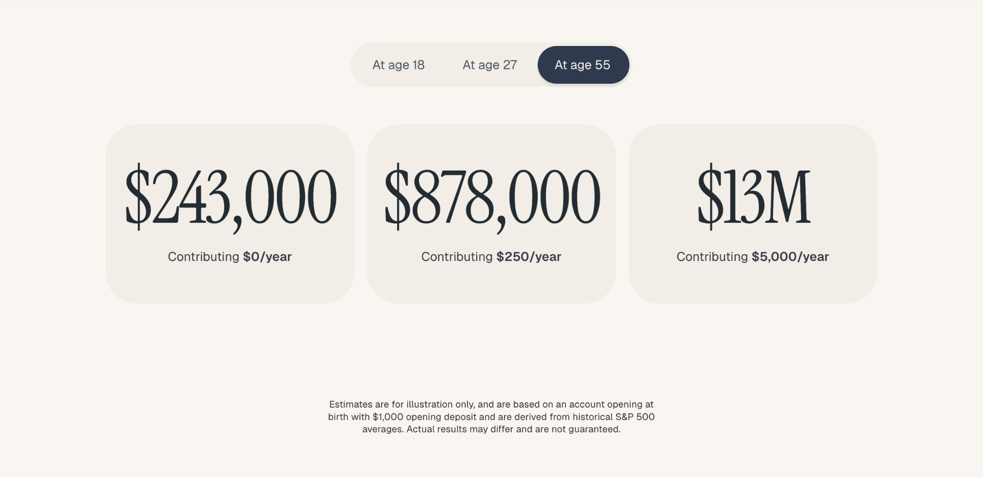
Notes:
After students have a chance to respond to the prompted question, teacher can say: “We’re going to learn what these accounts actually do, and compare them to options that build wealth through real saving and investment incentives.”

Slide 80
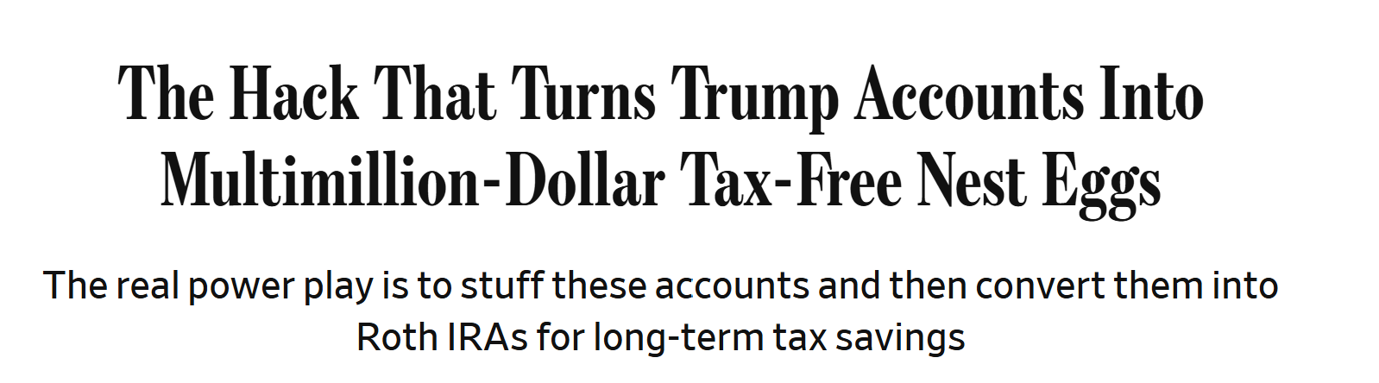
Trump Account → Roth IRA!
Notes:
https://www.wsj.com/personal-finance/the-hack-that-turns-trump-accounts-into-multimillion-dollar-tax-free-nest-eggs-53d303c3?gaa_at=eafs&gaa_n=AWEtsqeyrb_t5fFiKCsehMq27EYuHKxkmLcWxAN9S7PXwO7FE9TgnSpU1YZGFgS1hz8%3D&gaa_ts=69c343a4&gaa_sig=E2qhCoawDuIo-AIk358UejbCmvzdlhbvhwny_Y_9Cn7YKFG8yNU-0_9Ly7v8V0joogbxPg6XAMl72glGZj74tQ%3D%3D

Slide 81
Trump Accounts
$1,000 government-funded account at birth to jump-start investing (born in 2025-28) or $250 from Michael Dell (age 10 and under)
Funds typically locked until adulthood to maximize compounding
Parents and guardians can contribute up to an annual limit ($5,000/year)
Decades of compounding can turn small early contributions into significant wealth
Can convert to a Roth IRA in early adulthood (age 24 ideal)

Slide 82
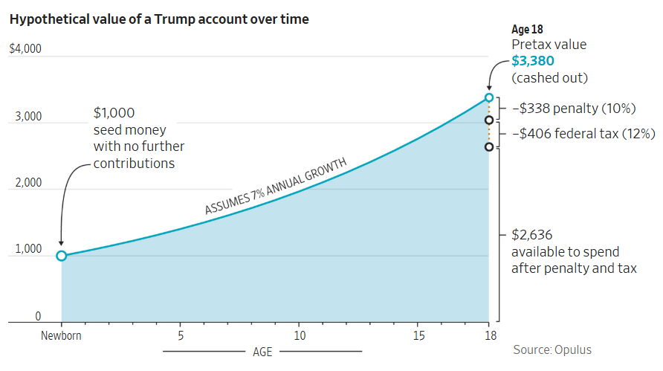

Slide 83
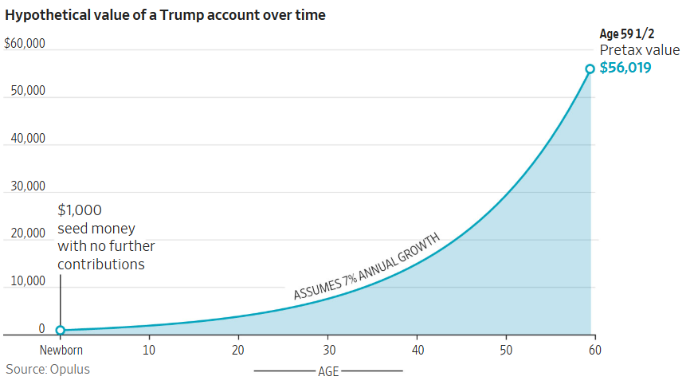

Slide 84
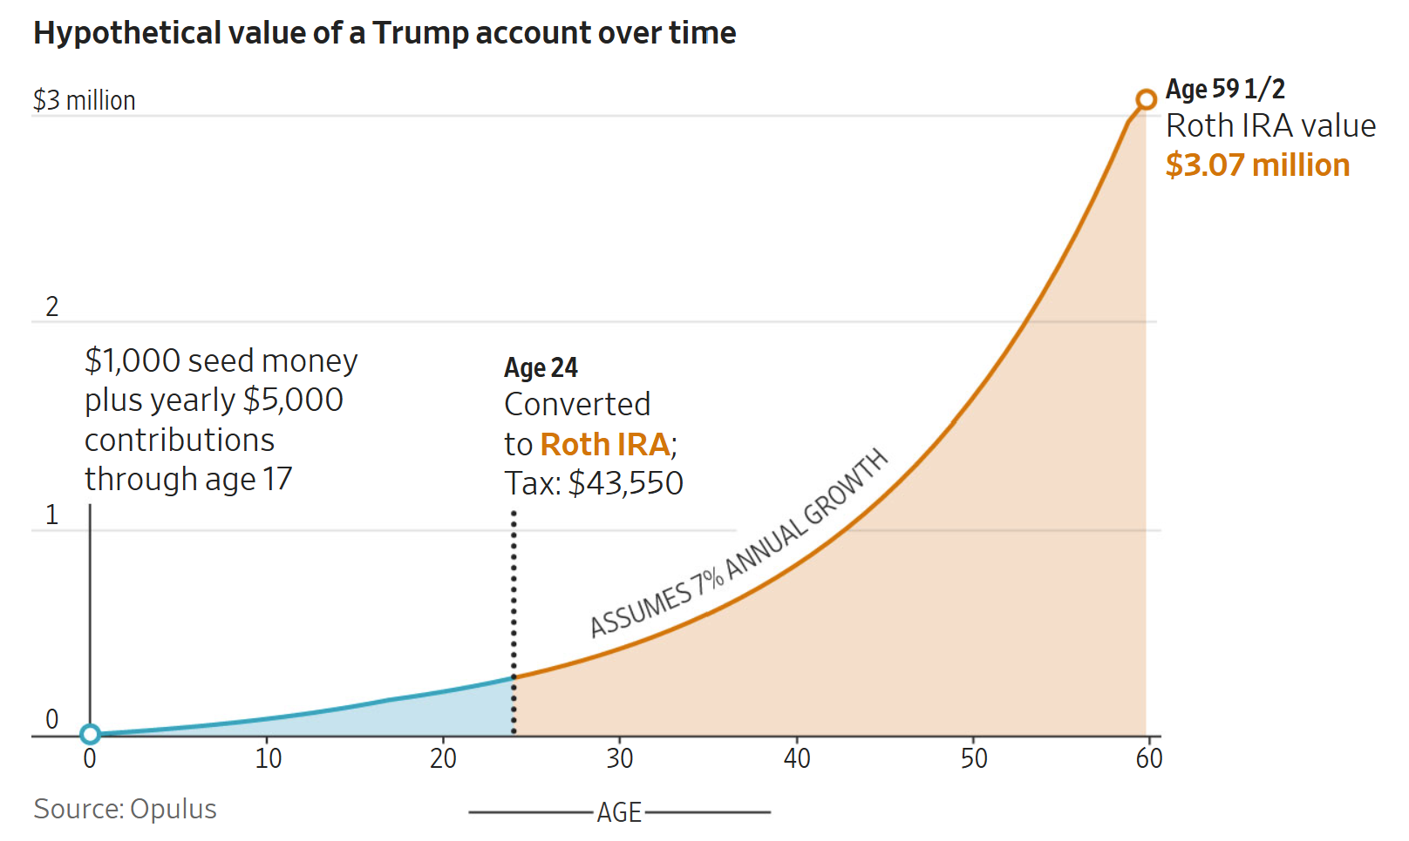

Slide 85
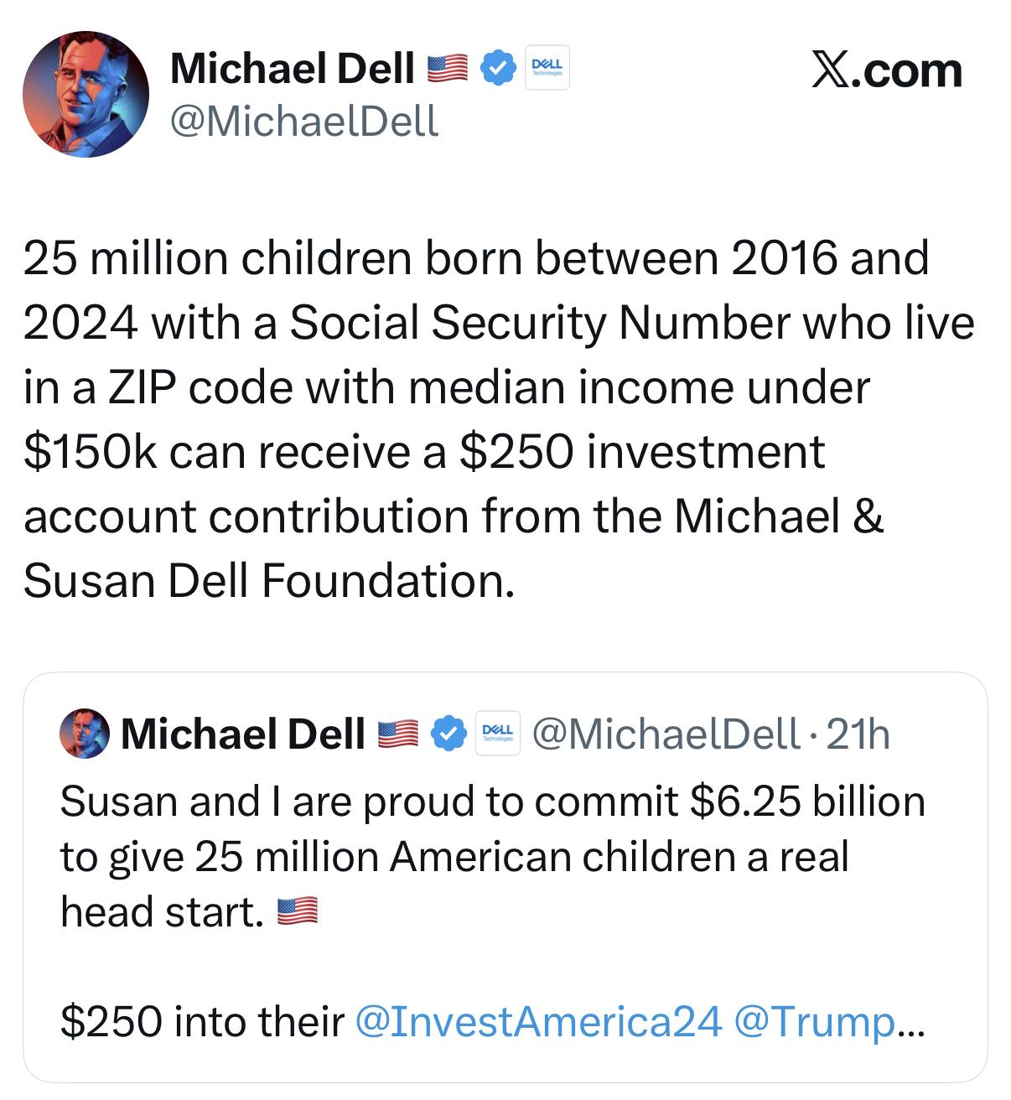

Slide 86
ROTH IRA
Put in your money after taxes. NO taxes when you take out your $!
Take out earnings tax free for education and your first house.
Can take out your principal at any time without a penalty.
Must have income (ex. $2000 wages = $2000 max contribution that year)
Can put in a max of $7500 (in 2026) a year

Slide 87
529 College Savings Plan
Tax-free growth and withdrawals when used for qualified education expenses
High contribution limits, often $300,000+ depending on the state
Can be used for college, K–12 tuition, and some apprenticeship programs
Account owner keeps control, can change beneficiaries if needed
Unused funds can roll into a Roth IRA after 15 years.

Slide 88
401K/403B
Money in pre-tax
May get a company match
Maximum of $24,500 per year (2026)
Taxes paid when you take out your money

Slide 89
Traditional IRA
Money in pre-tax
Separate from employment, but need income
Maximum of $7,500 per year (2025)
Taxes paid when you take out your money
Early withdrawals for 1st house or education but owe income tax

Slide 90
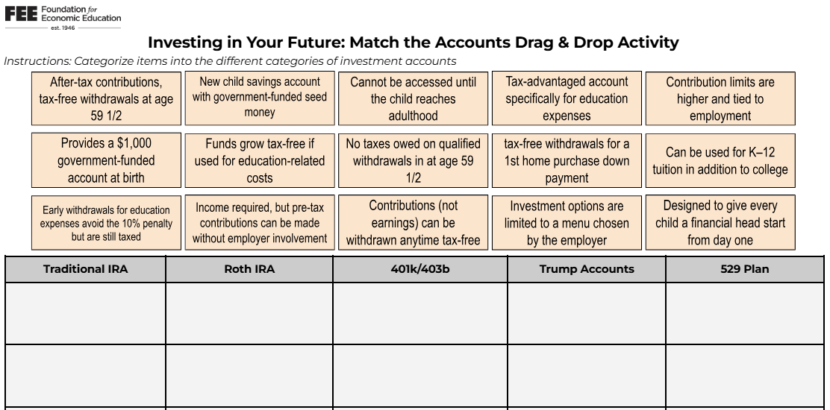
Educators: Click here or below for the
Investing in Your Future: Match the Accounts Drag & Drop Activity
tinyurl.com/Invest-FEE
Notes:
https://docs.google.com/document/d/11JqNZ6tMvPAmAFW_E0Nb8kF5VK0P3Pk3UOZ1jITfdoo/edit?usp=sharing

Slide 91
Lesson Exploration & Discussion
01 Investing in Your Future: Match the Accounts
02 Compounding Magic: Unlocking Exponential Power
03 Saving Early is a Million Dollar Decision!
04 Inquiry Lesson: Will I Have to Work Until I'm 70?
05 The Benefits of Investing Early
01
What is one activity, discussion, or strategy from these lessons that you could implement this school year?
02
Which part of the lesson do you think students would find the most engaging?
03
What modifications, if any, would you make to better fit your students or classroom?

Slide 92

nbea.org/FIT
Notes:
nbea.org/FIT

Slide 93
Contact Us
James Redelsheimer
jred@fee.org

Slide 94
Thank you!

