Slide 1




Courtside Capital:
Economics of the WNBA

Slide 2
Certificate Requirements
To earn professional development hours for webinars, you must:
Watch a minimum of 75% for all sessions
You will automatically receive a professional development certificate via e-mail within 24 to 48 hours.

Slide 3
Objectives
Teachers will be able to:
relate economic concepts to WNBA/women’s professional basketball
engage with social media/news content to help students use economic analysis to understand how to make sense of the news/social media they are seeing
Notes:
NOTE: The two WNBA lessons highlighted today are currently being finalized for publication through Federal Reserve Education. In the meantime, the examples, assessments, and EconEdLink materials shown today can be adapted immediately for classroom use.

Slide 4

Presenter
Lynn MacDonald, Ph.D.
Economics Professor
Co-Director, St. Cloud State University Center for Economic Education
lcmacdonald@stcloudstate.edu
Linkedin.com/in/lynn-macdonald-b65a85404

Slide 5
The SCSU Center for Economic Education (SCSU CEE) strives to develop a well-informed and economically literate citizenry in Central Minnesota. The Center provides timely and relevant economic content and curriculum to students, K-12 educators, and the broader community.

Slide 6
Session Agenda
WNBA as an Economics Case Study
Markets Lesson Highlights
Labor Lesson Highlights
Sponsorships, Media Rights, and Advertising
Entrepreneurship
Questions
Classroom integration ideas throughout

Slide 7

National Standards
4.H.5 Markets: Changes in supply or demand for a good or service cause the prices of the good or service to change; as a result, buyers and sellers adjust their purchase and sales decisions.
8.H.4 Labor and Income: Changes in the demand for goods and services often have significant impacts on the job opportunities and incomes of workers in affected industries in the short run.
8.H.8 Labor and Income: Students will know that: Labor unions are organizations that represent workers in collective bargaining over issues such as wages, benefits, and working conditions. Labor unions also work to influence labor laws and regulations in market economies.
https://www.councilforeconed.org/policy-advocacy/k-12-standards/

Slide 8

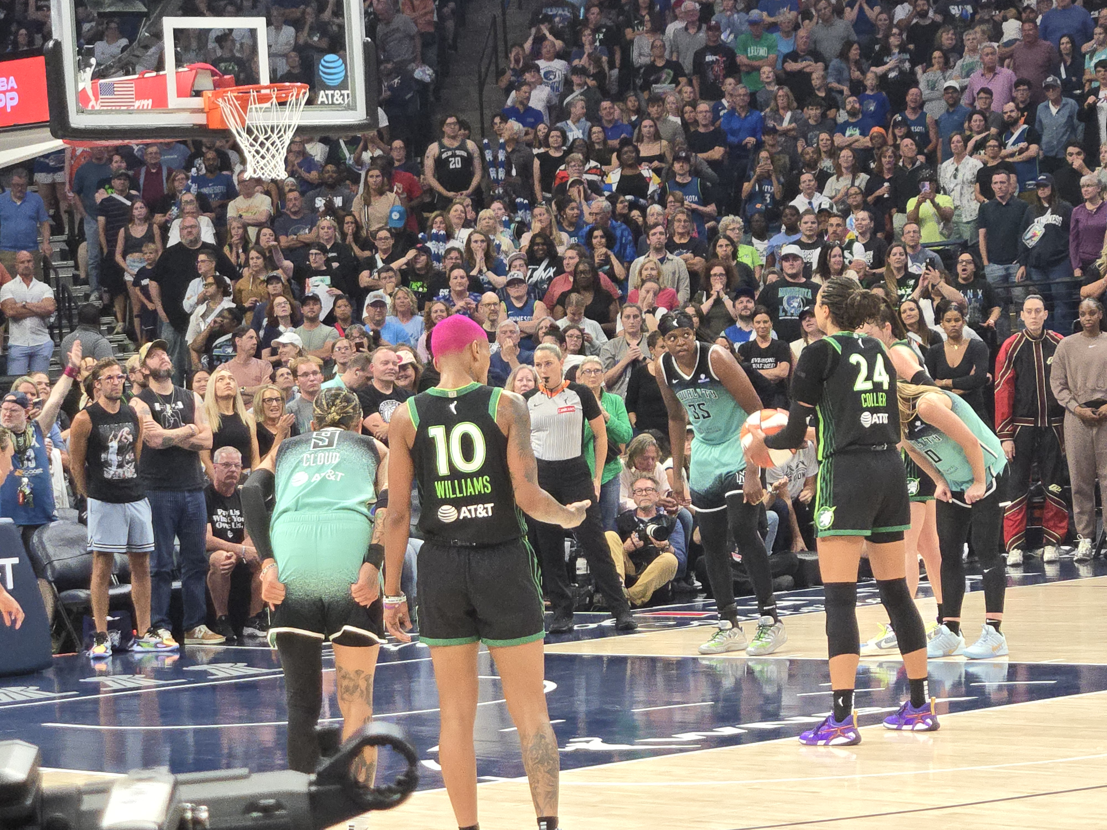

Slide 9
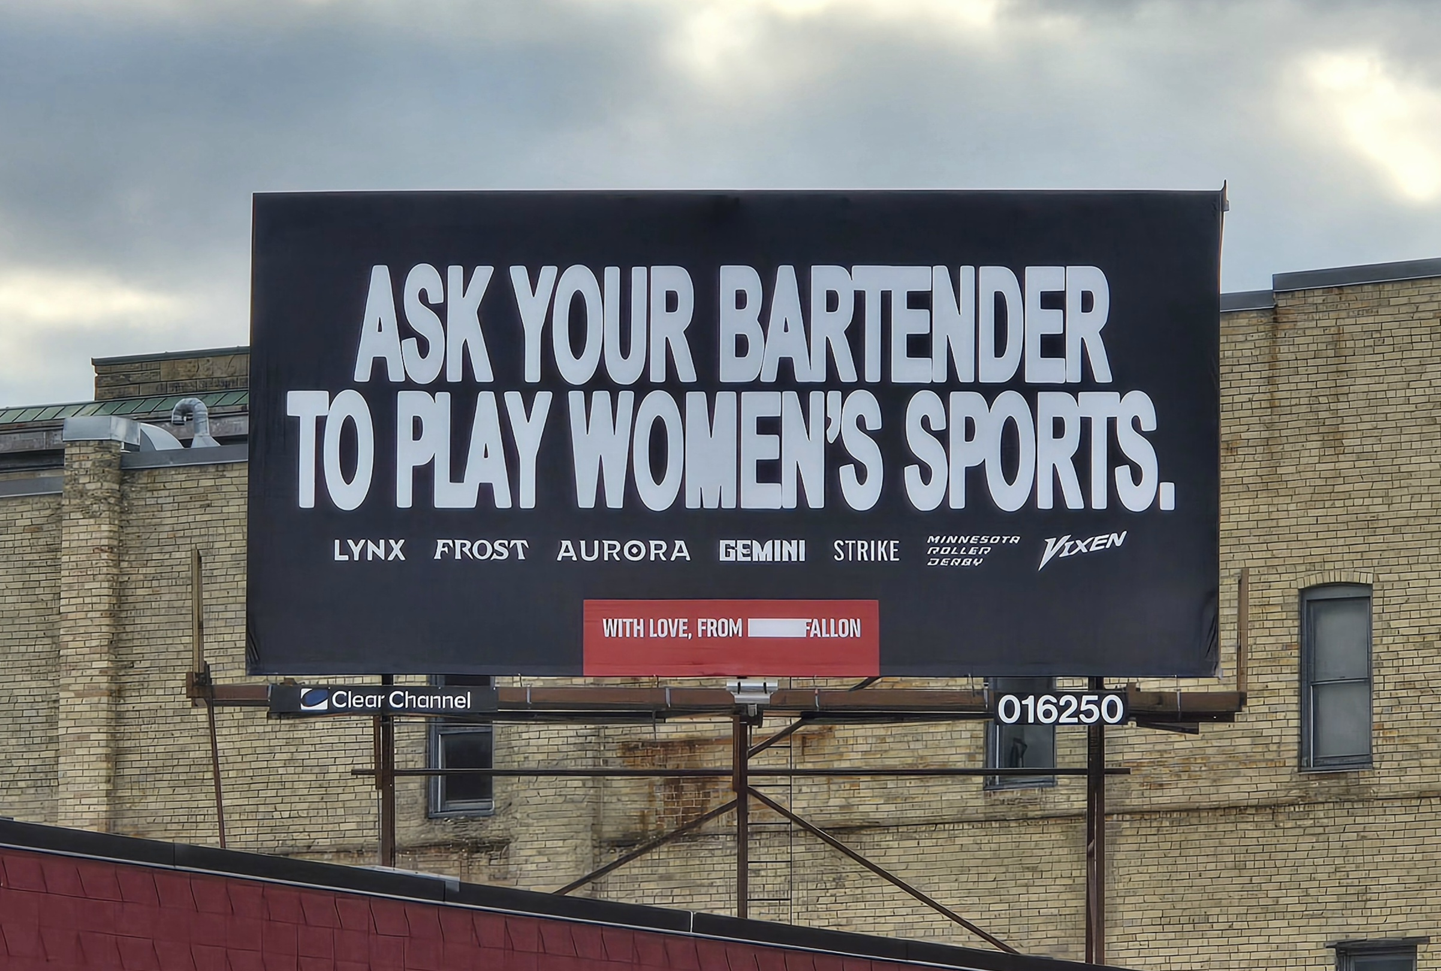

Slide 10
Why is the WNBA an Economics Story?
Rapid growth in attendance
Rapid growth in viewership
Expansion teams
Rising franchise values
New media-rights agreements
Historic collective bargaining agreement

Slide 11
Market Lesson Highlights
Why Are WNBA Ticket Prices Rising?
Notes:
The WNBA Market Lesson is currently being finalized for publication by Federal Reserve Education (FRE). This lesson is co-authored by David Berri, Lynn MacDonald, and Scott Wolla.

Slide 12
What Happened?
In 2025, the cheapest ticket to the WNBA All-Star Game was $66.
In 2026, the cheapest ticket to the WNBA All-Star Game was $354.
Think-Pair-Share
Would you pay $354 for a ticket?
Why do you think the price increased?
What evidence would you need to explain the increase?
Notes:
Teacher Notes
Tell students:
Don't worry about having the "right" answer yet. We are going to investigate what happened and use economics to explain it.
BOTH SOLD OUT
2025: https://www.wfyi.org/wfyi-news/2025-07-19/players-shine-at-wnba-all-star-weekend-in-indianapolis
2026: sold out and drew larger attendance than NBA all-star game https://ktla.com/news/wnba-all-star-game-record-attendance/

Slide 13
Compelling Question
How can supply and demand explain rising WNBA ticket prices?

Slide 14
What is a League?
The WNBA operates in a league. A league is an organization of teams that agree to compete under shared rules, schedules, and governance to produce a unified sports product.
Key Functions
Sets the rules of play
Organizes schedules and championships
Governs player movement (drafts, trades, free agency)
Shares revenue (TV deals, sponsorships)
Question: Does a sports league have a greater influence on Demand or Supply?

Slide 15
Question
Does a sports league have a greater influence on Demand or Supply?
Answer: Mostly Supply
The League controls:
1. number of games
2. roster rules
3. schedules
4. number of teams

Slide 16
Demand
What are some ways we see evidence of demand?
      Viewership
      Attendance
      Sales/Merchandise
      Advertising
      Higher ticket prices can signal higher Demand
      Franchise valuations (growing market)

Slide 17
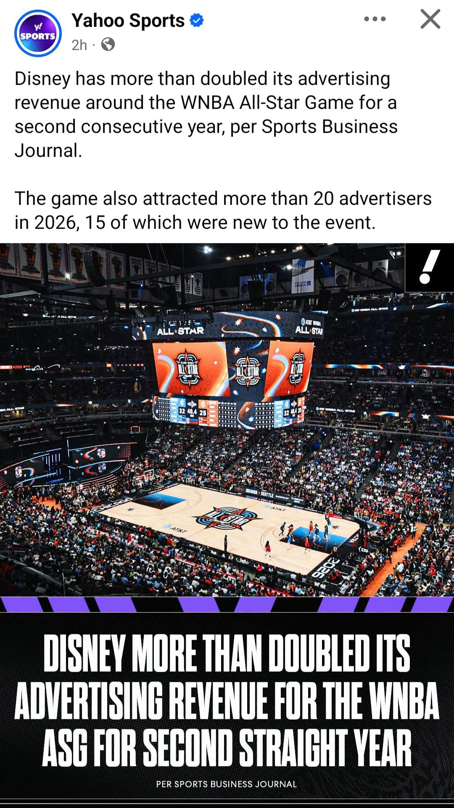
Demand
Disney more than doubled its ad revenue two years in a row for the WNBA All-Star game.
Number of advertisers increased
More viewers → advertisers see greater value in the audience.
More advertisers compete for ad space.
Disney can charge more for advertising.
This is another market responding to increased demand.
Notes:
Source: Yahoo Sports Facebook post, screenshot captured July, 26, 2026.

Slide 18
Supply
What are some ways we measure supply?
seats
games
teams
The League governs number of teams, schedules etc. and has an effect on supply.

Slide 19
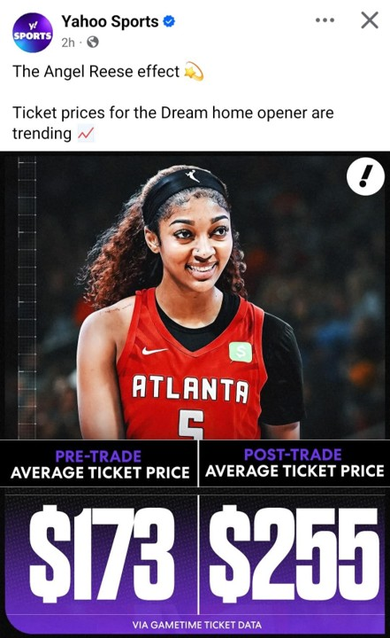
Prices
In 2026, Atlanta Dream ticket prices increased from approximately $173 to $255 following the Angel Reese trade announcement.
This example illustrates how increased consumer interest can affect market prices.
Notes:
Source: Yahoo Sports Facebook post, screenshot captured April, 6, 2026.

Slide 20
How did the market respond?
Buyers
More fans purchased tickets despite higher prices.
Some fans paid substantially more.
Some fans chose not to attend because prices were too high.
Sellers
Tickets sold at higher prices.
More advertisers sought access to WNBA audiences.
The league expanded by adding teams and increasing the number of games.
As interest in the WNBA grew, expansion created additional opportunities for fans, advertisers, and investors.

Slide 21
Market Equilibrium
Market equilibrium occurs where supply and demand meet. The equilibrium price is the price at which buyers and sellers agree to exchange tickets.
Use either the Angel Reese trade or All-Star Game example to have students graph out and explain the change in market equilibrium price and quantity.

Slide 22
Class Assessment
Use this Social Media post to have students graph and describe in words what happened.
This can be completed individually or in groups. Have students submit their responses.
Prompt: Draw two possible graphs that explain how this increase in the average price of tickets could have occurred.
  Label everything on both graphs
  Describe in words, what is happening for each graph.
  Explain which scenario (of the 2 graphs) likely fit for this Angel Reese example.
Notes:
Source: Yahoo Sports Facebook post, screenshot captured April, 6, 2026.

Slide 23
Classroom Applications: Markets
Teachers can use WNBA examples to teach:
Supply and demand
Price changes
  Example – Rising WNBA Prices (NYT)
Market equilibrium
Buyer and seller behavior
Reading data and social media critically
  Example – Interactive WNBA Attendance Data
Notes:
Students can explore the attendance data by team and by league. https://www.acrossthetimeline.com/wnba/attendance.html#

Slide 24
Exit Ticket
The popularity of the WNBA continues to grow. Use economic reasoning and evidence from today's lesson, explain:
What happened to demand.
What happened to prices.
How buyers responded.
How sellers responded.

Slide 25
The Same Growth Story Creates Many Economics Lessons
Growth in the WNBA affects:
Ticket prices (Markets)
Player salaries (Labor Markets)
Sponsorships and advertising
Franchise values
Entrepreneurship opportunities

Slide 26
Labor Lesson Highlights
Labor Unions and Collective Bargaining
Notes:
The WNBA Labor Market Lesson is currently being finalized for publication by Federal Reserve Education (FRE). This lesson is co-authored by King Banaian, David Berri, Lynn MacDonald, and Scott Wolla.

Slide 27
What is a Labor Union?
A labor union is an organization that represents workers during collective bargaining over:
wages
benefits
working conditions
The WNBPA serves this role for WNBA players.
Notes:
WNBPA = Women’s National Basketball Players Association

Slide 28
What is Collective Bargaining?
Negotiation between workers (through a union) and employers.
Determines wages.
Determines benefits.
Determines working conditions.
In the WNBA, collective bargaining occurs between the WNBPA and the league.

Slide 29
Why Were Players Dissatisfied?
In fall 2025, Napheesa Collier publicly raised concerns about player compensation, working conditions, and league leadership in the WNBA.
Watch a media discussion of player concerns during the 2025 labor negotiations.
VIDEO: WNBA Labor Negotiations and Player Concerns (ESPN)
Notes:
Teacher Notes: Discussion Prompt
What concerns are the players raising?
What information would you need before deciding whether the players have a strong economic case?

Slide 30
Why Did Salaries Change in 2026?
New CBA negotiated.
Greater player bargaining power.
Increased league revenues.
Growth in attendance and viewership.
Competitive alternatives for players (e.g., Unrivaled).
Growth in WNBA attendance, viewership, and revenues increased demand for WNBA-related labor.

Slide 31
Revenue Sharing and the New CBA
Before the 2026 CBA
WNBA players received a relatively small share of league revenues.
Players argued compensation did not reflect their economic contribution.
2026 CBA Changes
The new agreement increased the share of revenue going to players to approximately 20%.
The salary cap increased substantially.
Maximum salaries increased.
Average player salaries increased dramatically.
Key Takeaway: Collective bargaining influences how revenue is shared between owners and workers.

Slide 32
Labor Market
Historically, WNBA players had relatively few domestic alternative employment options, giving the league greater bargaining power.
Unrivaled has likely offered players more leverage in their WNBA (CBA) contract negotiations.
Notes:
Teacher note: loosening monopsony power in wnba. (Examples from mens sports of attacks on monopsony power: AFL, WHA, ABA.) Doesn’t happen in European system with open admission, promotion/relegation, etc.
evidence of labor supply here

Slide 33
EconEdLink Sports Labor Lessons
Sports Economics MLB Underpaid Millionaires (EconEdLink)
Are MLB players overpaid?
Identify if MLB is competitive market, monopsony, or monopoly
Sports Economics: To keep the strike going or not? NBA (EconEdLink)
1998 NBA players’ strike
Identify incentives, costs, and benefits related to the strike
Sports Economics: Mystery of the 2.3M% Pay Raise (EconEdLink)
Students read and use economics to try to solve the mystery of the MLB offering a 2,300,000% pay increase for attracting Puig from Cuba.
Why did his pay increase dramatically in such a short time?

Slide 34
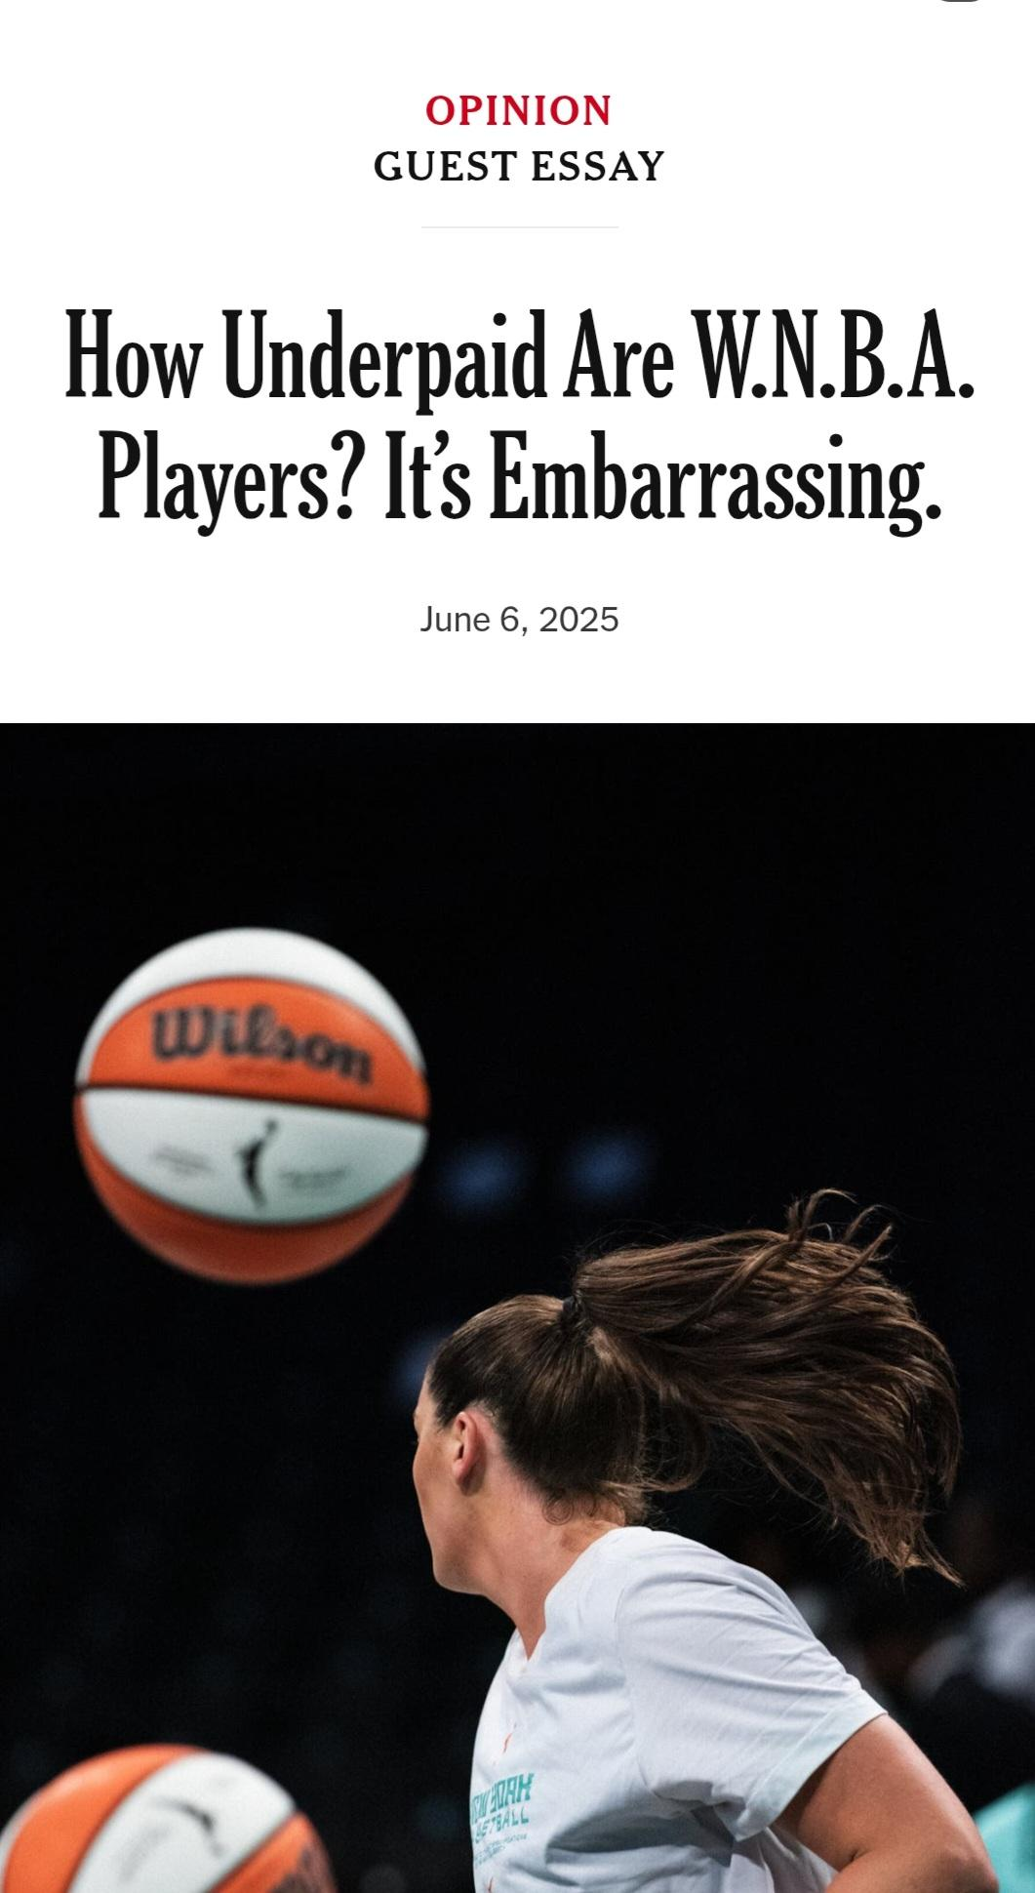

Economist Spotlight
Claudia Goldin
Nobel Prize in Economics
Harvard Economist
Labor Market Expert
NYT Opinion Piece
Believed the WNBA players are underpaid.
Helped WNBPA negotiate in 2024-25.

Slide 35
Goldin’s Conclusion: WNBA Players Were Underpaid
Using 2024 attendance and viewership data, Goldin estimated that WNBA players should be earning somewhere between 25-33% of NBA salaries.
This is roughly double the compensation levels established under the 2020 CBA.
Average salary would jump to ~$2.5 million.
Max contract = $11.5 million (not supermax).
Goldin’s Takeaway: WNBA players were significantly underpaid compared to their economic value.
Notes:
https://www.worldscientific.com/doi/10.1142/S2810943025500118

Slide 36
The Outcome: A Historic Salary Increase
Following negotiations during the 2025-2026 CBA process
WNBA salaries increased dramatically in 2026.
The league salary cap increased substantially.
Maximum player salaries reached $1.4 million.
Multiple players signed record-breaking contracts.
On average, player salaries increased by 400%.

Slide 37
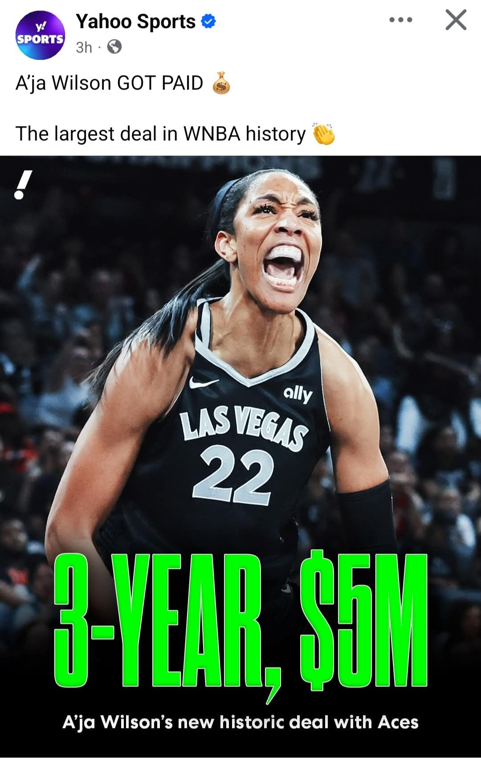
Record-Breaking WNBA Contracts
A'ja Wilson
3 years, $5.0 million
$1.4 million salary in 2026
First player to reach the new WNBA supermax level
Aliyah Boston
4 years, $6.3 million
Largest total-value contract in WNBA history at signing
$1.0 million salary in 2026

Slide 38
Key Takeaway
Worker pay is influenced by both market forces and labor market institutions.
In the WNBA, increased revenues, collective bargaining, and greater player bargaining power all contributed to higher salaries.

Slide 39
Classroom Applications: Labor Markets and Entrepreneurship
Teachers can use WNBA examples to teach:
Marginal Revenue Product
Labor unions
Collective bargaining
Wage determination
Labor market competition
NYT What’s going on in this graph?
Notes:
NYT graph relates to this original article by Dave Berri: https://www.nytimes.com/interactive/2025/10/03/opinion/wnba-pay.html

Slide 40
Labor Market Simulation: Salary Caps and Collective Bargaining
Notes:
This salary cap simulation is part of the WNBA Labor Market Lesson is currently being finalized for publication by Federal Reserve Education (FRE). This lesson is co-authored by King Banaian, David Berri, Lynn MacDonald, and Scott Wolla.

Slide 41
Labor Market Simulation: Salary Caps and Compensation
Objectives: Students will see how
League rules (caps and maximum salaries) affect the distribution of income.
Markets (teams) and institutions (leagues and unions) produce different compensation outcomes.
Individuals face opportunity costs when making decisions.
Organizations must operate within budget constraints.
Notes:
This salary cap simulation is part of the WNBA Labor Market Lesson is currently being finalized for publication by Federal Reserve Education (FRE). This lesson is co-authored by King Banaian, David Berri, Lynn MacDonald, and Scott Wolla.

Slide 42
Labor Market Simulation: Overview
Overview: This activity illustrates the budget constraint of a salary cap. Students will decide how to allocate the limited salary budget between 12 players on a team.
There are 4 rounds
Round 1: Pre-2026 CBA. Students decide how to allocate salaries based on player talent and contribution to revenue.
Round 2: After 2026 CBA.
Round 3: League adds a supermax salary
Round 4: League adds a rookie scale salary

Slide 43
WNBA Team Roster
12 players, all on the same team
Player Type | Number of Players | Revenue Contribution
Elite Players | 2 | Very High
Strong Starters | 3 | High
Solid Contributors | 3 | Moderate
Role Players | 3 | Low
Rookie (#1 Pick) | 1 | Very High

Slide 44
Pre-CBA: 2025 Actual WNBA Salaries
Current Salary Cap $1.5 Million, 12 Players
Player Type | Players | Salary Each
Elite Players | 2 | $249,244
Strong Starters | 3 | $165,000
Solid Contributors | 3 | $78,831
Role Players | 3 | $66,079
Rookie (#1 pick) | 1 | $78,831
Notes:
For simplicity, we use the 2025 supermax for the two elite players. Many teams only had one. The other non-rounded numbers are the actual values permitted in 2025 before the new CBA.The “solid contributors” and “role players” are set to league minimums for players with 3+ and 0-2 years experience, respectively, and the remainder is allocated to create a fictional salary for the “strong starters”. Rookie cap in 2025 was $78,831, the same as the 3+ minimum..

Slide 45
Round 2: One Possible Outcome
Salary Cap $7M, 12 Players
Player Type | Players | Salary Each
Elite Players | 2 | $1,325,000
Strong Starters | 3 | $550,000
Solid Contributors | 3 | $350,000
Role Players | 3 | $150,000
Rookie (#1 pick) | 1 | $1,200,000

Slide 46
Round 3: One Possible Outcome
Salary Cap $7M, 12 Players, Supermax = $1.4M
Player Type | Players | Salary Each
Elite Player #1 | 1 | $1.4M (supermax)
Elite Player #2 | 1 | $1,350,000
Strong Starters | 3 | $550,000
Solid Contributors | 3 | $350,000
Role Players | 3 | $150,000
Rookie (#1 Pick) | 1 | $1,000,000
Notes:
Question: why might a team choose to come in under the salary cap?

Slide 47
Round 4: One Possible Outcome
Salary Cap $7M, 12 Players, Supermax = $1.4M, Rookie Scale $500,000
Category | Players | Salary Each
Elite Player #1 | 1 | $1.4M (supermax)
Elite Player #2 | 1 | $1,400,000
Strong Starters | 3 | $700,000
Solid Contributors | 3 | $350,000
Role Players | 3 | $150,000
Rookie (#1 Pick) | 1 | $500,000

Slide 48
Round 4: Discussion
The rookie may generate substantial revenue but cannot be paid according to full market value because of rookie-scale rules.
Key Takeaway
Compensation can differ from MRP because collectively bargained rules create constraints.

Slide 49
Exit Ticket
Use evidence from today's lesson to answer the following question:
Why did WNBA player salaries increase dramatically in 2026?
In your response, explain:
How Marginal Revenue Product (MRP) helps determine worker pay.
How changes in demand for WNBA games affected player salaries.
How labor unions and collective bargaining influenced compensation.
One way league rules affected worker pay.

Slide 50


Athlete-Driven Entrepreneurship
Notes:
Social media, streaming platforms, and athlete-created content have opened new entrepreneurial opportunities for professional athletes.

Slide 51
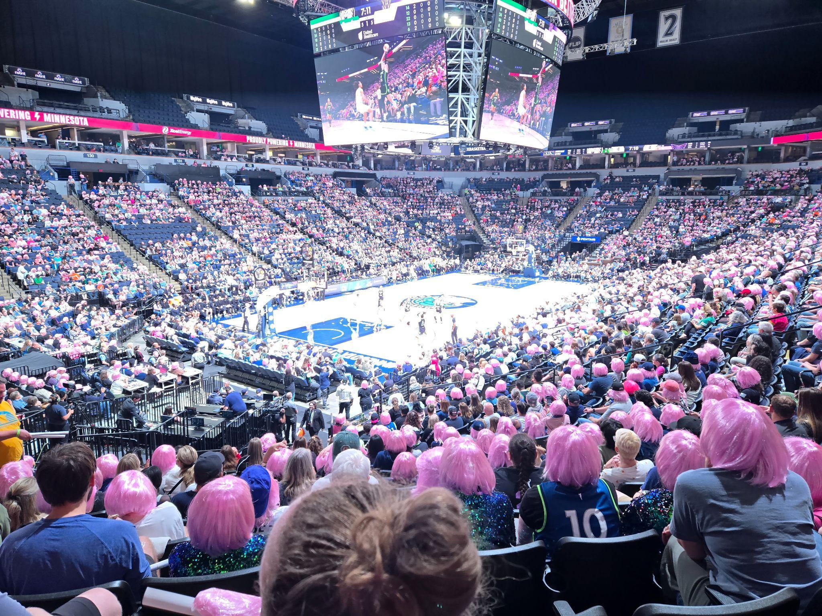
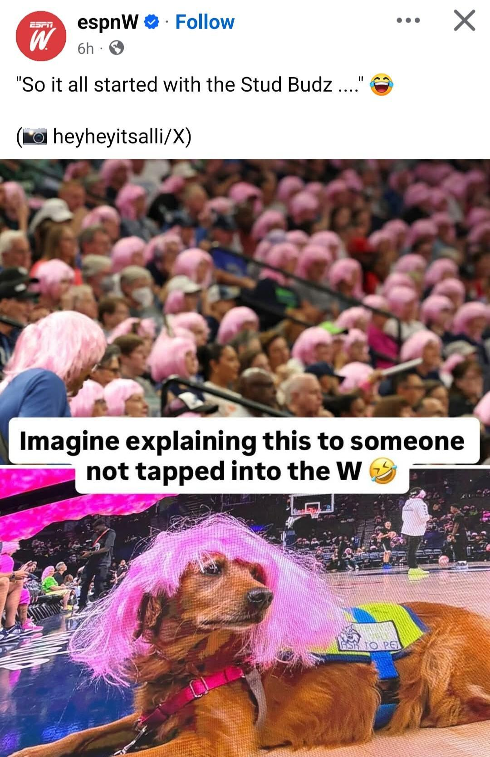

Studbudz
Background
insert info

Slide 52
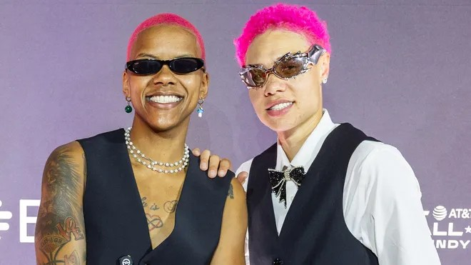

Studbudz
“Twin”
Courtney Williams and Natisha Hiedeman
Launched Studbudz Twitch account in June 2025
July 18-19, 2025 - rose to fame after 72-hour Twitch stream during WNBA All Star Weekend. Unprecedented access.
Unapologetically themselves

Slide 53
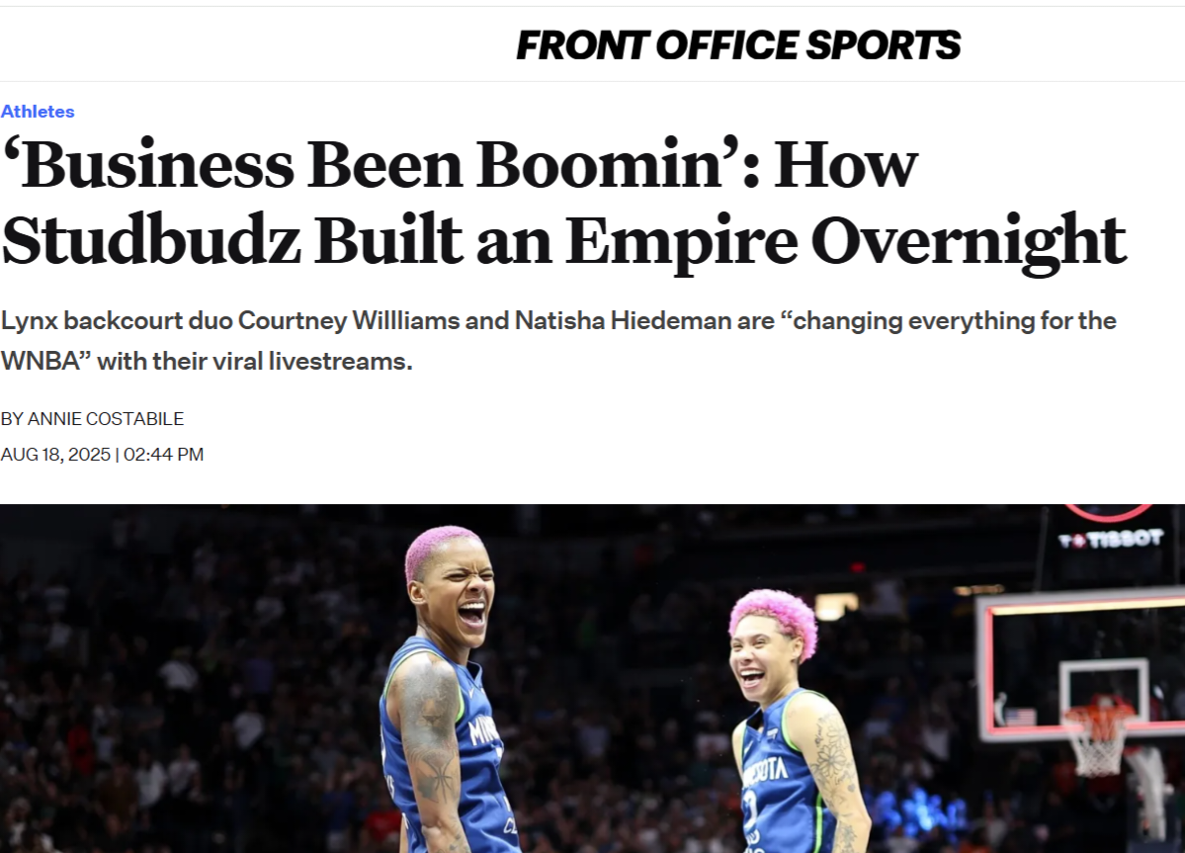
Studbudz
Secured multiple sponsorship deals together
U by Kotex
DoorDash
Starbucks
Sprite
Cash App
Reese’s
Togethxr
Knickerbocker Hotel

Slide 54
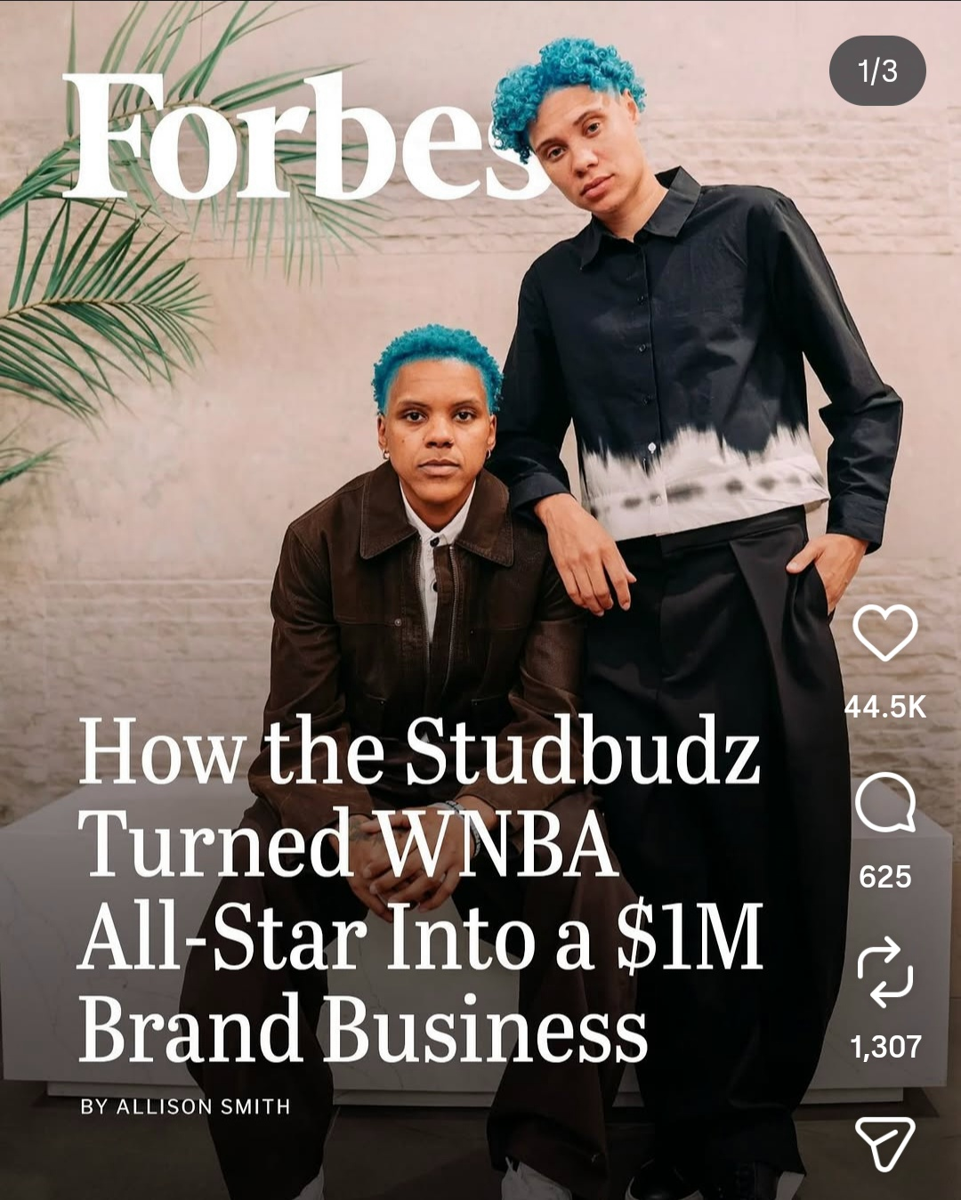
Studbudz
From pink hair to “AT&T blue” hair in 2026
Continued Studbudz from different teams
Brand business

Slide 55

Unrivaled
Founded by: Breanna Stewart & Napheesa Collier
Vision: To empower women athletes with better pay, equity, and visibility. The league centers athlete driven storytelling and pop culture influence
What is it? 3x3 Professional League, unique off-season opportunity for elite athletes to compete with high salaries and equity stakes.

Slide 56
Unrivaled
Quick Facts
Expanded from 6 to 8 teams in 2026
8-week season Jan-Mar.
48 roster spots in 2027, games air 4 days a week.
Athlete investors and media partners such as Serena Williams, Steph Curry, and Warner Brothers.
Financial Highlights
$35M raised in Series A (2025)
Valued $340M after Series B (2026)
Total League Valuation: $650 Million (Sept 2026)
Average Salary: $220,000
Equity Stakes offered to players
Notes:
48 players in 2026 with 6 player development pool for injuries
Year 1 revenues ~$27 million; $100m 6-year deal with WBD.

Slide 57
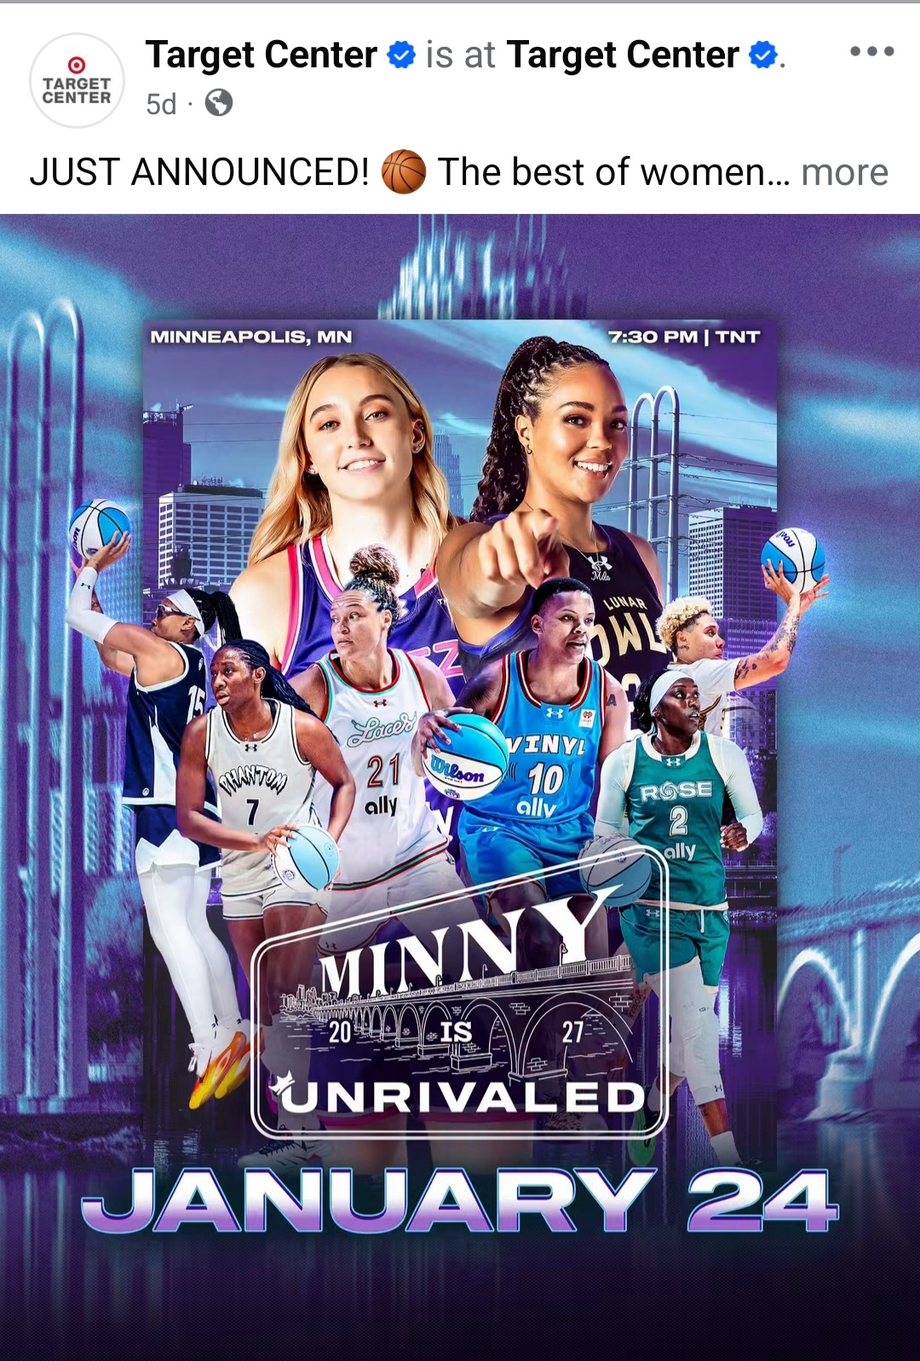
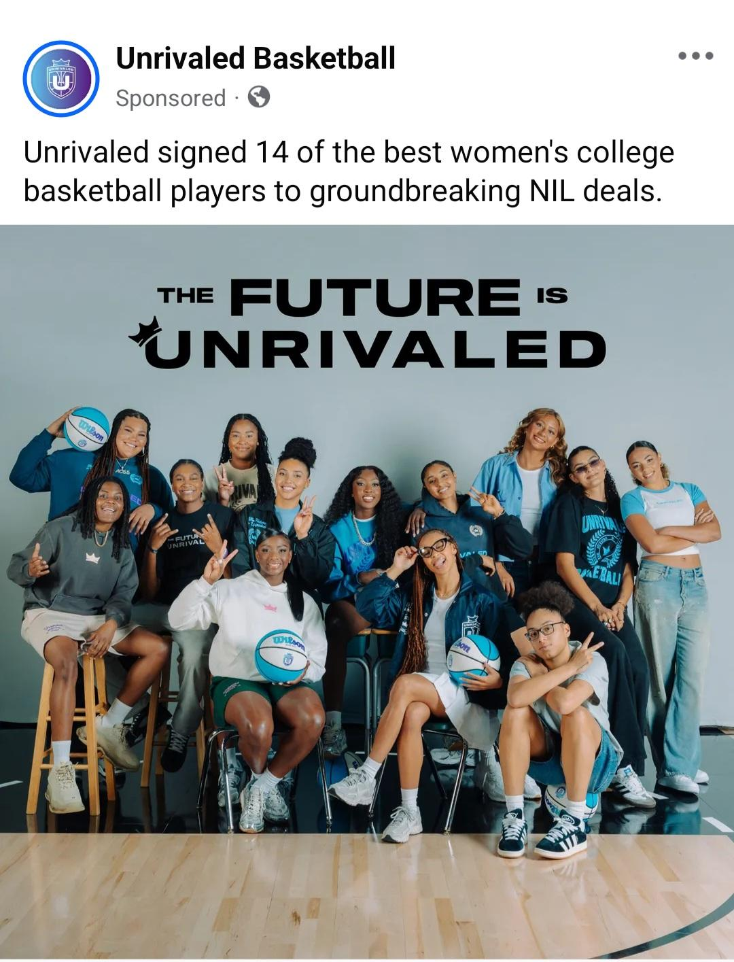
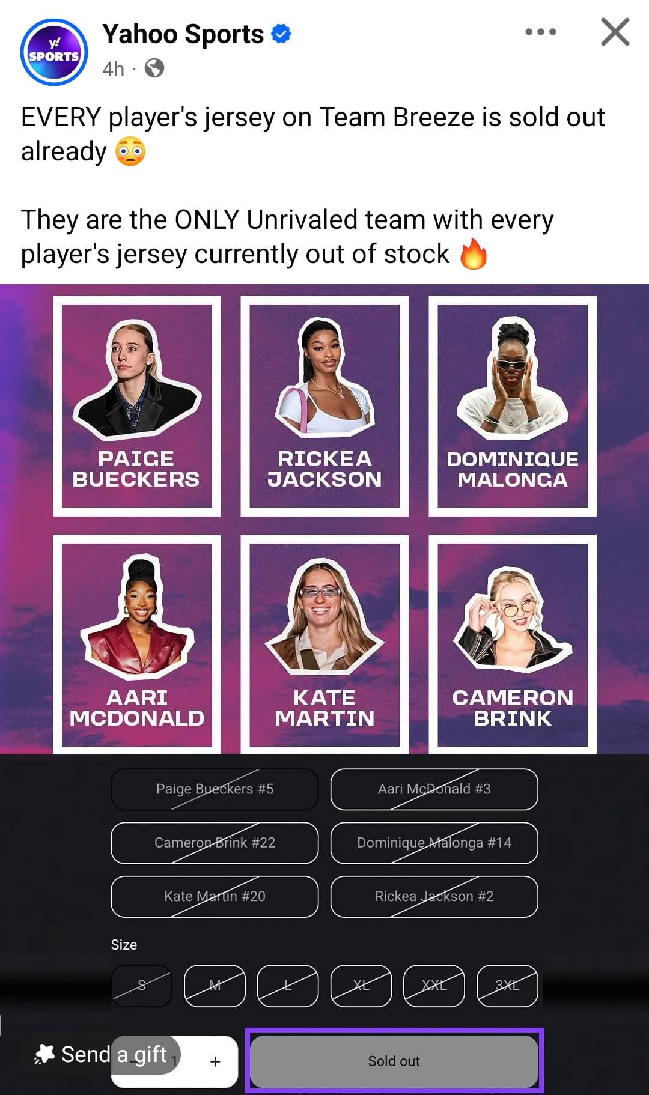
Notes:
NCAA rules say that college athletes can’t be paid to play in pro sports settings. Unrivaled found an opening (through NIL) and is paying 14 of the best women’s college basketball players…to be themselves. To show up at the weekend summit in August wearing Unrivaled merch, participate in skills sessions, and photo ops–with NO commitment required to later play in Unrivaled.
https://www.si.com/college-basketball/unrivaled-is-thinking-outside-nil-box?utm_source=gol

Slide 58
What This Means
Players building leverage outside WNBA
Creating alternative income streams
Personal brand > team loyalty
Unrivaled average salary is $220,000 (more than 2025 WNBA salary)
Economic concept: Competition in labor markets

Slide 59
Entrepreneurship: Take it to your classroom
Use Tomorrow
StudBudz
  Studbudz Turned All-Star into $1M Business (Forbes)
Unrivaled
Branding
Competition

Slide 60
Relevant Lessons
Economics of Sports Lesson Collection (EconEdLink)
Human Capital and Labor Markets Video Series (EconEdLink)
WNBA Markets and Labor Markets lessons highlighted in today's webinar are currently in development with Federal Reserve Education and will be published at a later date.

Slide 61
Additional Resources
MCEE K-12 Teacher Resources
CEE EconEdLink
Federal Reserve Education
SCSU Center for Economic Education
MCDE Diverse and Inclusive Classroom Resources

Slide 62
Contact Us
Lynn MacDonald, Ph.D.
Economics Professor
Co-Director, St. Cloud State University Center for Economic Education
lcmacdonald@stcloudstate.edu
Linkedin.com/in/lynn-macdonald-b65a85404

Slide 63
Thank you

