Slide 1





The Economics of Caregiving: A Labor Market Study

Slide 2
Certificate Requirements
To earn professional development hours for webinars, you must:
Watch a minimum of 75% for all sessions
You will automatically receive a professional development certificate via e-mail within 24 to 48 hours.

Slide 3
Objectives
You will be able to:
define caregiving and relate it to GDP in terms of unpaid labor
explore economic public policy options and weigh the costs and benefits of each

Slide 4


Presenter
Dr. Cynthia Fitzthum
K-12/Secondary Educator Preparation Department, Chair
Center for Economic Education, Co-Director
Social Studies Education, Faculty
St. Cloud State University, Minnesota
SH 345
cjfitzthum@stcloudstate.edu

Slide 5


Session Agenda
Standards Overview
What is caregiving?
How is it connected to GDP and unpaid labor?
What are the costs and benefits of public policy options regarding caregiving?
Recap and Reflection

Slide 6
Reflect...
Family caregivers now provide $1 trillion worth of care annually, AARP finds
"Caregiving intersects deeply with economics, highlighting both the heavy financial sacrifices borne by families and the foundational, unpaid labor required to sustain society."
(CNBC, 2026)
https://www.cnbc.com/2026/03/26/family-caregivers.html

Slide 7

Journal Idea here
Open up a new Word document or grab a pad of paper
Reflect (Question, Connect, Follow-up)
Take time to review
Action

Slide 8

National Standards
Earning Income 8-2: People make many decisions over a lifetime about their education, jobs, and careers that affect their incomes and opportunities.
Saving 12-8: People can reduce the potential for future financial strife with a partner or spouse by sharing personal financial information, goals, and values prior to combining finances.
https://www.councilforeconed.org/policy-advocacy/k-12-standards/

Slide 9

National Standards
7.H.2: To determine the optimal level of a public policy program, voters and government officials should compare the marginal benefits and marginal costs of providing a little more or a little less of the program’s services. In some cases, the best option may be no government intervention at all.
https://www.councilforeconed.org/policy-advocacy/k-12-standards/

Slide 10

What is caregiving and how does it impact our economy? Understand caregiving through data from GDP and various public policies to bring back into your classroom through discussion and debate. Teachers will leave with current labor market data and activities to discuss with students in their classrooms.

Slide 11
What is caregiving?
Caregiving: A caregiver is a person who attends to the needs of and provides assistance to someone else who is not fully independent, such as an infant or an individual with an illness, disability, or disorder. A person who does the majority of the work is called the primary caregiver (APA, 2026)
GDP: The value of the final goods and services produced in the United States (BEA, 2026)
Unpaid Labor: Unpaid labor is work that is done without getting any money or pay. It includes household chores, taking care of family members, volunteer work, and unpaid internships. This type of work helps the economy and society run, but it is not counted in official money numbers like the gross domestic product (GDP) (Wikipedia, 2026)

Slide 12
Examples of Caregiving
A son helping his father dress and bathe due to physical limitations
A daughter driving her mother to medical visits
A husband supporting his wife with dementia
A neighbor running errands for an injured friend
A grandparent watching their grandchildren while parents work
Reflect: What other examples of caregiving do you observe in your life?

Slide 13
How is caregiving connected to GDP and unpaid labor?
Unpaid labor is a large part of our economy that is not counted in GDP
Enables the workforce to function and our economy to grow
Women perform the majority of this unpaid labor (UN Women, 2025)
Is linked to career and wage penalties when unpaid workers re-enter the formal workforce
Analysis of new data from the 2025 American Time Use Survey finds that Americans spend an average of 234 hours a year caring for and helping family, friends and loved ones.
Reflect: How have you been impacted by this in your personal life?

Slide 14
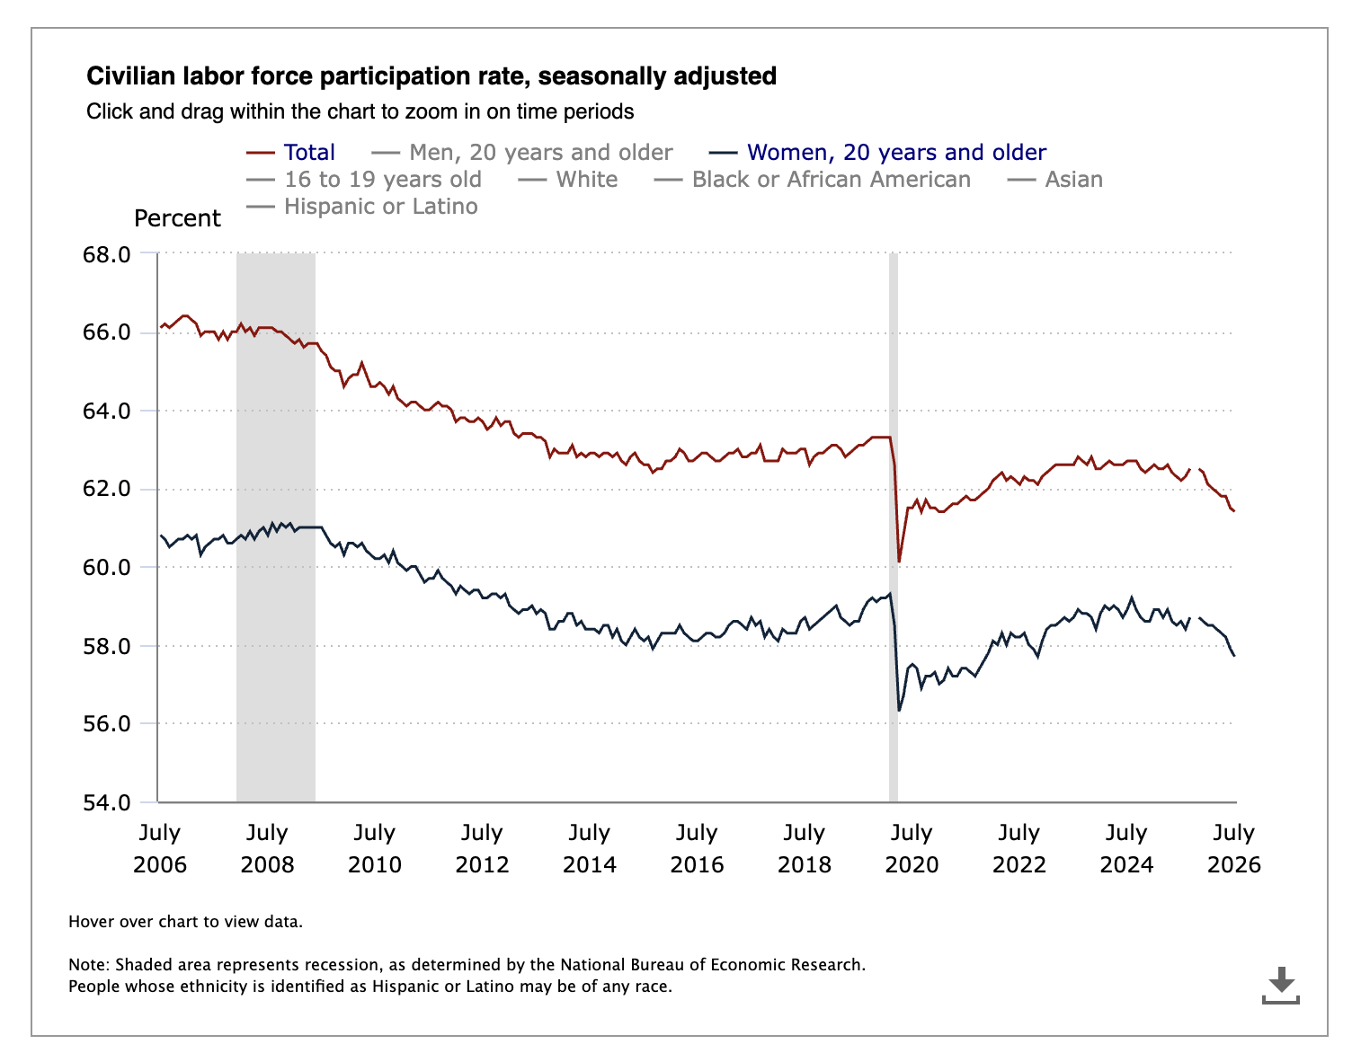
U.S. Bureau of Labor Statistics

Slide 15
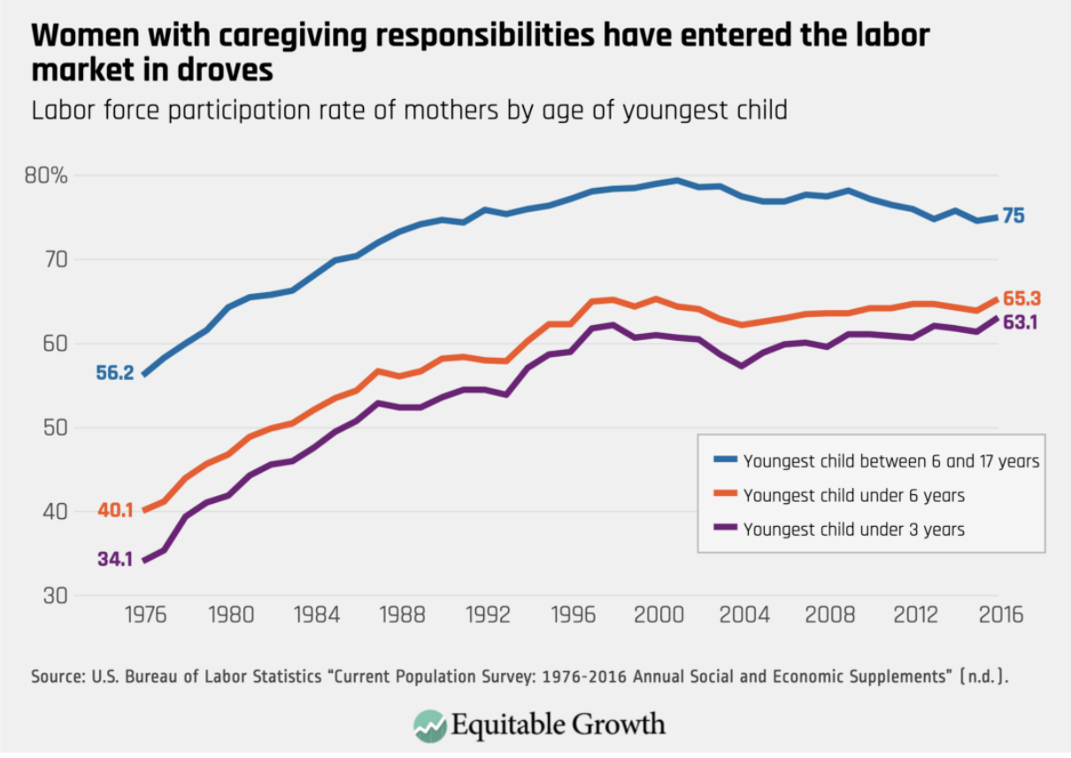
U.S. Bureau of Labor Statistics

Slide 16
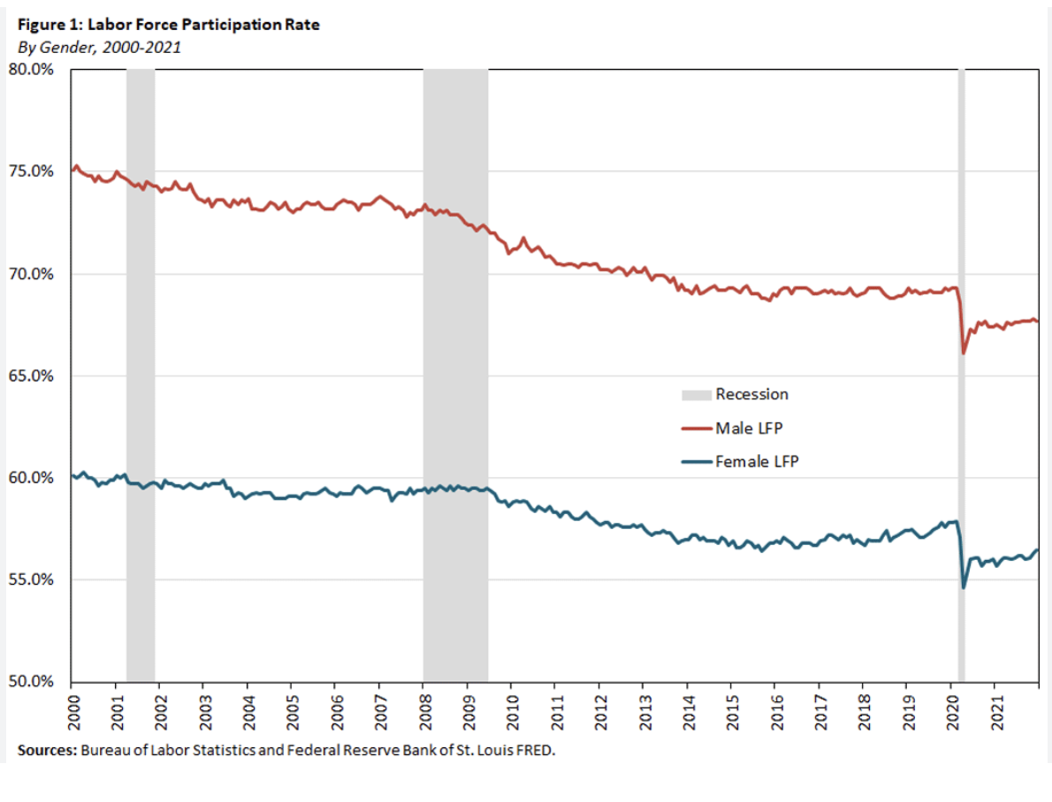
U.S. Bureau of Labor Statistics/St. Louis FRED

Slide 17
How is unpaid caregiving impacting the labor market?
Reduces workforce participation, especially seen in women (BLS Data)
Forces workers to cut hours or take flexible jobs at lower pay
Lowers lifetime earnings of workers
Disrupts talent retention and productivity in economy
Labor Market Work and Home Care's Unpaid Caregivers: A Systematic Review of Labor Force Participation Rates, Predictors of Labor Market Withdrawal, and Hours of Work
As people continue to age and receive complex health care services at home, concern has arisen about the availability of family caregivers and their ability to combine employment with caregiving. This article evaluates the international research on unpaid caregivers and their labor market choices, highlighting three conclusions: first, caregivers in general are equally as likely to be in the labor force as noncaregivers; second, caregivers are more likely to work fewer hours in the labor market than noncaregivers, particularly if their caring commitments are heavy; and finally, only those heavily involved in caregiving are significantly more likely to withdraw from the labor market than noncaregivers. Policy recommendations are targeting greater access to formal care for “intensive” caregivers and developing workplace policies for employed caregivers. https://pmc.ncbi.nlm.nih.gov/articles/PMC2690351/

Slide 18
EconEdLink Lessons: Preview
GDP Data: Is the Economy Healthy? (https://econedlink.org/resources/gdp-data-is-the-economy-healthy/)
Unpaid Labor/Labor Markets: Video Series and Quiz (https://econedlink.org/resources/human-capital-and-labor-markets-video-series-and-quiz/)
Other ideas of how you teach these? Use chat now and/or journal.

Slide 19
EconEdLink Lessons
GDP Data: Is the Economy Healthy? (https://econedlink.org/resources/gdp-data-is-the-economy-healthy/)
Overview: This series of lessons will introduce you to economic data that economists use to assess the health of the economy. You will learn about economic data and what they communicate about the health of the economy. This lesson focuses on Gross Domestic Product (GDP), which is important for analyzing the health of the broader economy.
ESSENTIAL QUESTION: What do current GDP data say about the health of the economy?
Learning Objectives
Define GDP, Real GDP, recession, and economic growth.
Examine the most recently reported GDP, Real GDP, and Real GDP growth rate data.
Differentiate between changes in the level of Real GDP and the economic growth rate.
Determine a trend based on the six most recent Real GDP releases.
Analyze the current health of the economy based on the current Real GDP growth rate, historical Real GDP data, and estimates of projected Real GDP growth.

Slide 20
EconEdLink Lessons
Unpaid Labor/Labor Markets: Video Series and Quiz (https://econedlink.org/resources/human-capital-and-labor-markets-video-series-and-quiz/)
Objective- Students will be able to:
Apply supply and demand analysis to how the marginal product of labor determines wages, human capital, labor unions, and compensating wage differentials.
This unit of five videos begins with an explanation of the marginal product of labor and how it determines wages. This serves as the foundation for an overview of related topics, such as human capital, labor unions, compensating wage differentials, and, of course, TANSTAAFL: There Ain’t No Such Thing as a Free Lunch. Every video comes with practice questions!

Slide 21

Reflect: Why is it important to understand caregiving and the impact on our economy?

Slide 22

Explore economic public policy options and weigh the costs and benefits of each: Class Discussion Ideas
Healthcare Access and Affordability
Caregiver Inclusion and Support
Medication Policy and Patient Protection
Long-Term and Institutional Care
Financial Relief for Family Caregivers
Support for Diverse Caregiving Communities
Enacted Laws Supporting Caregivers
Reflect: What are the costs and benefits of each?
Utilize chat and/or journal now.
https://www.caregiveraction.org/legislation-and-public-policy/

Slide 23
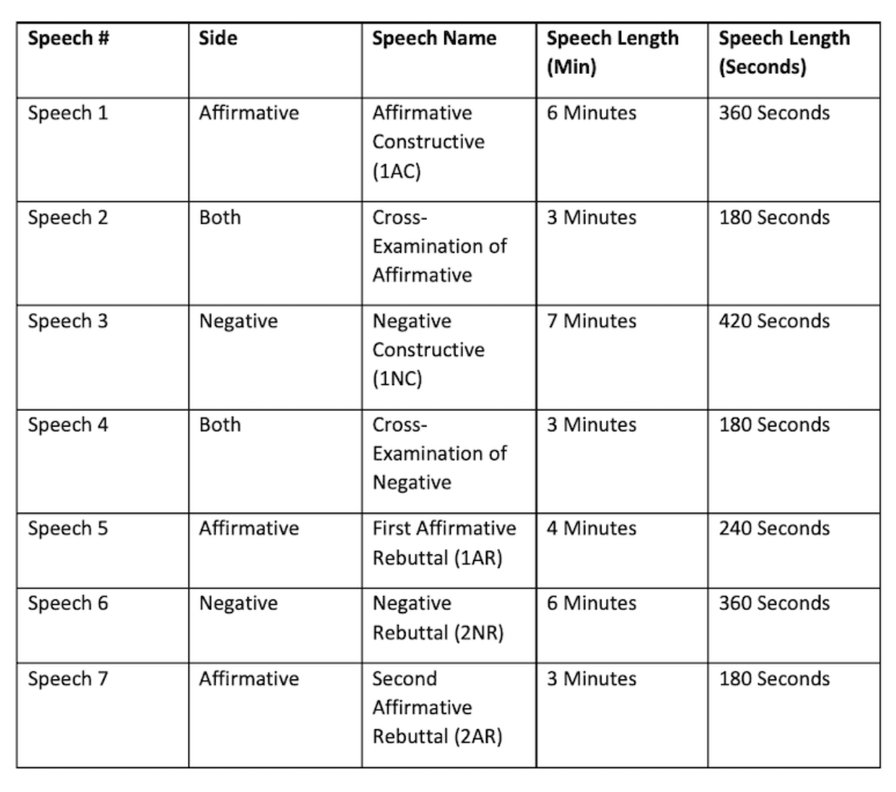
Class Dialogue/Debate Ideas
Assessments
Lincoln Douglas Debate Structure (https://www.nsdebatecamp.com/lincoln-douglas/debate-format)
Deliberative Dialogue Activity (https://nifi.org/)

Slide 24

Recap:
What is caregiving?
How is it connected to GDP and unpaid labor?
What are the costs and benefits of public policy options regarding caregiving?

Slide 25

"Family caregivers are holding up a system that millions of Americans rely on every day. With the economic value of family caregiving now exceeding $1 trillion annually, it is clear that employers, health care providers, and policymakers must do more to recognize and support them."
Dr. Myechia Minter-Jordan
(CEO, AARP)

Slide 26
Thank you!
Cjfitzthum@stcloudstate.edu

