Slide 1
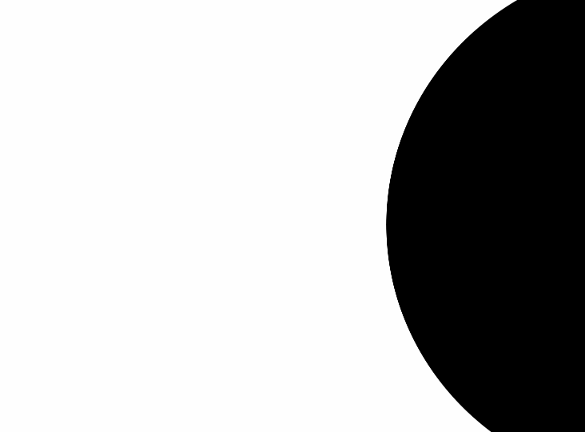




How is Frugal Minimalism Related to Economics?

Slide 2
Certificate Requirements
To earn professional development hours for webinars, you must:
Watch a minimum of 75% for all sessions
You will automatically receive a professional development certificate via e-mail within 24 to 48 hours.

Slide 3
Objectives
You will be able to:
use frugal minimalism to explore consumer demand and behavior
explore the idea of a circular economy that emphasizes sustainability

Slide 4
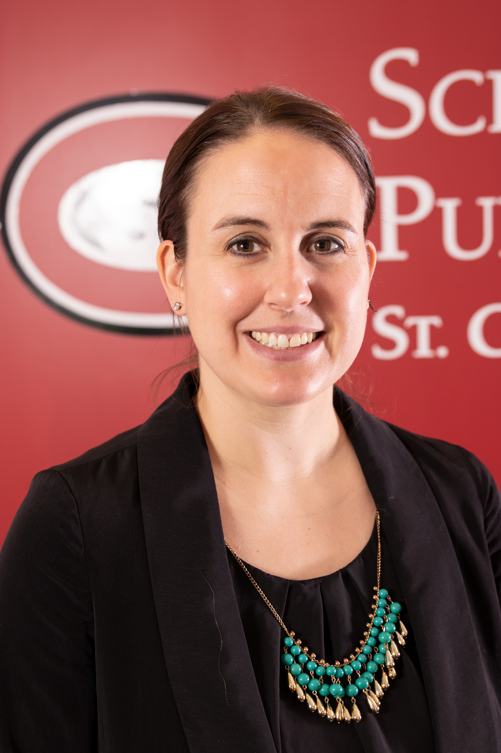

Presenter
Dr. Cynthia Fitzthum
K-12/Secondary Educator Preparation Department, Chair
Center for Economic Education, Co-Director
Social Studies Education, Faculty
St. Cloud State University, Minnesota
SH 345
cjfitzthum@stcloudstate.edu

Slide 5

Session Agenda
Standards Overview
What is Frugal Minimalism?
How is it connected to consumer demand and consumer behavior?
How is it connected to the circular flow and sustainability?
Recap and Reflection

Slide 6


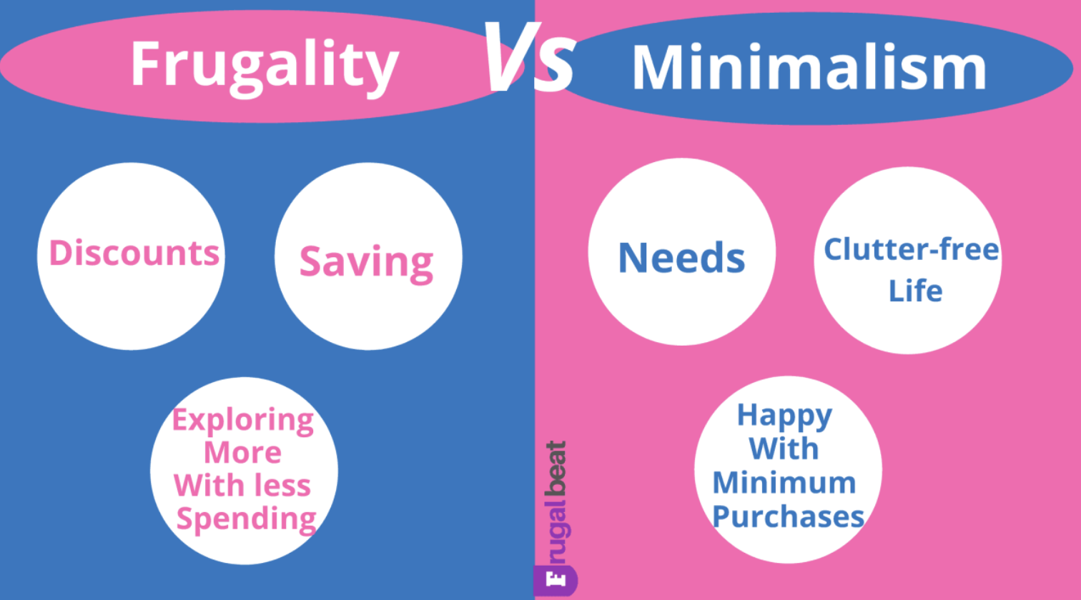

Slide 7
Reflect...
"Too many people spend money they haven't earned to buy things they don't want to impress people they don't like." — Will Rogers
"Do not save what is left after spending, but spend what is left after saving." — Warren Buffett
"Frugal living is not about having less of everything; it's about having more of what you truly value." — Anonymous

Slide 8

Journal Idea
Open up a new Word document or grab a pad of paper
Reflect (Question, Connect, Follow-up)
Take time to review
Action

Slide 9
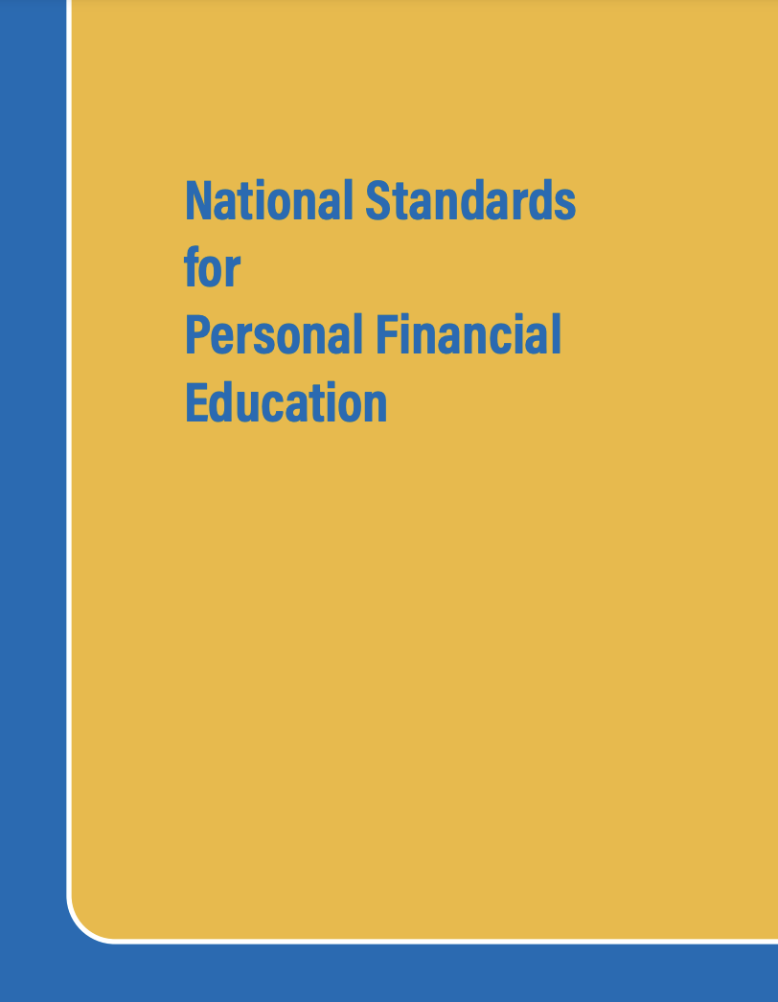
National Standards
Spending 12-1: A budget helps people achieve their financial goals by allocating income to necessary and desired spending, saving, and philanthropy
Spending 12-2: Consumer decisions are influenced by the price of products or services, the price of alternatives, the consumer’s budget and preferences, and potential impact on the environment, society, and economy.
https://www.councilforeconed.org/policy-advocacy/k-12-standards/

Slide 10

National Standards
2.H.1: Acting as consumers, producers, workers, savers, investors, and citizens, people respond to incentives in order to allocate their scarce resources in ways that provide them the highest possible net benefits.
https://www.councilforeconed.org/policy-advocacy/k-12-standards/

Slide 11

What is frugal minimalism and how is it connect to economics? Explore how this is driving the circular economy and consumer behavior. This session will focus on key economic terms such as consumption, debt and savings. Teachers will investigate how they can connect this back into their traditional economic classrooms.

Slide 12
What is frugal minimalism?
Frugal: Intentional spending, seeking value, resourcefulness
Minimalism: Intentional living, little to no excess, purposeful living
Frugal Minimalism: focuses on money saving habits while owning few possessions, allowing you to prioritize what you value the most in life

Slide 13
What is frugal minimalism?
Intentional spending (running shoes example)
Non-material investments (education, travel examples)
Simplify (life, budget examples)
Secondhand goods and repairs when able (sustainability)

Slide 14
How can we use frugal minimalism to explore consumer demand and behavior?
Consumer Demand: total amount of goods and services that people are willing to buy at various prices
Consumer Behavior: study of how people buy and use goods and services
Reflect: How can these be related to frugal minimalism?

Slide 15
EconEdLink Lessons
Consumer Demand Lesson: Would you demand it? (https://econedlink.org/resources/would-you-demand-it/)
Consumer Behavior Lesson: Be an Energy Saver (https://econedlink.org/resources/be-an-energy-saver/)
Frugal Minimalism Connections? Use chat now and/or journal to brainstorm how these lesson topics might be connected.

Slide 16

EconEdLink Lessons
Consumer Demand Lesson: Would you demand it?
Students will be able to:
Explain the basic principles of demand.
Recognize the relationship between price and quantity demand.
Demonstrate an understanding of the determinants of demand
Example: Ask student to explain why prices increased during this time period. Answers should include an increase in the number of features, memory, etc.) Ask students what they think would happen if the price of today’s cell phones were only $5. Most likely, more people would want to buy them because the price is so low. Explain that low prices tend to increase the quantity demanded for goods and services, while higher prices tend to decrease the quantity demanded. This inverse relationship between price and demand is called the law of demand. Understanding this concept will help them appreciate the role of consumers in the marketplace.

Slide 17
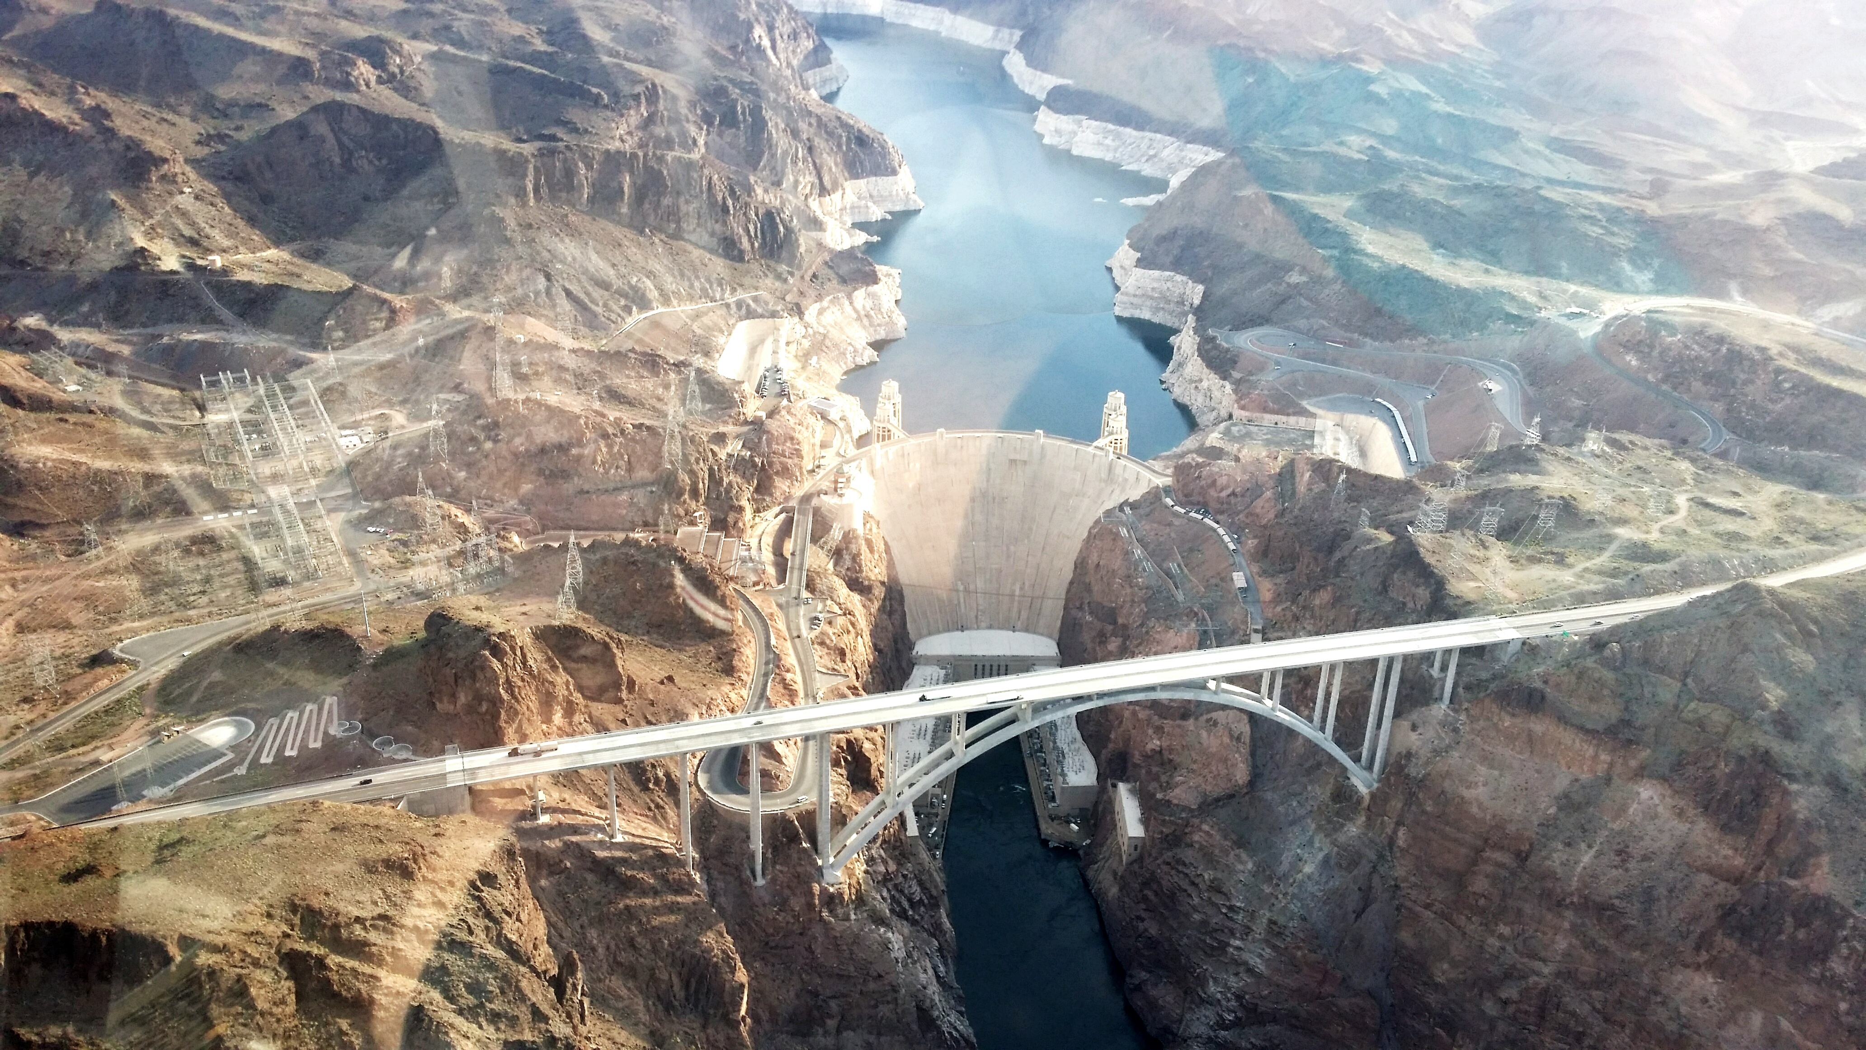
EconEdLink Lessons
Consumer Behavior Lesson: Be an Energy Saver
Learning Objectives
Identify energy alternatives that use people power.
Compute the operating cost of a major appliance.
Choose the best deal on an appliance after considering both the purchase price and lifetime operation costs of an appliance.
Explain how economic incentives influence people’s behavior.
This lesson focuses on the scarce and nonrenewable nature of fossil fuels in order to stimulate student thinking about energy conservation.
In this lesson, students examine options for reducing their dependence on energy resources, especially by substituting people power for other forms of energy and purchasing energy efficient home appliances. Students also explore some of the government programs that are influencing consumer choices in the marketplace

Slide 18

Reflect: How can our students benefit by learning about frugal minimalism? Journal and/or use chat now.

Slide 19
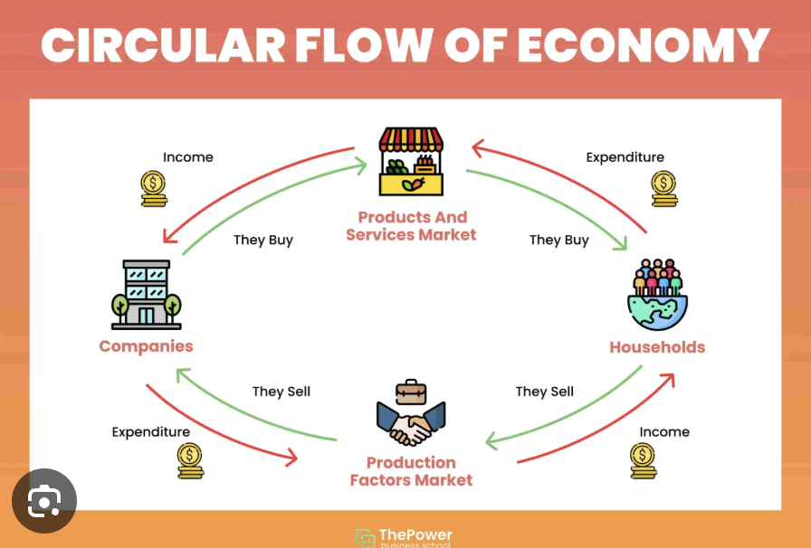
How can we explore the idea of a circular economy that emphasizes sustainability?
Lesson Plan: Circular Flow & GDP
Webinar/Slides: https://econedlink.org/webinar/ap-macro-unit-2-circular-flow-and-gdp/
Also: ECONOLand
https://mrpintar.weebly.com/uploads/6/3/1/9/6319125/econoland_-_circular_flow_simulation.pdf

Slide 20
How can we connect the circular flow with sustainability?
Continue to circulate assets by recycling, sharing, reusing and repairing.
Make companies in charge of ownership of pollution and waste, with incentives to create a cleaner environment.
Leasing and sharing models that can extend economic utility are encouraged in this economy.
Reflect: Can you think of any others? Utilize chat and/or journal now.

Slide 21
How can we assess this?
Assessments*
Jigsaw Research: Brainstorm as a class further research topics they would like to dig into under the umbrella of "Frugal Minimalism". Then, have each small group pick a subtopic and create a presentation, sharing with the class to piece a more holistic view of the topic. (The Federal Reserve website has some fantastic data to dig into!) Thus, the "jigsaw" effect.
Create a Frugal Living Book: Assign each student/group a chapter topic to write about and compile into a classroom book about frugal living tips related to economics and minimalism. Suggestions to start: Transportation, Buying Groceries, Traveling, Schooling, Entertainment, etc. This can be focused on high school or college students taking an economic or personal finance course.
*In addition to the lesson assessments covered previously

Slide 22

Recap:
What is Frugal Minimalism?
How is it connected to consumer demand and consumer behavior?
How is it connected to the circular flow and sustainability?
Reflect: Can you answer these?

Slide 23
Economic Connections To Recap:
Shift from consumption to personal utility focus.
Reducing costs and environmental impacts.
Understanding the value of time and opportunity costs.
Prioritizing long term growth over short term instant gratification.

Slide 24

Reflection: How can I use an economic mindset of frugal minimalism in my current life to better serve myself?

Slide 25

Thank you!
Cjfitzthum@stcloudstate.edu

