Slide 1



Keynes v Hayek
Clash of Ideas that Shaped the World

Slide 2
Certificate Requirements
To earn professional development hours for webinars, you must:
Watch a minimum of 75% for all sessions
You will automatically receive a professional development certificate via e-mail within 24 to 48 hours.

Slide 3
Objectives
You will be able to:
Explain and compare the core ideas of the Keynesian and Austrian schools, including their views on government intervention, markets, and economic cycles.
Apply Keynes's and Hayek's ideas to current policy debates such as inflation, stimulus spending, and regulation.

Slide 4


Presenter
Lynn MacDonald, Ph.D.
Economics Professor
Co-Director, St. Cloud State University Center for Economic Education
lcmacdonald@stcloudstate.edu
Linkedin.com/in/lynn-macdonald-b65a85404

Slide 5
The SCSU Center for Economic Education (SCSU CEE) strives to develop a well-informed and economically literate citizenry in Central Minnesota. The Center provides timely and relevant economic content and curriculum to students, K-12 educators, and the broader community.

Slide 6

MCEE
MINNESOTA COUNCIL ON ECONOMIC EDUCATION
Misson
Vision
We equip Minnesotans with the economic and personal finance knowledge and skills to make informed decisions and thrive in our complex world.
Economic and financial literacy education has transformed the lives of Minnesotans, empowering them to find pathways to life and workplace success, and to provide for family and community stability.

Slide 7
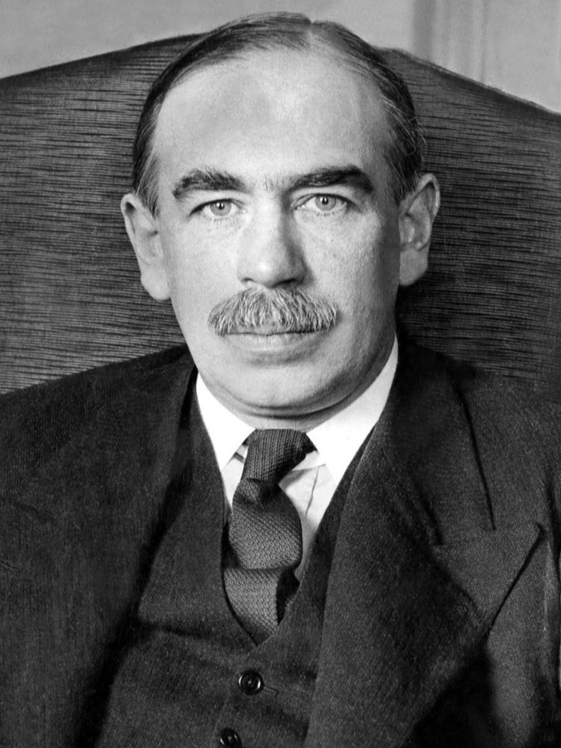
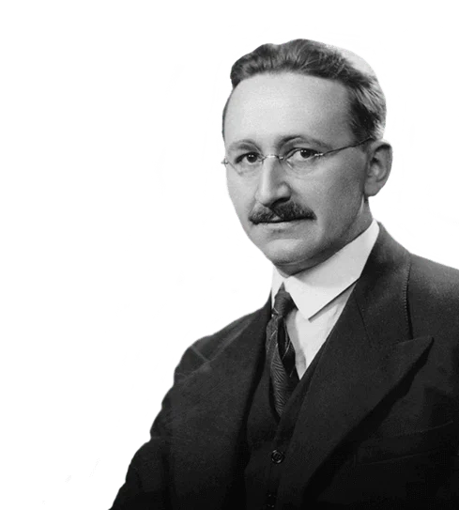
Session Agenda
1. Historical Context - Great Depression, WWII
2. Keynesian and Austrian Schools of Thought
3. John Maynard Keynes
4. Friedrich Hayek
5. Clash of Ideas
6. Current Applications
Classroom integration ideas throughout

Slide 8

National Standards
Standard 7: Role of Government
7.H.1 Government policy involves tradeoffs among efficiency, equity, stability, freedom, and growth.
Standard 16: Growth and Fluctuations
16.H.6 Recessions and expansions
16.H.7 Business cycles
16.H.8 Unemployment and economic fluctuations
Standard 18: Fiscal Policy and Taxation
18.H.1 Fiscal policy affects output, employment, and prices
18.H.5 Expansionary and contractionary fiscal policy effects
NATIONAL STANDARDS ALIGNMENT PDF
https://www.councilforeconed.org/policy-advocacy/k-12-standards/

Slide 9
Question
Do you mention any historical economists in your classes already? If so, who?

Slide 10
Warm-up Question
Who should steer the economy–governments or markets?
possible debate prompt later
could show a warm-up video before posing this question to students

Slide 11
Historical Context

Slide 12
Historical Context
Great Depression - global economic downturn (collapse) with high unemployment and deflation
stock market crash → kicked off collapse
bank failures → people lost their savings and reduced spending.
businesses reduced production and let workers go

Slide 13
Historical Context
Great Depression
consumer prices fell 25%
real GDP fell 29%
1929-pre-depression, unemployment was 3%
1933 - unemployment in U.S. was 25%. 13-15 million unemployed. Worst year.
widespread poverty, homelessness, and hunger.
People were struggling and relief wasn’t coming quickly.
Notes:
https://www.stlouisfed.org/the-great-depression/curriculum/economic-episodes-in-american-history-part-3

Slide 14
Question
How many U.S. banks failed during the Great Depression between 1929-1933?
Answer: 7,000
That’s 33% of U.S. banks
Notes:
https://www.stlouisfed.org/the-great-depression/curriculum/economic-episodes-in-american-history-part-3

Slide 15
Historical Context
Great Depression–worldwide impact
Every continent was affected
world unemployment peaked around 30% in 1932
international trade fell by 30% and tariff policies worsened the impact. (Countries raised tariffs)
sharp decrease in industrial production
falling crop prices devastated agricultural economies worldwide (demand from industrialized nations fell)
Notes:
copilot and https://www.stlouisfed.org/the-great-depression/curriculum/economic-episodes-in-american-history-part-3

Slide 16
Historical Context
Great Depression-Policy Approach
Many governments initially attempted to balance budgets through spending cuts and tax increases. Critics argued these policies deepened the downturn, while supporters viewed them as necessary for fiscal stability.
Led to major policy shifts
  U.S. abandoned the gold standard in 1933
  U.S. expanded social programs
*created with copilot
Notes:
https://www.stlouisfed.org/the-great-depression/curriculum/economic-episodes-in-american-history-part-3

Slide 17
Lesson Plan
Where did all the money go: a great depression mystery (EconEdLink)
Students explore history and engage in 5-year time period analysis in groups
Includes
Activity
Reading
Quiz
WhatDunnit? The Great Depression Mystery Lesson Demo
How Bad was the Great Depression? (St. Louis FRB)

Slide 18
Historical Context
The New Deal
U.S. response under FDR: large-scale public works (WPA), Social Security Act, banking reforms.
Introduced unemployment insurance, labor protections, and infrastructure investment.
Marked a turning point toward active government intervention in the economy.
Helped expand support for a larger government role in economic stabilization and social welfare.
*created with copilot

Slide 19
Lesson Plan
Unemployment and the New Deal (EconEdLink)
Analyze Great Depression unemployment data and New Deal programs to determine those programs’ possible impact.
Includes
Students analyze New Deal Programs
Teaches students about the New Deal

Slide 20
Historical Context
Rise of Nazi Germany (1933-1945)
1933: Hitler & Nazi Party seized power during economic crisis.
Extremist Policies:
Totalitarian dictatorship: one-party rule, propaganda, suppression of freedoms.
Racial ideology: persecution of Jews and others → Holocaust.
Economic Actions:
Massive state control: rearmament, public works (Autobahn), push for self-sufficiency.
*created with copilot
Notes:
Impact:
Short-term recovery through jobs and military spending.
Long-term devastation: war, destruction, human tragedy.

Slide 21
Historical Context
World War II (1939-1945)
Total war economies that included:
  Rationing
  price controls
  centralized resource allocation
*created with copilot

Slide 22
Question
How did this pave the way for economists like Keynes and Hayek?

Slide 23
Context
We often see that historical context matters
Economics is no exception
What people were experiencing around the world, influenced economic thinkers.
Enter–Keynes and Hayek
Both were influenced by the Great Depression and the suffering people were experiencing
They had different ideas on how to fix it

Slide 24
Keynes and Hayek
John Maynard Keynes (England)
Friedrich Hayek (Austria)
Two economic philosophers who grew up in different countries.
Both were leaders in their respective “schools” (i.e., Schools of Thought)
Viewed causes and consequences of the Great Depression differently.

Slide 25
Austrian and Keynesian
Schools of Thought

Slide 26
Austrian School (1871- )
Major Tenets/Principles
Focus on Individual and Subjectivity
Private Ownership
Emphasize qualitative analysis and caution against relying exclusively on aggregate statistical measures.
Spontaneous Order → markets are self-correcting
Focus on Long-run
Fundamental Economic Problem—how individuals coordinate their plans with those of others.
Notes:
Core Idea: Markets are self-regulating; government intervention distorts signals and creates inefficiencies.
Key Principles:
Individual Choice and Subjective Value: Economic value is determined by individual preferences, not aggregates.
Business Cycle Theory: Booms and busts are caused by artificial credit expansion and low interest rates set by central banks.
Role of Prices: Prices convey critical information for resource allocation; interference disrupts this process.
Spontaneous Order: Markets naturally coordinate complex economic activity without central planning.
Critique of Intervention: Government spending and monetary manipulation lead to misallocation of resources and inflation.
Policy Implication: Limit government intervention; allow markets to adjust naturally—even if painful in the short run.

Slide 27
Austrian School
Core Ideas
Markets generally coordinate economic activity more effectively than central planners.
Government intervention distorts information/signals and creates inefficiencies.
Policy Approach
Limited Government Intervention → allow markets to adjust naturally even if this is painful in the short run.

Slide 28
Keynesian School (1936- )
Major Tenets/Principles
Focus on aggregate demand and employment.
Markets may not self-correct quickly.
Prices and wages can be "sticky."
Government can stabilize the economy through fiscal and monetary policy.
Focus: Short run
Notes:
Core Idea: Markets are not always self-correcting; government intervention is necessary during economic downturns.
Key Principles:
Aggregate Demand Drives Output: Economic activity depends on total spending (consumption, investment, government).
Sticky Prices and Wages: Prices and wages adjust slowly, so recessions can persist without intervention.
Fiscal Policy as a Stabilizer: Government should use spending and taxation to manage demand and smooth business cycles.
Multiplier Effect: Increased government spending can have a magnified impact on overall economic activity.
Short-Run Focus: Emphasis on managing short-term fluctuations rather than relying solely on long-run equilibrium.
Policy Implication: During recessions, increase government spending and/or cut taxes; during booms, reduce spending or raise taxes.

Slide 29
Keynesian School
Core Ideas
Markets are not always self-correcting.
Government intervention is necessary during economic downturns to stabilize the economy
Policy Approach-Countercyclical Policy
Recessions: increase government spending and/or cut taxes
Booms/Expansions: reduce government spending and/or raise taxes

Slide 30
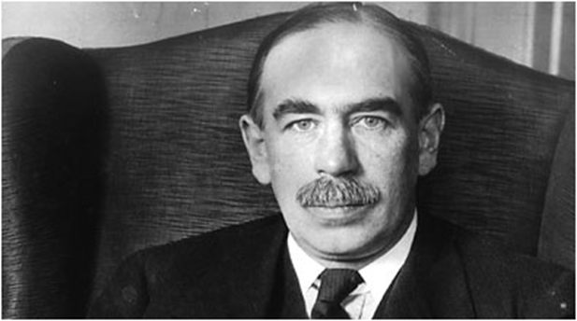
John Maynard Keynes
(1883 - 1946) England
Keynesian School of Thought

Slide 31
John Maynard Keynes
Born in Cambridge, UK
Read Alfred Marshall and studied under Marshall
Keynes did not major in economics
Keynes wrote “Marshall is continually pestering me to turn professional economist…Do you think there is anything in it? I doubt it.”

Slide 32
John Maynard Keynes
1923 Tract on Monetary Reform: “in the long run we are all dead”
1930 Treatise on Money
1936 The General Theory of Employment, Interest, and Money. Very theoretical book. Revolutionized Macroeconomics
Paul Samuelson “It is a badly written book, poorly organized; any layman who, beguiled by the author’s previous reputation, bought the book was cheated of his five shillings . . .It abounds in mares’ nests and confusions . . . In short, it is a work of genius.”
NOTE: Keynes’ General Theory provided a framework for understanding the economy. Many of his policy suggestions were already being considered. Those policies would later be called Keynesian.
Notes:
Paul Samuelson “It is a badly written book, poorly organized; any layman who, beguiled by the author’s previous reputation, bought the book was cheated of his five shillings . . .It is arrogant, bad tempered, polemical and not overly generous in its acknowledgments. It abounds in mares’ nests and confusions . . .
In short, it is a work of genius.”
Related to “in the long run we are all dead” = Keynes's point was that policymakers should not ignore severe current suffering while waiting for markets to adjust.

Slide 33
Keynes-Contributions
Multiplier Effect
An initial increase in spending leads to a larger overall effect on income and output
Keynes argued that government spending can have a multiplier effect on income and output.
Important for understanding stimulus spending
*created with copilot

Slide 34
Keynes-Contributions
Aggregate Demand and Employment
Aggregate Demand (AD) → i.e., total spending in the economy. AD determines output and employment
Employment levels depend on aggregate expenditures, not just wages or prices.
Unemployment is often because of insufficient AD, not high wages
Together firms produce a level of output they expect to sell. But, sometimes aggregate expenditures aren’t enough to buy everything that’s been produced.
When this happens unsold goods accumulate and firms lay off workers and cut back on output. Actual output is less than the amount that would be produced under “full employment”
*created with copilot
Notes:
Moved economics to more demand focus, away from previous more supply focus of the classical school of thought.
Major cyclical unemployment during recessions often reflected demand shortfalls.

Slide 35
Keynes-Contributions
Bretton Woods Conference (1944)
Established IMF and World Bank to stabilize global finance and promote reconstruction.
Keynes was a chief architect, advocating managed exchange rates and international cooperation.
Created a framework for post-war prosperity and global trade.
*created with copilot

Slide 36
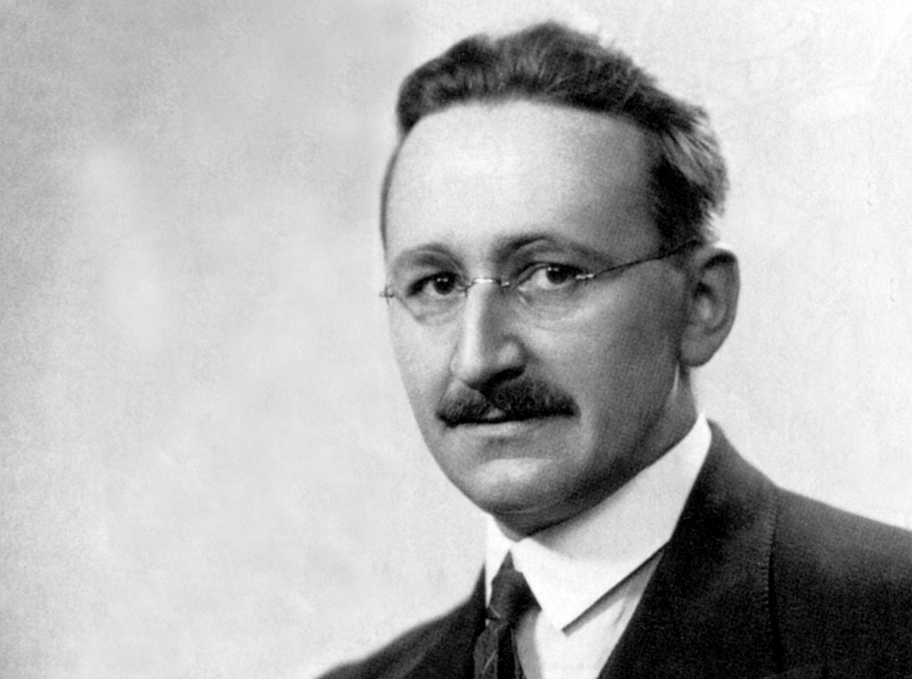
Friedrich Hayek
(1899 - 1992) Austria
Austrian School of Thought

Slide 37
Friedrich Hayek
Born in Vienna
Doctorate in law and political science
1927—Director, Austrian Institute for Business Cycle Research
1931—moved to London with family (exiled)
Faculty at London School of Economics (during war)
Became a British citizen in 1938—began to attack Nazi regime in print
1950-1962–University of Chicago

Slide 38
Hayek-Contributions
Spontaneous Order
Markets are of spontaneous order → unplanned
But, markets don’t work perfectly
Credit expansion and artificially low interest rates can distort investment decisions.
Investors may make unsustainable investments, contributing to boom-bust cycles.
This causes mistaken capital investment which could take us from boom to bust

Slide 39
Hayek-Contributions
Business Cycles
Busts are important and are a necessary readjustment.
If we want to avoid the busts we must also avoid the booms that cause them.
Hayek believed Keynesian policies for full employment would cause inflation

Slide 40
Hayek-Contributions
Effectiveness of Social Planning
Central planning suffers from an information problem
Selected writing on this topic
  (1944) Road to Serfdom
  (1945) “The Use of Knowledge in Society” AER
  (1988) Fatal Conceit

Slide 41
Hayek-Contributions
The Knowledge Problem
Knowledge is scattered among millions of people.
No planner can know everything needed to run an economy.
Prices communicate information. Prices are like messages.
Markets help coordinate decisions without central direction.

Slide 42
Clash of Ideas

Slide 43
Clash of Ideas
Aspect | Keynesian School | Austrian School
Core Idea | Markets can fail; government intervention stabilizes economy | Markets generally self-correct; intervention distorts signals
Focus | Aggregate demand and short-run fluctuations | Individual choices and long-run market processes
Business Cycle View | Caused by insufficient demand; fix with fiscal stimulus | Caused by credit expansion and interest rate manipulation
Role of Government | Active role: spending and taxation to manage demand | Minimal role: avoid interference in markets
Policy Tools | Fiscal policy (spending, taxes); monetary policy | Free markets; sound money; limit central bank influence
*created with copilot.

Slide 44
Clash of Ideas
Aspect | Keynesian School | Austrian School
Critique of one another | Hayek’s laissez-faire approach leads to prolonged unemployment | Keynesian government intervention causes inflation and misallocation of resources
Legacy | Welfare state, stimulus policies, modern macroeconomics | Influenced modern free-market economics, public-choice perspectives, and debates over regulation and central planning.
Table of information in Clash of Ideas slides available as class handout. Handout: Keynesian v Austrian School

Slide 45
Clash of Ideas
Two well-known economists are taking very different approaches to solving the same issues.
Public statements and written work offer opposing ideas
When did it start?

Slide 46
Timeline-Clash of Ideas
1931: Hayek criticizes Keynes’s Treatise on Money—debate on capital theory begins.
1936: Keynes publishes The General Theory—redefines macroeconomics.
1937: Hayek responds, warning against short-run Keynesian focus.
1944: Hayek publishes The Road to Serfdom—attacks central planning.
1946: Keynesian economics became increasingly influential in post-war policymaking while Hayek's ideas received less attention.
1974: Hayek wins Nobel Prize; resurgence during inflation crisis.
*created with copilot.

Slide 47
Lesson Plan
Keynes v Hayek: the rise of the Chicago School of Economics (EconEdLink)
Students will compare different schools of thought on the role of government in the economy. Focus on: Keynesian and Chicago Schools
Students will learn about Keynes, Hayek, and Milton Friedman
Includes:
Reading a Milton Friedman Essay
Class Activity
Commanding Heights video

Slide 48
Lesson Plan
Keynes v Classical Tool (Econ Ed Link)
Drag and drop interactive where students match economic ideas to either New Classical School or Keynesian School
5-10 minute interactive tool
Fiscal and Monetary Policy Process Interactive Quiz (Econ Ed Link)
Relates to some schools of economic thought and provides resource links to information on schools

Slide 49
Timeline-friendship
1931: Hayek criticizes Keynes’s Treatise on Money—start of their intellectual rivalry.
1933: Keynes writes to his wife, Lydia, about enjoying Hayek’s company despite disagreements.
1944: Keynes nominates Hayek for British Academy fellowship; Hayek publishes The Road to Serfdom.
1946: Keynes dies; Hayek acknowledges Keynes’s brilliance. Wrote to Lydia that Keynes was “the one really great man I ever knew, and for whom I had unbounded admiration.”
1974: Hayek wins Nobel Prize; Keynesian ideas dominate mid-century policy.
*created with copilot.

Slide 50
Who said this?
1. “The one thing I stand for above all else is free trade throughout the world.”
2. “We cannot seriously argue that the government ought to do nothing.”
3. “Capitalism is the extraordinary belief that the nastiest of men, for the nastiest of reasons, will somehow work for the benefit of us all.”

Slide 51
Who said this?
1. “the one thing I stand for above all else is free trade throughout the world.” - Hayek
2. “we cannot seriously argue that the government ought to do nothing.” -Hayek
3. “Capitalism is the extraordinary belief that the nastiest of men, for the nastiest of reasons, will somehow work for the benefit of us all.” -Keynes

Slide 52
Current Applications

Slide 53
Keynesian Ideas in Action
COVID-19 Stimulus Packages (2020–2021)
  Governments worldwide spent trillions on relief checks, unemployment benefits, and business aid.
  Reflects Keynes’s belief in fiscal stimulus during economic downturns to boost demand and prevent deep recessions.
Infrastructure Investment Debates
  U.S. and other countries investing in roads, bridges, and green energy to spur growth.
  Keynesian principle: public spending creates jobs and multiplies economic activity.
Inflation and Interest Rate Policies
  Central banks adjusting interest rates to manage demand and inflation.
  Keynes emphasized monetary policy alongside fiscal policy for stability.
* created with copilot
Notes:
copilot

Slide 54
Hayekian Ideas in Action
Debates on Government Overreach
  Concerns about pandemic lockdowns, vaccine mandates, and economic controls.
  Some commentators drew on Hayek's work when debating whether emergency public-health powers should be limited to protect individual liberty.
Free Market vs. Regulation in Tech
  Should governments regulate big tech companies or let markets self-correct?
  Hayek’s principle: markets coordinate complex systems better than central planners.
Global Supply Chain Disruptions
  Hayek argued that price signals guide resource allocation—recent shortages show what happens when signals are distorted.
* created with copilot
Notes:
copilot

Slide 55
Classroom Integration

Slide 56
Class Idea
Long standing debate between Keynes and Hayek
How much and what kind of government intervention is compatible with a free society?
Two fun videos for classroom use
Students could watch and summarize
Students could create their own videos highlighting differences in Keynes’ and Hayek’s economics contributions.
VIDEO 1: Fight of the Century: Round 1 “Fear the Boom and Bust”
VIDEO 2: Fight of the Century: Round 2

Slide 57
Class Idea: Debate
Debate Prompt: Who should steer the economy–governments or markets?
Using this handout as a guide: Handout: Keynesian v Austrian School
Assign (or allow students to pick) which school of thought they want to research for their debate. Split the class into two groups
Provide some in-class time to prepare (20+ minutes). Instruct them to prepare economic arguments to support their position.
Choose a structured debate format that fits your class
Ideas: 4 Fast Debate Formats (Thoughtco)

Slide 58
Class Idea
Project
Have students work on a project either individually or in small groups. This can be done in part of 2 class periods or as homework.
Let them select an important historical or current economist who helped shape economic ideas
Have them prepare an analysis that includes the following components: School of Economic Thought, Historical Context, Major Contributions, Lasting Contributions
Modification: this project can be modified to focus on women and people of color.
Optional: 5-minute presentations

Slide 59
Class Idea
Read and Summarize
Have students read Hayek’s (1945) “The Use of Knowledge in Society” AER
Ask them to summarize the key points
Have them work in groups to improve their summaries
Have them discuss/analyze whether and how they see the article having relevance today.

Slide 60
Class Idea
Research
Have students look for more recent examples that relate to the clash between Keynes and Hayek.
Have them select and analyze a current issue and go through the the potential/expected responses from Keynes or Hayek
What has the government policy response been and who does this most align with–Keynes or Hayek.

Slide 61
Exit Ticket
Keynes and Hayek agreed that economic downturns cause hardship. What did they disagree about
What is one benefit and one drawback of government intervention in the economy?
Which idea from today's lesson seems most relevant to a current economic issue? Explain.

Slide 62
Economics Resources
The Evolution of Economic Thought Brue and Grant (textbook)
How Bad was the Great Depression? (St. Louis FRB)
New Ideas from Dead Economists Buchholz
Teachings from the Worldly Philosophy Heilbroner
(1945) “The Use of Knowledge in Society” AER
The Worldly Philosophers Heilbroner

Slide 63
Additional Resources
MCEE K-12 Teacher Resources
CEE EconEdLink
Federal Reserve Education
SCSU Center for Economic Education

Slide 64
Standards Alignment Resources
Minnesota Benchmarks in Economics
9.2.11.5
9.2.7.1
9.2.8.4
Additional social studies benchmarks in History and Government/Civics are also addressed. See alignment map: Keynes v. Hayek HS Standards Alignment Map

Slide 65
Contact Us
Lynn MacDonald, Ph.D.
Economics Professor
Co-Director, St. Cloud State University Center for Economic Education
lcmacdonald@stcloudstate.edu
Linkedin.com/in/lynn-macdonald-b65a85404

Slide 66
Thank you

