Slide 1


MINNESOTA COUNCIL ON ECONOMIC EDUCATION
Beyond the Numbers: Integrating Economics and Personal Finance into Elementary Math
An award-winning interdisciplinary curriculum designed to empower young learners.
Presented by: Lisa Wiener

Slide 2

Minnesota Council on Economic Education
Mission & Vision
Our Mission
We equip Minnesotans with the economic and personal finance knowledge and skills to make informed decisions and thrive in our complex world.
Our Vision
Economic and financial literacy education has transformed the lives of Minnesotans, empowering them to find pathways to life and workplace success, and to provide for family and community stability.

Slide 3

Award-Winning Excellence
MCEE's curriculum is nationally recognized for educational excellence.
2024 NAEE Platinum Award of Excellence
In March 2024, the National Association of Economic Educators (NAEE) honored this curriculum with the Platinum Award of Excellence, recognizing its outstanding achievements in education.
The revised and expanded Mathematics and Economics Grades K-5 curriculum provides hands-on lessons that seamlessly blend math and economic benchmarks.

Slide 4


Minnesota Council on Economic Education
The Interdisciplinary Imperative
Interdisciplinary learning addresses the growing need for inclusive, equitable education.
K-5 Targeted Lessons
Developed in response to the increased demand for interdisciplinary K-5 lessons.
Diversity, Equity & Inclusion
Revisions focus heavily on ensuring access for all learners through anti-bias considerations.
Adaptable & Empowering
Empowers educators to teach integrated math, economics, and personal finance effectively in daily, after-school, or summer school settings.

Slide 5
Dual-Standard Alignment
The curriculum is built on a foundation of rigorous academic standards to support dual-subject mastery. Both in English and Spanish formats.
Economics & Social Studies
All lessons are fully aligned with the Minnesota 2021 Social Studies Standards and the National Economics Standards.
Mathematics Mastery
Simultaneously, the activities meet the Common Core Standards in Mathematics and the Minnesota Math 2007 standards.
This ensures students practice critical math skills daily.

Slide 6
Three Core Pillars Across Grades K-5
To ensure comprehensive financial and economic literacy, every grade level in the K-5 curriculum is organized around three essential topics.
Decision-Making
Evaluating alternatives and understanding opportunity costs.
Personal Finance
Budgeting and responsible money management.
Business & Production
Foundational concepts of goods, services, and productivity.

Slide 7

Decision-Making
Students use mathematical data to evaluate trade-offs and make informed choices.
Decision-making lessons introduce the costs and benefits of different choices using graphic organizers and grids.
First Graders
Read Tia Isa Wants a Car and use pro/con organizers to evaluate alternatives.
Third Graders
Analyze elapsed time to identify opportunity costs and convert class schedules into pie charts.

Slide 8

Personal Finance
Practical budgeting exercises build essential money management skills.
Birthday Party Budget
First graders work collaboratively on a birthday party budget to plan a classroom event, tackling real-world spending decisions based on predetermined criteria.
Learning about Income
Fifth graders will calculate budgets and apply their understanding of income and expenses

Slide 9

Business & Production
Hands-on activities introduce students to productivity and global trade concepts.
Core Economic Concepts
Engages students with scarcity, incentives, and globalization, using interactive tools to show how supply, demand, and resources intertwine.
Plotting Potential Production
Students play the role of workers in packet factories, create production data based on their experience, measure productivity and analyze production.

Slide 10
Flexible, Google-Based Formats
MCEE designed the curriculum for maximum usability and adaptability.
Google Drive Integration
All lessons are formatted as Google Documents, allowing instant copying, sharing, and organizing.
Complete Customization
Teachers can modify, shorten, or adapt the prompts, numbers, and reading levels for their students.
Maximum Adaptability
Completely customizable formats ensure teachers can adapt every lesson to any diverse classroom setup and instructional setting.

Slide 11

Measurable Classroom Benefits
Integrated lessons provide broad benefits for diverse learning environments.
Equitable Learning
Focus on anti-bias and culturally responsive teaching fosters equitable environments for all students.
Instructional Efficiency
Combining math and economics maximizes instructional time while supporting diverse populations.
Measurable Outcomes
Pre- and post-assessments ensure students successfully grasp quantitative and financial skills.

Slide 12
Materials included with all grade level lessons
Pre & Post Tests
A paper version of the pre- and post-assessments is also available, allowing teachers to analyze student data and measure learning growth.
Glossary
Teacher and student friendly definitions of economic vocabulary, simplifying key concepts for classroom engagement.
Curriculum Print List
Easy to manage print list designed for quick preparation and efficient organization of all learning materials.
Children’s Literature Connection
Annotated bibliography of children’s literature and resources along with direct links to digital read alouds.
What hurdles do you run into when teaching economics to your students?

Slide 13
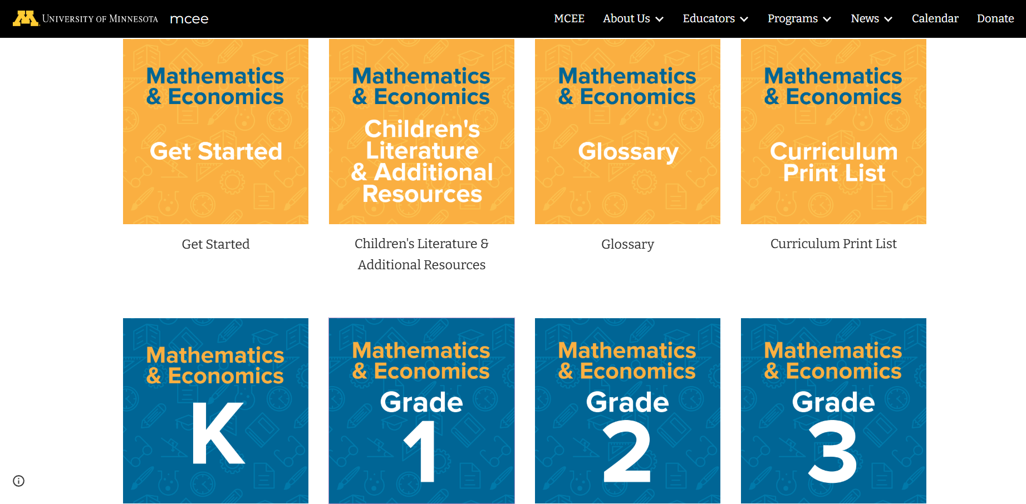

Slide 14
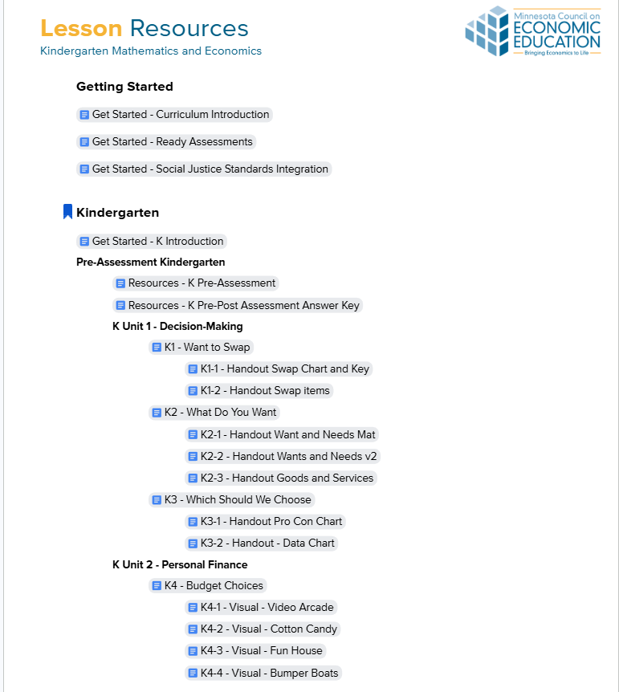
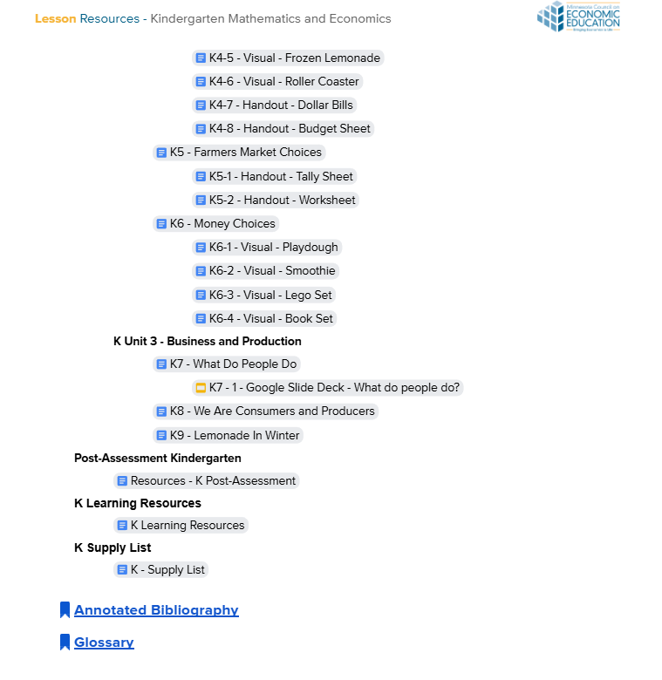

Slide 15
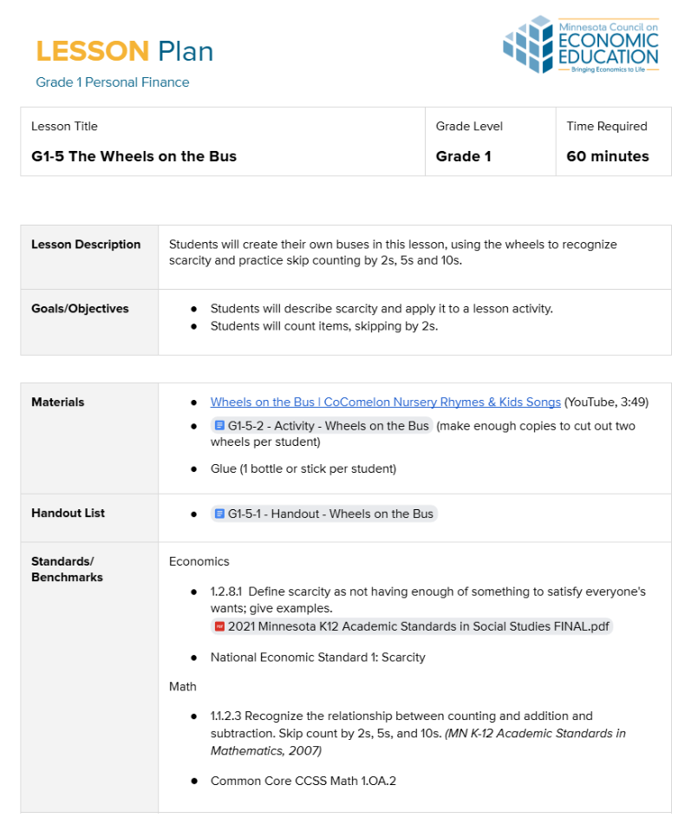
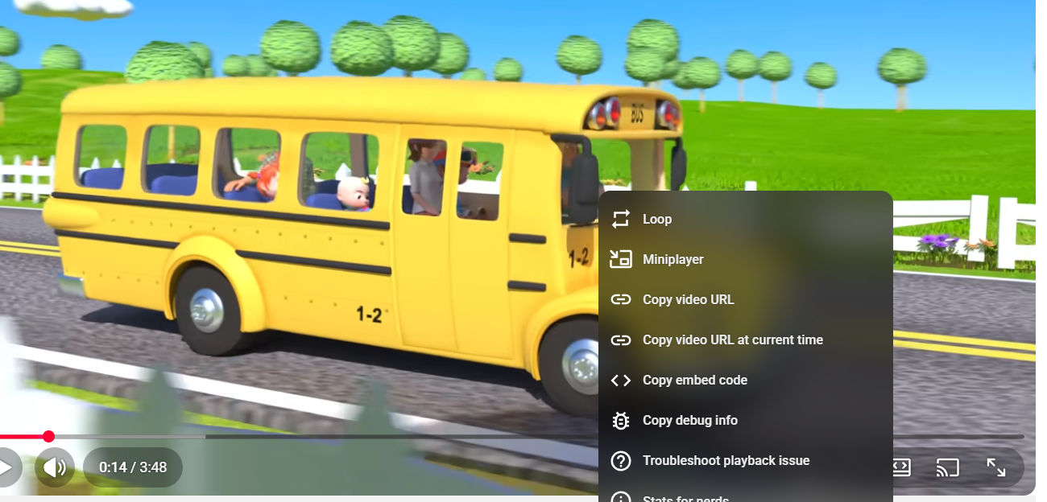

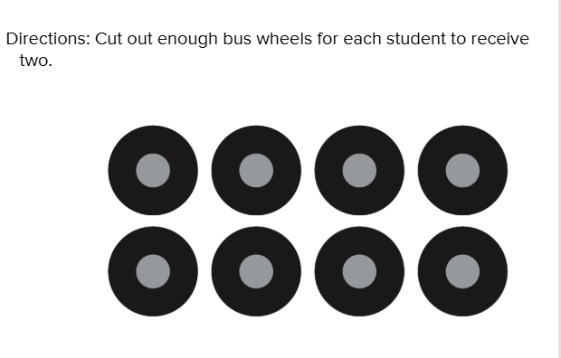
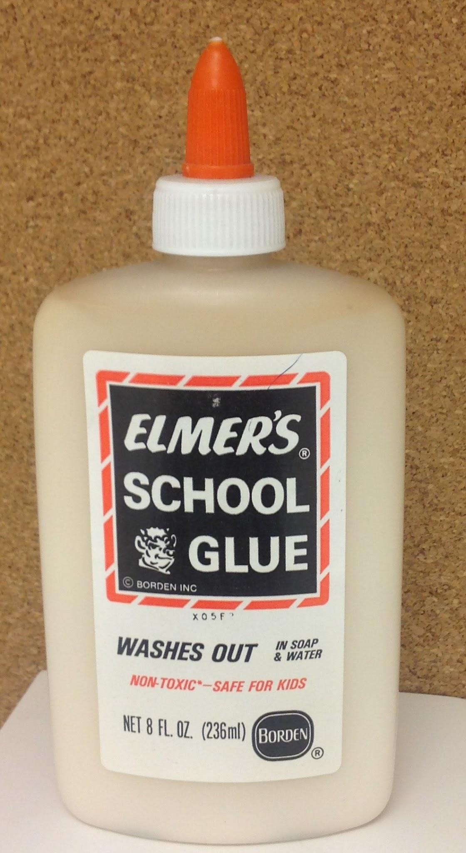

Slide 16
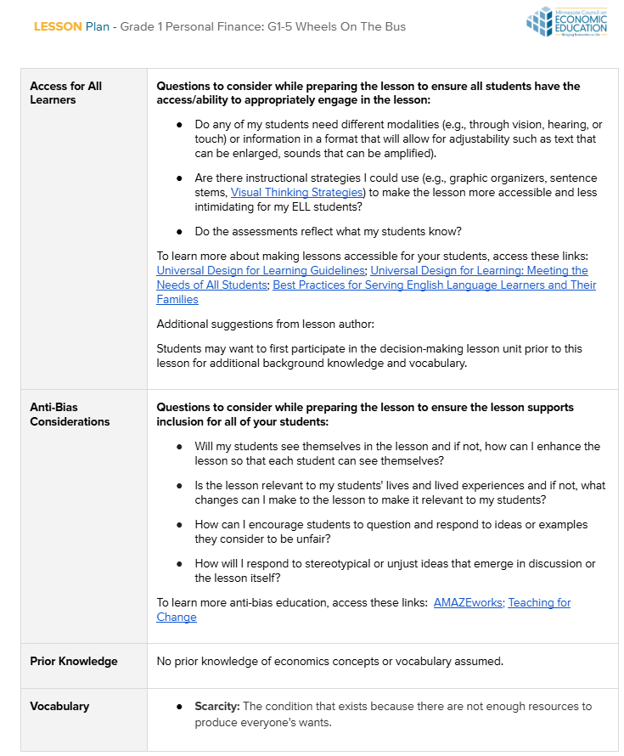
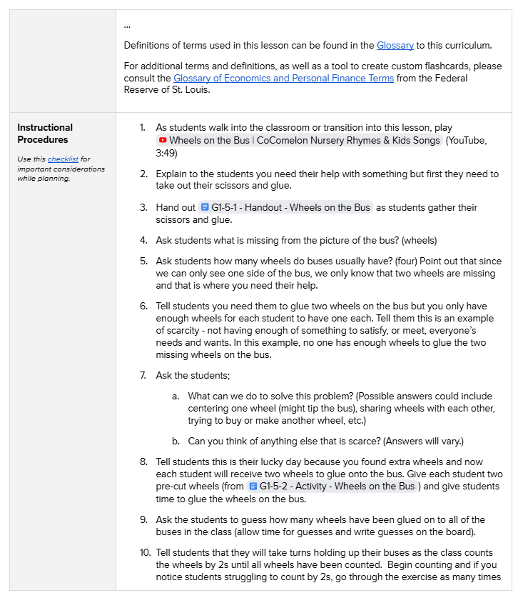

Slide 17
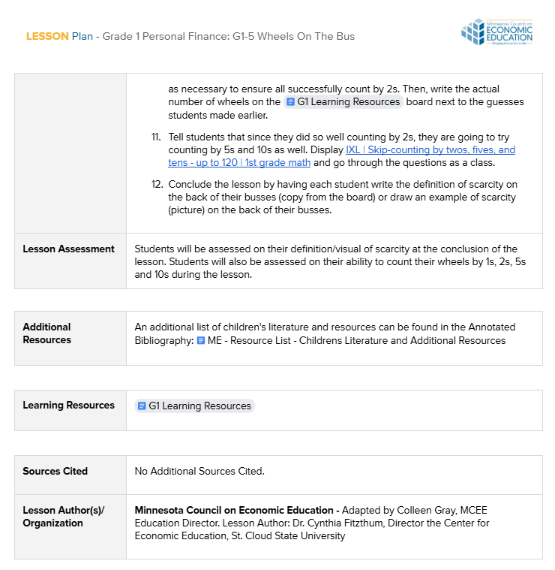
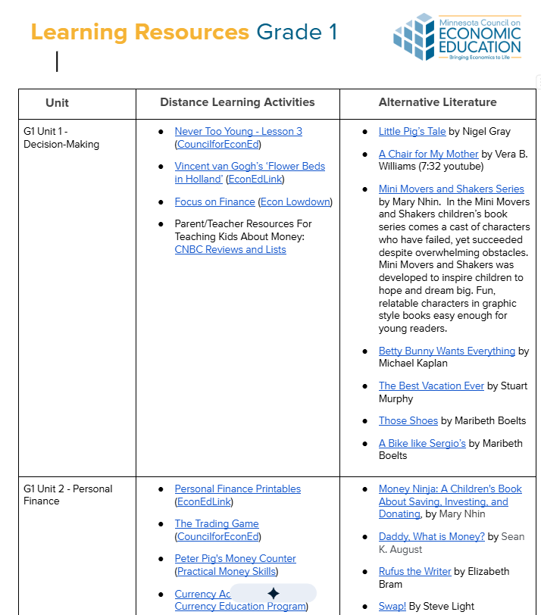

Slide 18
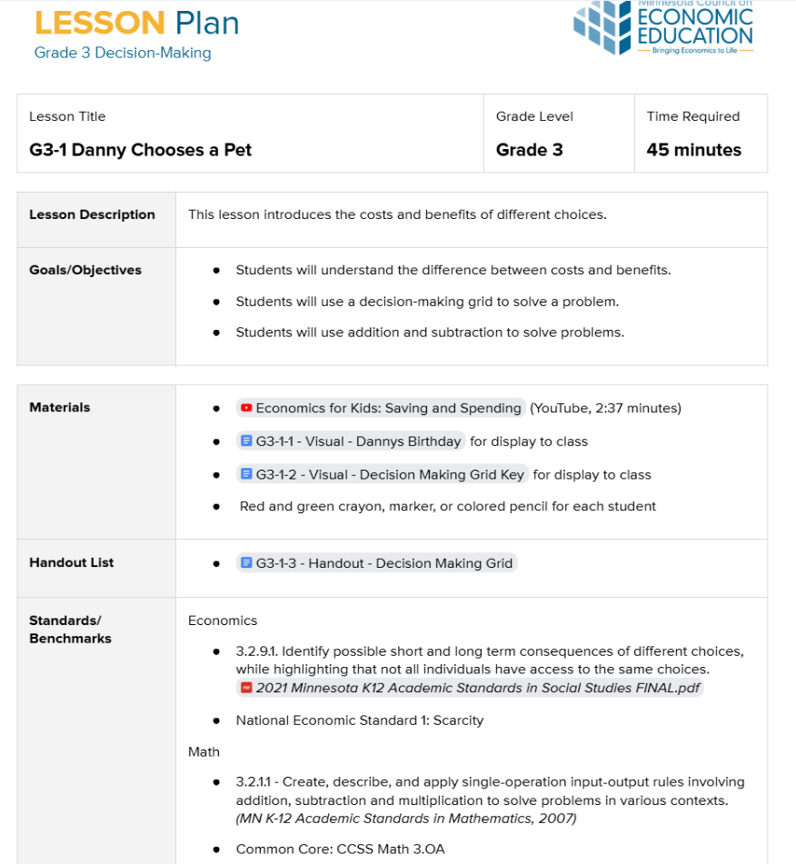
Let’s see what this would look like in action in a 3rd grade classroom!

Slide 19

01 Introduction & Video
Explain to students that the lesson is about the costs and benefits of choices and show them the video.
Economics for Kids: Saving and Spending
YouTube, 2:37 minutes

Slide 20
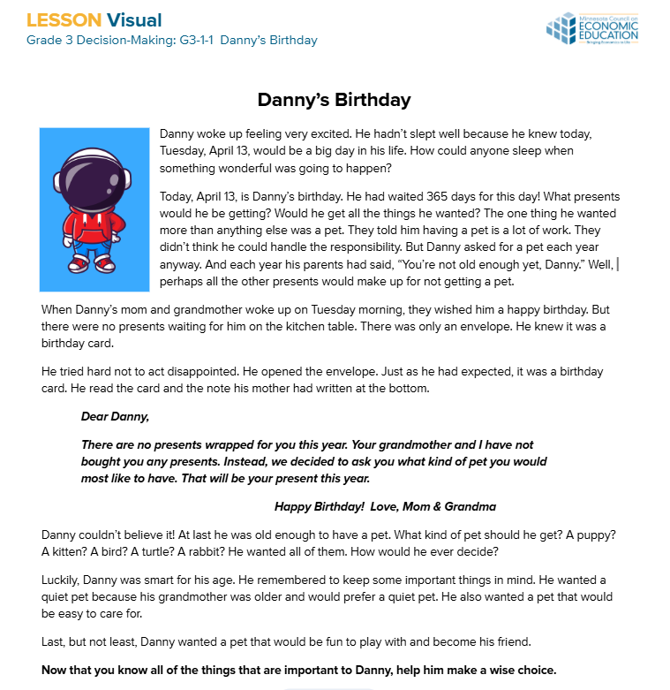
02 Read & Identify
Introduce Danny's scenario to help students practice identifying real-world decision-making problems.
Activity Steps
Display the Story: Present the birthday story on a SmartBoard or print for individual reference.
Read Aloud: Read the narrative to the students to set up the decision context.
What is Danny's core dilemma?

Slide 21
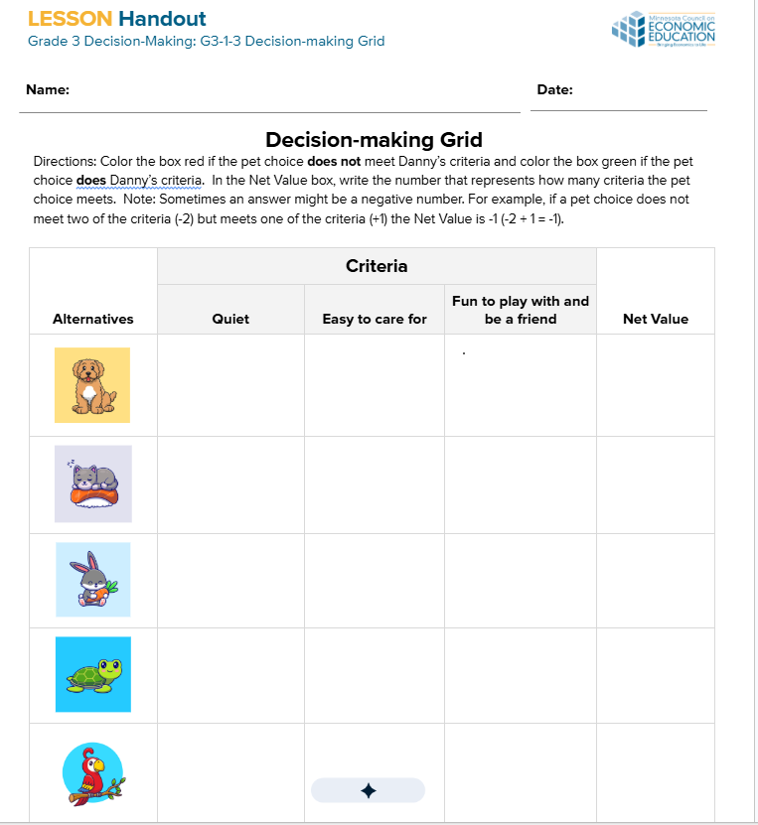
03 Decision-Making Grid
1.Distribute the G3-1-3 - Handout - Decision Making Grid to each student. Have them get a red and green crayon, marker, or colored pencil.
2.Explain that the first column contains Danny's choices or alternatives: dog, cat, rabbit, turtle, or bird.
3.Define criteria on the board as things Danny must consider. Recall his three criteria: Quiet, easy to care for, and fun to play with/be a friend.

Slide 22
04 Guided Practice
Read directions to students and complete the first pet option (Puppy) together to demonstrate the decision grid. Remind them that differing answers are okay.
A. Quiet? Quiet pet? (Puppies bark/whine; color the first box red)
B. Easy Care? Easy to care for? (Needs training, walks, food; color second box red)
C. Fun/Friend? Fun & a good friend? (Puppies are fun; color third box green)
D. Net Value? Count colored boxes. (2 red boxes = -2 as "two strikes". Ask: how many green?) Then create an equation with our two numbers -2 + 1 = -1. Enter -1 in the Net Value box of the puppy column). NOTE: If negative numbers are new for students, take time to answer their questions.

Slide 23
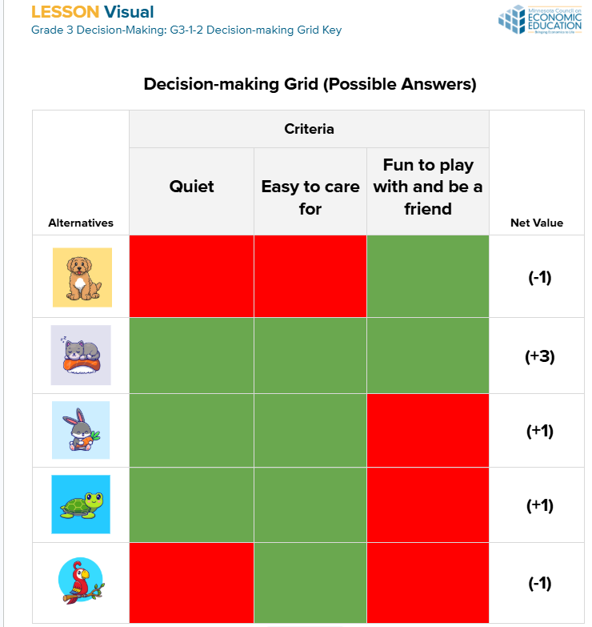
05 Evaluate & Discuss
1. Danny's Best Choice: The Kitten (+3)
The pet that meets the most criteria and has the highest Net Value.
2. Discussion Points:
Second Choice: Rabbit or Turtle (+1 tie).
What was given up? Either the rabbit or the turtle, but not both.
Opportunity Cost
The next-best alternative Danny gave up when choosing the kitten (either the rabbit or the turtle).
The 5-Step Decision Process
Define Problem → List Alternatives → State Criteria → Evaluate → Make Decision

Slide 24



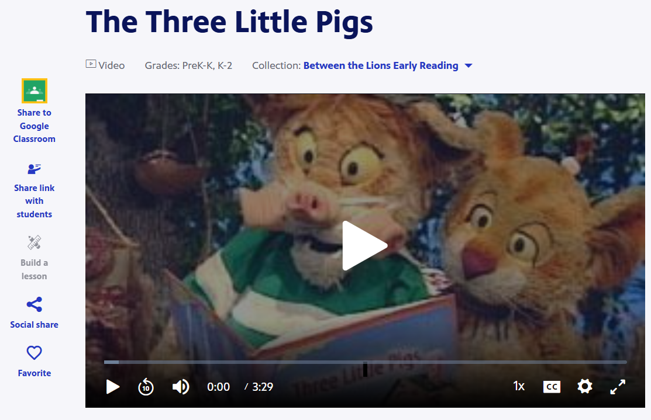
Additional Lessons for extra practice or review

Slide 25
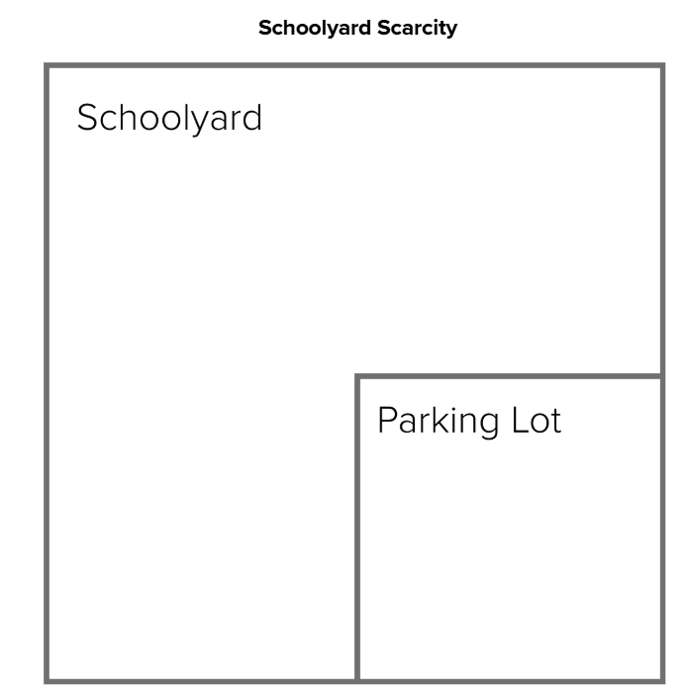
01 Activity Setup
Grade 4 • 45 Minutes • Personal Finance
1. Distribute & Explain
Distribute a copy of G4-3-1 - Activity - Schoolyard Scarcity and scissors to students
The Scarcity Dilemma:
Explain that the school is trying to decide how to use the limited recreational space it has around its parking lot. There are four possible uses:
Fields: Baseball or softball
Hockey Rinks: Skateboard/inline skates in summer
Playground Areas
Courts: Basketball, tennis, pickleball

Slide 26
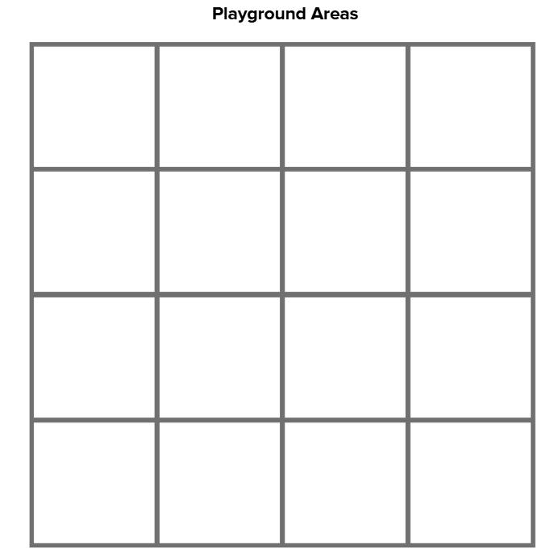
02 Discussion & Analysis
PLAYGROUND AREAS
Suppose you know that the width and length of each Playground Area is 30 meters.
Ask the Class:
"What would the area of each Playground Area be?"
Expected Answer:
900 meters (30m × 30m)

Slide 27
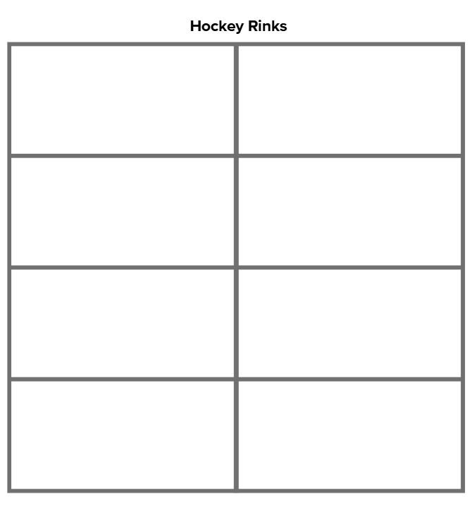
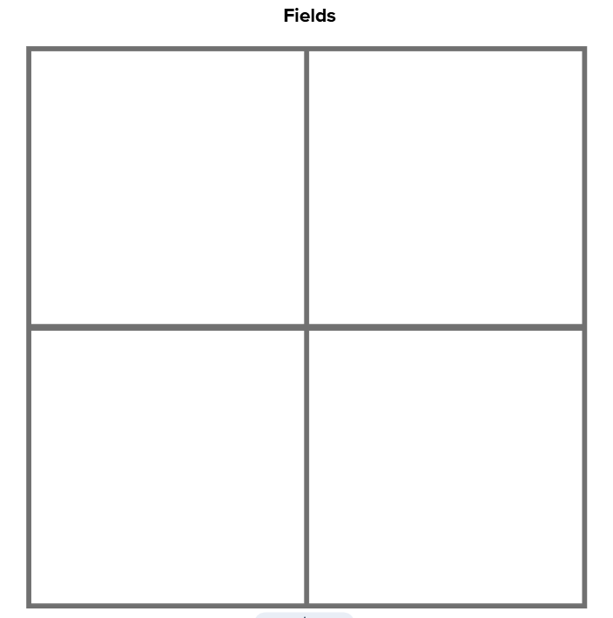
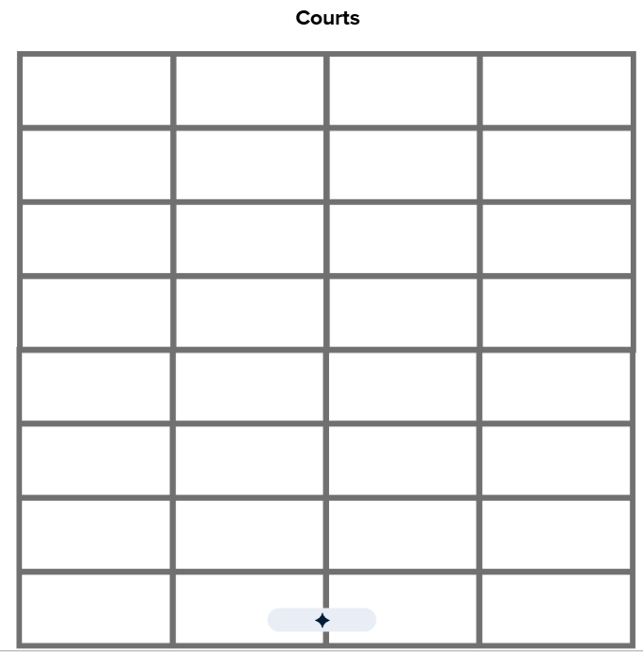
03 Analysis of Space
Given this information, have each group use their Playground Area cutouts to determine each of the following:
The area of a Hockey Rink. (Two Playground Areas cover it exactly, so 900 + 900 = 1800 square meters, or 900 x 2 = 1800 square meters).
The area of a Field. (Four Playground Areas cover it exactly, so 900 + 900 + 900 + 900 = 3600 square meters, or 900 x 4 = 3600 square meters).
The area of a Court. (It takes two Courts to exactly cover one Playground area so, a Court is one‐half the size of a Playground Area, or 900 x 1⁄2 = 450 square meters).

Slide 28
Pro Tip: print each different recreational space on different colored paper

Slide 29
04 Scarcity of Space
1. Share Designs
Since not every student wanted the same recreational space, have students share their schoolyard design with the class or with partners.
2. Partner Reteach
Have students partner up with a classmate and reteach the lesson to each other.
Highlight how area was found by multiplying
Incorporate the concept of scarcity in discussion

Slide 30
Get Started with MCEE
Access MCEE's free resources and workshops to transform your classroom.
FREE LESSONS
Get started today by accessing MCEE's extensive database of free, standards-aligned lessons.
Economics is Everywhere
Teaching Econ from BIPOC authors
Award Winning Lesson from MN teachers
INTERACTIVE TOOLS
Teachers can explore free online finance games, interactive tools, and resources designed for remote or multi-language instruction.
WORKSHOPS & PD
View upcoming MCEE workshops for professional development to master integrative teaching strategies.

