Slide 1



2026 Summer Institute:
Invest Now, Thank Yourself Later

Slide 2
Certificate Requirements
To earn professional development hours for webinars, you must:
Watch a minimum of 75% for all sessions
You will automatically receive a professional development certificate via e-mail within 24 to 48 hours.

Slide 3
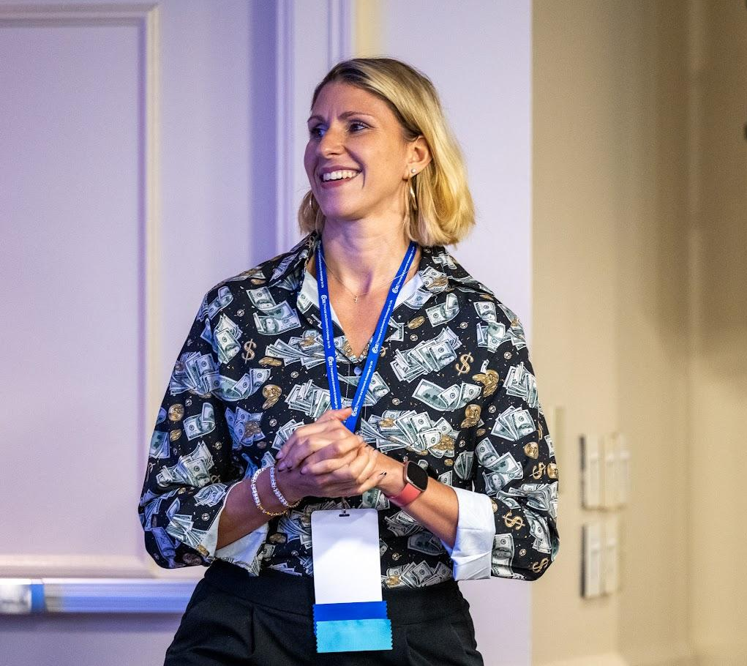
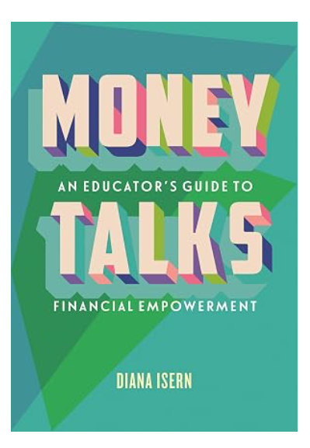
Presenter
¡Hola! I'm Diana Isern:
  Assistant Principal – 20 years in NYC Public Schools
  Financial Educator & Advocate
  Advisor, Invest in Girls (A Program of CEE)
  Curriculum Designer
  AFC® Accredited Financial Counselor
  Soon-to-be author August 25, 2026!
    Money Talks: An Educator's Guide to Financial Empowerment (Beacon Press)
LinkedIn: linkedin.com/in/dianaisern ​ Email: dianaisern@gmail.com
Website: dianafinancialeducation.com

Slide 4
Objectives
You will be able to:
Implement student-centered investment activities aligned to national personal finance standards.
Facilitate discussions that connect students’ cultural and community contexts to wealth-building concepts.
Adapt lesson materials for grades 6–12 across varying levels of financial literacy prior knowledge.

Slide 5
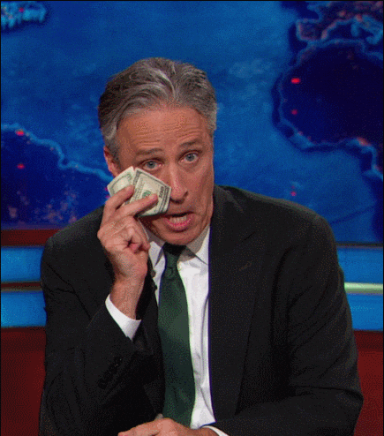
Session Agenda
Introduction: Yay, you're here!
Opening: Community Connection
Part 1- Lesson: Accessing the Stock Market
Part 2 - Lesson: Real Estate
Part 3: Closing & Resources

Slide 6
Opening Connection
Did you grow up talking about investing at home?
Drop a YES or NO in the chat, plus one word for how investing makes you feel.

Slide 7
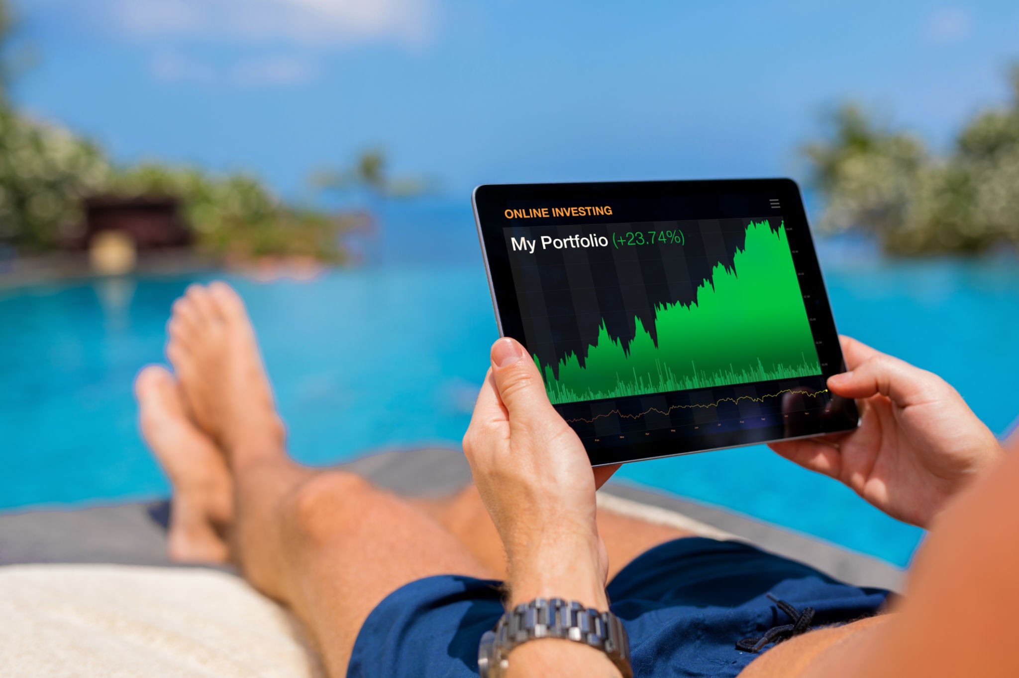

PART 1
Lesson: Accessing the Stock Market

Slide 8

Entry Task: Investing Myth Busters DEMO
True or false? Drop your answers in the chat:
You need a lot of money to start investing
  Reality: You can start with $1–$50. Time in the market matters more than income level.
Investing is only for people who “know what they’re doing”
  Reality: Every investor started not knowing. The learning happens while you invest.
The stock market is basically gambling
  Reality: Gambling is chance. Investing is ownership, time, and strategy.
Notes:
Speaker note: Reveal each one. You can invest with $1. Long-term investing is ownership, not gambling. The best time to invest was yesterday, the next best time is today.

Slide 9
Hook: Would You Rather?
Take $1 million today
or
Take a penny that doubles every day for 30 days?
Vote in the chat: MILLION or PENNY

Slide 10
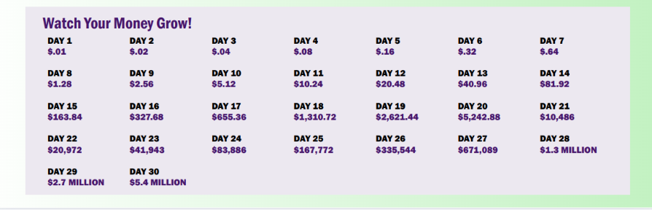
A penny eventually grows to more than $5.3 million! Thanks to how compound interest works.
Notes:
This is compound interest. Time, not timing, creates wealth.
Time in the market beats timing the market.

Slide 11
Activity 1: Stock Market Scavenger Hunt
My Life = A Portfolio
Purpose: Students discover they already have relationships with publicly traded companies. Investing starts with what they know.
Fill in one for each category, then find the company that owns it:
Morning: Sneakers I wear → ______Company: ______
School Day: App I use most → ______Company: ______
Entertainment: Streaming service or game ______ → Company: ______
Weekend: Store or restaurant I go to ______ → Company: ______
How to look it up:
Google "who owns [brand]," then confirm on finance.yahoo.com to find the ticker.

Slide 12
Activity: Stock Market Scavenger Hunt
Wait... Brand or Company?
You wrote Gatorade. You found PepsiCo.
A brand is what we buy. A company is what we can own.
Investors learn to see who actually owns what.
One company often holds many brands you already love.
Wise words…Follow the ownership!
Quick! Find out and drop it in the chat:
Can you buy stock in TikTok?
Can you buy stock in the company that makes your favorite chips?

Slide 13

Activity: Stock Market Scavenger Hunt
Notes:
Speaker note: TikTok reveal. ByteDance is a private company, so no. This is where "publicly traded" clicks. Frito-Lay leads back to PepsiCo again.

Slide 14
Activity: Stock Market Scavenger Hunt
Build Your First Mini-Portfolio
Look at your scavenger hunt list.
You have $500 and you can pick only ONE company.
Which one do you choose?
Why that one?
Drop your pick in the chat.
Notes:
Speaker note: Let the discomfort sit for a moment. "How does it feel to bet it all on one?"

Slide 15
Activity: Stock Market Scavenger Hunt
What If You Didn't Have to Choose?
Picking one winner is hard. Even the pros get it wrong!
A fund pools many companies into one purchase.
An index fund or ETF can hold all 500 companies in the S&P 500.
Your $500 buys a small piece of every single one.
Don't put all your pasture-raised eggs in one basket.
Notes:
Speaker note: Let the discomfort sit for a moment. "How does it feel to bet it all on one?"

Slide 16
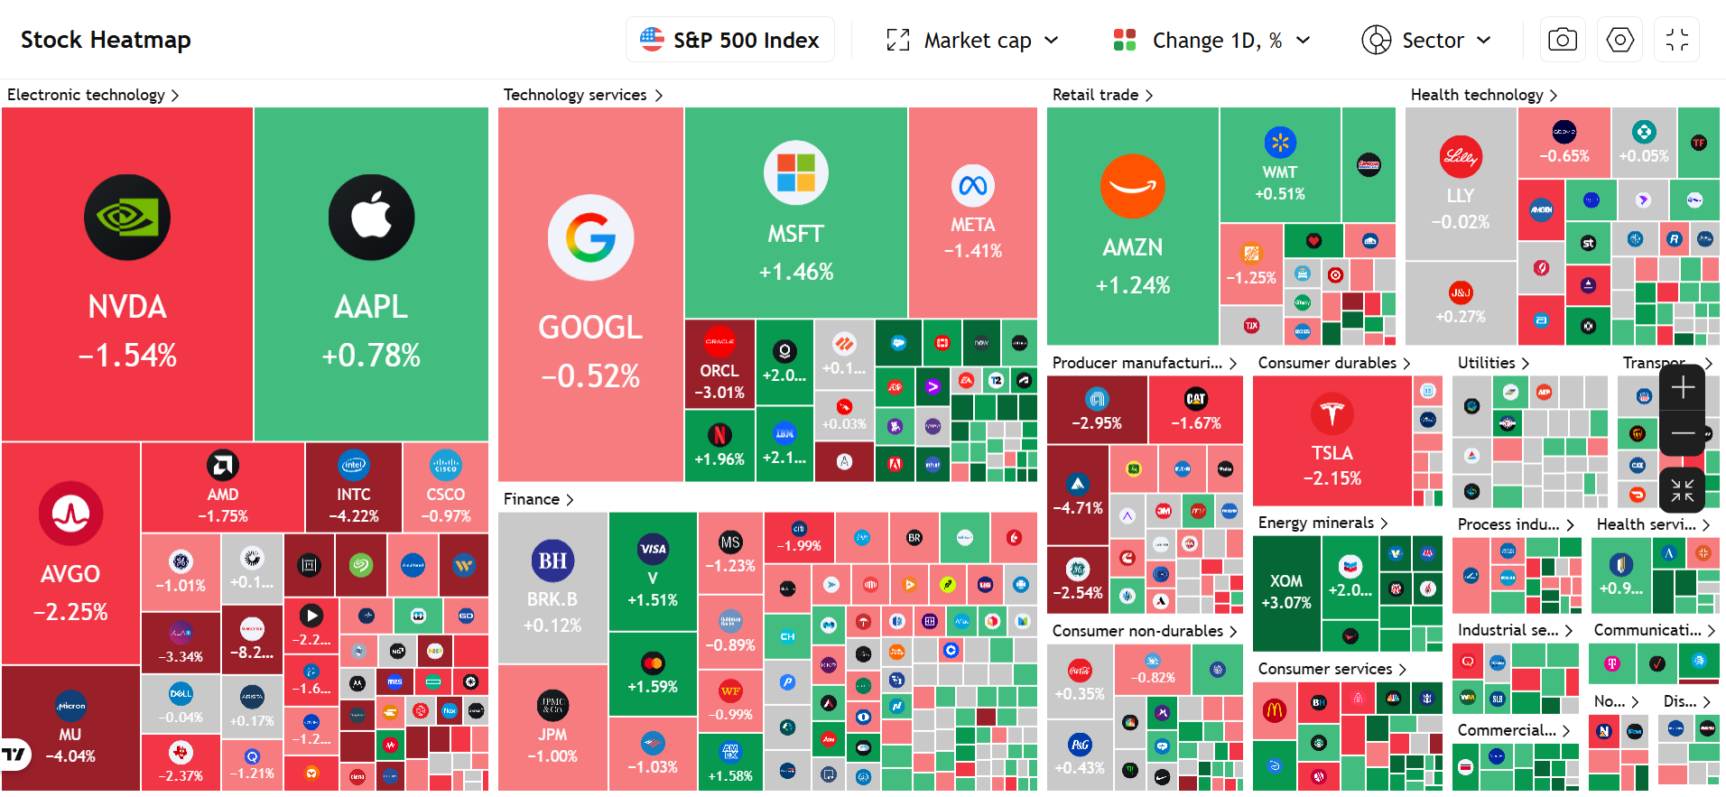
Activity: Stock Market Scavenger Hunt
Notes:
Speaker note: Let the discomfort sit for a moment. "How does it feel to bet it all on one?"

Slide 17
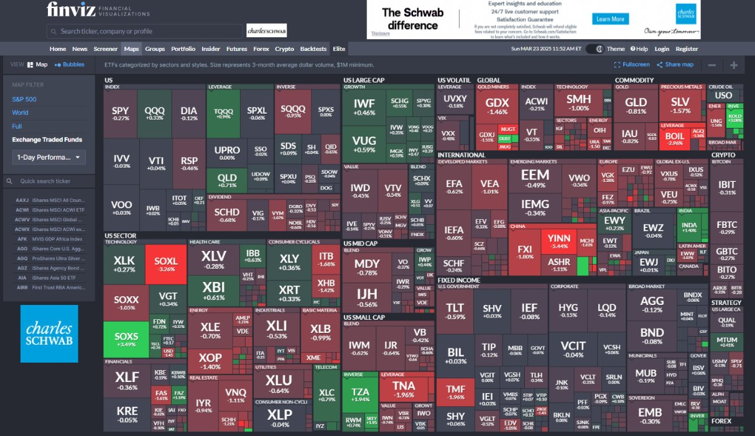
Activity 2: Research a Fund
Open finance.yahoo.com and search one ETF: VOO, SPY, or QQQ
Find:
What are the fund's top 10 holdings?
How many of YOUR scavenger hunt companies are inside it?
What is its performance over 1 year? 5 years? 10 years?
Notes:
Speaker note: The moment they find their own companies inside the fund is the payoff.

Slide 18
Adapting Ideas for Your Students
Grades 6 to 8: Use the "Backpack Portfolio" variation: students analyze 3 items they're carrying right now.
Grades 9 to 12: ETF Research. Students choose one fund on Yahoo Finance, find the top 10 holdings, and performance over 1, 5, and 10 yrs.
ELL students: Brand logos are a universal language. Lead with images, build vocabulary from there.
Advanced students: Company Deep Dive. Students research one company they already support: CEO, performance history, financial health, recent news, competitors, and growth potential. Then they defend a buy, hold, or pass recommendation.
No devices? Print a brand-to-company matching set and run it as a card sort.

Slide 19
Breakout & Shareout
Make It Yours
Task: Adapt one investing activity for YOUR students.
Choose one: Myth Busters, Scavenger Hunt, Mini-Portfolio, or ETF Research
Name your grade level and one modification you'd make
Identify one barrier you anticipate (reading level, devices, prior knowledge) and how you'd address it
Discuss: Where does this fit in your existing scope and sequence?

Slide 20
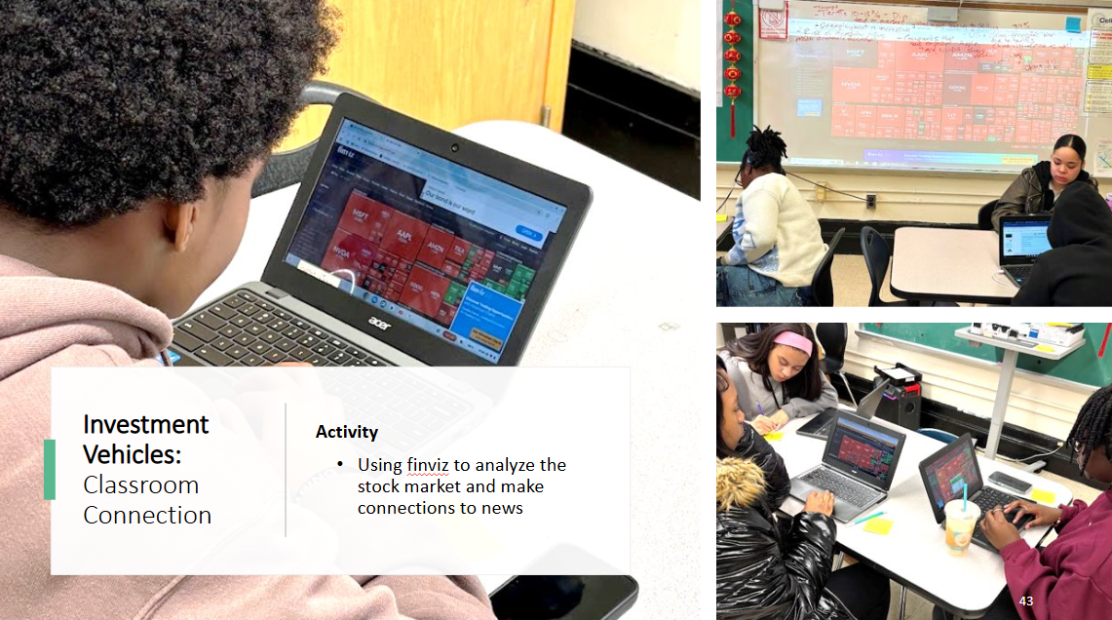
Student examples
Related Daily Routine

Slide 21
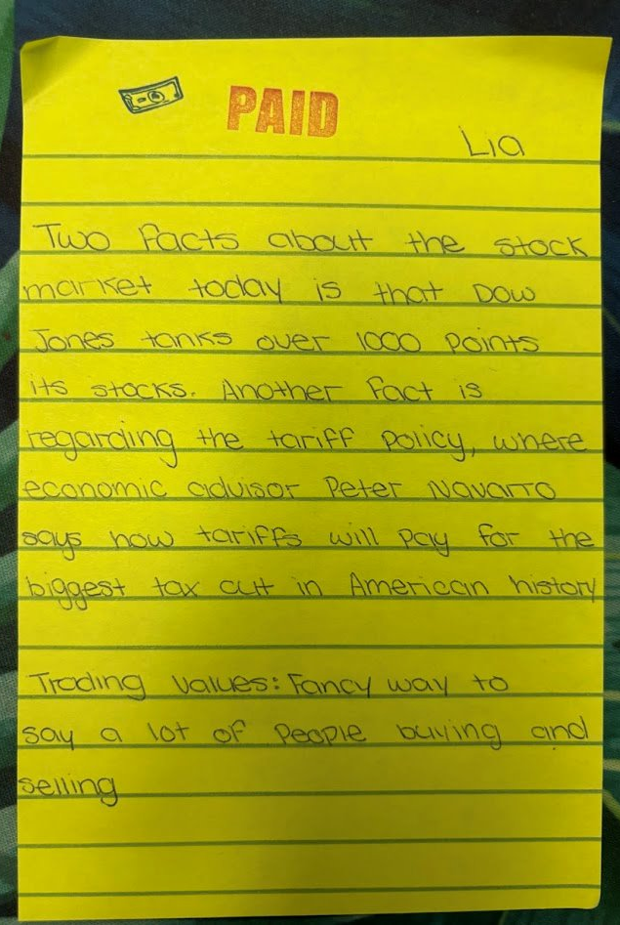
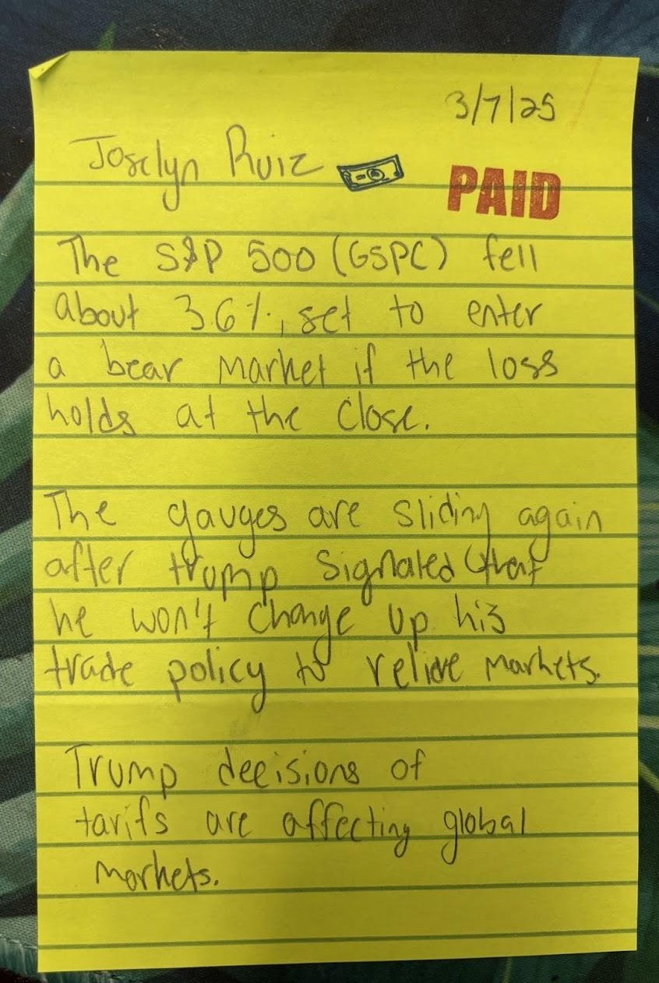
Questions you could use:
"What is happening?"
"What's the main financial concept at play here?"
"Who benefits from this? Who might be harmed?"
"How does this connect to our unit on ______?"
"How does this impact us and our community?"

Slide 22
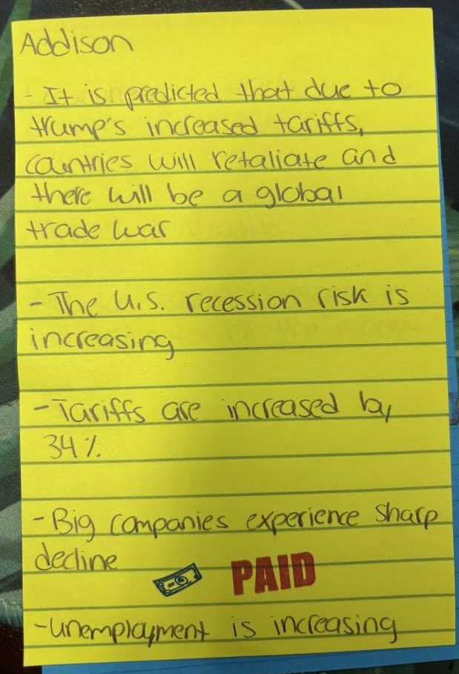
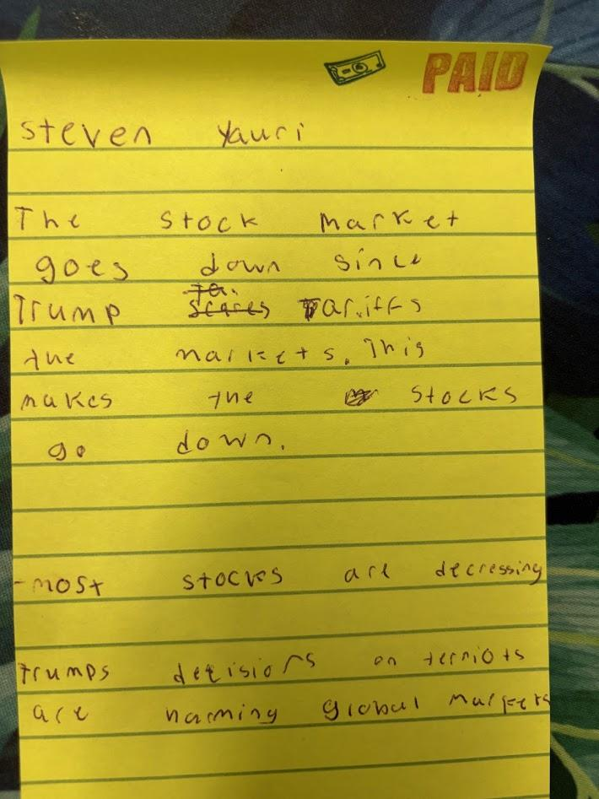
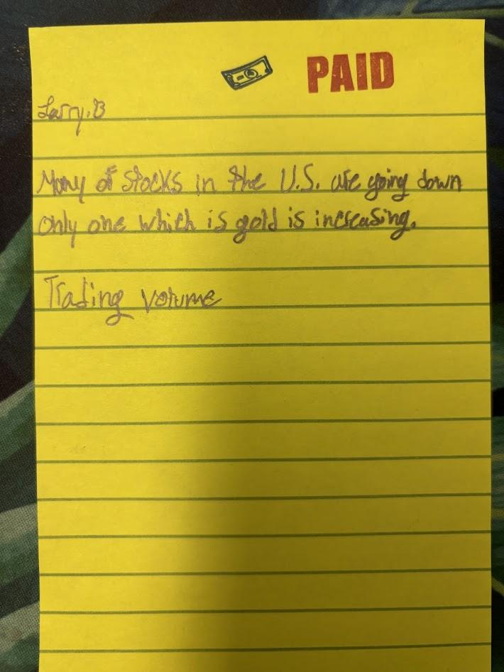
Student examples

Slide 23

PART 2
Lesson: Keeping It Real. Estate.

Slide 24

Entry Task: Real Estate Math Lightning Round DEMO
Speedy wins!
  A home costs $400,000. What's a 10 percent down payment? What's 20 percent?
  Property taxes are 1.2 percent of the home price. How much is that on a $350,000 home?
  If rent increases 3 percent each year, what happens to $2,000 rent next year?
Notes:
Speaker note: Reveal each one. You can invest with $1. Long-term investing is ownership, not gambling. The best time to invest was yesterday, the next best time is today.

Slide 25
Hook: Would You Rather?
Have your landlord be your history teacher, or your gym teacher?
Why???

Slide 26
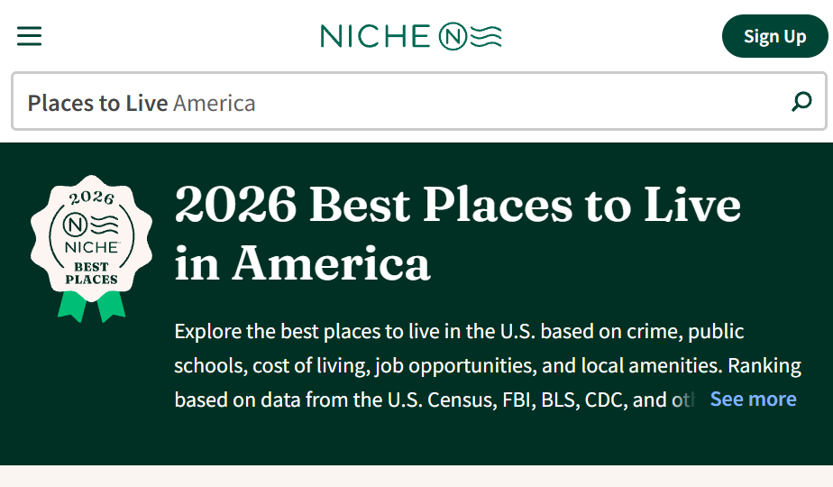
Activity: Home Search Challenge
Start with your zip code.
Go to niche.com. What is the average price of a house in your zip code?

Slide 27
Activity: Home Search Challenge
You are the home buyer!
Purpose: Students discover how cost of living, geography, and local economies shape housing, while defining what a home means to them.
Task:
In group A, B or C, you will find a home anywhere in the US on Zillow or Redfin that fits your needs and values.
Agree on ONE property
Note the size, location, walkability, and community features your budget buys.
Notes:
Before this you can have a lesson where they do this criteria as an agent first. choose a student to be the buyer and they have to find a property based on the needs.

Slide 28
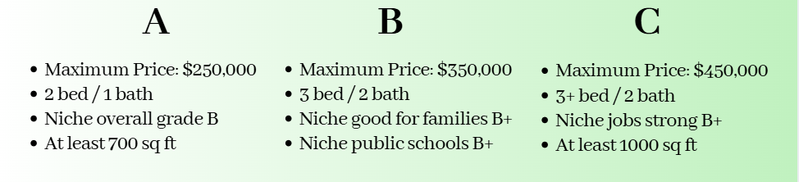
Breakout & Shareout
Roommates are fun!
Prep a 60-second pitch. Share your home choice and why!

Slide 29
Extension: Home Search Challenge
You are the real estate agent!
Purpose: Students practice research, persuasion, and client-centered thinking.
Choose the Buyer. One student is the Buyer and shares a quick profile: budget, location, must‑haves, dealbreakers.
Agents Search. Everyone else searches Zillow/Redfin for the best match.
Agents pitch. Agent gets 60 seconds to present their listing, or give block of time and buyer moves around the whole time.
The Buyer chooses. They announce their pick and explain the deciding factor. Which agent listened best?
Extra Fun: Rotate a new buyer each round. Add a commission twist where the winning agent earns points toward a class incentive..
Notes:
Before this you can have a lesson where they do this criteria as an agent first. choose a student to be the buyer and they have to find a property based on the needs.

Slide 30
Adapting Ideas for Your Students
Grades 6 to 8: Neighborhood Snapshot. Students look up one familiar address on Zillow and reflect on changes they've observed over time.
Grades 9 to 12: Rent vs. Buy Analysis. Students compare the monthly cost of renting vs. owning the same property and debate which fits their goals.
Advanced students: First-Time Homebuyer Simulation. Add down payment, closing costs, taxes, insurance, and monthly payments using the mortgage calculator on calculator.net.
Sensitive contexts: Offer fictional buyer personas so no student has to draw on personal housing circumstances.

Slide 31
Closing
Connection
What’s one thing you’ll try with students this year?

Slide 32
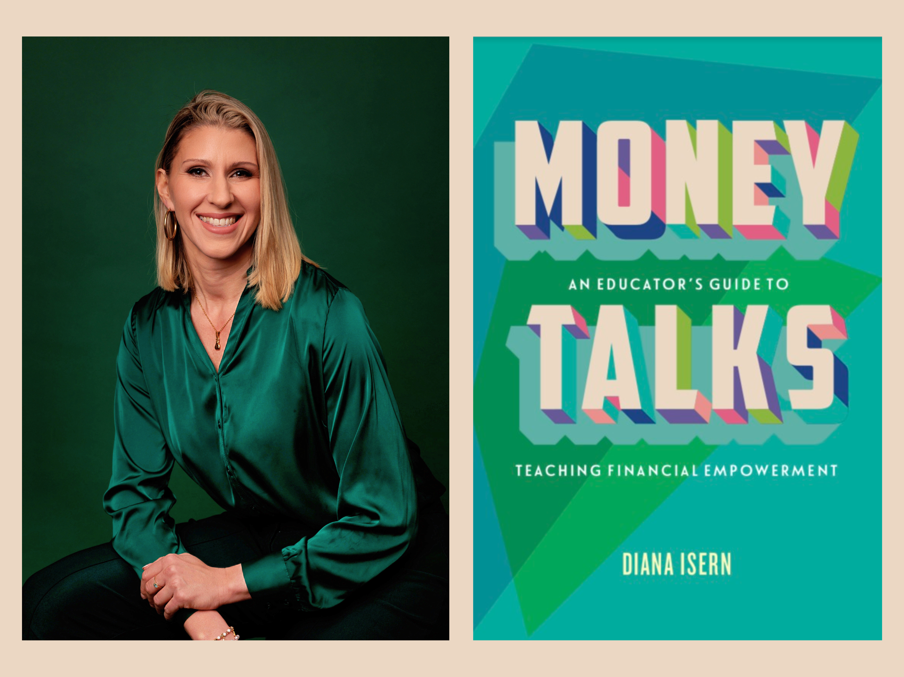

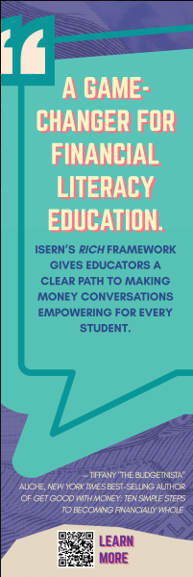
Thank you!
LinkedIn me! linkedin.com/in/dianaisern
Email me! Dianaisern@gmail.com
IG me! @Dianadinero_edu
Web: dianafinancialeducation.com/book
Let's connect!

