Slide 1
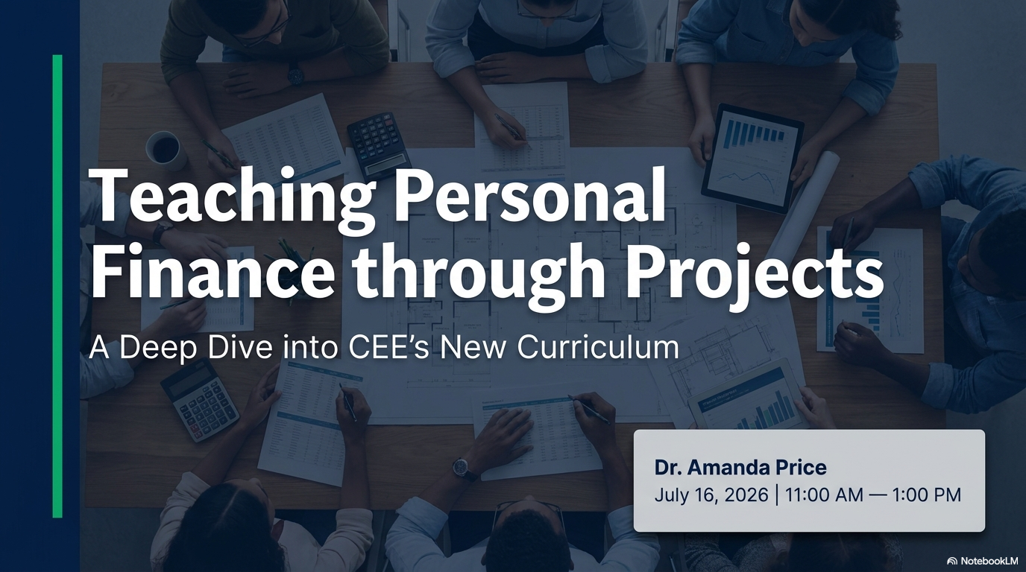

Slide 2
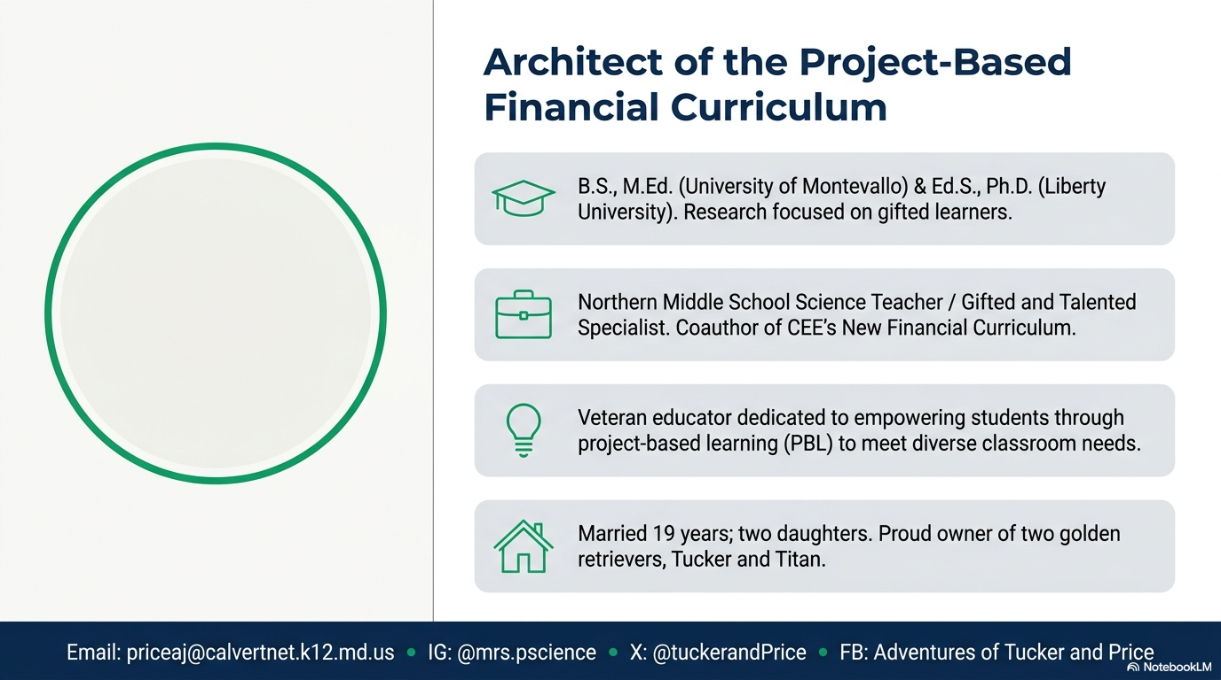
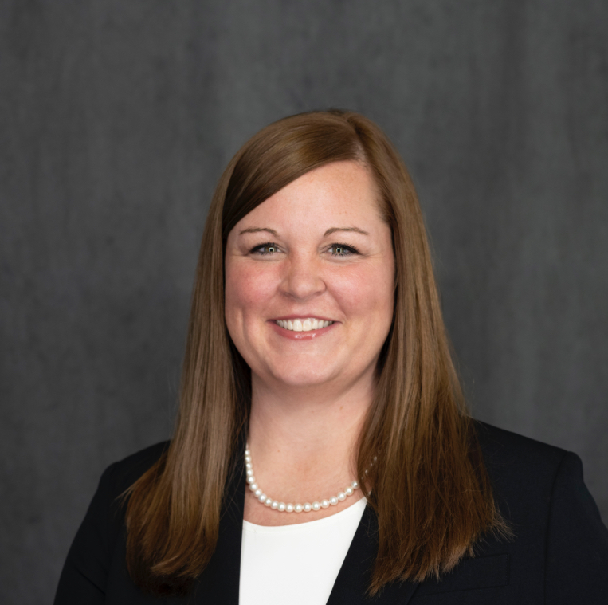

Slide 3
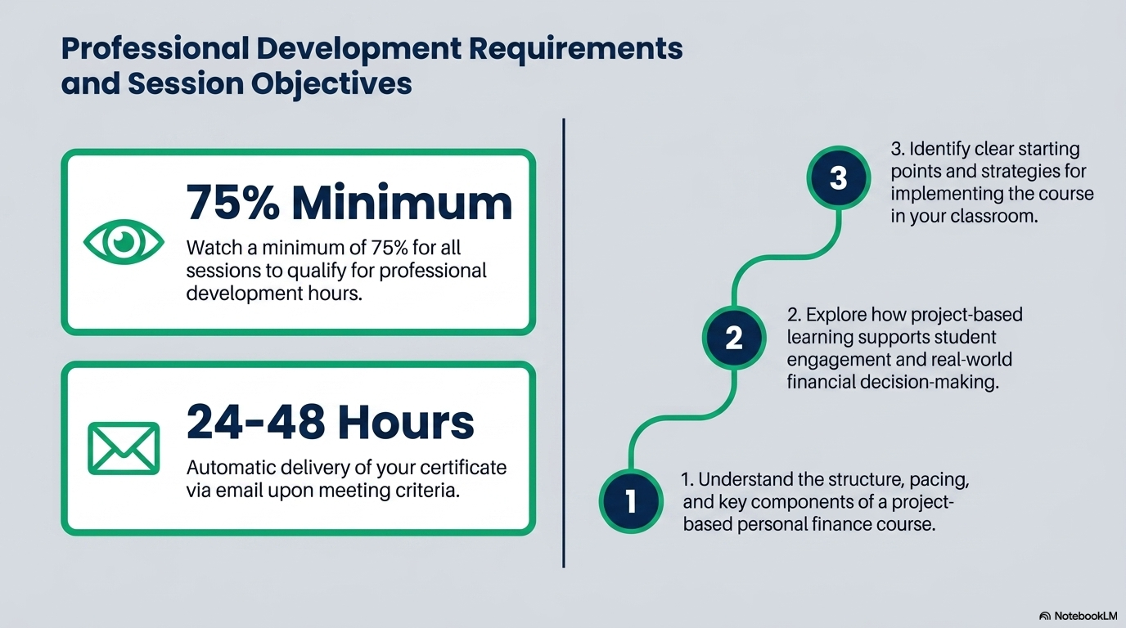

Slide 4
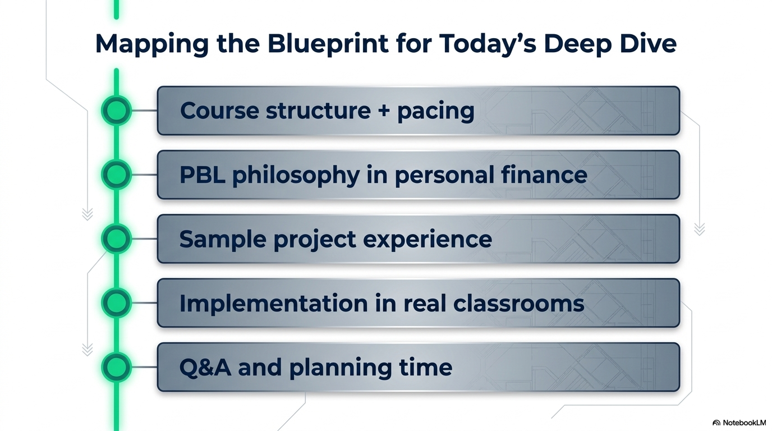

Slide 5

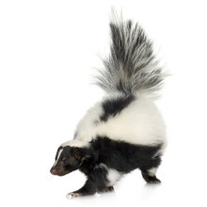
Activity Preview
SKUNK
The game of SKUNK involves 5 rounds using the letters S, K, U, N, K. A pair of dice is rolled, and students accumulate points represented by the sum of the numbers on the dice.
At the start of the game all students stand up. Dice are rolled and students earn points represented by the sum of the numbers rolled. Students must then decide to remain standing and continue to playing (keep accumulating points) or sit for the remainder of the round. Doing so allows the players to keep their points without risk of losing them.
Students who are standing can choose to sit after any roll of their choice, but once a student sits, they are not allowed to stand back up for the round.
If a 1 is rolled, the round is over and the students standing lose their points for that round. However, if a double 1 (snake eyes) is rolled then students who are standing lose all their points they have accumulated for the game.

Slide 6
Activity Preview
SKUNK
Today, we will play on the honor system
You can decide when to keep playing or hold what you have each round
The player that accumulates the most points wins

Slide 7

Let’s Play a Game of SKUNK
S | K | U | N | K

Slide 8
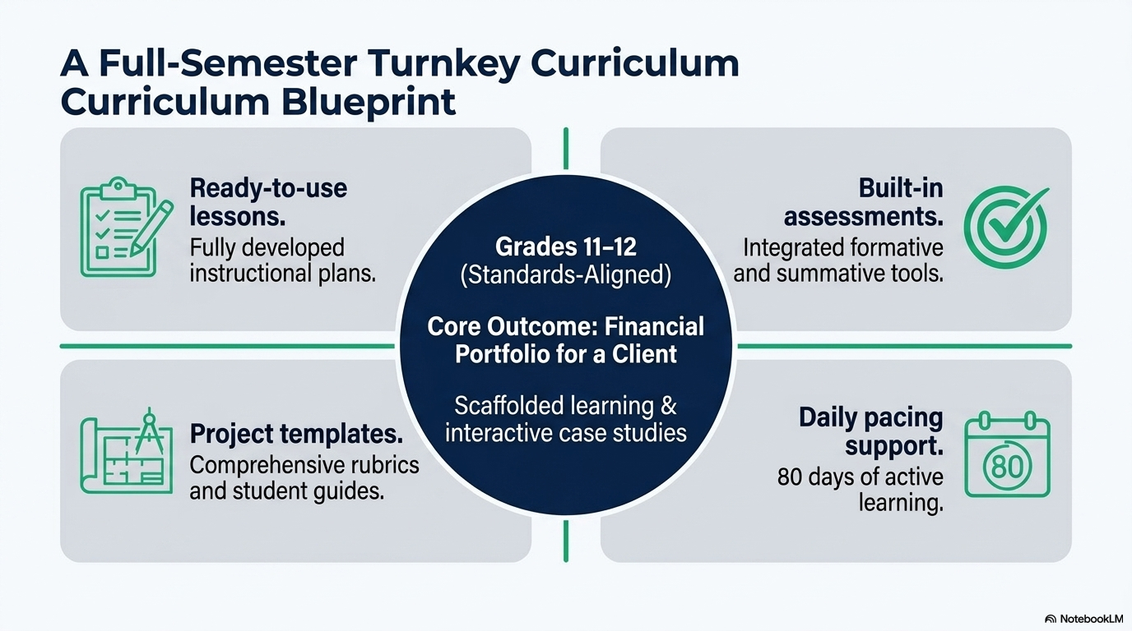

Slide 9


Slide 10
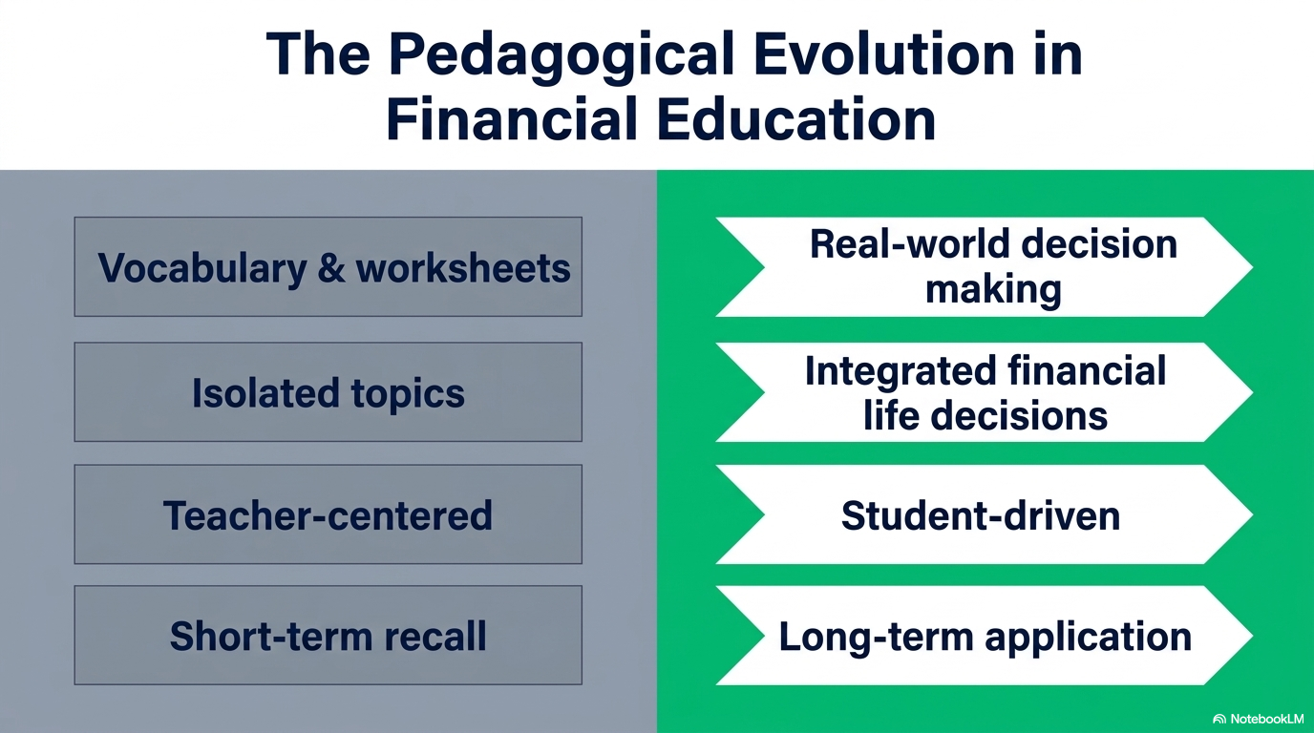

Slide 11
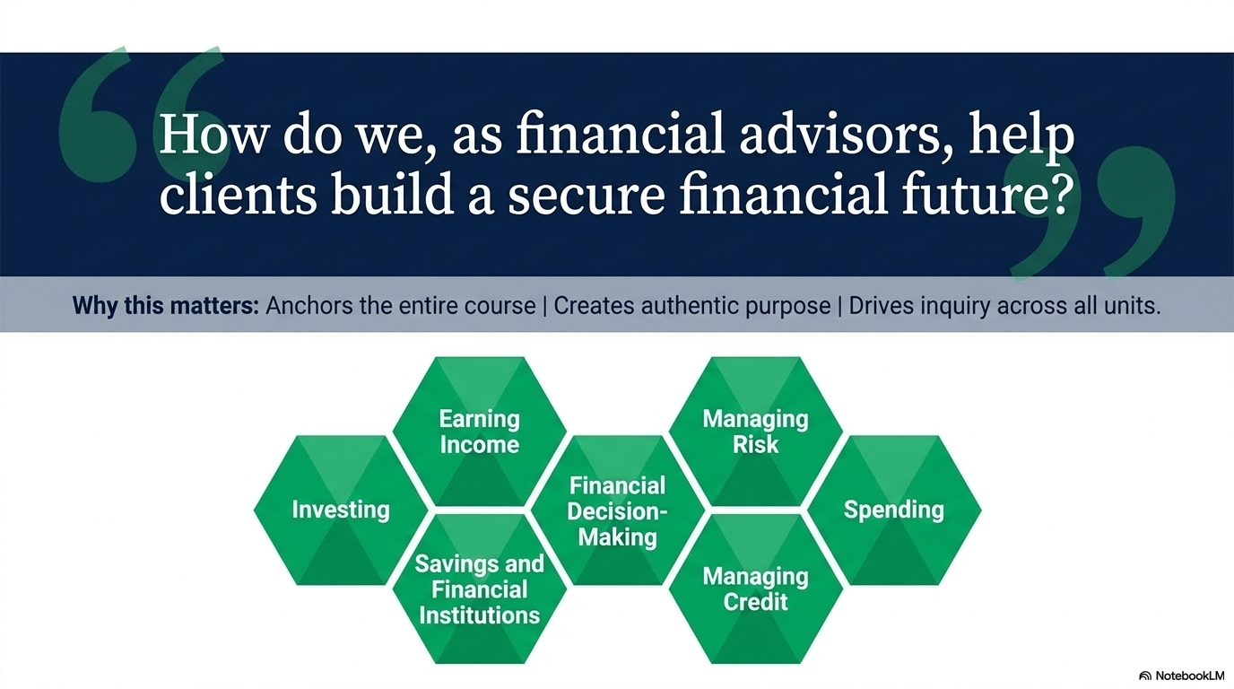

Slide 12
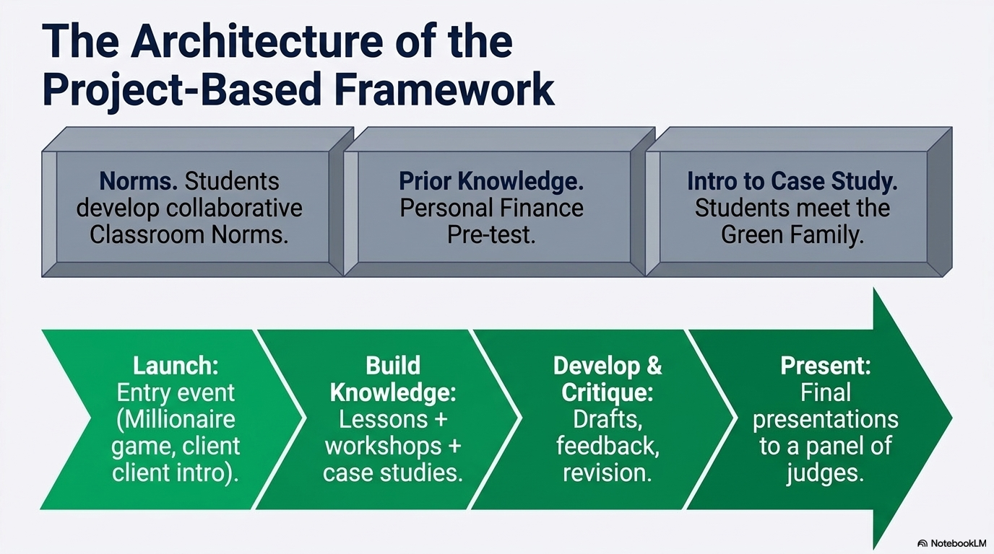

Slide 13
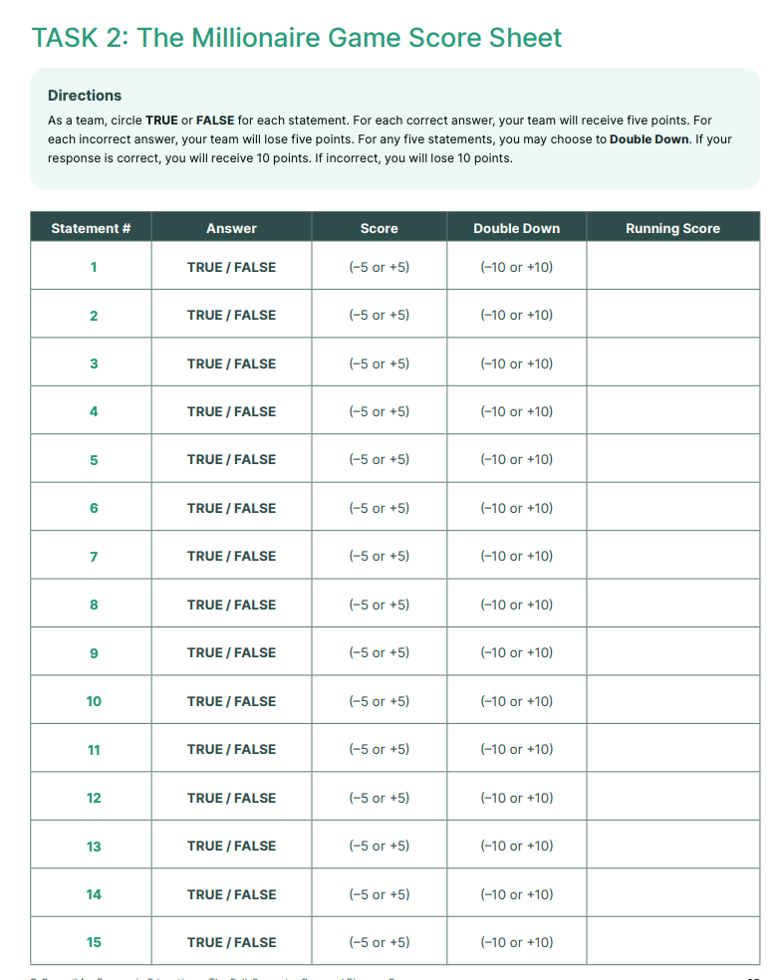
Activity Preview
The Millionaire Game
In the Class Setting, we would divide into 2 to 3 teams. However, for this setting we will go by the honor system and every man for themselves.
Each Player gets five points for each correct answer (Give us a thumbs up if you got it right). Each player loses five points for each incorrect answer (Hand clap for those who got it right).
Each player may choose to “Double Down” on any statement, up to a total of five statements by sending a peace emoji. If the team answers correctly, it receives 10 points; if the team answers incorrectly, it loses 10 points from its current score.
Teams should use this tactic on questions they are most confident about answering correctly.
A perfect score is 100 points.

Slide 14
True or False?
Most millionaires are college graduates.
STATEMENT #1
TRUE
Notes:
88% millionaires are college graduates.
52% have a master’s degree or higher (PhD, JD, MD)

Slide 15

True or False?
Most millionaires work fewer than 40 hours a week.
STATEMENT #2
Notes:
2/3rd work 45-55 hours a week.

Slide 16
True or False?
Half (53%) of wealthy Americans are self-made—from a low- or moderate-income upbringing and with no inheritance.
STATEMENT #3
Notes:
Only 27% are.
Wealthy Americans are defined as a net worth of over 3 million.
46% have a head start: Almost half the super rich people surveyed either had some inherited wealth or an affluent upbringing.
28% have legacy wealth: People with both an affluent background and inherited money.

Slide 17
True or False?
Stock markets have bears, bulls, unicorns, and ostriches.
STATEMENT #4
TRUE
Notes:
A bear market is a market in a prolonged decline with stock prices dropping generally 20% or more.
A bull market is a market in which stock prices are rising, encouraging buying.
The ostrich effect is used to describe investors who tend to ignore tumbling stock markets or tough financial situations
A unicorn company is a privately held startup with a valuation of $1 billion or more. In 2024, Stripe, a San Francisco-based payment processing services company, led the U.S. fintech unicorn sector with a valuation of 65 billion U.S. dollars. Following Stripe was Chime, another significant player in the fintech space, valued at 25 billion U.S. dollars. The substantial valuations of these companies underscore the growing importance and financial clout of innovative payment and banking solutions in the U.S. financial technology landscape.

Slide 18
True or False?
A poor credit rating can keep you from being able to rent an apartment or find a job.
TRUE
STATEMENT #5
Notes:
Also higher prices on insurance.

Slide 19
True or False?
Evidence of good and bad credit stays on your credit report for 5 years. Credit information older than 5 years is taken off.
STATEMENT #6
Notes:
7 to 10 years in some instances

Slide 20
True or False?
College graduates earn about 65% more than high school graduates.
TRUE
STATEMENT #7
Notes:
And Professional degrees earn 150% more than high school grads.

Slide 21
True or False?
When you arrive on your college campus, credit card issuers will be offering you free gifts to sign up for their credit cards.
STATEMENT #8
Notes:
Credit card issuers are NOT allowed on college campuses. BUT they are allowed across the street (within 1,000 feet of property) where they might offer sign-up gifts (free t-shirt, water bottle, etc) to students in exchange for completing a credit card application.

Slide 22
True or False?
If you can’t pay your student loans, you can declare bankruptcy. Your student loans will be treated the same as the rest of your debt.
STATEMENT #9
Notes:
Student loans can be bankrupted but they are NOT treated like other debt. It is very difficult and typically requires proving "undue hardship" through an adversary proceeding in bankruptcy court. This process requires showing that repayment would cause you to suffer a minimal standard of living, that your current financial situation is likely to persist for a significant portion of the loan's repayment period, and that you have made good-faith efforts to repay the loans.

Slide 23
True or False?
Personal spending is out of control and as a result, credit card debt is the number one cause of personal bankruptcies.
STATEMENT #10
Notes:
A majority of bankruptcies are filed because of unpaid hospital bills. Getting sick is the number one cause, followed by losing your job, then excessive credit card debt.

Slide 24
True or False?
Credit card bills must clearly state how long it takes to pay off your bill if you only pay the minimum monthly payment. It’s the law.
TRUE
STATEMENT #11
Notes:
Credit Card Act of 2009

Slide 25
True or False?
At age 18, if you decide to save $10.00 a week and invest it at 8% annual interest until you are 65, at age 65, your savings will total $250,000.
TRUE
STATEMENT #12
Notes:
This is the magic of compound interest.
Fast food, cigarettes - If you won’t quit because of the health warnings, maybe saving money will convince you?

Slide 26
True or False?
Many low-income people become millionaires by winning the lottery.
STATEMENT #13
Notes:
One in 12 million chance to win. If you played the lottery every day you would have to live about 33,000 years to win once.
In contrast, one in 2 million chance of being hit by lightning.
A pregnant woman has a one in 705,000 of having quadruplets.
How many sets of quads do you know? Do you know someone who has been hit by lightning?

Slide 27
True or False?
Most millionaires fly first class, wear designer labels, and eat out in restaurants all the time.
STATEMENT #14
Notes:
They become millionaires by saving their money and being thrifty. It pays to live below your means.

Slide 28
True or False?
Single people are more often millionaires than married people.
STATEMENT #15
Notes:
Most millionaires are married and stay married. It is important to choose a marriage partner carefully.

Slide 29
How did you do?
WRAP-UP
A total of 100 points is a perfect score—you might be a “Millionaire of Tomorrow!”
To earn this score, your team must have answered all the questions correctly and used the “Double Down” correctly on five of those questions.

Slide 30
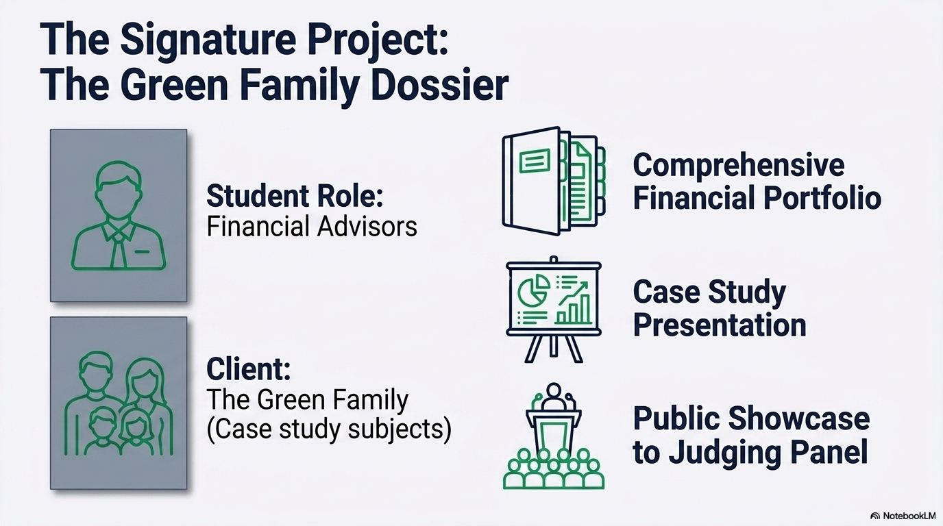

Slide 31
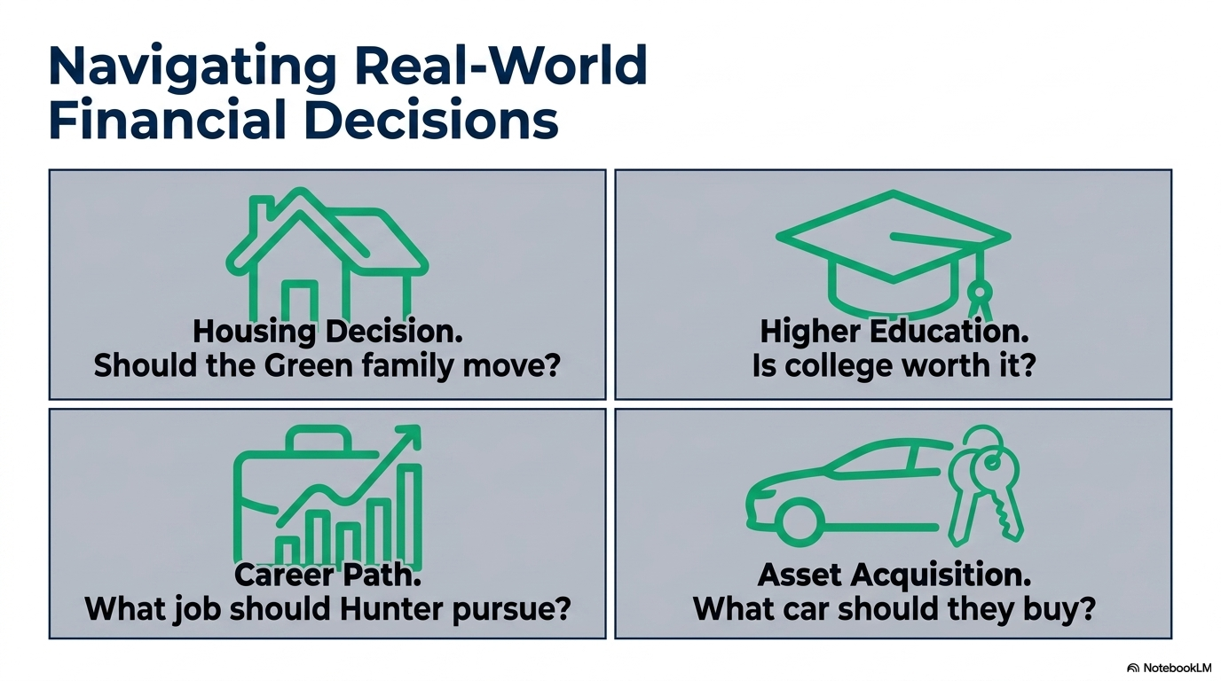

Slide 32
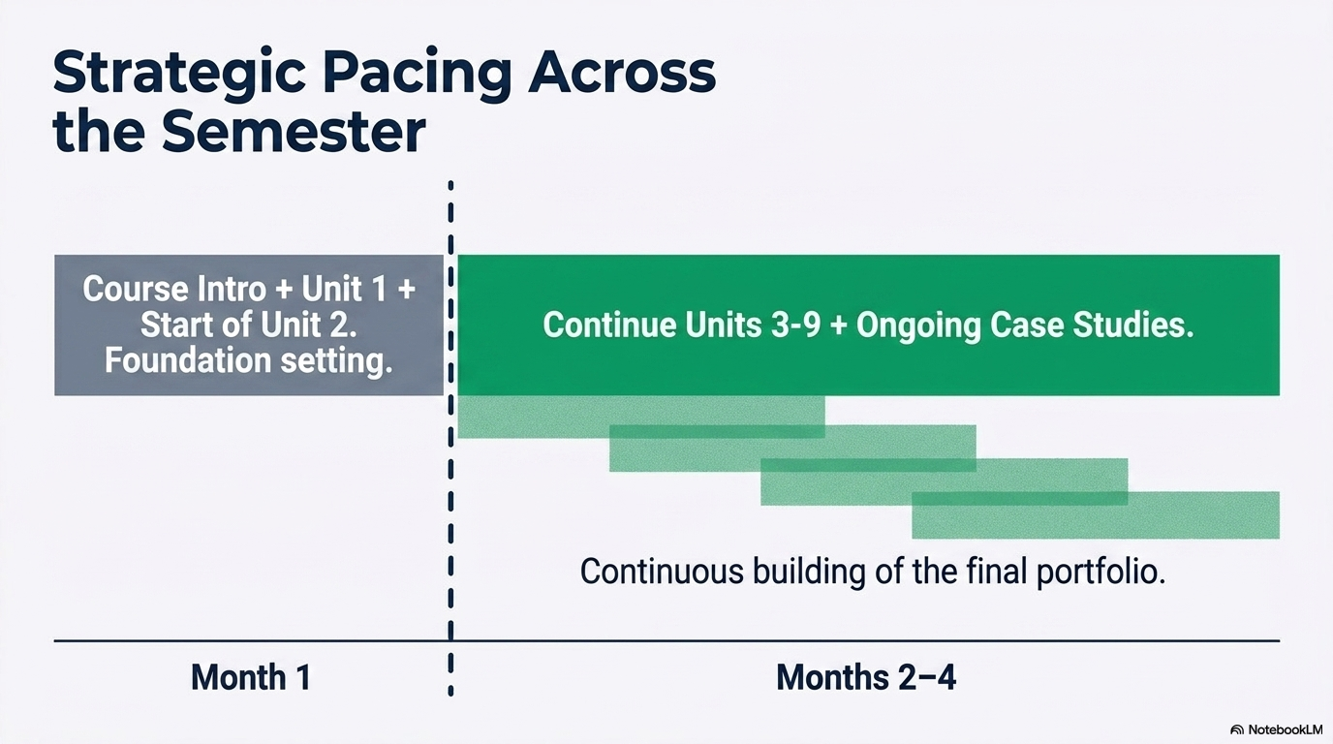

Slide 33


Slide 34
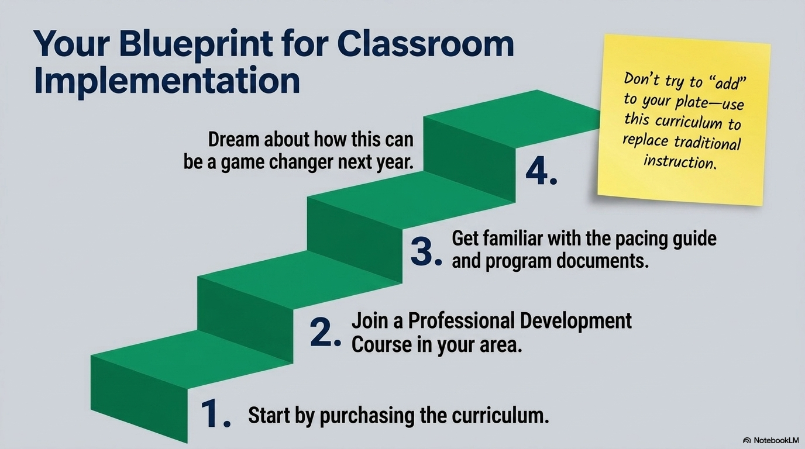

Slide 35
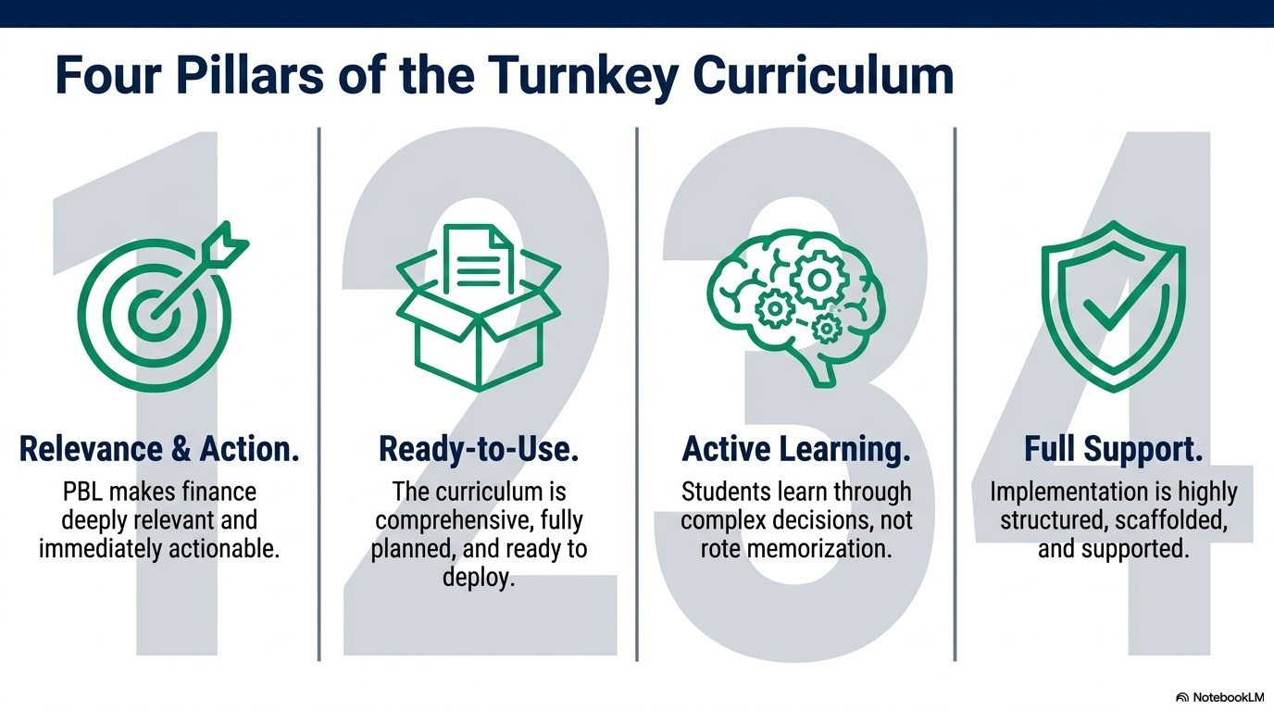

Slide 36
