Slide 1
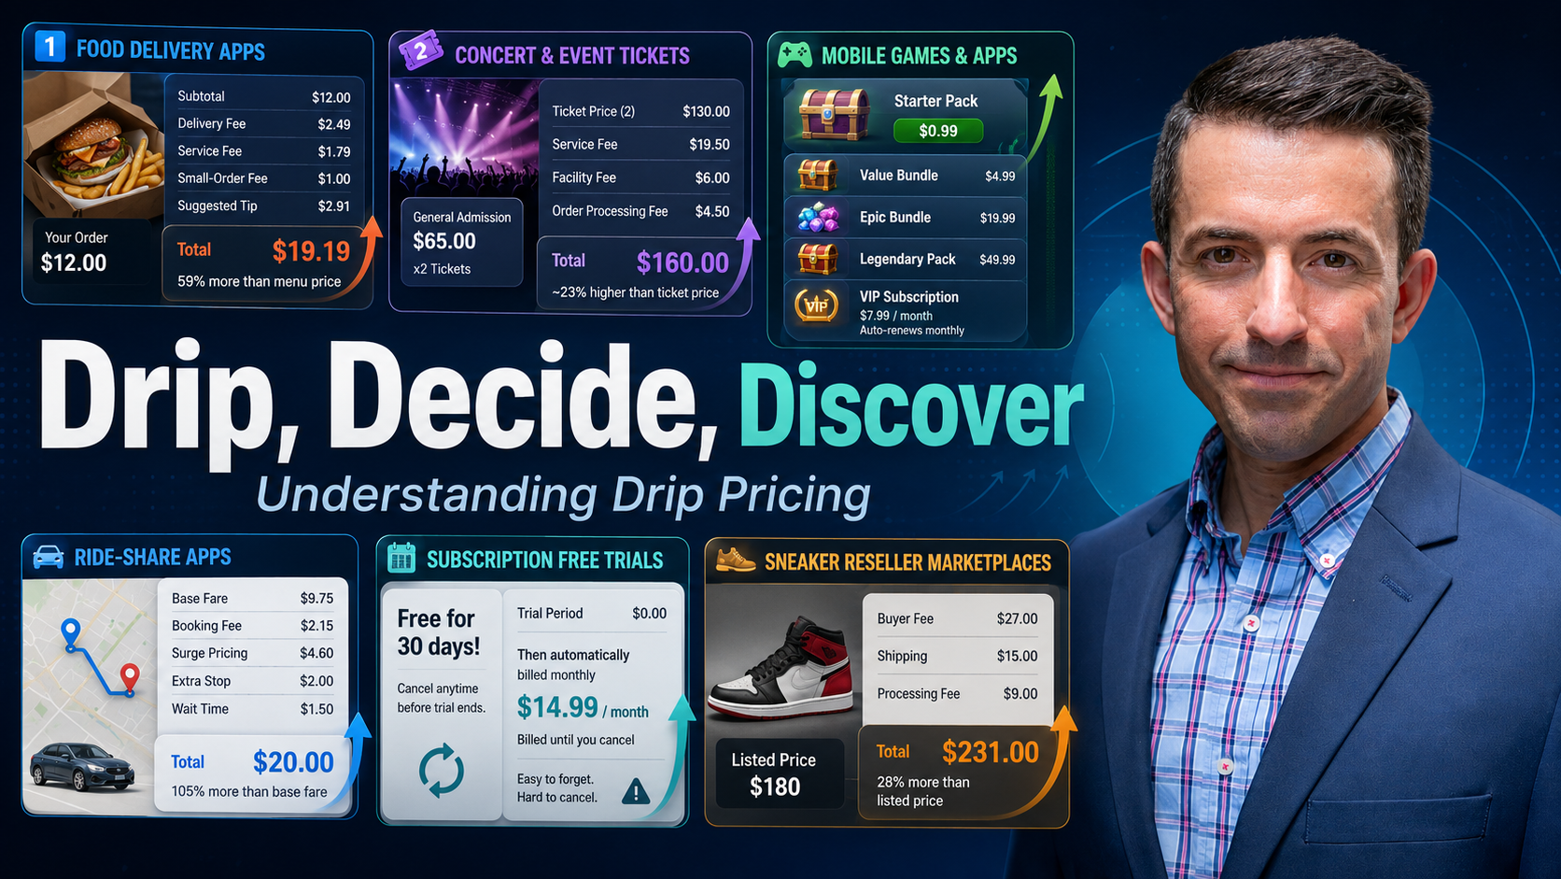

Slide 2


ECONEDLINK PROFESSIONAL DEVELOPMENT WEBINAR
Drip, Decide, Discover
Turning Behavioral Economics into Classroom-Ready Lessons
Featuring a live demo of Perfect Pairings: Economics in Action, from FEE's Learning Center and the University of Chicago's Econ4Everyone.
July 14, 2026
1:45 PM – 3:45 PM ET
Presented by Joel Miller, Foundation for Economic Education
EconEdLink Professional Development Webinar | Presented by Joel Miller, Foundation for Economic Education
1

Slide 3

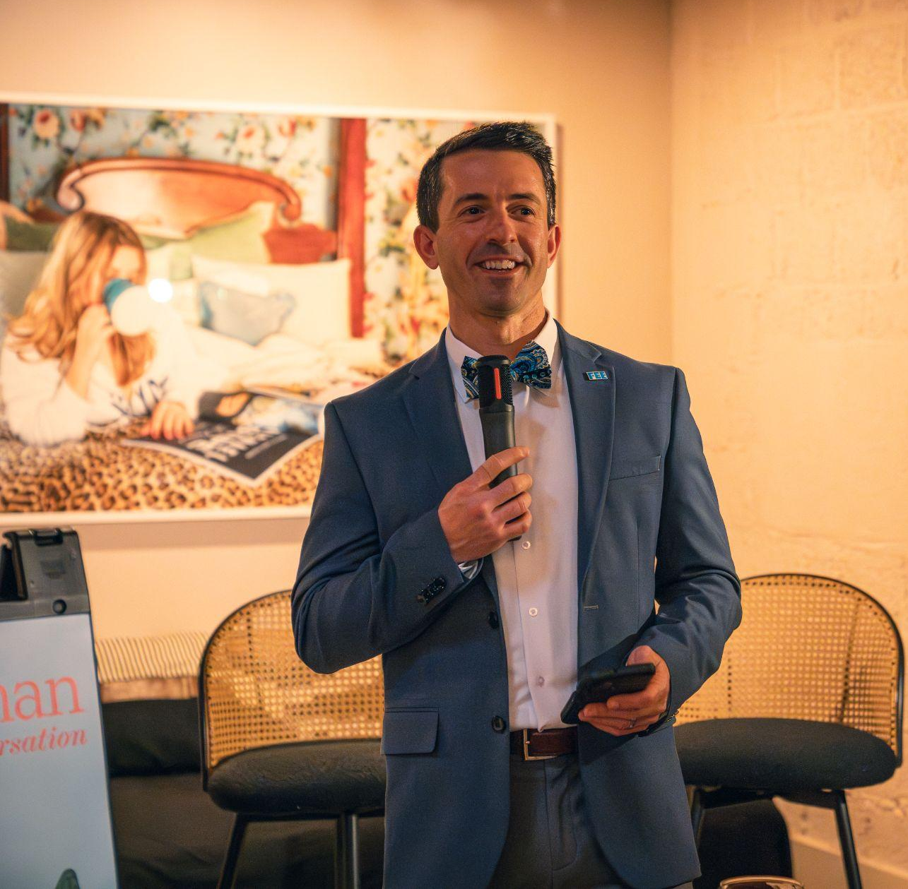
JOEL MILLER
Director of Educator Engagement, FEE
14 year veteran educator with Ed.S. in Educational Leadership: Curriculum and Instruction
John Morton Excellence in the Teaching of Economics
Creator of the Financial Intelligence Teacher (FIT) Certification
Co-Chair, National Association of Economic Educators – Professional Development Committee
Designs curriculum and PD workshops for secondary economics & personal finance educators nationwide
Notes:
Before we move into today's discussion, I want to be clear about where FEE stands on behavioral economics, particularly in relation to the Austrian tradition much of our work draws on.
FEE views behavioral economics as a useful complement to Austrian economics, not a substitute for it. The findings from behavioral research, things like anchoring, loss aversion, and present bias, describe real, observable patterns in how people make decisions. That descriptive work has value. It helps us understand our students, our markets, and ourselves more accurately.
But behavioral economics cannot resolve what Hayek identified as the knowledge problem. Documenting that people deviate from a textbook rational actor does not tell any planner, regulator, or institution what a given individual actually values, or what choice would truly serve that individual's best interest. The knowledge required to make that judgment remains dispersed, personal, and, in large part, unknowable to anyone standing outside the choice itself.
This distinction matters most when behavioral findings are used to justify policy. Identifying a bias is not the same as possessing the standing or the knowledge to correct it. When research on behavioral tendencies is used to license paternalistic intervention, nudges, defaults, or mandates designed by planners who claim to know better, it runs into the same information limits Hayek described. The individual, however imperfectly they reason, still holds local knowledge about their own circumstances and preferences that no outside authority can fully replicate or override.
So our position is this: behavioral economics can inform how we teach, how we design lessons, and how we understand decision-making. It cannot, on its own, justify the policy conclusions some draw from it. We can use these findings to sharpen our understanding of human choice while still holding firm to the view that dispersed knowledge and individual judgment, not centralized correction, remain the foundation of sound economic reasoning.

Slide 4

Inspiring the next generation of economic thinkers since 1946
Notes:
Welcome and thank you for being here today.
We are the Foundation for Economic Education, and this is a quick look at who we are, what we believe, and the work we are doing with students across the country.
FEE has been around since 1946 -- making us one of the longest-running economics education organizations in the United States.
Everything we do comes back to one core idea: that economic understanding empowers individuals to make better decisions, build better lives, and contribute to a stronger society.
Let's get started.

Slide 5
The ideas at the heart of our work
01
02
03
Individual empowerment
Equality before the law
Property and prosperity
Every person has the right to live freely and pursue their own path. The purpose of any system is to enable individuals to flourish.
All people, regardless of background, share equal rights to life, liberty, property, and the pursuit of happiness.
Secure property rights are the foundation of opportunity. When ownership is protected for everyone, individuals can lift themselves from poverty.
04
05
06
Markets empower people
Freedom of thought and speech
The next generation
Entrepreneurship and voluntary exchange are humanity's greatest engines of upward mobility. Success is earned by creating value, not through privilege.
A healthy society depends on open inquiry, spirited debate, and the freedom to challenge prevailing ideas without fear.
Freedom must be actively taught and passed on. The fate of a free society is always just one generation away.
Notes:
These six beliefs are the foundation of everything FEE produces.
We believe every individual has inherent dignity and the right to chart their own course. Systems -- political or economic -- exist to serve people, not the other way around.
We believe in equality before the law, full stop. Every person, regardless of background, deserves the same rights and the same protections.
We believe secure property rights are one of the most powerful tools for lifting people out of poverty. When people can own, build, and protect what they earn, opportunity follows.
We believe markets -- voluntary exchange and entrepreneurship -- are the most effective engine of upward mobility ever developed. Success in a market economy comes from creating value for others.
We believe a healthy society requires free expression and open debate. Ideas should compete in the open, not be suppressed.
And finally, we believe freedom is never guaranteed. It has to be taught, modeled, and passed on. That is precisely why FEE exists.
This quote from our president captures it well: liberty is not a political direction -- it is a framework for living. We are here to help the next generation understand and use that framework.

Slide 6

Making a pencil takes thousands of people across the world, each contributing a small piece. No central authority coordinates any of it.
"I, Pencil"
A simple story with a powerful lesson by FEE Founder Leonard Read
"No single person on earth knows how to make a pencil from scratch."
Notes:
One of the most powerful tools in our curriculum is an essay written by our founder, Leonard E. Read, in 1958.
It is told from the perspective of a simple pencil, and it makes one of the most profound economic arguments you will ever encounter: no single person on earth knows how to make a pencil from scratch.
Think about what goes into one. Wood from a forest in the Pacific Northwest. Graphite mined in Sri Lanka. Rubber from Malaysia. Paint, lacquer, metal -- each from different corners of the world.
And yet, no central authority planned or directed any of it. Thousands of people, most of whom will never meet, each contributed their small piece -- guided by prices, incentives, and the freedom to trade.
'I, Pencil' is a short read, but it changes how students see the world around them. That pencil on their desk suddenly becomes a window into how the entire global economy works.
We use it as an anchor for our Economic Marvels lesson series, which we will talk about on the next slide.

Slide 7
“I, Pencil”: What students take away
01
02
03
04
Built on cooperation
Value through specialization
Incentives and exchange
Participate in the economy
The world runs on millions of voluntary exchanges, not central control.
Individuals create value by doing what they do best and trading for the rest.
Systems work because people respond to incentives, not mandates.
Opportunity comes from engaging with the system — students are already part of it.
Notes:
When students finish 'I, Pencil,' these are the four things that tend to stick with them.
First: the world runs on cooperation. Not top-down direction, but millions of people voluntarily working together, each contributing something the others need.
Second: specialization creates value. You do not have to know how to do everything -- you just have to be good at something and willing to exchange.
Third: systems work through incentives. Prices, profits, and competition are not obstacles -- they are the signals that coordinate all of that cooperation.
Fourth, and this is the one that resonates most with students: you are already part of this. Every time they buy something, work a shift, or start a project, they are participating in this system.
That last insight -- 'participate, don't wait' -- is what we try to leave every student with. The economy is not something that happens to them. It is something they are already in.

Slide 8

Prices are signals.
Prices are…
Millions of pieces of local knowledge transmitted simultaneously without any central authority.
Millions of data points wrapped in an incentive that directs human action toward where it is most valuable.
Notes:
When you license who may enter a market; you don't just regulate competition. You jam the signal.
— F.A. Hayek,
1974 Sveriges Riksbank Prize in Economic Sciences in Memory of Alfred Nobel

Slide 9



TEACHERS.FEE.ORG

Slide 10

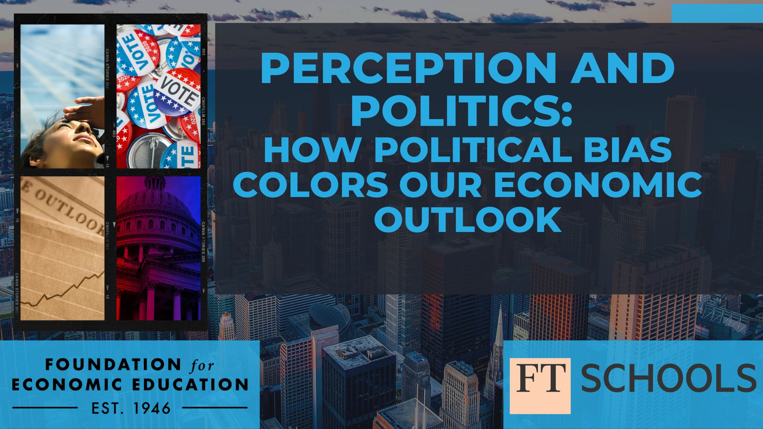
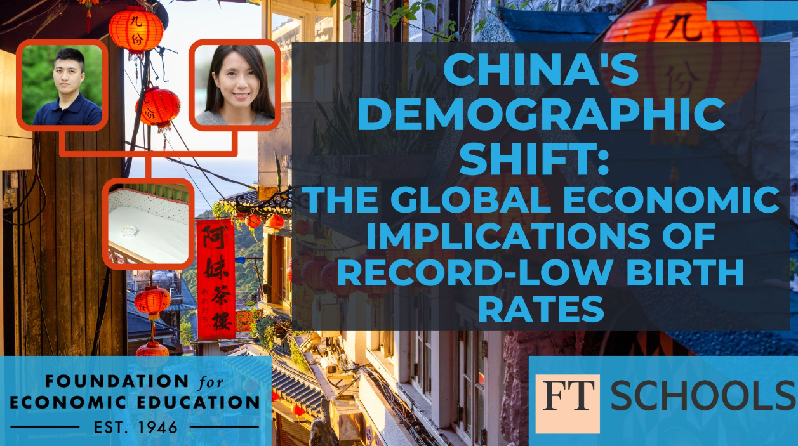

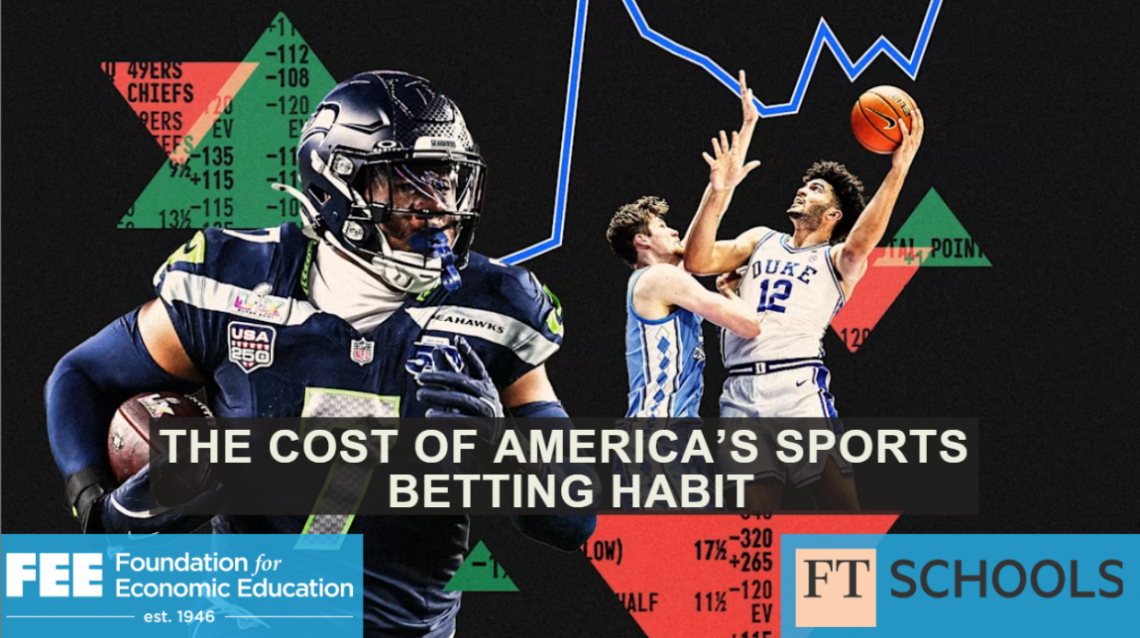
Notes:
Sample FT Classroom Ed. Lesson: https://docs.google.com/document/d/1ae0IXu3v0ByT_piVVtt_HO5QrEtrmtn0XBVpjSL7zHU/edit?usp=sharing

Slide 11

Economic Marvels Lesson Series:
Seeing the Invisible Connections
Everyday stories
Innovation at work
Common products and services students know reveal powerful economic principles students can relate to.
Trade, specialization, incentives, and entrepreneurship drive the world students live in every day.
Notes:
We bring these ideas to life through Economic Marvels: everyday objects students recognize, unpacked to show the hidden economic story inside. What students start to see is that the world is incredibly complex and coordinated — often with no one in charge of the whole system. That realization changes how they see work, opportunity, and where they fit in.

Slide 12
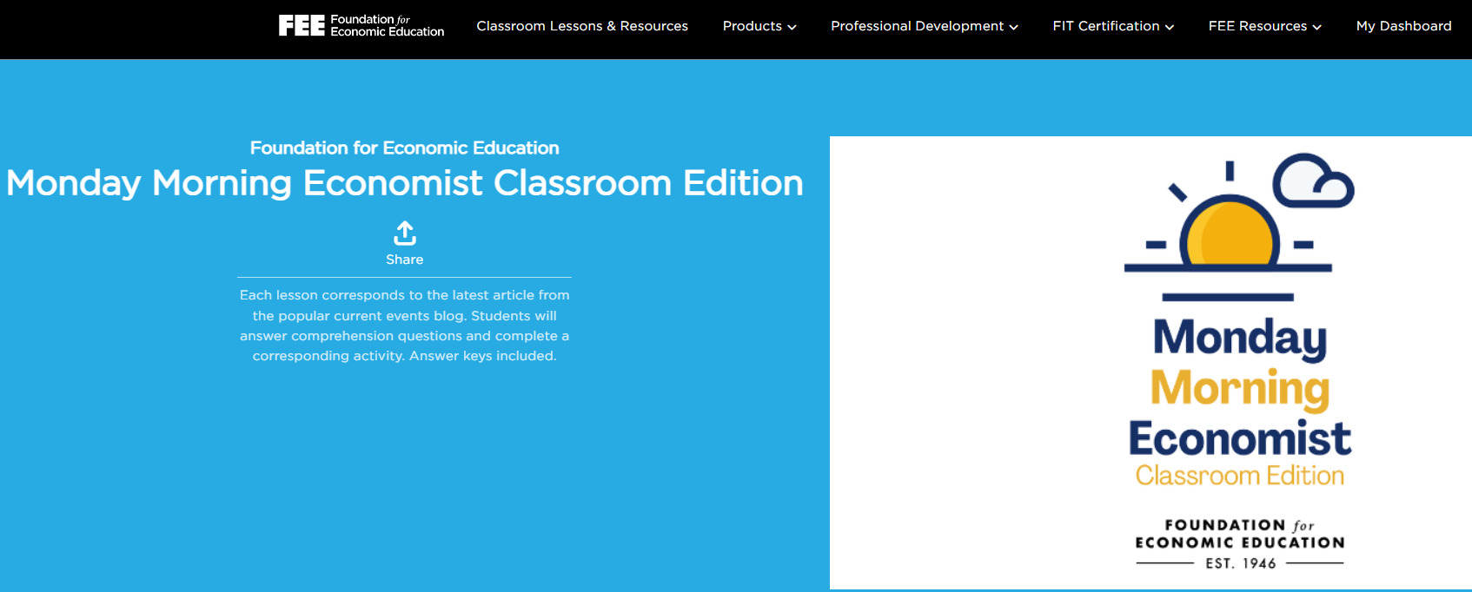
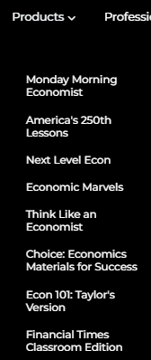
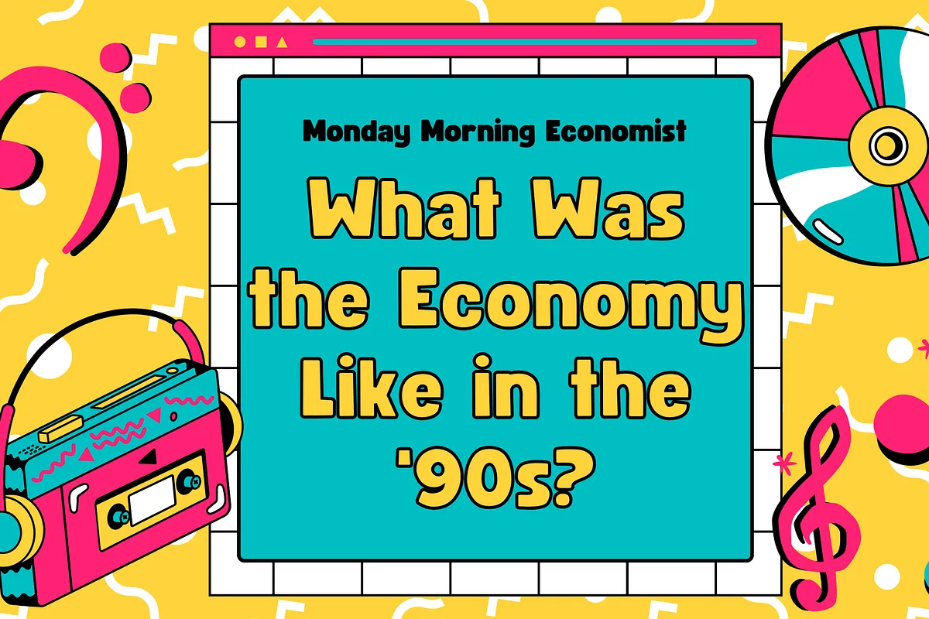
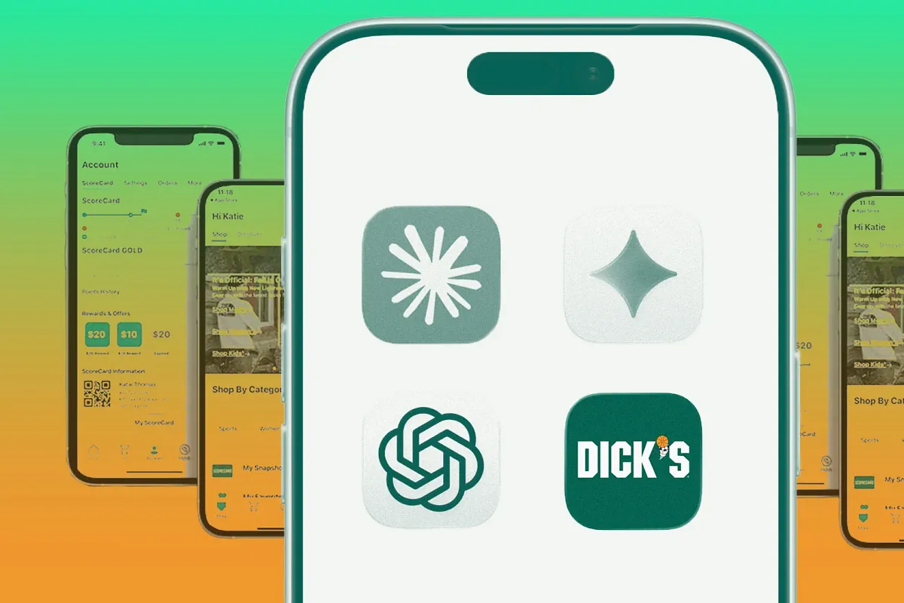
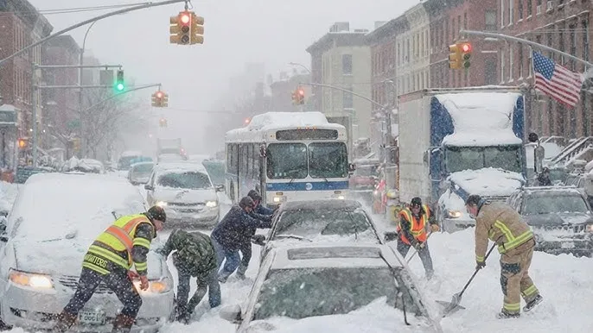


Slide 13


Slide 14
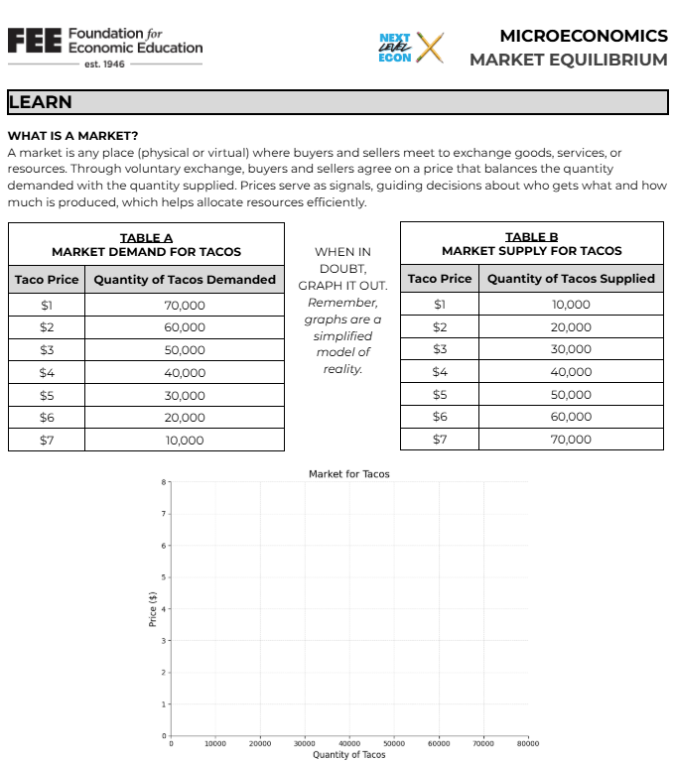
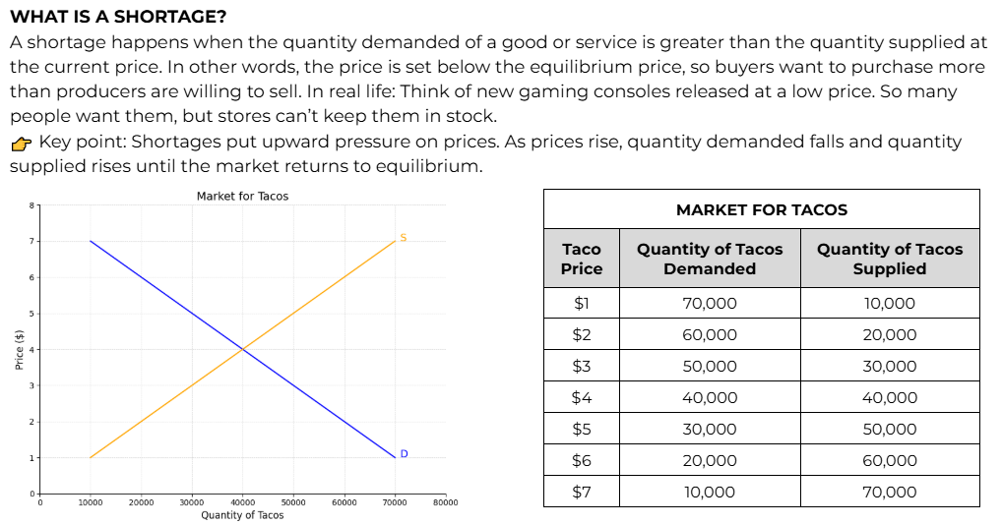
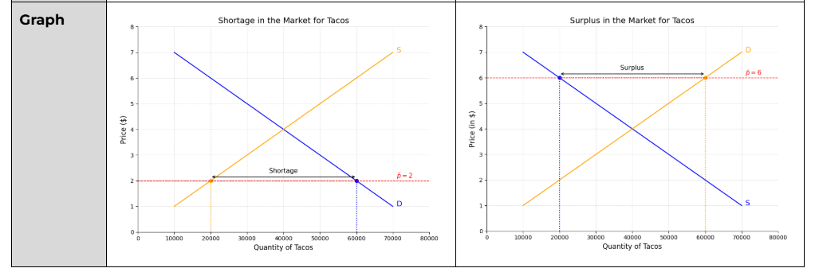

Slide 15


Notes:
https://teachers.fee.org/courses/think

Slide 16
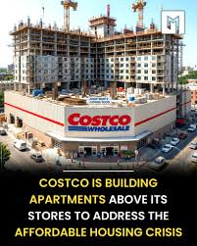
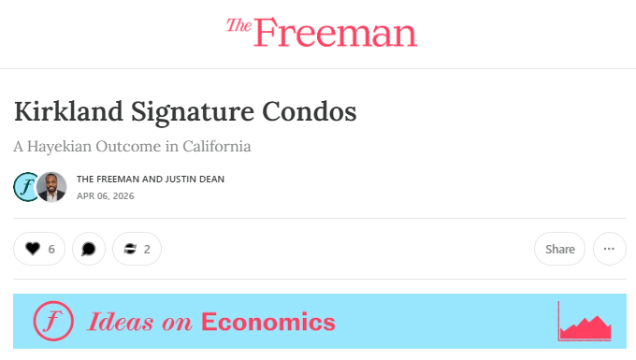
THE SOLUTION?
thefreemanmag.substack.com/p/kirkland-signature-condos

Slide 17


Slide 18




WELCOME
Before We Get Started
Today's Format
Certificate of Completion
2 hours, live on Zoom, with one 10-minute break. This is a working, hands-on session — expect to read, decide, and argue, not just listen.
Stay engaged for the full session and you'll receive an EconEdLink certificate of completion within 24 hours.
Interactive Throughout
A Sneak Preview
Watch for Slido polls, discussion prompts, and a knowledge check woven into today's slides — join on your phone or laptop when prompted.
We'll close with a first look at Perfect Pairings: Economics in Action, a new monthly lesson series launching in 2026–27.
EconEdLink Professional Development Webinar | Presented by Joel Miller, Foundation for Economic Education
3

Slide 19







AGENDA
How We'll Spend Our 2 Hours
12:45
Welcome & warm-up poll
10 min
12:55
PART ONE — DRIP (Explore: The Economic Puzzle)
30 min
1:25
PART TWO — DECIDE (Apply: The Decision Lab)
20 min
1:45
Break
10 min
1:55
PART THREE — DISCOVER (Decide & Defend: SAC)
25 min
2:20
Capstone: Four Principles Travel Check
10 min
2:30
Preview: Perfect Pairings — Economics in Action
10 min
2:40
Certificate, resources & Q&A
5 min
EconEdLink Professional Development Webinar | Presented by Joel Miller, Foundation for Economic Education
4

Slide 20


What is Economics?
The science of human action — how people pursue chosen ends with scarce means.
EST. 1946
Notes:
Based on the Hazlitt Fellowship lecture and assignment by FEE’s Dan Sanchez: https://docs.google.com/document/d/1Ak52gUEcns6Tb4TBnSJsEDyxGo8BsqapZdbu6j4wtlo/edit?tab=t.0

Slide 21


Teach choice before you teach curves/models.
Why do people act at all?
Answer that, and supply, demand, and price all follow naturally.
Start with people
Economics begins with human beings making choices.
1
Build, don't memorize
Each idea follows from the one before it, so students reason rather than recall.
2
Transfers everywhere
The logic of choice explains prices, trade, and everyday decisions alike.
3
Notes:
https://www.mondayeconomist.com/p/tuesdays-assorted-links-7fd
Foreign demand for American government debt is becoming much less reliable [The Economist | Archive]
New Jersey became the latest state to pass a law banning surveillance pricing, joining Maryland and Connecticut [Gizmodo]
250 years of the U.S. economy [NPR’s Marketplace]
OpenAI is in early discussions to give the US government a share of the company as part of an effort to soften increasing political pressure on the AI industry [CNBC]
Google loses fight over record $4.7 billion EU antitrust fine [Reuters]

Slide 22
Economics is the science of human action.
Human action is purposeful behavior, a person using means to reach a chosen end. Every choice in an economy—from a grocery run to a global trade—is an instance of human action.
Ludwig von Mises, Human Action (1949)
EST. 1946

Slide 23






The six building blocks of action
Action
Ends
Means
Purposeful behavior aimed at improving one's situation.
The goals an actor seeks: survival, comfort, enjoyment.
The scarce things used to pursue those ends.
Scarcity
Economizing
Value
Means are limited relative to all the ends they could serve.
Choosing which ends to serve, and which to forgo.
A ranking of ends, revealed through the choices a person makes.
EST. 1946

Slide 24
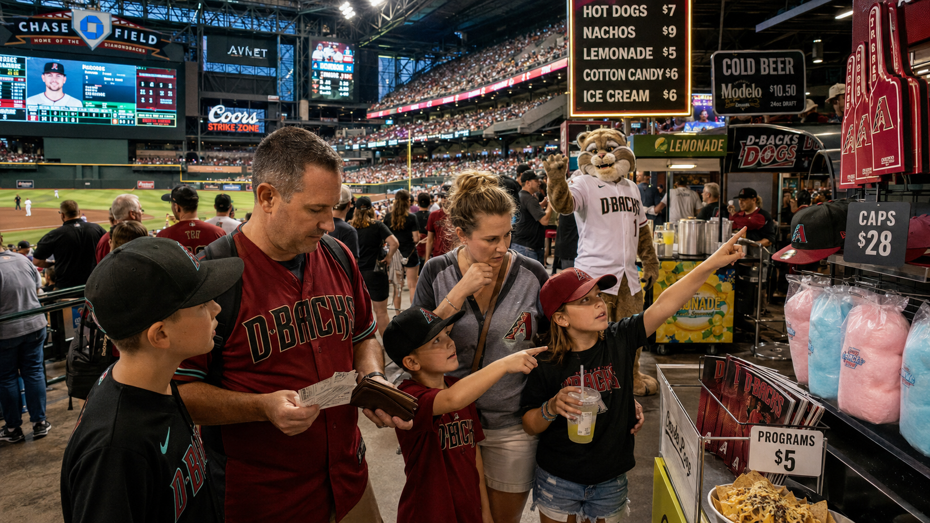

Slide 25

A Story from the Perspective of a Groundskeeper
It's a brutal afternoon doubleheader in the Arizona heat, and the clubhouse has only a limited supply of cold, fresh water left in the cooler. The Diamondbacks' manager has to decide how to ration it. Each use serves a different end — and he can't fund them all.
Hydration
Cooling down
Celebration
End: Performance (survival of the game)
End: Recovery
End: Fun
Keeping his players hydrated enough to stay on the field and compete — the most urgent need the water can meet.
Cold towels and cooling between innings, valued once players are hydrated enough to keep playing.
A water-cooler dump on the rookie after a walk-off — worthwhile only when there's water to spare.
EST. 1946

Slide 26

Value scale & opportunity cost
Our choices reveal a ranking. With only 5 gallons you drink; with 10 you drink and bathe. What you gives up each time is the opportunity cost.
Opportunity Cost
Rank | End | Use | Water
1st | Survival (performance) | Hydration | 5 gal
2nd | Recovery | Cooling Down | 5 gal
3rd | Fun | Celebration | 5 gal
The value of the highest-ranked end you give up when you commit a means to one use.
5 gallons → drink.
Cost = cleanliness.
10 gallons → drink + bathe.
Cost = fun.
FOUNDATION FOR ECONOMIC EDUCATION
EST. 1946

Slide 27
The Law of Marginal Utility
The value of one more unit depends on the lowest-ranked end it serves at the current supply. As supply rises, each added gallon serves a less urgent end — so its marginal value falls.
5 gallons
10 gallons
15 gallons
Trading 5 away costs the game.
Trading 5 away costs recovery.
Trading 5 away costs only celebration.
Highest cost
Lower cost
Lowest cost
FOUNDATION FOR ECONOMIC EDUCATION
EST. 1946

Slide 28
Economics is the science of human action.
The classroom payoff is that students stop asking "what is X really worth?" and start asking "to whom, under what conditions, and compared to what?"
FOUNDATION FOR ECONOMIC EDUCATION
EST. 1946

Slide 29

The Diamond–Water Paradox, resolved
Water
Diamonds
Essential, but abundant. Any one gallon serves only a trivial end, so its marginal value—and price—is low.
A mere luxury, but scarce. Each one serves a highly-ranked end, so its marginal value—and price—is high.
Menger's insight (1871): price tracks the usefulness of the marginal unit, not a good's importance in general.
EST. 1946

Slide 30
From the jeweler’s case to the batter’s box
Same logic, new diamond. Value lives in the marginal unit—and context sets it.
The gem diamond
The ballpark diamond
Scarce, so the next stone serves a highly-ranked end. Its price is high—not because the rock is useful, but because one more is hard to get.
An empty field at noon is nearly worthless. The same diamond in the bottom of the 9th, down a run, is priceless. Context—not the dirt—sets the value.
Ask your students: what is a baseball player “worth”? The honest answer is always—to whom, and compared to what?
EST. 1946

Slide 31
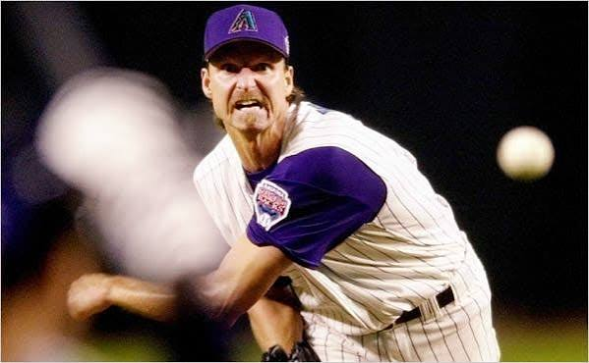
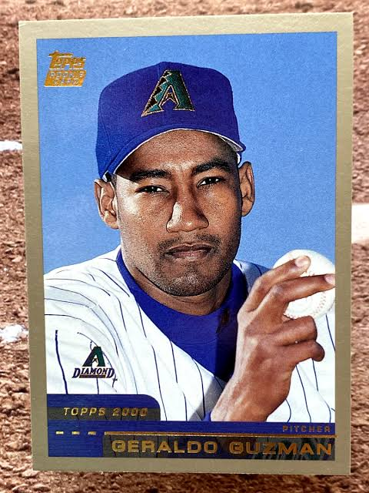
Same “category,” very different price
2001 World Series champion Arizona Diamondbacks — one roster, two ends of the value scale
THE ACE
THE ROSTER FILLER
Randy Johnson
League-minimum bench player
$13.1M
$200K
Per year (4-yr / $52.4M deal). 2001 NL Cy Young — the scarcest arm in baseball.
2001 MLB minimum salary. A replaceable contribution—many players could fill the spot.
65× the price for the same job title. Price tracks the value of the next, scarce contribution—not “baseball player” in general.
EST. 1946
Notes:
His 2001 pitching statistics outline the following details:
Games Pitched (G): 4
Earned Run Average (ERA): \(2.89\)
Innings Pitched (IP): \(9.1\)
Strikeouts (SO): 4 [1, 2]

Slide 32
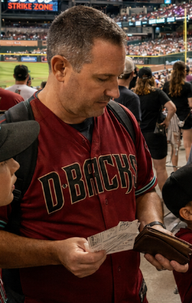

One bottle of water, two prices
Nothing about the water changes, only the scarcity and urgency of the next unit
STOREROOM
CONCOURSE STAND
7TH INNING, 108°F
¢
$5
Priceless
The 10th case sitting in back. Abundant supply—the marginal bottle is nearly worthless.
Same bottle, now scarce relative to a stadium full of thirsty fans on a hot day.
To one overheating fan, the next bottle meets the most urgent end of all.
Marginal utility in one image: we never value “water” as a category—only the next unit, in context, to a specific person.
EST. 1946

Slide 33
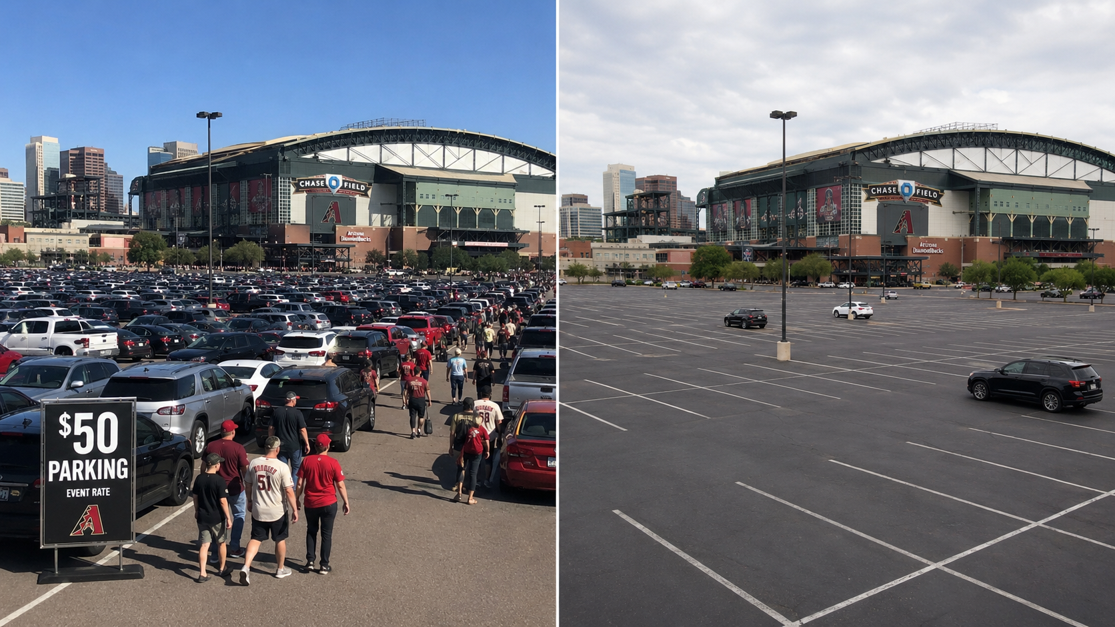
One parking lot, two prices.
Nothing about the parking lot changes, only the scarcity and urgency of the next unit
7TH INNING, 108°F
“Priceless”
To one overheating fan, the next bottle meets the most urgent end of all.
Marginal utility in one image: we should never value “parking” as a category—only the next unit, in context, to a specific person.
EST. 1946

Slide 34



Economics is the logic of choice.
Start with a person acting under scarcity, and prices, trade, and markets all follow. Give your students that foundation, and the graphs finally mean something.
Take it further with FEE’s Learning Center resources (free @ TEACHERS.FEE.ORG)
FEE Learning Center
'Everyday Economics' Webinars
ECONOMIC CLUBS
TEACHERS.FEE.ORG
Live Webinars throughout the school year
Build a community of Economic Thinkers at your school
FOUNDATION FOR ECONOMIC EDUCATION
EST. 1946

Slide 35


The logic of choice is the engine.
Where we've been
Where we're going
What is Economics?
Think Like an Economist
Human action is purposeful behavior
The zero-sum instinct — and why we're wired for it
Value is subjective — in the chooser, not the good
How voluntary exchange creates value for both sides
Every choice forecloses an alternative (opportunity cost)
Incentives, trade-offs, and spontaneous order
Value falls at the margin as supply rises
Price signals as distributed knowledge
Price tracks the marginal unit, not importance in general
Entrepreneurial alertness and expanding the pie
EST. 1946

Slide 36
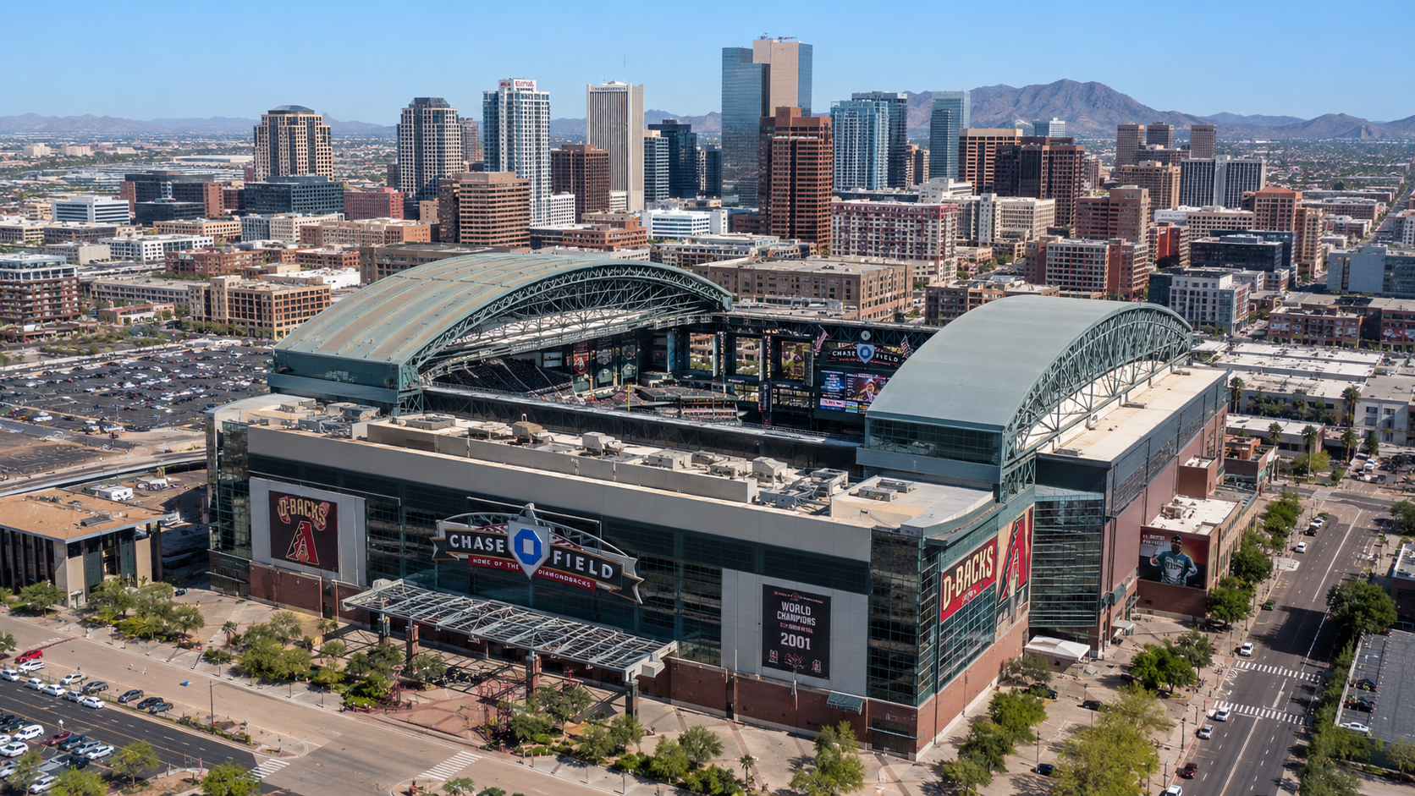
PRICE THEORY • CORE MECHANISM
What Prices Tell Us
How a single number coordinates millions of strangers — without anyone in charge
Arizona Council on Economic Education & Foundation for Economic Education
Chase Field • Professional Development Workshop
FOUNDATION FOR ECONOMIC EDUCATION • EST. 1946
Notes:
Title slide. Open by orienting the room: this is the conceptual heart of the day. Everything before built up subjective value and marginal utility; now we ask what PRICES do with all those individual valuations. Tell them by the end they'll explain (1) why a Dodgers ticket costs 3x a midweek game and (2) how a piece of cardboard hits $1M — using the same single idea.

Slide 37


Slide 38

SESSION ROADMAP
Where this fits
Subjective value
Prices as signals
The Invisible Hand
You just covered this
We are here
Up next
Lesson Objective
Teachers will explain how prices act as signals that coordinate the dispersed, private knowledge of millions of strangers using live Chase Field ticket data and the $1M Paul Skenes rookie card.
Essential Question: If no one sets the “right” price, why does a Dodgers game cost three times a midweek game — and how does a piece of cardboard reach $1 million?
FOUNDATION FOR ECONOMIC EDUCATION • EST. 1946
Notes:
Frame the arc: prices are the engine that connects the subjective-value session to the invisible-hand session. Read the essential question aloud and tell them to hold both puzzles — the whole session is the answer. Don't answer yet. ~2 min on this slide.

Slide 39
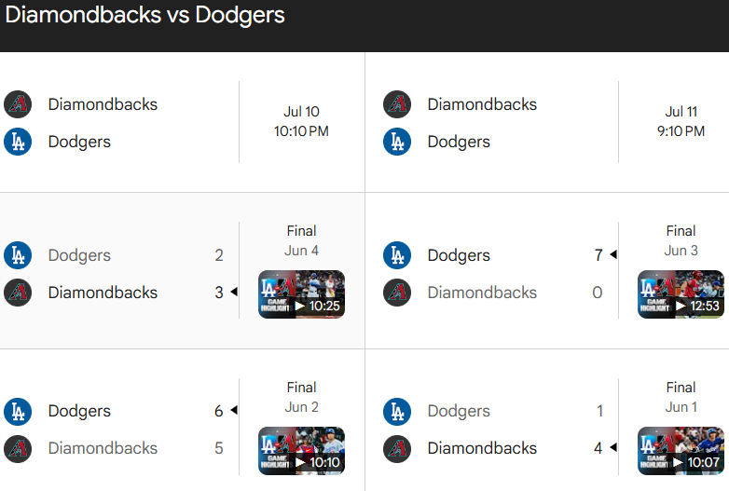
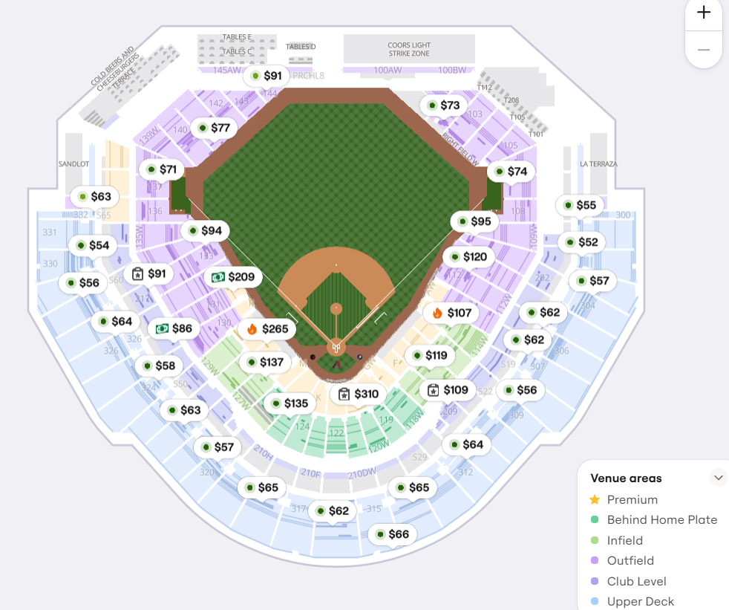
If no one sets the “right” price, why does a Dodgers game cost three times a midweek game, and how does a piece of cardboard reach $1 million?
Matchup | Day / Demand
D-backs vs. Dodgers | Rivalry series — high demand
D-backs vs. small-market club | Midweek — lower demand
Prices as signals: a price is a compressed message carrying information no single person possesses
(Hayek, “The Use of Knowledge in Society,” 1945).

Slide 40
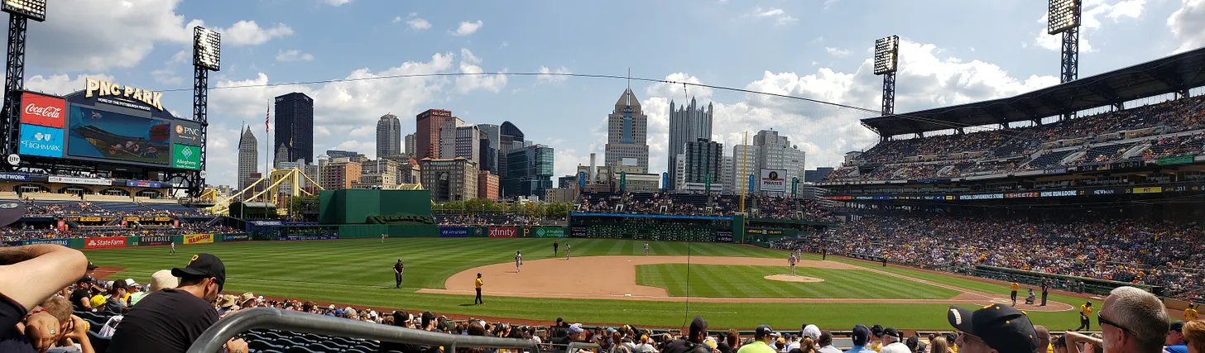
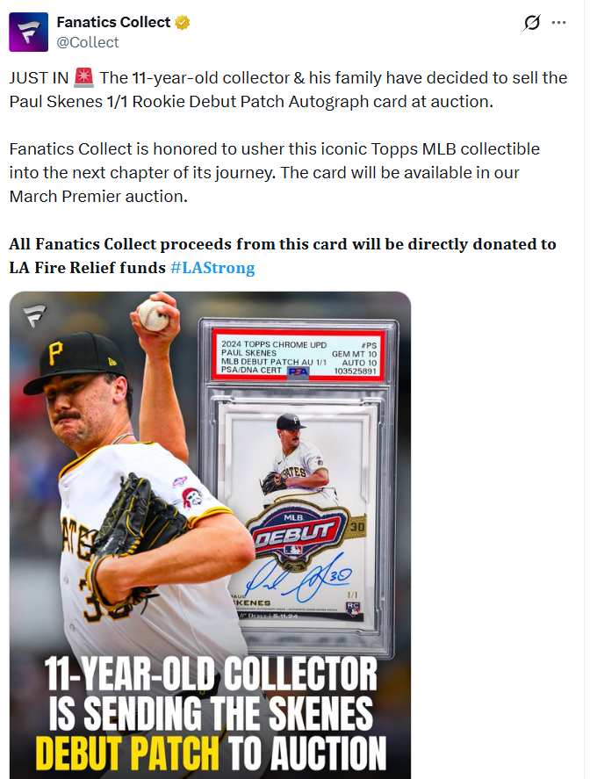

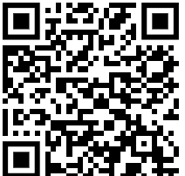
Why a Paul Skenes Baseball Card Is Worth A Million Dollars
“We must look at the price system as … a mechanism for communicating information.”

Slide 41
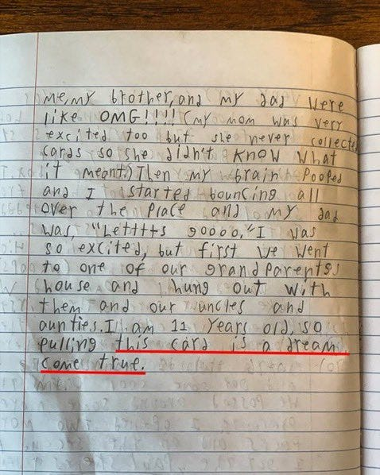
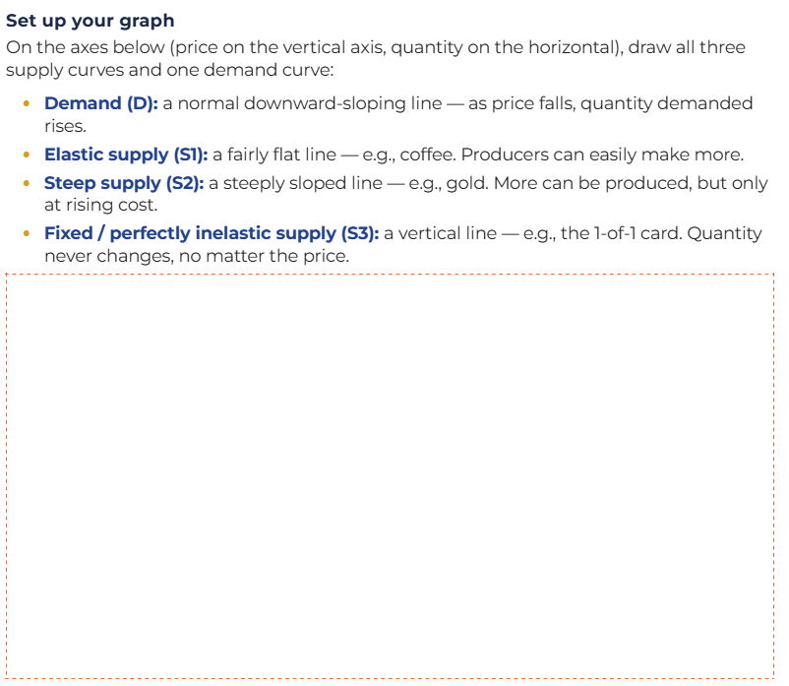

Slide 42
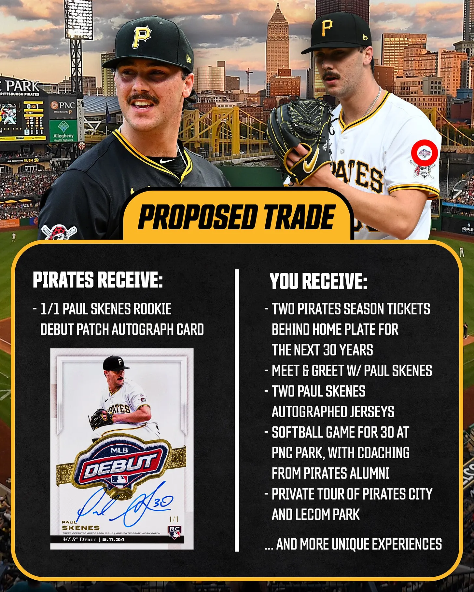
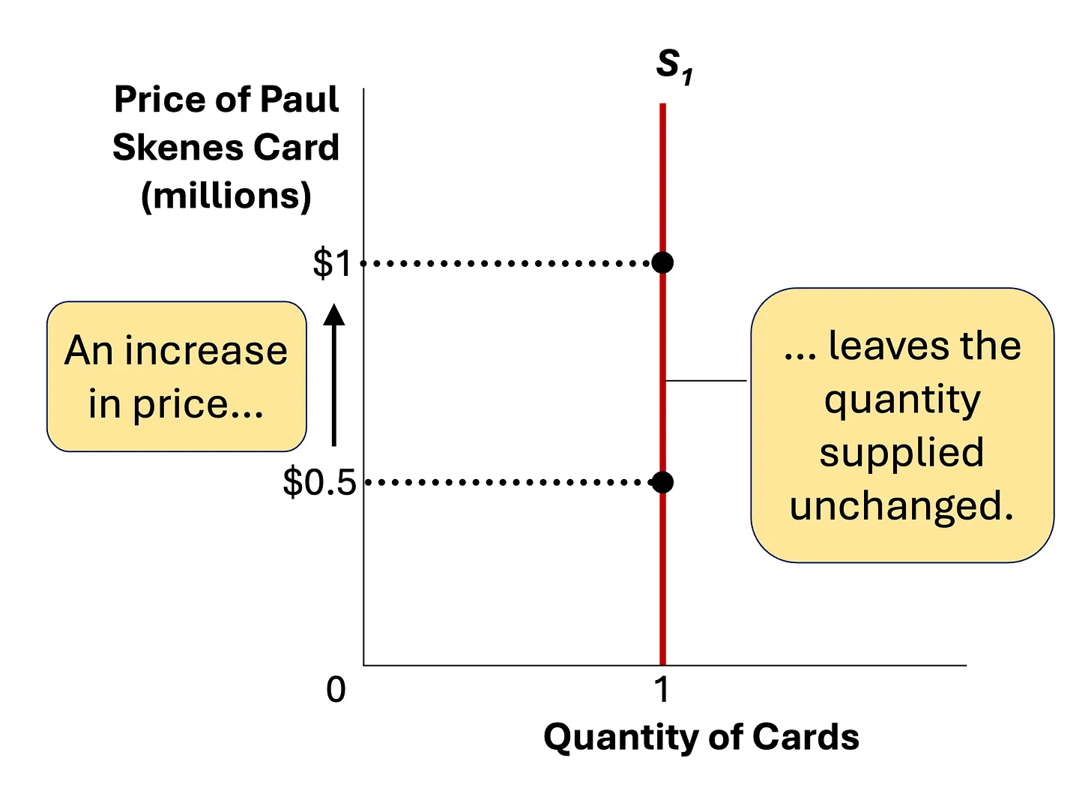
Notes:
Production cost: pennies of ink, paper, and fabric. Expected auction value: around $1 million — more than an average Pittsburgh house. The Pirates offered 30 years of season tickets to pry it loose; the card still headed to auction, because an auction is exactly how a market rations the single unit that can’t be reproduced: whoever values it most, wins it.

Slide 43
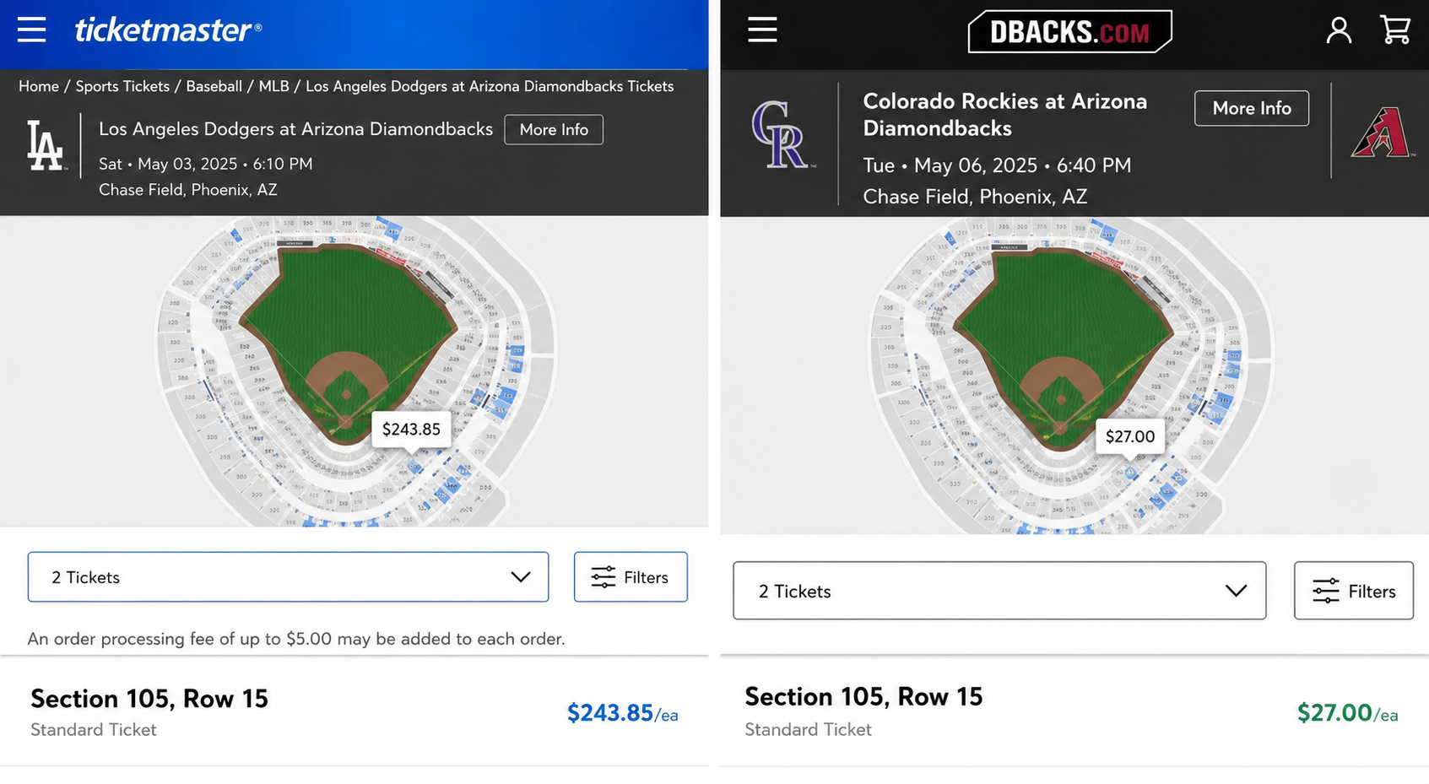
What’s this worth?
Same seat. Same stadium. Same team. Two very different prices. Why?
D-backs vs. Dodgers
D-backs vs. small-market club
Rivalry series — high demand
Midweek — lower demand
~$40+
~$10–$19
Source: Diamondbacks single-game face prices run roughly $10–$68 under dynamic pricing; Dodgers rivalry dates carry the highest demand, midweek small-market games the lowest.
FOUNDATION FOR ECONOMIC EDUCATION • EST. 1946
Notes:
Hook, 5 min. Project the two tickets and let the room call out which is pricier and WHY before you reveal. Resist the word 'greed' — write it on the board and cross it out; we'll replace it with 'signal.' Key beat: nothing about the seat changed; only how many people want in changed. Hold the puzzle.

Slide 44


A price is a message
Dynamic pricing isn’t the team being greedy. It’s the box office listening.
Knowledge is scattered
Who’s in town, who’s a rival fan, who has Friday night free — no employee could ever gather it all.
“We must look at the price system as … a mechanism for communicating information.”
The price compresses it
Thousands of fans independently decide the game is worth more. The price rises to report exactly that.
No one is in charge
— F. A. Hayek, 1974 Nobel laureate
Nobody at the Diamondbacks 'set' the Dodgers premium. The fans did; the price simply broadcast it.
Check Your Understanding: “Who at the Diamondbacks decided the Dodgers game should cost more?”
FOUNDATION FOR ECONOMIC EDUCATION • EST. 1946
Notes:
Core concept, 12 min — this is the heart of the session. Walk the three rows top to bottom: knowledge is dispersed -> price compresses it -> no central command. Then read the Hayek quote; this is THE Austrian point (The Use of Knowledge in Society, 1945). Land the facilitator prompt hard — it reframes 'greed' as 'information.' If a teacher pushes back that the team obviously sets prices, clarify: they set an algorithm that RESPONDS to demand; they don't know the right number in advance any more than you do.

Slide 45


When supply can’t answer
Tickets are elastic-ish — the team can open the upper deck. But what if supply literally cannot move?
Coffee, concert seats
Highly elastic — grind more beans, add showtimes. Price barely moves.
Gold, diamonds
Steep but not vertical — miners dig deeper if price climbs high enough.
Standard rookie cards
Topps prints another set; condition and edition still matter.
Skenes 1-of-1 patch card
Perfectly inelastic — a vertical line. No reprint, no backup. Price is the ONLY thing left that can move.
Cost to make: pennies. Expected at auction: ~$1 million — more than an average Pittsburgh house.
FOUNDATION FOR ECONOMIC EDUCATION • EST. 1946
Notes:
Extreme case, 12 min. Build the spectrum from elastic (coffee) to perfectly inelastic (the 1-of-1). The visual payoff: when the supply curve is vertical, a demand spike has nowhere to go but PRICE. That's why pennies of materials become $1M. Mention the Pirates dangled 30 years of season tickets and Livvy Dunne offered a suite seat — and the kid still sent it to auction, because an auction is how a market rations a single unreproducible unit: highest bidder wins. Tie back: same mechanism as tickets, just the limiting case.

Slide 46
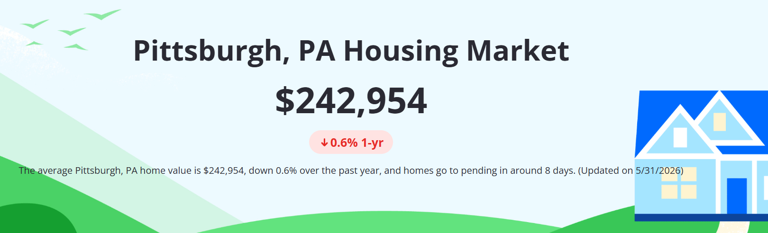
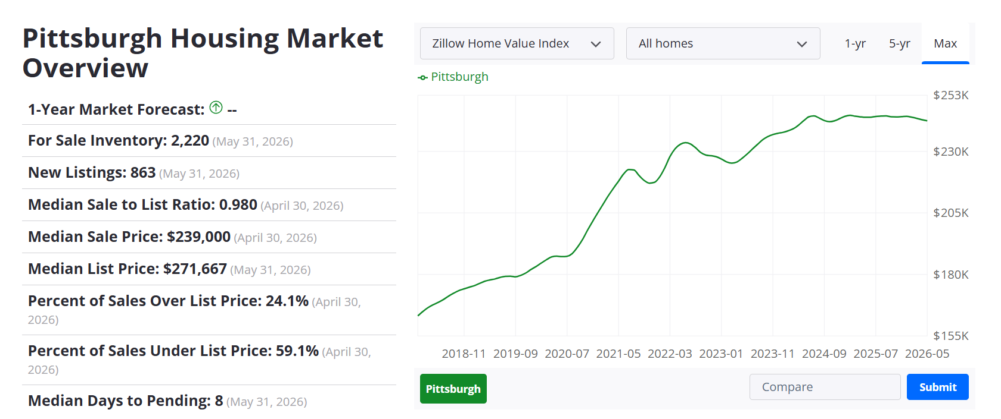

Slide 47
One mechanism, two stories
Price and quantity share the job of adjusting. How that work splits depends entirely on whether supply can respond.
Dodgers tickets
Skenes 1-of-1 card
Demand rises
Yes
Yes
Can supply respond?
Somewhat — release seats
Never — fixed at one
What absorbs the change?
Price + quantity
Price ALONE
Who decides the price?
Thousands of fans
The highest bidder
The takeaway: in both cases the price wasn’t handed down — it was discovered.
FOUNDATION FOR ECONOMIC EDUCATION • EST. 1946
Notes:
Synthesis, 8 min. Put both cases on one axis. The single most important row is 'what absorbs the change' — tickets split it between price and quantity; the card forces it all onto price. Drive home: the price was DISCOVERED, not dictated. That word is the bridge to the next session. End by asking: if prices coordinate strangers this well with no one in charge, what ELSE does the market organize on its own? (→ Invisible Hand.)

Slide 48




Take it back to students
1. Live price hunt
2. Elastic vs. inelastic sort
3. “De gustibus” discussion
Students pull the same seat for a rivalry game and a midweek game, then explain the gap in “signal” language—not “greed.”
Rank ten goods (insulin, sneakers, a 1-of-1 card, gas…) by how much supply can respond—predict where price does the heavy lifting.
“No accounting for taste.” Economists observe what people pay, not whether the taste is right —separating positive from normative.
Exit question: “Name one thing whose price you now read differently — and what knowledge that price is quietly carrying.”
FOUNDATION FOR ECONOMIC EDUCATION • EST. 1946
Notes:
Classroom transfer, 5 min. These are ready-to-use moves — tell teachers to pick one for tomorrow. The 'de gustibus' move is the sleeper: it teaches the positive/normative distinction, which is a standards staple. Close with the exit question; have a few teachers share aloud. This doubles as your formative check that the signal concept landed.

Slide 49




LEARNING OBJECTIVES
By the End of Today, You'll Be Able To
Explain the Framework
Run a Live Demo Lesson
Describe the difference between “Econs” (rational, cost-benefit decision-makers) and “Humans” (real students, subject to cognitive bias).
Facilitate a full Explore–Apply–Decide lesson built around a real Perfect Pairings article on airline drip pricing — hook, layered data, and a modified SAC.
Place the Lessons
Assess Understanding
Identify exactly where each EconEdLink and Perfect Pairings resource fits in a course you already teach.
Walk away with four ready-to-use assessment formats, a grading rubric, and a reusable instructional framework.
EconEdLink Professional Development Webinar | Presented by Joel Miller, Foundation for Economic Education
5

Slide 50

HOW TODAY IS BUILT
This Session Models Tomorrow's Curriculum
Everything from the hook question forward follows the same three-phase framework you'll see previewed at the end of today's session — Perfect Pairings: Economics in Action.
DRIP
EXPLORE
The Economic Puzzle — a cold hook question, a short reading, then vocabulary
DECIDE
APPLY
The Decision Lab — layered data revealed step by step, Seen vs. Unseen
DISCOVER
DECIDE & DEFEND
A Structured Academic Controversy — argue a position, then synthesize
EconEdLink Professional Development Webinar | Presented by Joel Miller, Foundation for Economic Education
6

Slide 51
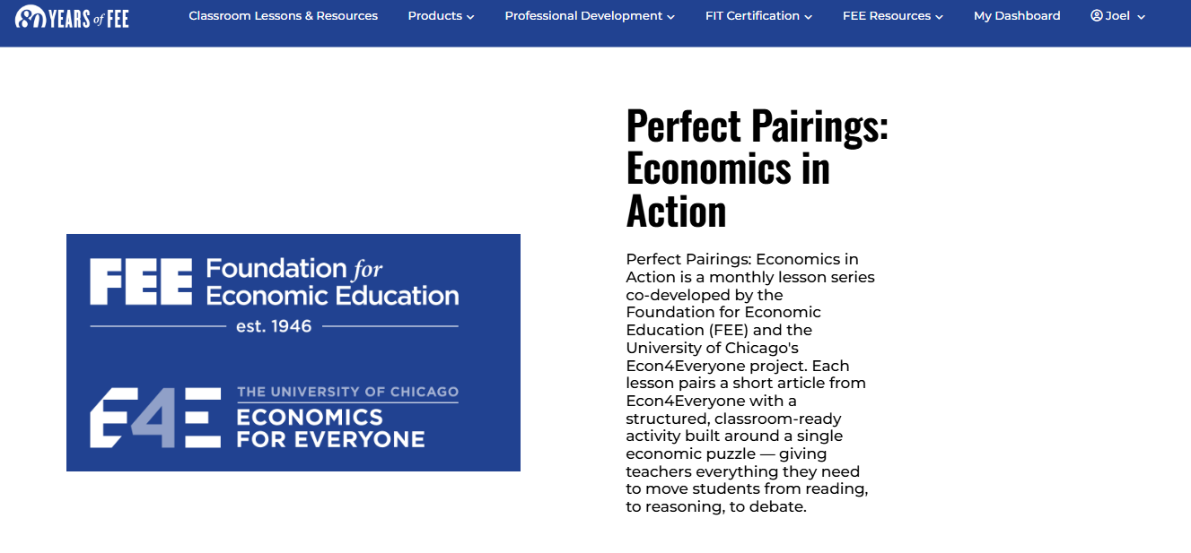
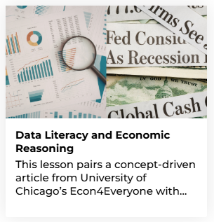
TEACHERS.FEE.ORG

Slide 52



Do not edit
How to change the design
When your students play a classroom trading or negotiation game, what usually decides the price they agree to?
Presenting with animations, GIFs or speaker notes? Enable our Chrome extension
Notes:
📣 This is Slido interaction slide, please don't delete it.
✅ Click on 'Present with Slido' and the poll will launch automatically when you get to this slide.

Slide 53
PART ONE
DRIP: Pricing, Anchors & the Relativity Trap
Live demo lesson: Is Oxygen Included? Pricing and Behavioral Economics
FRAMEWORK PHASE: EXPLORE — The Economic Puzzle
EconEdLink Professional Development Webinar | Presented by Joel Miller, Foundation for Economic Education
8

Slide 54
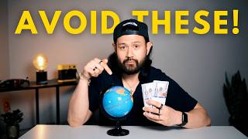

Slide 55


HOOK QUESTION — ANSWER COLD, BEFORE READING
How Does a $199 Flight Become $340?
HOOK QUESTION (COLD)
Before we read anything: why do you think the price grows between the ad and the checkout button, and is that a “fair” way to sell a ticket?
$199
advertised fare
Answer this before the reading. We'll come back to your first instinct after we've unpacked the psychology behind it.
$340
what you actually pay
EconEdLink Professional Development Webinar | Presented by Joel Miller, Foundation for Economic Education
9

Slide 56

Do not edit
How to change the design
Word cloud: In one word, how does it feel when a price grows at checkout?
Presenting with animations, GIFs or speaker notes? Enable our Chrome extension
Notes:
📣 This is Slido interaction slide, please don't delete it.
✅ Click on 'Present with Slido' and the poll will launch automatically when you get to this slide.

Slide 57

PHASE 1 — THE READING
Today's Article
“Is Oxygen Included? Pricing and Behavioral Economics”
Carl Coates • Econ4Everyone • March 4, 2026
A firsthand account of a family flight booking that quietly grows from a budget-friendly fare into seat fees, baggage fees, and a forgotten “free” fast-lane subscription — used to explain unbundling in the airline industry.
FOCUS QUESTION FOR THE READ
FOCUS QUESTION
As you read, watch for every moment the author feels a small win, followed by a small loss. What is he noticing — and what is he not noticing until later?
EconEdLink Professional Development Webinar | Presented by Joel Miller, Foundation for Economic Education
10
Notes:
Introduced only after the reading: unbundling — separating what was once one all-inclusive price into multiple components priced separately. Pioneered by Spirit Airlines in 2006, following deregulation that let low-cost carriers compete on price.

Slide 58
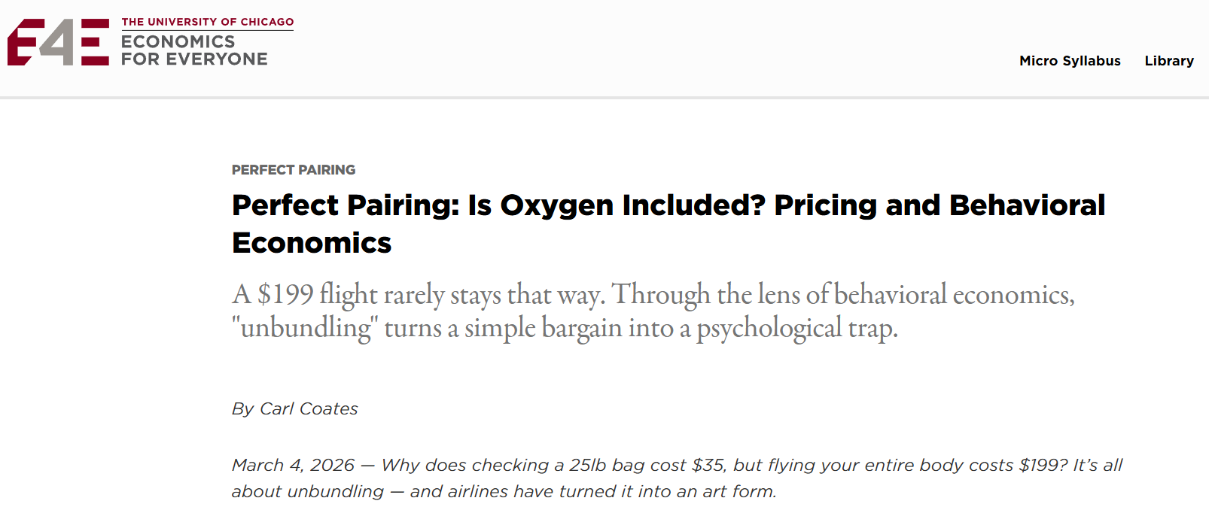
LET’S READ! 5-6 mins. (no video)
Notes:
https://econ4everyone.uchicago.edu/perfect-pairing-is-oxygen-included-pricing-and-behavioral-economics/

Slide 59

Do not edit
How to change the design
Discussion — where else have you seen unbundling (streaming add-ons, concert tickets, etc.)?
Presenting with animations, GIFs or speaker notes? Enable our Chrome extension
Notes:
📣 This is Slido interaction slide, please don't delete it.
✅ Click on 'Present with Slido' and the poll will launch automatically when you get to this slide.

Slide 60

PHASE 2 — THE DECISION LAB • LAYER 1 OF 4
What You See and What You Don't
At the moment of the ad, here is everything the traveler in the article can evaluate:
SEEN | UNSEEN (revealed later)
Base fare: $199 | Seat selection fee
Flight times & destination | Checked and carry-on baggage fees
The feeling: “what a deal!” | A “free” fast-lane security pass that auto-renews if not cancelled
Behavioral concept: People weigh what is most obvious— the base fare—and underweight costs that are revealed sequentially, later, in smaller pieces.
EconEdLink Professional Development Webinar | Presented by Joel Miller, Foundation for Economic Education
11

Slide 61
THE DECISION LAB • LAYER 2 OF 4
Consumer Surplus: How You Might Win or Lose
Consumer surplus = the gap between what you're willing to pay and what you actually pay. Unbundling can widen it or erase it depending on who's flying.
HOW YOU MIGHT WIN
HOW YOU MIGHT LOSE
Disciplined, minimal-needs travelers pay only for what they use
Consumer surplus rises; the outcome is more efficient — price moves closer to true willingness-to-pay
Fewer resources wasted on features some travelers don't value (deadweight loss falls)
Firms try to move price toward each traveler's maximum valuation — this can shrink or erase consumer surplus
Research shows people systematically underestimate total cost when prices are split into parts
The article's family “saved very little” once every fee was tallied
EconEdLink Professional Development Webinar | Presented by Joel Miller, Foundation for Economic Education
12

Slide 62

THE DECISION LAB • LAYER 3 OF 4
Why Don't Competitive Markets Fix This?
COMPELLING QUESTION
If travelers hate hidden fees, why doesn't competition force airlines to show the full price upfront?
Shrouded attributes (Gabaix & Laibson, 2006): prices or features whose existence isn't readily apparent to consumers
Their model: even in a competitive market, firms have little incentive to reveal (“deshroud”) fees — doing so doesn't win enough sophisticated shoppers to offset the revenue lost from less-attentive ones
This is information asymmetry in action: firms know the full cost structure; travelers, mid-search, often don't
In 2024, the U.S. Department of Transportation issued a rule requiring airlines to disclose critical extra fees upfront — a direct policy response to shrouded pricing
SLIDO PROMPT: Discussion — is a disclosure mandate the right fix, or does it just add compliance cost? (We'll debate this later.)
EconEdLink Professional Development Webinar | Presented by Joel Miller, Foundation for Economic Education
13

Slide 63

THE DECISION LAB • LAYER 4 OF 4
Why Nobody Abandons the Cart
SUNK COST & ESCALATION OF COMMITMENT
CHOICE ARCHITECTURE
After minutes spent navigating the booking funnel, travelers are psychologically less likely to abandon it and start over — even when a competitor's total is now lower.
The booking funnel itself is designed: base fare shown first (most salient), each add-on introduced one screen at a time, defaults pre-selected — every step nudges you toward completing the purchase as priced.
EconEdLink Professional Development Webinar | Presented by Joel Miller, Foundation for Economic Education
14

Slide 64

Do not edit
How to change the design
Which Is Hardest to Abandon Once It's in Your Cart?
Rank these six checkout flows from hardest to walk away from (1) to easiest to walk away from (6), once you've already started the process and the fees start stacking up:
Presenting with animations, GIFs or speaker notes? Enable our Chrome extension
Notes:
📣 This is Slido interaction slide, please don't delete it.
✅ Click on 'Present with Slido' and the poll will launch automatically when you get to this slide.

Slide 65
THE FRAMEWORK
Econs vs. Humans
Every EconEdLink lesson we walk through today returns to the same distinction.
ECONS | HUMANS
Use System 2 (analytical, deliberate) for every decision | Use System 1 (automatic, intuitive) for routine decisions
Weigh costs & benefits equally, every time | Weigh losses more heavily than equivalent gains
Are immune to arbitrary anchors | Are swayed by numbers that have nothing to do with value
Are unaffected by how a choice is framed or defaulted | Tend to stick with whatever default is presented
Make decisions based only on costs & benefits | Also weigh fairness, meaning, and emotion
Source: William Bosshardt, Florida Atlantic University — EconEdLink, “How to Use the Behavioral Economics Lessons”
EconEdLink Professional Development Webinar | Presented by Joel Miller, Foundation for Economic Education
15
Notes:
Presenter's aside (optional, for Q&A): behavioral economics sits somewhat uneasily inside the Austrian tradition FEE draws on. Mises's praxeology treats all purposeful action as rational by definition -- from the actor's own subjective standpoint there is no 'irrational' choice to correct, only successful or unsuccessful attempts to satisfy one's own subjectively-ranked ends. Behavioral economics' laboratory claims about systematic 'bias' import an external, economist-defined standard of rationality that many Austrians reject on subjectivist grounds. There is also a policy-level tension: behavioral findings are frequently used to justify paternalistic 'nudge' policy, which sits uncomfortably next to the Hayekian knowledge problem -- if planners cannot out-know dispersed individual knowledge, they are equally unlikely to reliably know when and how to correct an individual's 'biased' choice. This is not a unanimous rejection, though -- some Austrian-influenced economists find behavioral economics useful descriptively (evidence of how real people act) while still resisting the paternalist policy conclusions often layered on top of it. Raise this only if asked -- it is not part of the core CEE-contracted content.

Slide 66
Do not edit
How to change the design
Which column better describes most of your students, most of the time?
Presenting with animations, GIFs or speaker notes? Enable our Chrome extension
Notes:
📣 This is Slido interaction slide, please don't delete it.
✅ Click on 'Present with Slido' and the poll will launch automatically when you get to this slide.

Slide 67
THE FRAMEWORK
Econs vs. Humans
Every EconEdLink lesson we walk through today returns to the same distinction.
ECONS | HUMANS
Use System 2 (analytical, deliberate) for every decision | Use System 1 (automatic, intuitive) for routine decisions
Weigh costs & benefits equally, every time | Weigh losses more heavily than equivalent gains
Are immune to arbitrary anchors | Are swayed by numbers that have nothing to do with value
Are unaffected by how a choice is framed or defaulted | Tend to stick with whatever default is presented
Make decisions based only on costs & benefits | Also weigh fairness, meaning, and emotion
Source: William Bosshardt, Florida Atlantic University — EconEdLink, “How to Use the Behavioral Economics Lessons”
EconEdLink Professional Development Webinar | Presented by Joel Miller, Foundation for Economic Education
15
Notes:
Presenter's aside (optional, for Q&A): behavioral economics sits somewhat uneasily inside the Austrian tradition FEE draws on. Mises's praxeology treats all purposeful action as rational by definition -- from the actor's own subjective standpoint there is no 'irrational' choice to correct, only successful or unsuccessful attempts to satisfy one's own subjectively-ranked ends. Behavioral economics' laboratory claims about systematic 'bias' import an external, economist-defined standard of rationality that many Austrians reject on subjectivist grounds. There is also a policy-level tension: behavioral findings are frequently used to justify paternalistic 'nudge' policy, which sits uncomfortably next to the Hayekian knowledge problem -- if planners cannot out-know dispersed individual knowledge, they are equally unlikely to reliably know when and how to correct an individual's 'biased' choice. This is not a unanimous rejection, though -- some Austrian-influenced economists find behavioral economics useful descriptively (evidence of how real people act) while still resisting the paternalist policy conclusions often layered on top of it. Raise this only if asked -- it is not part of the core CEE-contracted content.

Slide 68
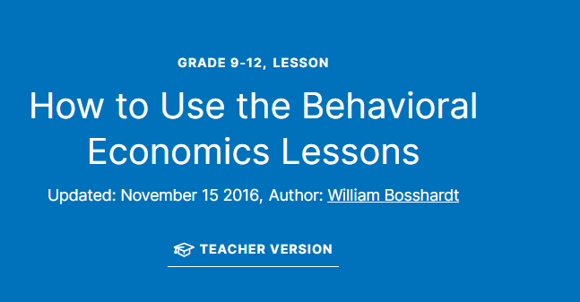
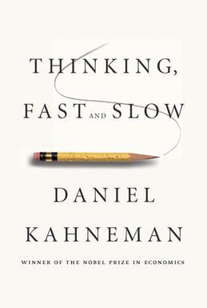
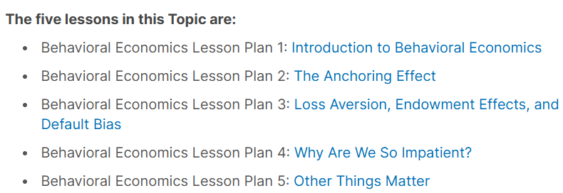
Notes:
https://econedlink.org/resources/how-to-use-the-behavioral-economics-lessons/

Slide 69
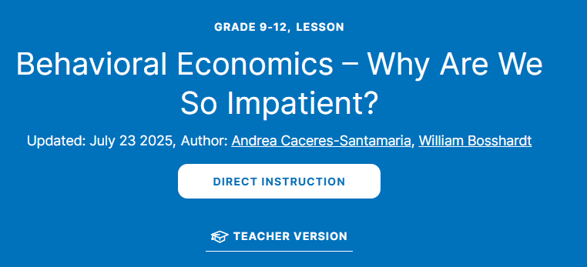


Notes:
https://econedlink.org/resources/behavioral-economics-lesson-four-why-are-we-so-impatient/

Slide 70
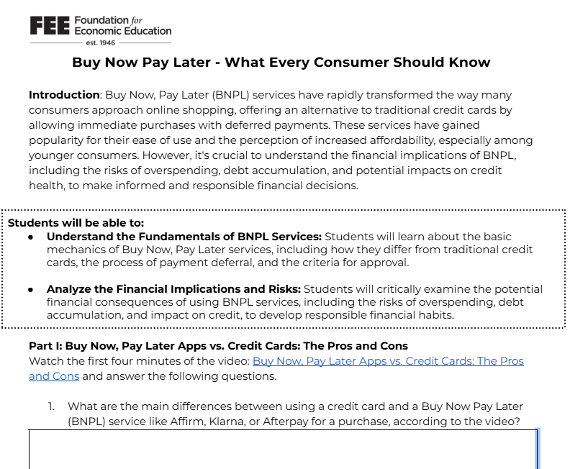
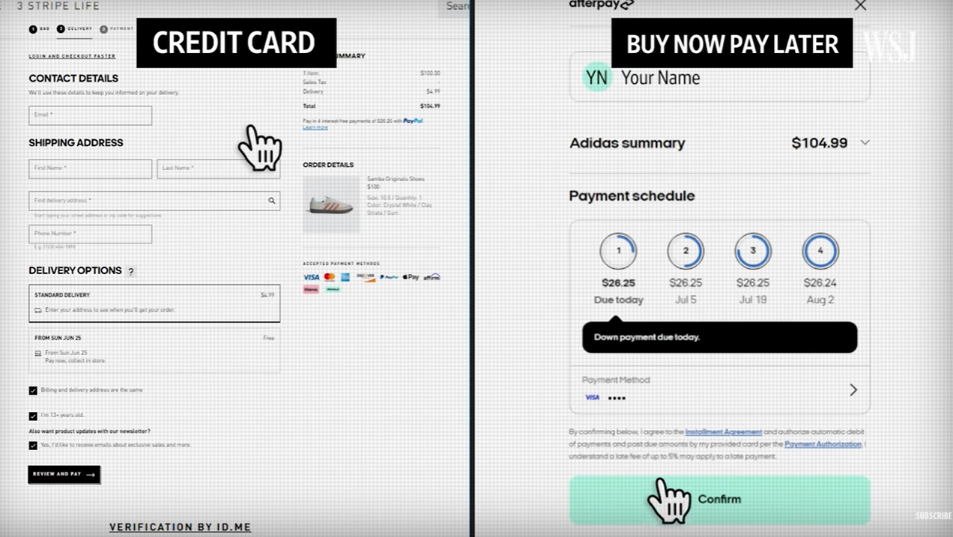
Notes:
https://docs.google.com/document/d/13kmEjH_Lg4dGhA8Zh8AcPZKlHCrCJXolFgWU_d2gqQ8/edit?tab=t.0

Slide 71
TODAY'S CORE RESOURCE
The Behavioral Economics Series (Grades 9–12)
1
Introduction to Behavioral Economics
60 min
Cost-benefit analysis, marginal analysis
2
Negotiating Prices & the Anchoring Effect
60 min
FEATURED
Anchors, the relativity trap
3
Loss Aversion, Endowment Effects & Default Bias
60 min
FEATURED
Reference points, nudges
4
Why Are We So Impatient?
60 min
Present bias, discounting
5
With “Fairness,” Other Things Matter
60 min
FEATURED
The Ultimatum Game, social preference
Free at econedlink.org/resources/collection/behavioral-economics. Lesson 4 (present bias) isn't covered live — it's a great take-home extension for AP Macro or a savings unit.
EconEdLink Professional Development Webinar | Presented by Joel Miller, Foundation for Economic Education
16

Slide 72
LESSON 2 — OVERVIEW
The Anchoring Effect
COMPELLING QUESTION
Can arbitrary numbers stick in our minds and affect our decision making?
LEARNING OBJECTIVES
KEY CONCEPTS
Explain how arbitrary numbers affect our decision making
Describe how anchors are used in negotiation
Analyze how retailers use anchors to sway purchasing decisions
Define the relativity trap and how it's used in the retail market
Cost-benefit analysis
Marginal analysis
System 1 vs. System 2
Reference point
Grades 9–12 • ~60 minutes
EconEdLink Professional Development Webinar | Presented by Joel Miller, Foundation for Economic Education
17

Slide 73

ACTIVITY WALKTHROUGH
The Anchoring Market Simulation
Half the class becomes sellers, half becomes buyers, negotiating the price of one textbook in a one-round, one-time trade.
LOW-ANCHOR BUYERS
HIGH-ANCHOR BUYERS
40–50
80–90
Expected result: lower average agreed price
Expected result: higher average agreed price
EconEdLink Professional Development Webinar | Presented by Joel Miller, Foundation for Economic Education
18

Slide 74
DEBRIEF
From the Classroom to the Storefront
THE RELATIVITY TRAP
ECON vs. HUMAN, AT THE ATV LOT
Placing excessive weight on an original (higher) price, then judging a lower sale price relative to that anchor — rather than against what the item is actually worth to you.
An Econ isn't swayed by a discount — acquiring the good at their own reservation price is satisfaction enough.
A Human gets caught up in “getting a good deal,” sometimes losing sight of whether the price still fits their budget or need.
RETAILERS USE IT VIA:
“MSRP $6,500” shown next to a lower sale price
Buy-one-get-one-free offers
“50% off” and “three for the price of one”
Classroom debrief: students score their own past purchases on an “Econ / Human” checklist and compare tallies as a class.
EconEdLink Professional Development Webinar | Presented by Joel Miller, Foundation for Economic Education
19

Slide 75
ASSESSMENT #2 — EDUCATOR DISCUSSION
Discuss Before We Move to DECIDE
USE AS SLIDO OPEN TEXT OR BREAKOUT
Why is price discounting such an effective tool for sellers — and where have you seen it in your own students' spending habits?
1
Where in your existing curriculum could the anchoring market simulation or the drip-pricing article replace or enhance a lesson you already teach?
2
How would you adapt these activities for a virtual or hybrid classroom?
3
EconEdLink Professional Development Webinar | Presented by Joel Miller, Foundation for Economic Education
20

Slide 76
PART TWO
DECIDE: Loss Aversion, Default Bias & Nudges
Featuring EconEdLink Lesson 3 — Loss Aversion, Endowment Effects, and Default Bias
FRAMEWORK PHASE: APPLY — The Decision Lab
EconEdLink Professional Development Webinar | Presented by Joel Miller, Foundation for Economic Education
21

Slide 77
LESSON 3 — OVERVIEW
Loss Aversion, Endowment & Default Bias
COMPELLING QUESTION
Why don't we always choose the best option when making a decision?
LEARNING OBJECTIVES
KEY CONCEPTS
Explain how decisions may be influenced by more than absolute costs and benefits
Discuss how the endowment effect and loss aversion affect decision making
Give an example of how default bias influences the choices people make
Endowment effect
Loss aversion
Default bias
Reference points
Grades 9–12 • ~60 minutes
EconEdLink Professional Development Webinar | Presented by Joel Miller, Foundation for Economic Education
22

Slide 78

ACTIVITY WALKTHROUGH
The Prize Box Demonstration
Every student receives a small prize — no choice, no trading allowed at first. Then a trade-in box opens.
THEORY PREDICTS
WHAT ACTUALLY HAPPENS
50%
~25%
of students trade for their preferred item — prizes were random.
actually trade — the endowment effect: once it's “mine,” I want to keep it.
SLIDO PROMPT: Poll — run this with your own group right now: would you trade your prize? Tally live.
EconEdLink Professional Development Webinar | Presented by Joel Miller, Foundation for Economic Education
23

Slide 79
SECOND ILLUSTRATION
Why Selling a Losing Stock Feels Different
Two gambles, identical math — a 50% chance of $1,000 and a 50% chance of $2,000 in each case, worth $1,500 either way.
FRAMED AS A GAIN
FRAMED AS A LOSS
Take the sure $1,500, or flip a coin for $1,000 / $2,000?
Lock in a guaranteed loss, or flip a coin to risk a bigger loss for a chance at none?
Most people take the sure thing.
Most people take the gamble — to avoid locking in a loss.
Source: adapted from Daniel Kahneman, Thinking, Fast and Slow, as presented in EconEdLink Lesson 3.
SLIDO PROMPT: Multiple choice — which framing made YOU want to gamble more, gain or loss? Be honest!
EconEdLink Professional Development Webinar | Presented by Joel Miller, Foundation for Economic Education
24

Slide 80
CASE STUDY — NUDGES IN PRACTICE
The Power of a Default: Retirement Enrollment
OPTION 1 — OPT IN
OPTION 2 — AUTO-ENROLL
Employees must actively sign up to contribute.
Employees are enrolled automatically and must opt out to stop.
37.4%
85.9%
participation rate with opt-in enrollment
participation rate with automatic enrollment
SLIDO PROMPT: Poll — did you predict the size of that gap? A) Yes, close B) I underestimated it C) I overestimated it
EconEdLink Professional Development Webinar | Presented by Joel Miller, Foundation for Economic Education
25

Slide 81

ASSESSMENT #3 — KNOWLEDGE CHECK
Quick Knowledge Check
RUN AS SLIDO OR KAHOOT QUIZ
John begins with $200. Scenario A: lose $50 for sure. Scenario B: flip a coin — heads, lose $100; tails, lose nothing. Behavioral economics predicts:
A
John will always take the sure loss
B
John will tend to gamble to avoid locking in the loss (correct)
C
John will flip a coin to decide
D
John's choice will be unrelated to framing
EconEdLink Professional Development Webinar | Presented by Joel Miller, Foundation for Economic Education
26

Slide 82
10-MINUTE BREAK
We're back at the top of the hour for Part Three: DISCOVER.
EconEdLink Professional Development Webinar | Presented by Joel Miller, Foundation for Economic Education
27

Slide 83
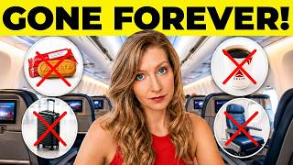
Notes:
https://youtu.be/PoiUyxw22Fs

Slide 84
PART THREE
DISCOVER: Fairness & a Structured Academic Controversy
Featuring EconEdLink Lesson 5 — With “Fairness,” Other Things Matter
FRAMEWORK PHASE: DECIDE & DEFEND — Structured Academic Controversy
EconEdLink Professional Development Webinar | Presented by Joel Miller, Foundation for Economic Education
28

Slide 85
LESSON 5 — OVERVIEW
With “Fairness,” Other Things Matter
COMPELLING QUESTION
Do people only care about maximizing their own payoff — or does fairness matter too?
THE ULTIMATUM GAME
KEY CONCEPTS
One student (the Proposer) offers to split a sum of money with a partner
The partner (the Responder) can accept — or reject, in which case both get nothing
A purely self-interested “Econ” Responder should accept any offer above $0
In practice, “Human” Responders routinely reject low offers, even at a cost to themselves
Allocation & fairness
Cost-benefit analysis
Grades 9–12 • ~60 minutes
Sets up today's SAC on drip pricing
EconEdLink Professional Development Webinar | Presented by Joel Miller, Foundation for Economic Education
29

Slide 86

ACTIVITY WALKTHROUGH
Running the Ultimatum Game
Pair students. One proposes a split of a fixed amount; the partner accepts or rejects. If rejected, both walk away with nothing.
WHAT AN ECON PREDICTS
WHAT ACTUALLY HAPPENS
Any offer above $0 should be accepted — something beats nothing.
Offers below ~20–30% of the total are frequently rejected — students punish unfairness.
SLIDO PROMPT: Poll — was rejecting a low offer irrational, or does it reveal fairness has real value?
EconEdLink Professional Development Webinar | Presented by Joel Miller, Foundation for Economic Education
30

Slide 87
DECIDE & DEFEND
Today's Modified Structured Academic Controversy
RESOLUTION
The federal government should require airlines (and similar sellers) to show one all-in price before checkout begins.
POSITION A — REQUIRE DISCLOSURE
POSITION B — LET FIRMS UNBUNDLE
Shrouded attributes create real information asymmetry; the 2024 DOT rule corrects a market failure competition alone won't fix.
Unbundling raises efficiency and lets disciplined travelers increase consumer surplus; mandates add compliance cost and can raise base fares for everyone.
FOUR-ROUND PROTOCOL: (1) Pairs prepare Position A → (2) Present A while partner listens & takes notes → (3) Switch: present Position B → (4) Drop assigned roles and build one group synthesis.
SLIDO PROMPT: Assign breakout rooms now — half argue Position A first, half argue Position B first.
EconEdLink Professional Development Webinar | Presented by Joel Miller, Foundation for Economic Education
31

Slide 88
DECIDE & DEFEND — SYNTHESIS
From Two Positions to One Reasoned Conclusion
The goal isn't declaring a winner. It's demonstrating that students can hold the strongest version of both arguments in mind at once — and then reason past them to something more precise than either side alone: for example, targeted point-of-comparison disclosure rules, without banning unbundled pricing itself.
WRITTEN CLOSE (INDIVIDUAL)
INDIVIDUAL WRITTEN CLOSE
In 2–3 sentences: what is your own conclusion, and name the one specific argument or data point from the OTHER side that most changed your thinking?
SLIDO PROMPT: Open text — paste your written close into Slido; we'll surface a few live as we debrief.
EconEdLink Professional Development Webinar | Presented by Joel Miller, Foundation for Economic Education
32

Slide 89

WHERE THIS ALL FITS
Placing These Lessons in a Course You Already Teach
Anchoring & Drip Pricing
Supply & demand, personal finance (buying goods & services), or psychology (reasoning & decision-making).
Loss Aversion & Default Bias
Personal finance savings units, investing/portfolio management, and any discussion of subscription or auto-renewal design.
Fairness & the SAC
Labor market units (“why people work”), negotiation units, and any policy/regulation discussion — pairs naturally with civics.
EconEdLink Professional Development Webinar | Presented by Joel Miller, Foundation for Economic Education
33

Slide 90
CAPSTONE — BRINGING DRIP, DECIDE & DISCOVER TOGETHER
Four Principles of Behavioral Economics
A
Try, But Don't Always Succeed
B
Self-Control Problems
People try to choose the best outcome but don't always succeed.
People have self-control problems — ties to DECIDE (loss aversion, present bias).
C
Left-Digit Bias
D
Caring About Others
People are swayed by the leftmost digit of a price — ties to DRIP (anchoring).
People care about their own interests, but also the outcomes of others — ties to DISCOVER (fairness).
Framework and activity format adapted from “The Hidden Forces Behind Your Everyday Decisions” (Special Topics in Economics: Behavioral Economics), inspired by Economics for Everyone (University of Chicago) lesson design — revised here with travel scenarios for a summer PD audience.
SLIDO PROMPT: Before we start: which of these four do YOU think shows up most in your own summer travel habits?
EconEdLink Professional Development Webinar | Presented by Joel Miller, Foundation for Economic Education
34

Slide 91
ASSESSMENT #4 — CHECK FOR UNDERSTANDING
Name the Principle: Summer Travel Edition (1–4)
A = TRY/FAIL B = SELF-CONTROL C = LEFT-DIGIT D = OTHERS
1. A teacher books the $399 flight over the $401 flight on a better airline with a better departure time.
A B C D
2. A teacher spends three hours comparing travel sites for the “best” vacation deal, then learns booking direct would have saved $40.
A B C D
3. A teacher promises to pack light to avoid baggage fees, then checks a bag anyway after “just one more” pair of shoes won't fit.
A B C D
4. A teacher gives up her aisle seat so a family of four can sit together, even though it means a less comfortable middle seat for her.
A B C D
SLIDO PROMPT: Post your A/B/C/D answers in Slido chat as we go — we'll reveal the key on the last slide of this set.
EconEdLink Professional Development Webinar | Presented by Joel Miller, Foundation for Economic Education
35

Slide 92
ASSESSMENT #4 — CHECK FOR UNDERSTANDING
Name the Principle: Summer Travel Edition (5–7)
A = TRY/FAIL B = SELF-CONTROL C = LEFT-DIGIT D = OTHERS
5. A teacher tells herself she'll browse the airport bookstore for “just five minutes” before boarding — and nearly misses her flight.
A B C D
6. A teacher books the hotel listed at $199/night over the $201/night hotel, even though the pricier one includes free breakfast.
A B C D
7. A teacher buys a bundled “vacation package,” believing it's the best deal, not realizing that booking flight and hotel separately would save $75.
A B C D
EconEdLink Professional Development Webinar | Presented by Joel Miller, Foundation for Economic Education
36

Slide 93
ASSESSMENT #4 — CHECK FOR UNDERSTANDING
Name the Principle: Summer Travel Edition (8–10)
8. A teacher tips her shuttle driver generously even though the fare already includes a mandatory service charge.
A B C D
9. A teacher sets a strict $50 souvenir budget for the summer trip, then spends $140 after “just one more” gift-shop stop.
A B C D
10. A teacher assumes a $49.99 travel pillow must be a better deal than a similar one priced at $52.
A B C D
ANSWER KEY
1-C 2-A 3-B 4-D 5-B 6-C 7-A 8-D 9-B 10-C
EconEdLink Professional Development Webinar | Presented by Joel Miller, Foundation for Economic Education
37

Slide 94
CAPSTONE REFLECTION
Lesson & Session Reflection
In what ways do psychological factors — habits, social expectations, emotional reactions — lead your students (or you, this summer) to make travel decisions that differ from a purely rational model?
1
How might you design a classroom experiment, like a fairness/transparency activity, to help students uncover why people behave differently when choices are public versus private?
2
Why do these insights matter for how you teach pricing, savings, or decision-making in your own classroom next year?
3
EconEdLink Professional Development Webinar | Presented by Joel Miller, Foundation for Economic Education
38

Slide 95
BRINGING IT TOGETHER
Drip, Decide, Discover — At a Glance
THEME | FRAMEWORK PHASE | CORE IDEA
DRIP | Explore — The Economic Puzzle | Firms set reference points and layered fees that shape what feels like a fair price
DECIDE | Apply — The Decision Lab | People weigh losses more than gains and tend to stick with defaults
DISCOVER | Decide & Defend — SAC | People value fairness enough to sacrifice their own payoff, and can reason past a single position
Every theme returns to the same throughline: Econs decide with cost-benefit math alone; Humans — our real students, and their real customers — are also shaped by anchors, defaults, and fairness.
EconEdLink Professional Development Webinar | Presented by Joel Miller, Foundation for Economic Education
39

Slide 96
TAKE IT BACK TO YOUR CLASSROOM
How to Access Every Resource We Used
Behavioral Economics Collection (all 5 lessons)
econedlink.org/resources/collection/behavioral-economics
Lesson 2 — Negotiating Prices & the Anchoring Effect
econedlink.org/resources/behavioral-economics-lesson-two-the-anchoring-effect
Lesson 3 — Loss Aversion, Endowment Effects & Default Bias
econedlink.org/resources/behavioral-economics-lesson-three-loss-aversion-endowment-effects-and-default-bias
Lesson 5 — With “Fairness,” Other Things Matter
econedlink.org/resources/behavioral-economics-lesson-five-other-things-matter
“Is Oxygen Included?” by Carl Coates
econ4everyone.uchicago.edu (Educator Hub)
“The Hidden Forces Behind Your Everyday Decisions” (adapted)
Econ4Everyone-inspired lesson — travel scenarios revised for this session
EconEdLink Professional Development Webinar | Presented by Joel Miller, Foundation for Economic Education
40

Slide 97


STANDARDS ALIGNMENT
Where This Series Fits the Standards
National Standards in Economics
Each lesson maps to specific National Standards in Economics benchmarks, viewable on its EconEdLink resource page.
State Standards
State-standard alignment is listed per lesson on EconEdLink — check your state's tag before assigning.
Common Core
Lesson 2 additionally carries Common Core State Standards alignment for literacy in history/social studies.
EconEdLink Professional Development Webinar | Presented by Joel Miller, Foundation for Economic Education
41

Slide 98


WRAPPING UP THE REQUIRED CONTENT
Your Certificate & What's Next
Certificate of Completion
Grading Rubric & Prompts
Issued automatically within 24 hours to educators who attended the full live session.
A companion Word document with discussion prompts and a grading rubric for the SAC written close accompanies this deck.
Post-Webinar Feedback
Questions Afterward
Watch your inbox for a short survey — your feedback shapes future EconEdLink PD offerings.
Reach out any time with classroom implementation questions or requests for additional resources.
EconEdLink Professional Development Webinar | Presented by Joel Miller, Foundation for Economic Education
42

Slide 99
A LOOK AHEAD
Coming 2026–27: Perfect Pairings — Economics in Action
A monthly lesson series from FEE's Learning Center and the University of Chicago's Econ4Everyone
The lesson you just experienced live is one of these monthly releases
EconEdLink Professional Development Webinar | Presented by Joel Miller, Foundation for Economic Education
43

Slide 100


PERFECT PAIRINGS — WHAT IT IS
One Article. One Puzzle. One Classroom-Ready Lesson.
A monthly lesson series co-developed by FEE and the University of Chicago's Econ4Everyone project. Each release pairs a short, concept-driven E4E article with a structured activity set built around a single economic puzzle — moving students from reading, to reasoning, to real debate.
Launching Spring 2026
Grades 9–12 + Intro College
Continuing monthly through the full 2026–27 academic year.
Built for high school economics and introductory college courses alike.
Zero Prep Required
FEE × UChicago E4E
No prior preparation or economics background needed to teach it well.
FEE's classroom-ready design paired with Econ4Everyone's rigorous, accessible economics.
EconEdLink Professional Development Webinar | Presented by Joel Miller, Foundation for Economic Education
44

Slide 101

PERFECT PAIRINGS — HOW IT WORKS
A Repeatable Three-Phase Structure
This is exactly what you just experienced today, built around Carl Coates's article on airline drip pricing.
Phase 1 — The Economic Puzzle
EXPLORE
A cold hook question, a short reading with a single focus question, then vocabulary introduced after — not before.
Phase 2 — The Decision Lab
APPLY
Layered data, revised judgments, and the Seen vs. Unseen framework: what does the data show, and who isn't in it?
Phase 3 — Decide and Defend
DECIDE
A Structured Academic Controversy: argue an assigned position, then work toward a group synthesis.
EconEdLink Professional Development Webinar | Presented by Joel Miller, Foundation for Economic Education
45

Slide 102
PHASE 1 DEEP DIVE
The Economic Puzzle
Students encounter a real-world scenario before they have the vocabulary to explain it
A hook question — answered cold, before any reading — surfaces intuitions and makes first instincts visible
Reading follows, guided by a single focus question designed to generate observation, not compliance
Key economic concepts are introduced after the article, so vocabulary attaches to something students have already experienced
EconEdLink Professional Development Webinar | Presented by Joel Miller, Foundation for Economic Education
46

Slide 103
PHASE 2 DEEP DIVE
The Decision Lab
Students work with layered data, forming provisional judgments and revising them as each new layer arrives
This isn't a simulation of economic reasoning — it is economic reasoning
Students discover what's visible in data, what's missing, and how incomplete information shapes the conclusions people draw
Each layer is structured around the Seen vs. Unseen framework — training students to ask not just what the data shows, but who isn't in it
EconEdLink Professional Development Webinar | Presented by Joel Miller, Foundation for Economic Education
47

Slide 104
PHASE 3 DEEP DIVE
Decide and Defend
Each lesson closes with a Structured Academic Controversy (SAC) — a cooperative discussion protocol
Students argue assigned positions, including ones they may personally disagree with
Pairs then work toward a group synthesis, rather than declaring a winner
The goal: understand the strongest version of both sides well enough to reason past them
EconEdLink Professional Development Webinar | Presented by Joel Miller, Foundation for Economic Education
48

Slide 105
WHAT STUDENTS LEARN TO DO
Durable Principles, Not Topic Coverage
By the end of each lesson, students are able to:
Apply core economic concepts (creative destruction, seen vs. unseen, spontaneous order, Goodhart's Law, confounding variables) to historical and contemporary scenarios
Distinguish between what data shows directly and what it obscures, omits, or implies
Identify missing populations and confounding variables in economic narratives
Present and evaluate evidence-based arguments from assigned positions, including ones they personally reject
Distinguish between a preference and an economically-reasoned position
Revise their initial thinking in writing, naming the specific argument or data point that changed it
EconEdLink Professional Development Webinar | Presented by Joel Miller, Foundation for Economic Education
49

Slide 106

WHAT TEACHERS GET
Every Monthly Release Includes
Student Materials
Teacher Guide
Article reading with guided annotation, layered data activities, a Seen vs. Unseen organizer, and a four-round SAC note-catcher with individual written close.
Phase-by-phase facilitation notes, suggested answers with talking points, common student confusions and how to redirect them, and formative assessment guidance with exemplars.
A Reusable Framework
60–75 Minutes, No Prep
The Explore, Apply, Decide structure is designed to be reused — teachers who learn it once can build similar lessons around any economic concept.
Total class time per lesson. Materials are ready to use as distributed.
EconEdLink Professional Development Webinar | Presented by Joel Miller, Foundation for Economic Education
50

Slide 107
WHY IT MATTERS NOW
Data Literacy Is Economic Reasoning
The most consequential economic questions students will face as citizens — AI and labor, trade policy, technological disruption — are being argued almost entirely through data. A student who can't interrogate that data, who can't ask what's missing or who isn't in the frame, is not equipped to reason about the most important policy debates of their lifetime.
Perfect Pairings treats data literacy and economic reasoning as the same skill: both require asking what is unseen, who is invisible, and what a planner cannot know. That's not an incidental outcome of the lessons — it's the design.
EconEdLink Professional Development Webinar | Presented by Joel Miller, Foundation for Economic Education
51

Slide 108
PERFECT PAIRINGS PREVIEW — A FUTURE RELEASE
Coming in the Series: Is AI a Substitute for Curiosity?
Curiosity
Critical Thinking
Self-Regulation
An LLM trained only on data before 1939 couldn't write “Yesterday” — it can recombine existing data, but not generate what hasn't happened yet. Once “peak data” is reached, AI improves only if humans keep creating new knowledge.
Bastiat's Economic Sophisms (1845): people defer to experts in hard science, but “no one admits ignorance” in social science. AI answers values questions with remixed opinion, not judgment — the judgment is still ours.
Knowing the right answer isn't the same as acting on it. Adam Smith's “self-command” remains the weakest link in the chain, even as AI gets better at telling us what to do.
This lesson would also revisit Goodhart's Law — already one of Perfect Pairings' six core concepts — through Campbell's Law and the modern problem of AI “data poisoning.”
Adapted from Pablo Peña, “Curiosity, critical thinking, and self-regulation matter more than ever in the AI age,” IMF Finance & Development.
SLIDO PROMPT: Poll — which of these three do you find hardest to teach explicitly in your own classroom?
EconEdLink Professional Development Webinar | Presented by Joel Miller, Foundation for Economic Education
52

Slide 109

ABOUT THE PARTNERSHIP
FEE's Learning Center × UChicago's Econ4Everyone
FEE's LEARNING CENTER
ECON4EVERYONE (UCHICAGO)
Expertise in classroom-ready economic education — turning ideas into materials teachers can use the same day, with no extra prep.
A commitment to rigorous, accessible economic thinking for educators and students nationwide — grounded in real research and real data.
Together: classroom-ready design + rigorous economic thinking, released monthly.
EconEdLink Professional Development Webinar | Presented by Joel Miller, Foundation for Economic Education
53

Slide 110

BRING IT TO YOUR SCHOOL
Want Early Access to Perfect Pairings?
Spring 2026 launch • monthly through the 2026–27 school year • grades 9–12 and intro college
SLIDO PROMPT: Poll — would you want your department added to the Perfect Pairings early-access list?
EconEdLink Professional Development Webinar | Presented by Joel Miller, Foundation for Economic Education
54

Slide 111
THANK YOU
Questions & Discussion
Joel Miller • Foundation for Economic Education • EconEdLink Professional Development
Slides, activity links, discussion prompts, and the grading rubric are all yours to keep — thank you for spending your afternoon making behavioral economics classroom-ready.
EconEdLink Professional Development Webinar | Presented by Joel Miller, Foundation for Economic Education
55

