Slide 1


Spending Ed: Driver’s Ed for Money
How Mindful Spending Paves the Way
to Lasting Financial Resilience
CEE Educator Webinar
October 27, 2026

Slide 2

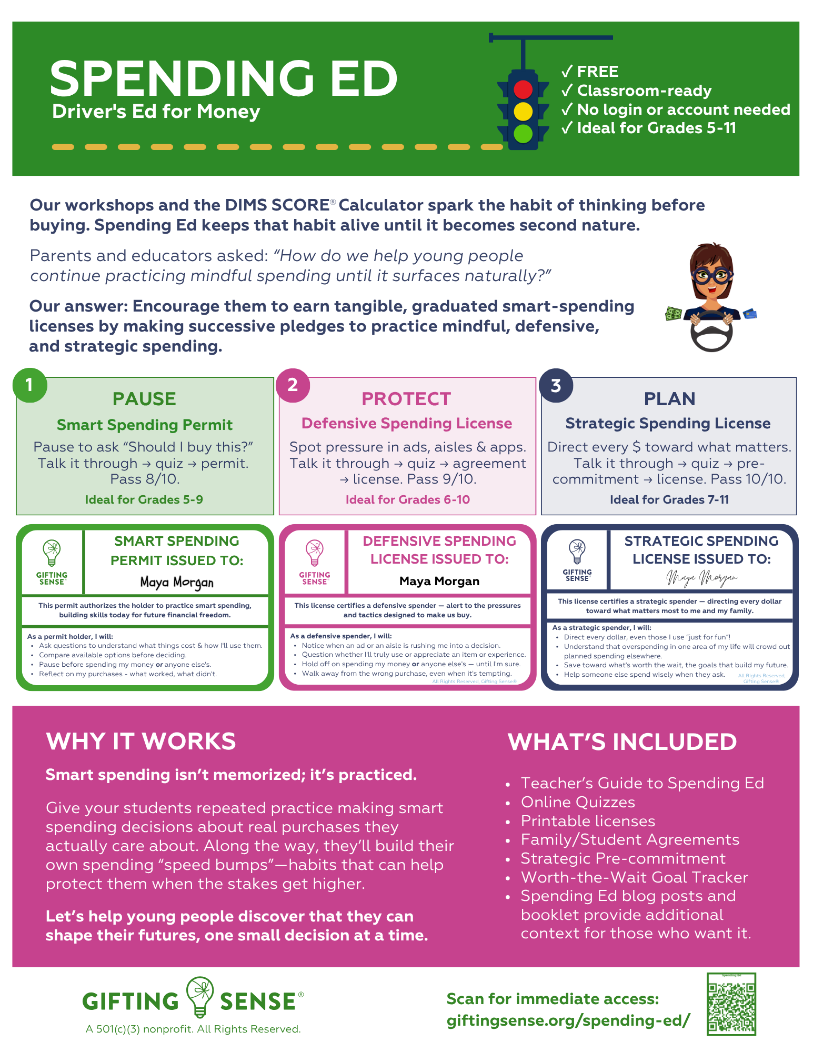
What you want to know about us
is on this flyer or the site.

Slide 3

We don't hand teenagers car keys and hope for the best.
✓
They earn a learner's permit.
✓
They practice driving in low-risk situations.
✓
They gradually earn independence as they demonstrate good judgment.
Spending Ed merely applies that same approach to money.

Slide 4
Welcome to
the Department of Smart Spending
(the FinLit Branch of the DMV)
Let’s complete this Smart Spending Permit Quiz, in order to earn our Smart Spending Learner’s Permit this evening.

Slide 5
In the Chat, please finish this sentence:
“A spending decision my students
discuss often is _______________.”

Slide 6



Students are already making and thinking about financial decisions. We want them to believe, early:
“I can make good decisions with money.”
Financial literate people don’t have the answers to money questions in their heads. They know they can get the answers that will support their current and future well-being.
That ability starts with a habit:
Pause, gather information and reflect (before spending), especially when the “right” choice isn’t obvious.
Spending Ed builds that habit early — between ages 9–18. Ideally the permit comes before high school,
when the stakes get higher.
The goal is agency
“I can find and use financial information to help shape my future.”
Spending Ed is a real-world place for your students to practice thinking before buying, in as little as 10 minutes of class time…

Slide 7
Ten Words That Can Help Students
Build Financial Resilience
Spend
Less
Than
You
Make.
Invest
The
Difference.
Be
Patient.

Slide 8
Mindful Spending → Spend < Make
Mindful spending is a time-tested way to live the life we want
and manage to spend less than we make.
Without Mindful Spending
→ Impulse buys pile up
→ "Meh" purchases crowd out what matters
→ Money feels like it quickly disappears
→ Financial stress can compound over time
→ No surplus to invest
Mindful Spenders
→ Make intentional choices
→ Spend money in alignment with their values & priorities
→ Have a sightline to the future they’re building
→ Which really helps an investable surplus emerge
→ So compound interest can start working early!
The goal? Help kids practice mindful spending until it becomes second nature, so they can start building an investable surplus asap.

Slide 9
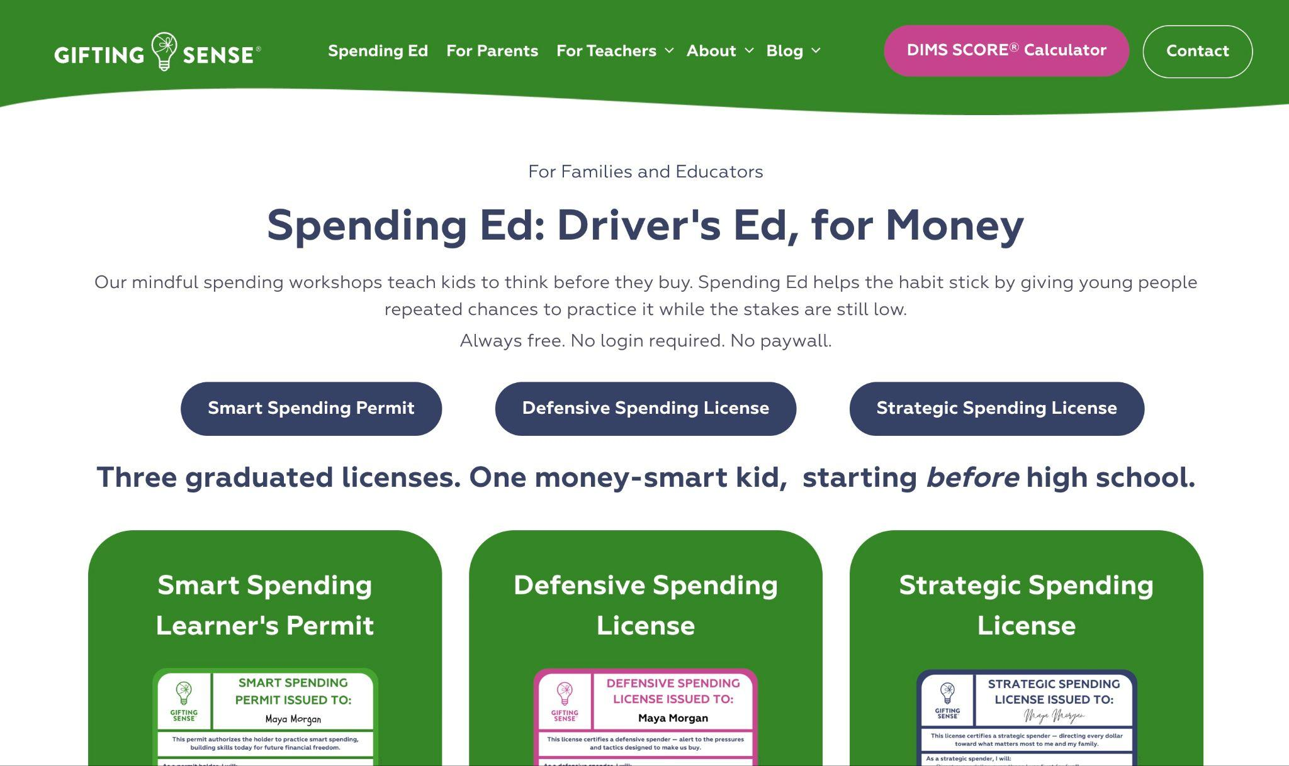
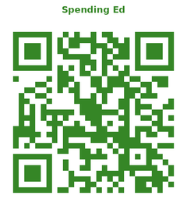
Spending Ed Roadmap
Spending Ed
Teaching Guide

Slide 10

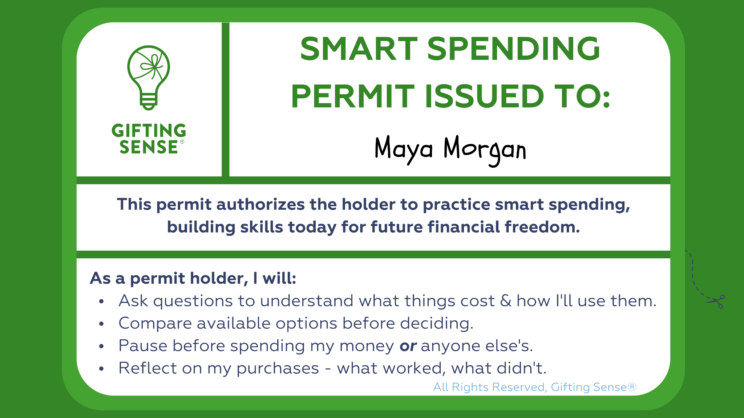

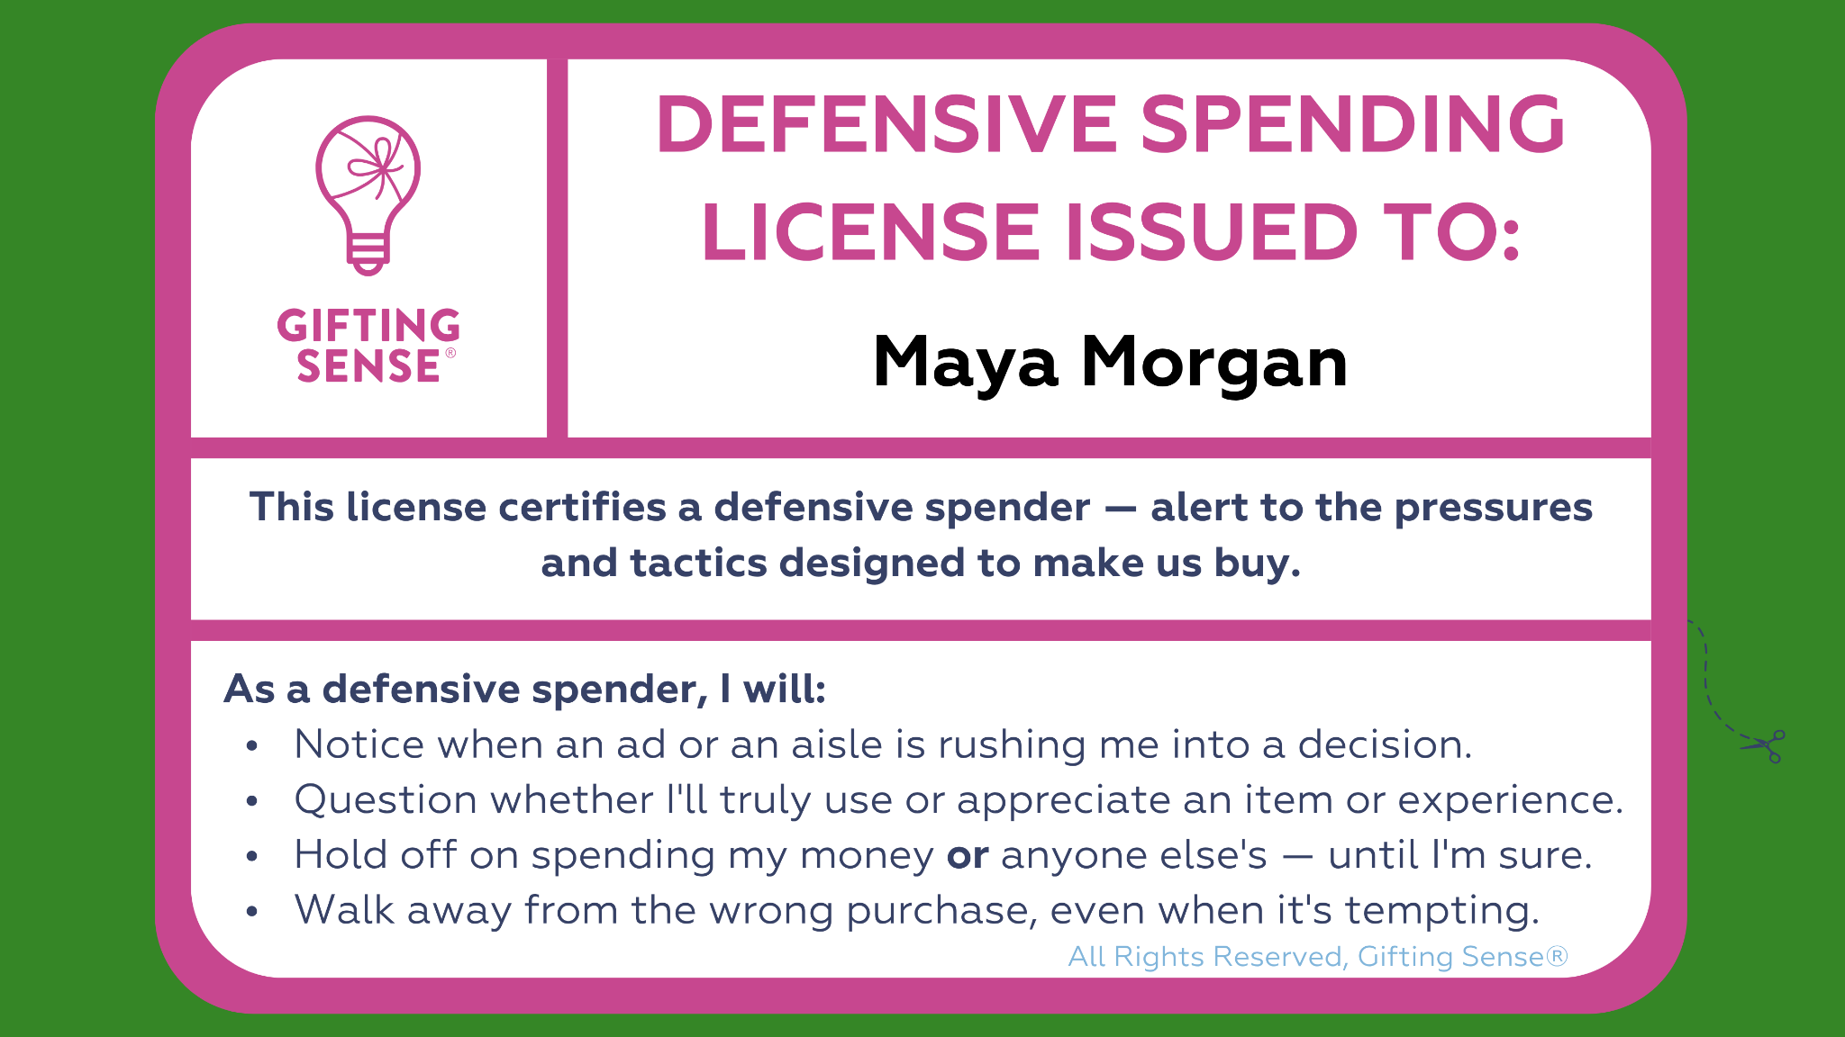
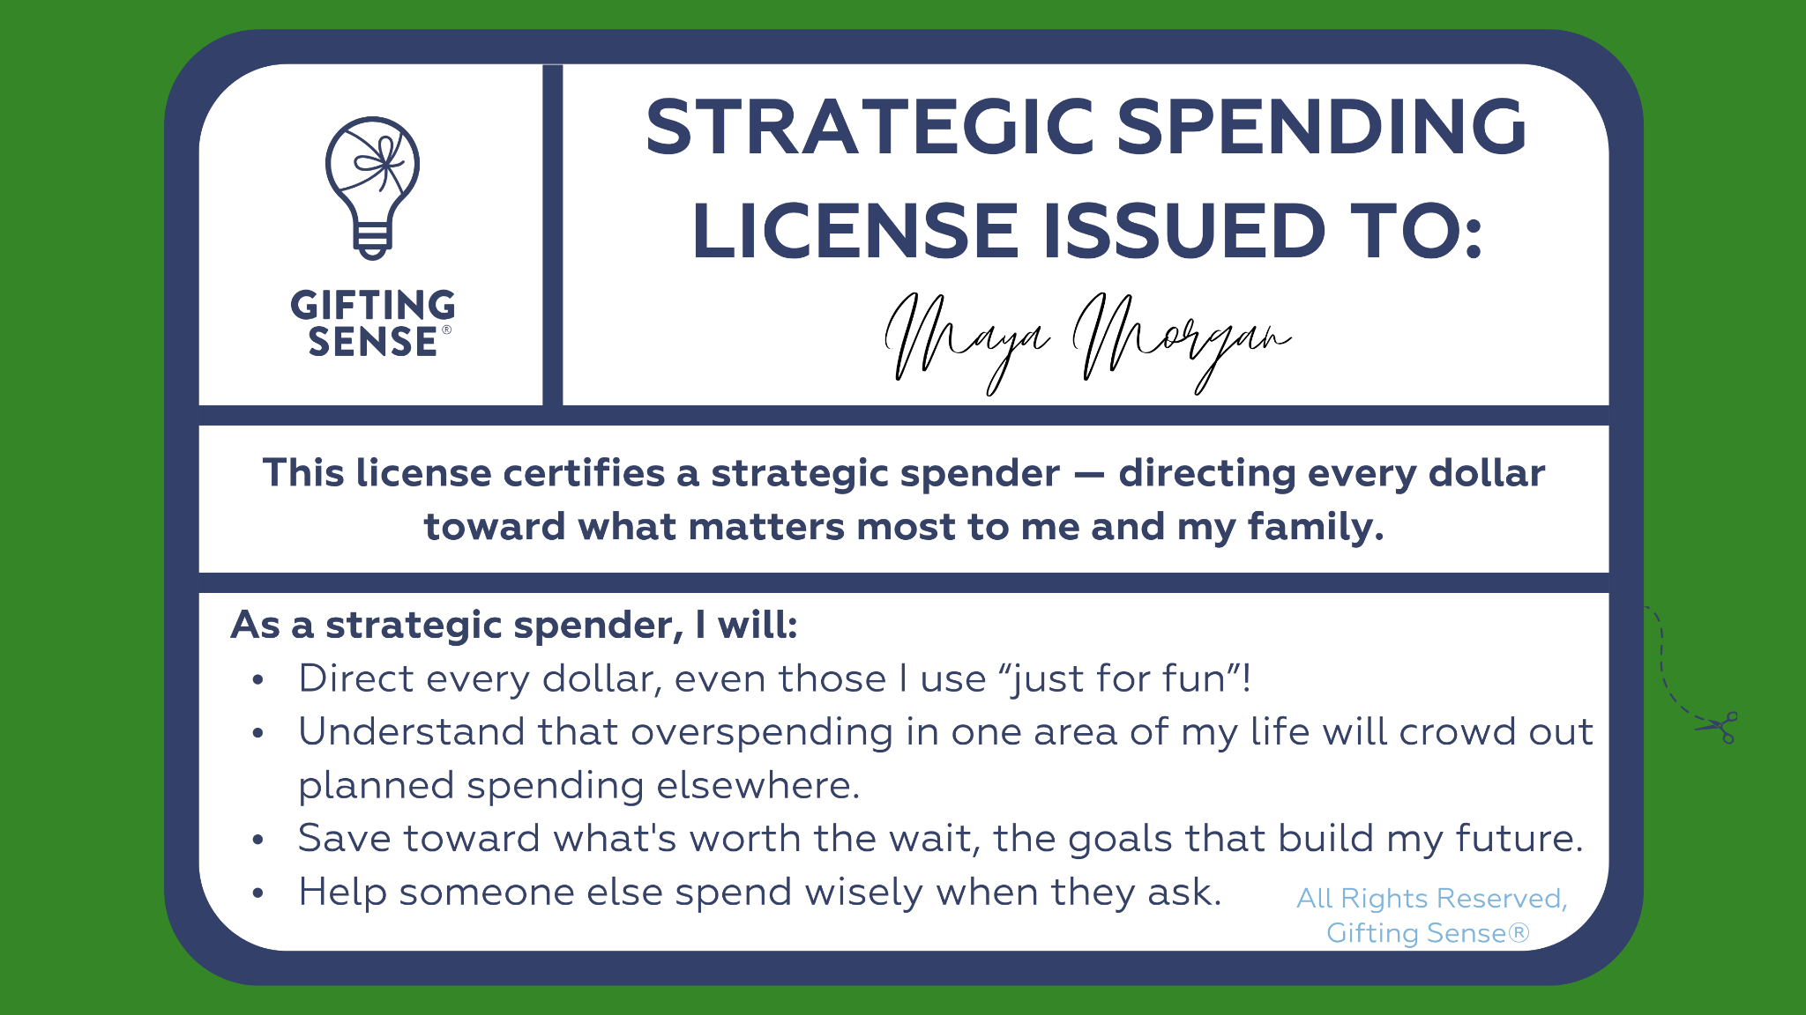
Three licenses, one money-smart student.
Each license gives young people a way to prepare for the money freedom and responsibility they seek.
Each level unlocks greater independence, earned after an upbeat talk and a short quiz.
Smart Spending Permit
STAGE 1 · PAUSE
1
Practice the pause — build the habit of asking “Should I buy this?”
Talk it through → Take the quiz → Issue the permit
~5 min quiz
Pass 8/10
Level 2 includes a family or student agreement to encourage independent defensive spending.
Defensive Spending License
STAGE 2 · PROTECT
2
Spot the pressure — identify the ads, aisles & apps designed to encourage us to buy. Spend independently within predetermined categories.
Talk it through → Quiz → Family Agreement → Issue the license
~6 min quiz
Pass 9/10
+ a Family Agreement you both sign (or a Student Agreement schools may prefer).
Level 3 adds a pre-commitment to the future a young person dreams of.
Strategic Spending License
STAGE 3 · PLAN
3
Direct every dollar — even the “fun ones”, toward the future a young person wants to build. Name possible roadblocks and guardrails.
Talk it through → Quiz → Pre-Commitment → Issue the license
~7 min quiz
Pass 10/10
+ a Pre-Commitment they sign first

Slide 11
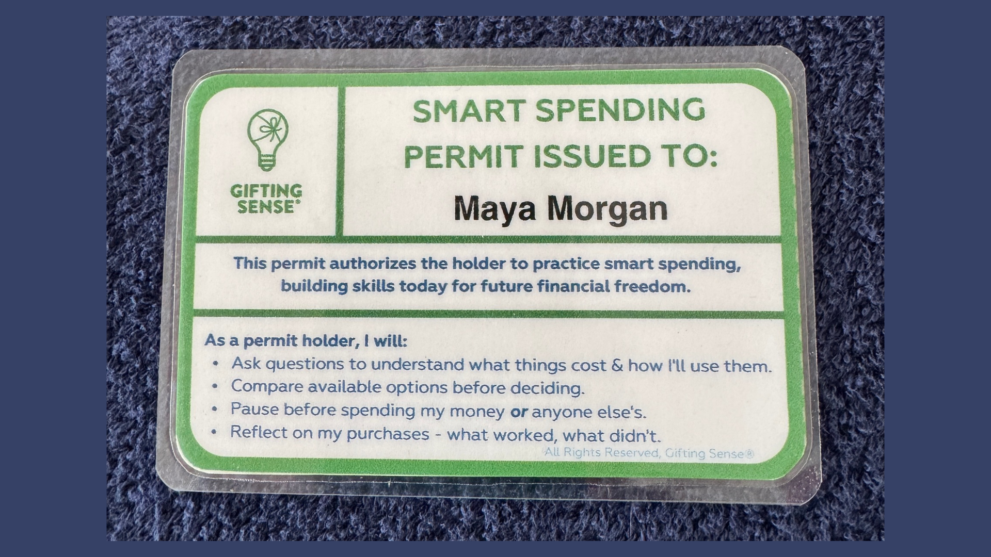
Every Level Has a Pledge

Slide 12
Let’s start with the...
Checkout Challenge
“PAUSE” Classroom Activity. You can Assign the Smart Spending Permit Quiz for Homework
POSSIBLE PURCHASE | BUY TODAY | WAIT 1 WEEK | PROB WON'T BUY
Bubble tea, Latté, Slice | ☐ | ☐ | ☐
Branded Hoodie | ☐ | ☐ | ☐
Video Game Avatar Skin | ☐ | ☐ | ☐
Concert ticket | ☐ | ☐ | ☐
Earbuds | ☐ | ☐ | ☐
New sneakers | ☐ | ☐ | ☐
In the chat, select a possible purchase and finish one of these sentences:
  I bought today because...
  I’m waiting a week to buy because...
  I probably won’t buy because...

Slide 13



Why is it so hard to pause before purchasing?
Spot the Pressure
“PROTECT” Classroom Activity. You can Assign the Defensive Spending License Quiz for Homework, and also the Student Agreement - or complete it in a subsequent class.
Algorithmic persuasion is embedded in every platform that tweens and teens—not to mention the rest of us—use daily.
These are not neutral, benign tools. They were designed to maximize engagement and accelerate commitment.
A practiced habit of reflection is no longer a “nice-to-have”.

Slide 14
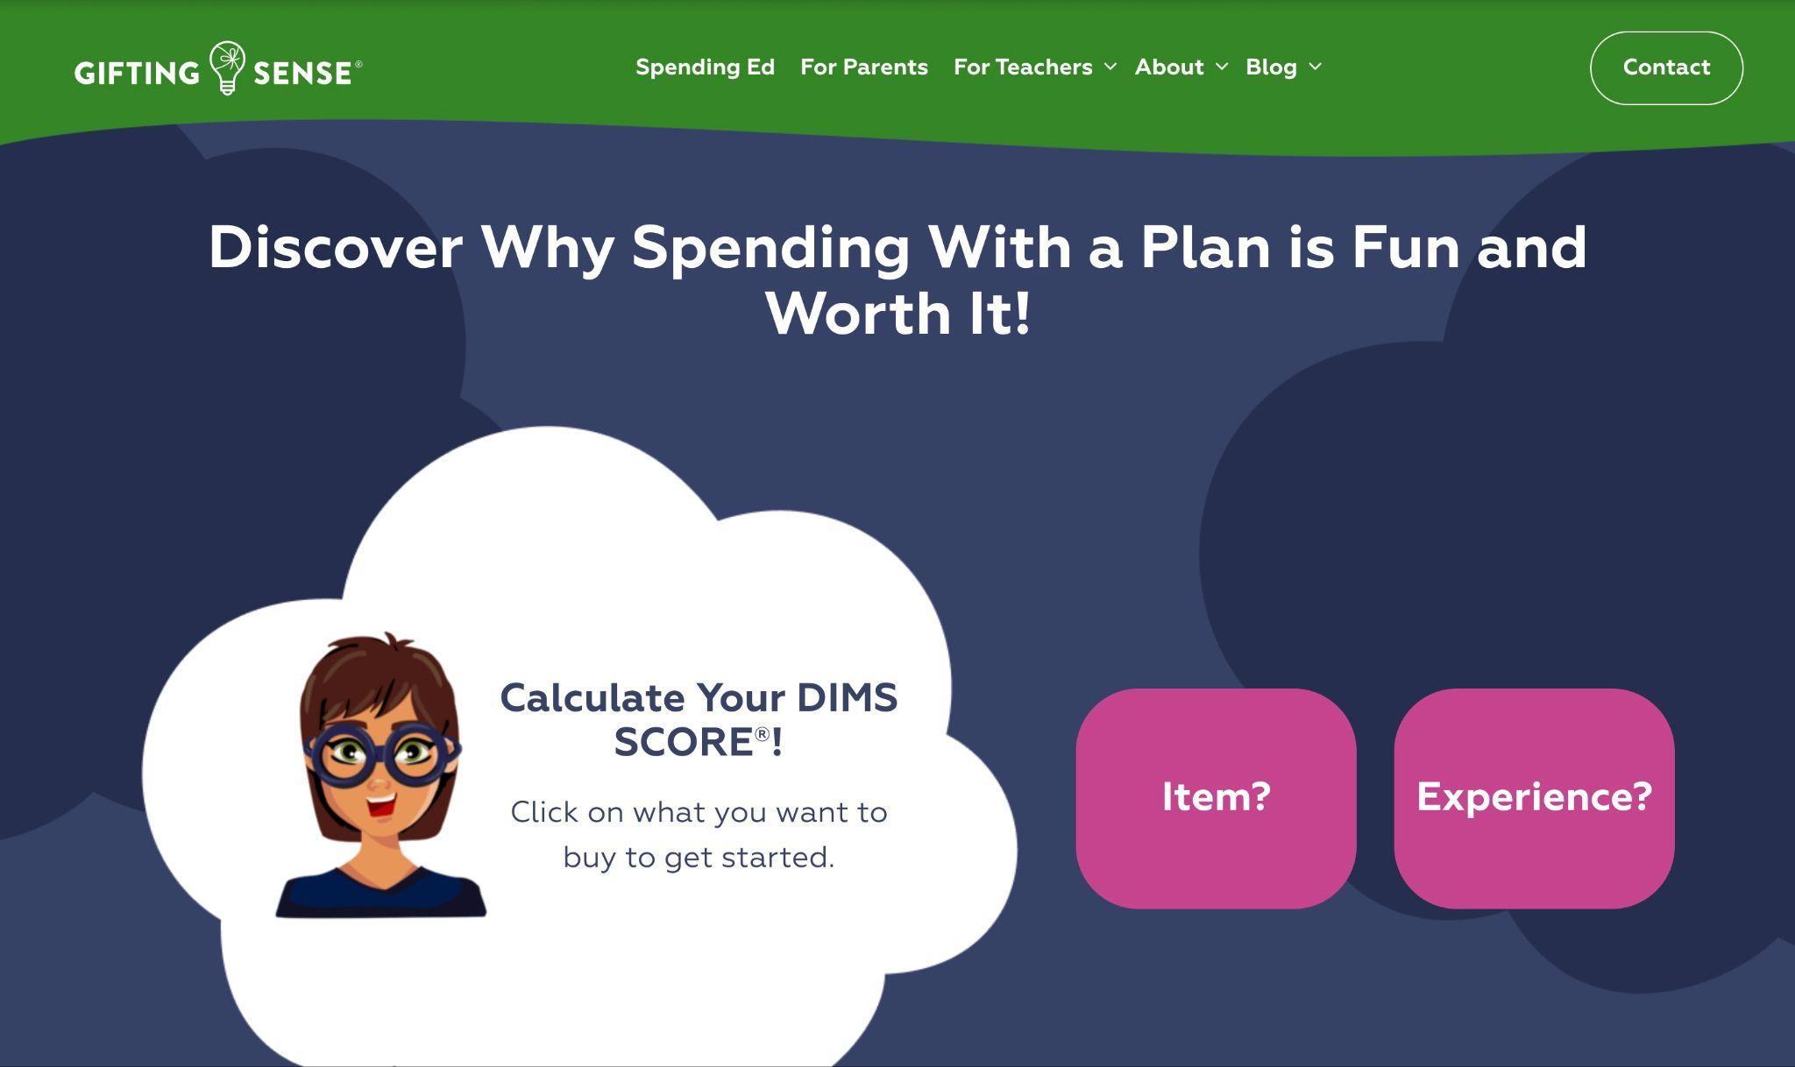
The DIMS - DOES IT MAKE SENSE?®
SCORE Calculator can help at every level
Our FREE mindful spending tool is available without login or registration at giftingsense.org

Slide 15






Here’s what DIMS SCORE® Reports look like:
For bringing home a pet:
https://giftingsense.org/dims-score-result/gtvkdwsi/?print=yes
For a new cell phone:
https://giftingsense.org/dims-score-result/mtqfl8rz/?print=yes
For Air Jordans:
https://giftingsense.org/dims-score-result/3vxg5qmo/?print=yes
For a fancy water bottle:
https://giftingsense.org/dims-score-result/5jh7t3xa/?print=yes
For tickets to FIFA’26:
https://giftingsense.org/dims-score-result/fntbrghy/?print=yes
For a first car:
https://giftingsense.org/dims-score-result/m6fq3alk/?print=yes

Slide 16
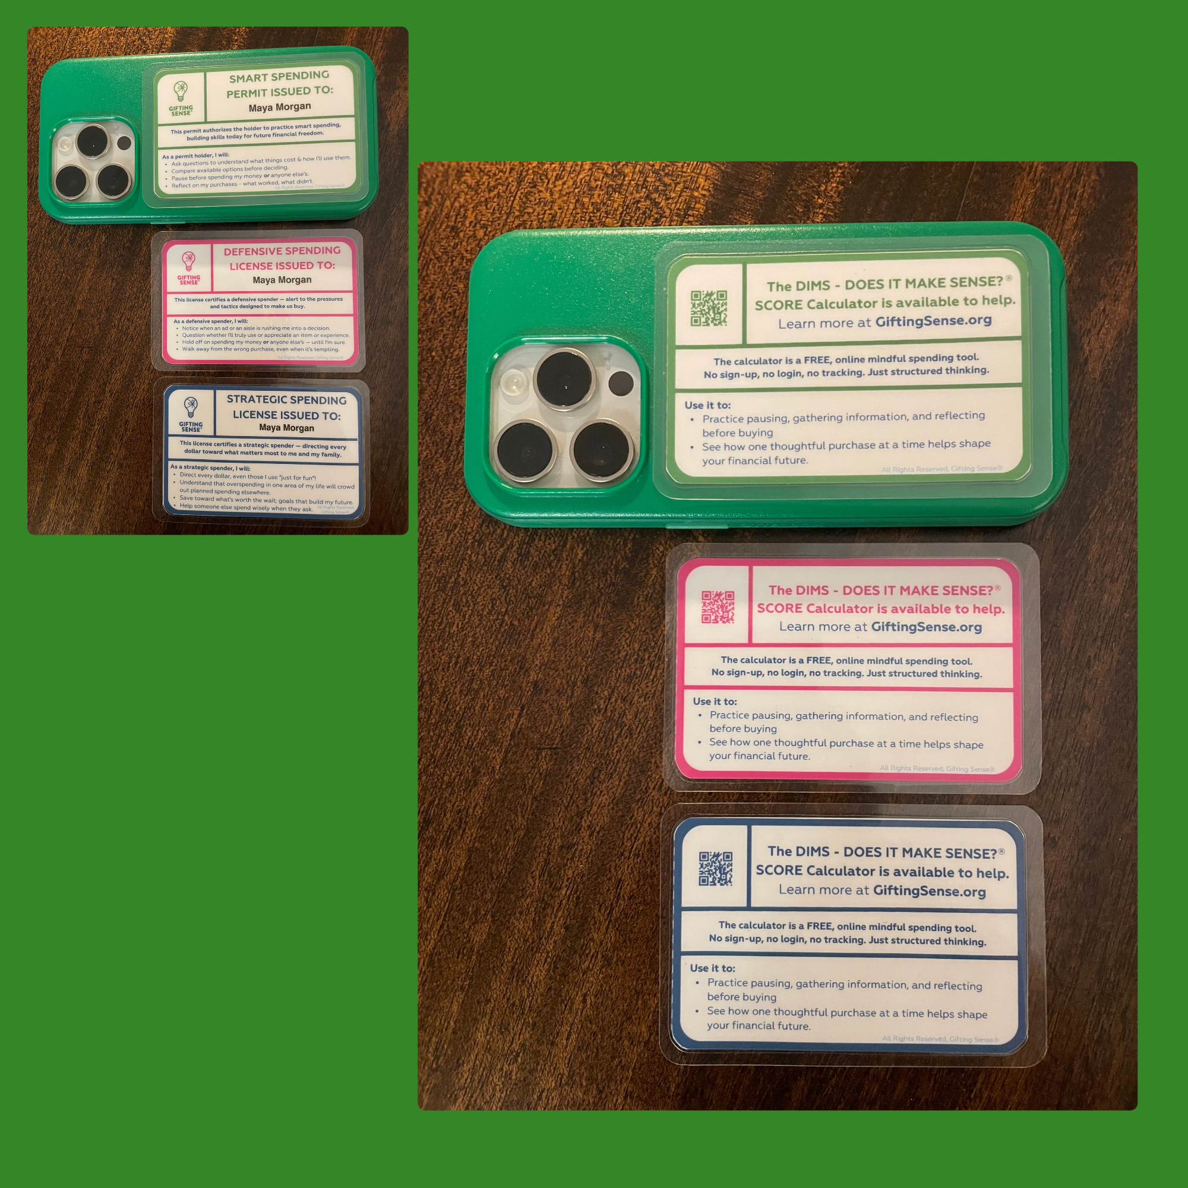
How can kids access the DIMS SCORE®
Calculator?
Type “Gifting Sense” into any browser on any device with access to the internet…

Slide 17

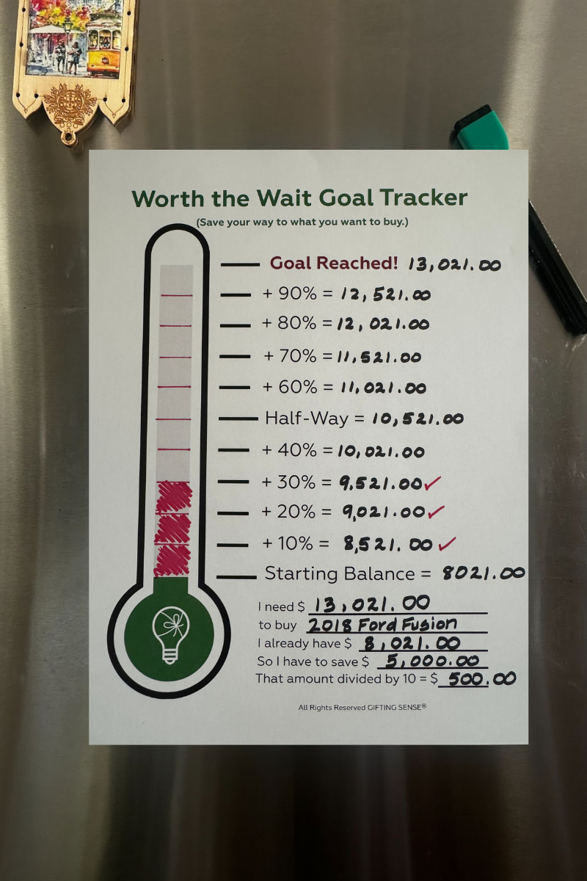
Crowding out is real!
Taste the Trade-Off Game
“PLAN” Classroom Activity. You can Assign the Strategic Spending License Quiz for Homework
The point isn't to always “skip” fun.
It's seeing the whole road ahead, and spending with purpose, so that “meh” buys don’t crowd out meaningful ones.
$10 of snacks a week is $400 over a school year.
Enough
to pay
for new
tech.
We're not just teaching young people to say “no” — we're teaching them how to say “yes,” and not regret it.
Alignment > Restraint
Wise spending isn't only about denying yourself — it's about giving every dollar — even the fun ones, a job.
Planned Spending is Powerful
“What gets measured gets done.” Families often place our
Worth the Wait Goal Tracker on the fridge while saving for a special purchase.
Understand that overspending in one area of their life will crowd out planned spending in another. Every dollar can only be spent once, so we want to spend every single one - wisely!
Notes:
Taste the Trade-Off (Plan) Awareness only, about 60-90 seconds
There are, of course, classroom activities and a quiz for the Strategic Spending License as well…you’ll find these in the PLAN Classroom Guide, the third of three.
Ten dollars of snacks a week is about $400 a school year. The Plan activity helps students see the road ahead.
You’ll give your students a realistic weekly budget and ask them to PLAN their spending across everyday wants, saving for a shorter- and then longer term goal…
You can assign the Strategic License quiz link for homework, and have students complete the Pre-Commitment Form either also as homework or in class, depending on how much time you have. The Pre-Commitment Form is linked to “Planned Spending is Powerful” in the second navy box.

Slide 18

Remember where we started?
We give kids Driver’s Ed, why not Spending Ed?
Students are already spending or thinking about spending on…
Spending Ed is low-stakes practice making financial decisions…starting is one ten-minute classroom activity away.

Slide 19
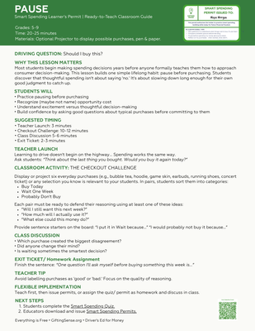
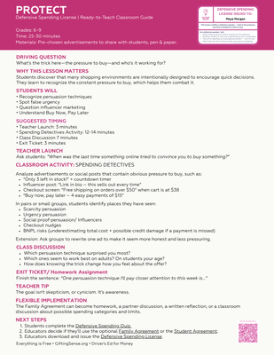
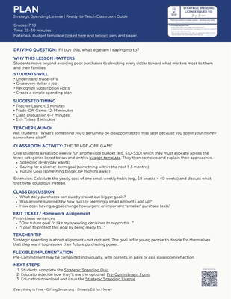
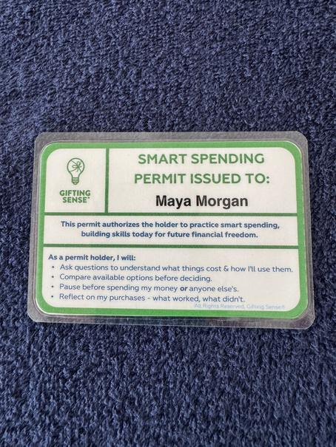
You have the Roadmap: Teaching Guide
✓ You’ve earned a Smart Spending Learner's Permit (please print it out)
✓ All Three Quick Start Lesson Plans are at the top of the Teaching Guide
✓ Downloadable/printable Student Agreement & Pre-Commitment Form
✓ FILLABLE Permit, Defensive + Strategic License Templates
⭐ So this week, you can ⭐
☐ Try the Checkout Challenge (10 min, use the PAUSE lesson plan)
Next week, you can
☐ Assign the Smart Spending Permit Quiz (Homework: Screencap your score.)
☐ Demo the DIMS - DOES IT MAKE SENSE? SCORE Calculator (2 min with your class)
Next month, you can
☐ Plan how students can earn all three licenses , learning how to PAUSE, PROTECT, and PLAN their spending, before graduating
✓
✓
✓
✓
Everything is free. Classroom-ready. Permissionless.

Slide 20

Once you’ve tried it - PLEASE let us know how it went!
karen@giftingsense.org
chitra@giftingsense.org

Slide 21

Years from now, imagine your students telling their kids:
“I think it's time for you to earn your Smart Spending Permit.”
Because Spending Ed is as commonplace as Driver’s Ed.
That future? That's what we can build - together!
Here’s to practical, early financial education.
And the educators who bring it to life.

Slide 22
Promised Links
Spending Ed Landing Page: giftingsense.org/spending-ed
Spending Ed Teacher’s Guide: teachers-guide-to-spending-ed
Quick Start Lesson Plans: Spending-Ed-Quick-Start-Lesson-Plans.pdf
Spending Ed Booklet: Spending-Ed-Booklet.pdf
DIMS SCORE Calculator DEMO Video: giftingsense.org/how-it-works
Printable Smart Spending Permits: Fillable Smart Spending Permits.pdf
Printable Defensive Spending License: Fillable Defensive Spending Licenses.pdf
Printable Student Agreement: Defensive License Student Agreement.pdf
Printable Family Agreement: Defensive License Family Agreement.pdf
Printable Strategic Spending License: Fillable Strategic Spending Licenses.pdf
Printable Pre-Commitment: Strategic License Pre-Commitment.pdf
Standards Alignment Map: National-Standards-Alignment-Map.pdf

