Slide 1




[INSERT FEATURED IMAGE OF WEBINAR SESSION]
[Session Title]

Slide 2

Certificate Requirements
To earn professional development hours for webinars, you must:
Watch a minimum of 75% for all sessions
You will automatically receive a professional development certificate via e-mail within 24 to 48 hours.

Slide 3
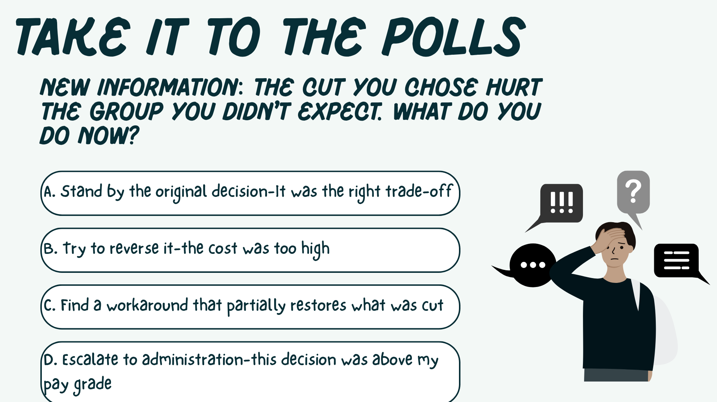
Objectives
You will be able to:
Insert objective – start with a verb
Insert objective – start with a verb
Insert objective – start with a verb
Notes:
CONSEQUENCES:
MOSTLY A: Three families filed complaints; those field trips were the only enrichment their kids got all year
MOSTLY B: Remaining teachers are burning out--two have already updated their resumes
MOSTLY C: New teacher evaluation requirements just came in--your staff has no support to meet them.
MOSTLY D: A parent coalition is demanding to know why textbooks from 2009 are still in use

Slide 4
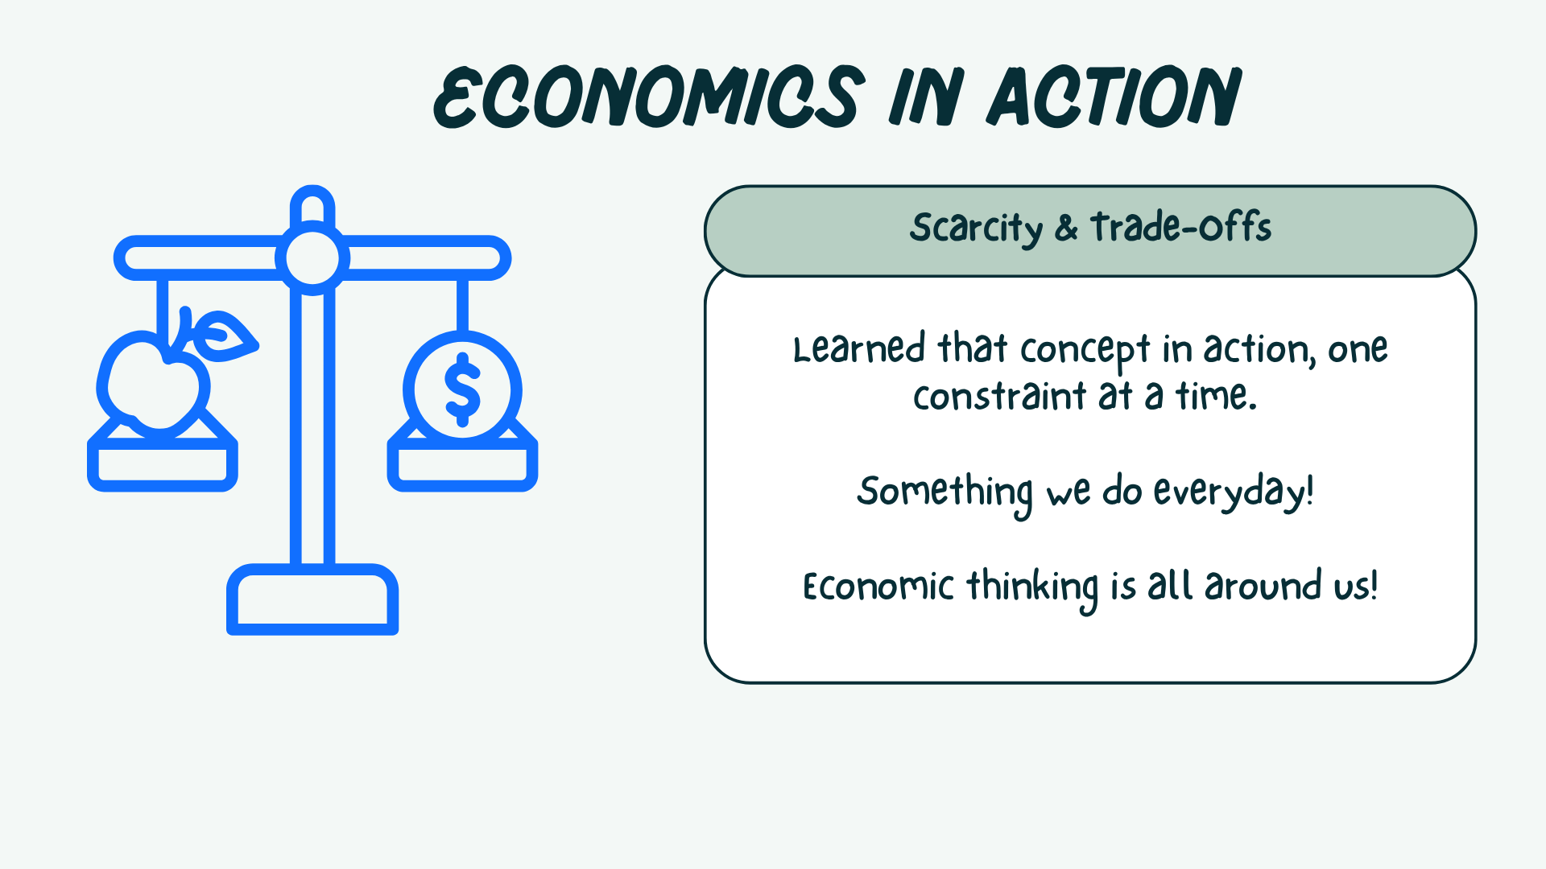

Session Agenda
Add agenda item
Add agenda item
Add agenda item
Add agenda item

Slide 5

Session Agenda
Add agenda item
Add agenda item
Add agenda item
Add agenda item

Slide 6

Session Agenda
Add agenda item
Add agenda item
Add agenda item
Add agenda item

Slide 7


National Standards
Content Standard...
Content Standard...
Content Standard...
https://www.councilforeconed.org/policy-advocacy/k-12-standards/

Slide 8


National Standards
Content Standard...
Content Standard...
Content Standard...
https://www.councilforeconed.org/policy-advocacy/k-12-standards/

Slide 9
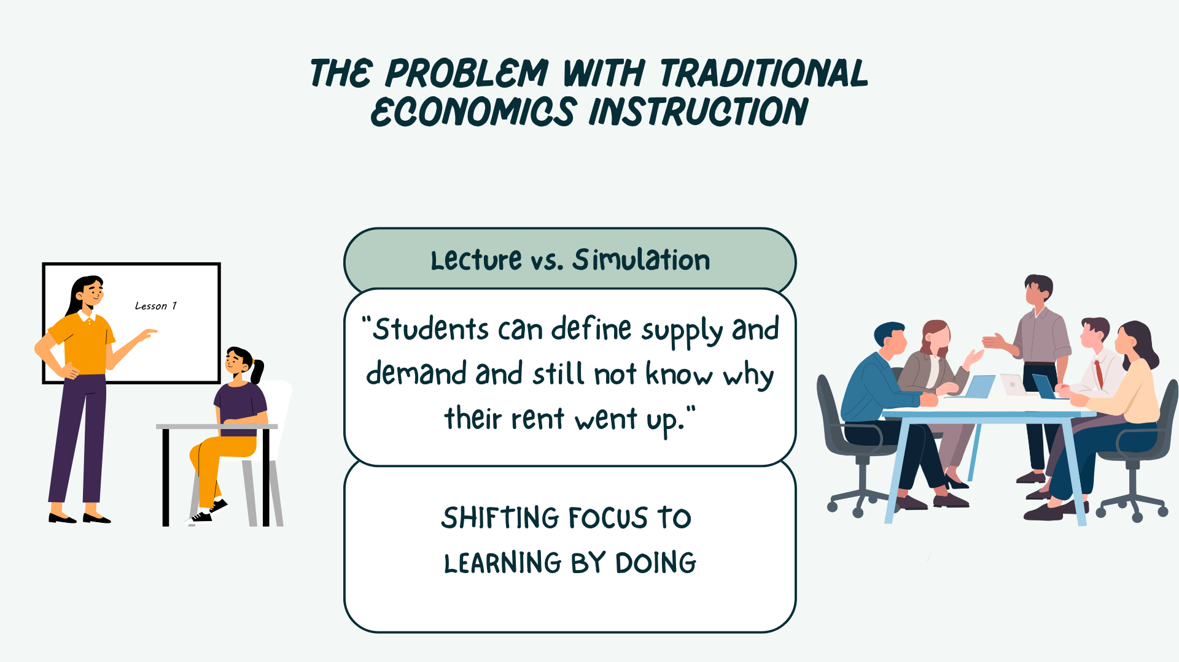
[INSERT FEATURED IMAGE OF WEBINAR SESSION]
1 - Agenda Title

Slide 10

Title
[Insert text]
List
List

Slide 11
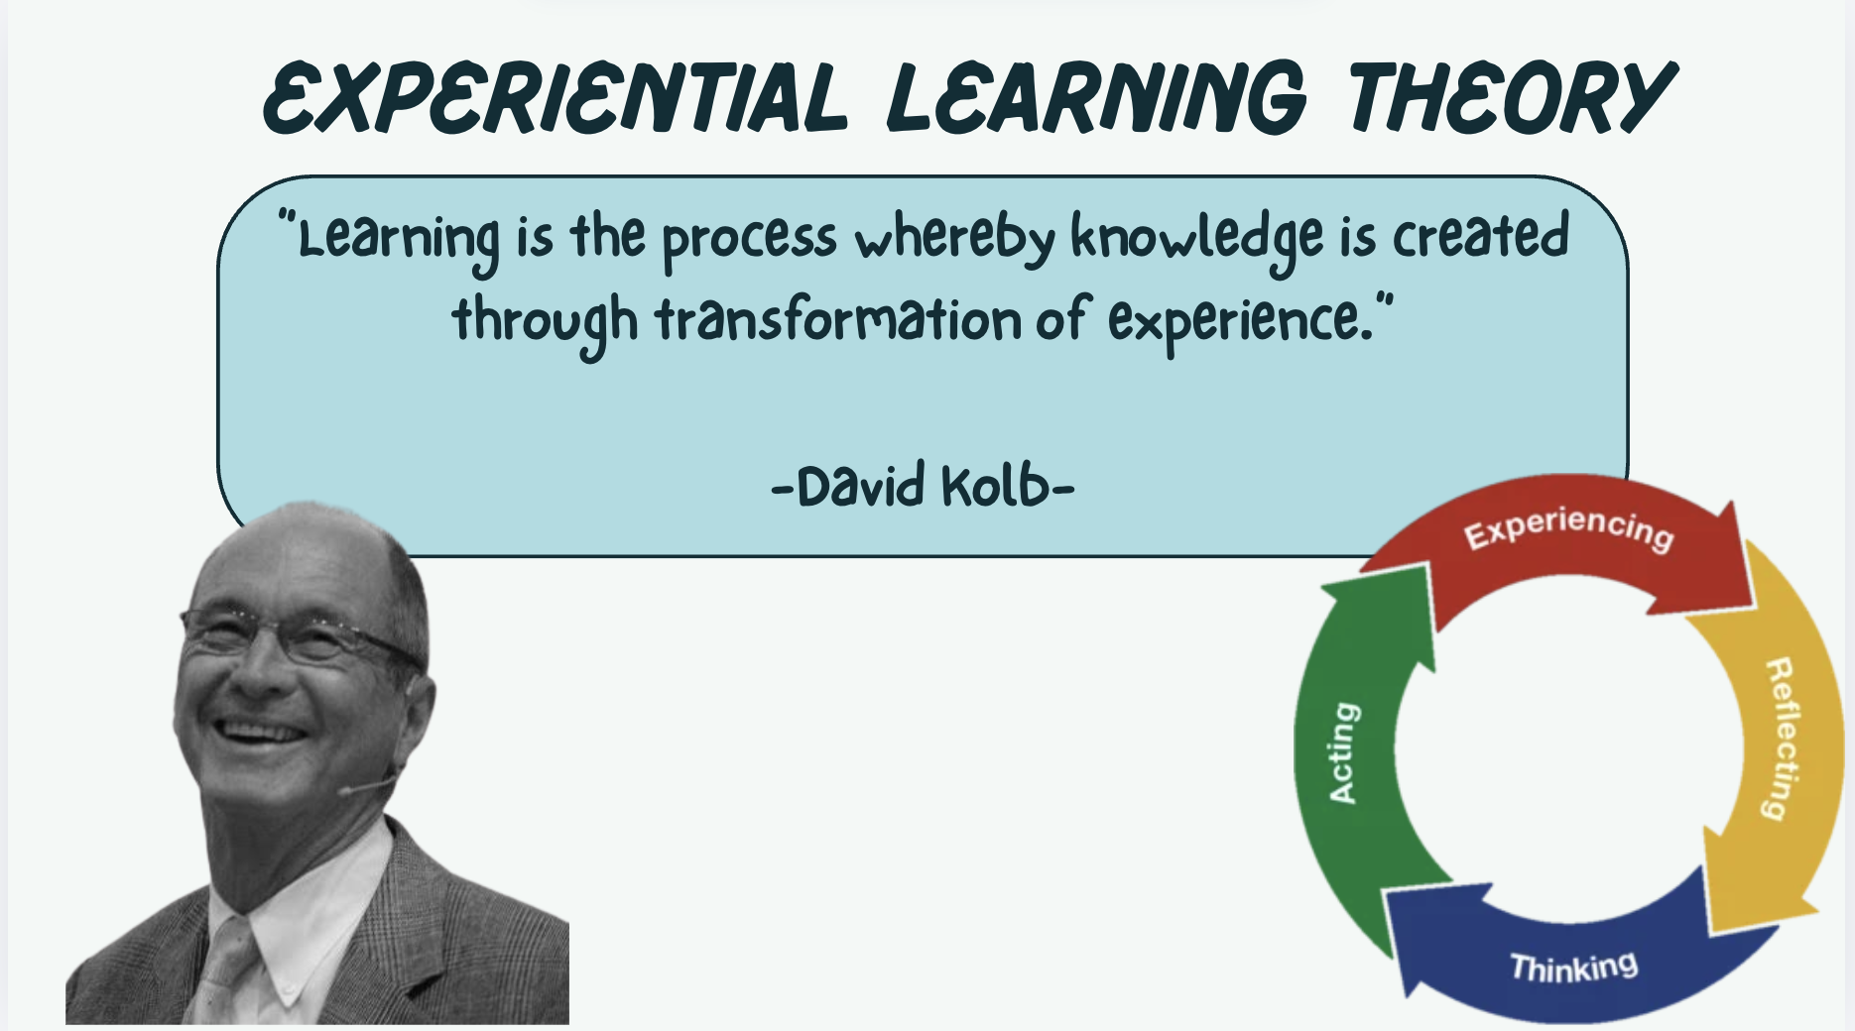
Title
[Insert text]
List
List

Slide 12
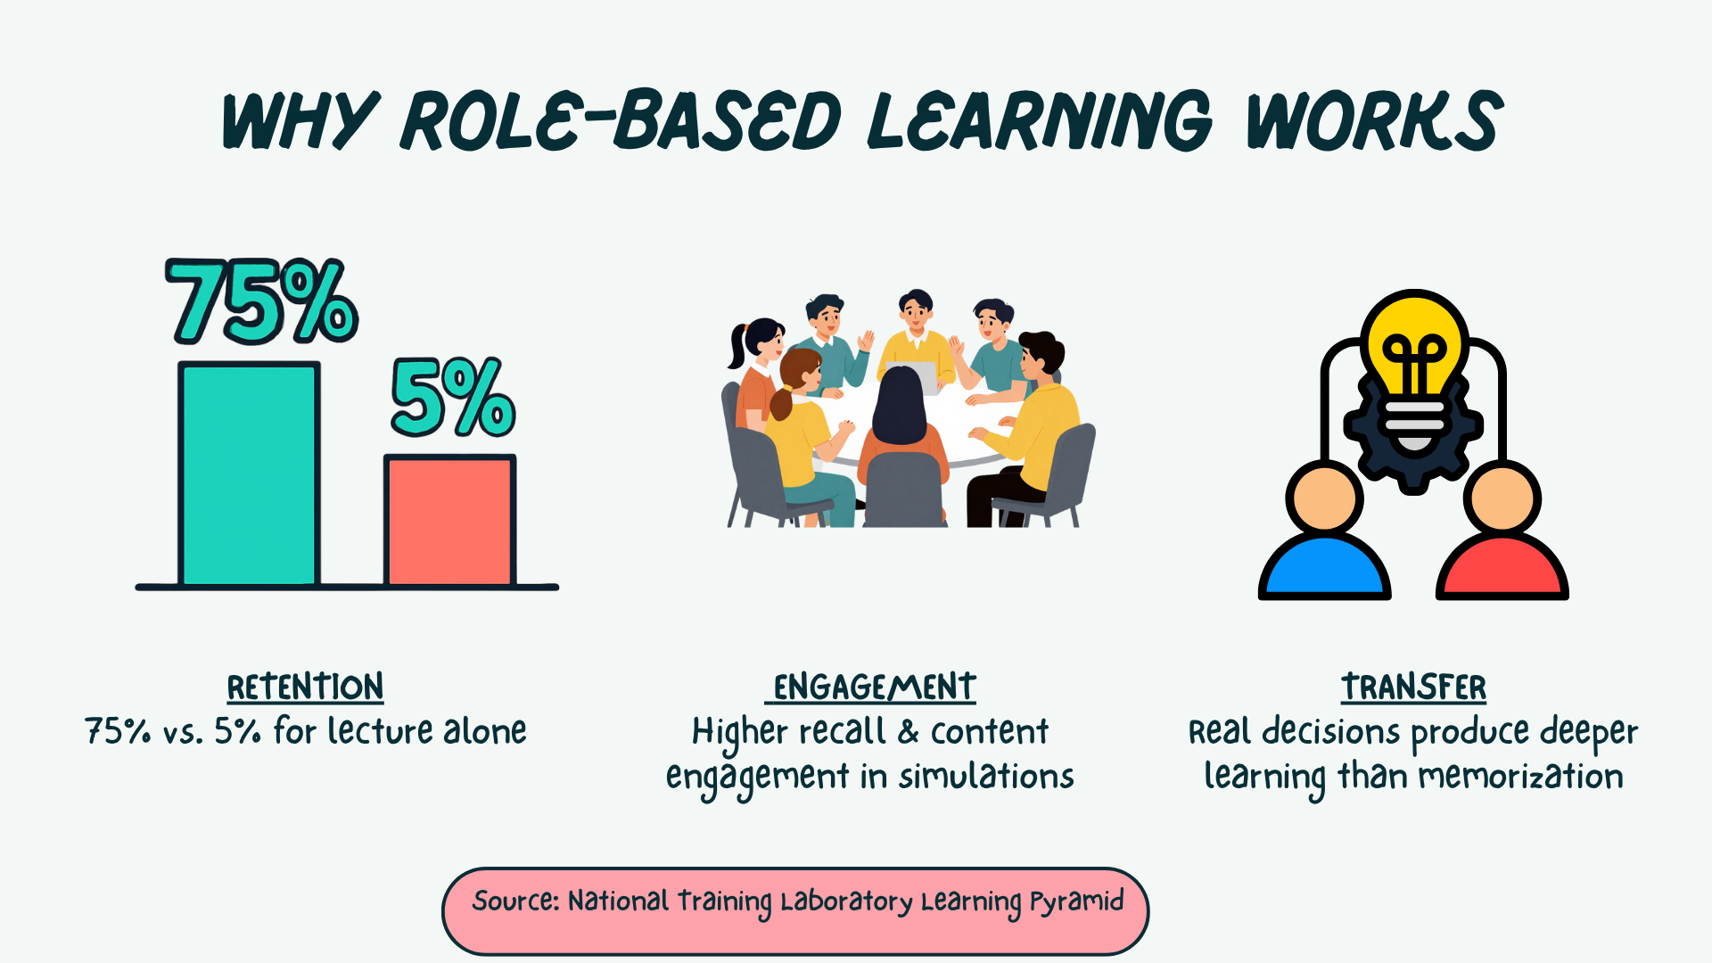
Slide with Animation

Slide 13

[INSERT FEATURED IMAGE OF WEBINAR SESSION]
2 - Agenda Title

Slide 14
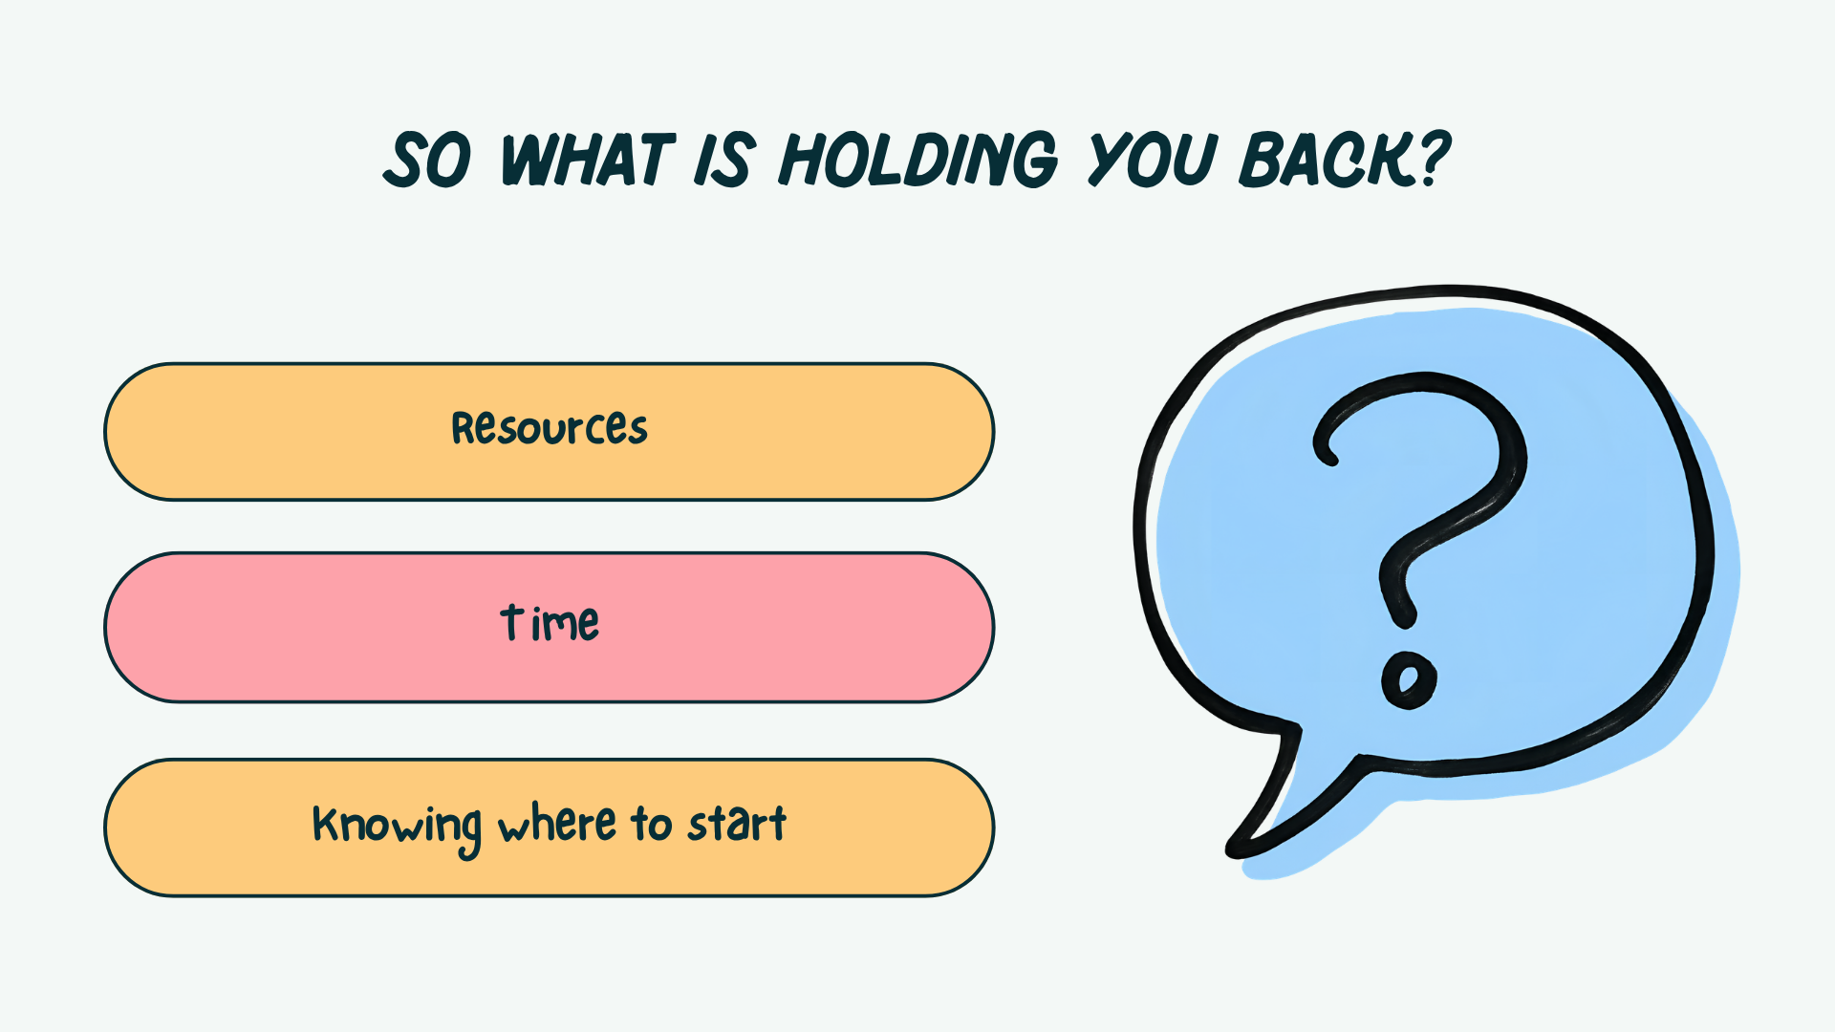
Embed Videos
[Insert URL] https://www.youtube.com/watch?v=lpwVwa8GaxI​

Slide 15

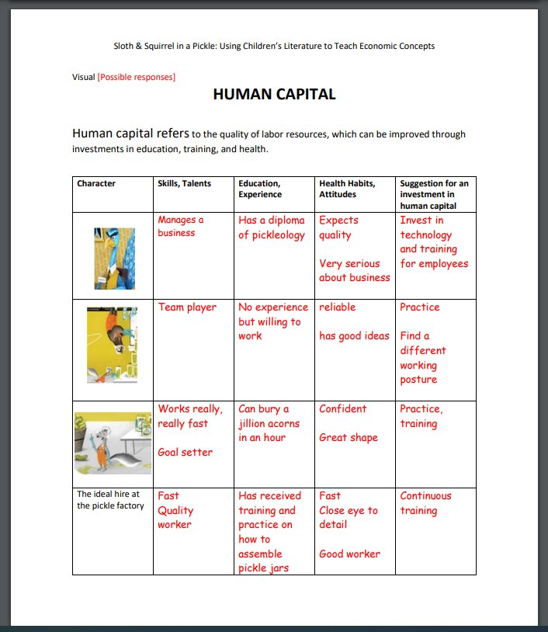
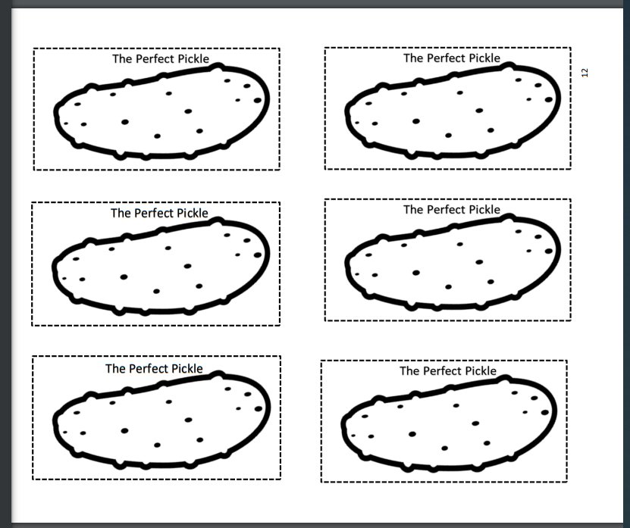
Title
Lesson Plan
[Describe the lesson]

Slide 16
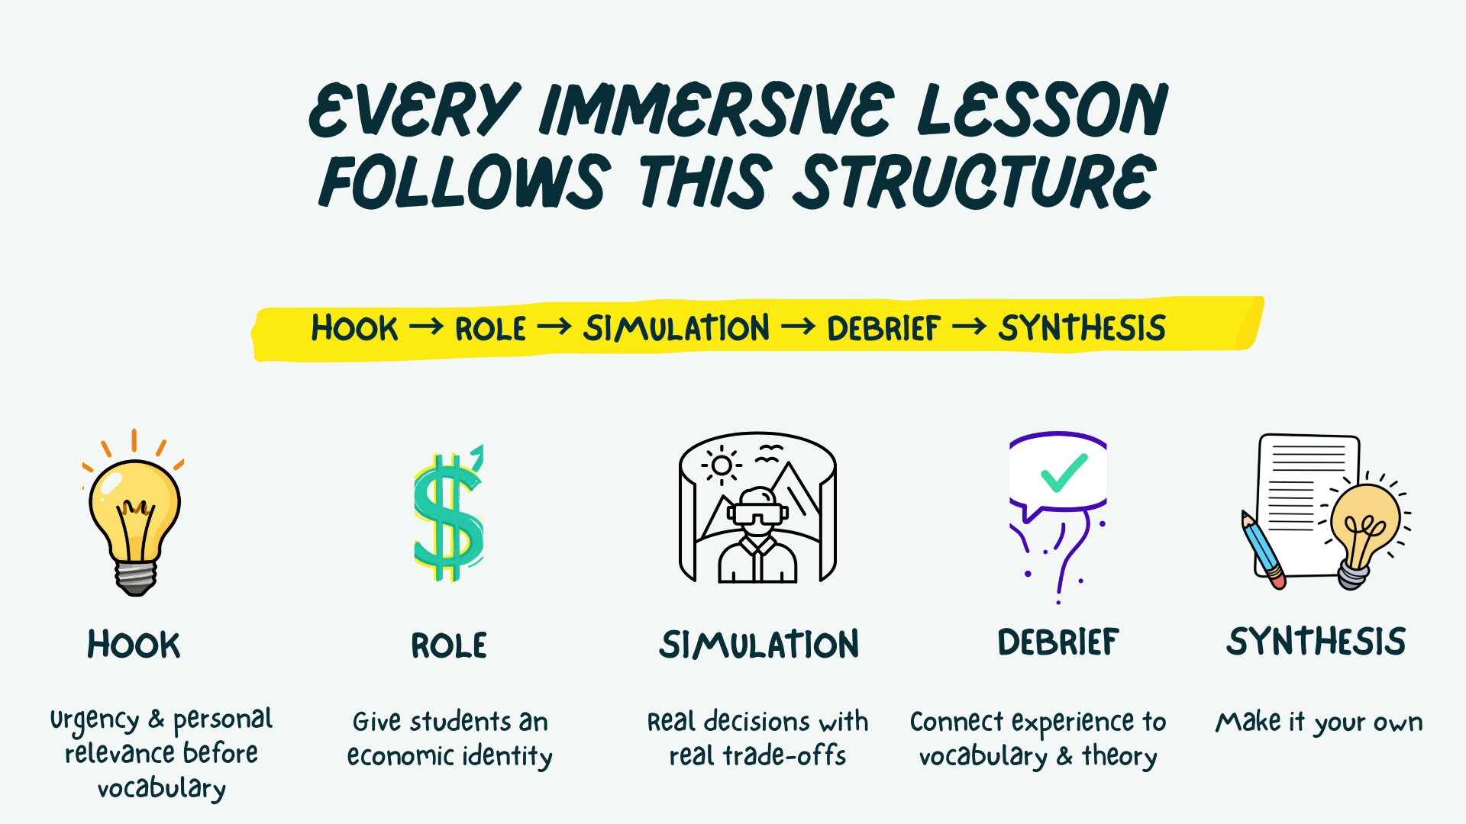
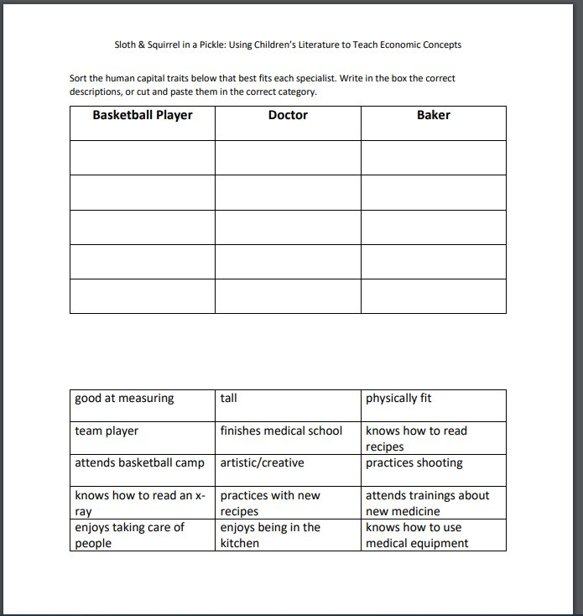
Title
Assessments
[Describe types of assessments]

Slide 17
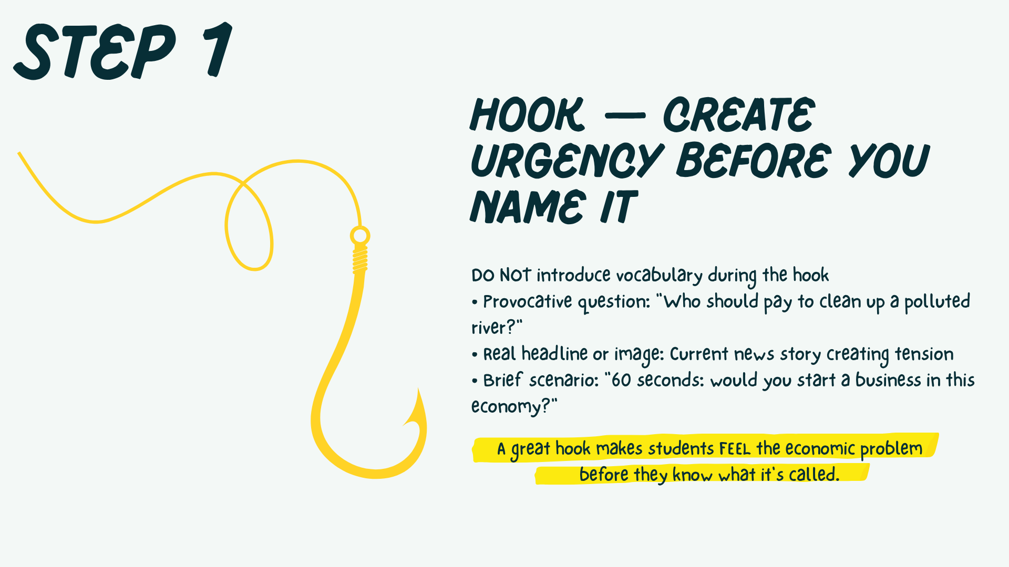
[INSERT FEATURED IMAGE OF WEBINAR SESSION]
2 - Agenda Title

Slide 18
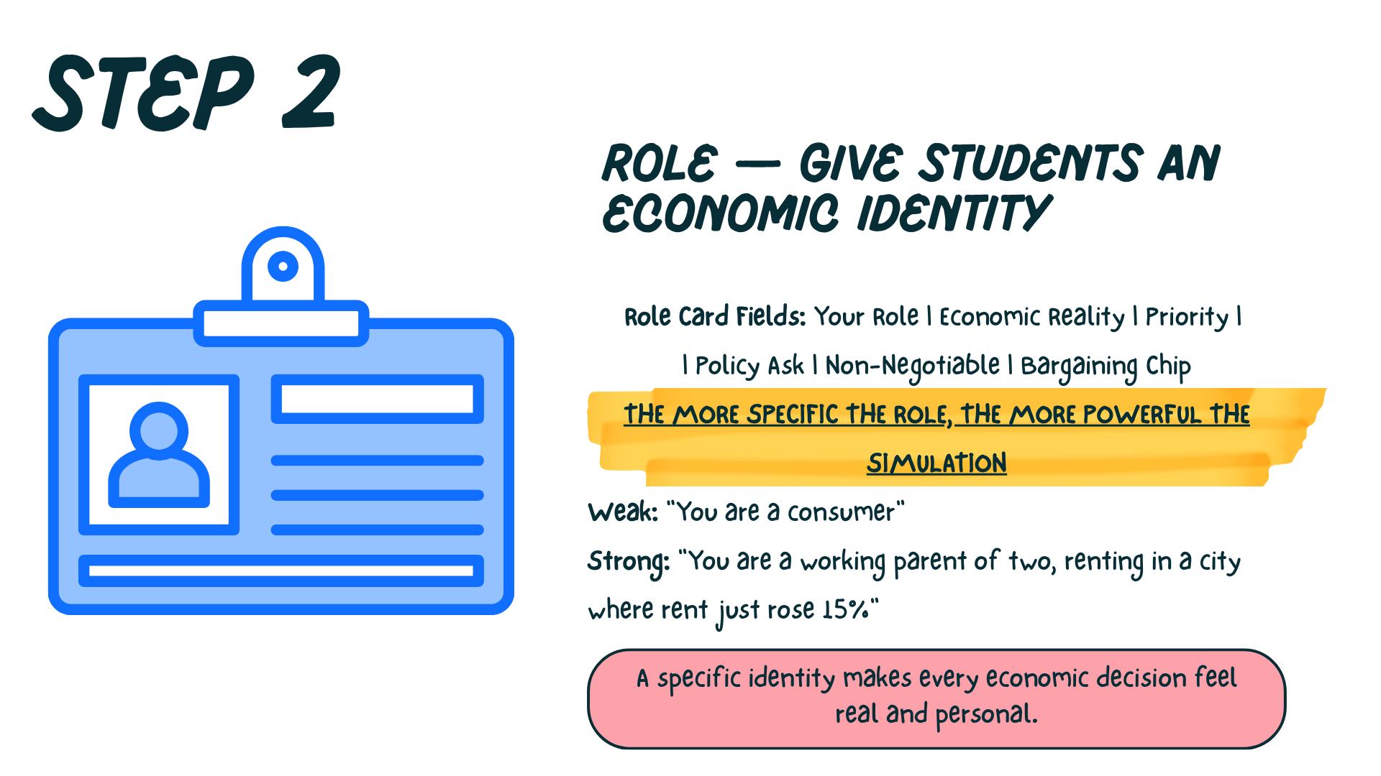


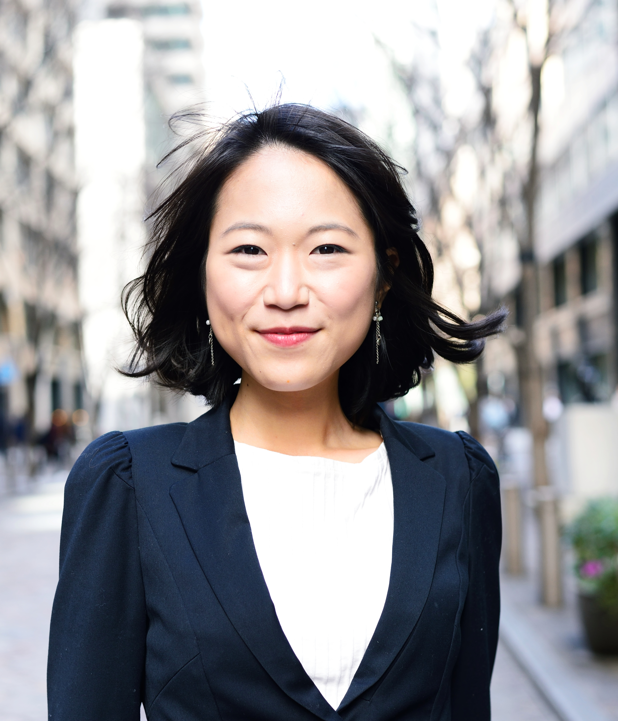
Contact Us
Name
Email Address
Social Handles
Name
Email Address
Social Handles
Name
Email Address
Social Handles

Slide 19
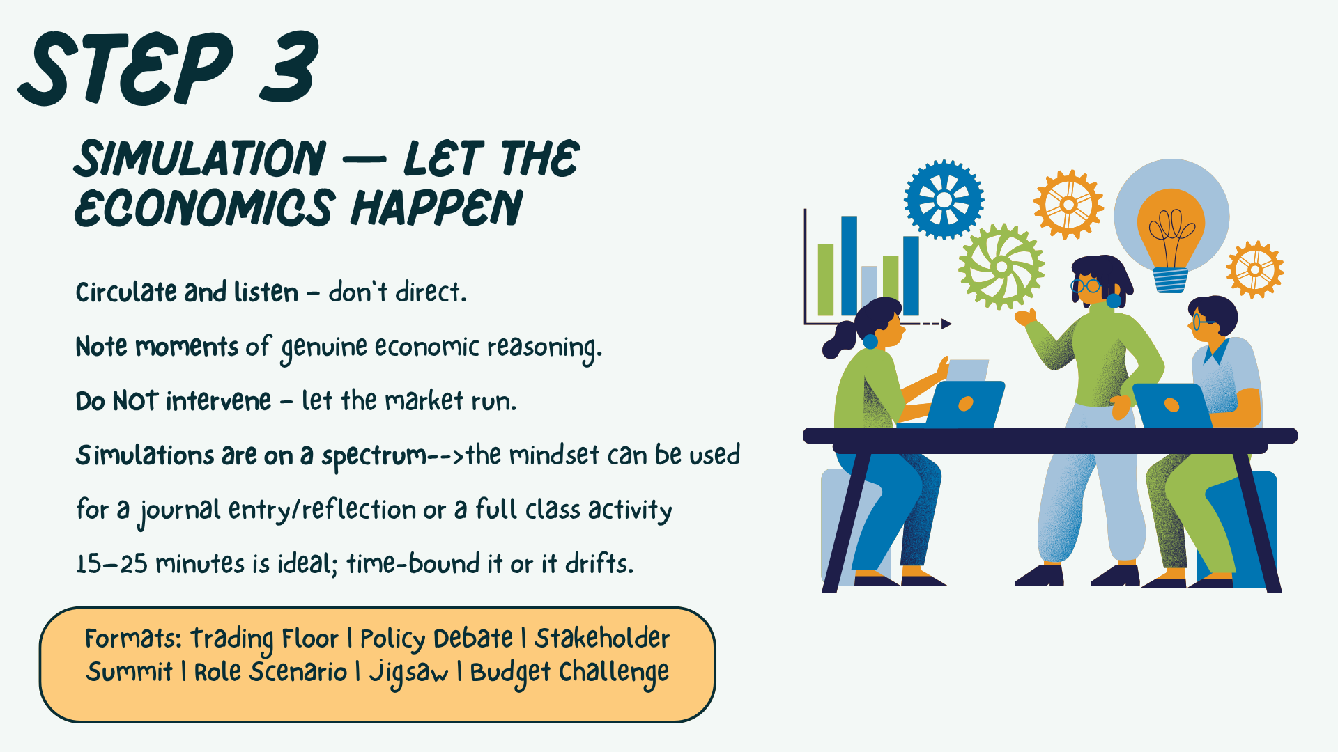
[INSERT FEATURED IMAGE OF WEBINAR SESSION]
Thank you

Slide 20
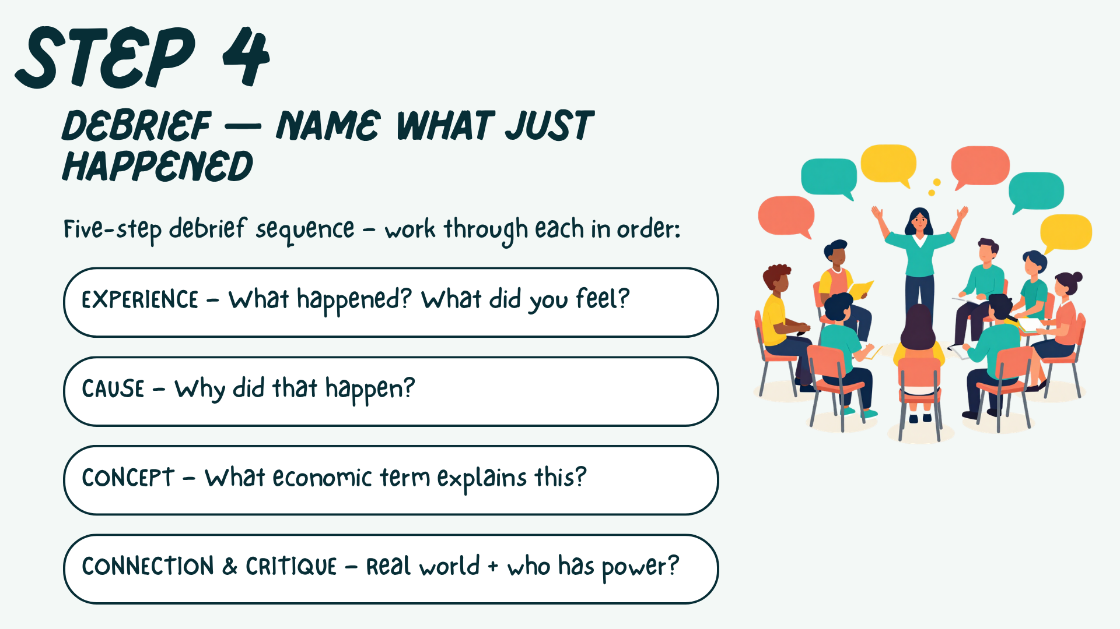
[INSERT FEATURED IMAGE OF WEBINAR SESSION]
Thank you

Slide 21
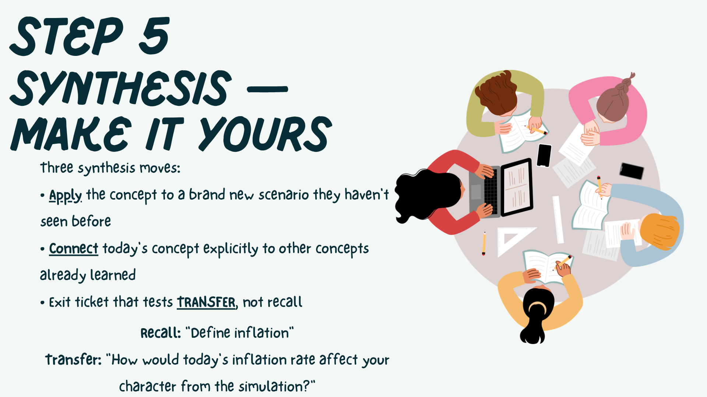
[INSERT FEATURED IMAGE OF WEBINAR SESSION]
Thank you

Slide 22
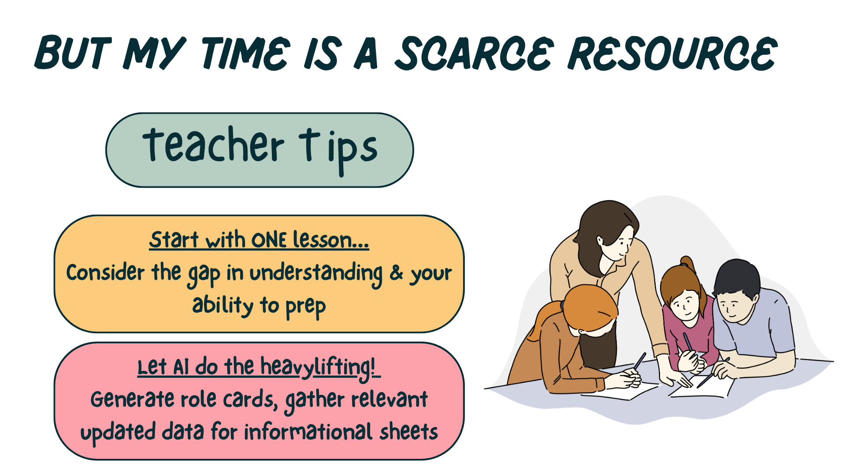
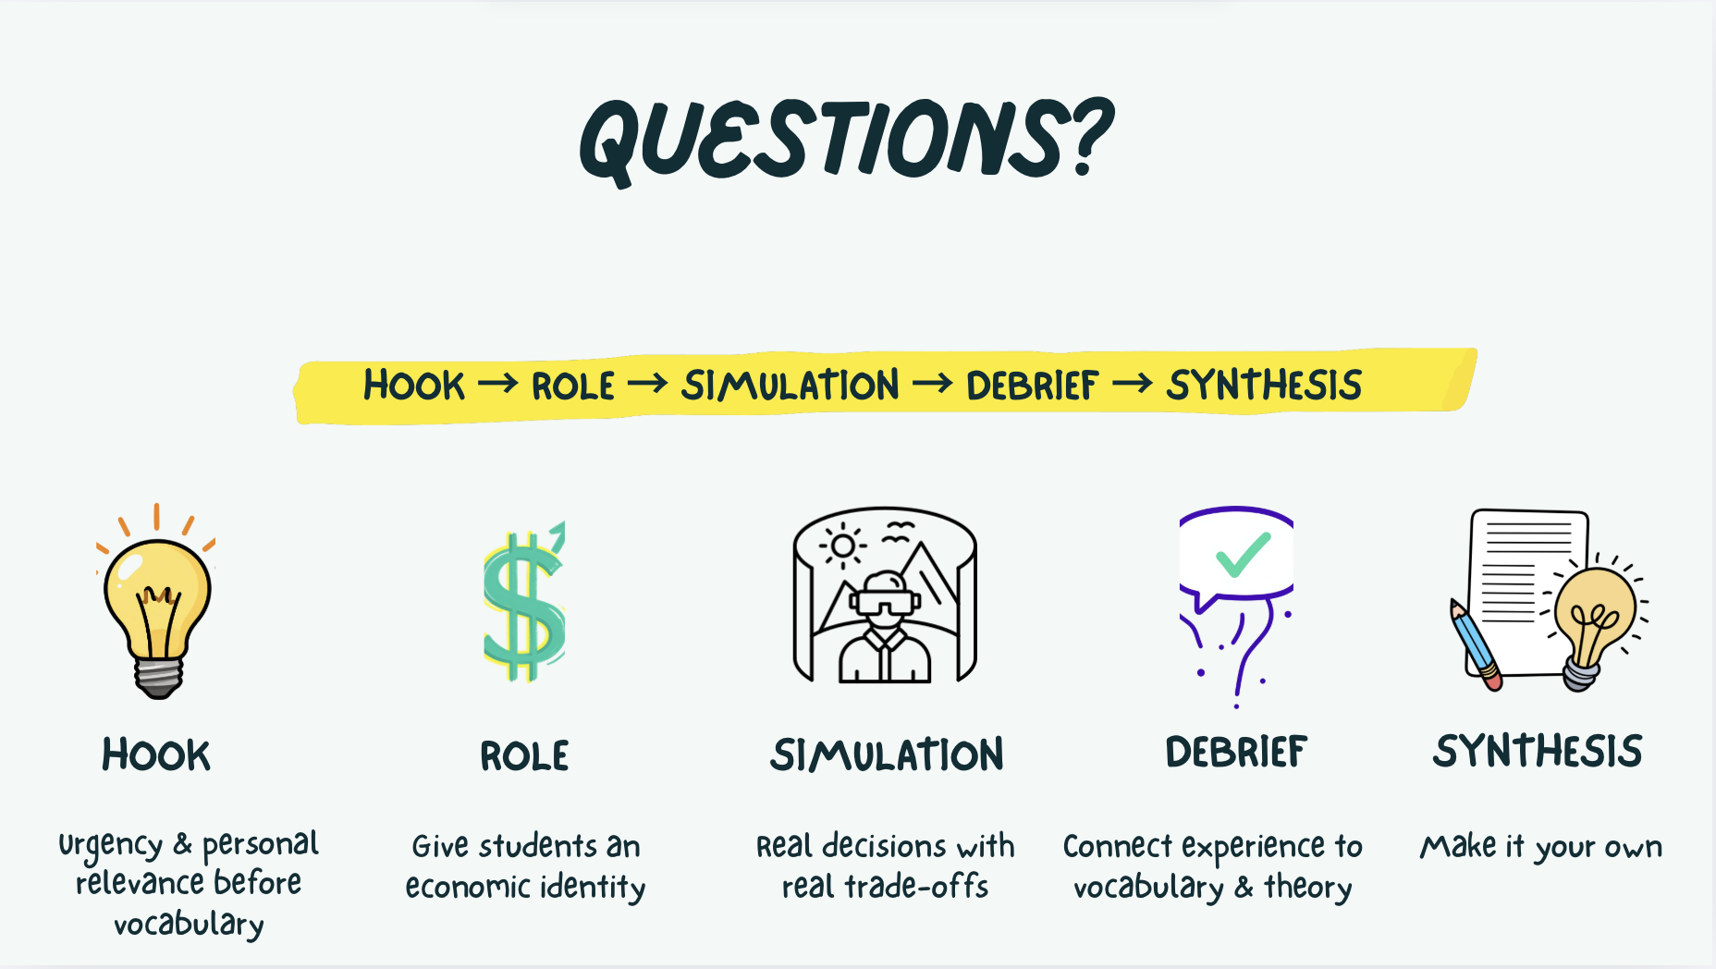
[INSERT FEATURED IMAGE OF WEBINAR SESSION]
Thank you

Slide 23

[INSERT FEATURED IMAGE OF WEBINAR SESSION]
Thank you

Slide 24

[INSERT FEATURED IMAGE OF WEBINAR SESSION]
Thank you

Slide 25

[INSERT FEATURED IMAGE OF WEBINAR SESSION]
Thank you

Slide 26
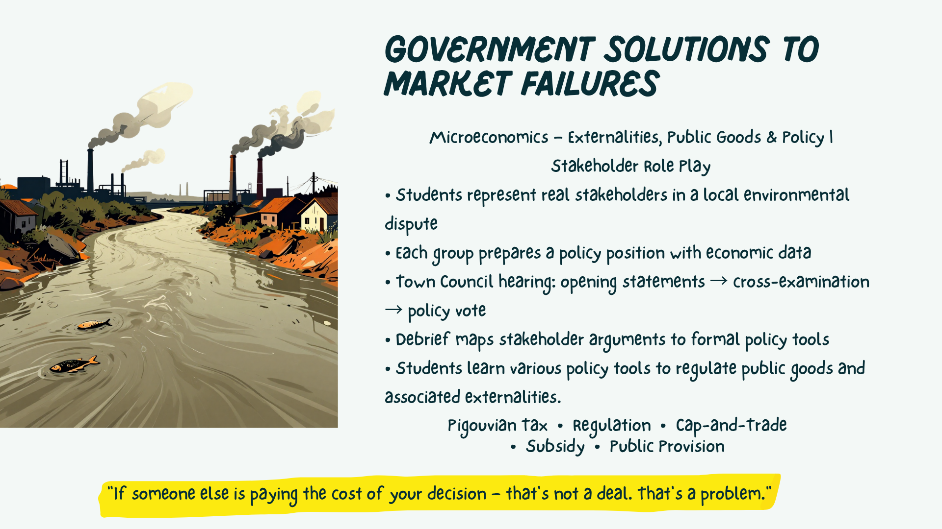
[INSERT FEATURED IMAGE OF WEBINAR SESSION]
Thank you

Slide 27

[INSERT FEATURED IMAGE OF WEBINAR SESSION]
Thank you

Slide 28
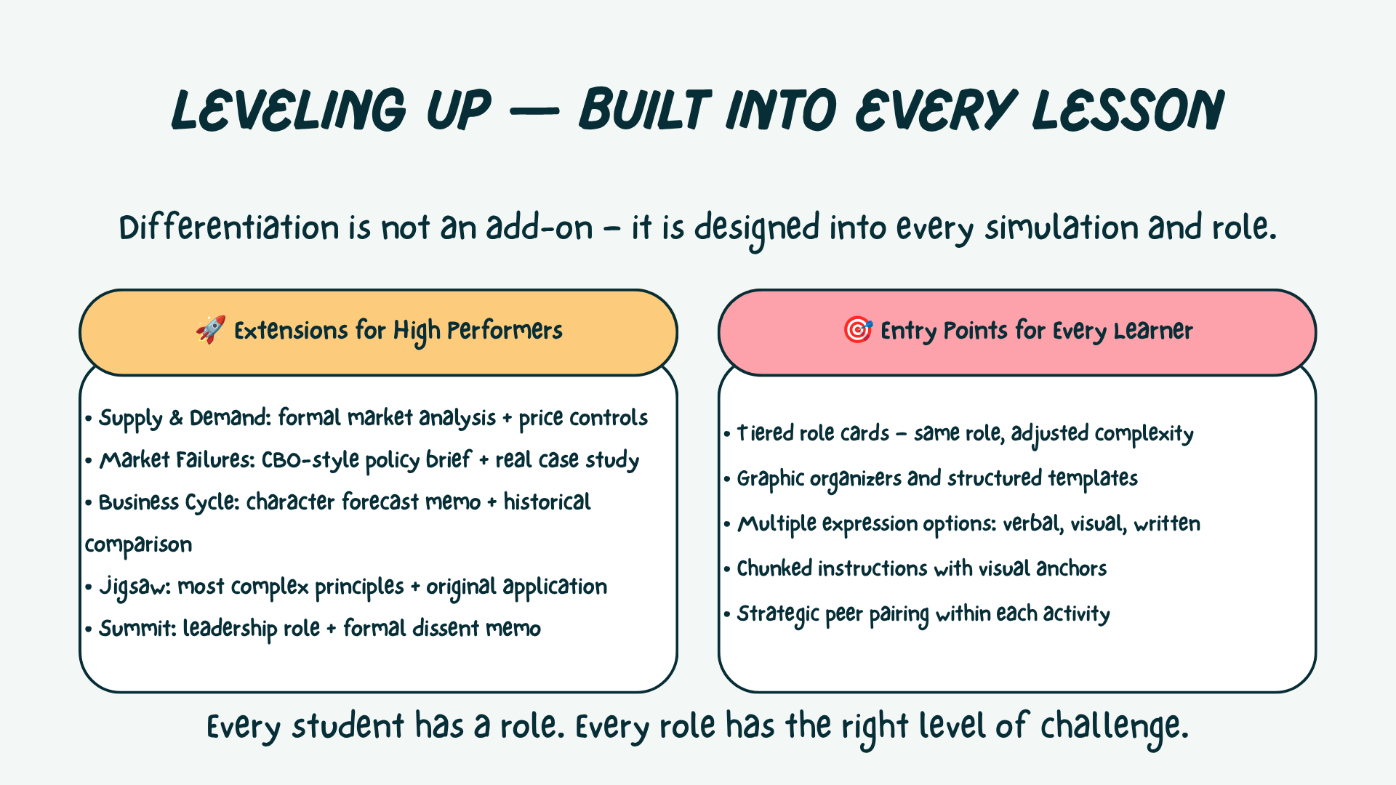
[INSERT FEATURED IMAGE OF WEBINAR SESSION]
Thank you

Slide 29
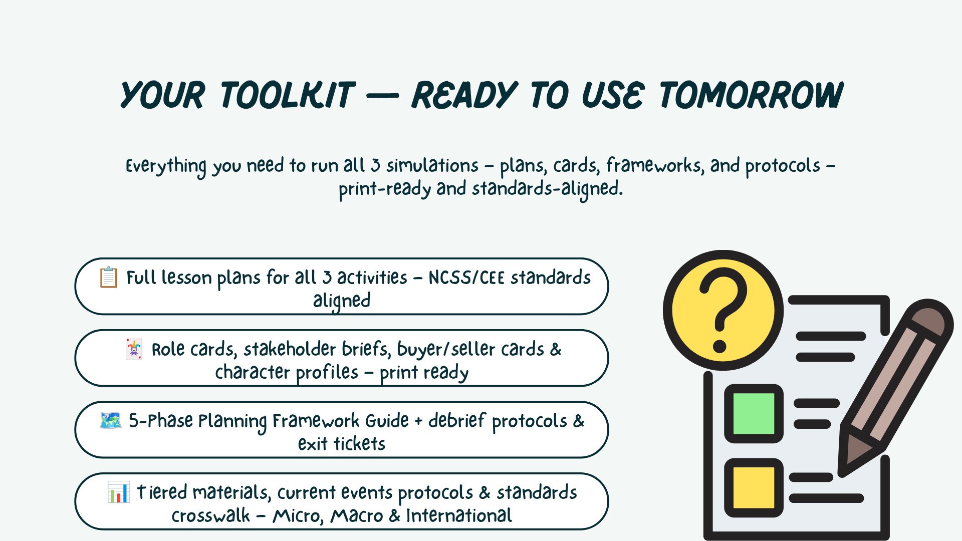
[INSERT FEATURED IMAGE OF WEBINAR SESSION]
Thank you

Slide 30

[INSERT FEATURED IMAGE OF WEBINAR SESSION]
Thank you

Slide 31

[INSERT FEATURED IMAGE OF WEBINAR SESSION]
Thank you

