Slide 1



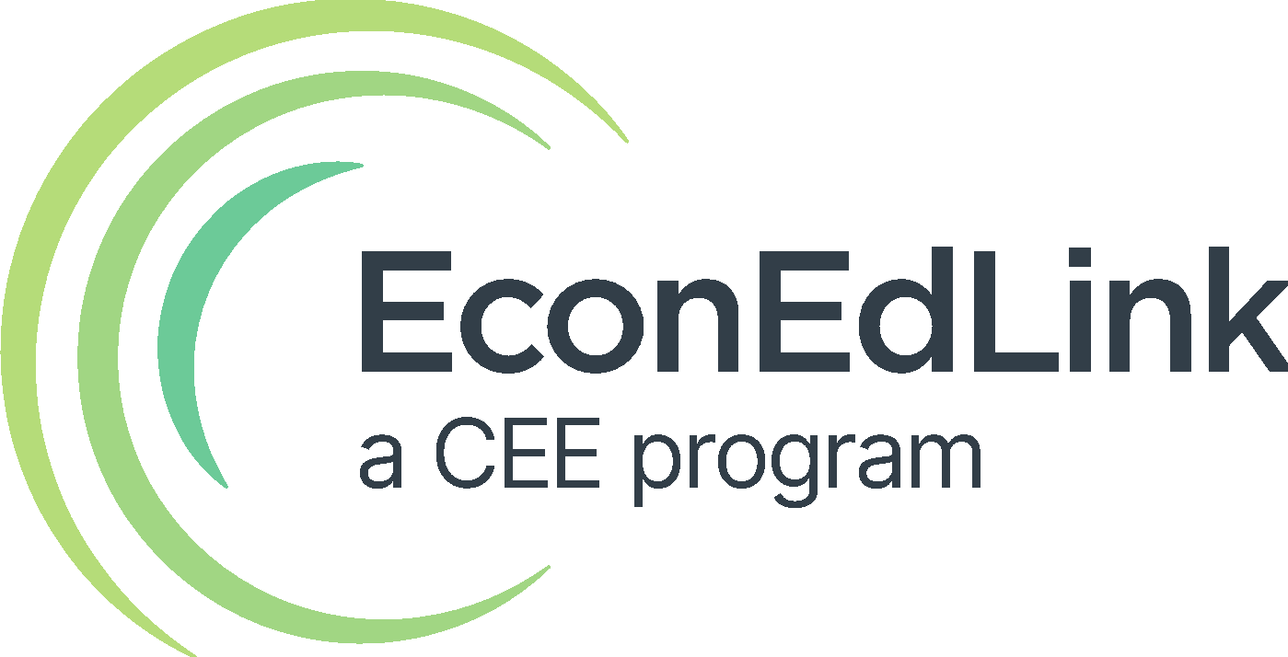
Exploring Monetary Policy
with Gemini Notebook & Wayground
Karen Yancy
Katie Beth Miller
Instantly create infographics and lessons on fiscal and monetary policy

Slide 2
Objective
The "Exploring Monetary Policy with Wayground, Part 2" webinar is a hands-on guide to using Notebook LM and Wayground to create economics lessons and assessments quickly.
We will cover fiscal and monetary policy by showing you how to turn PDFs and websites into infographics, slides, and videos using Notebook LM. You will also learn to upload these materials into Wayground to auto-generate questions for your students

Slide 3
About Us
Karen Yancy
Economics, Macroeconomics, & US Government Teacher
30+ years teaching experience at high school and college level
Several lessons published by EconEd
I strive to make lessons engaging and meaningful for all students.
Katie Beth Miller
Instructional Technologist
16 years in education as a librarian, English teacher, and instructional technologist at the secondary level
Presented at local, regional, and state conferences
I advocate for using technology to expand understanding and save time.

Slide 4

Expectations
Please keep on your video so we can familiarize names and faces.
Add any questions in the chat during the session.
Engage in the presentation during the Q/A and group discussion.

Slide 5
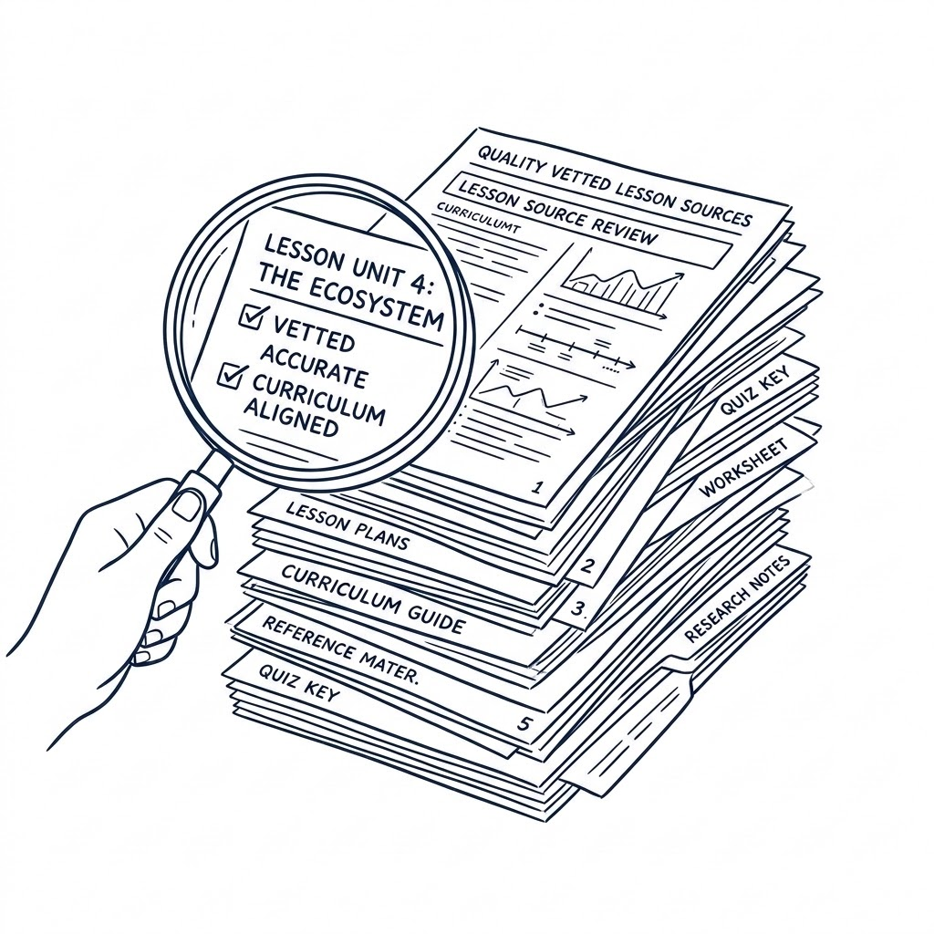

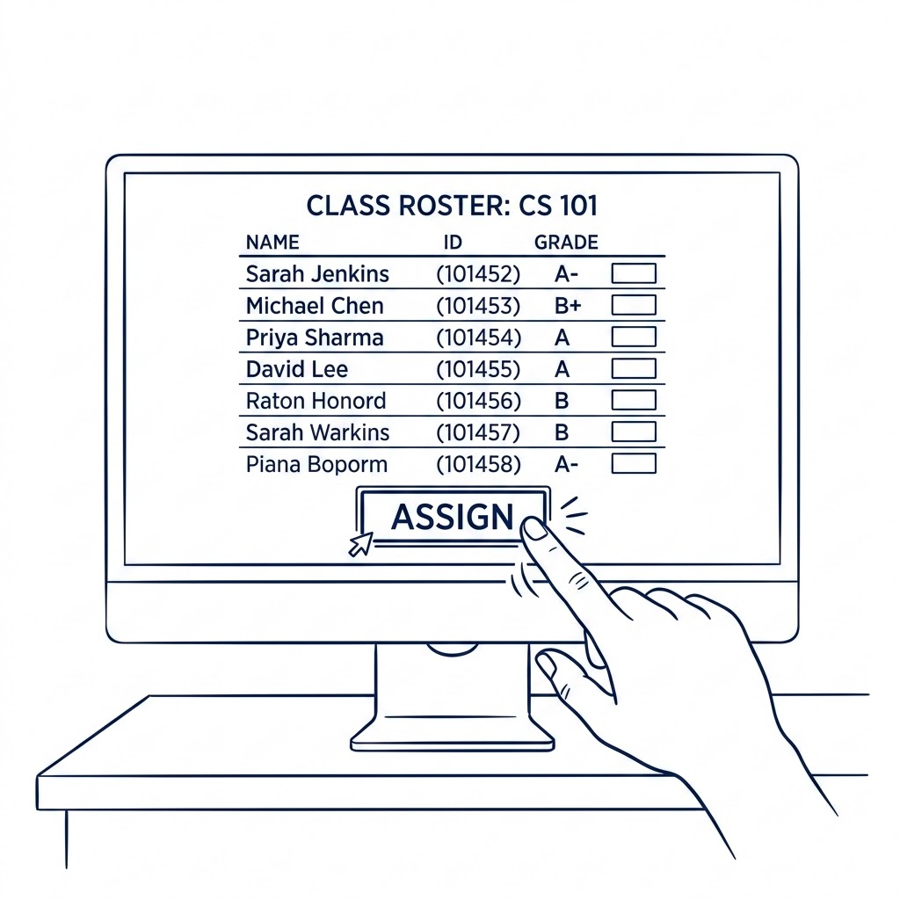
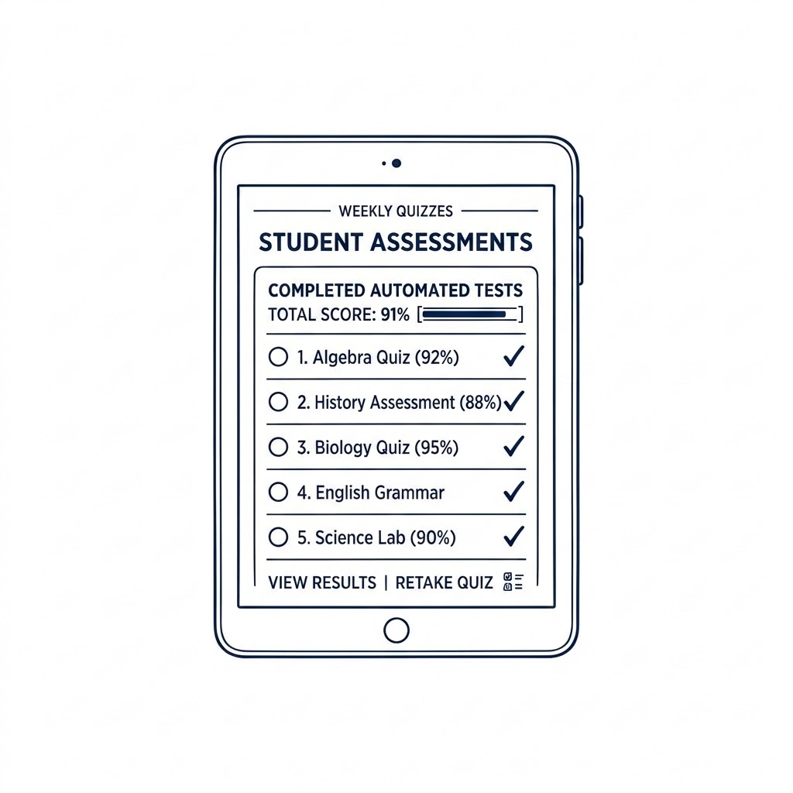
Overview
Resources
Gemini Notebook
Wayground
Integration
Notes:
We’re taking quality resources and creating engaging infographics with Gemini Notebook. This visual alone helps understanding. However, we’re taking it one step further by then uploading that infographic into Wayground as an interactive passage. This allows us to determine if students truly comprehend the content of the infographic and thus the original sources. Adjustments can be made in real time based on student performance or the content can be retaught and tested again in the future.Furthermore, we can get instant results that can then be taken as a grade in Google Classroom or Canvas.

Slide 6
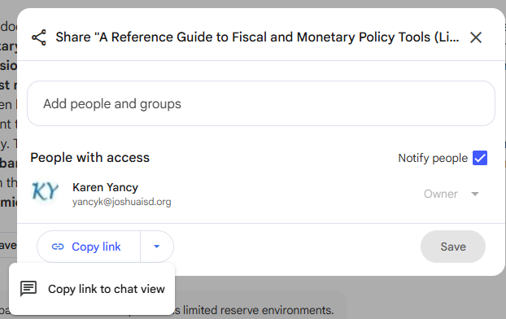
Resources
Gemini Notebook
Gather trusted documents
  Google Docs or .docx
  Google Slides
  Google Sheets
  PDF
  Website
  YouTube video link
  Audio
  Images
  Notes
Examples
  Fiscal Ample v Limited Monetary Policies Cheat animated
  Limited, Ample & Limited
Upload documents into Gemini Notebook
Create resources for yourself or your students
  Quizzes
  Flashcards
  Study Guides
  Mind Maps
  Infographics
  Audio Overviews
  Video Overviews
  Slides
Examples
  Gemini Notebook Example
Sharing
  Give link
  Create within Google Classroom
Gemini Notebook Instructions
Notes:
Click on resources
It’s recommended that you use Chrome and make sure that you’re logged in before accessing Gemini Notebook.
Talk about what can be created with Gemini Notebook
Show Gemini Notebook Example
Discuss sharing
Mention directions
Go to Gemini Notebook
Create new notebook and add resources
Create infographic

Slide 7
Wayground
Upload infographics generated in Gemini Notebook directly into Wayground to serve as reading passages.
Utilize Wayground's AI engine to instantly analyze text and auto-generate customized, standards-aligned multiple-choice and short-answer questions.
Examples
  Wayground Example 1
  Waygound Example 2
Wayground Passage Instructions
Notes:
Infographics made in Gemini Notebook can then be uploaded in Wayground as a passage activity.
Embedded AI in Wayground will create questions based on the infographic
Click on Example 1
Click on Example 2 and show student preview
Mention instructions
Go to Wayground
Select passage activity
Upload infographic
Create AI questions
Publish
Show how to assign

Slide 8

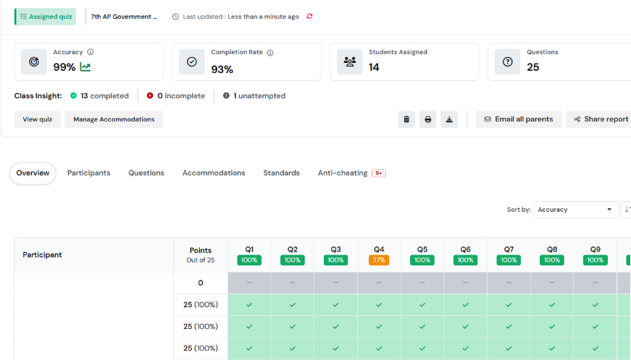
Overall Results
View results in real time
Accuracy
Completion Rate
Overview
Notes:
Show where results are in Wayground, but don’t click on details with student names
Go back to slides to show screenshots
See results in real time
View accuracy, completion rate, and overview
You can click on a question to view the details which is shown on the next slide

Slide 9
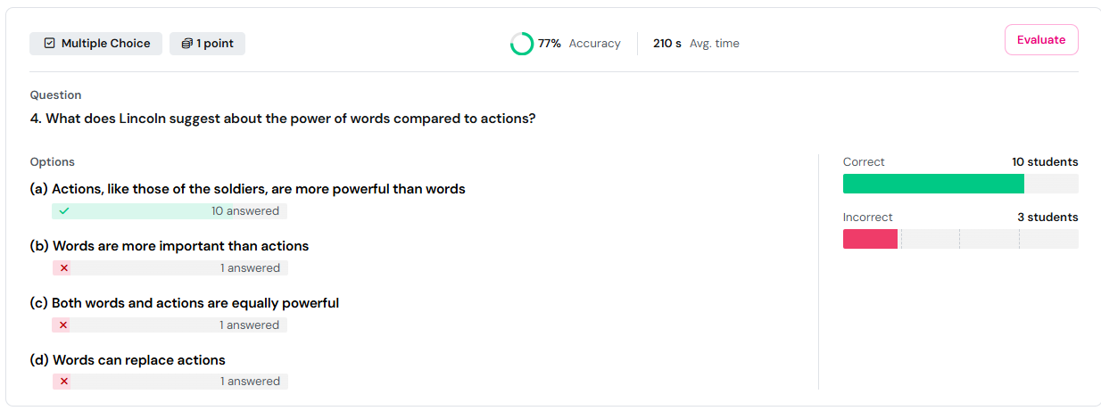
Individual Results
Click on question to view details
  Correct
  Incorrect
  Accuracy
  Average time
Notes:
See correct and incorrect and understand misconceptions
The average time also helps you to determine how much effort was given

Slide 10
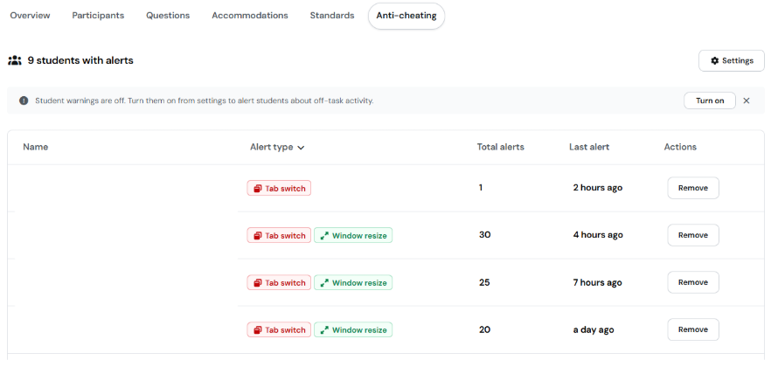
Anti-cheating
Tab switch
Window resize
Turn on warnings
Notes:
This is an optional feature that allows you to see when students switch to a different tab or resize their window in order to use another window
You can turn on warnings for students that will pop up on their device
It’s also nice that you can see how many alerts took place

Slide 11
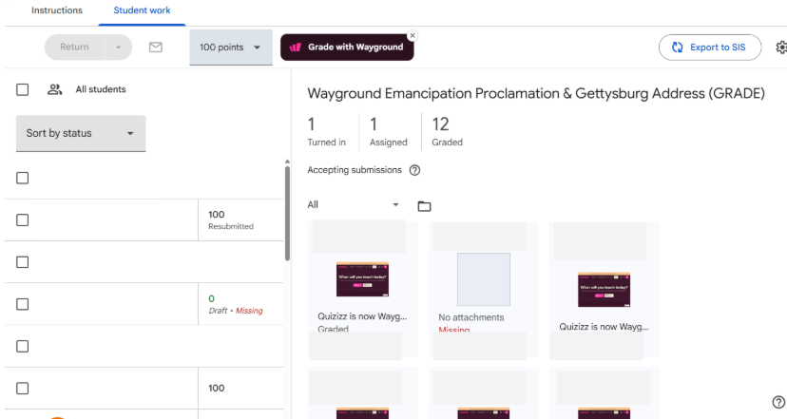
Google Classroom
Import grades
Updates automatically
Export grades from Google Classroom to grading platform
Notes:
Wayground grades can be synced with Google Classroom and Canvas.
The grades can then be exported to your electronic gradebook
Deductions can be made if it is turned in late

Slide 12
Questions?
Karen Yancy
  yancyk@joshuaisd.org
Katie Beth Miller
  millerk@joshuaisd.org

