Slide 1



Monetary Tug-of-War: Limited vs. Ample Control

Slide 2
Limited Monetary Policy

Slide 3
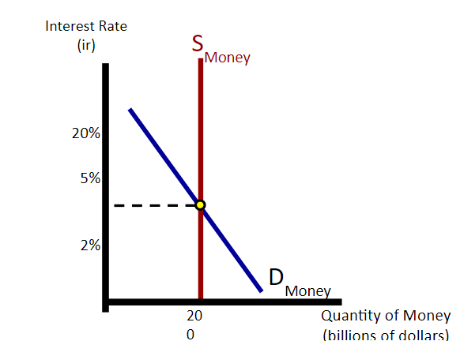
Limited Reserves
Before the Great Recession of 2008, the Fed’s policy focused on moving S_{m} to influence monetary policy. The tools used were discount rate, required reserve ratio, and OMO.
OMO and RRR ARE NOT CALLED ADMINISTERED RATES!
Quantity of Money

Slide 4
Limited Monetary Policy
Definition:
Limited Monetary Policy refers to a constrained approach by a central bank (such as the Federal Reserve) in influencing the economy through money supply and interest rates.
Purpose:
Control inflation
Stabilize the currency
Encourage sustainable economic growth

Slide 5
Key Tools
Open Market Operations (OMO) - The buying and selling of government securities in the open market to regulate the money supply.
Discount Rate - The interest rate charged by central banks on loans to commercial banks.
Reserve Requirements - The minimum fraction of customer deposits that banks must hold as reserves.

Slide 6
What to do to fight inflation or recession
Increase money supply
Buy securities (OMO)
Lower Discount Rate
Lower Reserve Requirements
Used to fight recession
Decrease money supply
Sell securities (OMO)
Raise discount rate
Raise Reserve Requirements
Used to fight inflation

Slide 7
What is the main goal of limited monetary policy?
A. Increase government spending
B. Control inflation and stabilize the economy
C. Reduce taxes for businesses
D. Create new banking regulations
Notes:
B is answer

Slide 8
What is the main goal of limited monetary policy?
A. Increase government spending
B. Control inflation and stabilize the economy
C. Reduce taxes for businesses
D. Create new banking regulations
Notes:
B is answer

Slide 9
If the central bank raises the discount rate, what is the likely
effect on the economy?
A. Increased borrowing by banks
B. Decreased interest rates for consumers
C. Reduced borrowing and slower economic activity
D. Immediate rise in inflation
Notes:
C is answer

Slide 10
If the central bank raises the discount rate, what is the likely
effect on the economy?
A. Increased borrowing by banks
B. Decreased interest rates for consumers
C. Reduced borrowing and slower economic activity
D. Immediate rise in inflation
Notes:
C is answer

Slide 11
Ample Reserves

Slide 12
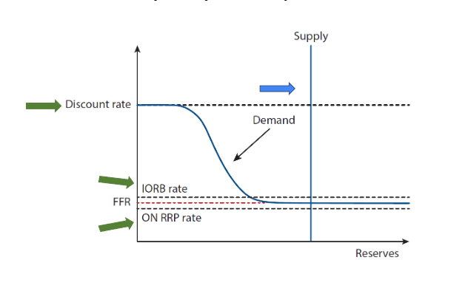
Ample Reserves
Discount rate–price ceiling
IORB rate-rate banks earn from Fedon funds they deposit in their reserve balances
ON RRP–price floor; Federal Reserve sells Treasury securities to eligible financial institutions with an agreement to repurchase them the next day at a predetermined price
Since the Great Recession of 2008, the Fed’s policy has focused on Dm. The main tools used are interest on reserve balances (IORB), ON RRP rate (overnight reverse repurchase agreement), discount rate. These are called the administered rates.

Slide 13
When implementing policy…
The Fed is targeting the Federal Funds Rate (FFR). This is the overnight interest rate banks charge each other on loans.
Where do banks get these funds to lend each other? From their reserves—the funds that banks hold in their vaults plus the deposits they maintain in their reserve balance accounts with the Federal Reserve Bank.
The Federal Funds Rate is not “set” by the Fed but determined by the borrowers (commercial banks who need money) and lenders (commercial banks who are loaning money) in the federal funds market.
Why is the Federal Funds Rate important? It influences the short-term and long-term interest rates, which influences the decisions made by consumers and businesses.

Slide 14
Fed tools
The Fed’s primary tool to influence the FFR is the IORB.
The IORB is based on two concepts:
Reservation rate: The lowest rate that banks are likely willing to accept for lending out their funds.
Arbitrage: The simultaneous purchase and sale of funds (or goods) in order to profit from a difference in price. This tool ensures that the FFR does not fall far below the IORB rate. (“If the federal funds rate falls far below the interest on reserve balances rate, banks will borrow at the federal funds rate and deposit these borrowed funds to earn the interest rate on reserve balances and earn a profit, which will increase the demand for federal funds and raise the federal funds rate.”)

Slide 15
When the interest on reserve balances rate
(IORB) is higher than the FFR, banks can
Lend at the IORB and borrow at the FFR, earning a profit on the difference
Lend at the FFR and borrow at the IORB, earning a profit on the difference
Borrow at the FFR and deposit at the IORB, earning a profit on the difference
Borrow at the IORB and deposit at the FFR, earning a profit on the difference
Notes:
C is answer

Slide 16
When the interest on reserve balances rate
(IORB) is higher than the FFR, banks can
Lend at the IORB and borrow at the FFR, earning a profit on the difference
Lend at the FFR and borrow at the IORB, earning a profit on the difference
Borrow at the FFR and deposit at the IORB, earning a profit on the difference
Borrow at the IORB and deposit at the FFR, earning a profit on the difference
Notes:
C is answer

Slide 17
Because banks can deposit as many funds as they want in their reserve balance account at the Fed, if the interest on reserve balance rate (IORB) is higher than the FFR, then arbitrage will ensure that
The IORB rate falls to the FFR as banks seek to profit on the difference
The IORB rate falls while the FFR rises as banks seek to earn a profit on the difference
The FFR rises to the IORB rate as banks seek to profit from the difference
The IORB rate rises while the FFR falls as banks seek to earn a profit on the difference
Notes:
C is answer

Slide 18
Because banks can deposit as many funds as they want in their reserve balance account at the Fed, if the interest on reserve balance rate (IORB) is higher than the FFR, then arbitrage will ensure that
The IORB rate falls to the FFR as banks seek to profit on the difference
The IORB rate falls while the FFR rises as banks seek to earn a profit on the difference
The FFR rises to the IORB rate as banks seek to profit from the difference
The IORB rate rises while the FFR falls as banks seek to earn a profit on the difference
Notes:
C is answer

Slide 19
ON RRP
Not every bank has a reserve balance at the Fed so the FFR could fall below the IORB. So the Fed offers overnight reverse repurchase agreement facility to large financial institutions, which includes money market mutual funds.
What is the difference between money market mutual funds and money market accounts?
Money market accounts (MMAs) are a type of savings account that is insured by the Federal Deposit Insurance Corp. (FDIC), while money market funds (MMFs) are a type of low-risk mutual fund. MMF is an investment whose objective is to earn interest for shareholders while maintaining a net asset value (NAV) of $1 per share. The portfolio is comprised of short-term (less than one year) securities representing high-quality, liquid debt and monetary instruments.

Slide 20
The ON RRP
The ON RRP allows banks to deposit funds at the Fed overnight, receiving a government security (Bond, note or other debt instrument sold by the US government to finance US government operations) as collateral. The next day the transaction is “unwound”--the Fed buys back the security. The Fed offers these institutions the ON RRP offering rate on the funds deposited at the Fed. This gives these institutions, an opportunity to deposit funds at the Fed and earn a risk-free return–similar to the opportunity offered to banks that deposit funds at the Fed to earn interest on their reserve balances. The ON RRP acts as a price floor for the FFR.

Slide 21
Limited vs Ample Reserves
Limited Reserves
Reserves are limited when banks’ reserve balances are relatively scarce and changes in the supply of reserves significantly affect the federal funds rate.
The Fed uses open market operations—buying or selling government securities—to change the supply of reserves and move the federal funds rate.
In the traditional limited-reserves model, the Fed may also change the required reserve ratio.
Financial institutions with insufficient reserves may borrow overnight from institutions with excess reserves in the federal funds market.
The Fed, mainly using Open Market Operations, is effective in influencing interest rates. Reserve requirements are a rarely used tool.
Commercial banks held very few reserves with the Central Bank.
Reserve requirement may be greater than 0.
Notes:
Stress to students that the reserve requirement alone being above zero for Limited Reserves should not be the only indicator of limited reserves The Fed might bring the RR down to zero for expansionary monetary policy when the economy is in a recession.
The Fed started charging interest on Reserves in 2008. Since 2021 the term IORB has been used to describe this monetary policy tool.

Slide 22
Limited vs Ample Reserves
Ample Reserves
Reserves are ample when the banking system has enough reserves that small changes in their supply have little effect on the federal funds rate.
The Fed primarily influences the federal funds rate by changing administered rates, especially the interest rate on reserve balances (IORB).
Raising IORB places upward pressure on the federal funds rate; lowering IORB places downward pressure on it.
The overnight reverse repurchase agreement (ON RRP) rate is a supplementary administered rate that helps support the lower end of the Fed’s target range.
Banks hold reserve balances at the Fed to earn interest, settle payments, and manage liquidity.
The required reserve ratio has been zero in the United States since March 2020, but a zero reserve requirement does not define an ample-reserves system.
Notes:
Stress to students that the reserve requirement alone being above zero for Limited Reserves should not be the only indicator of limited reserves The Fed might bring the RR down to zero for expansionary monetary policy when the economy is in a recession.
The Fed started charging interest on Reserves in 2008. Since 2021 the term IORB has been used to describe this monetary policy tool.

Slide 23
Key points
Limited Reserves:
Small changes in the supply or reserves significantly affect the federal funds rate.
The Fed (or central bank) primarily uses open market operations to influence the federal funds rate.
Former U.S. monetary policy framework
Ample Reserves:
Small changes in the supply of reserves have little impact on interest rates.
The Fed (or central bank) primarily changes administered rates, especially the IORB, in influence the federal funds rate.
Open market operations become less effective in influencing interest rates.
Current U.S. monetary policy framework

Slide 24
Monetary Policy Tools
Limited Reserves
Discount rate
Reserve requirement
Open Market Operations
(OMO)
Ample Reserves
Interest on reserve
Balances (IORB)
Overnight reverse
repurchase
agreement facility
(ON RRP)
Discount rate
OMO can be used to ensure banks have ample reserves
Administered rates: IORB, ON RRP, Discount rate

Slide 25
Discussion Question
What is the main difference between ample and limited monetary policy, and how does each approach affect the economy?
Sentence Starter:
The key difference between ample and limited monetary policy is that...

Slide 26
Scenarios
Use the yarn and graph the following scenarios on limited and ample reserve graphs.

Slide 27
Scenario 1
The country is facing inflation. What would the Fed do?

Slide 28
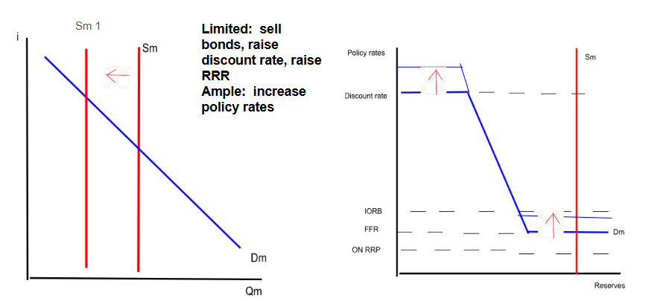
Solution: The country is facing inflation. What would the Fed do?

Slide 29
Scenario 2
The country is facing recession. What would the Fed do?

Slide 30
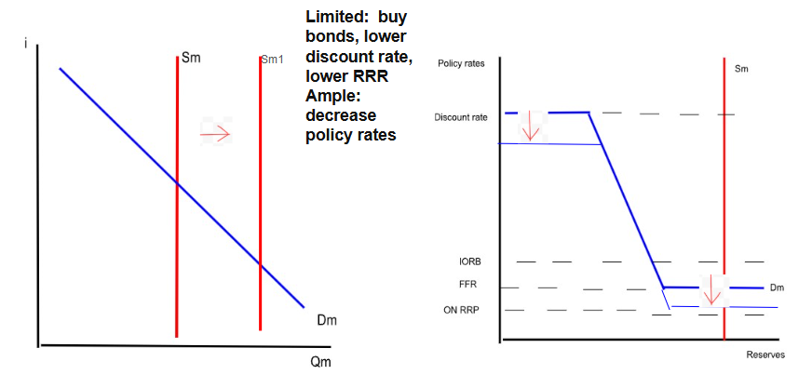
Solution: The country is facing recession. What would the Fed do?

Slide 31
Scenario 3
The country is experiencing deflation. What would the Fed do?

Slide 32
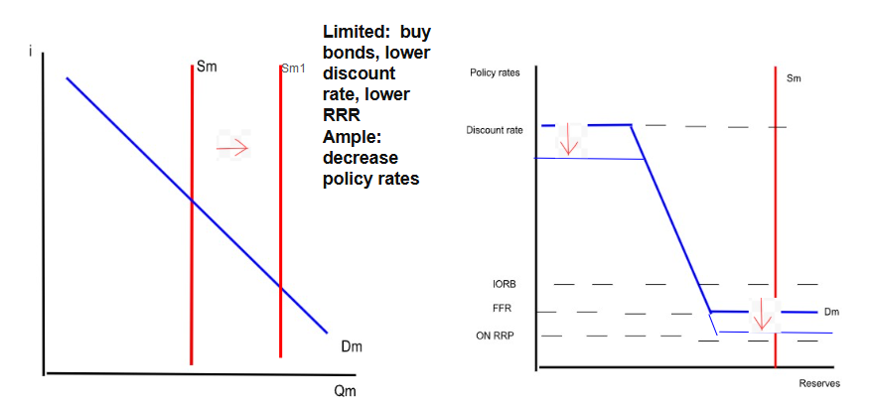
Solution: The country is experiencing deflation. What would the Fed do?

Slide 33
Scenario 4
Inflation is 2% and unemployment is 5%.

Slide 34
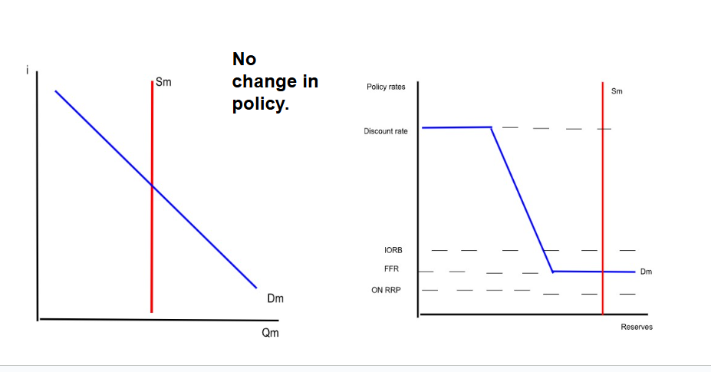
Solution: Inflation is 2% and unemployment is 5%.

